Slide 1
Ku and Ka Band FSS Characteristics and Link Budgets for support of RPAS
FSMP WG/10 IP-02

Slide 2
Content
FSS C2 Link budgets
Philosophy
Why we need link budgets
Required Link Performance
vs.
Achieved Link Performance
Operational / safety requirements
Basis for SARPs / specifications
C2 Link Parameter Inputs
FSS based C2 Link: Data rate independent link budget formula
Satellite link overview
General key parameters and their sources
Input parameter variations
Link Performance Analysis (Part 1)
Link Performance Results (Part 1)
Compliance checks of input parameters
Link budget calculations (clear sky conditions, time invariant losses)
Derivation of driving link parameters
Parameter dependent feasibilities for full C2 Link connections
Statistical evaluation of the large number of link budget results
Next Steps: sensitivity analyses of the results

Slide 3
Why do we need FSS Link Budgets?
Link budget analysis needs to confirm that the Required Link Performance can be Achieved
Need to define the minimum performance values of the C2 Link characteristics in the SARPs
Need to define any technical boundary conditions in the SARPs
Need to define any operational boundary conditions in the SARPs
This should be carried out for nominal solutions but considering potential mitigations

Slide 4
Why do we need FSS Link Budgets?
Will the Fixed Satellite Service enable the C2 Link to Achieve the Required RLP?
  C2 Links using the FSS shall operate within the notified and recorded parameters of the satellite networks in accordance with Resolution 155 (Rev.WRC-19)
  Will the limitations imposed by FSS networks (transmitter power etc.) enable the C2 Link RLP to be achieved?
  Will C2 Link interruptions due to operational effects (e.g. weather, and/or potential coexistence or interference issues) allow the Required C2 Link RLP to be Achieved?
Can the satellite based C2 Link operate successfully under the conditions stipulated in Resolution 155 (Rev.WRC-19)?
  RLP conforming satellite links not causing more interference than coordinated/notified incumbent FSS applications
  RLP conforming satellite links not requiring more protection than coordinated/notified incumbent FSS applications

Slide 5
How do we determine the Required and Achieved Link Performance?
The Required C2 Link Performance (RLP) is based on safety considerations
  RTCA and EUROCAE are working on this topic
  Performance depends on class of airspace, phase of flight and pilot activities
The Achieved C2 Link Performance is based on technical and operational considerations
  ICAO needs to make this analysis for the Ku and Ka Band FSS by developing link budgets
If the Achieved C2 Link Performance meets or exceeds the Required C2 Link performance, then the C2 Link can be used to provide adequately safe RPAS operation

Slide 6
How do we determine the Achieved Link Performance?
Describe the C2 Link technical solution in sufficient detail to enable representative link budget analysis to show that meeting the RLP is possible under defined conditions
  Each RPAS Operator/C2SP will have to show they comply with specific safety requirements imposed by their Aviation Authority
  Mitigation measurements according to the Lost C2 Link procedure are to be considered/included for cases when the RLP and Lost C2 Link Decision Time is not met in order to control the situation to an adequate level of safety
  Include the minimum performance values of the C2 Link system parameters
  Include any operational limitations and/or mitigations
High level in the SARPs with supporting detail in the Manual on the C2 Link

Slide 7
FSS Link Budgets for Achieved Link Performance – Main Principle
What information is needed to perform link budget analysis?
Basic link budget equation → Data rate independent
E_{S}/N₀ dB = EIRPSD dB - Path Loss dB + G/T dB + 228.6 dB*
  E_{S}/N₀ = Received Energy per Symbol compared to Noise Power in 1Hz
    Signal entering the receiver demodulator (E_{b}/N₀ comes out of the demodulator)
  EIRPSD = Transmitted Radiated Power (EIRP) in 1Hz (SD, Spectral Density)
  Using E_{S}/N₀ and EIRPSD means analysis is independent of data/symbol rate
  Path Loss:
    Part 1): for “clear-sky”, Path “Loss” includes time-invariant effects like free-space loss, polarization losses, intermodulation impairments, fixed interference (FSS + terrestrial in general), satellite tolerances.
    Part 2): additional atmospheric attenuation and time-variant interference will be included in the Path “Loss” to determine the E_{S}/N₀ and link availability for determining if the RLP can be met.
  * 228.6 (log of Boltzmann Constant) converts T (in G/T) to noise power in 1Hz

Slide 8
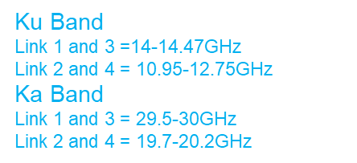
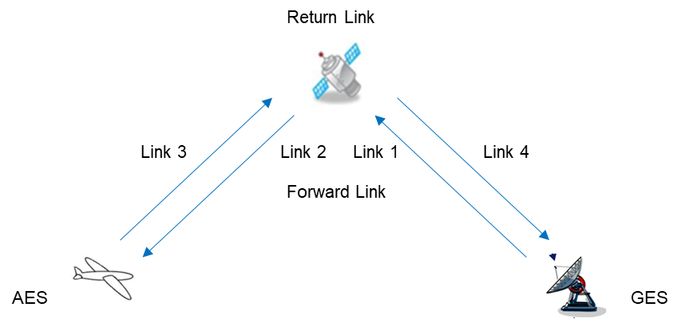
FSS Link Budgets – Link Definitions
Edge of Coverage - EoC
Center of Beam
Link 1 and 2 provide the Forward Link (i.e. telecommands)
Link 3 and 4 provide the Return Link (i.e. telemetry)

Slide 9
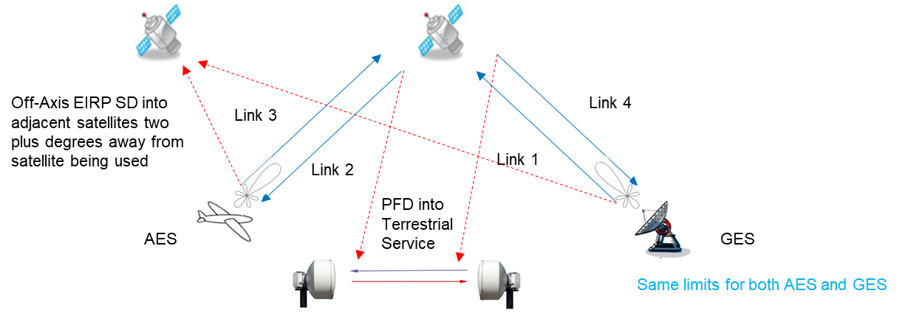
FSS Link Budgets – General Link Related Limits
Off-Axis EIRPSD into adjacent satellites two or more degrees away from satellite being used
Uplinks 1 and 3 must meet the Off-Axis EIRP SD limits set by ITU-R
  ITU-R Article 22.26 and ITU-R Recommendation S.728 (Ku band);
  * Link 3 may also have PFD limitations for certain frequencies and in certain regions – Annex 2 to Resolution 155
  ITU-R Article 22.32 and ITU-R Recommendation S.524 (Ka band)
Downlinks 2 and 4 must meet the PFD limits set by ITU-R
  ITU-R Article 21.16 for Ku Band
  No ITU-R limit in Ka Band so using coordination levels from the FCC

Slide 10
FSS Link Budgets – System Characteristics 1/2
All satellite networks must go through a process of notification, assessment, coordination and recording with the ITU-R before they can be used
This process allows ITU-R, administrations and satellite operators to make sure that these networks will not cause harmful interference to recorded users of the same allocations or receive harmful interference from those recorded users
This recorded information is held within the ITU-R Master International Frequency Register (MIFR), which is an MS Access relational database updated and published every two weeks by the Radiocommunications Bureau (BR)

Slide 11
FSS Link Budgets – System Characteristics 2/2
To assist ITU-R and ICAO in their work related to Resolution 155 ITU-R has been using the MIFR to assess the “envelope” of characteristics of the FSS satellite networks that comply with Resolution 155 and to provide statistical information on the values of the parameters of those characteristics
ITU-R can then check that the proposed RPAS C2 Link characteristics parameter values are inside the envelope of these notified and recorded parameter values
ICAO can then use those characteristics parameter values in their link budget analysis to check for adequately safe operation
  ITU-R WP5B/712 Annex 5 liaised to ICAO in FSMP WG/08 WP02 > RPASP/13 WP/5

Slide 12
How do we use the MIFR Data?
The filed FSS satellite networks according to the ITU-R MIFR cover a wide range (within their authorized envelope of operation) of characteristics parameter value variations
  Often beyond typical system realizations and providing a large envelope of characteristics parameter values
  Hence, a set of characteristics parameter values with a certain minimum or maximum performance inside the filing envelope needs to be derived
Assessing each of the thousands of satellite network filings is not effective and would not lead to:
  Maximizing the Achieved performance to provide a highly reliable link for safety of life applications fulfilling the RLP
  Maximizing the ability of the RPA to operate in different combinations of flight altitudes and latitudes, for different elevations (larger than a minimum recommended one)
  A comprehensive set of values (performance thresholds) for each of the characteristics in the SARPs not just a “go/no go” for each satellite network with no indication of the suitability of future satellite networks or the parameter values that were necessary to meet the RLP

Slide 13
FSS Link Budgets – Key Link Parameters
MIFR: Parameters used in the link budget equation:
  Antenna gains
  Power / power density per reference bandwidth (satellite and Earth station)
  Noise temperature
MIFR: Derived parameters used in the link budget equation:
  EIRP / EIRPSD (from power and signal bandwidths in MIFR)
  G/T (from antenna gain and receive noise temperature in MIFR)
  Saturated Flux Densities
Limits used in the link budget equations:
  Recommendations ITU-R S.524, S.728:
    Off-axis EIRPSD for uplink from AES and GES in Ka band and Ku band, respectively
  ITU-RR, Appendix 7:
    Antenna gain pattern for AES antenna (plus Capped Bessel model) and GES antenna
  Recommendations ITU-R S.1432:
    Interference caused noise increase for both, uplink and downlink
  ITU-RR Article 21.16:
    Satellite downlink PFD limits in Ku band

Slide 14
FSS Link Budgets - Link Parameter Values
RPASP WGWHL/1 WG2 WP/5 contains the specific parameter values used (see back up slides 24-26)
RPASP WGWHL/1 WG2 WP/5 explains how they were derived from the ITU-R MIFR data (see back up slides 24-26)
Six sets of characteristics parameter values were chosen from within the ITU-R MIFR envelope
  Satellite, Low and High Gain
  RPS, Medium and Large Antenna
  RPA, Small and Medium (each with two patterns) Antenna
They maximized the link margin available to counteract rain and time varying interference
They ensured many of the satellite networks in the ITU-R MIFR could be used for RPAS

Slide 15
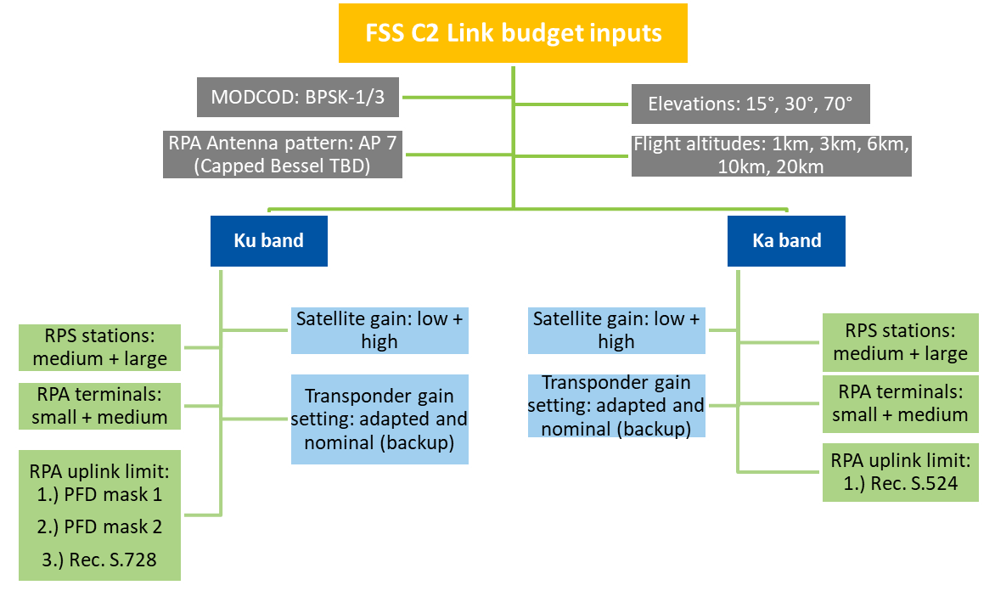
FSS Link Budgets –Summary of Link Parameter Variations
Operational
Inputs
Satellite
Operations
Parameters
Example b) Res. 155 (Rev.WRC-19)

Slide 16
FSS Link Budgets – Calculation Flow And Main Steps
Input selection
See previous slides summarizing all input parameter variations (1920)
Ku band: 1440 input variations → 720 C2 Link connections with forward link and return link, each
Waveform
Max. data rates r_{B} = 30 kbps (FW), 300 kbps (RT) ^{Note} ¹
Signal bandwidth = r_{B} * (1Hz/bit / (1/3)) * (1 + r_{off}) = 103.5 kHz (FW), 1035 kHz (RT) ^{Note 3}
Uplink (link 1 and 3) limit checks
Ku band: Uplink EIRP against off-axis PFD limits mask a) and b) from Example 2 Res 155 (Rev.WRC-19)
Ku band: Uplink EIRP against off-axis EIRP limits from Recommendation ITU-R S.728
Ka band: Uplink EIRP against off-axis EIRP limits from Recommendation ITU-R S.524
All: Uplink EIRP against downlink PFD limit (Ku band) or downlink coordination limit (Ku / Ka band) via the uplink-downlink transmission gain based on the satellite gain
MODCOD = BPSK-1/3, Roll-off-factor r_{off} = 15% ^{Note 2}
Ka band: 480 input variations → 240 C2 Link connections with forward link and return link, each
All: Uplink EIRP against system internal limits (terminal performance, satellite SFD limit)
Note 1. Data rates are derived from RTCA DO-377 MASPS for C2 Link Systems
Note 2. Waveform/MODCOD chosen for good operation at low Es/No to maximize link margin
Note 3. Using the formula in slide 9 avoids the need for data rates and bandwidths, but all the compliance checks against limits (per reference bandwidth) require to apply such inputs

Slide 17
FSS Link Budgets – Calculation Flow And Main Steps
Start uplink calculations
Ku band uplink EIRP: Minimum from uplink PFD mask or S.728 EIRP, from EIRP limit for needed input backoff (IBO) versus saturation, from terminal EIRP (capability) limit and finally from satellite downlink PFD limit reversely transferred to the uplink via the satellite gain
Ka band uplink EIRP: Minimum from S.524 EIRP, from EIRP limit for needed input backoff (IBO) versus saturation, from terminal EIRP (capability) limit and finally from satellite downlink EIRPSD limit reversely transferred to the uplink via the satellite gain
Uplink losses, impairments
Free Space loss for different AES distances (elevation dependent) and for GES distance fixed @ 10° elevation (worst case)
Satellite payload gain
Calculation of input power flux density (IPFD) and IBO
Earth station EIRP tolerance / pointing loss / radome loss (dB):
Ku band: 0.5 dB up to 1 dB depending on the version of the AES or GES
Ka band: 0.5 dB up to 2 dB depending on the version of the AES or GES
Polarization loss of co-polarized signal = 0.5 dB plus cross polarization interference (XPD = 25 dB)
Satellite receive gain versus center of beam: -5 dB
Time invariant interference: ΔT/T = 32% from S.1432-1
IBO setting based on intermodulation and gain compression requirements
Satellite gain tolerance: ±0.75 dB
Total satellite gain for downlink EIRP

Slide 18
FSS Link Budgets – Calculation Flow And Main Steps
Downlink (link 2 and 4) losses, impairments
Satellite transmit gain versus center of beam: -5 dB
E_{S}/N₀ aggregations
Required E_{S}/N₀ _{required} > 0 dB (including 1 dB system margin)
C2 Link performance
Success will be achieved when the complete C2 Link connection comprising the forward link (link 1 and 2) AND the return link (link 3 and 4) both provide positive link margins of the E_{S}/N_{0 total} compared to the E_{S}/N_{0 required}
Achieved E_{S}/N₀ _{total} based on combination of:
E_{S}/(N+I)₀ uplink
E_{S}/N+I)₀ downlink
Determining the driving link budget elements:
Free Space loss for different AES distances (elevation dependent) and for GES distance fixed @ 10° elevation (worst case)
Cross polarization interference (XPD = 25 dB)
Time invariant interference: ΔT/T = 32% from S.1432-1
Earth station EIRP tolerance/ pointing loss / radome loss (dB):
Ku band: 0.3 dB up to 2.4 dB depending on the version of the AES or GES
Ka band: 0.1 dB up to 2 dB depending on the version of the AES or GES
E_{S}/N₀ intermodulation
E_{S}/N₀ polarization
Highest share of transponder resource: power driven versus bandwidth driven
Smallest E_{S}/N₀ margin for: uplink / downlink / intermodulation
First limiting parameter for uplink EIRP: PFD mask / terminal capability / satellite IBO / downlink PFD

Slide 19
FSS C2 Link Budgets Results
Success criteria: Positive link margins for forward link (link 1 and 2) AND return link (link 3 and 4)
 | For C2 Link adapted transponder gain setting
 | AES antenna pattern per AP7 |  | AES antenna pattern per Capped Bessel
 | Fulfillment rate for | No. of feasible links | Fulfillment rate for | No. of feasible links
Ku band low gain satellite | 58.3% | 105 (from 180) | 69.4% | 125 (from 180)
Ku band high gain satellite | 73.9% | 133 (from 180) | 81.7% | 147 (from 180)
Ka band low gain satellite | 100.0% | 60 (from 60) | 100.0% | 60 (from 60)
Ka band high gain satellite | 100.0% | 60 (from 60) | 100.0% | 60 (from 60)
 | Statistics of successful link budgets
 | AES antenna pattern per AP7 |  |  | AES antenna pattern per Capped Bessel
 | Minimum E2E link margin | Average E2E link margin | Maximum E2E link margin | Minimum E2E link margin | Average E2E link margin | Maximum E2E link margin
Ku band low gain satellite | 0.1 dB | 11.7 dB | 15.5 dB | 0.1 dB | 11.6 dB | 15.5 dB
Ku band high gain satellite | 0.1 dB | 12.2 dB | 16.3 dB | 0.2 dB | 12.4 dB | 16.3 dB
Ka band low gain satellite | 3.7 dB | 9.8 dB | 13.3 dB | 2.0 dB | 9.6 dB | 13.3 dB
Ka band high gain satellite | 11.6 dB | 12.9 dB | 14.5 dB | 10.0 dB | 12.5 dB | 14.5 dB

Slide 20
FSS C2 Link Budgets – Conclusions on Performance defining Key Link Parameters
Highest criticality from the combination of small AES antenna size and off-axis transmit limitations
  On-Axis EIRPSD limited because of the off-axis EIRPSD limit due to the limited antenna angular gain discrimination;
  Gain and G/T of small sized AES antennas in the lower half of the parameter envelope of typical FSS Earth stations in the MIFR;
  To compensate a robust BPSK 1/3 waveform was chosen, but its less bandwidth efficient → no significant effect as the date rates are very small from the FSS point of view;
  Out of all individual link budgets in 56.3% cases, the E_{S} /(N+I)₀ total is driven by the E_{S} /(N+I)₀ uplink, the rest from the E_{S} /(N+I)₀ downlink (see slide 21)
Typical RPA antenna sizes 0.8m (medium) and 1.2m (large) with ITU-R AP7 or Capped Bessel pattern and 55% efficiency
  covering planar antennas as well as dish-based antennas with 65% efficiency
  Capped Bessel pattern did not give as much improvement as expected because off-axis pattern was not optimized over the required range of angles to minimize off-axis gain and maximize on-axis gain
*

Slide 21
FSS C2 Link Budgets – Conclusions on Results Dependencies
When considering all C2 Link calculations (Part 1)
  Inside the FSS link conditions the uplink (off-axis limitations) are more driving than the downlink.;
  Impacts from satellite settings (IBO, gain settings) are small → capability for using backup satellites (nominal gain settings in table) without specific (Adapted) settings.
Results on C2 Link connectivity basis |  | Adapted Gain Setting |  | Nominal Gain Setting
End-to-End link budget results (AP 7 pattern) |  | 960 C2 Link connections (FL + RL) |  | 960 C2 Link connections (FL + RL)
First limiting parameter for uplink EIRP (Link 1 and Link 3) | U/L mask (Link 1, Link 3) | 342 | 35.6% | 414 | 43.1%
 | U/L SGT power capability (Link 3) | 0 | 0.0% | 0 | 0.0%
 | Satellite IBO | 120 | 12.5% | 120 | 12.5%
 | D/L Limit (from Link 2, Link 4 reversely transferred to Link 1 and Link 3) | 498 | 51.9% | 426 | 44.4%
Highest share of transponder resource, power vs. bandwidth (all links) | Power | 426 | 44.4% | 390 | 40.6%
 | Bandwidth | 534 | 55.6% | 570 | 59.4%
Smallest E_{S}/N₀ margin for | Uplink E_{S}/N₀ | 540 | 56.3% | 480 | 50.0%
 | Intermodulation E_{S}/N₀ | 0 | 0.0% | 0 | 0.0%
 | Downlink E_{S}/N₀ | 420 | 43.8% | 480 | 50.0%

Slide 22
FSS C2 Link Budgets – Next Steps
Part 1 – “Clear Sky” link analysis
  Initial link analysis completed
  Validation of link analysis is now underway
Part 2 – Time varying rain and interference analysis
  Some of the links from Part 1 will not have enough “clear sky” link margin to compensate for the effects of time varying interference and rain so that the RLP can be achieved
    Interruptions will be longer or more frequent than acceptable for safety
Analyze Part 1 and Part 2 to determine the characteristic parameter minimum values for the SARPs
  Relationship between results and key parameter variations based on a statistical evaluation to derive the parameter value limits
Include any operational and technical mitigations in the SARPs

Slide 24
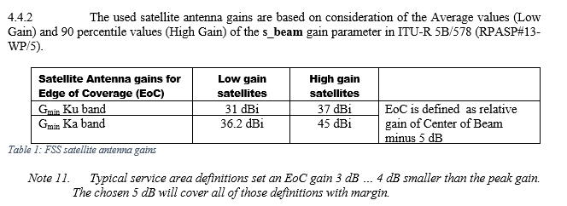
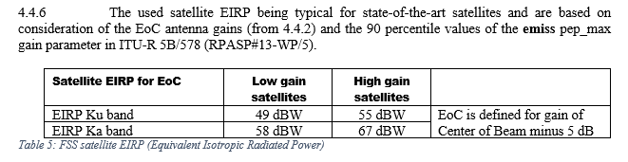
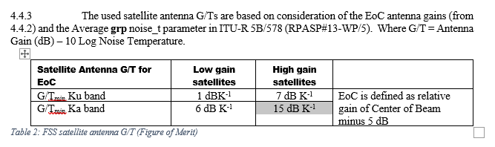
Satellite Parameter Values
Based on MIFR data which gives the center of beam peak gains

Slide 25
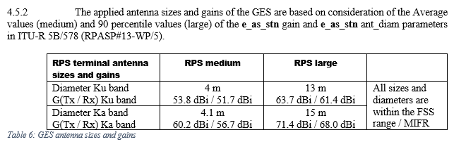
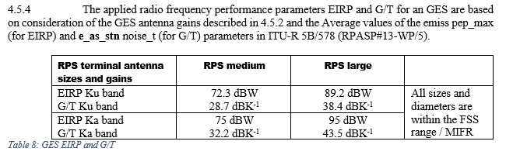
GES Parameter Values

Slide 26
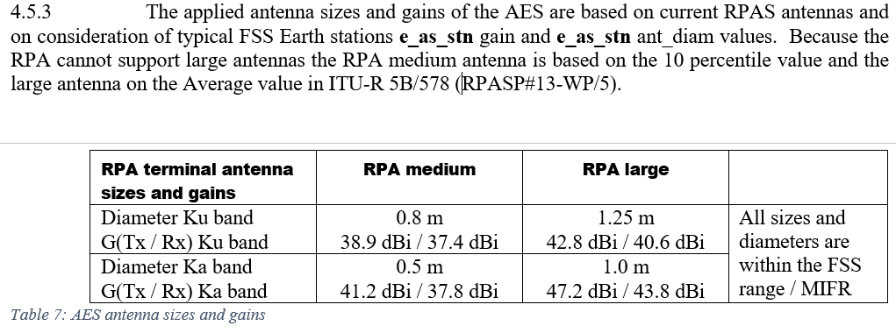
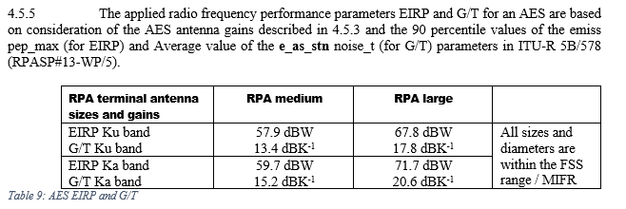
AES Parameter Values
Based on the 10 - 50 percentile values because the RPA antenna is small

