Slide 1
ICAO REGIONAL PREPARATORY GROUP (RPG) ESAF and WACAF Regions
Spectrum for Drones / UAS
Current EUROCONTROL work programme on Drones
Raffi KHATCHERIAN
Head of International Spectrum Management
Johannesburg, South Africa, 4 – 5 September 2018

Slide 2
UAS @ EUROCONTROL (ECTL)
Contribution to Research & Development
UAS @ EUROCONTROL
Support to Operations
Support to Regulations & Standards

Slide 3
R&D Contribution
IFR/VFR
Contribution to Research & Development
VLL
R&D
Update ECTL Validation Platform
Focused in the integration of large certifiable RPAS into controlled airspace

Slide 4
Operations
IFR/VFR
Support to Operations
VLL
VHL
Protect GAT flows from the risks induced by the increasing number of small UAVs, to preserve the CNS network infrastructure against radio-congestion, and to ensure consistency of RPAS CNS with the aviation spectrum strategy

Slide 5
Regulations & Standards
ICAO SARPs
Support to Regulations & Standards
JARUS regulatory proposals
EC/EASA Regulations
EUROCAE standards
Expert support to key international regulatory bodies (particularly JARUS, ICAO) and panels developing RPAS regulations and standards with a link to ATM such as EASA. The Agency will also continue close cooperation with the Air Traffic Service Providers, Radio Regulators, IATA, ESA, standardisation organisations, as well as with NATO.

Slide 6
Objectives
Enable development of UAS market
Address safety and Security
issues
Share expertise
Development of ATM UAS CONOPS
Development of relevant ATM guidelines
Network impact assessment
Support to States
UAS treated like any other airspace user

Slide 7
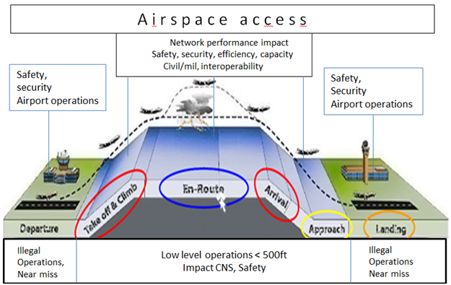

Slide 8
RULES of the AIR and Flight rules

Slide 9
Small UAS Altitude Measurement & Reference Point
Two main sources of discrepancy concerning manned/ unmanned aviation:
  Usage of different reference points
  Usage of different equipment for elevation measurement
Two main areas of concern:
  airspace close to the airports
  upper limit of VLL (very low level) airspace

Slide 10

SESAR 2020
CORUS
IMPETUS
PODIUM
U-space
DREAMS
SECOPS

Slide 11
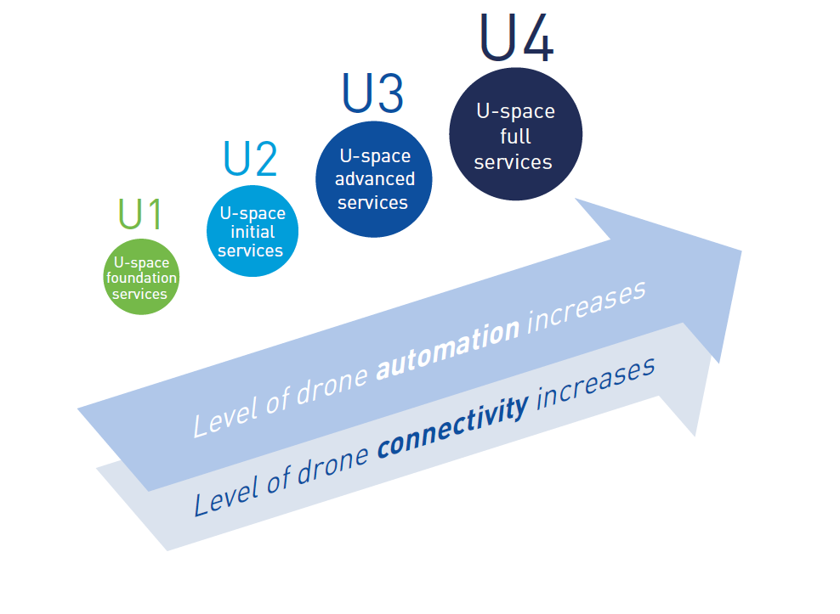
U-space Blueprint /UTM
U1 - U-space foundation services provide e-registration, e-identification and geo awareness.
U2 - U-space initial services support the management of drone operations and may include flight planning, flight approval, tracking, airspace dynamic information, and procedural interfaces with air traffic control.
U3 - U-space advanced services support more complex operations in dense areas and may include capacity management and assistance for conflict detection. Indeed, the availability of automated ‘detect and avoid’ (DAA) functionalities, in addition to more reliable means of communication, will lead to a significant increase of operations in all environments.
U4 - U-space full services, services offering integrated interfaces with manned aviation, support the full operational capability of U-space and will rely on very high level of automation, connectivity and digitalisation for both the drone and the U-space system.

Slide 12
CORUS
Concept of Operation for EuRopean UTM Systems (CORUS)
CORUS aims to address VLL airspace, also including the airspace around airports
  Establish and clearly describe a concept of operations. Develop clear use cases for nominal scenarios and describe how losses of safety in non-nominal situations (e.g. contingency, emergency …) can be minimized.
  Address drones operations in uncontrolled airspace as well as in and around controlled or protected airspace (e.g. airfields).
  Develop a concept enabling safe interaction with all different classes of airspace users taking into account contingencies and emergencies, and making clear any assumptions about the volumes of traffic.
  Examine non-aviation aspects, identifying key issues for society (e.g. safety and privacy, noise …) and offering solutions to ease social acceptance
  Identify necessary services and technical development, quantifying the level of safety and performance required and proposing an initial architecture description.

Slide 13

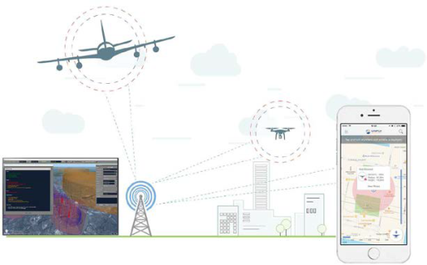
PODIUM
Proving Operations of Drones with Initial UTM Management
SESAR 2020 VLD
U-space blocks
  Foundation U1
  Initial U2
  Some advanced U3
Situational awareness
Tracking: Mode-S, L-Band, GSM
EUROCONTROL (leader), Airbus, DSNA, DELAIR, Drones Paris Region, INAS, Naviair, NLR, Orange, Unifly, + 17 LTPs, + 4 subcontractors
+185 drone flights
VLOS & BVLOS
Urban & rural, airport vicinity
Uncontrolled & controlled A/S
Eelde (NL), Odense (DK),
Paris & Toulouse (FR)
- Demo report = end 2019
    - Prep. & Demos = 2018 – 2019
  - Kick-Off = Jan 2018
- GA signature = 12 Dec 2017
Notes:
.

Slide 14

SECOPS
The main objective of SECOPS is to define such an integrated security concept for drone operations that ensures that security risks in U-space are mitigated to an acceptable level, in particular:
  Drones do not divert from their intended mission, due to unexpected interference.
  Drones cannot deliberately be misused for illegal or dangerous activities.
  Detect and act when drones are misused (by the pilot or an external party).

Slide 15

DREAMS
Fill the gap between the existing information used by traditional manned aviation and the needs of the new unmanned aviation;
Analyse and simulate present and future real-world applications, to ensure that the system can be scaled as the market for drones grows and the number of applications increases;
Analyse and validate the technologies related to information exchange that will make possible the implementation of the future U-space concept for the management of drones in Europe

Slide 16
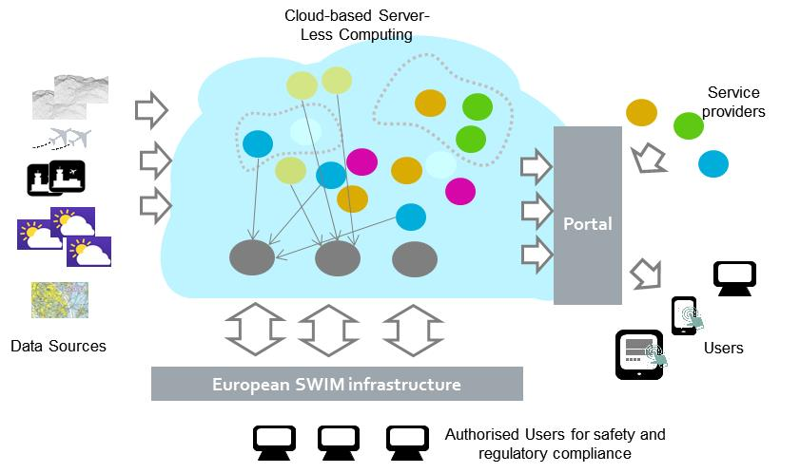
IMPETUS
Information Management Portal to Enable the inTegration of Unmanned Systems - IMPETUS

Slide 17
Drone Critical Communications - DroC2om
DroC2om project contributes to the definition of integrated cellular-satellite data link specifications for UASs.
Design a cellular-satellite system architecture concept, which ensures reliable and safe operation for remote controlled, semi-autonomous and fully autonomous small UAS

Slide 18


CLASS
Ground based technologies for a real-time unmanned aerial system traffic management system (UTMS) - CLASS

Slide 19

Conclusion
UAS integration is very complex as it affects all aspects of civil and military ATM
EUROCONTROL contributions in full support to EC, EASA, EDA, SJU, NATO, ICAO, JARUS
ICAO and ITU have a major role

Slide 20
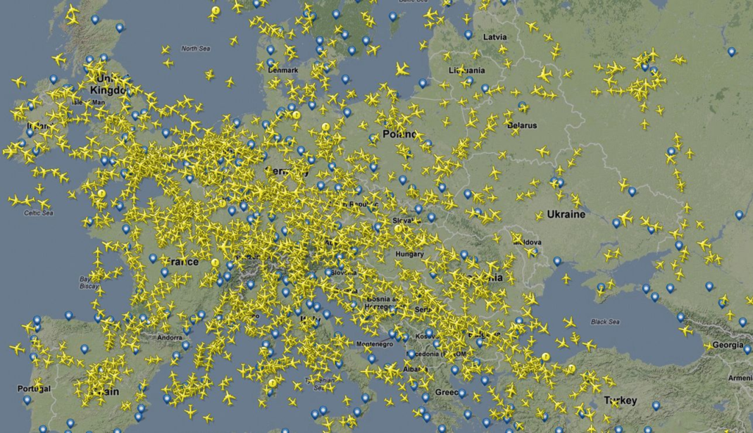
Thank You
Questions?

