Slide 1
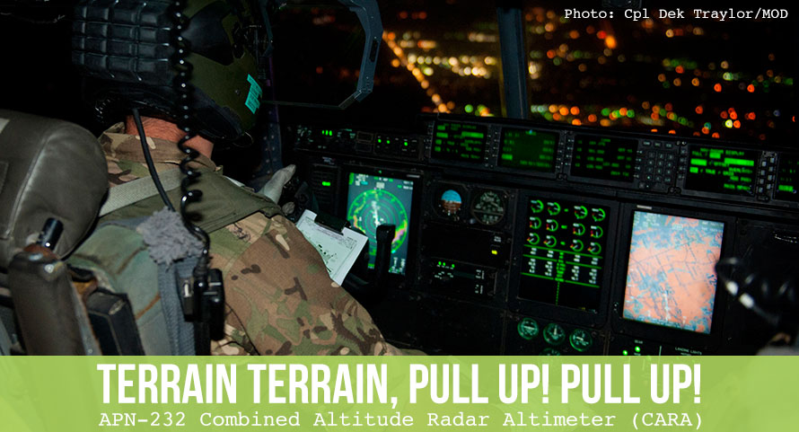
Radio Altimeter Spectrum

Slide 2
Scope
Radio altimeter operations and requirements
Spectrum used
Equipage and performance
Assessment of radio altimeter performance during interference
Protection of the radio altimeter
Questions

Slide 3
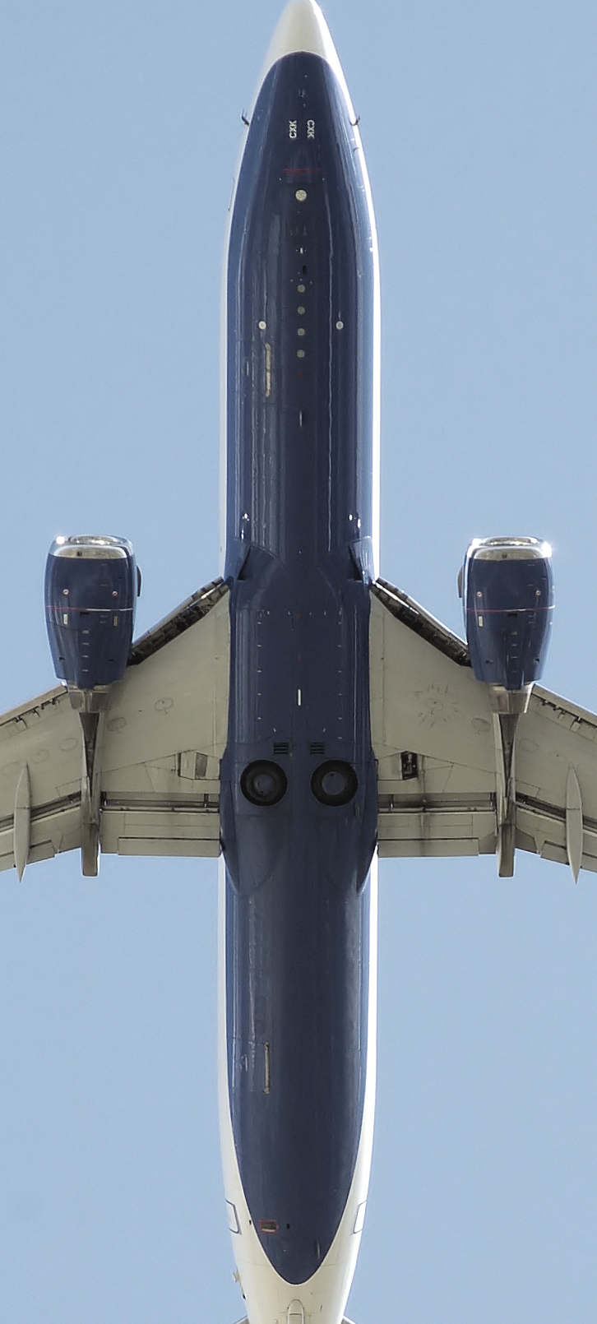
Radio Altimeters
Radio altimeter a critical avionics systems
  Developed to prevent Controlled Flight Into Terrain (CFIT)
    Major source of accidents before 1970’s implementation
  Part of the Ground Proximity Warning System (GPWS)
    Modern systems combined with GPS to enhance safety (eGPWS)
Current usage
  Core aircraft sensor system during the critical phases of flight (landing and takeoff in low/zero visibility weather)
  Provides readings from -10 to 15000+ feet
  Accuracy to 3 feet or less
  Used by autopilot system to control altitude

Slide 4
ICAO Requirements
ICAO Annex 6 Part 1 Chapter 6 states:
‘All turbine-engine aeroplanes of a maximum certificated take-off mass in excess of 15 000 kg or authorized to carry more than 30 passengers shall be equipped with a ground proximity warning system which has a forward looking terrain avoidance function.’
(other paragraphs have similar provisions for different weight categories of aircraft.)

Slide 5

Equipage and operation
US National Example
All FAA Part 135 helicopters are now required to have an operational radio altimeter
  Approx. 22,000 operational civil rotorcraft*
Some FAA Part 91 aircraft require altimeters for certain operations such as Cat II ILS, etc.
  Approx. 34,000 general aviation/private aircraft
All large passenger aircraft
  Approx. 7000 US based civil aircraft*
  Plus international carriers

Slide 6
Radio Altimeter Spectrum
Altimeters operate within the 4200-4400 MHz ARNS allocation
  Worldwide allocation
  Traditionally almost no other users within the band
WAIC system recently allocated to the same band as an AM(R)S
  Wireless Aircraft Intra Communications
  WRC-15 primary allocation across whole band
  Radio altimeters have primary status over WAIC systems
FSS (s-e)
ARNS
FS
MS (AMT)
4200
4400
Frequency (MHz)

Slide 7
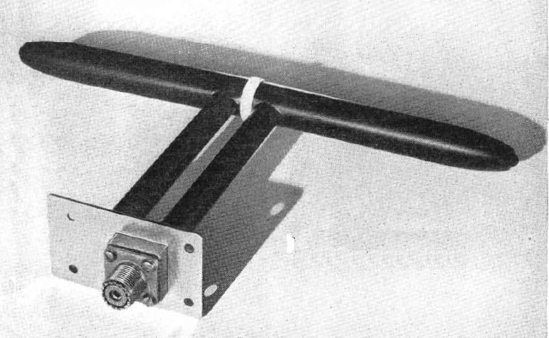
Altimeter Technical Requirements
Technical operation
  Frequency Modulated Continuous Wave (FMCW) radar system for most civilian altimeters
  Pulsed system used by state aircraft and helicopters
Both systems measure time from transmission of a radio signal from the aircraft to reception of the reflected signal
  For FMCW, difference in transmitted signal and received generated a beat frequency that corresponds to a distance
Few standards that define altimeter system performance
  ITU-R Rec M.2059 - Operational and technical characteristics and protection criteria of radio altimeters utilizing the band 4 200-4 400 MHz
  RTCA DO-155 – MOPS for Airborne Low Range Radar Altimeters

Slide 8
Altimeter Technical Requirements
FMCW altimeter sweeps most of the 200 MHz
  Largest known bandwidth is 196 MHz (40dB B/W)
  Transmit power between 0.1 and 100 watts
Protection criteria (as per ITU standard)
  Desensitization: I/N = –6 dB
  Front End Overload: I RF ≤ P T ,RF as defined in Tables 1 and 2
  False Altitudes (for FMCW Altimeters only): ID < IT,FA, where IT,FA = –143 dBm/100 Hz following the instantaneous altimeter local oscillator
  6 dB safety margin applicability
Any interference that compromises the reported information can immediately affect aircraft safety systems
  Autopilot function, GPWS, and HTAWS
  Receiver adjacent channel isolation rolloff starts at band edge

Slide 9

Attempts to Change the Spectrum Neighborhood
US NTIA assessment in 2011
  Mistook lack of US licenses for unused spectrum
  US aviation industry and manufacturers required several years of pressure to drop proceeding
WRC-15 under AI 1.1
  Several nations sought repurpose 3.7-4.2 and 4.4-4.9 GHz while at WRC
  Required coordinated effort with ICAO, IATA and other aviation attendees to prevent changes
European CEPT work on Ultra Wide Band (UWB)
  Would be implemented across whole 200 MHz
US FCC public proceeding for broadband in 3.7-4.2 GHz
  Options for fixed/mobile broadband

Slide 10
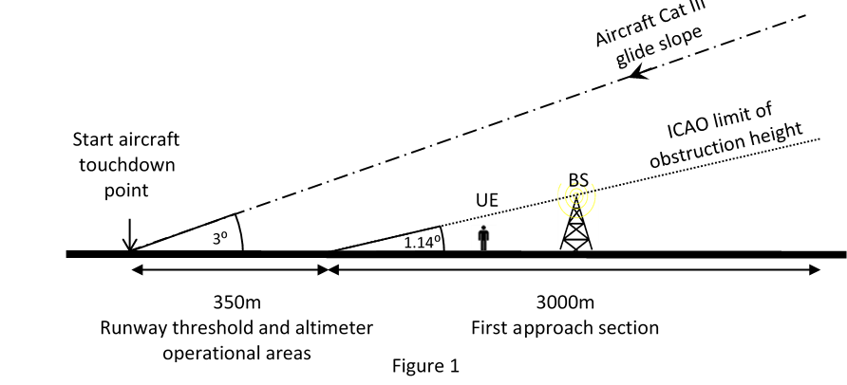
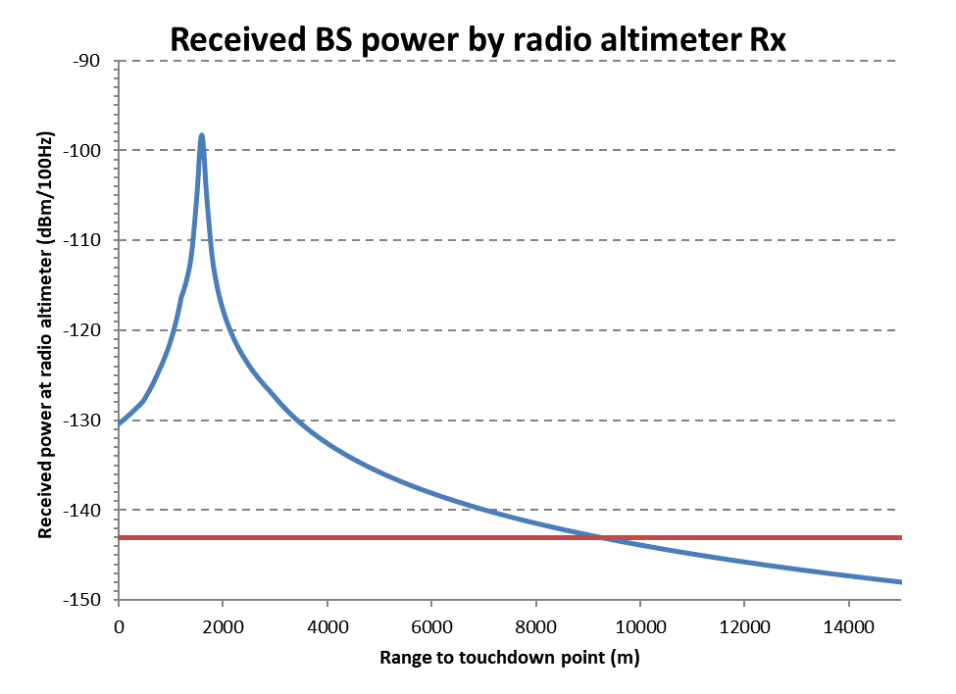
Assessment of Radio Altimeter Performance During Interference
Preliminary ICAO studies provide best known impact at this time
  Used parameters from ITU-R recommendation
  Altimeters highly vulnerable to interference
  Revealed current data is not fully coherent
Additional performance testing required
  IATA has agreed to fund study
  Will use equipment from the WAIC development process
  Awaiting response from manufacturers

Slide 11
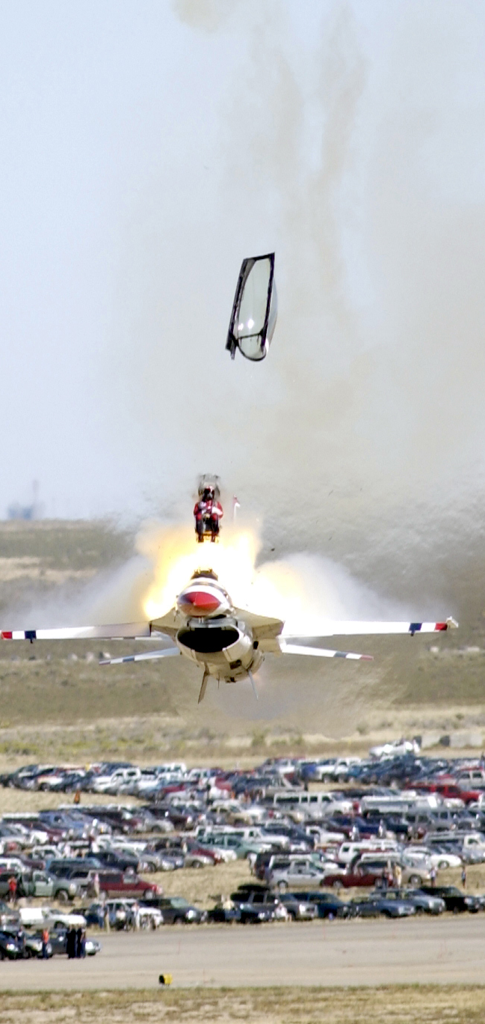
Radio Altimeter Protections
Need to consider both in and out of band effects
  In band protection has been strengthened by WAIC
  Adjacent band repurposing being considered by several nations
Operational scenarios critical
  Helicopter ops most likely to be impacted
  …but close proximity to ground provides a higher power reflected signal
Testing critical to identify core performance protection requirements

Slide 12
Summary
Radio altimeter spectrum critical to almost all classes of aviation
New demand for ‘mid-band’ spectrum places altimeters in a desirable location
There will continue to be attempts on the frequency band and to those adjacent
Aviation needs all the information available to ensure a robust defense of the system

Slide 13
Questions?

