Slide 1
2019 World Radiocommunication Conference Agenda Item 1.10
Global Aeronautical Distress & Safety System
(GADSS)
Radio Regulatory Provisions
ICAO Regional Preparatory Group meeting
Mexico City, Mexico 6-7 February 2018
John Mettrop
UK CAA

Slide 2
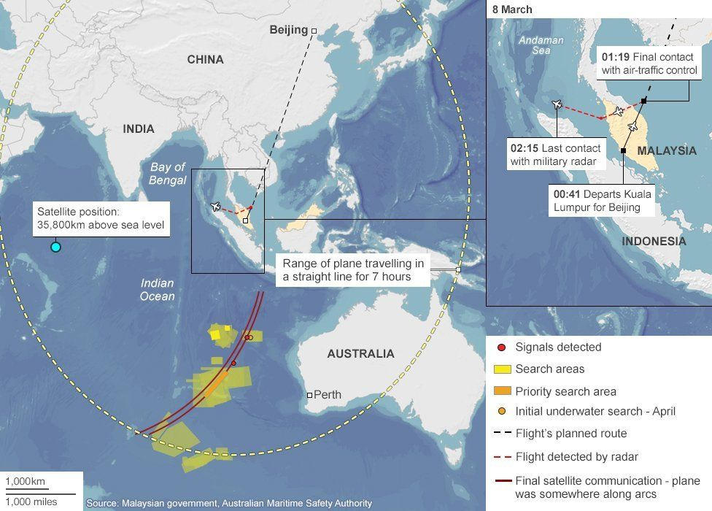
WRC-19 Agenda Item 1.10
invites ITU-R
to conduct the relevant studies, taking into account information and requirements provided by ICAO for both the terrestrial and satellite components, including:
quantification and characterization of radiocommunication requirements related to GADSS, such as:
data traffic requirements for different system components of GADSS (such as the aircraft tracking, autonomous distress and flight data recovery systems) and their terrestrial and satellite components at each phase of the operation;
information on the radiocommunication requirement related to safety-of-life applications;
performance criteria for terrestrial and satellite systems;
analysis of the existing allocations to the relevant aeronautical services and determining whether any additional spectrum is required;
studies on sharing and/or compatibility with the existing services;
to undertake studies of the existing regulatory provisions to determine whether it might be necessary to apply additional regulatory measures,

Slide 3

GADSS What We Know?
Concept Built on use of Existing Systems
Deficiencies in Surveillance Capabilities
  Identified as a result of AF 447 & MH 360 Incidents
  Addressed at WRC-19
  Allocation for satellite ADS-B
No need for Additional Allocations Identified
No need for Modifications to Existing Footnotes Identified

Slide 4

Why Do We Need Agenda Item 1.10
Normally Concentrate on Article 5
Other Articles and Appendices of Interest
  Chapter V – Administrative provisions
    Article 18 – Licences
  Chapter VI – Provisions for services and stations
    Article 28 – Radiodetermination
  Chapter VII – Distress and safety communication
    Article 30 – General
  Appendix 12 – Special rules applicable to radio-beacons
  Appendix 27 – Frequency allotment plan for the aeronautical mobile (R) service and related information

Slide 5

Why Do We Need Agenda Item 1.10
Other Articles and Appendices of Interest
Chapter VIII – Aeronautical Services
Article 35 - Introduction
Article 36 - Authority of the person responsible for the station
Article 37 - Operator’s certificate
Article 38 - Personnel
Article 39 - Inspection of stations
Article 40 - Working Hours of stations
Article 41 - Communication with stations in the maritime services
Article 42 - Conditions to be observed by stations
Article 43 - Special Rules relating to the use of frequencies
Article 44 - Order of priority of communications
Article 45 - General communication procedures

Slide 6

Potential Issues Within
Articles 18, 28, 30,32 & 35-45
GADSS Related
  Pilot’s authority
  Secrecy
  Additional Provisions
Aviation in General
  Technical
Provisions for Other Services
  Chapter V – Administrative Provisions
    Article 18 – Licences
  Chapter VI – Provisions for Services and Stations
    Article 28 – Radiodetermination
  Chapter VII – Distress and Safety Communication
    Article 32 – Operational procedures for distress communications in the global maritime distress and safety system (GMDSS)

Slide 7
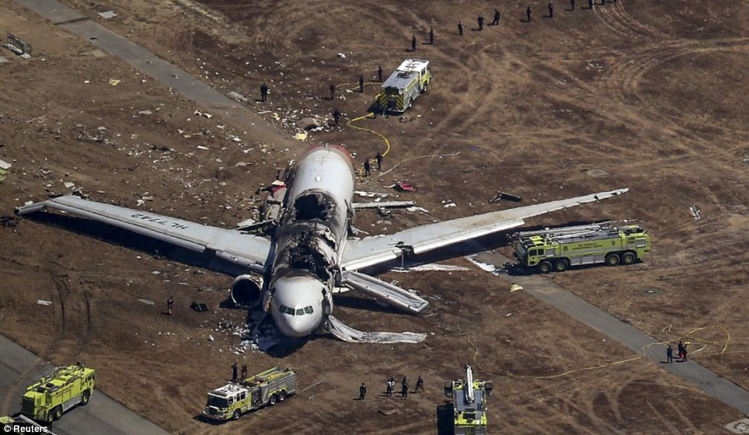
Current Proposals within the ITU
PDN Report
ITU-R M.[GADSS]
(https://www.itu.int/dms_ties/itu-r/md/15/wp5b/c/R15-WP5B-C-0538!N21!MSW-E.docx)
  No allocation issues
  Need to modify Chapter VII Article 30 in a manner that:
    GADSS is made up of a number of systems which operate under an allocation to one or more aeronautical services
    Recognises GADSS whilst avoiding any impact on GMDSS
    Defines GADSS and its main functions
    Identifies ICAO as the responsible UN agency further detail
    Detailed information on the system is contained in ICAO documentation
  Identifies additional regulatory provisions which are outdated and need to be reviewed at a future WRC
Draft CPM text on
WRC-19 AI 1.10
(https://www.itu.int/dms_ties/itu-r/md/15/wp5b/c/R15-WP5B-C-0538!N06!MSW-E.docx)
  Method A: - Add provisions in Chapter VII that specify
  that the details of the GADSS elements are contained in Annexes to the ICAO Convention;
  that the type of radiocommunication service used depends on the requirements of the specific GADSS function,
  that operation of GADSS elements under RR No. 4.4 is precluded.
  Method B: - Add a new article in chapter VII that
  that the details of the GADSS elements are contained in Annexes to the ICAO Convention;
  that GADSS shall only operate using primary service allocations;
  that the GADSS must operate in accordance with the terms of new Resolution

Slide 8

ICAO Position
To support studies to identify any regulatory changes required for the implementation of GADSS in accordance with ICAO requirements, and action by WRC-19 to integrate those changes into the Radio Regulations.

Slide 9
Outstanding Questions within the ITU
Chapter VIII Aeronautical Services
Whether the provisions of Articles 18.4 and 36.3, taking into account the definition in Article 17, would require that aircraft tracking information be encrypted.
Whether the provisions of Articles 36.1, 36.2, 37.1 and 37.2 would preclude GADSS including a provision that the aircraft autonomous distress tracking function could not be turned off.
Whether Article 37.3 would preclude GADSS including, under some conditions, a provision for remote triggering of position reporting.

Slide 10
Other Issues that may need Future WRC Action (1)
ARTICLE 36
Authority of the person responsible for the station
36.1 § 1 The service of a mobile station is placed under the supreme authority of the person responsible for the aircraft or other vehicle carrying the mobile station.
36.2 § 2 The person holding this authority shall require that each operator comply with these Regulations and that the mobile station for which the operator is responsible is used, at all times, in accordance with these Regulations.
36.3 § 3 Except as otherwise provided for in these Regulations, the person responsible, as well as all the persons who may have knowledge of any information whatever obtained by means of the radiocommunication service, are placed under the obligation of observing and ensuring the secrecy of correspondence
36.4 § 4 The provisions of Nos. 36.1, 36.2 and 36.3 shall also apply to personnel of aircraft earth stations

Slide 11
Other Issues that may need Future WRC Action (2)
ARTICLE 37
Operator’s certificates
Section I − General provisions
37.1 § 1 1) The service of every aircraft station and every aircraft earth station shall be controlled by an operator holding a certificate issued or recognized by the government to which the station is subject. Provided the station is so controlled, other persons besides the holder of the certificate may use the radiotelephone equipment.
37.2 .
37.3 3) The service of automatic communication devices installed in an aircraft station or aircraft earth station shall be controlled by an operator holding a certificate issued or recognized by the government to which the station is subject. Provided the devices are so controlled, they may be used by other persons

Slide 12
Other Issues that may need Future WRC Action (3)
ARTICLE 18
Licences
18.1
18.2
18.3 .
18.4 § 2 The holder of a licence is required to preserve the secrecy of telecommunications, as provided in the relevant provisions of the Constitution and the Convention. Moreover, the licence shall mention, specifically or by reference, that if the station includes a receiver, the interception of radiocommunication correspondence, other than that which the station is authorized to receive, is forbidden, and that in cases where such correspondence is involuntarily received, it shall not be reproduced, nor communicated to third parties, nor used for any purpose, and even its existence shall not be disclosed.

Slide 13
Other Issues that may need Future WRC Action (4)
ARTICLE 28
Radiodetermination Services
28.16 § 9 In the absence of prior arrangements, an aircraft station which calls a radio direction-finding station for a bearing shall use for this purpose a frequency on which the station called normally keeps watch.
Section IV − Radiobeacon stations
28.18 § 11 When an administration thinks it desirable in the interests of navigation to organize a service of radiobeacon stations, it may use for this purpose:
28.19 a) radiobeacons properly so-called, established on land or on ships permanently moored or, exceptionally, on ships navigating in a restricted area, the limits of which are known and published. The emissions of these radiobeacons may have either directional or non-directional patterns;
28.20 b) fixed stations, coast stations or aeronautical stations designated to function as radiobeacons, at the request of mobile stations.

Slide 14
Other Issues that may need Future WRC Action (5)
ARTICLE 32
Operational procedures for distress communications in the
global maritime distress and safety system (GMDSS)
Section III − Distress traffic
32.60 C − Locating and homing signals
32.61 § 36 1) Locating signals are radio transmissions intended to facilitate the finding of a mobile unit in distress or the location of survivors. These signals include those transmitted by searching units, and those transmitted by the mobile unit in distress, by survival craft, by float-free EPIRBs, by satellite EPIRBs and by search and rescue radar transponders to assist the searching units.
32.62 2) Homing signals are those locating signals which are transmitted by mobile units in distress, or by survival craft, for the purpose of providing searching units with a signal that can be used to determine the bearing to the transmitting stations.
32.63 3) Locating signals may be transmitted in the following frequency bands:
117.975-137 MHz;
156-174 MHz;
406-406.1 MHz; and
9 200-9 500 MHz.

Slide 15
Other Issues that may need Future WRC Action (6/1)
Appendix 12 Section I – Aeronautical radiobeacons
The assignment of frequencies to aeronautical radiobeacons operating in the bands between 160 kHz and 535 kHz shall be based on a protection ratio against interference of at least 15 dB for each beacon throughout its service area.
The radiated power should be kept to the minimum value necessary to give the desired field strength at the service range.
The daylight service range of radiobeacons referred to in § 1) above shall be based on the following field strengths:
4) Regions 1 and 2
  – 70 μV/m for radiobeacons north of 30° N;
  – 120 μV/m for radiobeacons between 30° N and 30° S;
  – 70 μV/m for radiobeacons south of 30° S.
5) Region 3
– 70 μV/m for radiobeacons north of 40° N;
– 120 μV/m for radiobeacons between 40° N and 50° S;
– 70 μV/m for radiobeacons south of 50° S.

Slide 16
Other Issues that may need Future WRC Action (6/2)
ICAO Annex 10 Volume 1
3.4.2.1 Recommendation.— The minimum value of field strength in the rated coverage of an NDB should be 70°microvolts per metre.
Note 1.— Guidance on the field strengths required particularly in the latitudes between 30°N and 30°S is given in 6.1 of Attachment C, and the relevant ITU provisions are given in Chapter VIII, Article 35, Section IV, Part B of the Radio Regulations.
A.— Minimum field strengths required at the boundary of the rated coverage:
By day for By night for
Latitude 15 dB S/N ratio 15 dB S/N ratio
5°N – 5°S 320 μV/m (+50 dB) 900 μV/m (+59 dB)
5° – 15°N&S 85 μV/m (+39 dB) 700 μV/m (+57 dB)
15° – 25°N&S 40 μV/m (+32 dB) 320 μV/m (+50 dB)
25° – 35°N&S 18*μV/m (+25 dB) 120 μV/m (+42 dB)
>35°N&S 18*μV/m (+25 dB) 150 μV/m (+35 dB)
A star shown against a figure indicates that a higher value of field strength — probably 2 or 3 times the values shown (plus 6 to plus 10 dB) — may be necessary in the presence of high aircraft noise and/or industrial noise

Slide 17


