Slide 1
GADSS in depth
Airbus views on Global Aeronautical Distress Safety System
ICAO Regional Preparatory Group / WRC-19 Workshop
Claude PICHAVANT
September 2018, Johannesburg

Slide 2
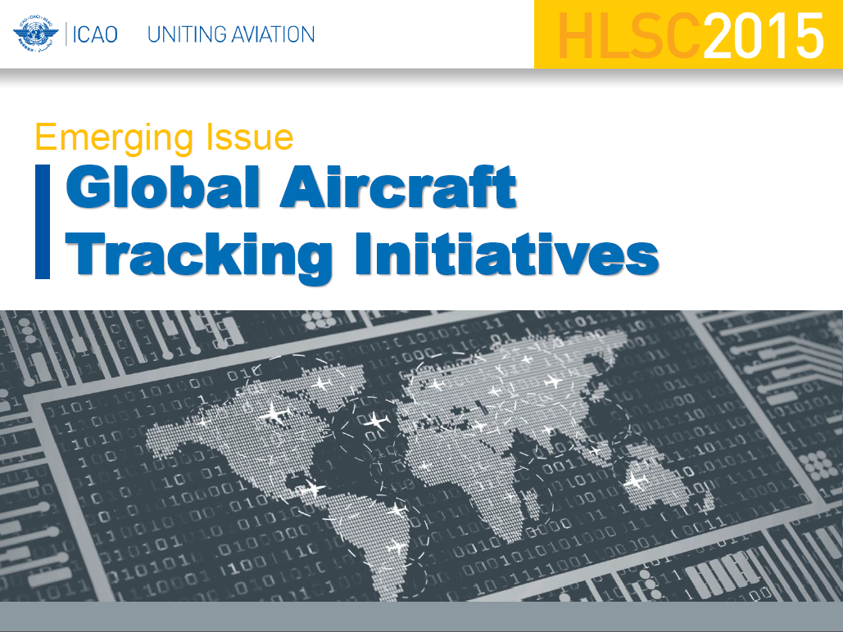



SECOND HIGH-LEVEL SAFETY CONFERENCE 2015 (HLSC 2015)
“ICAO should encourage States and the International Telecommunication Union (ITU) to discuss allocation requirements at the World Radio Communication Conference in 2015 (WRC 15) to provide the necessary spectrum allocations for global air traffic services surveillance as a matter of urgency; “
WORLD RADIO CONFERENCE 2015
Resolution 425 (WRC-15)
“Use of the frequency band 1 087.7-1 092.3 MHz by the Aeronautical Mobile-Satellite (R) Service (Earth-to-space) to facilitate global flight tracking for civil aviation.”
>>> “Space ADS-B “
New Agenda Item 1.10
“To consider spectrum needs and regulatory provisions for the introduction and use of the Global Aeronautical Distress and Safety System (GADSS), in accordance with Resolution 426 (WRC15).”

Slide 3
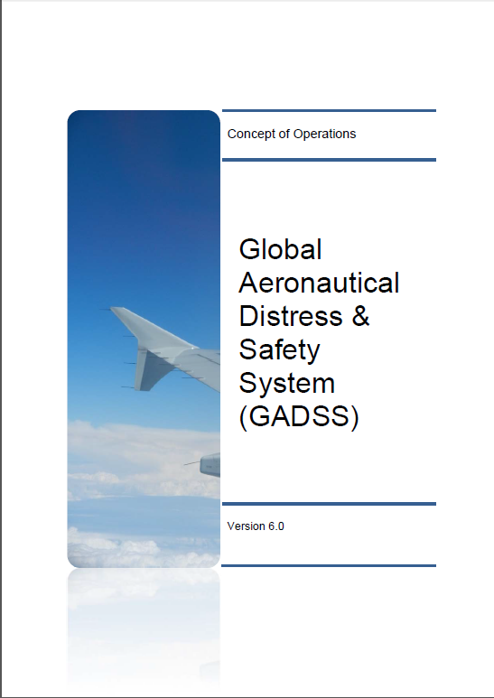
This Concept of Operations document specifies the high-level requirements and objectives for the GADSS.
Responding to the requirements and objectives, the ConOps specifies the high-level functions needed, with a description of users and usages of aircraft position information, in all airspaces, during all phases of flight, both normal and distress flight conditions including the timely and accurate location of an aircraft accident site and recovery of flight data.
Version 6 released and distributed June 2017

Slide 4
Global Aeronautical Distress Safety System
AT
Aircraft Tracking
ADT
Autonomous Distress Tracking
PFLR
Post Flight Localization & Recovery
GADSS Information Management
ATS
Airline
SAR
ALERT
Accident Investigation Authority
RCC

Slide 5
ICAO Recommendations
        90 days ULB “Underwater Locator Beacons” (37,5Khz) attached to recorders CVR and DFDR (replacement of 30 days ULB)
        >>>>> January 2018 Forward fit & Retrofit
        (EASA: 16 June 2018 for retrofit)
        90 days Low Frequency ULD “Underwater Locating Devices” (8,8Khz) attached to the aircraft for long-range over-water flights
        >>>>> 2019 Forward fit & Retrofit
(ICAO: Not later than 1 January 2018 ; EASA: By 1 January 2019)
        25 hours CVR
        >>>>> Jan 2021 -Forward fit

Slide 6
ICAO Recommendations
        Aircraft Tracking Normal (& Abnormal) Conditions
        >>>>> Nov or Dec 2018 Forward fit & Retrofit
        Location and tracking of an Airplane in Distress
        >>>>> Jan 2021 - Forward-fit
      Flight Data Recovery , two alternative means:
          Data streaming (CVR and FDR data content)
          or ADFR “Automatic Deployable Flight Recorders” (with integrated ELT).
        >>>>> Jan 2021 - new Type Certificate

Slide 7
GADSS Concept
ICAO Conops (V6)
ICAO SARPs
  Manual (Doc 10054)
    Distress Tracking Repository
National Regulations
  AMC & GM
  (Acceptable Means of Compliance Guidance Materials)
Industry Requirements and Standards
  EUROCAE (ED 237, ED62B)
  ARINC (680, 681,..)
ICAO Annexes (6, 11, 13, ..)
ICAO Manuals
Regulations
AMC & GM
Industry Standardization

Slide 8
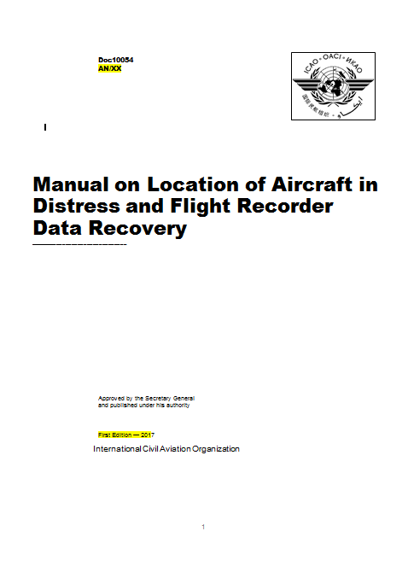
Main ICAO activities
ICAO GADSS-Advisory Group activities are on going, a work programme has been establish related to the GADSS implementation .
ICAO has developed a Manual Doc 10054 to provide guidance in support of Standards and Recommended Practices (SARPs) introduced into Annex 6 regarding Flight Recorder Data Recovery and the Location of an Aircraft in Distress.
This document was defined by the ICAO “Flight Recorder” Working Group.
>>> ICAO Doc 10054 is expected to be released soon

Slide 9

Current ICAO Recommended Practices
Normal
(Abnormal)
Distress
Data Recovery
Routine Aircraft Tracking
        Localizing A/C
        in distress
        Flight Data Recovery
All new manufactured
Aircraft from
Jan 2021
All Aircraft from Nov 2018*
Oceanic area
New Type Certification
from Jan 2021
Recommendations into ICAO SARPS
Refer to Annex 6, 10, 11, 12
*: implementation date can be different according to regional or national regulations

Slide 10
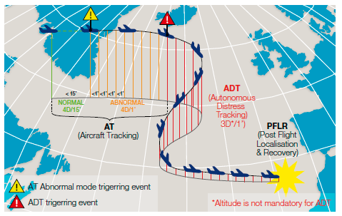

Slide 11
Global Aeronautical Distress Safety System
AT
Aircraft Tracking
Provides automatic A/C position at least once every 15 minutes
ATS Surveillance may be utilized
Can be isolated by Flight crew
Multiple solutions
May have airline defined triggers for abnormal operations with higher reporting rate
GADSS Information Management
ATS
Airline
Use of any type of spectrum properly allocated, on a primary basis

Slide 12



Regulatory FrameWork – NAA status
States regulations
National Aviation Authorities (NAA) are defining their regulations according to ICAO recommendations.
Amendment to AIR-OPERATIONS (EU 965/2012) with new requirement CAT.GEN.MPA.205
Aircraft tracking from December 2018.
Abnormal mode detection required, but no modification of transmission rate requested (i.e: abnormal detection from ground based on 15 min reporting rate)
No regulation on Aircraft tracking
Amendment to "Aircraft Operator Certificate Requirements" with issue 3 revision 30
Aircraft tracking effective since July 2016 (with automated solution by November 2018).

Slide 13
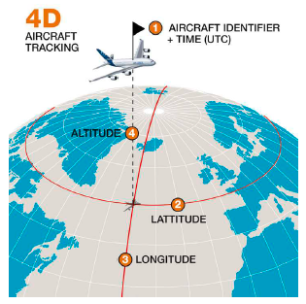
What is 4D (4 dimensions) ?

Slide 14
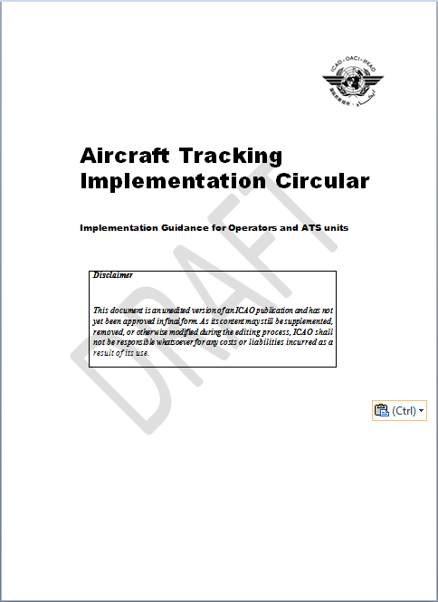





Aircraft tracking supported by existing technologies
Applicability November 2018 (Recommended in all areas of operations and mandatory over Oceanic areas)
Normal
Abnormal
Aircraft Tracking
Normal Operations
Aircraft Tracking
Abnormal Operations
Same content as Normal Tracking (4D)
Higher transmission rate triggered on abnormal event
4D (Lat, Long, Alt, Time) position
+ A/C Ident
Normal Aircraft Tracking Implementation Initiative
(NATII)
≤15 mins
1 min
AIRCRAFT TRACKING IS PLACED UNDER
OPERATORS RESPONSIBILITY

Slide 15





Datalink communication means on Airbus Aircraft
Communication systems Geographical Coverage
VHF Datalink Continental areas | Basic | Basic | Basic
SATCOM Inmarsat Worldwide except polar area | Option | Basic | Basic
SATCOM Iridium Worldwide | Option | Option | Not yet available
HF Datalink Worldwide | Option | Basic | Basic
ADS-B out Continental areas and soon Worldwide | Basic | Basic | Basic
Note: Operators will need to make sure that the A/C are equipped with the proper Datalink communication means (VDL / Satcom / HFDL) with regards to their operated routes and that coverage is ensured for these routes.

Slide 16







Airbus way forward for implementing Aircraft Tracking function
AOC Application
Airline Operational Control
Airbus recommendation for A320/ A330 /A350/ A380: A/C tracking solution based on existing AOC datalink applications (ACARS network) and without any additional flight crew action
Partnership was established between Airbus and AOC suppliers, in order to provide generic solution for normal and abnormal tracking conditions through AOC customized database
Activation/Deactivation of abnormal tracking will be done automatically through the monitoring of specific sets of A/C parameters that will trigger the emission of the A/C information at least every 1mn. Ground Airline center will also be able to activate abnormal mode upon uplink request if necessary.
ACARS
SATCOM
VHF
HF
Supported by existing technologies
Airline
Fast and simple solutions available in most of Airbus fleet
Already implemented by some Airlines
Reference
ISI 23.21.00007

Slide 17














Aircraft Tracking – Other solutions
Other existing technologies installed by Supplemental Type Certification (STC).
A wide variety of Standalone solutions using various Satcom constellations are available on the market.
N-TRACKING

Slide 18
Implementation aspects
  Airbus Aircraft Tracking solution is used by a first set of customers.
  As a first general feedback, the need for Airlines to check every 15 minutes « the good » reception of A/C routine tracking messages may highlight some communication delays .
  Note: Transmission rate in normal mode can be modified to answer to some regulations or to anticipate some delays in ACARS network depending on Aircraft routes
Cost Aspects;
Costs of communication will depend on contracts that Airlines have negotiated with their Service Providers (Fees, Volume, Package…) .
Based on a 10 hours long range flight , the following amount of data is expected :
Routine / normal mode: 3ko
Abnormal mode: 40ko

Slide 19
Global Aeronautical Distress Safety System
ADT
Autonomous Distress Tracking
Provides automatic A/C position at least once every minute
Must be active prior to accident event
Location of an accident site within 6 NM
Operates autonomously of aircraft power
Results in Distress signal to appropriate SAR FIR
May be manually activated
Cannot be isolated
Only protected aeronautical safety spectrum, or protected distress spectrum (e.g., 406.1 MHz), can be used
GADSS Information Management
ATS
Airline
SAR
ALERT
Accident Investigation Authority
RCC
Note: “Distress is a situation which, if left uncorrected, is likely to result in an accident”.

Slide 20
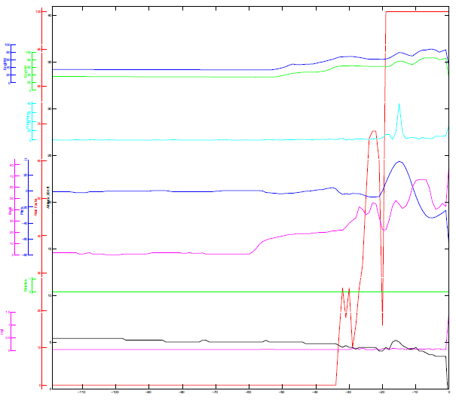
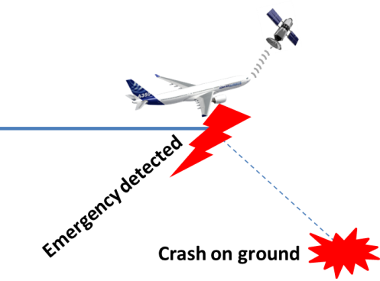

ADT -Autonomous Distress Tracking
Need new equipment on board like ELT 2nd Generation (pre-crash triggered)
  Location of an accident site within a 6 NM radius,
  Automatic transmission of 3D position +ID at a rate of 1 minute
  First burst no later than 5 seconds
  Distress will only be able to be de-activated using the same mechanism that activated it
  Standalone powered and autonomous controlled
  Could be remotely activated
Emergency detected
24s
A/C monitored parameters
ATS
SAR
Impact
Airline/Third party
Time (s)
Note: ADFR with integrated ELT is an alternative equipment for ADT.

Slide 21

Triggers for Distress Tracking are defined by EUROCAE MASPS ED-237
Scenario
Criteria
Pitch excessive
Roll excessive
Unusual A/C attitude
Pitch rate excessive
Roll rate excessive
Pitch margnial and Pitch rate marginal
Roll margnial and Roll rate marginal
Unusual Lateral acceleration
Lateral acceleration excessive
Nuisance alerts to SAR
should not exceed more than
2 per 100 000 Flight Hours
Vertical speed excessive with 5s confirmation time
Unusal speed/energy
STALL warning with 3s confirmation time
Eng1N1 or Eng2N1 is high AND pitch is marginal
Unusal energy
negative with 5s confirmation time
Eng1N1 and Eng2N1 is low AND pitch is marginal
positive with 5s confirmation time
Collision with terrain
Radio altitude and Vertical speed in the Mode1 Pull-
up enveloppe with 3s confirmation time
Total loss of Engine thrust
Eng1N1 and Eng2N1 failed with 5s confirmation time
Excessive cabin altitude in
Excessive Cabin Altitude warning and Vz>-3000
combination with no descent
fpm with 30s confirmation time

Slide 22

ELT Distress Tracking principle (pre-crash triggered)
GADSS in Depth - Airbus views on Global Aeronautical Distress Safety System
ELT includes
internal GNSS receiver
and Battery!
Activation /
Cancellation
Distress event detection &
Trigger as per ED-237
(trigger scenarios)
HOST
Inputs for
distress detection
ELT
ON/OFF
ELT control panel
Operating Status /
Maintenance
Integrated in ADFR
Standalone ELT-DT
A/C Position
A/C Position
Power Supply
Power Supply
Cockpit Control Panel

Slide 23
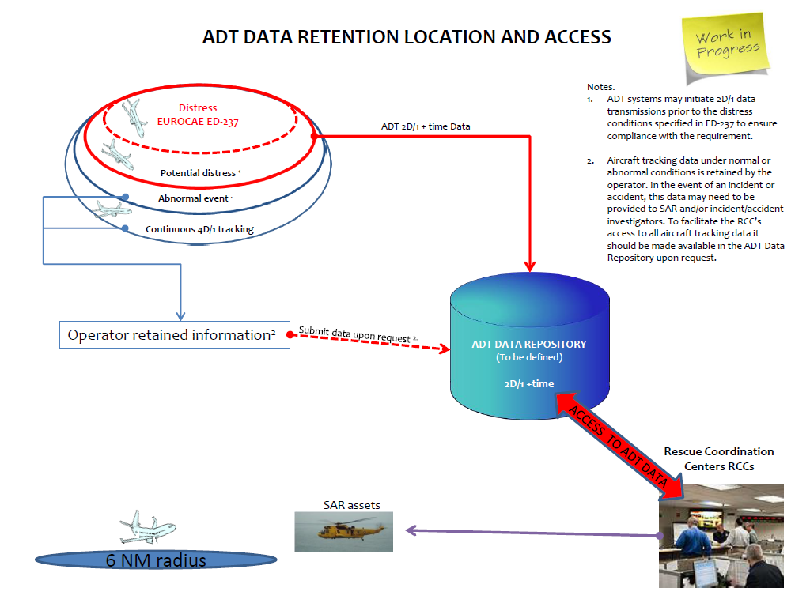
ADT –GADSS information sharing and processes for Notification of Distress Condition
GADSS Extract

Slide 24
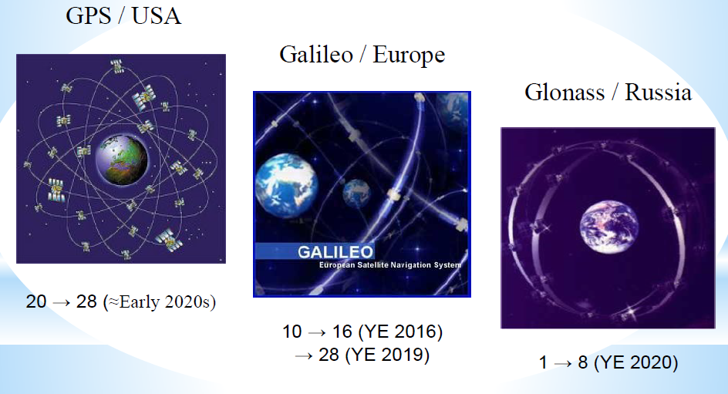
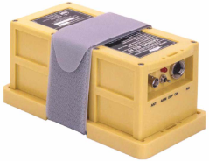
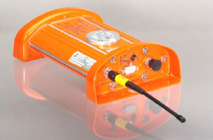
ADT- Autonomous Distress Tracking
2nd Generation ELT- Main new features
GPS position information embedded in distress signal
Use of new COSPAS-SARSAT -MEOSAR constellation based on payloads on GPS, Glonass and Galileo satellites
100% worldwide coverage reached
  first burst will be spotted by satellite anywhere in the
  world, at any time
Potential Return Link Service
Availability expected 2018-20

Slide 25
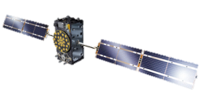

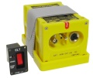
“GADSS-compliant” Data Distribution
406 MHz
ELT-DT alerts
Current Cospas-Sarsat alert data distribution
Mission Control
Center
Nodal MCC
Network
Destination MCC
RCC
Non-406 MHz GADSS Alerts
Communication
RCC/ATSU/Operator
per Annex 11/12 provisions
406 MHz
ELT alerts
ATSU
Distress Tracking
Data Repository
(DTR)
Distress Tracking
Data Repository
FLAG data availability/
Pull ADT data
“GADSS-compliant”
data distribution
(in development)
Airline Operator

Slide 26
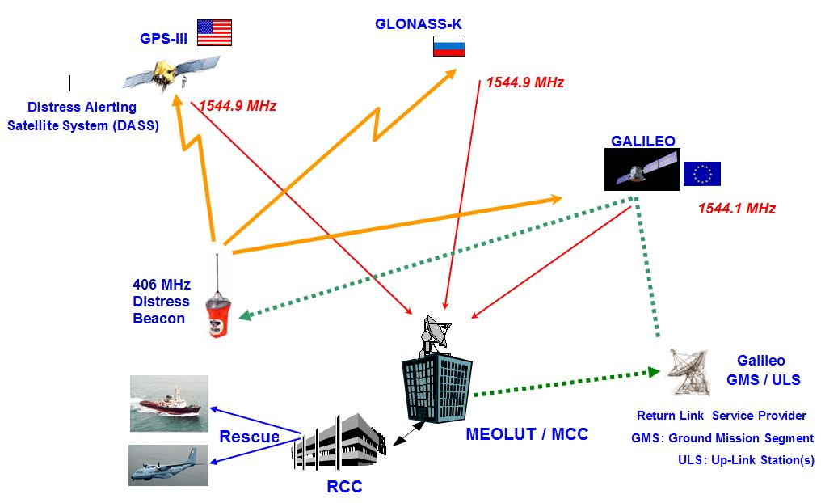
Typical MEOSAR System- Configuration with RLS
RLS
Return Link Service

Slide 27
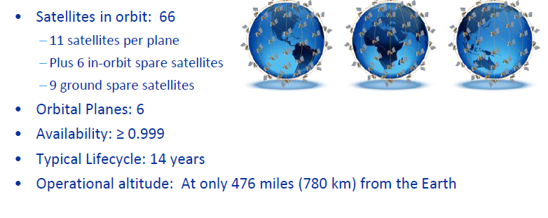

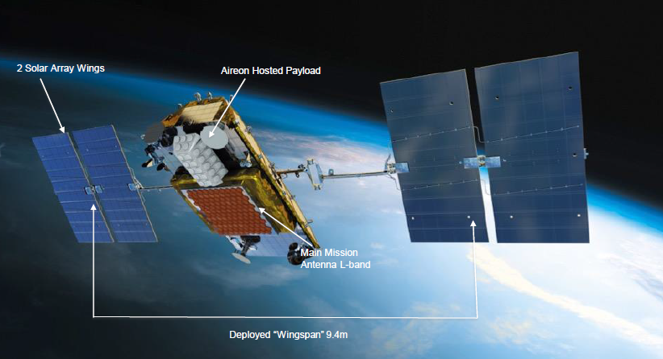
Space ADS-B based on Iridium Next constellation
9
6
Further the last rocket launch during July 2018,
65 satellites are currently in orbit.
Intention to launch 10 additional satellites during 2018 thus completing the constellation (including Spare ones)

Slide 28
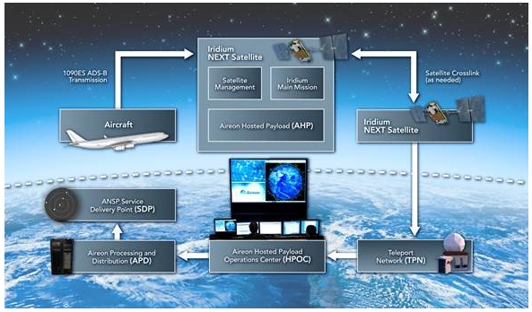
Autonomous Distress Tracking (ADT) - Example of other proposed solutions: Space ADS-B
Aireon ALERT solution will provide GPS location and real-time tracking data to assist rescue coordination centers in emergency situations.

Slide 29

Standardization of Autonomous Distress Tracking (ADT)
In order to specifically address expected, forthcoming ADT mandate in the most effective way (accounting for system complexity, cost, schedule, risk, etc.), the aviation industry proposed to launch a standardization activity through ARINC.
The work is structured in 3 main phases:
- Definition of requirements and main functional block diagrams (ARINC Report 680 available)
- Proposition of candidate architectures (ARINC Report 680 available) .
- Develop detailed equipment, interfaces, and aircraft installation requirements, for selected architecture(s). Define accordingly new ARINC or updated Characteristics.
Global Aircraft Tracking Working Group at full speed…
>>> Completed work expected Jan 2019

Slide 30
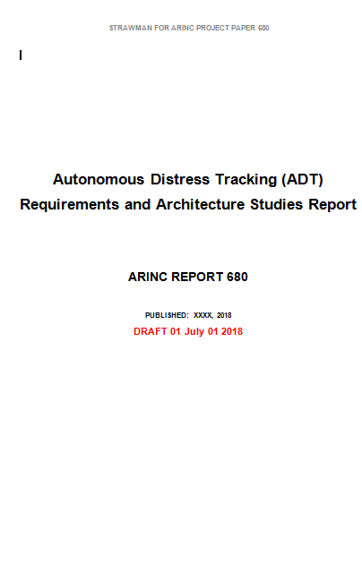
Outcome of AEEC GAT group, scope of ADT
  Phase 1: Initial Requirements - Complete
  Phase 2: Architecture Teams developing proposed architectures:
        Emergency Locator Transmitter – Distress Tracking (ELT-DT)
        Spaced-Based Automatic Dependent Surveillance – Broadcast (SB ADS-B)
        SATCOM-based Tracker (Inmarsat)
        SATCOM-based Tracker (Iridium)
        Other (ie stand alone solution)…
  Good support from industry: Airlines, Suppliers,
  Airframers, Service providers, and government agencies

Slide 31
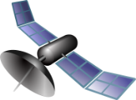
Outcome of AEEC GAT group, scope of ADT
Typical ADT Block Diagram architecture whatever Com means
Main ADT Function Blocks
Event/ Trigger logic/ Crash detection algorithm
Aircraft State
A/C systems/
parameters
Transmission System/means
Distress Detection Logic
Triggering Criteria Logic
Distress Tracking Transmission
Autonomous
(Power supply, 3D position...)
Distress Report
Human Machine Interface
Ground Part
Airlines, ATS, MCC, RCC
SAR

Slide 32
Post Flight Localization and Recovery :
localization systems: only protected aeronautical safety spectrum, or protected distress spectrum (e.g., 406.1 MHz), can be used
flight recorder data recovery system: Use of any type of spectrum properly allocated, [on a primary basis], for the function being performed
To be confirmed according to ITU and ICAO
on going discussions
Global Aeronautical Distress Safety System
Performance Based Solutions
Make it available in a timely manner
  approved by the State of the Operator
  Data Streaming
    Ensures a minimum dataset of CVR and DFDR information
  ADFR (Automatic Deployable Flight Recorder)
    Floatable
    Contains ELT to aid location
PFLR
Post Flight Localization & Recovery
GADSS Information Management
ATS
Airline
SAR
ALERT
Accident Investigation Authority
RCC

Slide 33
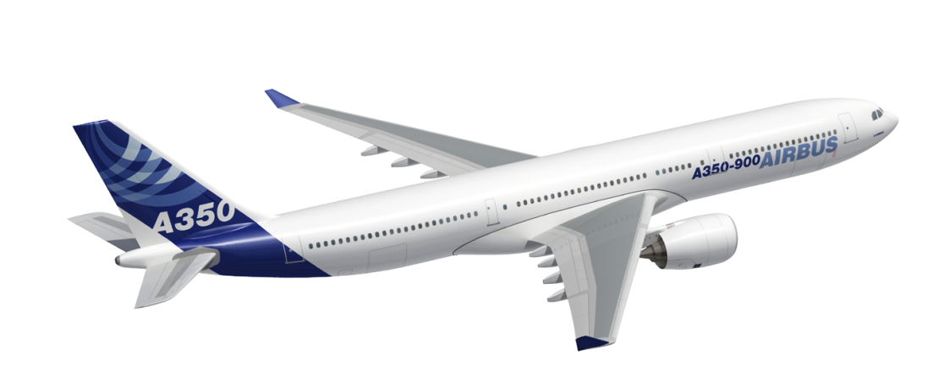

PFLR: Deployable Combined Recorder with integrated ELT
GADSS in Depth - Airbus views on Global Aeronautical Distress Safety System
Feb 2018
2 . ADFR immediately initiates the Emergency Locator Transmitter (ELT) and then releases from aircraft
1. Sensors detect the
start of a crash
3. ELT transmits aircraft ID and country of origin as well as Aircraft location via COSPAS-SARSAT satellites to SAR authorities.
4. Deployable lands
safely and floats on
water ensuring quick
recovery.
Source: DRS
6. SAR personnel recover survivors and Deployable Recorder to enable quickly data accident analysis
5. ELT in the deployable recorder continues to update its position using its embedded GNSS receiver. It acts also as homing device for rescue crews..
Page 33

Slide 34
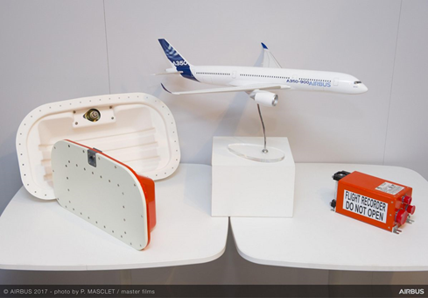
Airbus Official Announcement
On June 21st 2017, during Paris Air Show, AIRBUS announced a new Recording System architecture
This new architecture is composed of:
  A combined Cockpit Voice and Data Recorder (CVDR)
  An Automatic Deployable Flight Recorder (ADFR)
  A Recorder Interface Unit (RIU)

Slide 35
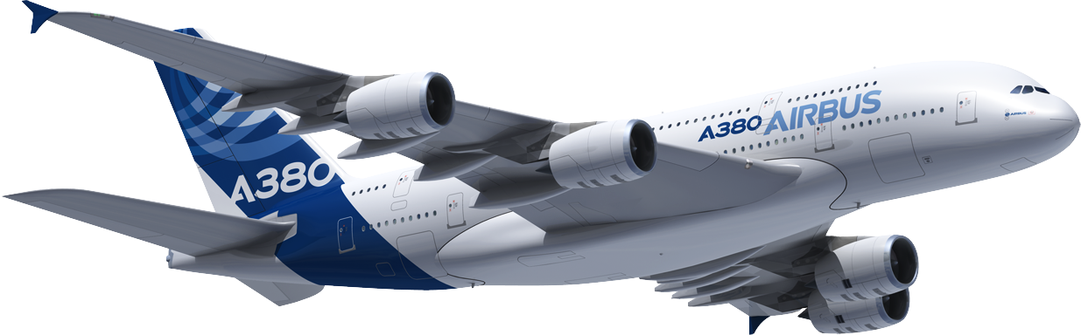
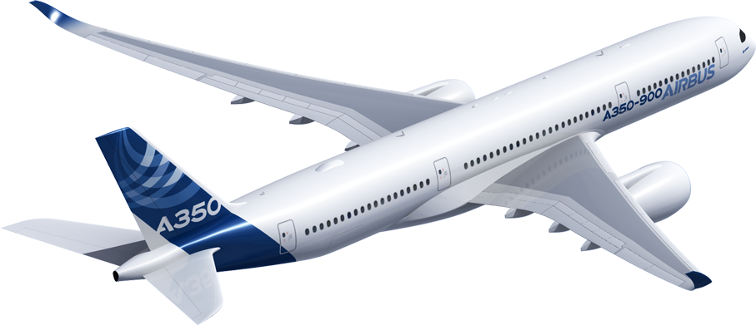
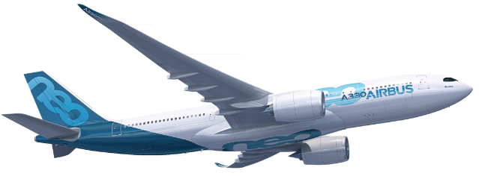
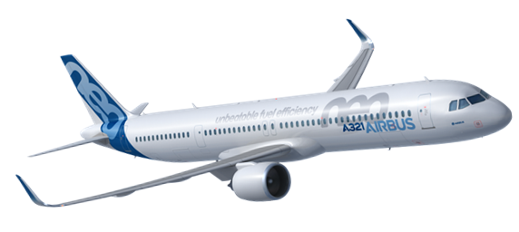
PFLR: Deployable Combined Recorder with integrated ELT
GADSS in Depth - Airbus views on Global Aeronautical Distress Safety System
Feb 2018
Airbus plan: Forward- fit application of ADFR (Automatic Deployable Flight Recorder) on all long range operations aircraft:
A380, A350, A330, and A321LR

Slide 36
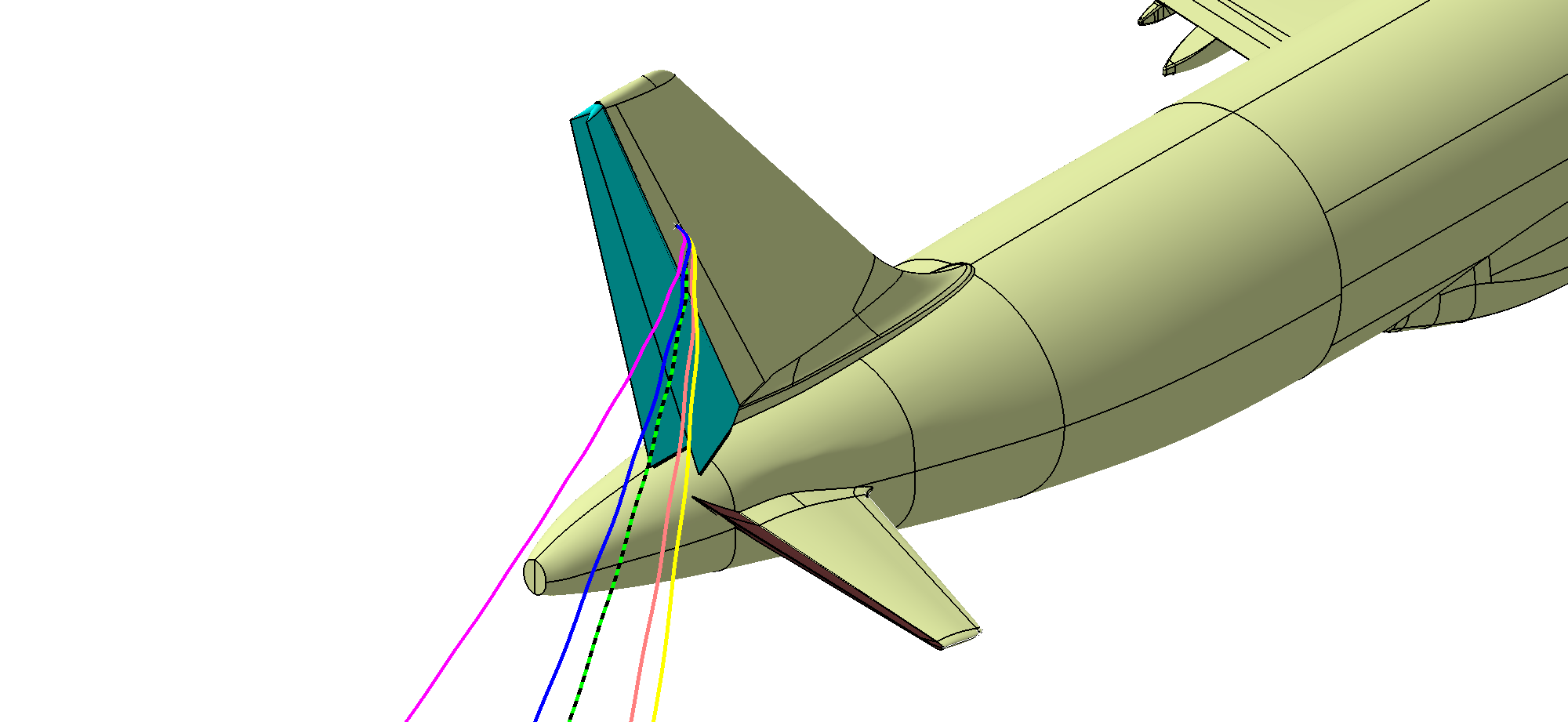
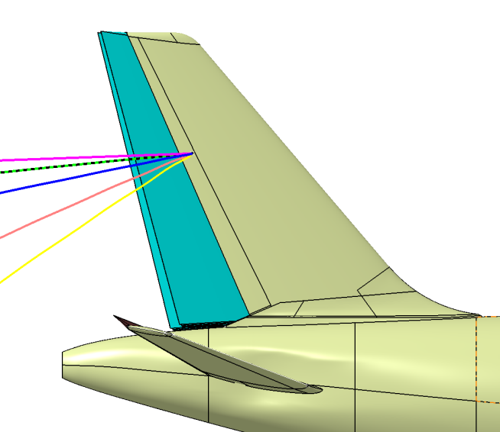
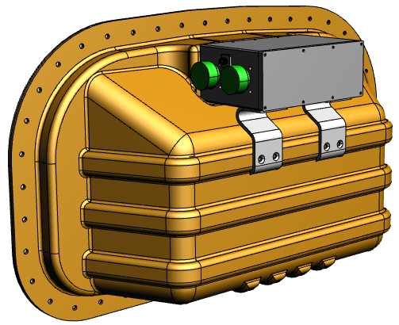
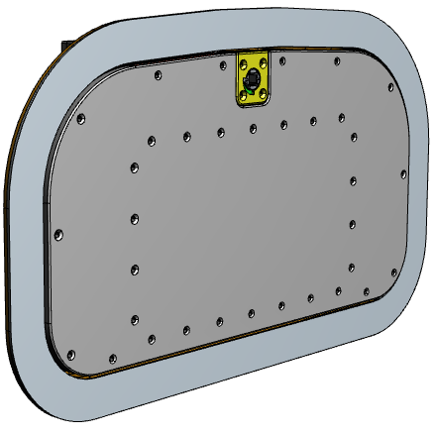
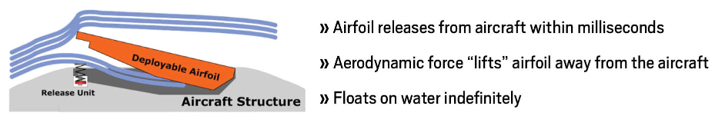


PFLR: Deployable Combined Recorder with ELT
Technology:
Dual Combination Recording System with:
  ADFR with integrated ELT/ADT installed in Vertical Fin
  Crash detection circuits (significant structural deformation
  or water submersion)
  CVDR installed in Avionics Bay
  25 hours recording
  Common system across Airbus fleet A350, A380, A330,
  A321 LR
Entry Into Service expected before mandate date
Ejection principle

Slide 37


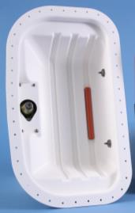
GADSS in Depth - Airbus views on Global Aeronautical Distress Safety System
Feb 2018
PFLR: Deployable Combined Recorder with ELT
Deployable Beacon Airfoil Unit (BAU):
Crash Survivable Memory Module
ELT/ADT Transmitter
GNSS Receiver
Antenna ( Combined ELT and GNSS)
Battery Pack
BAU Tray:
Mounts conformal to aircraft skin
No aerodynamic impact
Holds BAU securely on Aircraft
Provides mounting points for Recorder Release Unit, Hydrostatic Switch(s)
Page 37

Slide 38
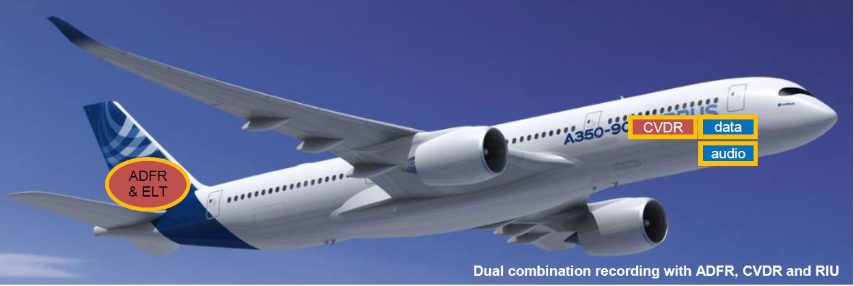

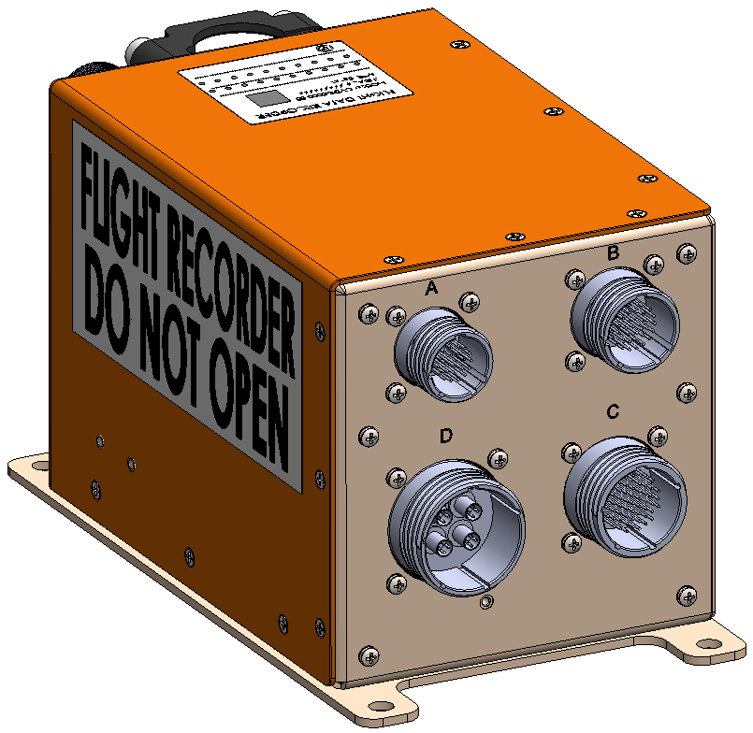
PFLR: Deployable Combined Recorder Architecture
Main Architecture/ locations
ADFR &
ELT-DT
Dual combination recording with ADFR and CVDR

Slide 39
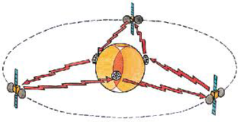
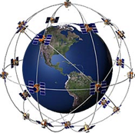

PFLR: Flight Data Streaming
Satcom Recorder
SATCOM GSO or LEO coverages
( L / Ku / Ka bands…)
Buffer
ICAO guidelines defined by Doc 10054
Emergency detected
Emergency flight

Slide 40
PFLR: Flight Data Streaming -Functional description
Performances & Requirements
covered by ICAO Manual 10054
Crash detection algorithm
SATCOM means
Encryption & compression
Recorders
Ground
Servers
Review of ICAO ANNEX 13 SARPs by
ICAO Accident Investigation Panel (AIGP) to ensure appropriate matching for future flight recording systems in a ‘Cloud’ environment
Decryption & Uncompress
Notes:
Main messages:

Slide 41
Standardization of Timely Recovery of Flight Data (TRFD)
In order to specifically address expected, forthcoming PLFR mandate in the most effective way (accounting for system complexity, cost, schedule, risk, etc.), the aviation industry proposed to launch a standardization activity through ARINC.
The APIM propose to structure the work in 3 main phases:
- Document the end to end system , Data Security and privacy requirements, develop System Functional Block Diagram (ARINC Report 681 Draft)
- Develop candidate architectures) / choose architecture(s) (ARINC Report 681 Draft) )
- Develop detailed equipment, interface, and aircraft installation requirements, as well for selected architecture(s). Define accordingly new ARINC or updated Characteristics

Slide 42
Standardization of Timely Recovery of Flight Data (TRFD)
There are two potential TRFD architectures that are expected to be evaluated, including (but not limited to) the following:
Automatic Deployable Flight Recorder (ADFR) - a combination flight recorder (Cockpit Voice Recorder (CVR)/Flight Data Recorder (FDR)) with integrated ELT installed on the aircraft which is capable of automatically deploying from the aircraft
Flight Data Streaming (FDS) – the ability to stream flight data from the airplane while in flight
>>> Completed work expected Sept 2020

Slide 43
ECC Spectrum aspects
Preliminary CEPT position (Issued from last PT-C April 2018)
CEPT is of the view
that systems contributing to the GADSS shall operate in accordance with ICAO requirements or recommendations contained in SARPs, manuals or guidance material;
that any changes to the Radio Regulations should be determined on the basis of the GADSS concept developed by ICAO;
that systems identified to contribute to the GADSS do not require any change to Article 5 of the Radio Regulations;
[that the list of the frequency bands and systems used by GADSS and also their technical and operational characteristics and operational parameters should be included in the corresponding ITU-R Recommendations.]
that additional regulatory actions for the introduction and use of GADSS should not place any additional constraints on the existing and planned systems.

Slide 44
ITU RR aspects (1/2)
Regulatory provisions
In accordance with invites 2 of ITU‑R Resolution 426 (WRC-15), the following regulatory areas have been reviewed in order to determine if regulatory provisions were necessary to facilitate the introduction and use of GADSS.
Chapter VII - Distress and Safety Communications
Two methods are currently defined to satisfy the AI
Method A:
The modifications of RR proposed under Method A specify:
– that the details of the GADSS elements are contained in Annexes to the ICAO Convention;
– that the type of radiocommunication service used depends on the requirements of the specific GADSS function,
– that operation of GADSS elements under RR No. 4.4 is precluded.

Slide 45
ITU RR aspects (2/2)
Method B:
The modifications of the RR proposed under Method B specify:
– that the details of the GADSS elements are contained in Annexes to the ICAO Convention;
– that GADSS shall only operate using primary service allocations;
– that the GADSS must operate in accordance with the terms of the new Resolution [A110-GADSS] (WRC-19), resolving:
• that systems composing the GADSS shall only operate in frequency bands that have already been provided for safety purposes;
• that ITU-R shall develop ITU-R Recommendations detailing the system elements of the GADSS including their operating frequency bands and technical characteristics;
that if constituent elements of GADSS are changed, those changes should be reflected in the relevant ITU-R Recommendation

Slide 46
GADSS Spectrum summary
GADSS ConOps table shows which types of frequency bands considered for the various categories of functions specified under the GADSS.
Function | Spectrum Category
Aircraft Tracking system | A
ATC Surveillance systems | B
Distress Tracking systems | C
Post Flight Localization and Recovery – Localization systems | C
Post Flight Localization and Recovery - Flight Recorder Data Recovery system | A
A: any type of spectrum properly allocated, on a primary basis, for the function being performed.
B: only protected aeronautical safety spectrum can be used.
C: only protected aeronautical safety spectrum, or protected distress spectrum (e.g. 406.1 MHz),
can be used.
*This chart is not intended to imply that any new spectrum allocations are necessary to support GADSS.

Slide 47
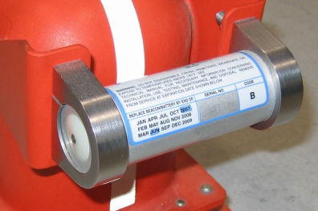

Underwater Locator Devices
Aircraft are equipped with flight recorders with Underwater Locator Beacons (ULBs) attached.
The detectable acoustic range of the currently used Flight Recorder ULBs is limited due to the transmit frequency of 37.5 kHz. Duration time has been increased to 90 days (from 30 days) .
        90 days Low Frequency ULB “Underwater Locating Beacons ” (8,8Khz) attached to the aircraft for long-range over-water flights
Transmission range is increased by a factor 4 using lower frequency.
ULB attached on CVR / DFDR
Airbus plan: already installed basically on all Airbus programs
Service Bulletins available for retrofit
ULB Type | Frequency | Transmission Range
Conventional ULB | 37,5 kHz | 5km (~2,5NM)
LF-ULB | 8,8 kHz | 22km (~12NM)

Slide 48

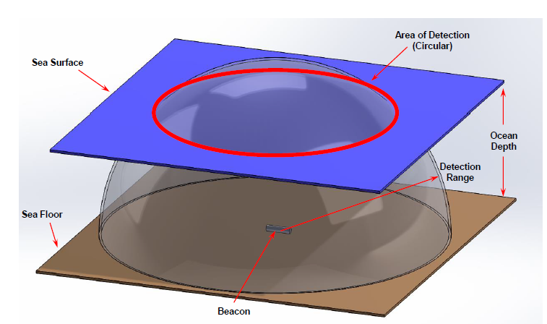
Underwater Locator Devices-Low Frequency Underwater Locator Beacons (LF-ULB)
  Compliance with ARINC 677 specification to harmonize the LF-ULB footprint to aircraft interface
  Guidance manual published by EASA in December 2015:
    Define the installation position on the fuselage (Attached to the aircraft structure)
    Define the applicable means for fixation (aircraft bracket)
    (E)TSO c200a qualification
    Retrofitability (zone not modified after A/C Type Certification)
Independent LF-ULB on A/C structure
Airbus plan: Forward- fit application on all Airbus programs :
A380, A350, A330, and A320 families
Service Bulletins available for retrofit

Slide 49
Lot of Working Groups are active, Airbus is involved in majority of them…

Slide 50
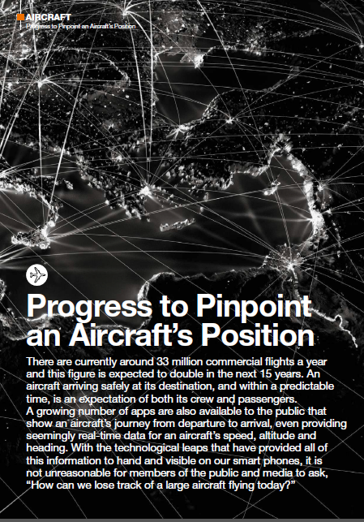

Aircraft Tracking article in Safety First Airbus Magazine
Claude PICHAVANT
Senior Expert Communications& Surveillance
Manage Flight Systems
Geraldine VALLEE
Director of Flight Safety
Safety Enhancement
Article available on demand

Slide 51
Glossary
DFDR: Digital Flight Data Recorder
DLK: Data Link
DSP: Datalink Service Provider
EASA: European Aviation Safety Agency
ELT: Emergency Locator Transmitter
EU: European Union
FAA: Federal Aviation Administration
FANS: Future Air Navigation System
FDR: Flight Data Recorder
FDS: Flight Data Streaming
FMS: Flight Management System
GADSS : Global Aeronautical Distress and Safety System
GEO: Geostationary Earth Orbit
GM: Guidance Material
GPS: Global Positioning System
GSO: Geo Stationary Orbit
HF: High Frequency
HFDL:HF Data Link
HFDR : HF Data Radio
HLSC: High Level Safety Conference
IATA: International Air Transport Association
ICAO: International Civil Aviation Organisation
ID: Ident
IP: Internet Protocol
ITU: International Telecommunication Union
LEO: Low Earth Orbit
MASPS: Minimum Aviation System Performance Specification
MCC :Mission Control Center
NAA: National Aviation Authorities
NATII: Normal Aircraft Tracking Implementation Initiative
NM: Nautical Miles
ACARS: Aircraft Communication Addressing and Reporting System
ACMS: Aircraft Condition Monitoring System
ACR: Avionics Communication Router
A/C: Aircraft
ADFR: Automatic Deployable Flight Recorder
ADS-B: Automatic Dependent Surveillance-Broadcast
ADS-C: Automatic Dependent Surveillance-Contract
ADT: Autonomous Distress Tracking
AEEC: Airlines Electronic Engineering Committee
A/L: Airlines
AMC: Acceptable Means of Compliance
AOC: Airlines Operational Control
APC: Airlines Passenger Communications
APIM: ARINC Project Initiation/Modification
AT: Aircraft Tracking
ATC: Air Traffic Control
AtG: Air to Ground
ATM: Air Traffic Management
ATS: Air Traffic Services
ATSU :Air Traffic Service Unit
ATTF: Aircraft Tracking Task Force
CAAS : Civil Aviation Authority of Singapore
CEPT: Conférence Européenne des administrations des Postes et Télécommunications
CONOPS: CONcept of OPerationS
CVR: Cockpit Voice Recorder
CVDR: Cockpit Voice Data Recorder
DAR: Digital Access Recorder
DB: Data Base

Slide 52
Glossary
OCC = Operational Control Center
OEM: Original Equipment Manufacturer
OPS: Operations
PFLR: Post Flight Localization & Recovery
QoS: Quality of Service
RCC: Rescue Coordination Center
RLS : Return Link Service
RTCA: Radio Technical Commission for Aeronautics
SAI : System Architectures and Interfaces
SAR: Search And Rescue
SARPs: Standards And Recommended Practices
SSCVR: Solid State Cockpit Voice Recorder
STC: Supplemental Type Certification
TRFD: Timely Recovery of Flight Data
ULB: Underwater Locator Beacon
ULD: : Underwater Locating Device
VDR: VHF Data Radio
VDL: VHF Data Link
VHF: Very High Frequency
VTP: Vertical Tail Plane
WRC: World Radio Conference

Slide 53
Thank you
Copyright mention

