Slide 1
Unmanned Aircraft Systems
Spectrum Topics
FSMP WG/06
WRC-19 Workshop
6-7 February 2018

Slide 2
Topics
Spectrum issues and challenges, not on the specific agenda for WRC-19
  Potential frequency bands
    ICAO Remotely Piloted Aircraft System Panel SARP amendment proposals
  Use of the Fixed Satellite Service
    ITU Resolution 155 (WRC-15)

Slide 3
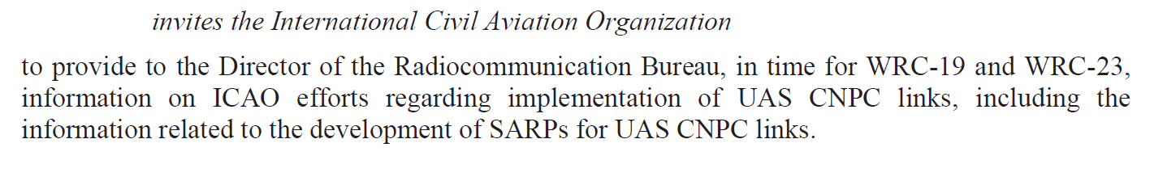
ICAO and WRC-15 Resolution 155
ICAO RPASP will have its first package of (technology neutral) C2 Link SARPs ready by WRC-19 and is planning to have its technology specific SARPs ready by WRC-23
Proposed amendments to Annex 10 Volume 5 do include some WRC-15 Resolution 155 resolves
  Resolves 1, 5 and 13 are respectively covered in 5.1.1.3, 5.1.2 and 5.1.3 of the first package of C2 Link SARP amendment proposals

Slide 4
RPASP WG2 Long-Term Schedule
2016
2017
2018
2019
2020
First Package of SARP Proposals
High Level – Technology Neutral
Submit First Package of SARP Amendment Proposals
Finalize SARP Amendment Proposals
Liaise and Concense with other Panels and RPAS WGs
Update Guidance Manual
Work with SASP and OPLDWG to develop details of Required Link Performance
Work with AVSECP to develop details of C2 Link Security Requirements
Second Package of SARP Proposals
Technology Specific
Submit Second Package of SARP Amendment Proposals
Terrestrial RLOS
Point to Point
Network
Satellite BRLOS
L Band
C Band
Ku and Ka Band
Airborne Networks
EUROCAE, ISO, ITU-R and RTCA contributions
Schedules will depend on level of interest and support

Slide 5
ICAO RPAS Panel
The C2 Link Working Group of the RPAS Panel is developing RPAS/UAS related SARP amendment proposals that are anticipated to be added to Annex 10 over the next two years (WG06-WP03)
Amongst approximately one hundred and fifty proposed additions to Annex 10 are a number related to specific frequency bands

Slide 6
5.2 Terrestrial C2 Link Communications services
5.2.1 Terrestrial RPAS systems shall operate in bands allocated to the Aeronautical Mobile (Route) Service (AM(R)S). Frequency bands with such allocations include the 117.975 - 137, 960 - 1164 and 5030 - 5091 MHz frequency bands. The operation of the C2 Link within any of these bands shall be in accordance with Regional Air Navigation Agreements, so that the C2 Links do not constrain other aeronautical systems using these allocations.

Slide 7
5.1 Satellite based C2 Link Systems
5.1.1. Satellite based RPAS C2 Link systems shall operate in the following frequency bands:
5.1.1.1 Frequency bands with an allocation to aeronautical safety services under the Aeronautical Mobile Satellite (Route) Service (AMS(R)S). Frequency bands that meet these criteria are: the 1 610 – 1 626.5MHz and the 5 030 - 5 091 MHz frequency bands;
5.1.1.2 Frequency bands with an allocation to aeronautical safety services under the Mobile-Satellite Services (MSS) where AMS(R)S operations have priority access. Frequency bands that meet these criteria are: the 1 545 - 1 555MHz and the 1 646.5 - 1 656.5MHz frequency bands;

Slide 8
5.1 Satellite based C2 Link Systems
5.1.1.3. Frequency bands with an allocation to the Fixed Satellite Service (FSS) where the conditions in ITU-R Resolution 155 (WRC-15) are met. Frequency bands where this resolution applies are: the frequency bands 10.95-11.2 GHz (space-to-Earth), 11.45-11.7 GHz (space-to-Earth), 11.7-12.2 GHz (space-to-Earth) in Region 2, 12.2-12.5 GHz (space-to-Earth) in Region 3, 12.5-12.75 GHz (space-to-Earth) in Regions 1 and 3 and 19.7-20.2 GHz (space-to-Earth), 14‑14.47 GHz (Earth-to-space) and 29.5-30.0 GHz (Earth-to-space) frequency bands operating with an ITU satellite earth station class of “UG”.
Note: UG is an Earth station on board an unmanned aircraft communicating with a space station of a geostationary-satellite network in the fixed-satellite service for the control and non-payload communications of unmanned aircraft systems in non-segregated airspaces in the frequency bands listed under resolves 1 of Resolution 155 (WRC-15).
Above ICAO SARPs text taken directly from Resolution 155 WRC-15

Slide 9
5.1 Satellite based C2 Link Systems
5.1.2. RPA and RPS Earth stations shall operate within the notified and recorded technical parameters of the associated satellite network, including specific or typical earth stations as published by the ITU Radiocommunication Bureau.
5.1.3. RPA and RPS Earth stations operating in accordance with Section 5.1.1.3. shall use FSS assignments that have been successfully coordinated under Article 9 of the ITU Radio Regulations and recorded in the Master International Frequency Register (MIFR) with a favorable finding under Article 11, of the ITU Radio Regulations including Nos. 11.31, 11.32 or 11.32A where applicable, and except those assignments that have not successfully completed coordination procedures under No. 11.32 by applying Appendix 5 § 6.d.i of the ITU Radio regulations.
Above ICAO SARPs text taken directly from Resolution 155 WRC-15

Slide 10
ITU-R Status Update
At WRC 2015 Resolution 155 was adopted
This presentation considers all of the resolves in the Resolution and discuss ITU-R’s status
  General Considerations
  Coordination Considerations
  Harmful Interference Considerations
  Non-RPAS/UAS System Protection Considerations
  RPAS/UAS System Considerations
  ICAO Considerations

Slide 11
At WRC 2015 Resolution 155 was adopted
General Considerations
  resolves
  1 that assignments to stations of geostationary FSS satellite networks operating in the
  frequency bands 10.95-11.2 GHz (space-to-Earth), 11.45-11.7 GHz (space-to-Earth), 11.7-12.2 GHz
  (space-to-Earth) in Region 2, 12.2-12.5 GHz (space-to-Earth) in Region 3, 12.5-12.75 GHz (space to-
  Earth) in Regions 1 and 3 and 19.7-20.2 GHz (space-to-Earth), and in the frequency bands
  14-14.47 GHz (Earth-to-space) and 29.5-30.0 GHz (Earth-to-space), may be used for UAS CNPC
  links in non-segregated airspace*, provided that the conditions specified in resolves below are met;
  2 that earth stations in motion on board UA may communicate with the space station of a
  geostationary FSS satellite network operating in the frequency bands listed in resolves 1 above,
  provided that the class of the earth station in motion on board UA is matched with the class of the
  space station and that other conditions of this Resolution are met (see also instructs the Director of
  the Radiocommunication Bureau 3 below);
  3 that the frequency bands specified in resolves 1 shall not be used for the UAS CNPC links
  before the adoption of the relevant international aeronautical standards and recommended practices
  (SARPs) consistent with Article 37 of the Convention on International Civil Aviation, taking into
  account instructs the Director of the Radiocommunication Bureau 4;
Ku and Ka FSS Bands
ITU-R Bureau has created the UG class
ICAO RPAS Panel is developing SARPs to be Effective by 2022

Slide 12
At WRC 2015 Resolution 155 was adopted
Coordination Considerations
  resolves
  4 that administrations responsible for an FSS network providing UA CNPC links shall
  apply the relevant provisions of Articles 9 (necessary provisions need to be identified or developed)
  and 11 for the relevant assignments, including, as appropriate, assignments to the corresponding
  space station, specific and typical earth station and earth station in motion on board UA, including
  the request for publication in BR IFIC of items referred to in resolves 2 and the course of actions
  identified in that resolves in order to obtain international rights and recognition as specified in
  Article 8;
  9 that the use of assignments of a FSS satellite network for UAS CNPC links shall not
  constrain other FSS satellite networks during the application of the provisions of Articles 9 and 11;
  10 that the introduction of UAS CNPC links shall not result in additional coordination
  constraints on terrestrial services under Articles 9 and 11;
RPAS/UAS Earth Stations (Air and Ground) are to be coordinated using the same process as other FSS networks and not be given any special status during coordination

Slide 13
At WRC 2015 Resolution 155 was adopted
Harmful Interference Considerations
  resolves
  13 UAS CNPC links shall:
    – ensure that the use of UAS CNPC links be in accordance with the international standards
    and recommended practices (SARPs) consistent with Article 37 of the Convention on
    International Civil Aviation;
    – take the required measures, consistent with No. 4.10, to ensure freedom from harmful
    interference to earth stations on board UA operated in accordance with this Resolution;
    – act immediately when their attention is drawn to any such harmful interference, as
    freedom from harmful interference to UAS CNPC links is imperative to ensure their safe
    operation, taking into account resolves 11;
    - use assignments associated with the FSS networks for UAS CNPC links (see Figure 1 in
    Annex 1), including assignments to space stations, specific or typical earth stations and
    earth stations on board UA (see resolves 2), that have been successfully coordinated under
    Article 9 (including provisions identified in resolves 4) and recorded in the Master
    International Frequency Register (MIFR) with a favorable finding under Article 11,
    including Nos. 11.31, 11.32 or 11.32A where applicable, and except those assignments
    that have not successfully completed coordination procedures under No. 11.32 by
    applying Appendix 5 § 6.d.i;
    – ensure that real-time interference monitoring, estimation and prediction of interference
    risks and planning solutions for potential interference scenarios are addressed by FSS
    operators and UAS operators with guidance from aviation authorities;
RPAS/UAS CNPC Links require careful monitoring and immediate action to be taken to minimize the potential for any safety effects due to harmful interference

Slide 14
At WRC 2015 Resolution 155 was adopted
Non-RPAS/UAS System Protection Considerations
  resolves
  8 that earth stations of UAS CNPC links of a particular FSS network shall not cause more
  interference to, or claim more protection from, stations of terrestrial services than specific or typical
  earth stations of that FSS network as indicated in resolves 5 that have been previously coordinated
  and/or notified under relevant provisions of Articles 9 and 11;
  14 that, unless otherwise agreed between the administrations concerned, UA CNPC earth
  stations shall not cause harmful interference to terrestrial services of other administrations (see also
  Annex 2);
  15 that, in order to implement resolves 14 above, power flux-density hard limits need to be
  developed for UAS CNPC links; one possible example of such provisional limits to protect the fixed
  service is provided in Annex 2; subject to agreement between the administrations concerned, that
  annex may be used for the implementation of this Resolution;
  16 that the power flux-density hard limits provided in Annex 2 shall be reviewed and, if
  necessary, revised by the next conference;
  17 that, in order to protect the radio astronomy service in the frequency band
  14.47-14.5 GHz, administrations operating UAS in accordance with this Resolution in the frequency
  band 14-14.47 GHz within line-of-sight of radio astronomy stations are urged to take all practicable
  steps to ensure that the emissions from the UA in the frequency band 14.47-14.5 GHz do not exceed
  the levels and percentage of data loss given in the most recent versions of Recommendations
  ITU-R RA.769 and ITU-R RA.1513;
Pfd masks are required to protect the terrestrial services, in particular the FS
Out of band emissions also need to be considered

Slide 15
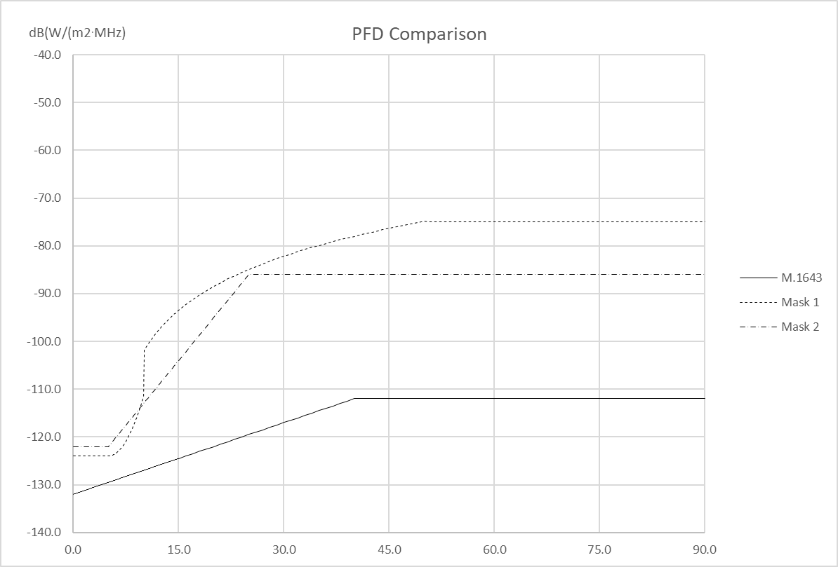
PFD Mask to Protect the Fixed Service
WP 5B is reviewing the ITU-R M.1643 based mask from Annex 2 of Resolution 155 (WRC-15). Alternate masks are being developed with the intent to review/revise the pfd mask during the next conference (WRC-19) as indicated in resolves 6
During its November 2017 meeting WP 5C provided WP 5B with the appropriate FS characteristics (5B/308) to be used in this pfd analysis
WP5B is expected to be ready with a pfd mask by WRC-19

Slide 16
At WRC 2015 Resolution 155 was adopted
RPAS/UAS System Considerations
  resolves
  5 that earth stations of UAS CNPC links shall operate within the notified and recorded
  technical parameters of the associated satellite network, including specific or typical earth stations of
  the geostationary FSS satellite network(s) as published by the Radiocommunication Bureau;
  6 that earth stations of UAS CNPC links shall not cause more interference to, or claim more
  protection from, other satellite networks and systems than specific or typical earth stations as
  indicated in resolves 5 as published by the Bureau;
  7 that, in order to apply resolves 6 above, administrations responsible for the FSS network
  to be used for UAS CNPC links shall provide the level of interference for the reference assignments
  of the network used for CNPC links upon request by an administration authorizing the use of UAS
  CNPC links within its territory;
WP 5B is developing CNPC Link characteristics to enable:
WP 5B to analyze compliance with the appropriate Radio Regulations
ICAO to perform its work on SARPs . Reference liaisons from RPASP/FSMP to WP 5B FSMP-WG/3-WP/04 and FSMP-WG/4 WP/12

Slide 17
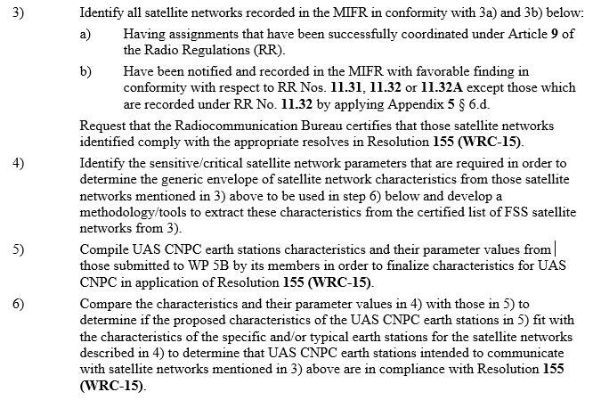
CNPC Link Characteristics
Guidelines extracted from Annex 28 of the November 2017 WP 5B meeting Chairman's Report 5B/411
During its November 2017 meeting WP 5B developed Guidelines on how RPAS/UAS CNPC Link characteristics should be developed.
3+4) All of the appropriately coordinated Earth stations in the MIFR will be reviewed to develop maximum and minimum values of key parameters that could affect interference and link performance
5) CNPC Link characteristics will be proposed
6) The MIFR derived Earth station characteristics will be compared with the proposed CNPC Link characteristics to see if the CNPC Link characteristics comply

Slide 18
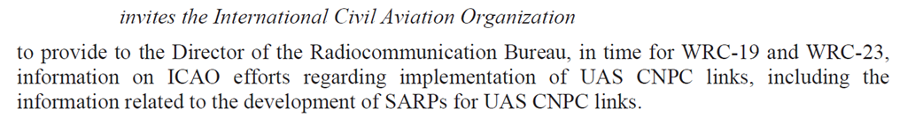
At WRC 2015 Resolution 155 was adopted
ICAO Considerations
  Resolves
  11 that earth stations on board UA shall be designed and operated so as to be able to accept
  the interference caused by terrestrial services operating in conformity with the Radio Regulations in
  the frequency bands listed in resolves 1 without complaints under Article 15;
  12 that earth stations on board UA shall be designed and operated so as to be able to operate
  with interference caused by other satellite networks resulting from application of Articles 9 and 11;
  18 to consider the progress obtained by ICAO in the process of preparation of SARPs for
  UAS CNPC links, to review this Resolution at WRC-23, taking into account the results of the
  implementation of Resolution 156 (WRC-15), and to take necessary actions as appropriate;
ICAO needs to consider harmful interference in its SARPs for FSS relatedC2 Links
ICAO RPASP plans to complete its FSS related SARP amendments prior to 2023

