Slide 1
FSMP WG/06
WG06-WP03 RPAS_SARPS
Comment Resolutions
February 2018

Slide 2



2.2.3 SARP Deleted in latest version

Slide 3

2.2.3 SARP Deleted in latest version

Slide 4
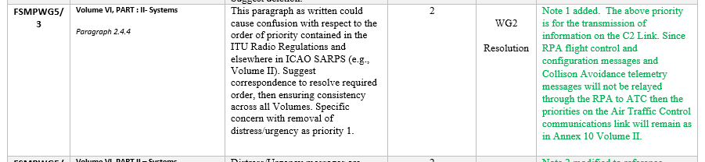
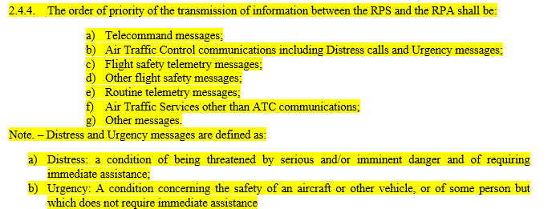


Slide 5

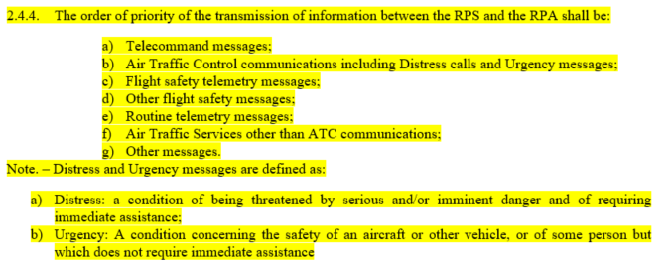

Slide 6
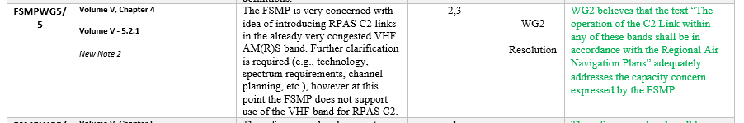
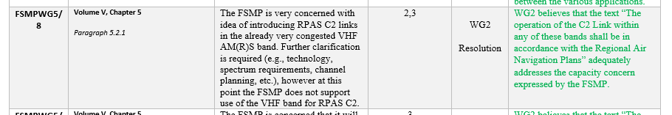


Added text
“so that the C2 Links do not constrain other aeronautical systems using these allocations.”

Slide 7
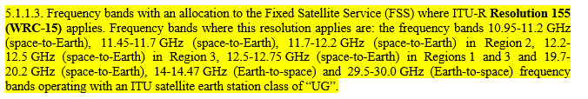
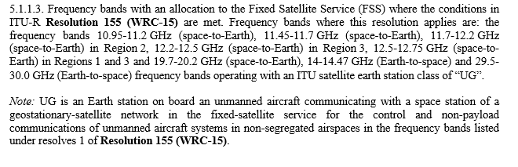
Added text
“where the conditions in ITU-R Resolution 155 (WRC-15) are met.”

Slide 8
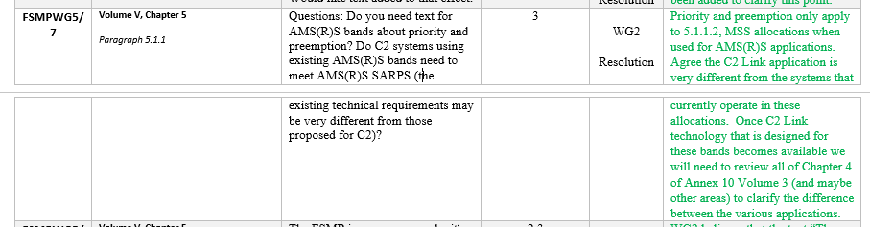
No change to text

Slide 9
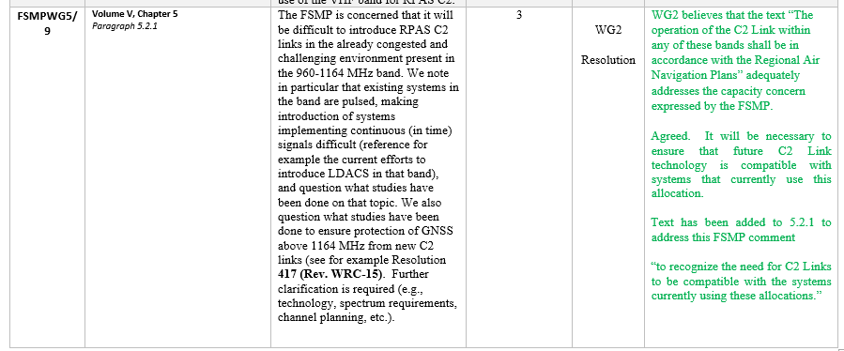
Added text
“so that the C2 Links do not constrain other aeronautical systems using these allocations.”

