Slide 2




COP30
Belém 2025
ICAO Side Event:
International Aviation and SDG7:
Accelerating the Global Clean Energy Transition Skyward
10 November 2025, 18:30 to 20:00
Side Event Room 4, COP30 Blue Zone
2

Slide 3
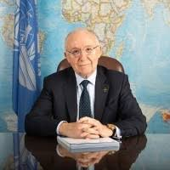
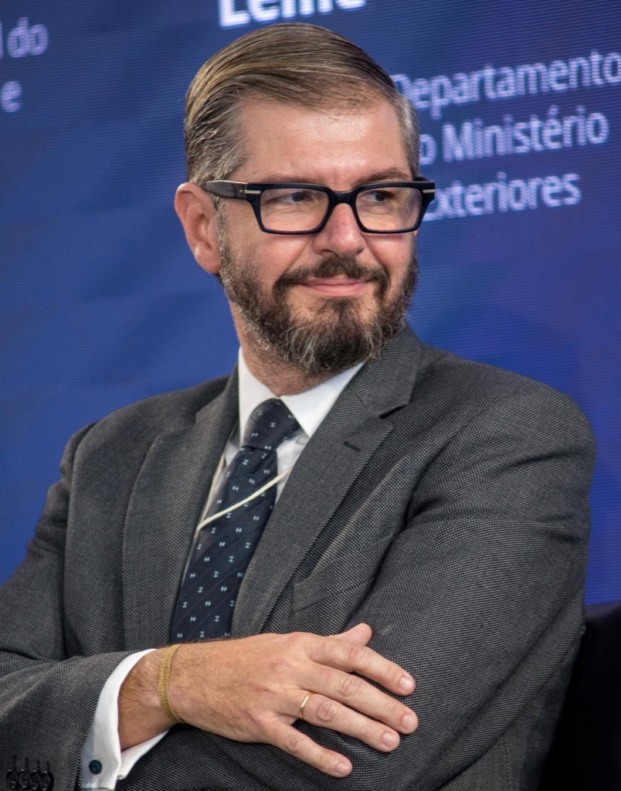

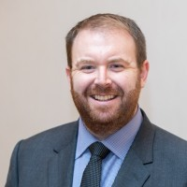
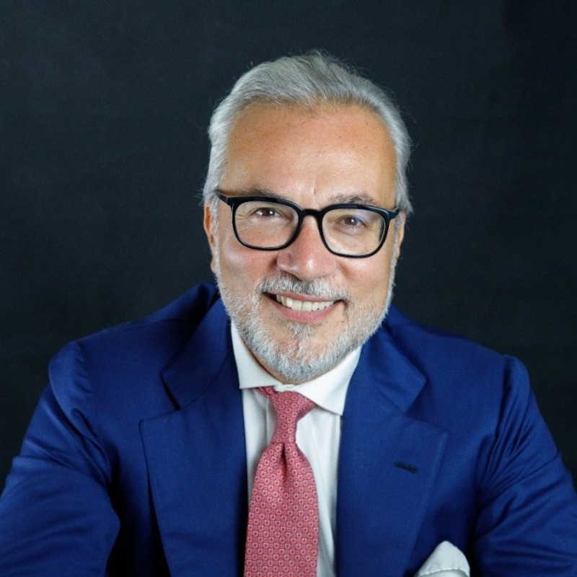
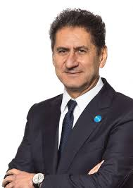
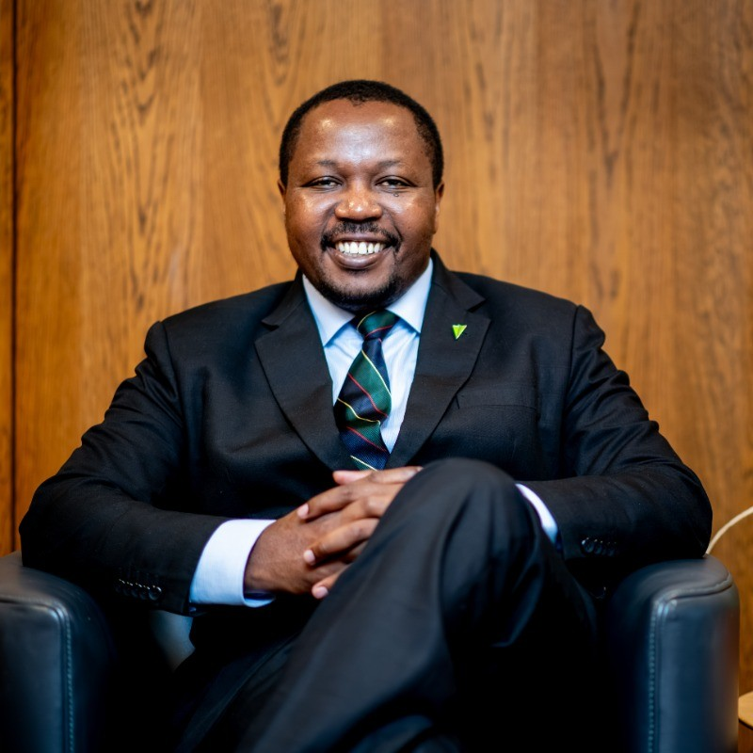
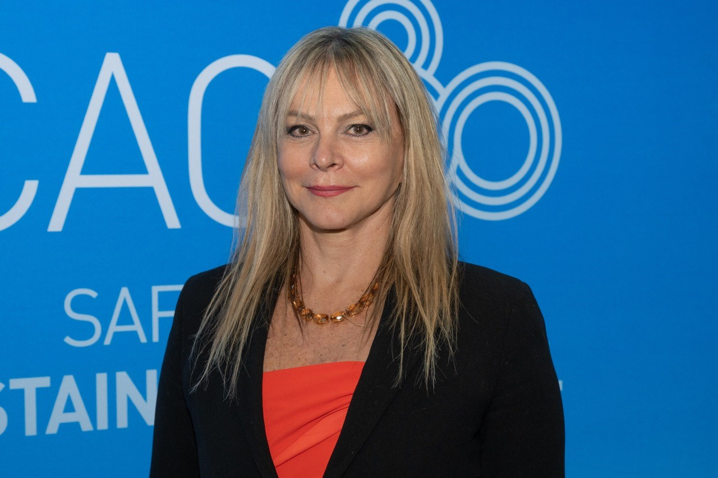
COP30
Belém 2025
Speakers
Mr. Salvatore Sciacchitano
President of the ICAO Council
Ms. Jane Hupe
Envoy of the ICAO Secretary General to the UNFCCC
Mr. João Marcos Paes Leme
Director of the Energy Department, Ministry of Foreign Affairs, Brazil
Dr. Pacifica F. Achieng Ogola
Director, Climate Change, State Department of Environment, Kenya
Mr. Haldane Dodd
Executive Director,
Air Transport Action Group (ATAG)
Mr. Stefano Marguccio
Deputy CEO, Sustainable Energy for All (SEforALL)
3

Slide 4
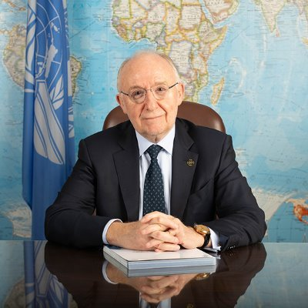

COP30
Belém 2025
International Aviation and SDG7:
Accelerating the Global Clean Energy Transition Skyward
Video Message by Mr. Salvatore Sciacchitano
President of the ICAO Council
4

Slide 5


Slide 6
COP30
Belém 2025
International Aviation and SDG7:
Accelerating the Global Clean Energy Transition Skyward
Panel Speakers
Ms. Jane Hupe
Envoy of the ICAO Secretary General to the UNFCCC
Mr. João Marcos Paes Leme
Director of the Energy Department, Ministry of Foreign Affairs, Brazil
Dr. Pacifica F. Achieng Ogola
Director, Climate Change, State Department of Environment, Kenya
Mr. Haldane Dodd
Executive Director,
Air Transport Action Group (ATAG)
Mr. Stefano Marguccio
Deputy CEO, Sustainable Energy for All (SEforALL)
6

Slide 7
COP30
Belém 2025
International Aviation and SDG7:
Accelerating the Global Clean Energy Transition Skyward
Scene-setting by Ms. Jane Hupe
Envoy of the ICAO Secretary General to the UNFCCC
7

Slide 8
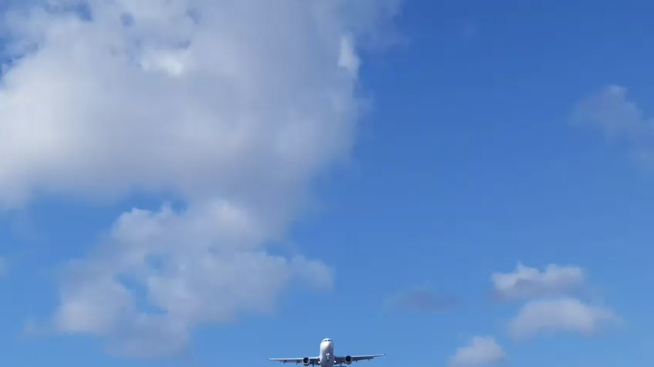

Slide 9
COP30
Belém 2025
International Aviation’s Climate Aspirations
Long-term global aspirational goal (LTAG): net zero carbon emissions from international aviation by 2050
ICAO Global Framework – Collective global aspirational Vision: to reduce CO₂ emissions by 5% by 2030 using aviation cleaner energies.
Collective medium-term global aspirational goal: carbon neutral growth from 2020 (CNG2020)
2010
2022
2023
9

Slide 10
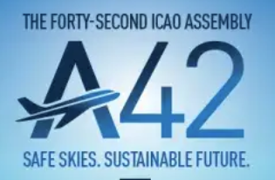
COP30
Belém 2025
Outcomes from the 2025 ICAO Assembly
Harmonized Regulatory Framework for SAF, LCAF and cleaner energies: confirmed that ICAO's sustainability criteria, certification, and life cycle emissions assessment under CORSIA form the accepted basis for the eligibility of aviation cleaner energies.
Encouraged the Acceleration of production pathways, feedstocks, life cycle assessment and sustainability certification to scale up aviation cleaner energies.
CAAF/4 by 2028 to update the aviation sector’s cleaner energy ambitions.
Reiterated Importance of Capacity-Building and Financing to Accelerate Aviation's Decarbonization – ICAO ACT-SAF programme and Finvest Hub.
Expressed Concern against Aviation Taxation which hinders global air connectivity and aviation decarbonization efforts toward the LTAG.
10

Slide 11
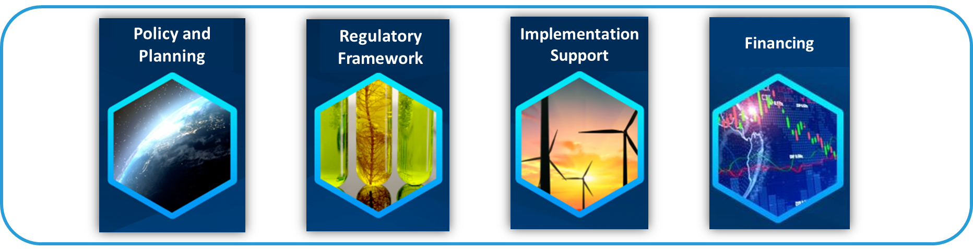

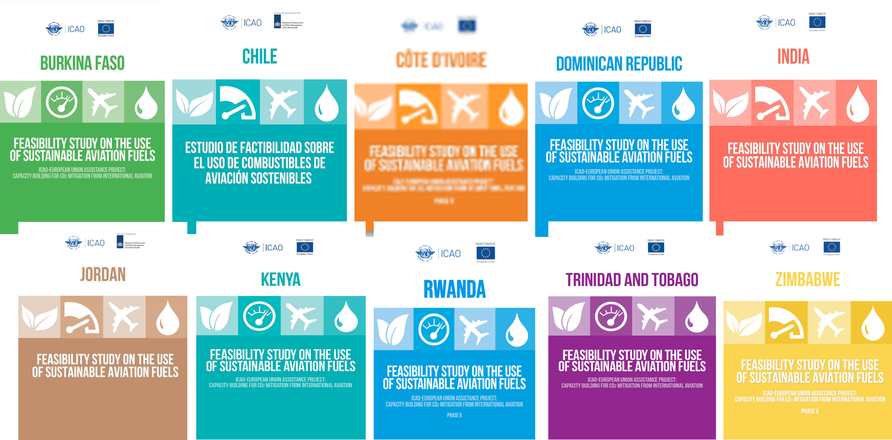
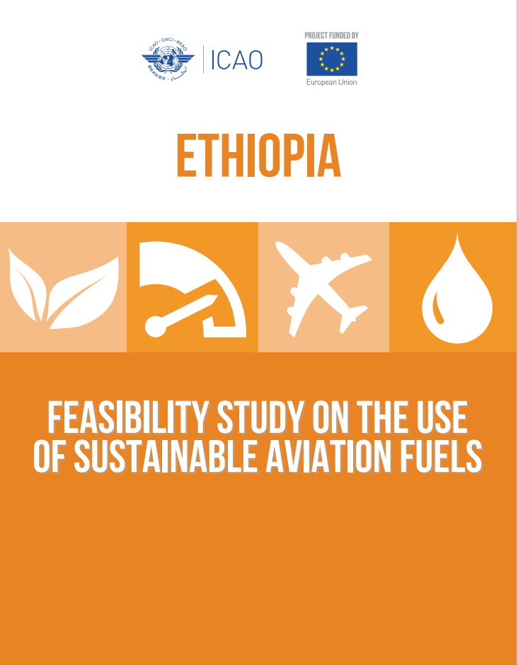
COP30
Belém 2025
Progress in Aviation Cleaner Energies
across the four Building Blocks of ICAO Roadmap
Increase in approved feedstocks
Increase in SAF studies: 11 delivered, 22 underway
Increase in airlines offtake agreements
Increase in SAF policies
2025
2025
2025
83
49
33
167
2025
2022
2022
2022
2022
25
42
4
93
Increase CORSIA certified refineries
Launch of Finvest Hub
2025
25
2022
6
11

Slide 12
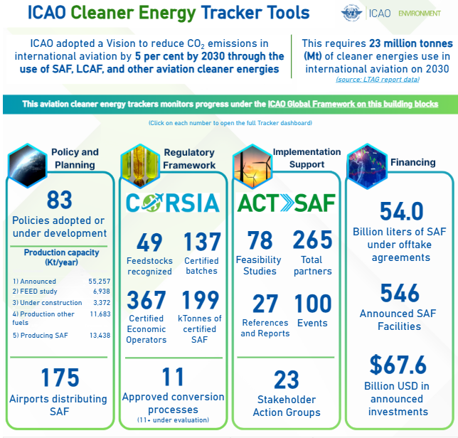

COP30
Belém 2025
ICAO’s Cleaner Energy Tracker Tools provides up-to-date information on indicators across the four building blocks
12

Slide 13
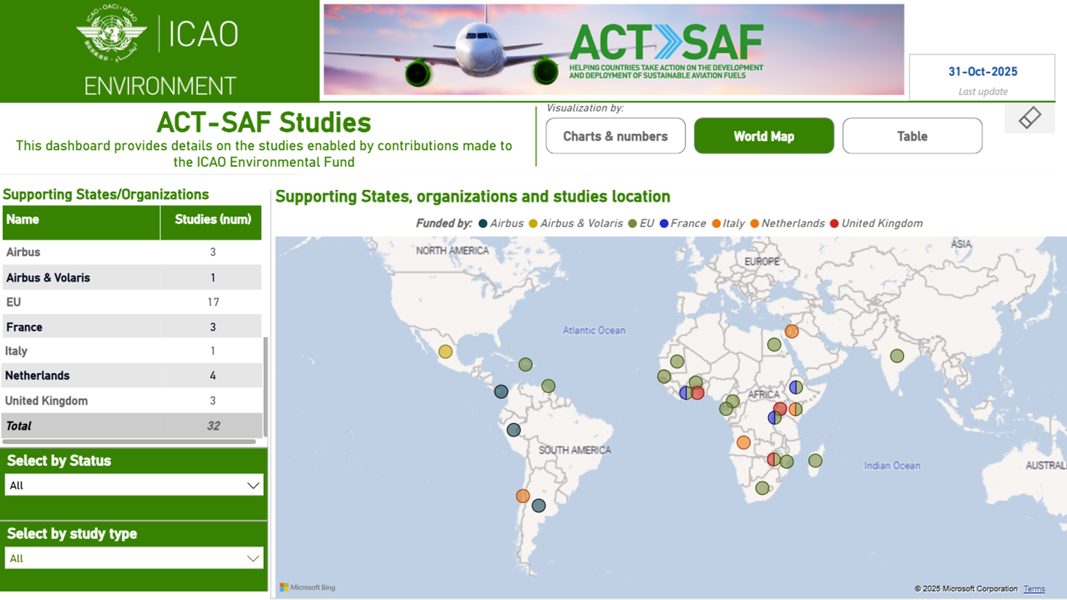

COP30
Belém 2025
ICAO ACT-SAF Programme
>280 ACT-SAF partners
20 training sessions concluded
33 SAF feasibility studies now
50 studies by 2028
13

Slide 14
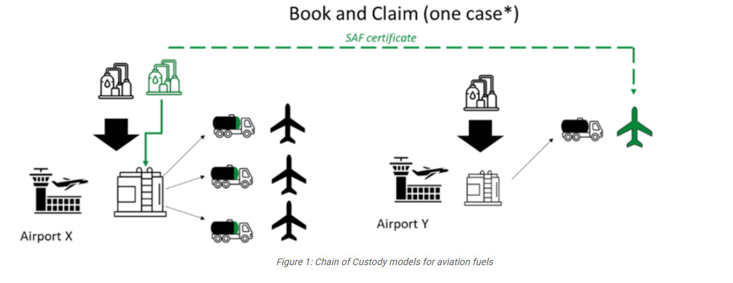


COP30
Belém 2025
Financing for Aviation Decarbonization
3.2 trillion USD needed in investments by 2050
SAF costs at least double of fossil jet fuels
For more details on
Book & Claim:
Book & Claim concept:
Airlines may allow third-party entities to share the SAF cost. In return, third parties receive the environmental attributes of the purchased SAF, which can be used to reduce their Scope 3 emissions. Third parties cannot claim the same attributes already claimed by an airline under CORSIA to avoid double counting.
14

Slide 15
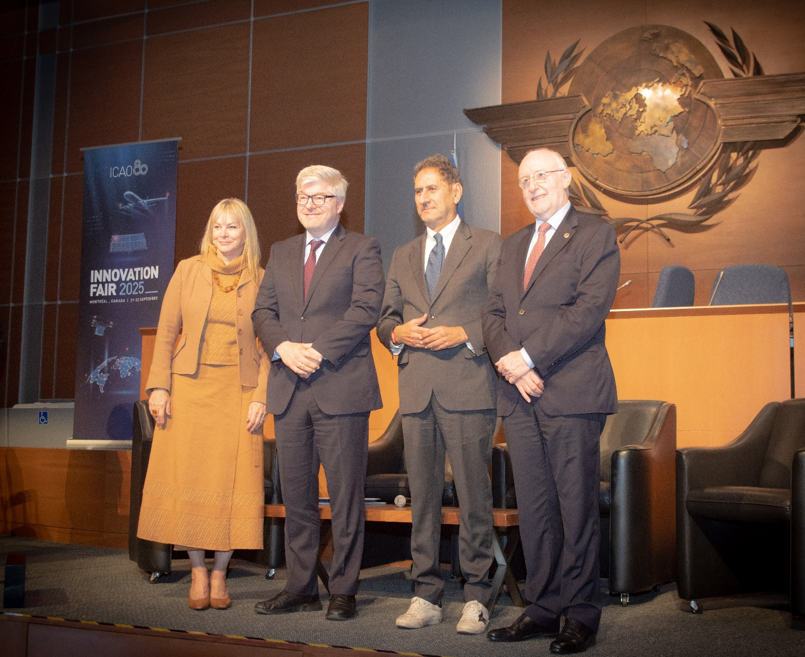


COP30
Belém 2025
ICAO Finvest Hub
Connect States and project developers with climate finance opportunities
Launch of the Finvest@ETAF portal by ICAO and IRENA in September 2025
15

Slide 16
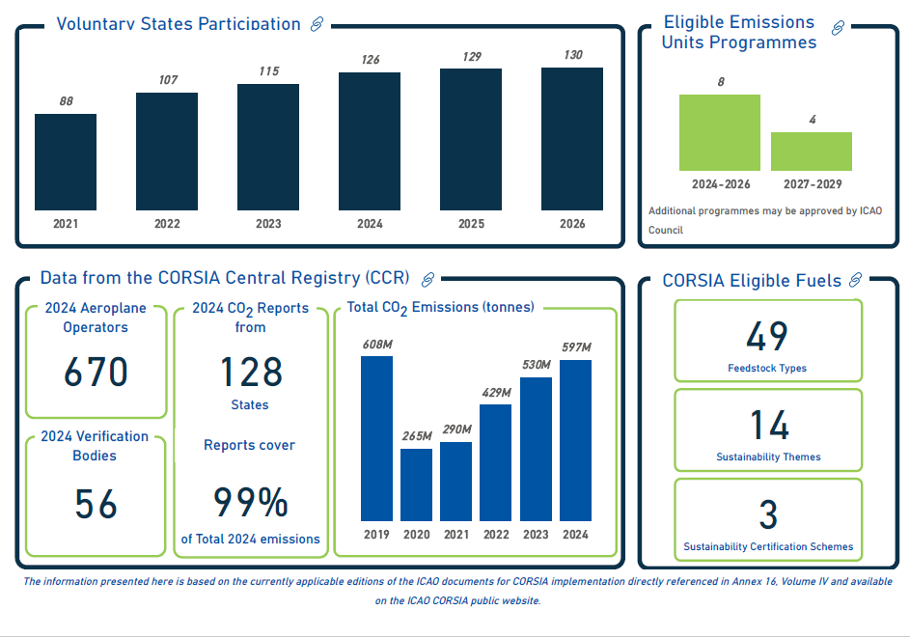

COP30
Belém 2025
CORSIA
“Only global market-based measure applying to CO₂ emissions from international aviation …ensuring that international aviation CO₂ emissions should be accounted for only once”
“Letters of Authorization” by host country is key to access CORSIA Eligible Emissions Units by aeroplane operators
16

Slide 17
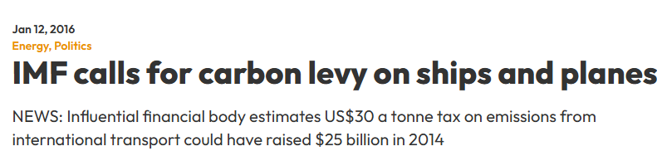
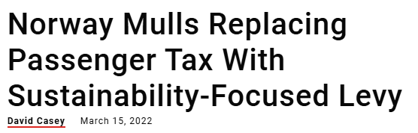
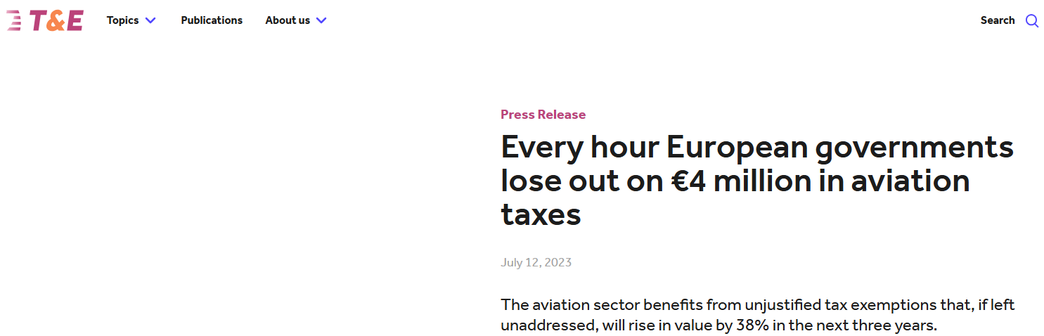
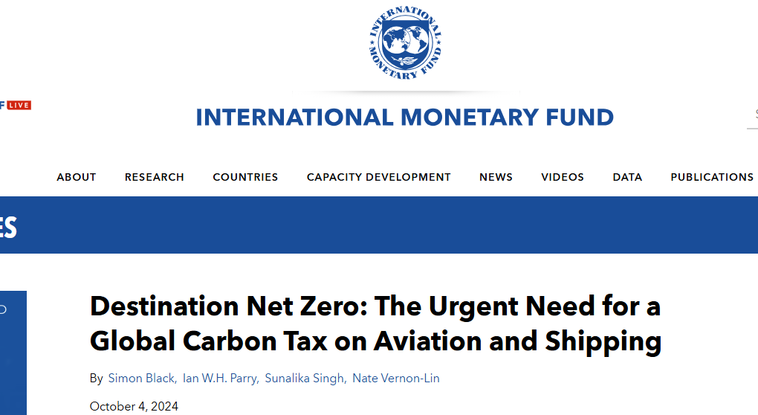
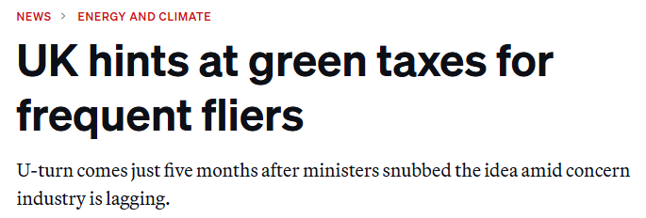
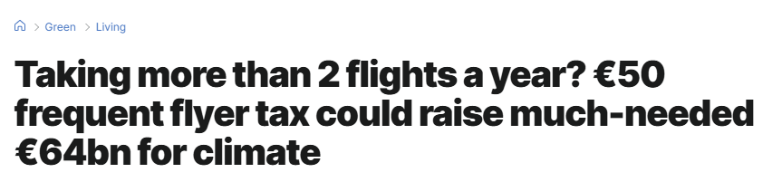
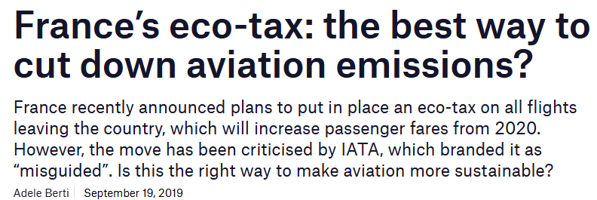
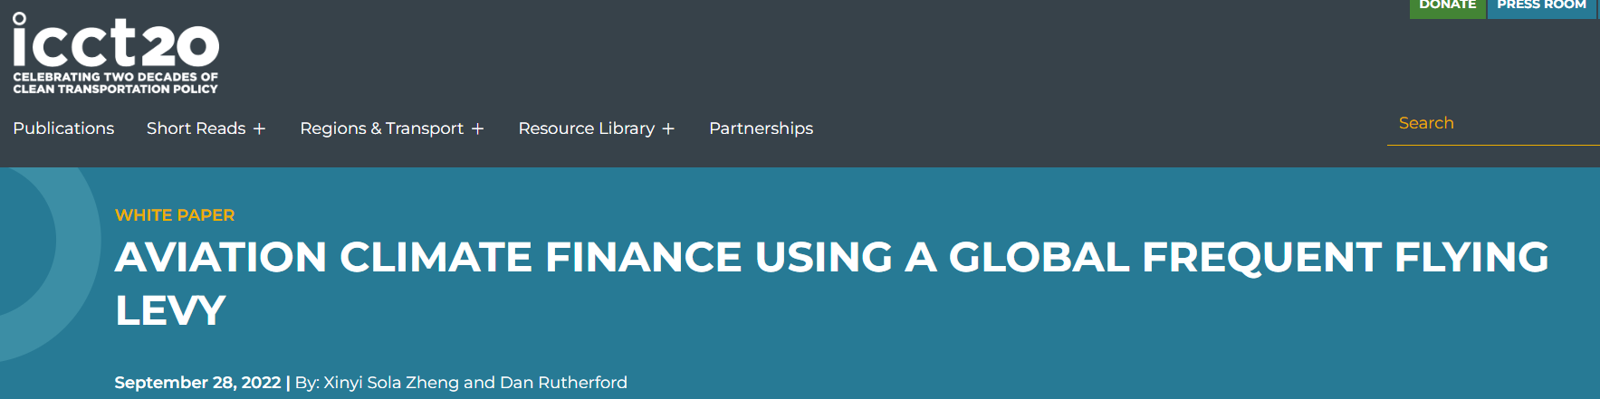
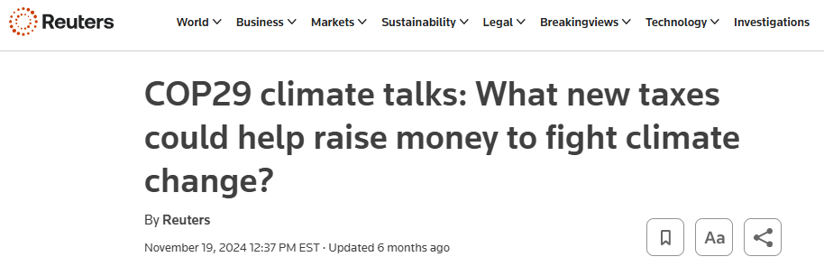
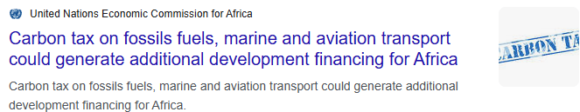
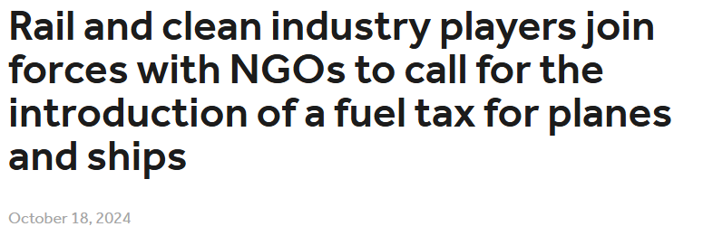
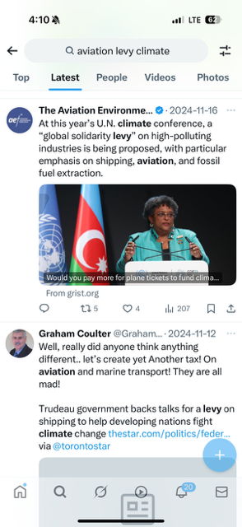
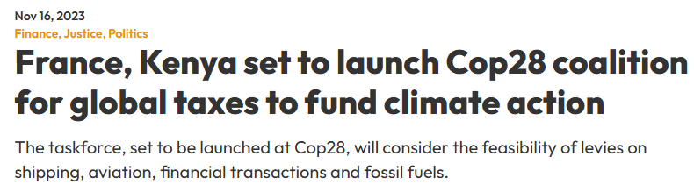
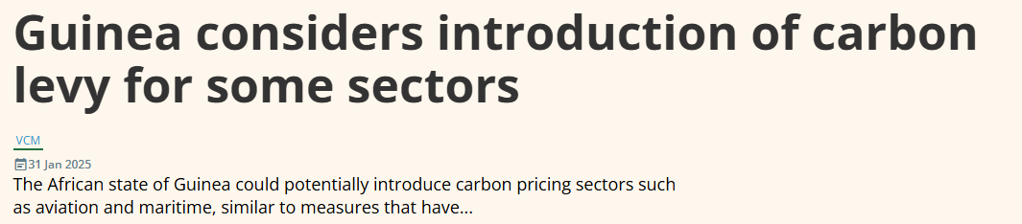

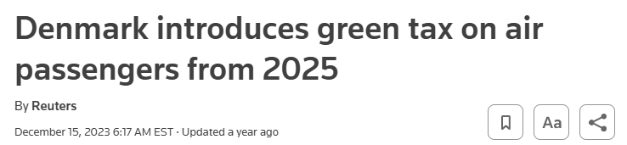
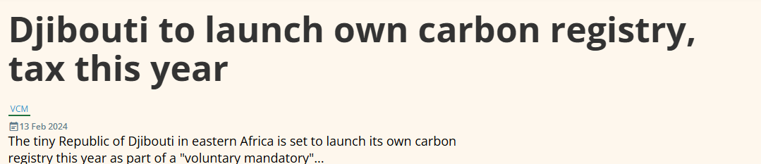

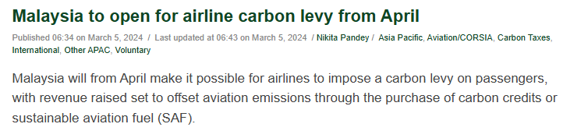
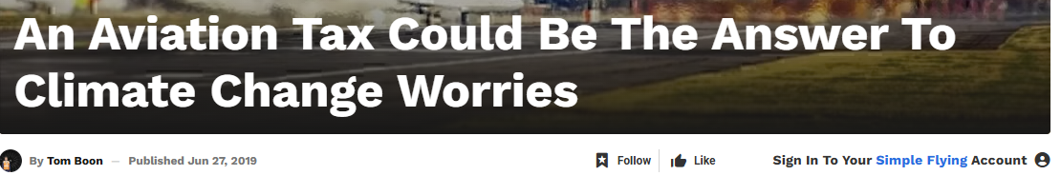
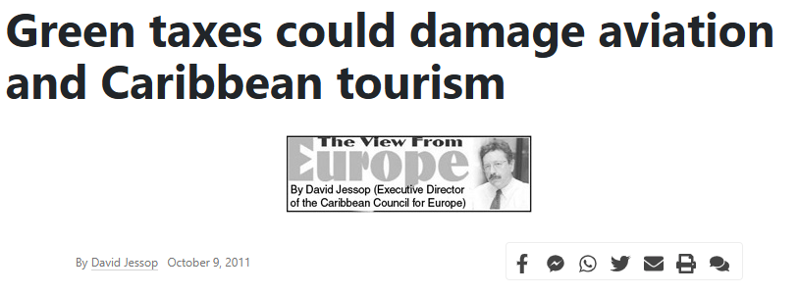
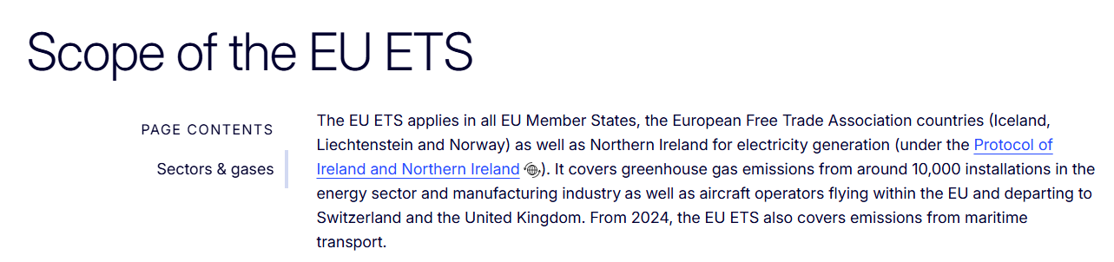
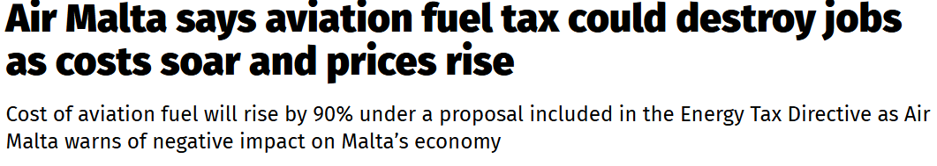
COP30
Belém 2025
Aviation Taxation and Climate Finance
Overlapping proposals for aviation emissions-related levies/taxes to mobilize financial resources for other purposes:
No direct correspondence to emissions reduction
Diverts financial resources away from aviation decarbonization
Negative impact on connectivity, socio-economic development
“only global market-based measure applying to CO₂ emissions from international aviation …ensuring that international aviation CO₂ emissions should be accounted for only once”.
17

Slide 18
COP30
Belém 2025
International Aviation and SDG7:
Accelerating the Global Clean Energy Transition Skyward
Remarks by Mr. João Marcos Paes Leme
Director of the Energy Department
Ministry of Foreign Affairs, Brazil
18

Slide 19
COP30
Belém 2025
International Aviation and SDG7:
Accelerating the Global Clean Energy Transition Skyward
Dr. Pacifica F. Achieng Ogola
Director, Climate Change,
State Department of Environment, Kenya
19

Slide 20
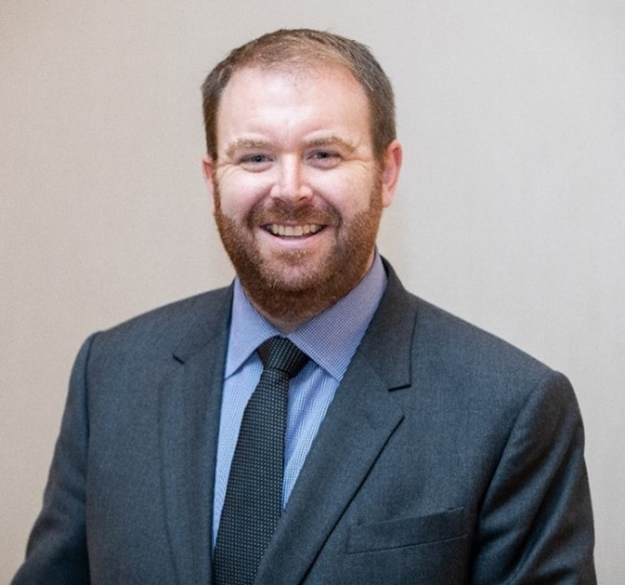
COP30
Belém 2025
International Aviation and SDG7:
Accelerating the Global Clean Energy Transition Skyward
Remarks by Mr. Haldane Dodd
Executive Director
Air Transport Action Group (ATAG)
20

Slide 21
COP30
Belém 2025
International Aviation and SDG7:
Accelerating the Global Clean Energy Transition Skyward
Remarks by Mr. Stefano Marguccio
Deputy CEO
Sustainable Energy for All (SEforALL)
21

Slide 22
COP30
Belém 2025
International Aviation and SDG7:
Accelerating the Global Clean Energy Transition Skyward
Panel Speakers
Ms. Jane Hupe
Envoy of the ICAO Secretary General to the UNFCCC
Mr. João Marcos Paes Leme
Director of the Energy Department, Ministry of Foreign Affairs, Brazil
Dr. Pacifica F. Achieng Ogola
Director, Climate Change, State Department of Environment, Kenya
Mr. Haldane Dodd
Executive Director,
Air Transport Action Group (ATAG)
Mr. Stefano Marguccio
Deputy CEO, Sustainable Energy for All (SEforALL)
22

Slide 23
COP30
Belém 2025
International Aviation and SDG7:
Accelerating the Global Clean Energy Transition Skyward
Question 1 for the Speakers
In your view, what can the international aviation sector, partner organizations, and stakeholders do more to overcome these longstanding challenges and effectively scale up the cleaner aviation energies?
23

Slide 24
COP30
Belém 2025
International Aviation and SDG7:
Accelerating the Global Clean Energy Transition Skyward
Question 2 for the Speakers
How do you view the competing demand for cleaner energies across different sectors, and how this could be managed to ensure that aviation have sufficient aviation cleaner energies to contribute effectively to the global clean energy transition?
24

Slide 25

COP30
Belém 2025
International Aviation and SDG7:
Accelerating the Global Clean Energy Transition Skyward
Q&A
25

Slide 26
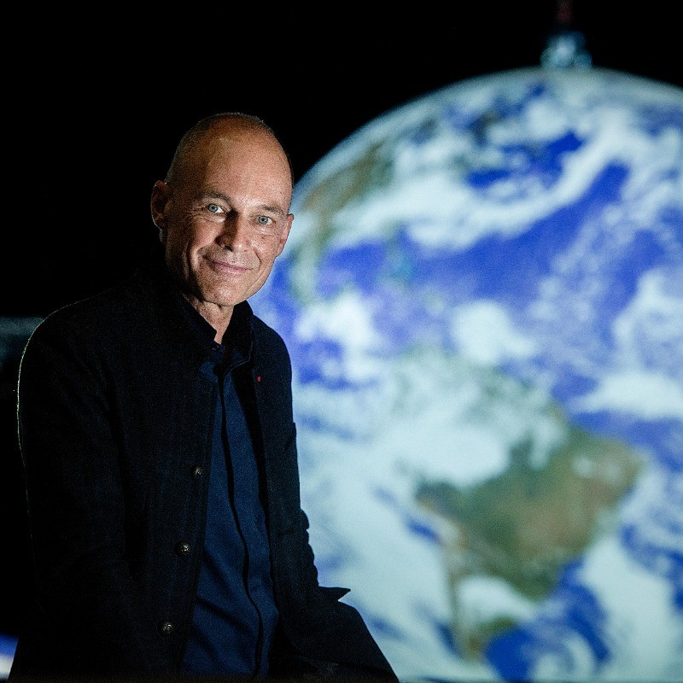
COP30
Belém 2025
International Aviation and SDG7:
Accelerating the Global Clean Energy Transition Skyward
Reflections by Dr. Bertrand Piccard
Chairman of the Solar Impulse Foundation
& Climate Impulse
26

Slide 27


Slide 28


First non-stop zero emission
flight around the world

Slide 29
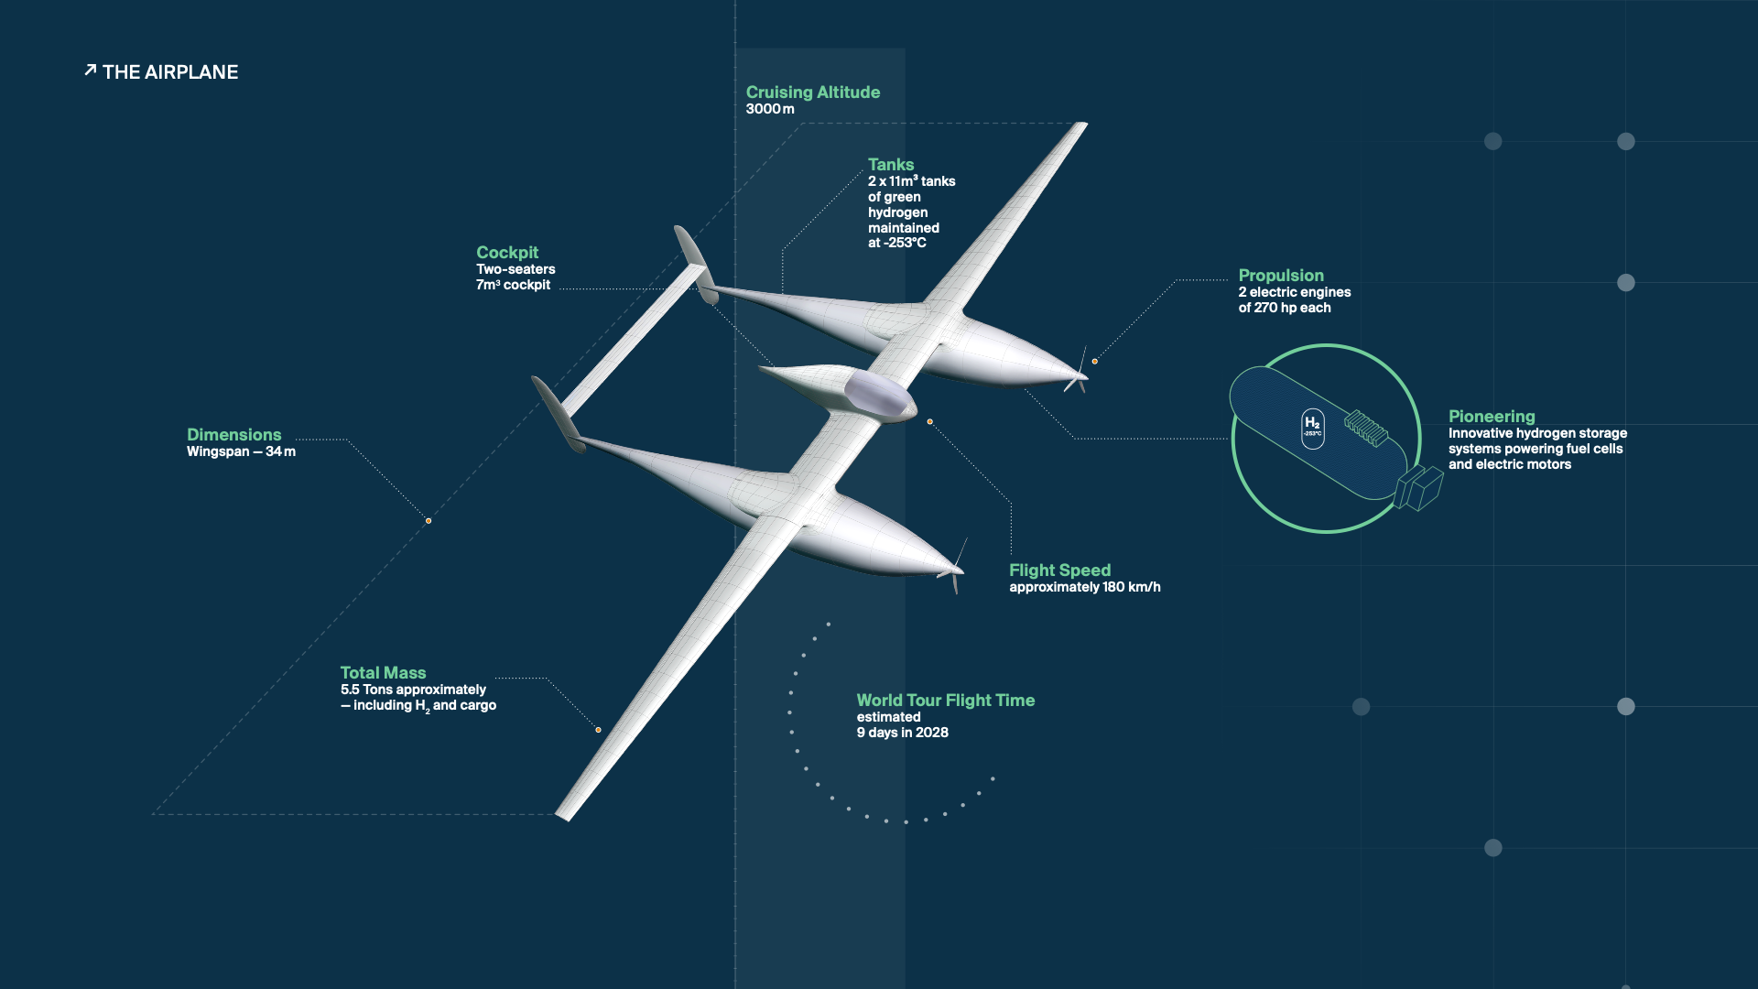

Slide 30
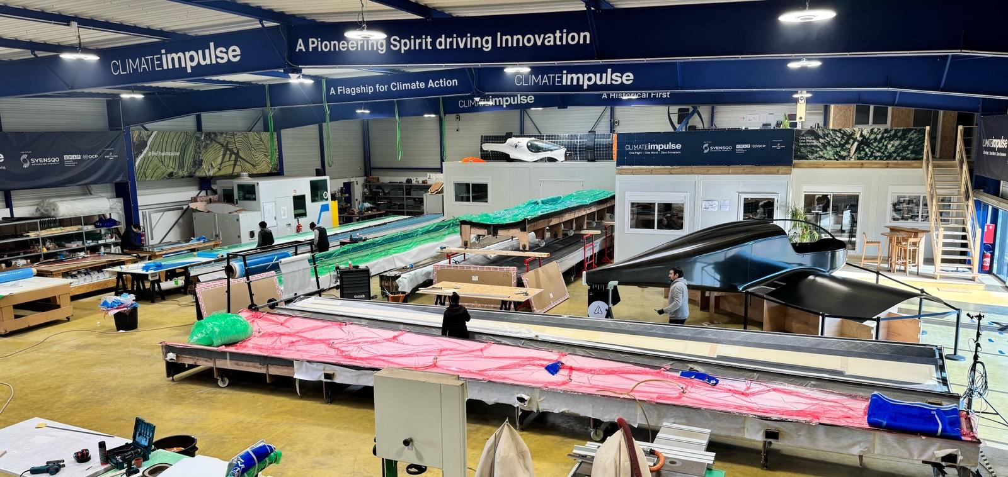

Slide 31
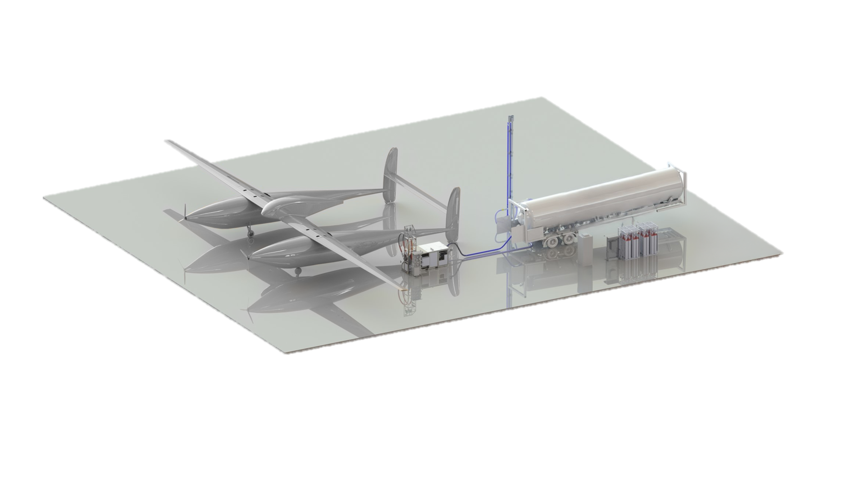

Slide 32
COP30
Belém 2025
International Aviation and SDG7:
Accelerating the Global Clean Energy Transition Skyward
Closing by Ms. Jane Hupe
Envoy of the ICAO Secretary General to the UNFCCC
32

