Slide 1
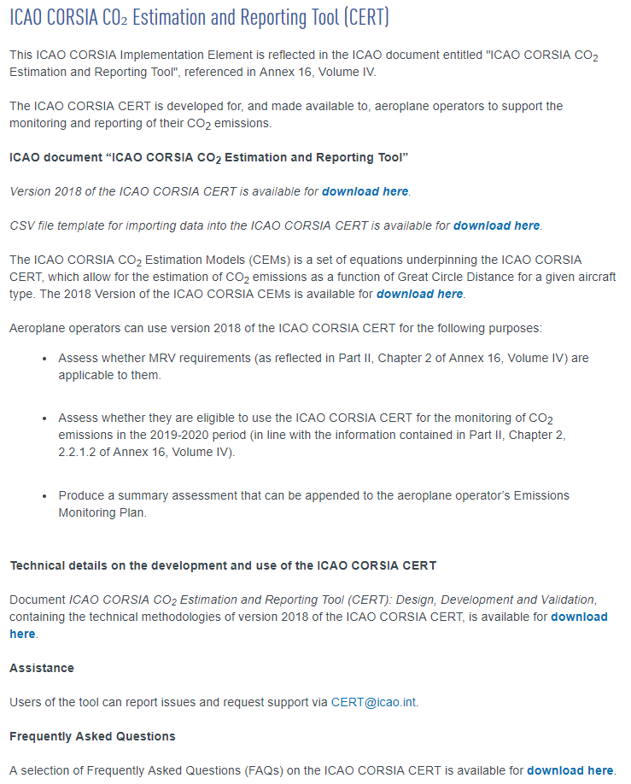
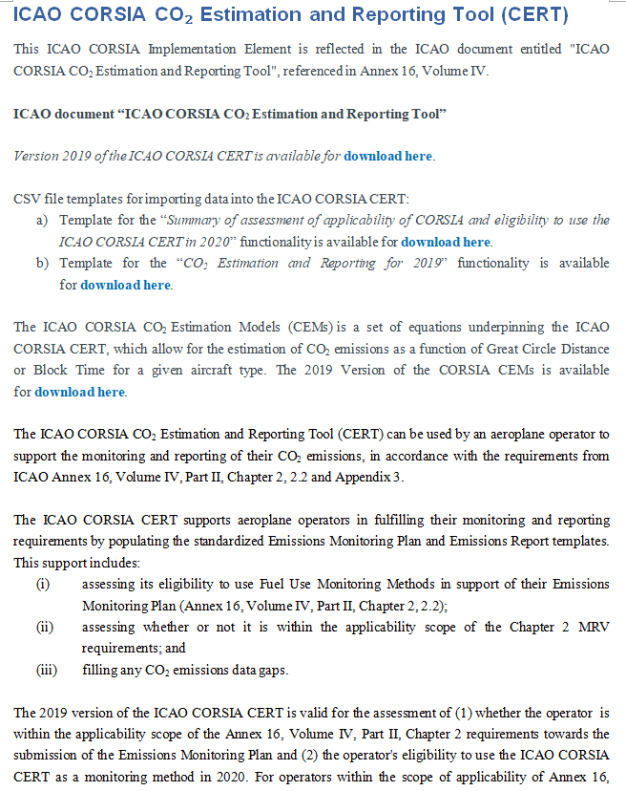
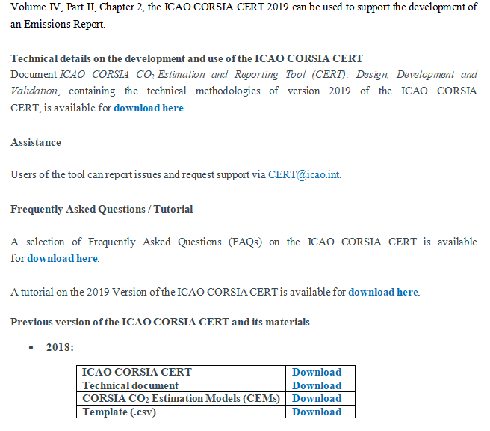
CURRENT VERSION OF THE WEBSITE
NEW VERSION OF THE WEBSITE
Link to a new page with agreement (1)
csv file (2)
csv file (3)
Link to a new page with agreement (4)
Pdf file (5)
Pdf file (6)
Pdf file (7)
Indicates where to relocate links into the new website
It will require the creation of a new page with the End User License Agreement for the CERT (similar than the page for the CERT 2018). The “I Accept” button will trigger the download of the CERT.
It will require the creation of a new page with the End User License Agreement for the CEMs and the form (similar than the page for CEMs 2018). The “Request CEMs” button will trigger the sending of an email to the CERT@icao.int.

