Slide 1
IATA’s Role – Implementation of Safety Activities
Presented by Tanja Grobotek
Regional Director Safety & Flight Operations
Africa and Middle East,
AFI Aviation Safety Symposium
Malabo June 28, 2016

Slide 2
Presentation Overview
IOSA Program
ISSA Program
ISAGO Program
Status of Aeronautical Information in AFI
Air Traffic Incidents
Runway Safety Go Teams & Loss of Control
Supporting ICAO initiative No Country Left Behind

Slide 3
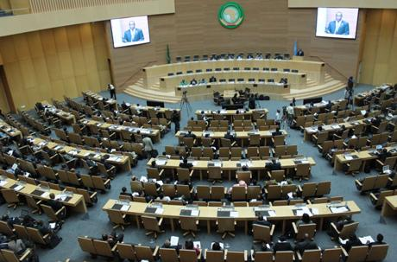

Abuja Declaration
In January 2013, the African Union Executive Council endorsed the Abuja Declaration and Associated Plan of Action on Aviation Safety in Africa
One of the targets requiring all airlines to obtain IOSA.
Notes:
While our 2014 IOSA-ITI was being deployed, we had encouraging news on the political front as the African Union Executive Council officially endorsed the Abuja Declaration and the Associated Plan of Action on Aviation Safety.
It is worth reminding that this Plan of Action includes the requirement for all African operators to be on the IOSA Registry by the end of 2015

Slide 4
IATA Operational Safety Audit (IOSA)
Statistics that led to this undertaking speak for themselves
In 2015 IOSA registered operators performed 3.5 times better than non-IOSA
To date IOSA Training Initiative extended 29 airlines
13 airlines had completed the audit and obtained registration
No obligation to become members of IATA
Not enough considering number of AOC holders in AFI
States need to demonstrate leadership in this matter
Notes:
A lot has been done by IATA to fulfil commitment made by all States in Abuja

Slide 5
IATA Standard Safety Assessment (ISSA)
Voluntary evaluation program based on IOSA
Developed for aircraft with MTOW below 5700kg
However once-off for operators that eligible for IOSA (5700+)
In AFI this would help airlines that find IOSA too big a step
Global Safety Standard for commercial operators not covered by existing programs
Measuring operator’s conformity with relevant ICAO Requirements
2 workshops provided: 1 in Nairobi, 1 in Johannesburg

Slide 6
IATA Safety Audit for Ground Operators (ISAGO)
Standardized and structured audit program of Ground Service Providers established in 2008
Improved safety and cut in costs by reducing ground accidents, injuries and delays
Program being enhanced as from 2018
Notes:
Introducing Charter of Professional Auditors (CoPA) – trained and qualified by IATA
Introducing Lead Auditing Entities (LAEs) - contracted by IATA to conduct audits
Anybody that wishes to purchase a report will be able to

Slide 7
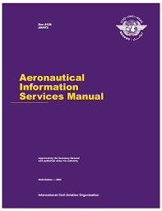
Aeronautical Information Service (AIS)
Lack of Quality and timeliness in AIS has serious impact on operational safety
Workshops conducted in conjunction with Eurocontrol
States have an obligation to timely provide
accurate information and adhere to AIRAC dates

Slide 8
AFI Incident Analysis Group (AIAG)
Platform to review ATS related incidents as reported by pilots and ANSPs
Just Culture
ANSPs/States to implement training programs to address ATC non-proficiency
ANSPs/States to address issues to do with Airspace Organization and ATC procedures
States and ANSP’s should review current and planned infrastructure to ensure adequate and reliable VHF/HF

Slide 9
Addressing High Operational Risk
2015 accident rate was better than 5 year moving average but remains challenge
IATA is part of RWY Safety Go Team with ICAO and ACI
Participated in four (4) go missions in 2015
Targeting to conduct another six (6) missions in 2016
IATA conducted one LOC-I awareness workshop in Sept 2015 (JNB)
Few operators participated and no regulators represented
States/regulators need to drive awareness and training if we are to realize improvements
Notes:
Challenge remains the unwillingness of some States/Airports to accept these missions yet alone team’s travel

Slide 10
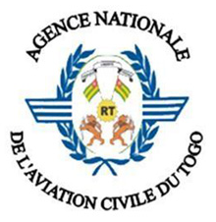

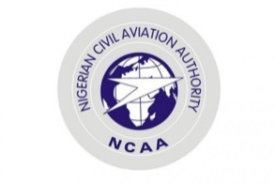

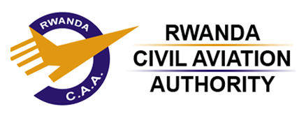



How to support ICAO “No Country Left Behind”?
The IATA Diploma in Safety Oversight was offered to 8 Civil Aviation Authorities (CAAs) in Africa to support the objectives of the Abuja Declaration
It comprises 4 modules:
IOSA Awareness Workshop for CAAs
Aircraft Airworthiness and Air Carrier Certification
Managing the Safety Oversight Function
CAA Compliance with ICAO ISARPS
Notes:
Challenge remains the unwillingness of some States/Airports to accept these missions yet alone team’s travel

Slide 11
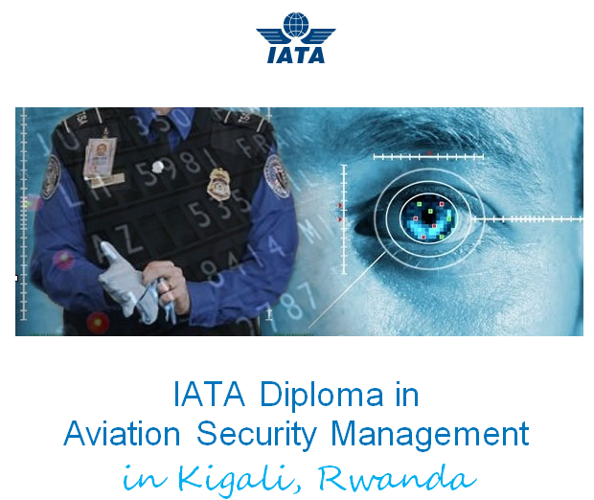
The IATA Diploma in Aviation Security was offered to 95 Aviation Security professionals from African airlines and CAAs.
It comprised 4 modules, hosted by the Rwanda Civil Aviation Authority :
Aviation Security Management
Security Management Systems
Security Risk and Crisis Management
Aviation Security Management Advanced

Slide 12
Questions?

