Slide 1
ICAO’s No Country Left Behind initiative -The Role of the ICAO Regional Offices, Successes and Challenges
Mr. Barry Kashambo
ICAO Regional Director, Nairobi
Malabo, Equatorial Guinea 28 June 2016

Slide 2
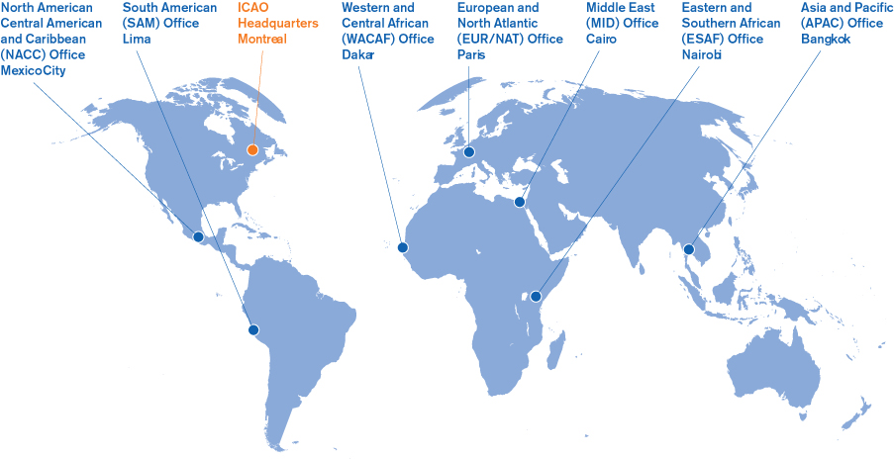
AFRICA-INDIAN OCEAN (AFI) REGION
ASIA (ASIA) REGION
MIDDLE EAST (MID) REGION
NORTH AMERICAN (NAM) REGION
CARIBBEAN (CAR) REGION;
EUROPEAN (EUR) REGION
NORTH ATLANTIC (NAT) REGION
PACIFIC (PAC) REGION
SOUTH AMERICAN (SAM) REGION
ICAO Regional Structure and Office location

Slide 3
ASIA/PAC
Bangkok
ESAF
(Nairobi)
SAM
(Lima)
WACAF
(Dakar)
NACC
(Mexico)
MID
(Cairo)
EUR/NAT
(Paris)
ICAO Regional offices
-Accreditations to States-
- 24 States
- 21 FIRs
- 1983
- 24 States
- 9 FIRs
- 1963
- 38 States
50 FIRs
1955
- 13 States
- 27FIRs
- 1948
- 56 States
- 109 FIRs
- 1946
- 26 States
- 44 FIRs
- 1957
- 15 States
- 14 FIRs
- 1953

Slide 4
Chicago Convention & Annexes (SARPs)
Implementation: Guidance, Support, Facilitation, Monitoring and Follow up
Regional Office work programmes
Regional Programmes, Plans and Targets
Global Plans for Air Navigation and Safety (GANP & GASP)
ICAO Strategic Objectives
State Corrective Action Plans (CAP), AVSEC Improvement Plans & Programmes

Slide 5
Role and Responsibilities of Regional Offices
Maintain continuous liaison with Stakeholders (States/Partners).
Promote implementation of ICAO SARPs & Regional plans.
Provide technical cooperation / assistance services.
Follow up on activities of Regional Groups (PIRGs/RASGs/RASFGs/ DGCAs) Capacity building activities in coordination with Training Centers
Guide and assist States in addressing Safety/Security deficiencies and implementation of new concepts and tools
Foster diplomatic/political contact for high level government commitment.

Slide 6

Regional Office Activities: Supporting of NCLB Initiative , Regional Office strengths and areas of success
Execution of Regional programmes tailored to reach out to ALL States such as the AFI Plan, AFI SECFAL Plan, and AFPP and AFI-CIS which are under key Stakeholders e.g. AFCAC;
Assistance delivery according to needs and priorities of States;
Evaluation and mitigation of risks to air transport sector;
Sustainable improvement of Effective Implementation (EI) and resolving of Significant Safety & Security Concerns;
Supporting Regional platforms such as RSOOs and RAIAs;
Establishing relationships with development and donor; partners to promote role of aviation as an enabler to National economies and social development.

Slide 7
Supporting Aviation Projects - ICAO Technical Cooperation/Assistance
Elements of Regional Offices Successes
  Advice/Technical expertise
    Certification process, economic studies
  Training
    Fellowships, courses/workshops
  Procurement of services and goods
    ANS and Airport infrastructure
Technical Assistance and /or Technical Cooperation Project

Slide 8
Collaboration with Partners & Stakeholders
Regulators: CAAs, RSOOs/COSCAPs
Operators: Airlines, Airports
Service providers: ANSPs& Airports
ANSPs and Airport service providers
Financial Institutions: ADfB, WB, EU,
International Industry partners: IATA, ACI, CANSO etc.
International Regional Aviation Bodies e.g. ACAC/AFCAC/ECAC/LACAC
Regulators
Intl/Regional Aviation Bodies
Financial Institutions
Intl Industry Partners
Operators
Service Providers
Manufacturers

Slide 9


















Key Regional Players and stakeholders
191 STATES

Slide 10

Consolidated Partnerships
Joint technical efforts in assisting States to effectively implement ICAO SARPs and achieve regional targets
Mobilization and pooling of resources for regional and individual State programmes and projects (regulatory oversight, infrastructure etc)
Cooperation in addressing Capacity building challenges and training of aviation personnel

Slide 11
Regional offices Challenges
Weak government support to Aviation and governance systems
Inadequate Communication between ICAO and some States
Inadequate human and financial resources in the sector and shortage of qualified technical expertise
Insecurity in some states;
Weak compliance with ICAO SARPS
Ability to combat communicable diseases /and pandemics
Resistance to Integration and defence of Sovereignty
Inability to develop infrastructure to support aviation growth
Inadequate funding and technical personnel to support RO activities

