Slide 1
Third AFI Aviation Safety Symposium
Malabo, Equatorial Guinea, 28 June 2016
Overview of The Comprehensive Regional Implementation Plan for Aviation Safety in Africa (AFI Plan)
Presented by: Halidou Moussa
Chairperson, AFI Plan Steering Committee

Slide 2
Presentation Outline
Background and Context of the Comprehensive Regional Implementation Plan for Aviation Safety in Africa (AFI Plan)
Objectives of the AFI Plan
Implementation Status
Perspectives and Challenges

Slide 3
BACKGROUND AND CONTEXT WHY AFI-PLAN?
Number of aircraft accidents in Africa
A review of the ICAO Accident/Incident Data Reporting (ADREP) data for a ten-year period, from 1997 to 2006, shows that there was an increase in the number of accidents in the AFI Region.
Safety oversight deficiencies
lack of effective safety oversight systems;
lack of expertise;
Issues regarding air operator certificates (AOCs);
lack of autonomous civil aviation authorities.
The Comprehensive Regional Implementation Plan for Aviation Safety in Africa (AFI Plan) was adopted by the 36th ICAO Assembly (Assembly Resolution A36-1).

Slide 4
Objectives of the AFI Plan
To strengthen civil aviation authorities with respect to their safety oversight capabilities;
To increase compliance with ICAO SARPs and industry’s best practices;
To increase the number of qualified personnel at the industry and oversight levels;
To improve the quality of inspectors and other civil aviation staff through training;

Slide 5
AFI PLAN IMPLEMENTATION
The work programme is developed around three focus areas to give effect to the objectives of the AFI Plan:
Enabling States to establish and maintain a sustainable safety oversight system;
Assisting States to resolve identified deficiencies within a reasonable time; and
Enhancing aviation safety culture of African aviation service providers.

Slide 6
AFI PLAN IMPLEMENTATION
Phase 1
OBJECTIVES in 2008-2010 (ACIP)
Transition
Integration of Activities into the Regional Offices
Establishment of ROSTs and intensifying their activities
Direct assistance to States to resolve identified deficiencies as detailed in the ICAO Plans of Action
Intensify training courses, seminars and workshops in safety-related areas
Gap Analysis to identify Focus Areas of intervention. Three focus areas were identified
JANUARY 2011
Intensify ROSTs Activities in all areas other than Operations and Airworthiness (AGA,ANS, AIG)
OBJECTIVES 2011-onwards
Building African Capabilities and capacity to meet national and international compliance requirements through provision of training
Improve Effective Implementation (EI) by States
Design capacity building projects for sustainability
Phase 2
Develop & Implement Plans of Action to address deficiencies & attain the High-Level Safety Targets of the Abuja Ministerial Conference.
Resolving of SSCs
Establishment & strengthening of RSOOs
Establishment of AFI Plan;
Notes:
There are two distinct phases in the life of AFI Plan.
Phase 1 is the period from 2008-2010
In the first Phase (2008-2010) AFI Plan was preoccupied on establishing itself, conducting Gap Analysis to identify areas of interventions and conducting trainings, workshops and conferences to build capacity.
As a result: …………….States were covered in the Gap Analysis
Transition
In January 2011, AFI Plan activities were integrated with the Regional Offices and the ROSTs intervention measures and training activities intensified.
I will mention more about ROSTs under the Development & Implementation of the ICAO Plans of Action.
Phase 2 is the period from 2011 onwards
From 2011 onwards major focus areas were:
Development & Implementation of Plans of Action to assist States.
Establishing & strengthening of RSOOs.
Resolving SSCs & Improvement of Eis.
Design capacity building projects to be jointly implemented by TCB & the Regional Offices.

Slide 7
Establishing & Strengthening of Regional Safety Oversight Organizations (RSOOS) In Africa (Letters of Understanding signed between AFI Plan and RSOOs)
Banjul Accord Group States
15 December 2008
C-DEC 185/6
AAMAC 17 ASECNA States Members
7 Partner States
20 December 2010
C-DEC 191/3
AFI Regional Safety Oversight Organizations
SADC States (SASO)
10 August 2011
C-DEC 190/4
UEMOA & Mauritania States
4 Sept 2009
C-DEC 187/13
EAC (CASSOA)
5 March 2010
C-DEC 188/11
CEMAC Sao Tome & Principe States
9 Sept 2010
C-DEC 190/4
Notes:
In all RSOOs in Africa, States requested ICAO to provide assistance in the establishment of their RSOOs.
After securing Council approval LoUs were signed between ICAO & the States on:
The scope of assistance and
Timelines for deliverables.
An overview of the RSOOs is as follows:
BAGASOO: Major preoccupation includes developing Generic Civil Aviation model Act, Harmonizing Generic Regulations, providing Technical Assistance to States and Organizing training for Member States.
CASSOA: Harmonization of Regulations, SMS/SSP for the Region
SADC-RSOO (SASO): The Charter to establish the SASO is not yet approved by the Council of Ministers.
CEMAC
UEMOA
SEVEN PARTNER STATES: Frameworks are under development

Slide 8
Courses held 2008-2015
Around sixty (80) training courses and workshops were delivered in the following fields :
Government Safety Inspectors (GSI- OPS)
Government Safety Inspectors (GSI- AIR)
Government Safety Inspectors (GSI – PEL)
Government Safety Inspectors (Aerodrome)
SSP and SMS
Safe Transport of Dangerous Goods
Aviation Medicine
SAR, AIG, ATM, Civil-military cooperation, MET
Safety of Air Traffic Services (US DOT/SSFA/FAA)
Approved Training Organisation certificate (EU project)
European Co-ordination Centre for Accident and Incident Reporting Systems (ECCAIRS)
Various Additional Safety Related Courses Provided through our Partners
More than 2,300 trainees
GSI OPS
(06)
GSI AIR
(07)
GSI PEL
(01)
SSP-SMS
(26)
ECCAIRS
(07)
GSI AERODROME
(08)
Aviation Medicine
(02)
Dangerous Goods
(03)
Training Courses and Workshops

Slide 9
Association of Africa Aviation Training Organizations (AATO)
Harmonization and standardization of Training
Special AFI RAN Recommendation 5/8 – Training Strategies for safety in Africa
The AFI Plan promoted the establishment of AATO
Constitutive Assembly of AATO held in Abuja (Nigeria) from 12th to 14th April, 2013
Support AATO to be hosted in Addis Ababa, Ethiopia
AATO already begun its operation from its headquarter at Addis Ababa Ethiopia
Notes:
AFI Plan secretariat played a key role to support AATO to be hosted in Addis Ababa Ethiopia. The matter was taken to the attention of the secretary General during her visit in Addis as well as ESAF office played a key role in drafting the host agreement and the consultation process with the Ethiopian Authorities. AATO already started to operate from its headquarter at Addis Ababa.

Slide 10
ICAO PLANS OF ACTION (32 Plans of action signed 2011-2015)
Immediate Term:
Near Term
Long Term
Address the major safety deficiencies
Continuation of the implementation of the State’s Corrective Action Plan (CAP) to address the remaining deficiencies
Continue to monitor the situation on an on-going basis to promote aviation safety
Regional Office Safety Teams (ROSTs) and/or AFCAC Cooperative Inspectorate Scheme (AFI-CIS)
Mostly AFI-CIS
Ensure that the State maintains its ability to comply with safety oversight requirements, mainly through SSP implementation
Notes:
All ICAO Plans of Action have three implementation phases.
REFER TO SLIDE

Slide 11
2016 AFI Plan Goals and Activities
70% of African States to achieve 60% EI and above
No Significant Safety Concerns
Certification of 45% of International Airports
Full implementation of Work programme (All scheduled training and other activities)

Slide 12


Progress so far achieved on Safety Targets – AFI SSCs
July’12-Dec’15
(Total no. of SSCs)
Resolved
Existing, 30 May’16
Target, 31 Dec’16
- ZERO -
20 SSCs in
13 States
16 SSCs in
9 States
4 SSCs in
4 States

Slide 13
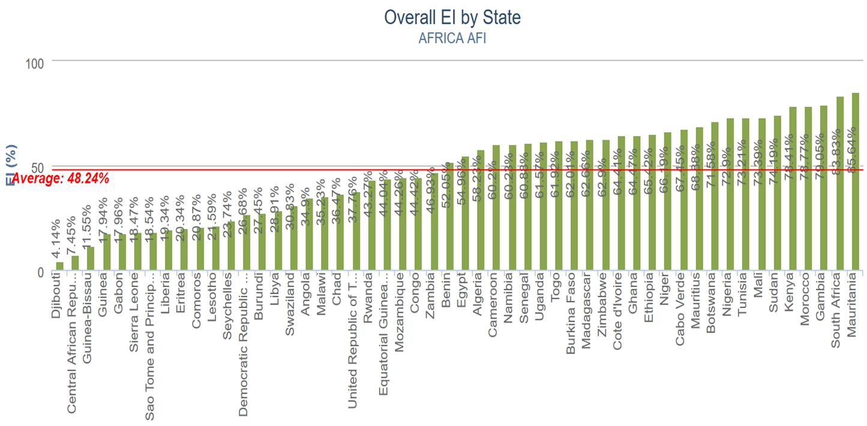
Source : iSTARS/ICAO 26/05/2016
24 out of 52 Countries have achieved the overall EI of 60% or more on 30th April 2016. That represents about 46% of African States
The Average Overall EI for AFRICA is 48,24%
The Average Overall EI for the World is 63,12%

Slide 14

Progress so far Achieved on Safety Targets ≥60% EI
July 2012
26 May 2016
31 Dec’16 Goal
Target, 31 Dec’17
100%
14 States
(25.9%)
37 States
(70%)
Actual:
24 States
(46.15%)

Slide 15
Perspectives and Challenges

Slide 16
Perspectives and Challenges
Continuation of the implementation of the AFI Plan based on the 3 focus areas
Assist States concerned to resolve SSCs
Support the ICAO Plans of Actions and AFI-CIS
Assist in Capacity Building through training
Promote and Strengthen RSOOs
Foster the synergy with all the regional groups
Notes:
In conclusion
The near term objectives of the AFI Plan were achieved by the establishment of the Plan the conducting of the Gap Analysis.
Since 2011 AFI Plan is in the implementation phase which is realizing the following:
The intensification of trainings, workshops and seminars.
Establishing of the African Association of Aviation Training Organizations (AATO) at the constitutive assembly which will be signified by the appointment of the Council and signing by the founding members on the constitution.
Successful resolving of SSCs and
Significant improvement of the EIs.

Slide 17
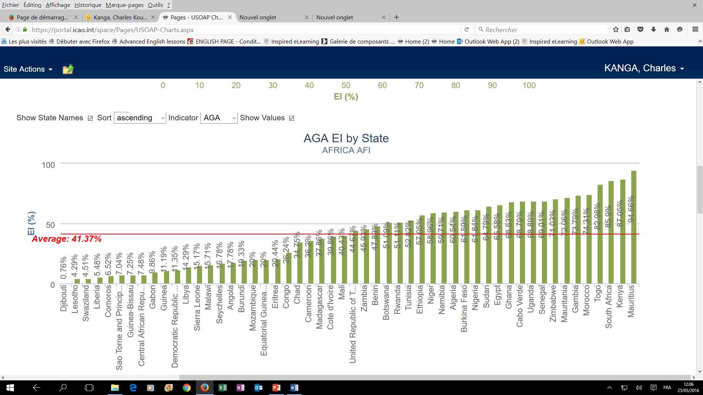
Aerodromes and ground aids (AGA)
Source : iSTARS/ICAO 26/05/2016
The Average EI of AGA for AFRICA is 41,37%
The Average EI of AGA for the World is 57,90%

Slide 18
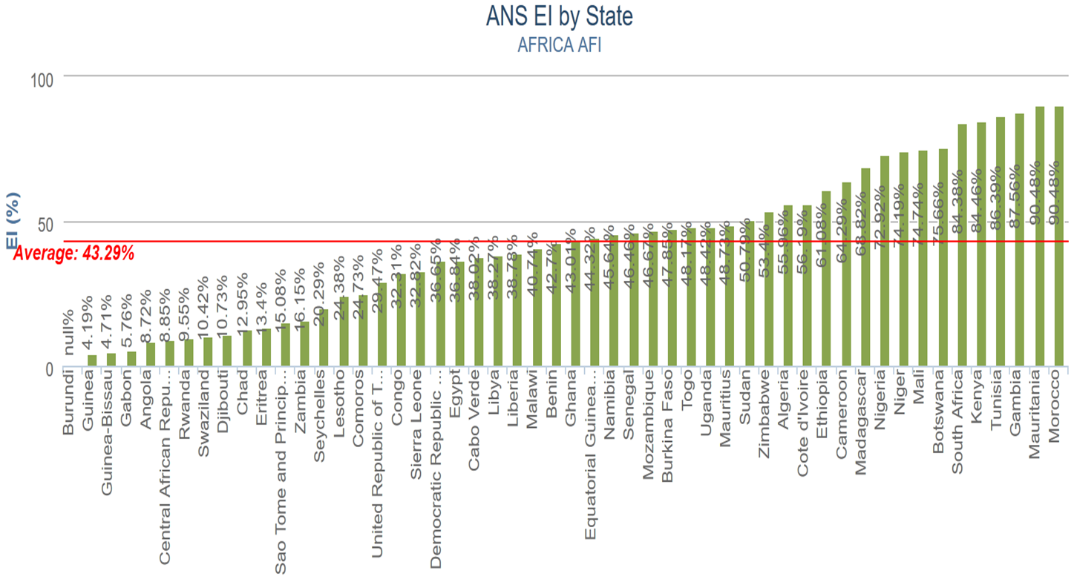
Air navigation services (ANS)
Source : iSTARS/ICAO 26/05/2016
The Average EI of ANS for AFRICA is 43,29%
The Average EI of ANS for the World is 58,58%

Slide 19
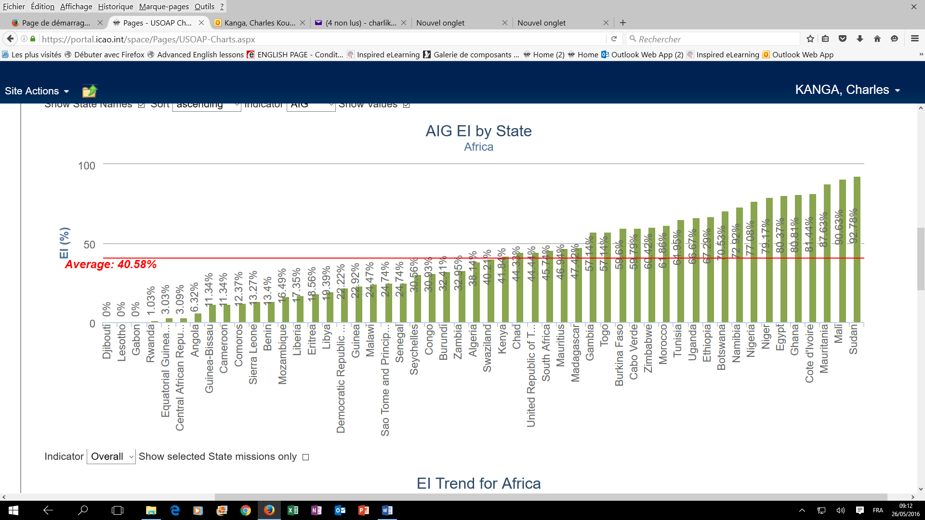
Aircraft accident and incident investigation (AIG)
Source : iSTARS/ICAO 26/05/2016
The Average EI of AIG for AFRICA is 40,58%
The Average EI of AIG for the World is 54,41%

Slide 20
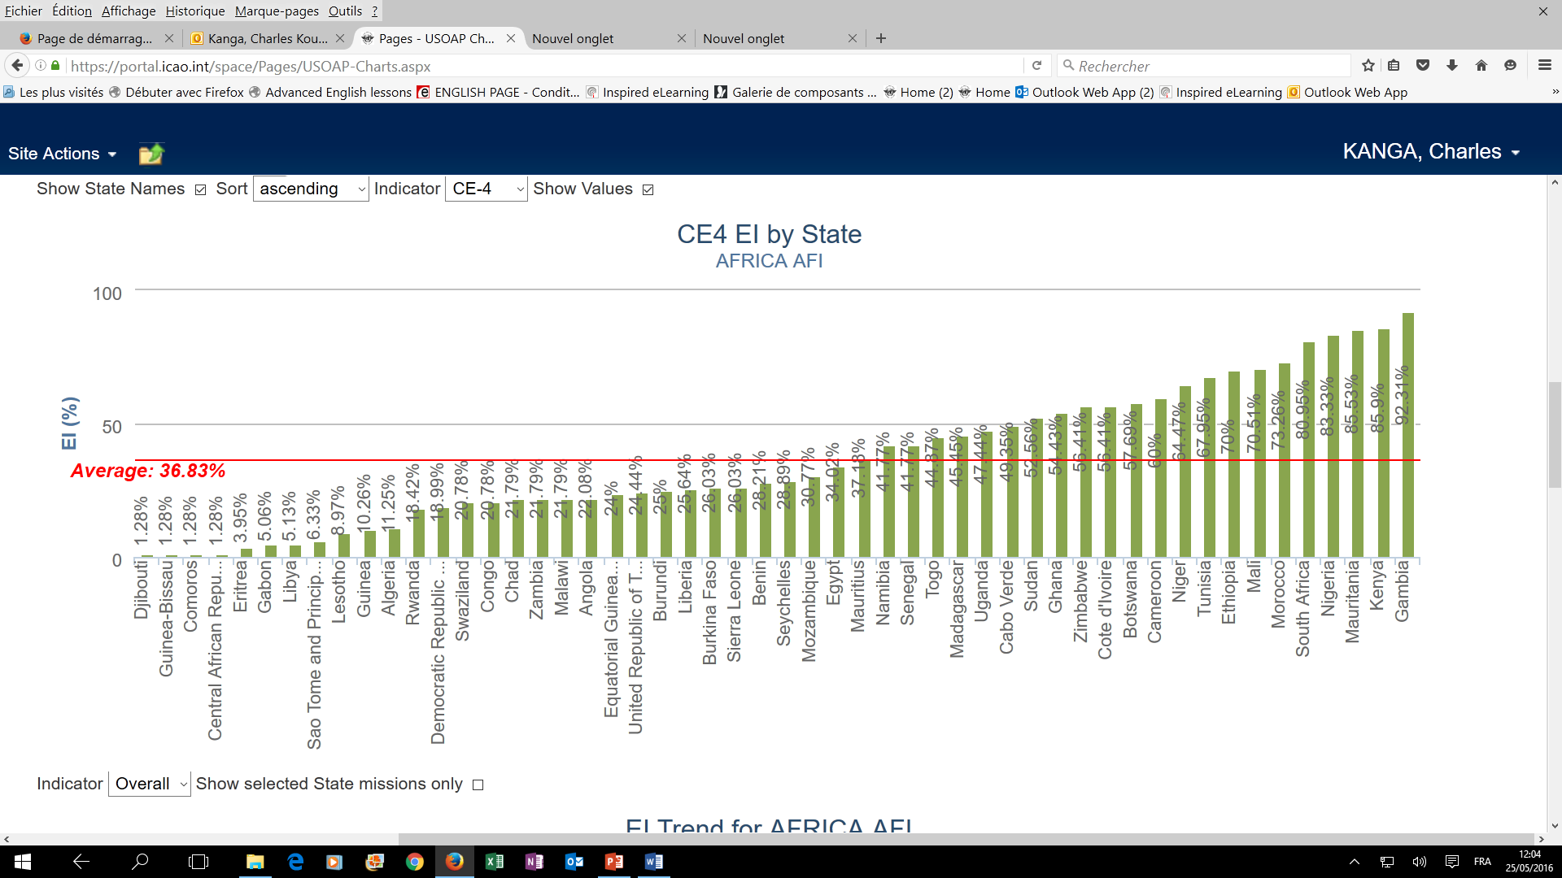
CE 4- Qualified technical personnel
Source : iSTARS/ICAO 26/05/2016
The Average EI of CE4 for AFRICA is 36,83%
The Average EI of CE4 for the World is 50,05%

Slide 21
STATE CIVIL AVIATION SYSTEM AND SAFETY OVERSIGHT FUNCTIONS (CE-3)
CAA
Empowerment
Autonomy
Legal framework
Finance
Trained & Qualified manpower
Notes:
SLIDE 3
Civil Aviation Regulatory entities in Member States of ICAO have different forms and sizes in which they are organized. However, the following are the foundation and pillars of a sound Civil Aviation Regulatory entity.
====================================================================================================================
As Safety oversight is one of the major responsibilities of a Member State, availability of trained & qualified personnel is essential.
Provision of appropriate training including initial and recurrent to maintain and enhance their competency at the desired level is imperative.
The cost of recruiting & retaining qualified technical personnel who satisfactorily meet the requirements of the profession represents a significant financial commitment and may require revisions to long-standing polices & regulations regarding remuneration for qualified technical personnel.
One of the important pillars is the provision of a comprehensive and effective aviation law or commonly known as “civil aviation code” consistent with the environment & complexity of the State’s aviation activity & compliant with the requirements contained in the Convention and its Annexes. Plus
The provision of adequate regulations to address at a minimum national requirements emanating from the primary aviation legislation.
This legal framework would enable the government & its administration to proactively supervise & regulate the whole spectrum of civil aviation activities.
It is through this instrument that the establishment of the CAA, the extent of its authority & empowerment & that of its Director General guaranteed.
=======================================================================================================
The other important pillar of the organization is the existence of adequate Financial resources.
The experience gained worldwide indicates that overall financial situation & managerial efficiency tended to improve when autonomous Civil Aviation entities are established.
A Regulatory entity with the above principles in place will be able to execute its responsibilities and attain a high level of oversight capability.

Slide 22

Support, Assistance and Cooperation
Representatives of African States to ICAO
ICAO Secretariat
Industry Representatives
Donor States
International Organisations
Banks
Composition of the AFI Plan Steering Committee

Slide 23
17th AFI Plan Steering Committee Meeting (Malabo, 30 June 2016)
Objectives:
To review activities of the AFI Plan and in particular, the status of implementation of the Abuja Safety Targets and 2016 AFI safety Goals.
To endorse the draft projects on aerodrome certification, training roadmap, ANSP peer review, SSP/SMS, SAR.
To endorse the AFI ANS performance indicators and targets;
Relevant outcomes of the AFI Safety Symposium will be considered by this meeting for incorporation in the AFI Plan work Programme.
Participants:
AFI Plan Steering Committee Members;
Directors General of Civil Aviation from AFI Region Member States; and
Invited representatives of other Member States and international/regional organizations.

Slide 24

AFI Plan Steering Committee

