Slide 1
AFI Aviation Safety Symposium Session 1 Setting the Scene
Moderator: Mr. Mohamed Elamiri, Deputy Director, Safety Management and Monitoring, Air Navigation Bureau, ICAO

Slide 2
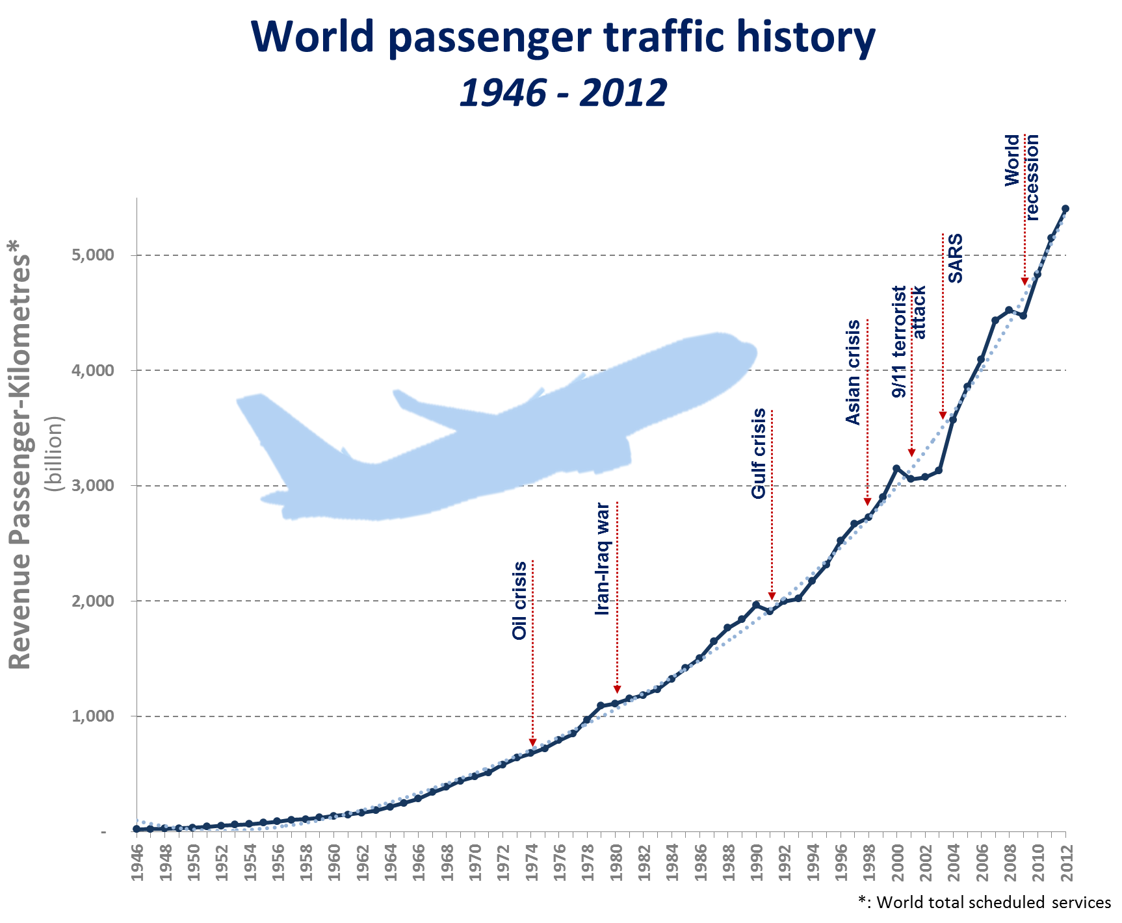
Continuous growth of air traffic
The question is not IF the traffic will recover,
But WHEN the traffic will recover
5.4 trillion
+4.9%
growth rate vs. 2011
Revenue Passenger-Kilometres
in 2012

Slide 3

1. How far have we gone towards improving aviation safety and air navigation in the AFI Region?
Setting the Scene
2. Can we do more to support its air transport development?

Slide 4
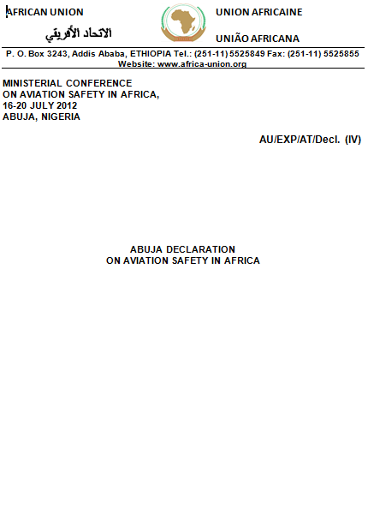
Conference on Aviation Safety in Africa 2012
Aviation safety targets agreed by Ministers attending the Conference held in Abuja, Nigeria in July 2012
Abuja safety targets endorsed by the Assembly of Heads of States of the African Union in January 2013

Slide 5
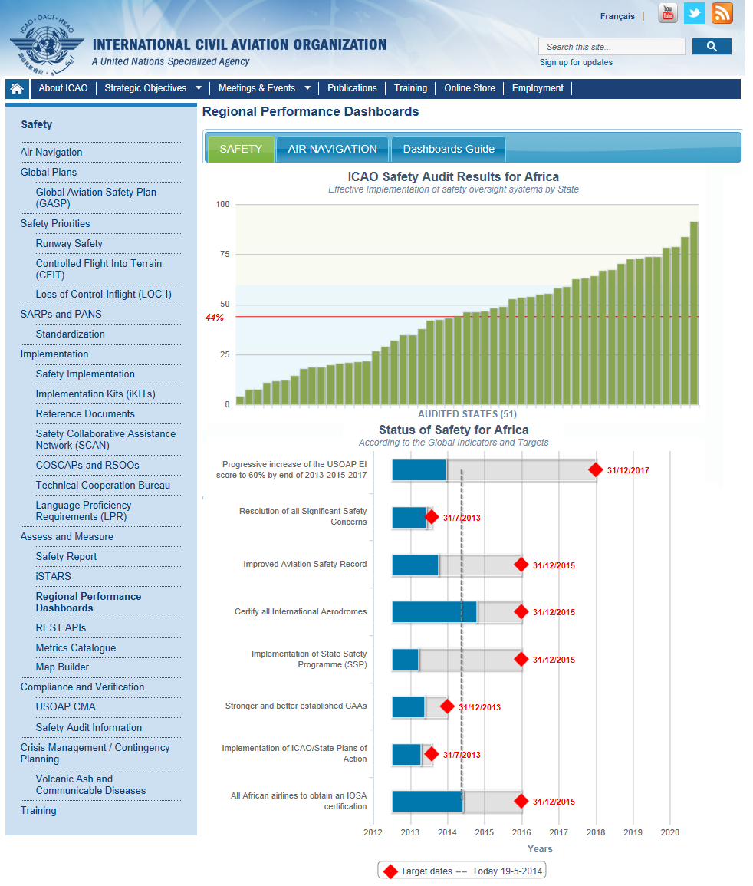
Regional Performance Dashboards by ICAO
Glance of Safety and Air Navigation strategic objectives
Status of Safety and Air Navigation by Region
LIVE level of attainment of Abuja safety targets
www.icao.int/safety/pages/regional-targets.aspx?region=Africa

Slide 6
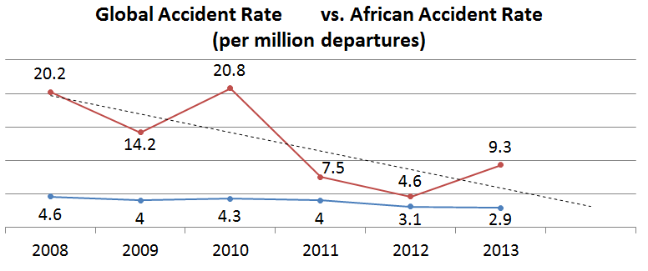
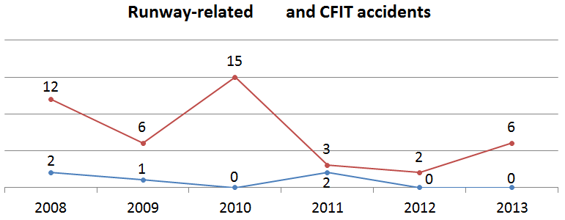
Abuja Ministerial Targets - Safety Record
Reduce the AFI accident rate to be in line with the global average by 2015
Reduce runway related accidents by 50% by 2015
Reduce CFIT related accidents by 50% by 2015
Heading in the right direction towards an enhanced safety record
Notes:
Heading in the right direction towards a progressive reduction of the African accident rate to be in line with the global average by the end of 2015

Slide 7
Abuja Ministerial Targets - Regulatory Oversight
Establish stronger and autonomous CAAs by 2013
Effective Implementation % (EI)
Resolve all SSCs by 2013 (7 remaining)
Increase the EI score to 60% or more by 2017
Implement 26 ICAO Plans of Action
States above 60% implement SSP and SMS
Egypt South Africa Gambia Kenya Mauritania | Tunisia Sudan Nigeria Morocco Cape Verde | Ethiopia Ghana Togo Zimbabwe
Notes:
Mauritania from 33.7% to 73.9%
Sudan from 49.3% to 73.6%

Slide 8
USOAP results improvement by area in the AFI region
Effective Implementation % (EI)
African CMA EI 44%
African CSA EI 38%
Notes:
Expansion of the AFI Plan to cover AIG, ANS and AGA.

Slide 9
USOAP results improvement by State
Effective Implementation % (EI)
Target of 60% EI

Slide 10
Potential USOAP EI improvement in the AFI region
Effective Implementation % (EI)
* Improvement on EI is contingent upon USOAP’s validation of the effective corrective actions implemented by States

Slide 11


Abuja Ministerial Targets – Industry involvement
All African airlines to obtain an IATA Operational Safety Audit (IOSA) certification by 2015
65 African airlines*
36 IOSA
Certify all International Aerodromes by 2015
214 aerodromes in AFI States
helps airports to identify
and mitigate aviation safety vulnerabilities
141 certified
* African regular passenger airlines
Notes:
Small airlines IOSA: 5 / Not: 17
Medium airlines IOSA: 19 / Not: 12
Large airlines IOSA: 12
Aerodromes <5000 scheduled departures certified: 100 / not certified: 63
Aerodromes >5000,<15000 scheduled departures certified: 32 / not certified: 7
Aerodromes >15000 scheduled departures certified: 9 not certified: 3

Slide 12
What about air navigation?

Slide 13
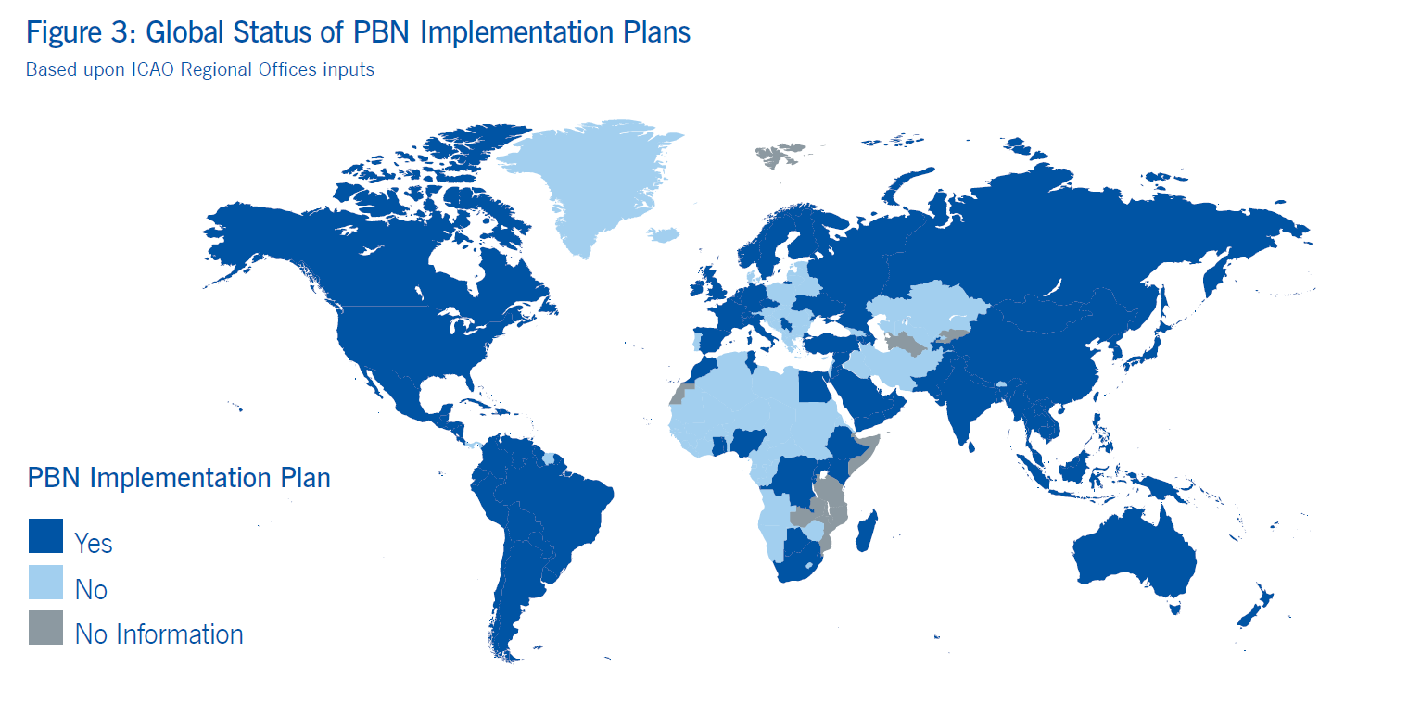
Air Navigation Priority - PBN

Slide 14
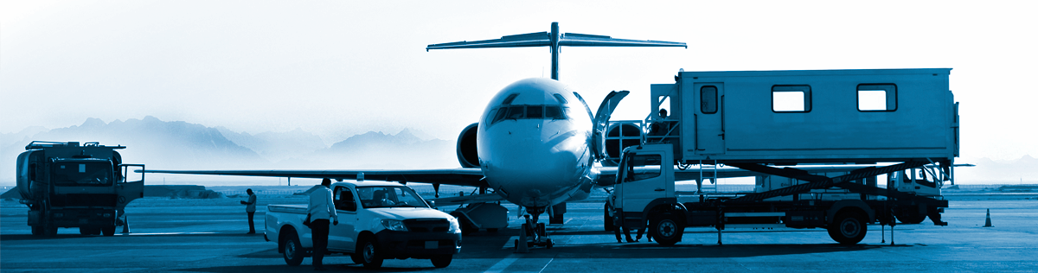
2. Can we do more to support air transport development in the AFI Region?

Slide 16
African operators traffic in 2013
72million
919thousand
+3.5%
vs 2012
+0.4%
vs 2012
Passengers carried
Aircraft departures
134 billion
+4.4%
vs 2012
3.1 billion
+4.1%
vs 2012
Revenue Passenger-Km
Freight Tonne-Km

Slide 17
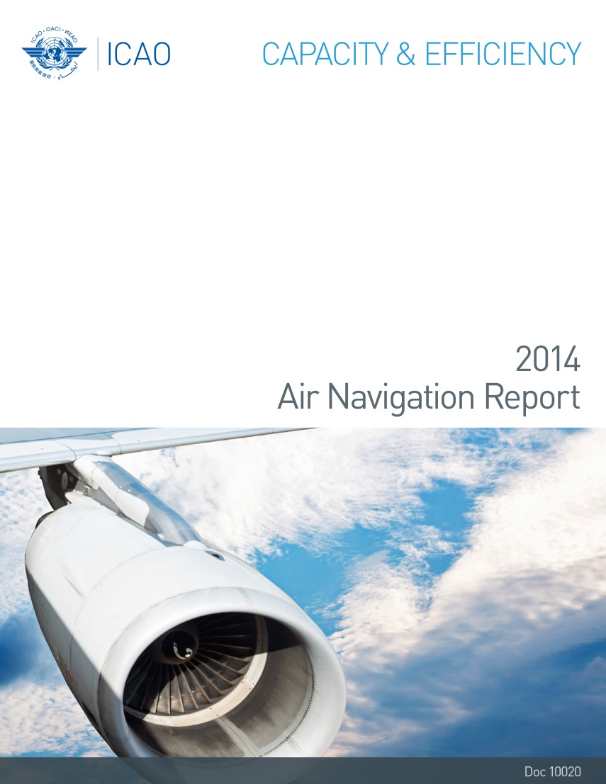
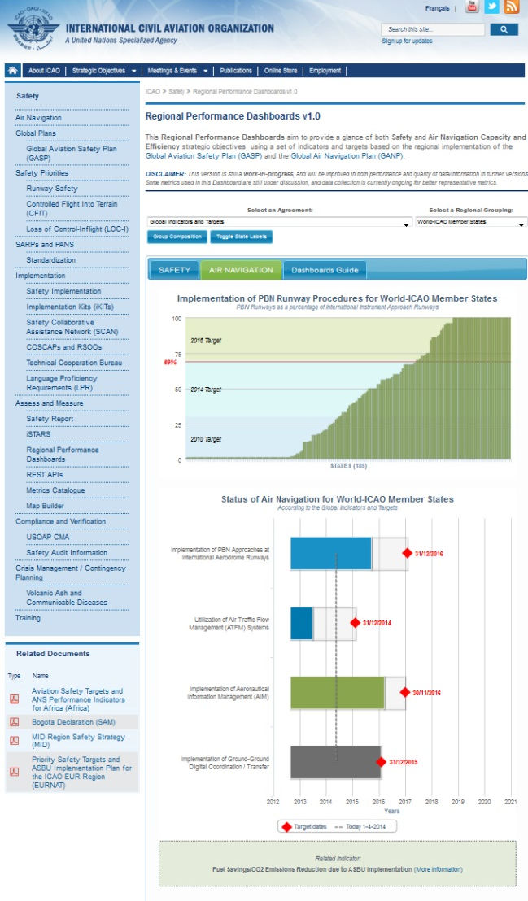
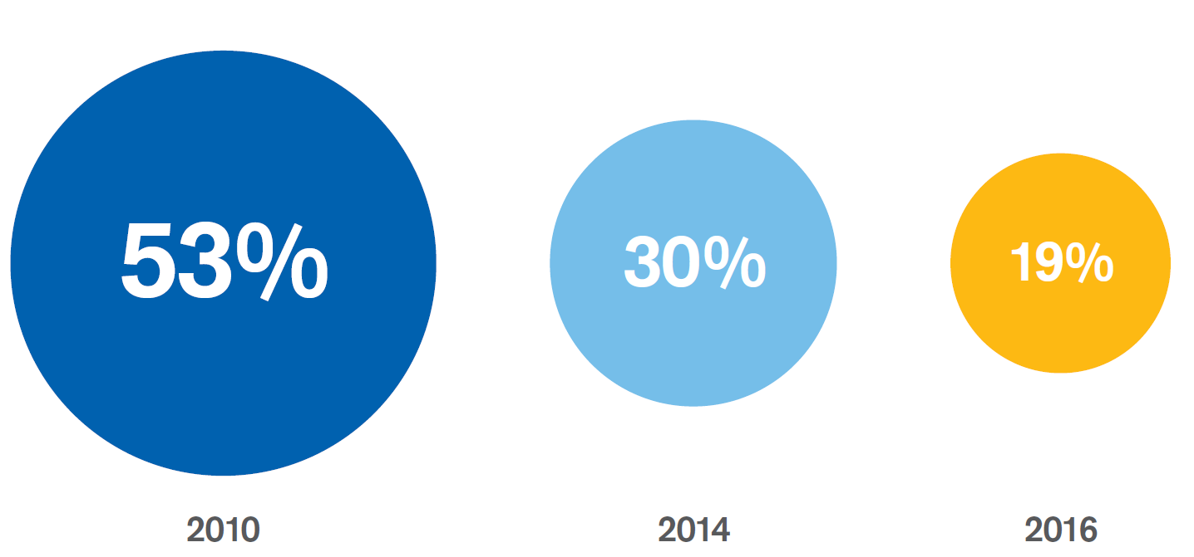
Air Navigation Priority - PBN
Percentage of States Meeting the A37-11 Resolution Targets for Applicable Years
FOR THE AFI REGION
FOR THE WORLD
62%
33%
24%

Slide 18
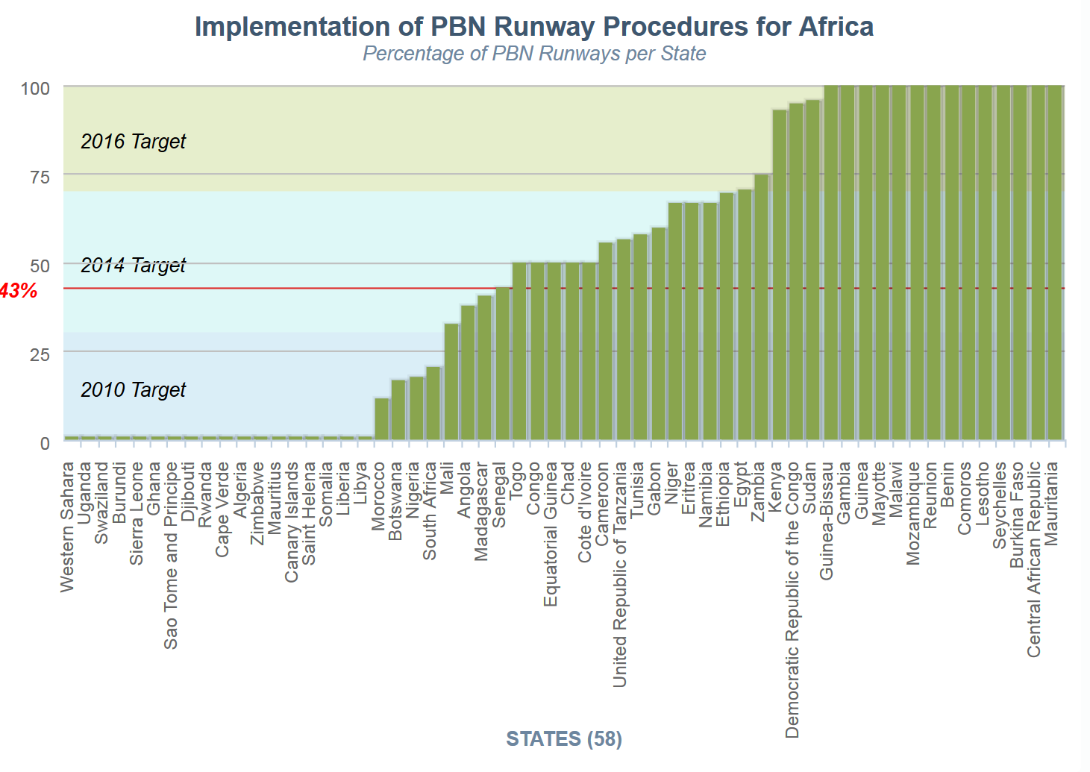
Implementation of PBN Runway Procedures the AFI Region

