Slide 1
AFRICAN CIVIL AVIATION COMMISSION (AFCAC)
Third Africa-Indian Ocean (AFI) Aviation Safety & Security Symposium
(Malabo, Equatorial Guinea, 27 June - 1 July 2016)
UPDATE ON THE IMPLEMENTATION OF THE ABUJA SAFETY TARGETS

Slide 2
INTRODUCTION
The Ministerial Conference on Aviation Safety in Africa adopted THE AVIATION SAFETY TARGETS and THE ACTION PLAN FOR AFRICA through the ABUJA DECLARATION in 2012.
The Secretariat of AFCAC was directed by the 25th AFCAC Plenary to establish a new questionnaire for the follow-up and monitoring of the implementation of the Abuja Safety Targets

Slide 3
INTRODUCTION
The campaign for the collection of data is based on the questionnaire developed in cooperation with ICAO and is oriented to the Abuja Safety Targets
Objective being detailed analysis based on comprehensive data requested from States for the monitoring of the Safety Targets
In accordance with Conclusion 3/11 of RASG-AFI/3, forty four (44) AFI States have designated Focal Points to facilitate coordination with AFCAC on safety matters and the monitoring of the implementation of the Abuja Safety Targets

Slide 4
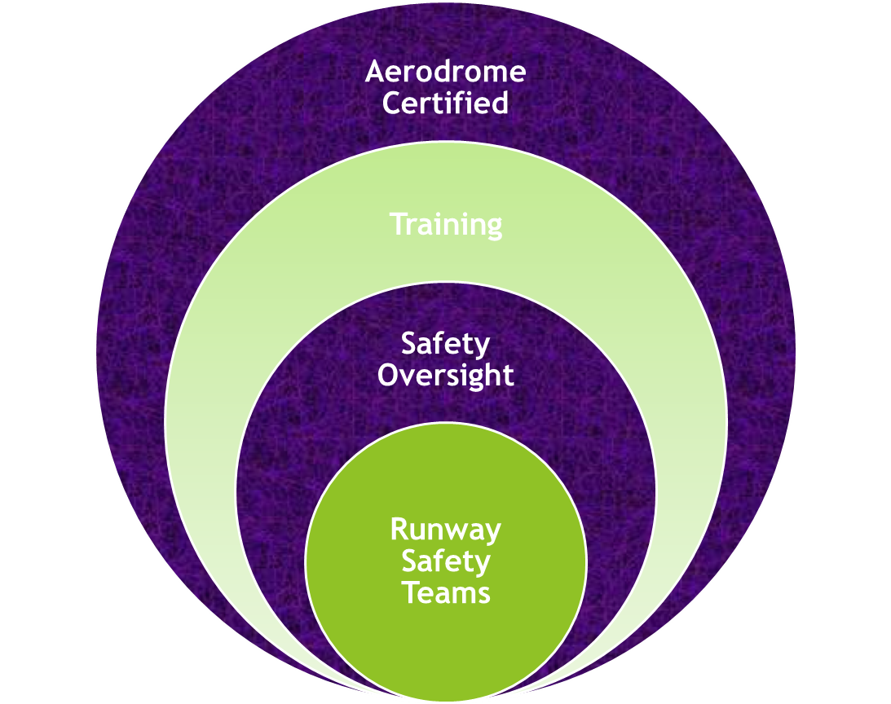

IMPLEMENTATION OF ABUJA SAFETY TARGETS
Safety Target 1: Reduce Runway related accidents and serious incidents by 50% by end of 2015
Safety Target Met

Slide 5
AFRICAN CIVIL AVIATION COMMISSION (AFCAC)
Safety Target 2: Reduce Controlled Flight Into Terrain (CFIT) related accidents and serious incidents by 50% by end of 2015
New Fleet
CCO/CDO
APV-PBN
Training
0 CFIT in 2015
Safety Target Met

Slide 6
IMPLEMENTATION OF ABUJA SAFETY TARGETS
Safety Target 3: Reduce LOC-I related accidents and serious incidents by 50% by end of 2015
Safety Target Met

Slide 7
IMPLEMENTATION OF ABUJA SAFETY TARGETS
Safety Target 4: States to establish and strengthen autonomous Civil Aviation Authorities by end of 2013
Primary Act
Regulatory texts
Financial Resources
Human Resources
Autonomous CAA in at least more than 22 States
Comprehensive data not available

Slide 8
Safety Target 5: Resolve ALL Identified Significant Safety Concerns
AFCAC and ICAO working on 4 PRIORITY STATES
Safety Target yet to be met

Slide 9
IMPLEMENTATION OF ABUJA SAFETY TARGETS
Safety Target 6: Implementation of Specific ICAO Plans of Action by July 2013
SMS/SSP
Different Stages of Implementation
ABUJA Safety Targets
32 States have accepted ICAO Plans of Action
EI ICAO SARPs
Significant progress in Safety oversight

Slide 10
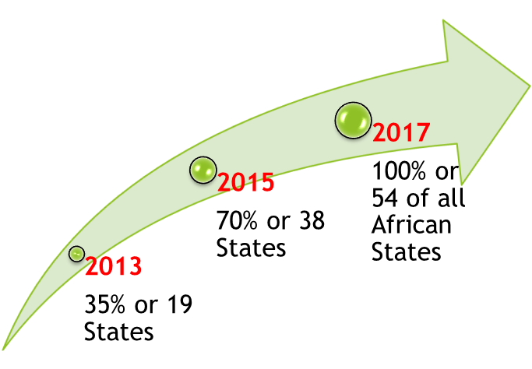

IMPLEMENTATION OF ABUJA SAFETY TARGETS
Safety Target 7: Progressively increase the Effective Implementation (EI) score of ICAO’s USOAP results to no less than 60%
ACHIEVABLE GOALS

Slide 11
IMPLEMENTATION OF ABUJA SAFETY TARGETS
Safety Target 7: Progressively increase the Effective Implementation (EI) score of ICAO’s USOAP results to no less than 60%
22 States
EI>=60%
14 States
EI<=30%
AFI-CIS Missions to
be intensified

Slide 12
IMPLEMENTATION OF ABUJA SAFETY TARGETS
Safety Target 8: Implement State Safety Programs (SSP) and ensure that all Service Providers implement a Safety Management System (SMS) by end of 2015
Eleven (11) States have initiated implementation of SSP and the highest attained is level 2.
None of the forty eight (48) States has attained level 4 implementation of SSP
Comprehensive data on SSP/SMS not available
Target is yet to be met

Slide 13
IMPLEMENTATION OF ABUJA SAFETY TARGETS
Safety Target 9: Certify ALL International Airports by end of 2015
As of April 2016, only 21.4% of International Airports have been certified
Process is on-going in almost All States
Expansion of AFI Plan to cover AGA and ANS
AFI-CIS missions to now include AGA and ANS
Target has not been met

Slide 14
IMPLEMENTATION OF ABUJA SAFETY TARGETS
Safety Target 10: Require all African airlines to obtain an IATA Operational Safety Audit (IOSA) certification by end of 2015
As of April 2016,
Progress has been very slow as only 11 more airlines have been added to the IOSA registry since 2012.
The total number of AFI airlines on the IOSA Registry as of December 31, 2015 was thirty (30)
Only Equatorial Guinea, Ghana, Mozambique and Togo indicated that they have incorporated IOSA certification into their regulatory Standards
Target is yet to be met

Slide 15
AFRICAN CIVIL AVIATION COMMISSION (AFCAC)
AFI-CIS Missions
Coopera-tion
ROST

Slide 16

AFRICAN CIVIL AVIATION COMMISSION (AFCAC)

