Slide 1
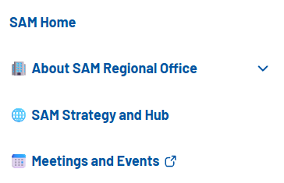
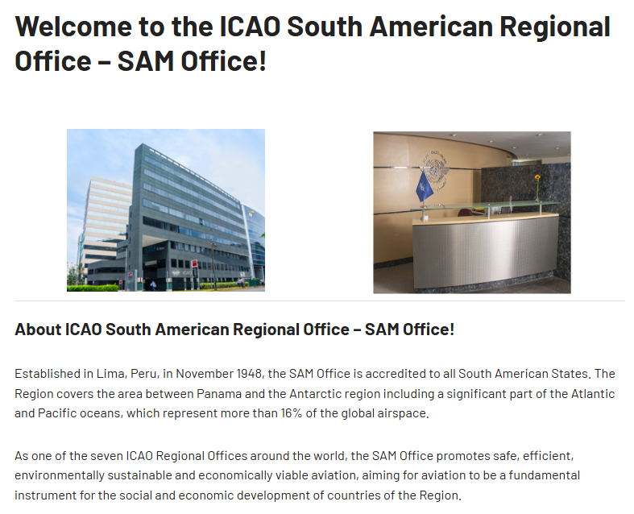

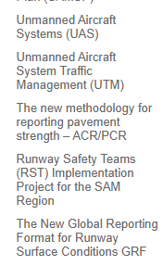
Safety
SSP/RSIG
Regional Aviation Safety Plan (SAMSP)
National Safety Plans (NASP) & Safety Reports
Proyecto FENIX
Safety Awareness Week
AIG
X
X
Notes:
La sección SSP, hay que modificar el nombre para que se llame SSP/RSIG
Hay que incluir 3 nuevas secicones (National Safety Plans & Safety Reports, Proyecto FENIX, Safety Awareness Week)
La sección AIG hay que traerla dentro de SAFETY
Los Links de UAS y ATM se van
Los enlaces de ACR/PRC, RST y GRF podrían estar desactualizados. Hay que consultar con Rodrigo si se quedan o sea van, o si AGA va a tener su propia página

Slide 2
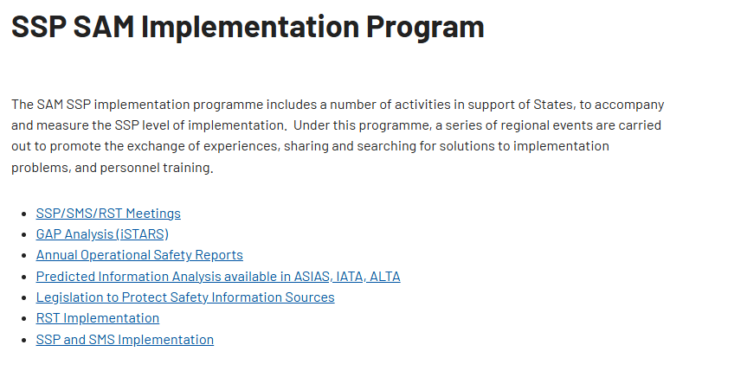
X
Safety
SSP/RSIG
Regional Aviation
Safety Plan (SAMSP)
National Safety Plans &
National Safety reports
Project FENIX
Safety Awareness Week
AIG
Notes:
En la sección del SSP, hay que elimnar todo el contenido actual, y remplazarlos por el contenido del siguiente slide

Slide 3
SSP/RSIG
The ICAO SAM Office SSP implementation plan supports South American States in building practical, risk-based and sustainable SSP capabilities. It focuses on phased implementation, minimum viable evidence, targeted assistance, and tools such as baseline assessments, quick-win guides, and knowledge-sharing resources, aligned with Annex 19, Doc 9859 and regional safety priorities.
The SAM Regional SSP implementation Group (RSIG) is the SAM Office’s regional forum for SSP focal points to exchange experiences, challenges, lessons learned and good practices. It also helps identify State-specific safety priorities, monitor SSP progress, and strengthen regional cooperation through a practical peer-support approach.
Safety
SSP/RSIG
RSIG Meetings & Reports
Regional Aviation
Safety Plan (SAMSP)
RSIG1/2026 Virtual Meeting Report (pdf)
RSIG2/2026 Virtual Meeting Report (pdf)
RSIG Annual Meeting (Link to site)
National Safety Plans &
National Safety reports
Project FENIX
Supporting Documents
Safety Awareness Week
ICAO SAM Policy on SMS acceptance and approval
Notes:
Este es el contenido para la sección SSP/RSIG, los documentos se los paso por mail

Slide 4
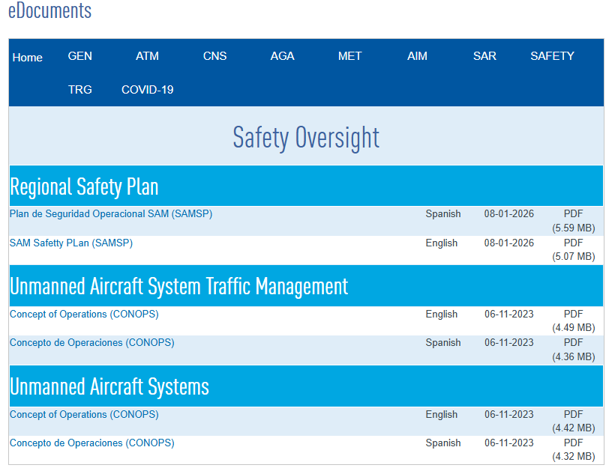
Safety
SSP/RSIG
X
Regional Aviation
Safety Plan (SAMSP)
National Safety Plans &
National Safety Reports
X
Project FENIX
Safety Awareness Week
Notes:
En la sección del SAMSP hay que dinamitar esa table, y remplazar por el contenido del siguiente slide

Slide 5
SAM Safety Plan (SAMSP)
The South American Region Safety Plan (SAM-SP) is the strategic planning instrument through which the ICAO South American (SAM) Regional Office guides, coordinates, and monitors regional actions aimed at strengthening civil aviation safety in South America.
The SAM-SP 2026–2028 is aligned with the ICAO Strategic Plan 2026–2050, the GASP 2026–2028, the SAM 2035 Regional Strategy, and the Declaration for the Transformation of Civil Aviation in South America (RAAC/17), ensuring coherence among global, regional, and national levels, and paving the way for alignment by SAM States.
Safety
SAM Safety Plan (SAMSP) 2026-2028 – EN
Plan de Seguridad Operacional SAM (SAMSP) 2026-2028– ES
Past editions
SSP/RSIG
Regional Aviation
Safety Plan (SAMSP)
SAM Safety Plan (SAMSP) 2023-2025 – EN
National Safety Plans &
National Safety Reports
SAM Safety Plan (SAMSP) 2020-2023 – EN
Project FENIX
Safety Awareness Week
Notes:
Por el momento para la página del SAMSP hay que ponder estos 4 documentos como se ve en el slide. Se los paso por mail.

Slide 6
National Safety Plans & Safety Reports
This section provides access to the National Aviation Safety Plans (NASPs) and National Safety Reports (NSRs) published by SAM States. NASPs are expected to be updated every three years, in alignment with the GASP and the SAMSP, while NSRs should be published annually to present safety performance results, progress achieved, and key safety priorities for continued action.
Safety
State | NASP 2026-2028 | NRS 2026 | NSR 2027 | NSR 2028 | Last updated
Argentina | View PDF | View PDF | Pending | Pending | DD/MM/YY
Bolivia | View PDF | View PDF | Pending | Pending | DD/MM/YY
Chile | View PDF | View PDF | Pending | Pending | DD/MM/YY
SSP/RSIG
Regional Aviation
Safety Plan (SAMSP)
National Safety Plans &
National Safety Reports
Archive
Project FENIX
State | NASP 2023-2025 | NRS 2023 | NSR 2024 | NSR 2025 | Last updated
Argentina | View PDF | View PDF | Pending | Pending | DD/MM/YY
Bolivia | View PDF | View PDF | View PDF | Pending | DD/MM/YY
Chile | View PDF | View PDF | View PDF | View PDF | DD/MM/YY
Safety Awareness Week
Notes:
Para los national safety reports, hay que crear una table correpsondiente al actual trienio (2026-2026) que incluya a los 13 Estados de SAM y publicar los coumentos que temenos, según si los estados han presentado o no. Entonces si temenos el documento ponemos un link. Si no temenos el documento pondemos “Pending”
Hay que crear la misma table para el trienio passado, para que queden registros de los couemntos. Le podemos llamar “Archivo”

Slide 7
Safety
SSP/RSIG
Regional Aviation
Safety Plan (SAMSP)
National Safety Plans &
National Safety Reports
Project FENIX
Safety Awareness Week
Notes:
El Proyecto FENIX tiene una página en el Sharepoint desarrollado por la sede:
FENIX Hub – Home
Por el momento esa es la dirección. La idea es que el tpitulo de esta sección direcicones directamente a esa página

Slide 8

Purpose
How to Participate
2026 Edition
Regional Activity Gallery
Resources
Previous Editions
Contact
Safety
SSP/RSIG
Regional Aviation
Safety Plan (SAMSP)
National Safety Plans &
National Safety Reports
Project FENIX
Safety Awareness Week
Notes:
En el safet awareness week. Necesitamos un banner, y las secciones que se describen en el slide. Les paso un word por mail con el contenido de cada sección.

