Slide 1

PA-RAST 54
Daniel Soares – ANAC/Brazil – States Co-Chair of the PA-RAST
Santiago Saltos – Airbus – Industry Co-Chair of the PA-RAST
Miami, February 2022

Slide 2
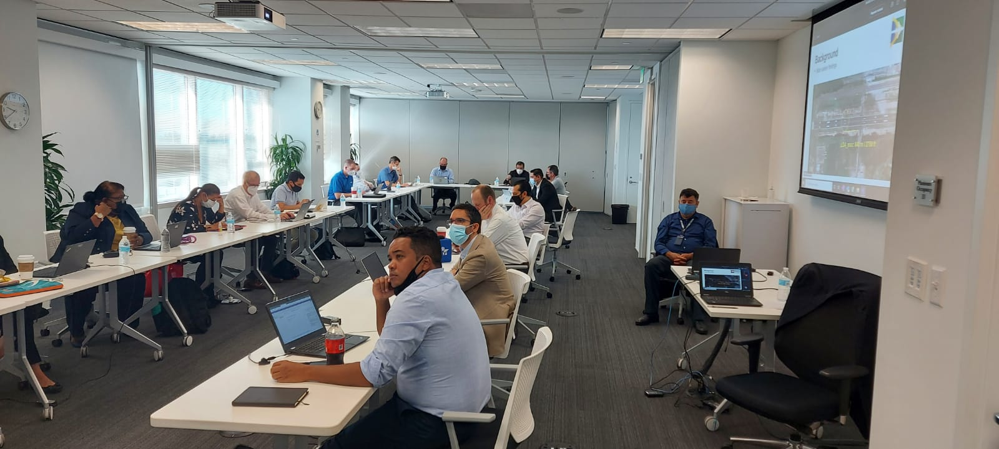

Meeting Summary
The working group to review previous PA RAST work, including BCAST recommendations and conclusions, and
Invite airlines/ CST Co-Chairs/ ALTA’s Committee President/ to next PA-RAST,
HRC Group leaders to review Work Plan stated on the next slide.
Specific Actions associated for each topic discussed during PA RAST 54 are summarized.

Slide 3
Working Plan - 2022
CFIT
LOC-I
MAC
RE
01/2022: 31OCT2022
Obstacle Chart Updates
(Promotion, SRVSOP OPS cooperation).
01/2022: 31OCT2022
Promotion for Aircraft State Awareness
(Misconfigurations, Go-Around Outcomes – initial ARC project drafts).
01/2022: 31OCT2022
Raising awareness on MAC issues
(promotion of results from the GREPECAS/GTE collaboration).
01/2022: 31JUL2022
Assessment of TDZ Markings and required landing performance
(TDZ with 4 markings pairs in short RWYs)
02/2022: 31JUL2022
Deployment of Detailed Implementation Plan
(resolution of specific safety enhancement opportunities).
02/2022: 31OCT2022
Guidance on “Recommended Touchdown Area” for air operators

Slide 4
Severe Weather
Conclusion: It was agreed that PA-RAST, for the time being, will not engage in the matter of severe turbulence considering there is minimum evidence of fatality risk. PA-RAST will present the ESC the option of developing a RSA.
Action: Gather more data and best practices from operators and other organizations
Deadline: Next PA-RAST 55

Slide 5
RE
Conclusion: It was agreed that PA-RAST will continue to review this information within the RE team.
Actions:
  IATA will review the issue on runway markings internally,
  CSTs to identify if there are exemptions in each State for runway markings,
  IFALPA will provide additional information on specific airports,
  ICAO will identify which country have reported different runway marking requirements versus Annex 14,
  The working group to review previous PA RAST work, including BCAST recommendations and conclusions, and
  IATA, IFALPA and ALTA to share information on the latest runway markings standards with the airlines.
Deadline: Next PA-RAST

Slide 6
CFIT
Conclusion: The PA-RAST identified the opportunity to review obstacle charts
Action: The region to consider actions as associated in the WP on obstacle charts,
The CFIT team will work on evaluating the obstacle charts, and
The working group to review previous PA RAST work, and consider future improvements.
Deadline: Next PA-RAST

Slide 7
LOC-I
Conclusion: The team validated the importance of reviewing the work that has been developed in the past to adapt to the new reality.
Action:
  LOC-I team will review previews work and present an action plan,
Deadline: Next PA-RAST

Slide 8
MAC
Conclusion: The data presented identified the areas of opportunity. These will be analyzed in more detail in collaboration with the joint RAST-PA and GTE group.
Action:
  IATA will present the data to Mexico CAST,
  Review the data with RAST-PA and GTE groups and develop a plan of action.
Deadline: Next PA-RAST

Slide 9
Collaborative Safety Team UPDATE
Conclusion: PA-RAST agreed the importance of continuing the promotion and support to CST.
Action:
  Review the Guidance Material for CSTs
  Present a plan to support current and new CSTs
  Support the CSTs plans for 2022
    Reengage with Ecuador, Colombia, Argentina, PASO-C and Peru CSTs
    New Chile, Caribbean CSTs
Deadline: Next PA-RAST

Slide 10
Mexico CAST
Conclusion: Update on the current status of the Mexico CAST was provided to the group with the key focus areas identified.
M CAST invited the PA-RAST to conduct its next meeting in Mexico City.
Action:
PA RAST To support the local authority with guidance and best practices to continue it’s process of consolidation
Mexico CAST will review with IATA the data regarding TCAS-RAs and will present PA-RAST a report on the outcome of the analysis, and
Mexico CAST to review outcomes from the RE topic.
Mexico CAST to monitor the safety performance of NLU Airport and the integration with the MEX Airport airspace.
Deadline: Share status at Next PA-RAST

Slide 11
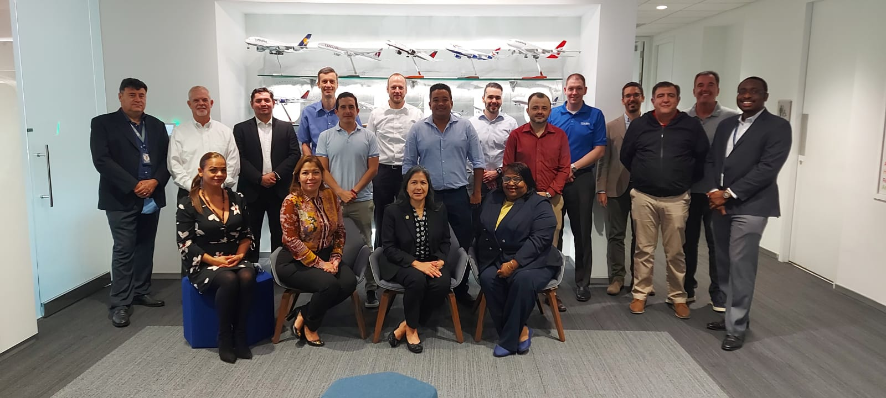
Gracias!
Thank you!
Obrigado!

