Slide 2
SUPPLIER REGISTRATION AND TENDER PARTICIPATION ------- QUANTUM
Edition 1 – 15 July 2025

Slide 3
SECTION | PAGES
REGISTRATION IN QUANTUM (GENERAL INTRO) | 4
IMPORTANT REGISTRATION / ACCESS CONSIDERATIONS | 5
REGISTRATION STEP-BY-STEP | 6 - 9
FIND TENDERS AND DOWNLOAD TENDER DOCUMENTS STEP-BY-STEP | 10 - 15
SUBMIT QUESTIONS AND REQUESTS – STEP-BY-STEP | 16 - 20
SUBMIT TENDERS / BIDS / QUOTATIONS – STEP-BY-STEP | 21-28
MODIFY TENDERS / BIDS / QUOTATIONS – STEP-BY-STEP | 29 - 36
IMPORTANT NOTES ON MIGRATED ACCOUNTS | 37
TABLE OF CONTENTS

Slide 4
Registration in Quantum
In order to participate in any ICAO Solicitation, companies are required to create a supplier account in Quantum ERP / e-procurement platform following this link: Quantum Applications.
The below presentation provides SIMPLIFIED instructions on supplier registration and tender participation, that is, it describes minimal / mandatory requirements the companies should follow to successfully register in Quantum and take part in ICAO tenders.

Slide 5
IMPORTANT REGISTRATION / ACCESS CONSIDERATIONS:
ONLY ONE ACCOUNT PER LEGAL ENTITY. No duplicates are allowed in Quantum. If a company is already registered in QUANTUM with any other UN agency, it does not need and SHOULD NOT create a new account with ICAO. The QUANTUM Supplier Number is a unique identifier used across all participating UN entities.
FORGOTTEN PASSWORD; QUANTUM LOGIN. If a company representative has forgotten one’s login credentials, such representative needs to use the "Forgot Password" feature on the portal to reset them. Your Quantum login is always the email address you used in creating your user account.
MIGRATED ACCOUNTS. If a company had ICAO contracts / purchase orders / payments before April 2025, its account is likely to have been migrated from the old ICAO ERP to Quantum. If you represent one of these companies, please get in touch with ICAO ASAP to initiate the activation of your migrated account. More instructions on this on page 37.
UNGM & QUANTUM. All ICAO procurement opportunities will continue to be advertised on the United Nations Global Marketplace (UNGM) as before. However, the solicitation documents will only be accessible through the QUANTUM Supplier Portal for entities registered on Quantum. There is no integration between the two systems: supplier accounts on Quantum and UNGM are not connected; supplier / account numbers, as well as logins and passwords from UNGM are not applicable in Quantum and vice versa.
NO NEED FOR APPROVAL. ICAO does not need to approve your initial registration, except in cases of migrated accounts or Spend Authorized suppliers (suppliers with awarded contracts). Therefore, accounts become active immediately (or very soon after) the registration.

Slide 6
REGISTRATION STEP-BY-STEP
HERE AND FURTHER, STEPS HIGHLIGHTED IN GREEN ARE ILLUSTRATED IN A BELOW PICTURE ON THE SAME PAGE
STEP 1. Click this link to start registration: Quantum Applications.
STEP 2. Enter your email address, preferably corporate, to the field in the right upper corner (screenshot below).
STEP 3. Click on "send access code“ button below the email field. DO NOT CLOSE THIS WEBPAGE, AS THE FIELD FOR ENTERING YOUR ACCESS CODE WILL APPEAR HERE.
abcdefgh

Slide 7
STEP 4. IMMEDIATELY go to your e-mailbox and retrieve a temporary activation code from an email received from Quantum address <no-reply@email-notifications.undp.org>. The code expires after 15 minutes.
If you do not receive this email, it may indicate that you already have an account associated with that email. Consider using the forgotten password feature to reset your password. Additionally, ensure that your email firewall is not preventing the delivery of emails.

Slide 8
STEP 5. Enter the access code you received by email (as described in Step 4) into the designated field (on the right).
STEP 6. Click the Continue button (below the access code field). This will launch the Supplier Registration Form as described on the next page.
abcdefghi

Slide 9
IN THE SUPPLIER REGISTRATION FORM, SOME OF THE SECTIONS ARE MANDATORY, AND SOME AREN’T.
THE MANDATORY SECTIONS INCLUDE: SUPPLIER DETAILS; CONTACTS; ADDRESSES; BUSINESS CLASSIFICATIONS; QUESTIONNAIRE. | NON-MANDATORY SECTIONS INCLUDE: BANK ACCOUNTS (only relevant for suppliers in case of contract award); PRODUCTS AND SERVICES.
IN THE MANDATORY SECTIONS, ONLY FIELDS MARKED AS ‘Required’ ARE MANDATORY.
STEP 7. Enter the information in the ‘Required’ fields and all other fields you choose to fill.
STEP 8. Click the Continue button to move to the next Section OR click Save if you choose to interrupt registration; you can also click Save, and then - Continue (to prevent loss of data).
STEP 9. On the last page (Questionnaire), click Submit button.
HINT: If you saved information in your incomplete Supplier Registration Form, you can continue your registration later by repeating the Steps 1-6; the system will recognize your email address and you will continue where you left off.

Slide 10
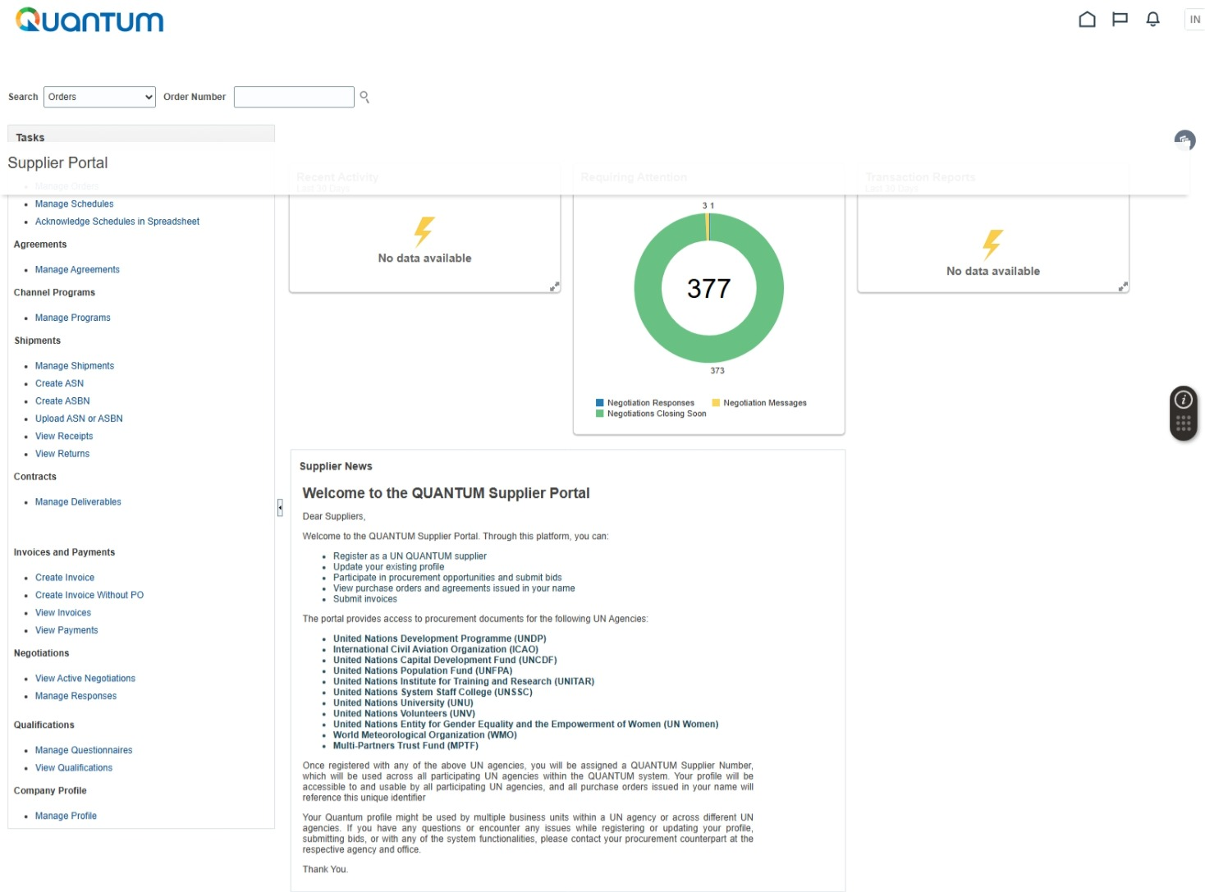
FIND TENDERS AND DOWNLOAD TENDER DOCUMENTS STEP-BY-STEP
STEP 1. Companies that are already registered should access Quantum using this link: Quantum Supplier Portal.
STEP 2. Once in the system, companies appear in the below main menu. To start tender search, they need to click ‘View Active Negotiations’, which opens the search menu shown on the next page.

Slide 11
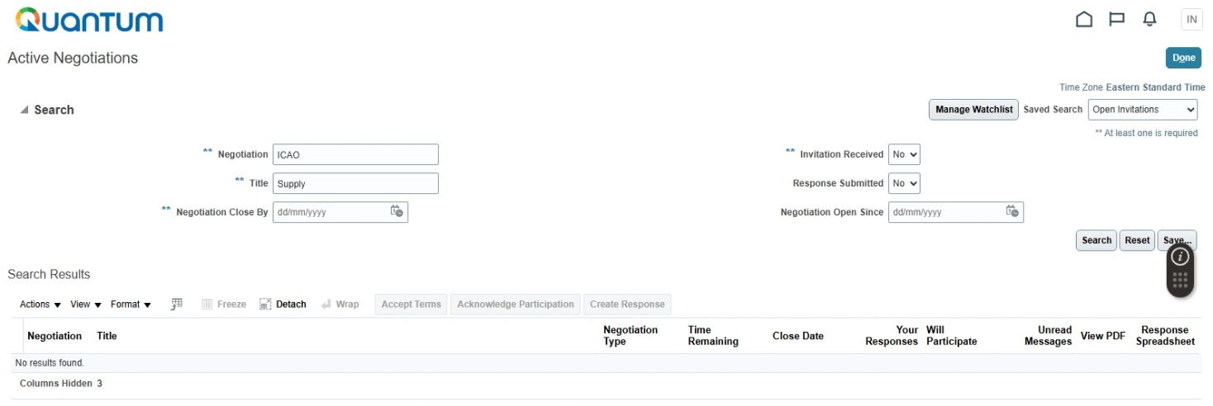
For simplicity and avoid possible errors, it is recommended to only perform one of the next two steps (Step 3 or Step 4).
STEP 3. In the field ‘Negotiation’ enter either the exact and full reference / number, or its first letters / digits. Example: if the full tender reference is ‘ICAO-00007’, you MUST enter either ‘ICAO’, or ‘ICAO-00007’ (for simplicity and to avoid possible errors, it is recommended to enter ‘ICAO’ only in this field and skip the Step 4; in this case, you will see all current ICAO tenders to choose from).
STEP 4. The field ‘Title’ refers to tender title / name and IS NOT MANDATORY. If this field is used, it’s important to enter either the exact and full title / name, or its FIRST letters / words.
STEP 5. IMPORTANT: Please select a ‘NO’ or a blank in the ‘Invitation Received’ field (unless you received an invitation to your email directly from the Quantum system).
STEP 6. Once the above actions are performed, you can click ‘Search’. Search results are illustrated in the following page.
STEP 4. Once in the system, companies

Slide 12
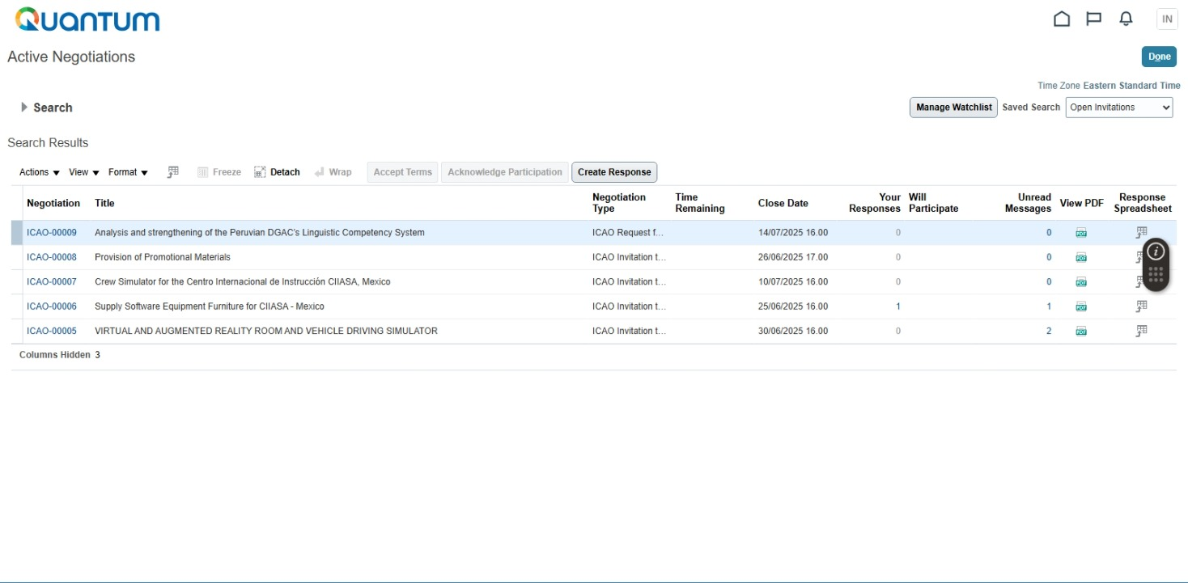
STEP 7. From the list of tenders responding to the set criteria, select a tender of interest, and click on the tender reference number in the Column ‘Negotiation’. This will open the tender webpage where all the actions shall be performed in relation to such particular tender.

Slide 13
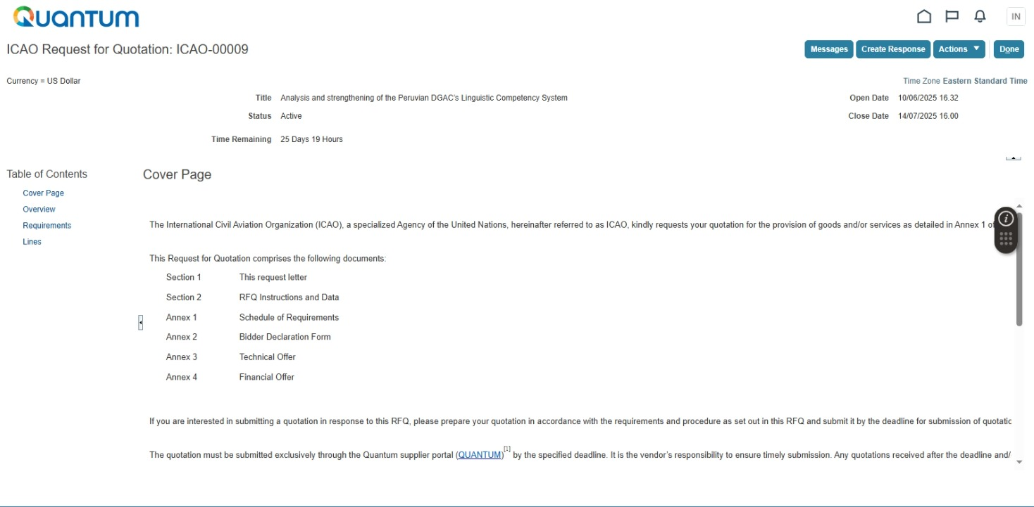
STEP 8. In the tender webpage, please click ‘Requirements’ to view requirements / download tender documents.

Slide 14
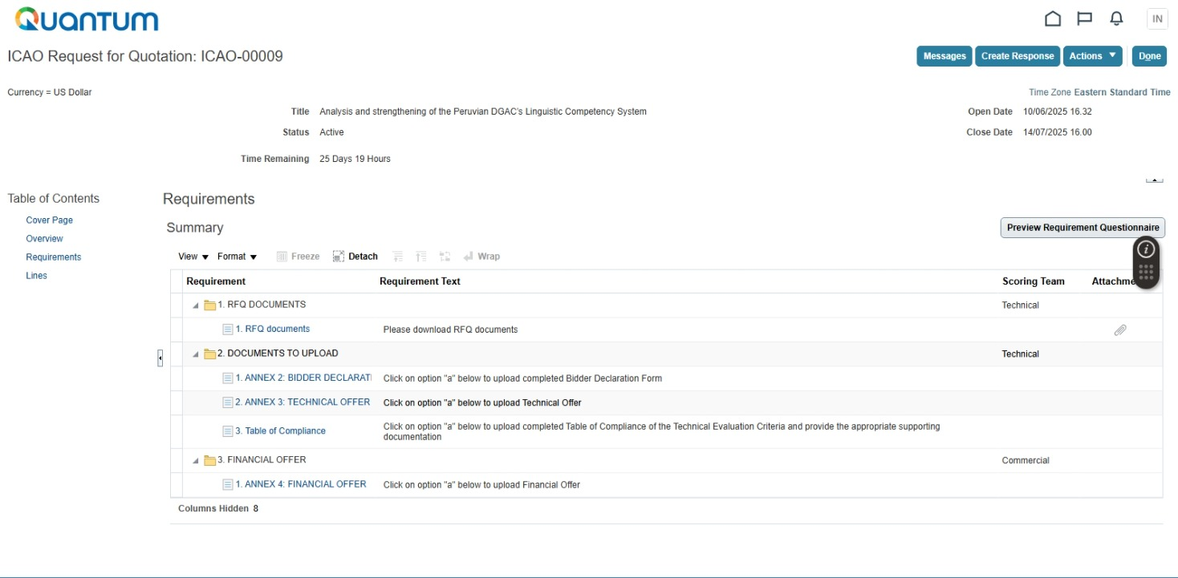
STEP 9. In the below screen, please click on the link to tender documents (for example, ‘RFQ documents’). A staple sign on the right is an indicator that there is / are (an) attachment(s).
Hint: To receive automatic notificationS of all communications RELATED to a tender, it is recommended to create a Draft bid response without submitting it. For this purpose, please click ‘Create Response’, and in the next screen – ‘Save and Close’. You will be able to modify and submit the bid response at any time before the tender submission deadline.

Slide 15
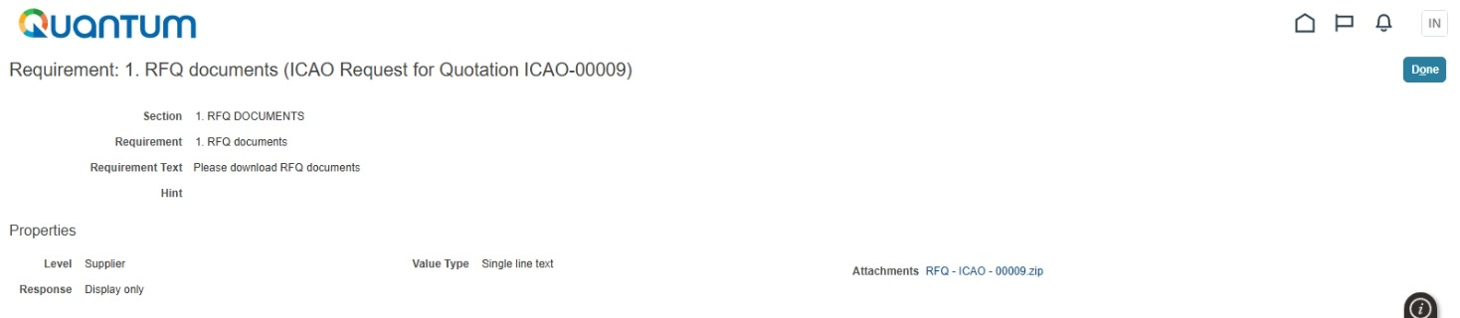
STEP 10. From the below screen, tender documents can be downloaded by clicking on the link(s) in the ‘Attachments’. Usually, the tender documents comprise a set of files in a single zipped folder.
TENDER DOCUMENTS ARE EXPECTED TO PROVIDE ALL THE INFORMATION NECESSARY FOR BIDDING. IN CASE THERE ARE ANY QUESTIONS WHATSOEVER RELATED TO THE MATTER OF THE TENDER, THE SPECIFICATIONS OR ANY TENDER REQUIREMENTS, THE POTENTIAL BIDDERS SHALL ADDRESS SUCH QUESTIONS TO ICAO ONLY THROUGH THE E-PROCUREMENT PORTAL, AS DETAILED IN THE FOLLOWING PAGES IN THE SECTION ‘SUBMIT QUESTIONS AND REQUESTS – STEP-BY-STEP’.
ONLY IF A POTENTIAL BIDDER HAS QUESTIONS OF GENERAL NATURE NOT RELATED TO THE MATTER OF THE TENDER, THE SPECIFICATIONS OR ANY TENDER REQUIREMENTS, SUCH AS QUESTIONS ON ACCESS / DOWNLOAD / UPLOAD ISSUES, CAN SUCH POTENTIAL BIDDER SEND AN EMAIL TO E-TENDER@ICAO.INT. SUCH EMAILS ARE ANSWERED AS QUICKLY AS POSSIBLE, WITHIN A FEW STATUTORY WORKING DAYS IN QUEBEC, CANADA.

Slide 16
SUBMIT QUESTIONS AND REQUESTS – STEP-BY-STEP
IN CASE THERE ARE ANY QUESTIONS WHATSOEVER RELATED TO THE MATTER OF THE TENDER, THE SPECIFICATIONS OR ANY TENDER REQUIREMENTS, THE POTENTIAL BIDDERS SHALL ADDRESS SUCH QUESTIONS TO ICAO ONLY THROUGH THE E-PROCUREMENT PORTAL, AS DETAILED BELOW.
ONLY IF A POTENTIAL BIDDER HAS QUESTIONS OF GENERAL NATURE NOT RELATED TO THE MATTER OF THE TENDER, THE SPECIFICATIONS OR ANY TENDER REQUIREMENTS, SUCH AS QUESTIONS ON ACCESS / DOWNLOAD / UPLOAD ISSUES, CAN SUCH POTENTIAL BIDDER SEND AN EMAIL TO E-TENDER@ICAO.INT. SUCH EMAILS ARE ANSWERED AS QUICKLY AS POSSIBLE, IN GENERAL WITHIN A FEW STATUTORY WORKING DAYS IN QUEBEC, CANADA.
STEP 1A. If you have NOT started your tender submission, find and select the tender that your questions concern, as described above in the Section ‘FIND TENDERS AND DOWNLOAD TENDER DOCUMENTS – STEP-BY-STEP’ (Steps 1 - 7).
OR
STEP 1B. If you have already started your tender submission, please click ‘Manage Responses’ in the main menu webpage and then select the tender in the next screen, as described in Step 7 of the above Section ‘FIND TENDERS AND DOWNLOAD TENDER DOCUMENTS – STEP-BY-STEP’.

Slide 17
STEP 2. In the tender webpage, please click ‘Messages’ to compose and submit your enquiries or requests.

Slide 18
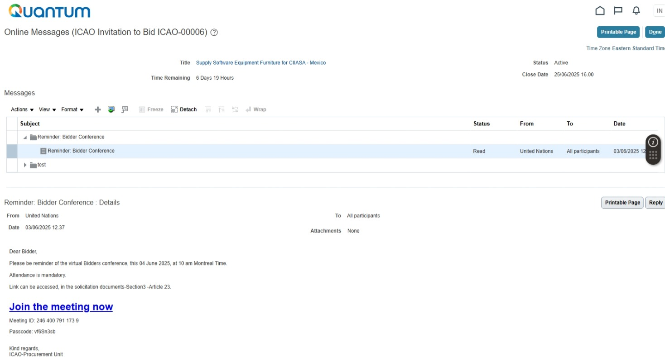
STEP 3. In the below screen, please click “ + ” in order to enter your enquiries or requests. This will open the window illustrated on the following page.

Slide 19
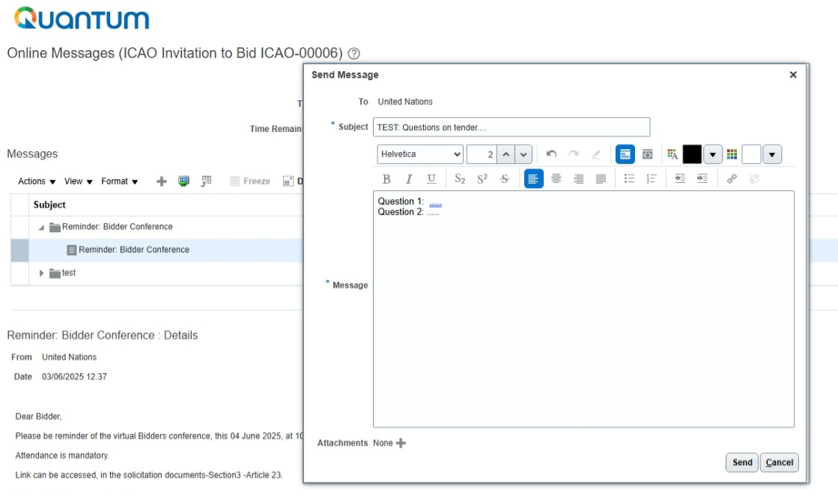
STEP 4. Enter the text of your inquiry / request in the below pop-up window. You can format your text using the menu in the pop-up window.
STEP 5. Click ‘Send’ when you are ready.

Slide 20
STEP 6. To view ICAO responses, you can visit the ‘Online Messages’ screen by following the above Steps 1-2 of this Section.
STEP 7. First, click on the upper level heading in the ‘Subject’ column to show the communication(s) available under the given heading – see the ‘green’ box below. Please note that this ‘Online Messages’ menu contains not only ICAO responses to supplier inquiries and requests, but also any other tender-related communications from ICAO, such as those related to tender deadline extension, etc.
STEP 8. Then, click on the lower level heading in the ‘Subject’ column to show the content of the message and attachments available for downloading, if any – see the ‘red’ boxes below. If ‘None’ is indicated under ‘Attachments’, it means the entire content of ICAO response / message is shown in the lower left corner.
content

Slide 21
SUBMIT TENDERS / BIDS / QUOTATIONS – STEP-BY-STEP
STEP 1A. If you have NOT started your tender submission, find and select the tender, as described above in the Section ‘FIND TENDERS AND DOWNLOAD TENDER DOCUMENTS – STEP-BY-STEP’ (Steps 1 – 7 on pages 10 - 12).
OR
STEP 1B. If you have already started your tender submission, please click ‘Manage Responses’ in the main menu webpage and then select the tender in the next screen, as described in Step 7 of the above Section ‘FIND TENDERS AND DOWNLOAD TENDER DOCUMENTS – STEP-BY-STEP’ (page 12).

Slide 22
STEP 2. In the tender webpage, please click ‘Create Response’ to start uploading your tender / bid / quotation.
Hint: To receive automatic notificationS of all communications RELATED to a tender, it is recommended to create a Draft bid response without submitting it. For this purpose, please click ‘Create Response’, and in the next screen – ‘Save and Close’. You will be able to modify and submit the bid response at any time before the tender submission deadline.

Slide 23
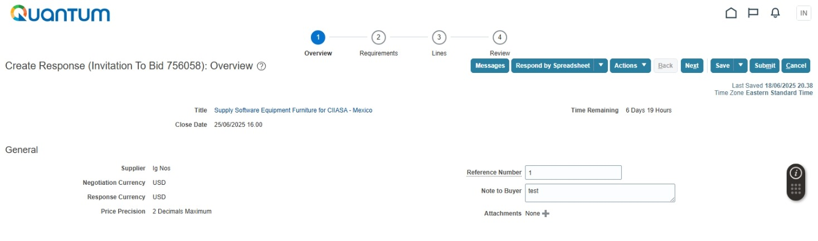
STEP 3. In the screen illustrated on this page, please click ‘Next’.

Slide 24
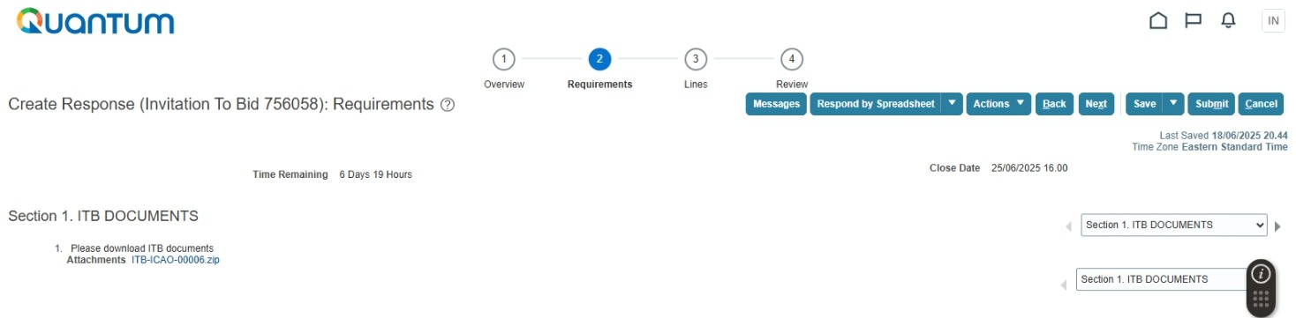
STEP 4. From the drop-down menu in the screen illustrated below, please select ‘Section 2. Documents to Upload’.

Slide 25
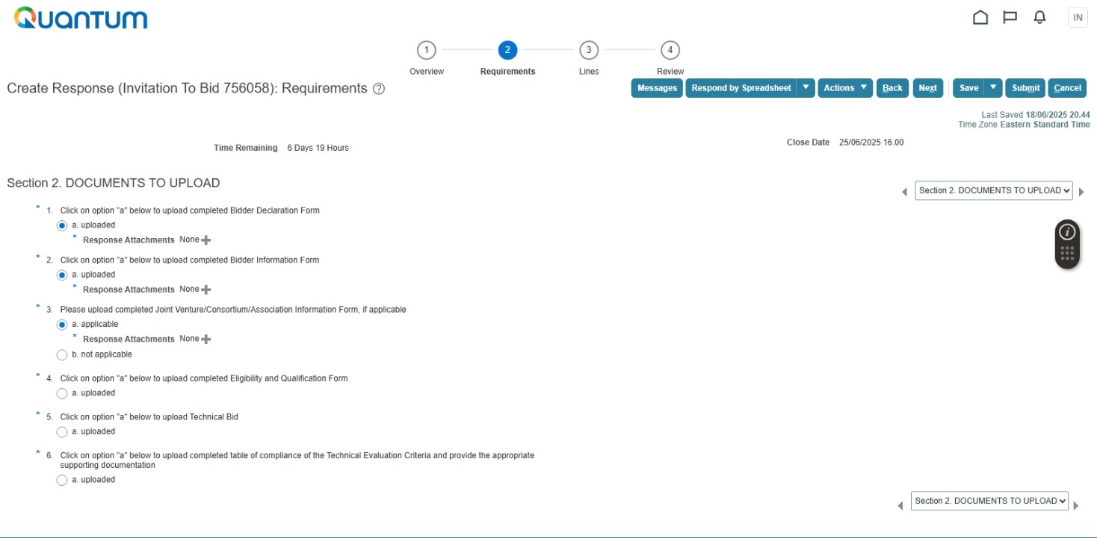
STEP 5. In the screen shown on this page, select a category of required documents to upload (by clicking in the circle).
STEP 6. Once the line ‘Response Attachments None’ appears, click ‘ + ’. This will bring a pop-up window for uploading attachment(s), as shown on the next page.

Slide 26
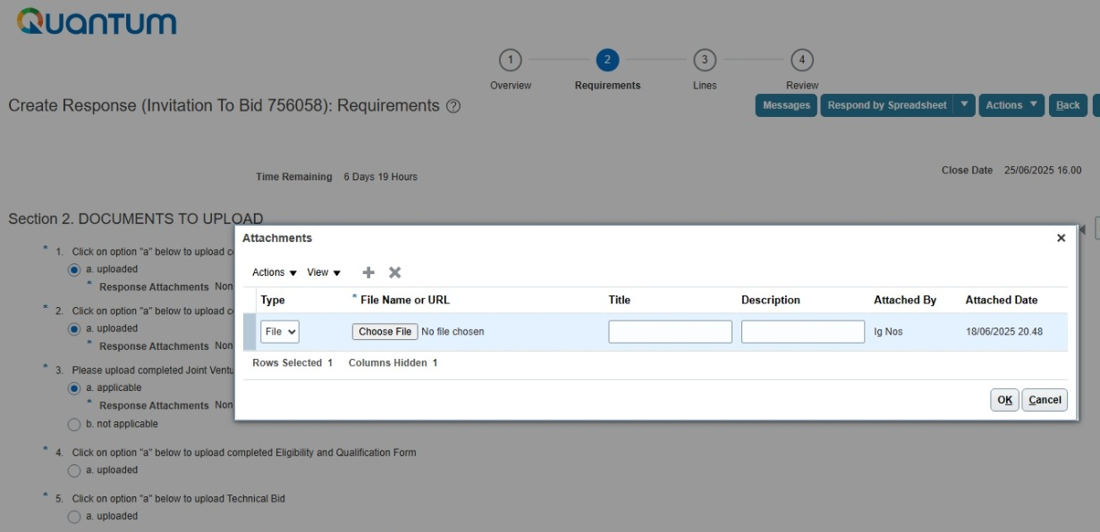
STEP 7. In the pop-up window shown below, you need to click ‘Actions’, which will open a drop-down menu.
STEP 8. In the drop-down menu, please click ‘Add’. This will add a line to select a file for uploading. You can see such line with a blue background in the illustration below.
STEP 9. Click ‘Add ’ again to add one more file in the same category of documents. This can be repeated multiple times, if you need to upload many documents in the same category.
STEP 10. Click ‘OK’, once you have finished selecting files.
STEP 11. Repeat Steps 5 – 10 for all other categories of documents to upload.

Slide 27
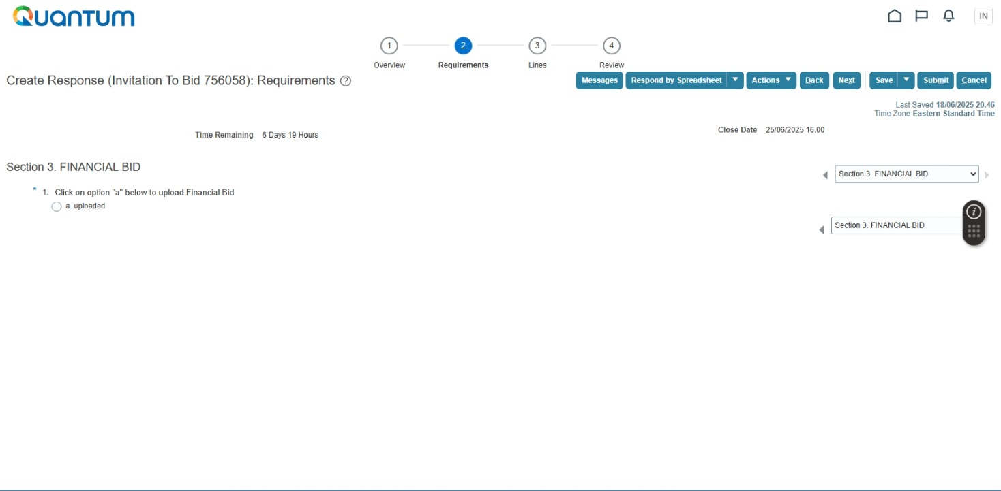
STEP 12. From the drop-down menu on the right, please select select ‘Section 3. Financial Bid’ to upload Financial Proposal. This action will open a separate screen shown at the lower part of this page.
STEP 13. Upload your Financial Proposal, as described in the Steps 5 – 10 above.
STEP 14. Click ‘Next’.
STEP 15. Fill in pricing information on the line(s), as / if requested in the tender.
STEP 16. Once finished, please click ‘Submit’.

Slide 28
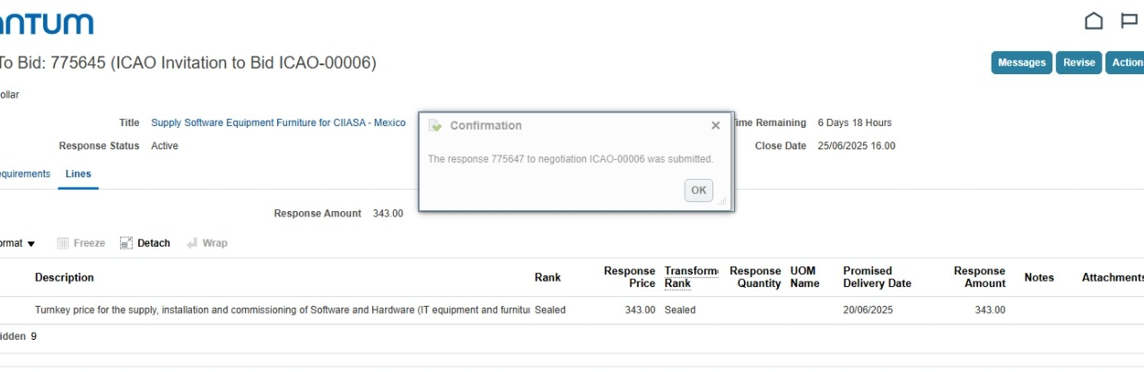
THE BELOW DIALOGUE BOX CONFIRMS THE SUCCESSFUL SUBMISSION OF YOUR TENDER / BID /QUOTATION.

Slide 29
MODIFY TENDERS / BIDS / QUOTATIONS – STEP-BY-STEP
STEP 1. To modify an already submitted tender / bid / quotation at any time before the submission deadline, click ‘Manage Responses’ in the main menu webpage and then select the tender in the next screen, as described in Step 7 of the above Section ‘FIND TENDERS AND DOWNLOAD TENDER DOCUMENTS – STEP-BY-STEP’ (page 12).

Slide 30
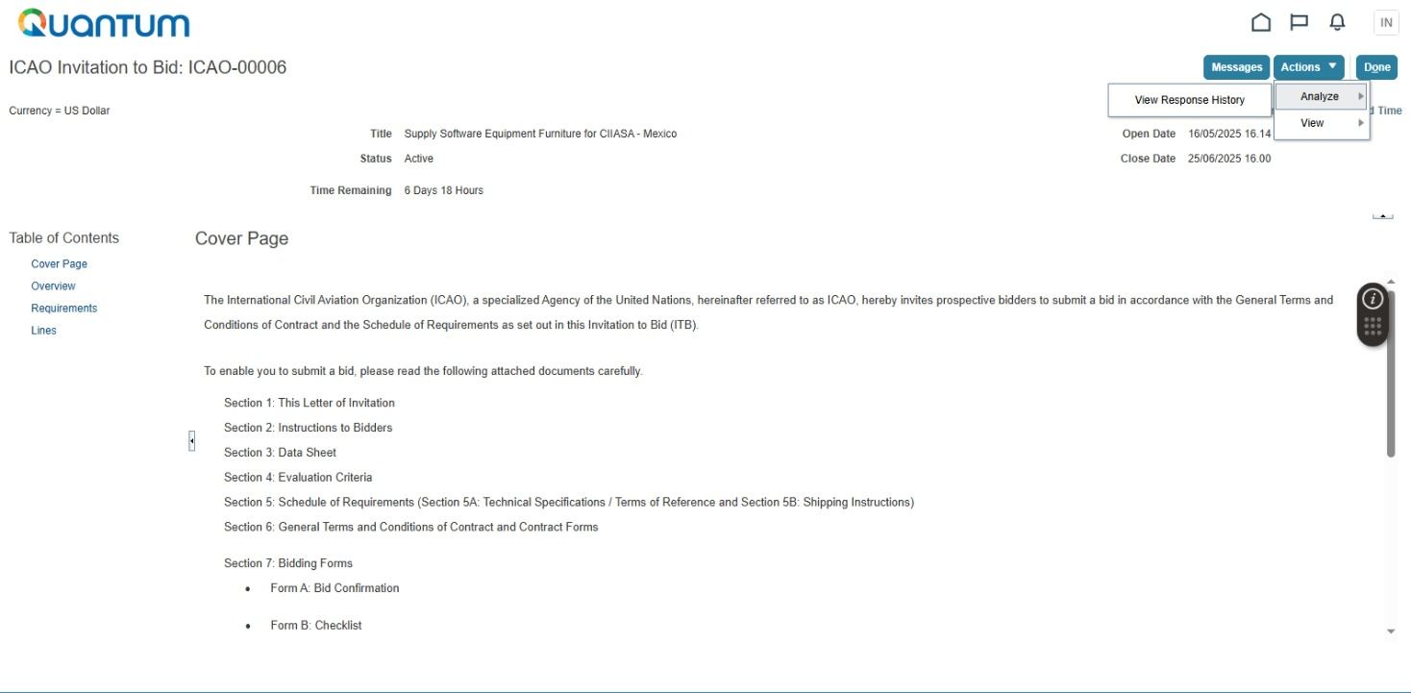
STEP 2. In the tender webpage, please click ‘Actions’, then - ‘Analyze’, and then - ‘View Response History’.

Slide 31
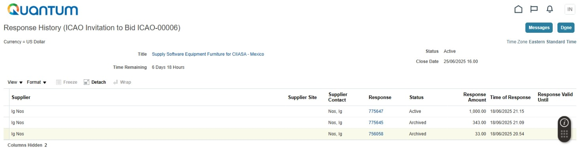
STEP 3. In the ‘Response History’ page, please select (click) the ‘Response’ to modify. ‘Response’ stands for tender / bid / quotation. If you have not modified your tender / bid / quotation before, there would be only one line in the below screen. In the below example, the ‘Response’ has already been modified twice. The last version of your ‘Response’ is the ‘Active’ one.

Slide 32
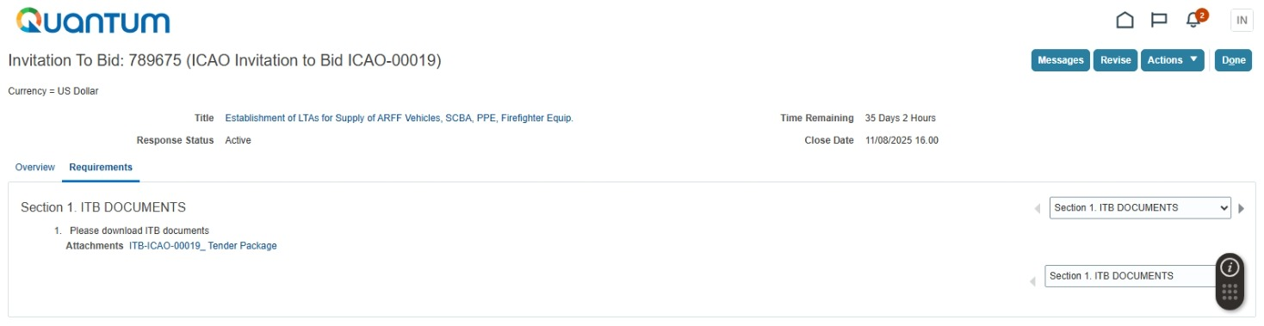
STEP 4. In the below screen, click ‘Revise’.

Slide 33
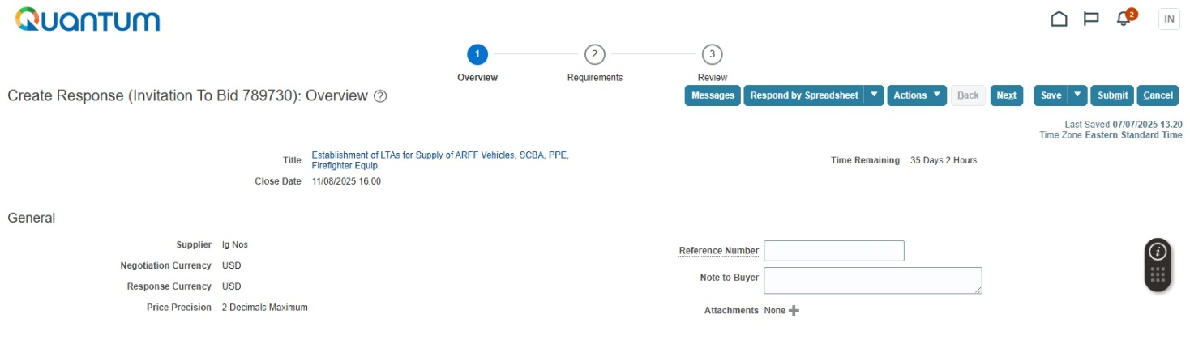
STEP 5. In the below screen, please click ‘’Next’.

Slide 34
STEP 5. In the below screen, select ‘Section 2. Documents to Upload’ or ‘Section 3. Financial Bid’

Slide 35
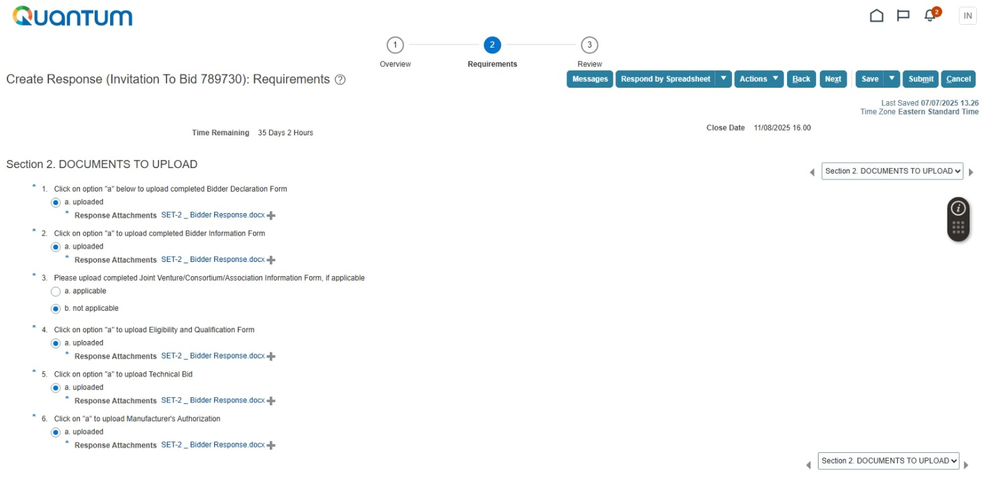
STEP 6. Modify your tender / bid / quotation by deleting the documents from and adding them to the ‘Section 2. Documents to Upload’ and/or ‘Section 3. Financial Bid’, like you did when you initially uploaded them when you first created your tender / bid / quotation (please refer to Steps 6 – 10 of the above Section ‘SUBMIT TENDERS / BIDS / QUOTATIONS – STEP-BY-STEP’ – pages – 25 – 26). Please only click on the ‘ + ’ sign to add or replace a document (not on the link to that document).

Slide 36
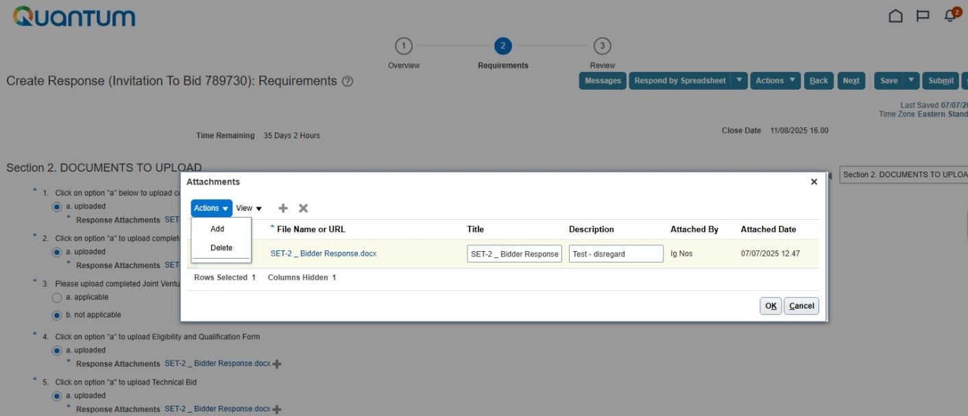
TO MODIFY / REPLACE A FILE, YOU NEED TO FIRST HIGHLIGHT A RESPECTIVE LINE BY CLICKING ANYWHERE IN THAT LINE (EXCEPT FOR THE LINK TO THE DOCUMENT), THEN CLICKING ‘DELETE’, AND THEN – ADDING A NEW FILE.
TO ADD A FILE, CLICK ‘ADD’. THIS PROCEDURE IS DESCRIBED IN THE STEPS 8 – 1O OF THE ABOVE SECTION ‘SUBMIT TENDERS / BIDS / QUOTATIONS – STEP-BY-STEP’ (PAGE 26).
STEP 7. Once finished, please click ‘Submit’. To view your changes, you can always repeat the Steps 2 – 3 above and check the uploaded documents.

Slide 37
IMPORTANT NOTES ON MIGRATED ACCOUNTS:
MIGRATED ACCOUNTS. If a company had ICAO contracts / purchase orders / payments before April 2025, its account is likely to have been migrated from the old ICAO ERP to Quantum. Such company cannot get access to Quantum without ICAO involvement.
HOW TO PROCEED. If you represent one of the companies whose accounts were migrated, please get in touch with ICAO ASAP by sending an email to e-tender@icao.int to initiate the activation of your migrated account. DO NOT TRY TO CREATE A NEW ACCOUNT. In response to your email, ICAO will prompt the Quantum ERP to send (an) automatically generated email(s) to (a) contact person(s) listed in the account. Please click the activation link in such Quantum email to activate your user account. Since you have not registered in Quantum before, you do not have a password yet. The system will request you to set a password. Please note that your login is by default your email address. Activation of user account and setting password are necessary to take part in tenders.
MAKING ACCOUNT CHANGES. Apart from taking part in tenders, companies owning migrated accounts may need to receive payments from ICAO, which are now processed by ICAO through Quantum. Here is the process for making changes in the account / adding any new information after the account activation:
Please kindly proceed to ‘Manage Profile’ (the lowest item in the main menu on the left side of the screen in your account);
Then click ‘Edit’ in the upper right corner of the screen; a pop-up window will appear; after clicking ‘Yes’ in the pop-up window, you will be able to change any parts of your profile.
To change banking information, please go to ‘Payment Methods’ Tab, make any necessary modifications, then to ‘Bank Accounts’ Tab; when you enter your banking info in the ‘Bank Accounts’ Tab, please show your main bank account information in the main (upper) section of the ‘Bank Accounts’ tab, and the Intermediary Bank info (if any) – below in the section for additional information. Please do not enter any currency in the ‘Currency’ Field of the ‘Bank Accounts’ Tab (any payments would in any case be done in the currency of contract / invoices). Please also make sure to attach any necessary supporting documents confirming your banking information in the ‘Attachments’ sub-Section of the ‘General’ Section of the ‘Organization Details’ Tab.
At the end, you need to click the “Review and Submit” button, and NOT ‘Save and Close’. ICAO will not be able to approve the changes, until you resume editing and click “Review and Submit”.
You can always re-enter the editing mode to modify your account by following the above instructions. However, if you need to make any changes before the earlier ones are approved by ICAO, you will need to cancel changes first, before making further modifications.

Slide 38
Questions*?
Contact ICAO Procurement Section e-tender@icao.int
*ONLY QUESTIONS OF GENERAL NATURE, SUCH AS QUESTIONS ON ACCESS / DOWNLOAD / UPLOAD ISSUES, CAN BE ADRESSED TO E-TENDER@ICAO.INT. SUCH EMAILS ARE ANSWERED AS QUICKLY AS POSSIBLE, WITHIN A FEW STATUTORY WORKING DAYS IN QUEBEC, CANADA. QUESTIONS RELATED TO THE MATTER OF A TENDER, ANY SPECIFICATIONS, OR ANY TENDER REQUIREMENTS, SHALL BE UPLOADED TO THE E-PROCUREMENT PORTAL, AS DESCRIBED ABOVE IN THIS INSTRUCTION.

