Slide 1
TAG/TRIP/5

Slide 2
ACTIVITIES OF THE NEW TECHNOLOGIES WORKING GROUP (NTWG)
Dr. Uwe Seidel, NTWG Chair
Day [#]

Slide 3
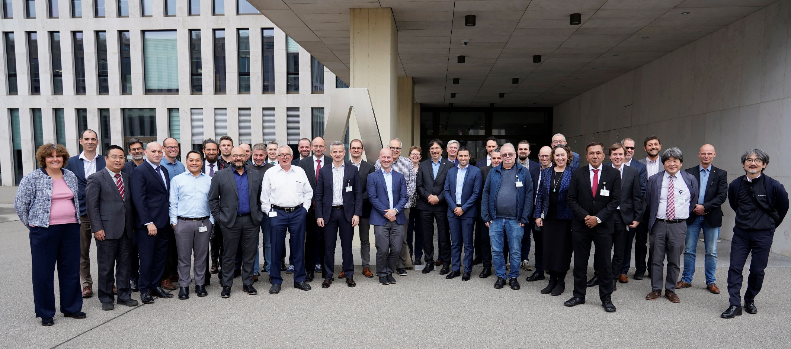
WP/19 - REPORT OF THE NEW TECHNOLOGIES WORKING GROUP
Bern, Oct. 2025

Slide 4
Updates since TAG/TRIP/4 (Oct. 2023)
Four Physical Meetings (thanks to all the hosts):
Tokyo, Japan (April 2024)
Copenhagen, Denmark (September 2024)
Ottawa, Canada (May 2025)
Bern, Switzerland (October 2025)
One Virtual meeting – September 2025 to prepare TAG
Since May 2019, Dr. Uwe Seidel of Germany holds the position of Chairman of the NTWG.
This presentation acts as a „bracket“: → NTWG will present for consideration 17 Working Papers (WPs) and 4 Information Papers (IPs)
This massive workload of mostly complex technical issues is the result of a extraordinary co-operation between many government and ISO colleagues, usually on top of a day-job. This is the right time and the place to express my gratitude to all of them!

Slide 5
NTWG update - Table of Content 1/2
IP/WP no. | Title | Presented by
IP01 | NTWG REQUEST FOR INFORMATION (RFI) 2024 | Mr. Seidel (D)
IP02 | ISO/IEC 39794-5 APPLICATION PROFILE INTEROPERABILITY TESTS | Mr. Rajeshkumar (ISO)
IP03 | FEASIBILITY OF A PASSPORT CARD - POLICY DOCUMENT WITH GUIDING CORE PRINCIPLES | Mr. Seidel (D)
IP04 | DEVELOPMENTS PERTAINING TO NAMING CONVENTIONS AND MACHINE READABLE TRAVEL DOCUMENTS | Mr. Thomas (USA)
WP03 | REVISION OF DOC 9303, MACHINE READABLE TRAVEL DOCUMENTS, 9TH EDITION | Mr. Urmann (ISO)
WP04 | REVIEW OF MANDATORY AND OPTIONAL DATA ELEMENTS USED IN MRTDS | Mrs. Cartrysse (NLD)
WP05 | TECHNICAL CHANGES TO THE 9TH EDITION OF DOC 9303 PARTS 3, 4, 5, 7, AND 8 | Mr. MacManus (ISO)
WP06 | ADDITIONAL TD1 AND TD3 LAYOUTS, VERSION 2.1 | Mr. MacManus (ISO)
WP07 | DOC 9303, PART 10, EIGHTH EDITION, AMENDMENT 2 | Mr. Rajeshkumar (ISO)
WP08 | HANDLING OF EMRTDS WITH A DEFECT IN CHIP AUTHENTICATION AND CLARIFICATION ON TERMINAL AUTHENTICATION | Mr. Hoppe (D)

Slide 6
NTWG update - Table of Content 2/2
IP/WP no. | Title | Presented by
WP09 | REVIEW OF CRYPTOGRAPHIC KEY LENGTHS IN DOC 9303 | Mr. Hoppe (D)
WP10 | DEPRECATION OF 3DES (DOC 9303 – PART 11) AND DSA (DOC 9303 – PART 12) | Mr. Hoppe (D)
WP11 | DIGITAL TRAVEL CREDENTIAL (DTC) POLICY UPDATE | Mr. Hansson (FIN)
WP12 | REVISION OF TECHNICAL REPORT RF PROTOCOL AND APPLICATION TEST STANDARD FOR EMRTD - PART 3 TESTS FOR APPLICATION PROTOCOL AND LOGICAL DATA STRUCTURE | Mr. Nakamura (ISO)
WP13 | ICAO DATA STRUCTURE FOR BARCODES (IDB) | Mr. Rajeshkumar (ISO)
WP14 | REVISION OF TECHNICAL REPORT RF AND PROTOCOL TESTING - PART 4 CONFORMITY TEST FOR INSPECTION SYSTEM | Mr. Nakamura (ISO)
WP15 | PHYSICAL TEST METHODS FOR TD1 SIZE MRTDS | Mr. Nakamura (ISO)
WP16 | UPDATE OF THE PHYSICAL CHARACTERISTICS FOR MRTDS | Mr. Nakamura (ISO)
WP17 | FUNCTIONAL REQUIREMENTS FOR INSPECTION SYSTEMS | Mr. Rajeshkumar (ISO)
WP18 | QUANTUM SAFE MECHANISMS FOR THE DOCUMENT ISSUING PKI AND PASSIVE AUTHENTICATION | Mr. Hoppe (D)
WP19 | REPORT OF THE NEW TECHNOLOGIES WORKING GROUP | Mr. Seidel (D)

Slide 7
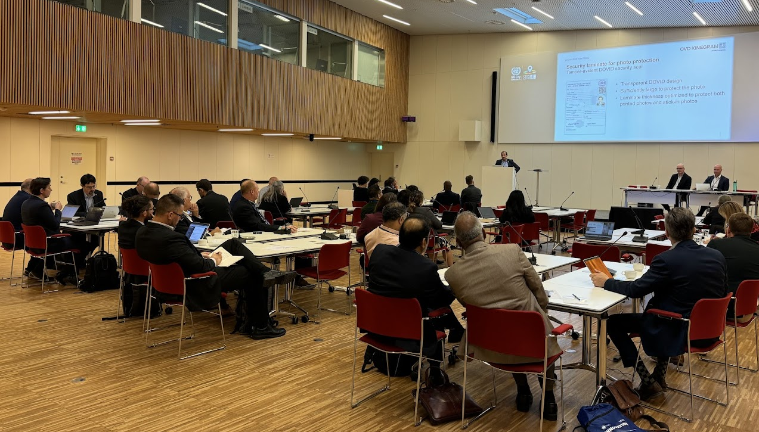
IP/1 -NTWG REQUEST FOR INFORMATION (RFI) 2024
Copenhagen, Sept. 2024

Slide 8
Background
The NTWG regularly NTWG issues and organizes an RFI to capture global innovations in secure travel document systems.
The RFI typically occurs every three years and focuses on capturing global innovations in secure travel document systems and related fields of technology.
The RFI keeps NTWG representatives updated on the latest specifications, developments, and implementation of new tools, systems, and technologies.
Collaboration with experts and stakeholders enhances travel programs and supports improvement of global travel.

Slide 9
2024 RFI – 1/2
This RFI was released for international response in March 2024 and closed for submissions in May 2024.
The RFI emphasized three main themes:
Increasing the security and issuance process of the passport book or travel card;
Leveraging existing eMRTD capabilities; and
Future forms of eMRTD and associated systems.
The RFI attracted 40 submissions (summary papers/proposals) from 24 vendors.
The NTWG review committee, comprising Members from Australia, New Zealand, the Netherlands, Japan, Germany, Iceland, and Switzerland, selected 28 proposals from 17 vendors for presentation to NTWG government members and state officials.
The RFI presentations were held at UN City Copenhagen over two days in a hybrid format with 79 participants from 20 states and government organizations attending.

Slide 10
2024 RFI – 2/2
Presentations provided important information on key areas of interest:
Advancements in passport construction materials and physical security techniques
The use of image-based barcodes containing traveler data and biometrics
Advancements in contactless, automated biometric capture technologies
The integration of eMRTDs with national digital identity schemes
The emergent threat of quantum computing and mitigation strategies
Border control performance issues: image quality and chip readability
Advancements in techniques to counter image morphing and spoofing

Slide 11
Action by the TAG/TRIP
TAG/TRIP is invited to note NTWG workstreams emerging from the RFI
Post-Quantum Cryptography: Technical and operational responses for maintaining eMRTD cryptographic integrity
Open Face Image Quality Score (OFIQ): Tracking the development of a standard for assessing photo quality compliance
MRTD and eMRTD Data Elements: Review of optional and mandatory elements to support new form factors
Digital Travel Credentials: Continued standardization of DTC including transmission protocols and wallet integration
TAG/TRIP is invited to note
The RFI represents a continuation of NTWG efforts to advance travel facilitation and
the NTWG aims to harness emerging technologies to elevate security, efficiency and interoperability of global travel process.

Slide 12
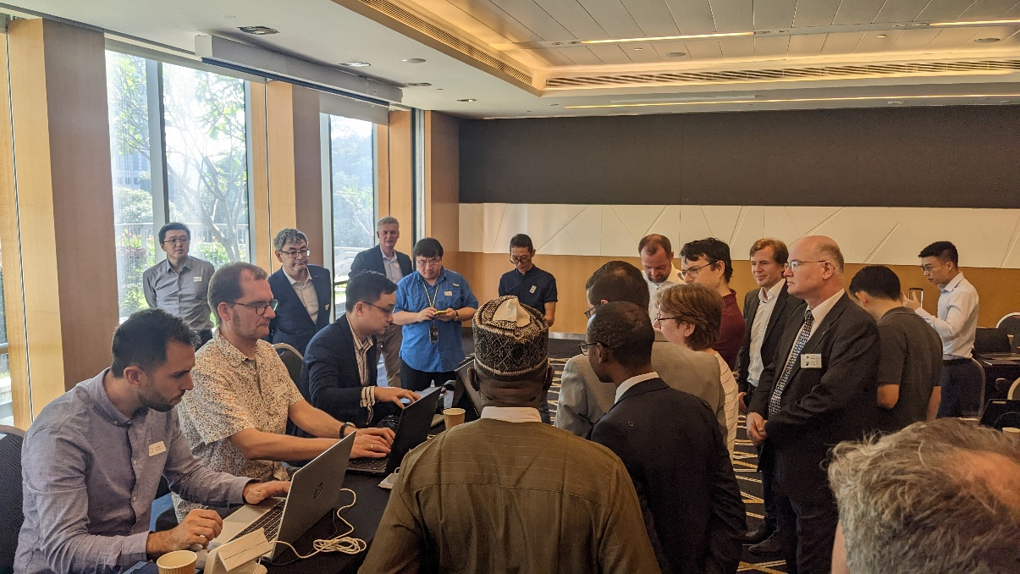
IP/2 - ISO/IEC 39794-5 Application Profile Interoperability Tests
Interop-Test, Singapore, Feb. 2025

Slide 13
Background
TAG/TRIP/4-WP14 agreed on the following timelines for transitioning from 19794-5 to 39794-5 Application Profile (AP) for encoded DG2 in the eMRTDs.
Inspection Systems MUST be able to handle ISO/IEC 39794-5 AP data by 1-2-2026.
Between 2026 and 2030, passport issuers can use the data formats specified in ISO/IEC 19794-X:2005 or in ISO/IEC 39794-X during a five-year transition period.
From 1-1-2030 on, passport issuers MUST use ISO/IEC 39794-5 AP for encoding biometric data.
This is the biggest change since the introduction of eMRTDs and requires extensive interoperability and conformance testing.

Slide 14
Details
SC17/WG3 formed a volunteer group to conduct interop tests
Test tools
A reference implementation of Inspection System that can handle both 19794-5 and 39794-5 AP encoded DG2 to test conformance of eMRTD samples
A set of reference cards with positive and negative test cases to test the conformance of eMRTD samples
Two emulator based test environments to test conformance of eMRTD samples and Inspection systems
A silver data set to demonstrate correct encoding using 39794-5 AP was created and published to SC17/WG3 github site
Two events held
Sydney (October 2024) - 13 eMRTD conformance testing, 12 Inspection System testing
Singapore (February 2025) – 10 eMRTD conformance testing and 10 Inspection System testing
Participants were informed of the non-conformance found and remedial measures

Slide 15
Details
In Sydney
25% of eMRTD samples were correctly encoded
Inspection Systems were able to read and display images from 79% of correctly encoded reference cards and 37% from the negative tests
In Singapore
82% of the eMRTD samples were correctly encoded
Inspection Systems were able to read and display images from 95% of the correctly reference cards, and 62% of the negative tests
In view of continued need to ensure readiness of both Issuing Authorities and Inspection Systems before the deadline, a third interop test will take place in Montreal in November 2025.

Slide 16
Action by the TAG/TRIP
TAG/TRIP is invited to note
This effort by NTWG and SC17/WG3 to ensure readiness of the eMRTD issuers and Inspection Systems for the transition to 39794-5 Application Profile

Slide 17
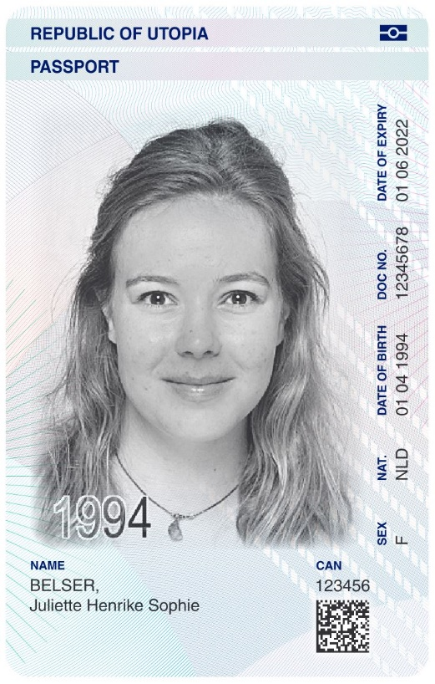
IP/3 - FEASIBILITY OF A PASSPORT CARD – POLICY DOCUMENT WITH GUIDING CORE PRINCIPLES
Illustration of a potential passport card (NLD)

Slide 18
Background
Due to increasing digitalization (including DTC, ETA, eVisa, and electronic entry and exit stamps) and a corresponding decline in paper versions, the use of additional pages is steadily declining, especially on major routes with high travel volume and in states with many frequent travelers.
The current trend is that travelers often can travel without a visa (visa waiver), or can make use of electronic visas (e-visas) and that physical entry and exit stamps are replaced by electronic registrations in databases.
This observation led to consideration of whether and eMRTD in card form (TD1 format) is feasible.
The passport card shall contain the same data (visual and in the chip) as the holder page of a passport booklet (Doc 9303-04).
To explore the feasibility of the Passport Card in such a context, the NTWG established a subgroup at its 2024 meeting in Tokyo, Japan.

Slide 19
Details
The sub-group established a policy paper “Feasibility of a Passport Card (PC): Draft Policy Document with Guiding Core Principles” - see appendix to the IP.
The current version
describes the background behind the introduction of a TD1 size passport card;
sets out the guiding core principles for the development and usage of a TD1 size passport, card;
explains potential benefits associated with the introduction of a TD1 size passport card; and
explores differences, limitations and key considerations by using a TD1 size passport card instead of a passport booklet.
It is envisaged that the passport card will co-exist with a traditional passport booklet (TD3 format) and potentially with a DTC.

Slide 20
Action by the TAG/TRIP
TAG/TRIP is invited to note
This effort by NTWG to define the policy surrounding the potential issuance of a TD1 size passport card with a possibility of creating technical specifications in the future.

Slide 21
IP/4 - NAMING CONVENTIONS AND MACHINE READABLE TRAVEL DOCUMENTS

Slide 22
Background
Doc 9303 requires names to be split between a Primary Identifier and a Secondary Identifier.
The Primary Identifier is intended to be a family name, surname, lastname etc.
The Secondary Identifier is intended to be a first name.
In cases where such a clean separation is not possible, the entire name is to be written into the primary identifier and the secondary identifier is to be left blank.
Naming conventions based on the norm in different cultures do not fit in neatly with the specifications contained in Doc 9303 and lead to non-conformance issues.
A sub-group has been formed to analyze cultural norms in naming conventions with an intention to either provide guidance on conformance to Doc 9303 or a revision of Doc 9303.

Slide 23
Details
Currently three (main) cases have been identified by the sub-group
Mononymous names (often in south and southeast Asia)
A name composed only by one word.
Inclusion of maiden surnames (often in Western societies)
After marriage, one partner assumes the spouse’s surname.
Inclusion of Mother’s maiden surnames (often in southeast Asia)
The mother’s maiden surname is often intrinsically tied to the holder’s identity.
NTWG Naming Conventions subgroup intends to collect more data from ICAO member states pertaining to issues related to Doc 9303 compliance and naming conventions through an ICAO-sponsored survey, regional focus groups, and stakeholder engagement.
Once more data is collected from travel document issuing authorities and border experts, the subgroup will analyze the data and find common trends.
From there, the NTWG will determine the most appropriate approach to reducing possible cases of non-compliance from naming conventions, most likely through revisions to Doc 9303 and the publication of new guidance material to clarify common issues.

Slide 24
Action by the TAG/TRIP
TAG/TRIP is invited to note
This effort by NTWG to investigate issues between ICAO Doc 9303 naming requirements and cultural naming conventions.

Slide 25
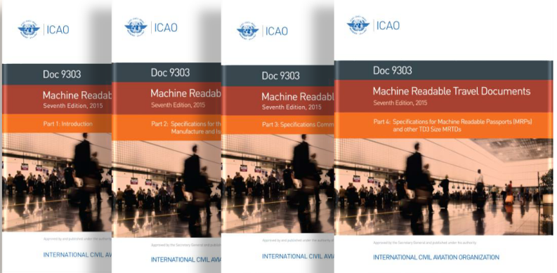
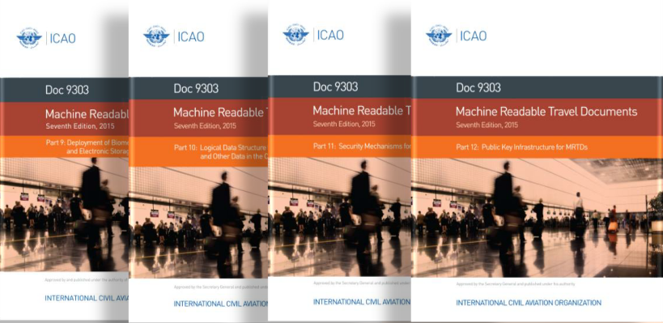
WP/3- REVISION OF DOC 9303, MACHINE READABLE TRAVEL DOCUMENTS, 9TH EDITION

Slide 26
Background
TAG/TRIP/3, in its 2020 pre-session, endorsed the 8th edition of Doc 9303 in its format of thirteen parts. The 8th Edition was published in 2021 and subsequently several parts were amended.
A new edition of Doc 9303 is issued on average every 5 years.
Approved technical reports are integrated into the current edition of Doc 9303 to form the new edition.
Drafting of the 9th edition started after NTWG approval in February 2024.

Slide 27
Details
The 9th Edition of Doc 9303 will have a new part 14 “Biometrics”to cover the ISO/IEC 39794-x encoding of biometrics: DG2 (face), DG3 (finger) and DG4 (iris).
Part 6 – TD2 size MROTDs will be removed as these specifications are no longer being used.
Part 13 is renamed from Visible Digital Seals to ICAO Data Structure for Barcode (IDB).
Following technical reports are being incorporated into the 9th Edition of Doc 9303
Additional TD1 layout specifications for Machine Readable Official Travel Documents (MROTDs)
Digital Travel Authorizations
Digital Travel Credentials (DTC) Virtual Component Data Structure and PKI Mechanisms
Digital Travel Credentials (DTC) Physical Component and Protocols
ICAO Data Structure for Barcode
ISO/IEC 39794-5 Application Profile for eMRTDs
VDS-NC Visible Digital Seal for non-constrained environments

Slide 28
Details
Most changes are editorial or of clarifying nature. Technical changes, if any, are discussed and approved by NTWG. Changes include:
The use of capitalized keywords in parts 2 to 8 to remove ambiguity with a view to support preparation of functional test specifications
Harmonization of terminology throughout Doc 9303, and consistency with terminology of Annex 9
In part 13, VDS and VDS-NC are moved to informative appendices, and the specifications for ICAO Data Structure for Barcode (IDB) is adopted in the normative part. VDS and VDS-NC may be deprecated in a future edition of Doc 9303.
Redundant specifications are consolidated throughout Doc 9303.
Certain parts of the specifications are restructured, in particular parts 2, 7 and 8, with a view to improve readability of the parts and adopt the current technology.
A first review of some of the 9th edition drafts has been performed by the editors of Doc 9303, editors of ICAO test specifications, and review group consisting of NTWG and SC17/WG3 experts.
In 2026, two review cycles for the complete set of Doc 9303, 9th Edition drafts, which incorporate the technical changes for the 9th edition endorsed by TAG/TRIP/5, are planned. These reviews will be conducted by ICAO NTWG and ISO/IEC JTC 1/SC 17/WG 3.
The final Doc 9303, 9th Edition drafts will be presented to TAG/TRIP/6.

Slide 29
ICAO Doc 9303 editors and co-editors
Doc 9303 Part | Editor | Co-Editor
1 - Introduction | Jens Urmann | R Rajeshkumar
2 - Security of the Design, Manufacture & Issuance of MRTDs | Patrick Beer | Christian Weigand
3 - Specifications Common to all MRTDs | Mike Neumann | Ewout Rensen
4 - Machine Readable Passports (MRPs) & other TD3 Size MRTDs | Dwight MacManus | Laurence Suzzarini
5 - TD1 Size Machine-Readable Official Travel Documents (MROTDs) | Dwight MacManus | Laurence Suzzarini
7 – Machine-Readable Visas | Patrick Beer | Christian Weigand
8 - Emergency Travel Documents | Mike Neumann | Ewout Rensen
9 - Deployment of Biometric Identification & Electronic Storage…. | R Rajeshkumar | Jens Urmann
10 - LDS for Storage of Biometrics & Other Data in the Contactless IC | Mark Stafford | Jurijus Cizas
11 - Security Mechanisms for MRTDs | Michael Hoppe | Jens Urmann
12 - Public Key Infrastructure for MRTDs | R Rajeshkumar | Andy Hing
13 - ICAO Data Structure for Barcode” (IDB) | Andy Hing | Wei Ren Kwan
14 - Biometrics | R Rajeshkumar | Andy Hing
15 – Functional Requirements for Inspection Systems | R Rajeshkumar | tbd

Slide 30
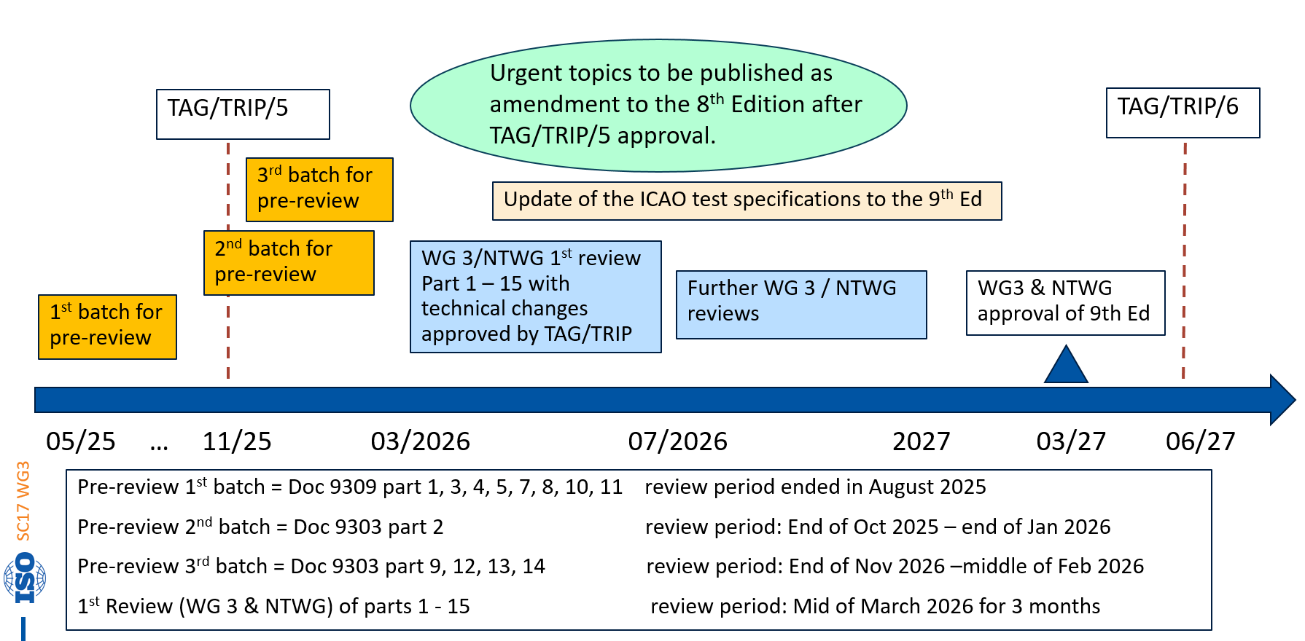
ICAO Doc 9303 9th Edition – Tentative Schedule

Slide 31
Action by the TAG/TRIP
The TAG/TRIP is invited to:
recognize the work of the editorial team ISO/IEC JTC 1/SC 17/WG 3/TF2 working on the 9th Edition; and
endorse the proposed changes to the structure of Doc 9303 and the changes to the content of Doc 9303 described in section 3 as well as the schedule presented in section 4 of the working paper.

Slide 32
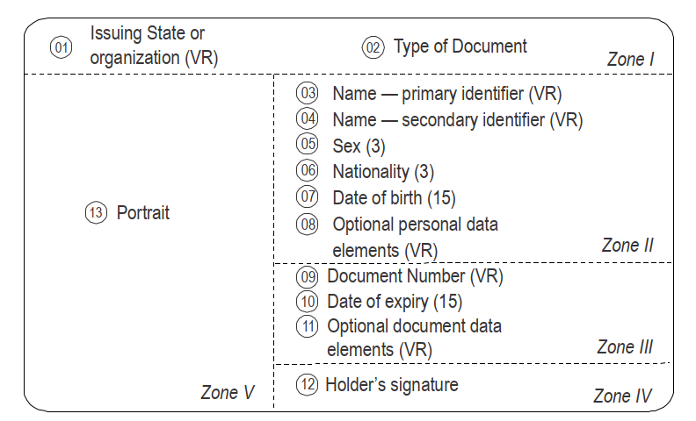
WP/4 - REVIEW OF MANDATORY AND OPTIONAL DATA ELEMENTS USED IN MRTDS
Doc 9303 Part 5, data elements

Slide 33
Background
NTWG in co-operation with ICBWG has established a subgroup to analyze data elements defined in Doc 9303, to check for their continued relevance and updates if necessary.
The group has identified changes that are amendments to the current 8th edition of Doc 9303 and also changes intended to be incorporated into the 9th edition of Doc 9303.

Slide 34
Details
Amendments to 8th edition of Doc 9303
Data group 11 provides additional personal details and data group 12 additional document details.
Rule for DG 11 and 12:
If the data element is mandatory on the VIZ then it is recommended for the chip
If the data element is optional and is personalized and present on the VIZ, then the data element is recommended for the chip
If the data element is Optional on the VIZ, then it will be decided case by case if the data element in the chip is optional or recommended
For DG11:
Name of Holder, Other name(s), full date of birth, place of birth are changed from Optional to Recommended
Title, Personal Summary and Proof of citizenship are changed from Conditional to Optional
For DG12:
Issuing Authority and Date of Issue are changed from Optional to Recommended

Slide 35
Details
Amendments to 9th edition of Doc 9303
Changes to Part 5 of Doc 9303:
Document Number is in zone III. For 9th edition, proposed change is to locate the Document Number in Zone I or Zone III. For readability reasons, the RECOMMENDED practice is to locate Document Number and the caption “Document Number” in Zone I.
Date of Issuance is not specified for TD1. In case an issuing State or organization wants to have the optional data element “Date of Issuance” personalized on the TD1 format, this shall be located either in Zone III or Zone VI.
Place of Birth is not specified for TD1. In case an issuing State or organization wants to have the optional data element “Place of Birth” personalized on the TD1 format, this shall be located either in Zone II or Zone VI.
Changes to Part 4 and 5 of Doc 9303 – holders signature
To provide more options when designing the document, the location of the signature is expanded to the adjacent page or to the back of the data page for TD3 document format. For the TD1 document format, Zone VI is added.
Changes to Part 3 - it is RECOMMENDED that the issuing States or organizations include besides French, Spanish or English, a maximum number of two official or working languages in the VIZ’s data elements – previously, there was no limitation on number of languages.

Slide 36
Details
Work in progress
Holder’s signature:
To find out if the holder’s signature should remain mandatory, a survey will be spread to the Member States. The ICAO New Technology Working Group (NTWG) will analyze the results of this questionnaire when determining whether the passport data page and /or ID card specifications should be changed.
The date of issuance and the version of the travel document are relevant to determine whether a specific change in the personalization has been applied or not (e.g. whether the document code denotes the national code or the harmonized code of Doc 9303) if that is known for a certain country.
The version of the travel document is particularly relevant for the security features to be authenticated by optical machine authentication.
The (optional) inclusion of this information in the MRZ will need further discussions in the subgroup.

Slide 37
Action by the TAG/TRIP
The TAG/TRIP is invited to:
take note of the content of this paper;
endorse the proposed changes in Section 2 of the WP as an amendment to the 8th Edition of Doc 9303;
endorse the proposed changes in Section 3 of the WP for the 9th Edition of Doc 9303; and
give endorsement to proceed with the ongoing work of the Mandatory and Optional data element subgroup.

Slide 38
WP/5 - TECHNICAL CHANGES TO THE 9TH EDITION OF DOC 9303 PARTS 3, 4, 5, 7, AND 8

Slide 39
Background
As part of the drafting of the 9th edition of Doc 9303, a few technical changes were found to be necessary by NTWG.
Related documentation:
WP/4: Selected technical changes will also be introduced as an amendment to the 9th edition, as detailed in WP/4 ‘Review of Mandatory and Optional fields used on MRTDs’.
WP/6: The Technical Report entitled ‘Additional TD1 and TD3 Layout Specifications for Machine Readable Travel Documents v2.1’ provides additional guidance for the introduction of an 2D-barcode (IDB) within a passport data page.
This working paper WP/5 is focused on the technical changes which are exclusively planned for the 9th edition.

Slide 40
Details
As part of the drafting of the 9th edition of Doc 9303, a few technical changes were found to be necessary.
Empty fields in the Visual Inspection Zone
Part 3: Captions SHOULD NOT appear when an optional field is not populated. Similarly, an asterisk (*) is RECOMMENDED when a secondary identifier is not present.
Use of oblique character (/)
Part 3: The issuing State or organization MAY include a blank space before and after the oblique character (/) which separates the entries in the different languages in the Visual Inspection Zone (VIZ).
Parts 3, 4, 5, 7 and 8: The data elements ‘issuing State or organization’ and ‘document’ in zone I of the VIZ MAY use a different separator instead of separating the entries using the oblique character (/).
Document Number format
Part 3: Mandatory requirement to ensure that document numbers SHALL NOT include intentional spaces and/or unintentional gaps when pre-numbered. This change will mitigate issues reported by States and carriers to the ICBWG non-compliance subgroup.
Removal of fingerprint images in Parts 3, 4, 5 and 7: not interoperable and outdated practise
Data Page on an inside cover page – removed in 9th edition as it is considered not secure.

Slide 41
Action by the TAG/TRIP
The TAG/TRIP is invited to:
take note of the technical changes intended for the 9th edition of Doc 9303, Parts 3, 4, 5, 7 and 8; and,
approve the cited changes in Section 3 of the WP for inclusion in the 9th edition.

Slide 42
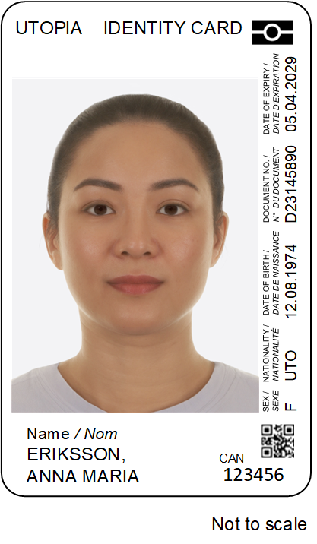
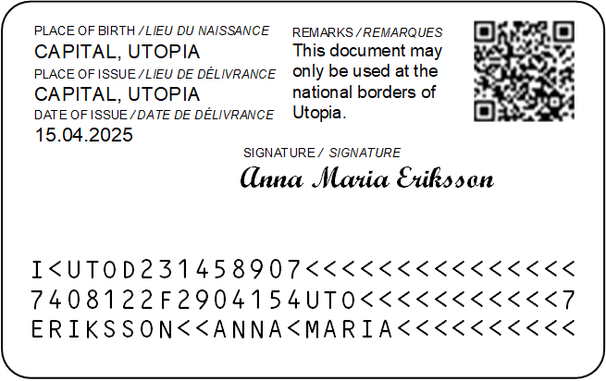
WP/6 - ADDITIONAL TD1 AND TD3 LAYOUTS, VERSION 2.1
Additional TD1 layout specifications for MROTDs

Slide 43
Background
TAG/TRIP-4 endorsed the additional layouts for TD1 size documents (refer TAG/TRIP4/WP/17)
The specifications were published as a Technical Report and it was authorized for inclusion in Part 5 of the 9th edition.
During the incorporation into the 9th edition, it was evident that some additional layout specifications should be incorporated in the 9th edition, leading to an updated version of the TR.
Furthermore, guidance related to the inclusion of the IDB within the TD3 format (MRP) did not exist and required additional clarification.

Slide 44
Details
Changes within the updated Technical Report:
Updated tables related to permissible variations of portrait oriented layout. Zone dimensions remain unchanged.
Added recommendations pertaining to the inclusion of the Card Access Number(CAN) for portrait orientations in Part 5. The updated technical specifications allow for more flexibility within the layout regarding the placement of the CAN and reflect the space constraints on the front side of the TD1 card.
Additional recommendations and technical specifications related to the placement of an IDB within the front and reverse side of the portrait-oriented and landscape oriented TD1 card.
New recommendations and technical specifications related to the placement of an IDB within a TD3 format document.
As the TR now contains recommendations for both TD1 and TD3 layout, the title of the TR is changed from “‘Additional TD1 layout specifications for MROTDs” to “Additional TD1 and TD3 layout specifications for Machine Readable Travel Documents”.

Slide 45
Action by the TAG/TRIP
The TAG/TRIP is invited to:
approve the publication of the revised Technical Report;
instruct the TAG/TRIP Secretariat to publish the updated TR on the ICAO website as a supplement to Doc 9303; and
approve the technical changes detailed within the TR for inclusion in the 9th edition of Doc 9303.

Slide 46
WP/7 - DOC 9303, PART 10, EIGHTH EDITION, AMENDMENT 2

Slide 47
Background
The editorial effort for the 9th edition uncovered several technical issues which necessitate an amendment to the current published 8th Edition of Doc 9303, Part 10, Amendment 1.

Slide 48
Details
The amendments are as follows:
The presence of Data group 11 and Data group 12 will change from OPTIONAL to RECOMMENDED;
Field length restrictions in Data Group 11 shall be removed;
Relevant (normative) sections in Doc 9303, Part10, Appendix B, will be moved to the body of the main text;
Provisions on “polling sequence” will be changed and updated to reflect current industry performance standards, and to RECOMMEND that eMRTD associated Inspection Systems be designed to handle only one eMRTD in the field; and
For both EF.DIR and EF.ATR/INFO change the requirement for a Short File Identifier from optional to OPTIONAL.

Slide 49
Action by the TAG/TRIP
The TAG/TRIP is invited to:
endorse the proposed Amendment No. 2 to the 8th Edition of ICAO Doc 9303, Part 10, Logical Data Structure (LDS) for Storage of Biometrics and Other Data in the Contactless Integrated Circuit (IC); and
instruct the TAG/TRIP secretariat to publish the amended 8th Edition of ICAO Doc 9303, Part 10.

Slide 50
WP/8 - HANDLING OF EMRTDS WITH A DEFECT IN CHIP AUTHENTICATION AND CLARIFICATION ON TERMINAL AUTHENTICATION

Slide 51
Background
This working paper proposes to amend Doc 9303, Part 11, 8th Edition:
Chip Authentication: ISO WG3 has identified eMRTDs in the field that implement Chip Authentication, but do not provide a Chip Authentication Info Security Object as required by the specifications provided in Doc 9303. Consequently, an inspection system which tries to inspect these eMRTDs is not able to retrieve the Chip Authentication cipher suites supported by the respective eMRTD and thus cannot successfully execute the Chip Authentication protocol. Thus, the inspection system cannot verify if the eMRTD’s chip is genuine and the inspection procedure may fail.
Terminal Authentication: Furthermore, ISO WG3 came to the conclusion that the current specification for Terminal Authentication does not sufficiently state how to implement the compression function for public keys in all cases.

Slide 52
Details
Current status:
An investigation by WG3 led to the conclusion that all eMRTDs affected by the defect implement one specific cipher suite. As a workaround, if an inspection system encounters an eMRTD with a missing ChipAuthenticationInfo Security Object, it can still inspect it by using that cipher suite.
Recommended changes to Doc 9303 Part 11
A note on how to handle eMRTDs without a Chip Authentication Info Security Object has been added to Section 8.5 of part 11.
The clarification to the specification for Terminal Authentication for the compression function for public keys has been added in Section 7, and covers all cases.

Slide 53
Action by the TAG/TRIP
The TAG/TRIP is invited to:
endorse the proposed amendment to the 8th Edition of ICAO Doc 9303, Part 11; and
instruct the TAG/TRIP secretariat to publish the amended versions.

Slide 54
WP/9 - REVIEW OF CRYPTOGRAPHIC KEY LENGTHS IN DOC 9303

Slide 55
Background
During its meeting in March 2024, ISO WG3 determined that Doc 9303 currently permits the implementation of cryptographic mechanisms that are no longer considered state-of-the-art.
Consequently, SC17/WG3 initiated a comprehensive review of all the cryptographic algorithms currently included in Doc 9303 (Parts 11,12 and 13)
The review culminated in the Information Paper “Doc 9303 Cryptographic key length review” which provides an inventory of all currently allowed cryptographic algorithms, domain parameters and key lengths in ICAO Doc 9303 (Parts 11, 12 and 13). These are mapped to their respective security strengths.

Slide 56
Details
Key findings of the review:
Implementation of the symmetric cipher 3DES is no longer recommended for future deployments of eMRTDs;
Use of RSA or Finite Field (DH/DSA) key lengths below 2048 bits is no longer recommended for new deployments except for Active Authentication; and
Being prepared for potential future advances in cryptanalysis and ensure future-proof security, algorithms with a security strength of at least 120 bits should be chosen for new deployments where feasible. For existing systems utilizing mechanisms with less than 120-bit security strength, it is recommended to develop a migration strategy towards algorithms with security strength of at least 120 bits, as soon as practicable.
NTWG proposed to make the Information Paper as a Standing Document, that will accompany Doc 9303, which will allow for timely updates when new information is available. The paper is informative and serves as a guidance.
It should be noted that the findings of the Information Paper currently address cryptographic strength with respect to classical computing attacks only, but not to quantum computing.

Slide 57
Action by the TAG/TRIP
The TAG/TRIP is invited to:
take note of the information provided by the Information Paper entitled “Doc 9303 Cryptographic key length review”; and
authorize the ICAO NTWG to publish the Information Paper as an accompanying document for Doc 9303, and to maintain it continuously.

Slide 58
WP/10 - DEPRECATION OF 3DES (DOC 9303 – PART 11) AND DSA (DOC 9303 – PART 12)

Slide 59
Background
Doc 9303 – Part11 (Security Mechanisms for MRTDs) specifies allowed cryptographic mechanisms for the encrypted communication between an eMRTD and an Inspection System, known as Secure Messaging. The latter protects the confidentiality, authenticity and integrity of the transmitted data and offers protection against eavesdropping.
Here, the use of the 3DES block cipher as an encryption algorithm for Secure Messaging is currently allowed.
Doc 9303 – Part 12 (Public Key Infrastructure for MRTDs) specifies allowed signature algorithms for the creation of digital signatures on eMRTD objects used by the eMRTD PKI.
Here, the use of the Digital Signature Algorithm (DSA) as signature algorithm in the CSCA, in Signing keys and, where applicable, Document Security Objects is currently allowed.
The comprehensive review of the cryptographic algorithms currently included in Doc 9303 led to the conclusion that 3DES and DSA are no longer cryptographically secure and should be deprecated.

Slide 60
Details
Current status of 3DES in Doc 9303 – Part 11
Part 11 recommends AES over 3DES. However, AES can only be used with PACE and not BAC. With the TAG/TRIP decision to deprecate BAC by January 1, 2028, all eMRTDs will support PACE and can hence use AES algorithm.
The ISO WG3 and the ICAO NTWG recommend deprecating 3DES from the list of allowed symmetric block ciphers.
The ISO WG3 and the ICAO NTWG recommend preferring AES over 3DES, if both are found on the chip of already issued eMRTDs.
To minimize the burden on issuing authorities, it would be advisable to align the transition periods for the deprecation of 3DES with those for the deprecation of BAC.
This implies that issuing States and organizations will no longer be allowed to issue eMRTDs with 3DES from 1 January 2028 and must ensure that all eMRTDs with 3DES are out of circulation by 1 January 2038.
Current status of DSA in Doc 9303 – Part 12
An investigation by WG3 came to the conclusion that DSA algorithm is not used by any issuing authority and deprecating DSA from part 12 will not impact current operations of issuing authorities.
The ISO WG3 and the ICAO NTWG recommend deprecating DSA from the list of allowed signature algorithms.

Slide 61
Action by the TAG/TRIP
The TAG/TRIP is invited to:
endorse the proposed amendments to the 8th Edition of ICAO Doc 9303, Part 11 and Part 12; and
instruct the TAG/TRIP secretariat to publish the amended versions.

Slide 62
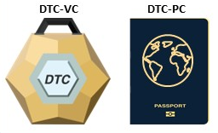
WP/11 - DIGITAL TRAVEL CREDENTIAL (DTC) POLICY UPDATE

Slide 63
Background
The current DTC Policy Paper was approved at the TAG/TRIP/4 meeting in 2023 and is regularly reassessed to ensure it is reflective of border management needs and emerging technology developments to provide clear parameters for the development of technical specifications and guidance.
The DTC approach is based on a ‘hybrid’ concept, in which the DTC will consist of a Virtual Component (DTC-VC) containing the digital representation of the holder’s identity and one Physical Component (DTC-PC) that is cryptographically linked to the Virtual Component. Three different types of DTC have been defined.
Type 1 is eMRTD-based, where DTC-PC is an eMRTD whose chip data forms base for DTC-VC.
The development of DTC has progressed to the point where the specifications for DTC-VC are complete, but those for DTC-PC are still pending for certain form factors (such as the mobile phone).
Only the DTC-VC specifications are needed to utilize type 1 DTC, as eMRTD acts as DTC-PC. It should therefore be clearly stated that the specifications for Type 1 DTC are complete and ready for implementation.

Slide 64
Background
In recent years, DTC has been tested in real-world travel environments, and plans are underway to implement DTC around the world. Information gathered from the pilots and various approaches has given rise to the need for clarifications and additions to the DTC Policy document.
It has become clear that the use of DTC, especially for border crossings, is only possible on a large scale if a protocol for DTC transmission is also standardized. This refers in particular to situations where, before traveling, a passenger sends a DTC from their device to the authorities of the country where the border crossing takes place.
DTC Policy should define main principles for this transmission protocol.

Slide 65
Details
The most important aspect of the updated policy document is the addition of a principle and clarifying statement for DTC protocols transmission.
9) The transmission of a DTC MUST be secure and privacy protective.
Policy clarification: The DTC must be protected during electronic transmission, including the employment of security protocols such as end-to-end encryption, secure endpoint and confirmation of information received.
A new section has been introduced to the Policy paper (Section 8) which outlines policy parameters and direction for ISO development of the transmission protocols.
The following requirements have been amended for type 2 and 3 DTCs, to improve technical clarity and also to allow for the possibility that the handshake between DTC-PC (device) and inspection system may not be able to reflect the current state exactly:
The DTC-PC MUST host a DTC-VC; and
For inspection system interfaces, the initial handshake with DTC-PC MUST be as identical as possible to the eMRTD, taking into account technical constraints

Slide 66
Details
The new version 5.0 of the Policy paper refers to a previously discussed use case, where a subset of the DTC-VC data content (e.g. Data Group 1 only) may be derived from an eMRTD and sent.
It has been also clarified that this variation is NOT considered a DTC as it does not contain a biometric and therefore cannot be used to establish identity for the purposes of facilitating border clearance. We refer to it as a ‘sub-set’ or a ‘micro-credential,’ but not a DTC.
One new risk has been added to the Risk Analysis chapter: the phone holding a DTC-VC is lost or stolen

Slide 67
Action by the TAG/TRIP
The TAG/TRIP is invited to:
endorse the revised Digital Travel Credential Policy Paper version 5.0, in the Appendix of the WP;
approve the continued work of the NTWG DTC subgroup; and
authorize the NTWG to develop a DTC transmission protocol.

Slide 68
WP/12 - REVISION OF THE TEST STANDARD FOR EMRTD – PART 3 TESTS FOR APPLICATION PROTOCOL AND LOGICAL DATA STRUCTURE

Slide 69
Background
The ICAO Technical Report on RF Protocol and application test standard for eMRTD – Part 3, Tests for Application protocol and logical data structure is widely used to confirm that eMRTDs developed by issuing States and organizations are in conformance with ICAO Doc 9303, Part 10 and Part 11.
In addition to ISO/IEC 18745 series, the ICAO Technical Report on RF Protocol and application test standard for eMRTD – Part 3 Tests for Application protocol and logical data structure is required before the release of new eMRTDs to ensure interoperability on the field with deployed Inspection Systems.
ICAO Doc 9303, 8th Edition, was published in 2021 and amendments to 8th Edition will be published soon. There is a need to ensure coherence between functional specification and conformity tests specification.

Slide 70
Details
The following changes in Doc 9303, 8th Edition, impact the ICAO TR Part 3 which has been modified as follows:
new TD3 document code integration;
update of nationality letters in Doc 9303, Part 3, Clause 5;
publication of the ISO/IEC 39794-5 application profile for eMRTD;
recommendation of the presence of EF.DG11 and EF.DG12 in the LDS;
deprecation of DSA algorithm in the eMRTD PKI; and
improvement and error correction of some test scenarios are requested by test stakeholders, such as chip vendors, eMRTD vendors and test laboratories

Slide 71
Action by the TAG/TRIP
The TAG/TRIP is invited to:
approve the publication of the revised ICAO Technical Report on RF protocol and application test standard for eMRTD – Part 3 Tests for Application protocol and logical data structure designated as Ver. 3.2; and
instruct the TAG/TRIP Secretariat to publish the Technical Report on the ICAO website.

Slide 72
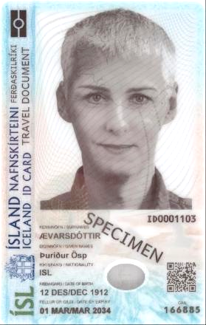
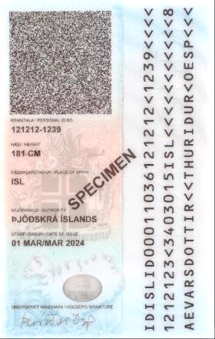
WP/13 - ICAO DATA STRUCTURE FOR BARCODES (IDB)
ISL ID card, using IDB

Slide 73
Background
Barcodes are identified by the first character used in the payload of the barcode.
Currently, IDB uses the character “I” as the first character. However, this character is reserved for use for postal services.
In the WG3 meeting in October 2024, it was resolved that the WG3 convener should reach out to the Data Identifier Maintenance Committee (DIMC) to request an allocation of a Data Identifier for ICAO barcodes.

Slide 74
Details
As all the other single character identifiers are already allocated, the DIMC has allocated the character “R” for ICAO barcodes.
The IDB TR will be updated to use the assigned Data Identifier for all the use cases.
Backwards compatibility will be maintained as some issuing States and organizations have already started using the current specifications.

Slide 75
Action by the TAG/TRIP
The TAG/TRIP is invited to:
endorse the proposed amendment to IDB TR; and
upon completion of the changes and comment resolution, instruct the TAG/TRIP secretariat to publish the amended versions.

Slide 76
WP/14 - REVISION OF THE TEST STANDARD FOR EMRTD - PART 4 CONFORMITY TEST FOR INSPECTION SYSTEM

Slide 77
Background
The ICAO Technical Report RF and Protocol Testing – Part 4, Conformity test for inspection systems is widely used to confirm that inspection systems used by issuing States and organizations are in conformance with ICAO Doc 9303, Part 10 and Part 11.
In addition to ISO/IEC 18745 series, this Technical Report – Part 4 is required before the release of new inspection systems to ensure interoperability on the field with deployed eMRTDs.
ICAO Doc 9303 8th Edition was published in 2021 and amendments to 8th Edition will be published soon. There is a need to ensure coherence between functional specification and conformity tests specification.

Slide 78
Details
The following changes in Doc 9303 8th Edition impact the ICAO TR Part 4 which has been modified accordingly:
publication of the ISO/IEC 39794-5 application profile for eMRTD; and
improvement and error correction of some test scenarios are requested by test stakeholders, such as inspection system vendors, system integrators and test laboratories.

Slide 79
Action by the TAG/TRIP
The TAG/TRIP is invited to:
approve the publication of revision of the ICAO Technical Report on RF and Protocol Testing – Part 4, Conformity tests for inspection systems, Ver. 3.00; and
instruct the TAG/TRIP Secretariat to publish the Technical Report on the ICAO website.

Slide 80
WP/15 - PHYSICAL TEST METHODS FOR TD1 SIZE MRTDS

Slide 81
Background
Doc 9303 – Part 3 describes the requirements that all MRTDs need to meet. An ISO/IEC standard (ISO/IEC 18745-1) has been published with test methods and criteria that new passports need to meet to ensure the durability of MRPs during their validity period.
Such a document with test methods and criteria for TD1 size MRTDs does not exist.
There are a few ISO/IEC standards with test methods for the testing of ID-1 card that have been published. However, one needs to use various standards to test a TD1 document as per the Doc 9303 – Part 3 requirements.
Since there is no document with test methods for TD1 size MRTD, each issuer can decide what test is to be performed on the document to meet the requirements in Doc 9303 – Part 3.
Furthermore, only test methods without pass/fail criteria are available for the testing of TD1 size MRTDs.

Slide 82
Details
This WP proposes guidelines for the creation of a Technical Report containing specific test methods and criteria for TD1 size MRTDs.
The tests will be based on ISO/IEC 18745-1 which covers the various requirements established in Doc 9303 part 3. The test methods for TD1 size MRTDs can be based on either test methods already published in several ISO/IEC standards for ID-1 cards or test methods published in ISO/IEC 18745-1.
All relevant test methods will be assessed for suitability. The selected test methods will be adapted for the evaluation of the Doc 9303 part 3 requirements of TD1 size MRTDs.
The pass/fail criteria after the tests will be adapted for a TD1 size MRTD. Once established, the pass/fail criteria will be established by ISO WG3 for approval by NTWG. A list of tests under current consideration is detailed in the Appendix to this document. This will be further expanded as necessary during the creation of the Technical Report.

Slide 83
Action by the TAG/TRIP
The TAG/TRIP is invited to:
endorse the new work item for the creation of a Technical Report for test methods to evaluate the durability of TD1 size MRTDs.

Slide 84
WP/16 - UPDATE OF THE PHYSICAL CHARACTERISTICS REQUIREMENTS FOR MRTDS

Slide 85
Background
Doc 9303, Part 3, Section 2 describes the physical characteristics of MRTDs needed to ensure their durability during their validity period.
Since this section was written, a TR and subsequently an ISO/IEC standard have been published with several tests required that new MRPs should meet to ensure durability during their validity period.
However, for TD1 cards, no specific test method for travel application has been developed. The existing test methods apply for all cards (transport, bank cards, ID cards), hence the test parameters may not be appropriate for travel document.
A gap analysis was performed, and the result is summarized in the Appendix to the Working Paper.

Slide 86
Details
The following changes are proposed:
removal of the paragraph regarding deformation; and
inserting new text to reflect all the testing that needs to be done on the MRTDs.
Proposed Provisions For Doc 9303, Part 3, Section 2
Toxicity. The MRTD shall present no toxic hazards in the course of normal use, i.e. shall not release unacceptably high levels of toxic substances; these levels are usually defined in the national or regional regulations.
Resistance to chemicals. The MRTD SHALL be resistant to chemical effects arising from normal handling and use, except where chemical sensitivity is added for security reasons.
Temperature stability. The MRTD SHALL remain machine readable at operating temperatures ranging from -10 °C to +50 °C (14 F to 122 F). The MRTD SHOULD NOT lose its functionality after being exposed to temperatures ranging from –35 °C to +80 °C (-31 F to 176 F).

Slide 87
Details
Humidity. The MRTD SHALL be machine readable at a relative air humidity ranging from 5 per cent to 95 per cent, with a maximum wet bulb temperature of 25 °C (77 F). The MRTD SHOULD NOT lose its reliability after being stored at, or exposed to, a relative air humidity ranging from 0 per cent to 100 per cent (non-condensing).
Thermal shock: The MRTD SHALL be machine readable after experiencing great temperature differences between -35 °C and +80 °C (-31 F to 176 F).
Light. The MRTD SHALL resist deterioration from exposure to light encountered during normal use.
Manipulability. The MRTD SHALL be resistant to normal use handling in the field as well as border control processes such as writing and rubber stamping.
Abrasion: The MRZ SHALL NOT be damaged due to multiple readings.
X-Ray: The chip SHALL remain unaffected by the exposure to the amount of X-ray encountered at the airports.

Slide 88
Action by the TAG/TRIP
The TAG/TRIP is invited to:
endorse the proposed changes in Sections 3 and 4 of the Working Paper, and also in the Appendix for inclusion within Doc 9303, Part 3, 9th edition.

Slide 89
WP/17 - FUNCTIONAL REQUIREMENTS FOR INSPECTION SYSTEMS

Slide 90
Background
Doc 9303 specifies requirements for the travel document. However, there is no specific chapter on the functional requirements of Inspection Systems when presented with these documents.
Some requirements on the behavior of Inspection Systems are scattered throughout Doc 9303. However, expected behavior of Inspection Systems are not specified.
Test Specifications exist for Inspection Systems which test these requirements, and they also include tests for requirements not specified in Doc 9303. This is an anomaly as test specifications without functional requirements do not make sense.

Slide 91
Details
The NTWG, in the meeting in Ottawa (May 2025), approved a New Work Item for creating functional requirements for Inspection Systems.
This will initially be published as a Technical Report and will collect all the distributed requirements that are present in Doc 9303 into a single TR.
It is envisaged that additional functional requirements, specifically when a non-conformant eMRTD is presented at the Inspection System, will also be specified.
The TR will then become Part 15 of Doc 9303.

Slide 92
Action by the TAG/TRIP
The TAG/TRIP is invited to:
endorse the New Work Item proposal to create functional requirements for Inspection Systems;
endorse the initial publication of a Technical Report; and
endorse the inclusion of the TR as part 15 of Doc 9303 in the 9th Edition.

Slide 93
WP/18 - QUANTUM SAFE MECHANISMS FOR THE DOCUMENT ISSUING PKI AND PASSIVE AUTHENTICATION

Slide 94
Background
The International Civil Aviation Organization (ICAO) standard for electronic Machine Readable Travel Documents (eMRTD) specifies cryptographic mechanisms to strengthen the security of travel documents.
The rise of quantum computing poses a significant threat to the cryptographic security mechanisms of electronic Machine Readable Travel Documents (eMRTDs).
These mechanisms rely heavily on public key cryptography using Rivest–Shamir–Adleman (RSA), Finite Field and Elliptic Curve (ECC) cryptography.
A quantum computer, however, could break these cryptographic mechanisms; consequently, undermining the security mechanisms of current eMRTDs.

Slide 95
Details
In order to develop mitigation strategies against emerging threats posed by quantum computers, the NTWG created the Post-Quantum-Computer (PQC) subgroup, in November 2022.
The NTWG’s PQC subgroup tasked ISO WG3 to compile and assess information on the current developments of quantum computing and their potential impact on the cryptographic security mechanisms employed in electronic Machine-Readable Travel Documents (eMRTDs).
In response, WG3 established the Crypto Agility Subgroup (CASG). The subgroup’s mandate was to review existing research on quantum computers, evaluate potential risks for currently implemented security mechanisms, and explore migration strategies to quantum-safe mechanisms for eMRTD security.
The Crypto Agility Subgroup has reviewed multiple sources, including academic research, industry assessments, and technical standards from international standardization bodies.
The CASG’s work resulted in two Information Papers issued by ISO WG3:
Developments regarding Cryptographic Agility and Post Quantum Cryptography for eMRTD; and
Quantum safe mechanisms for the Document.
The Information Papers are in the Appendix A and Appendix B of this Working Paper.

Slide 96
Details
Information Paper on “Developments Regarding Cryptographic Agility And Post Quantum Cryptography for eMRTDs”
This Information Paper has revisited all cryptographic mechanisms currently implemented in eMRTDs, including Passive Authentication, Active and Chip Authentications, PACE and Terminal Authentication.
The threat to Passive Authentication (PA), which relies on digital signatures from the Document Issuing Public Key Infrastructure (PKI), has been identified to be the most systemic threat.
The NTWG has tasked ISO/WG3 to identify options for the migration of the Document Issuing PKI and Passive Authentication to quantum-safe mechanisms.
The Information Paper on “Developments regarding Cryptographic Agility and Post Quantum Cryptography for eMRTDs” will be continuously updated to reflect the current status of potential risks to cryptographic security mechanisms and potential mitigation options.

Slide 97
Details
Information Paper on “Quantum Safe Mechanisms for the Document Issuing PKI And Passive Authentication”
This Information Paper investigates potential options for migrating the security mechanisms that ensure the authenticity and integrity of data stored by eMRTDs and their impacts on security, readiness, and backward compatibility.
The following aspects have been addressed:
quantum-safe signature algorithms that are currently standardized, including all algorithms currently standardized by ISO and those from NIST’s Post-Quantum Cryptography Standardization project;
options for issuing certificates in the document-issuing PKI that support quantum safe algorithms or a hybrid scheme that combines classical (RSA/ECC) with quantum-safe algorithms; and
options to store digital certificates and signatures on the chip of an eMRTD to accommodate quantum-safe signatures without disrupting interoperability.
The paper furthermore analyses strategies for the migration of the PKI to quantum-safe mechanisms while simultaneously considering the recommended lifespan of up to 10 years of currently issued documents, and balancing security requirements with the long validity period of existing travel documents.

Slide 98
Action by the TAG/TRIP
The TAG/TRIP is invited to:
take note of the information provided by the Information Papers “Developments regarding Cryptographic Agility” and “Post Quantum Cryptography for eMRTDs and Quantum-safe mechanisms for the Document Issuing PKI and Passive Authentication”;
issue a State Letter asking countries to participate in a survey regarding their opinion on the next steps for standardizing quantum safe mechanisms for the Document Issuing PKI and Passive Authentication and to circulate the information provided by this working paper through complementary informal channels (NTWG, ICBWG, PKD Board) to encourage broader engagement;
approve the continued work of the NTWG PQC subgroup;
approve the creation of a new work item aimed at producing a technical specification on the implementation of quantum-safe mechanisms in the Document Issuing PKI and Passive Authentication; and
encourage WG3 to establish and maintain liaisons with relevant international standardization bodies and working groups in order to identify and develop missing building blocks necessary for this transition.

Slide 99
WP/19 - REPORT OF THE NEW TECHNOLOGIES WORKING GROUP …continued

Slide 100
Future activities of the NTWG (chair report)
The NTWG will continue its reviews of technologies, their application and the role of MRTDs in facilitating international travel and security. Specifically, the NTWG intends to undertake the following:
Continue the ongoing work as presented.
Continue the ongoing work of developing technical reports, in all areas, authorized by the TAG and subsequently developing these into specifications for eventual incorporation into Doc 9303.
Develop a comprehensive approach to policy and process issues that arise from the use of advanced technologies in MRTDs, eMRTDs and especially DTCs.
Develop specifications that enable States to leverage the full functionality of eMRTD’s.
Develop guidance material to promote the use of eMRTDs for all of the travel continuum community involved in identity verification activities.
Develop guidance material to promote the real time secure validation of travel document data, among states and authorities.
Monitor and respond to the evolution of technology to ensure access control and PKI schemes continue to provide a secure infrastructure for eMRTDs and data validation.

Slide 101
Future activities of the NTWG (chair report) contd.
Normalize digital tokens that preserve security and contribute to enhanced travel facilitation.
Develop and employ strategies to improve relationships with border control authorities and other key stakeholders to ensure that modernization efforts are aligned and effective.
Implement strategies to improve future RFI activities.
Seek-out and remedy deficiencies with existing ePassport technology and testing standards/methodologies.
Support the TAG/TRIP, ICBWG, PKD Board, and Facilitation Panel.

Slide 102
Action by the TAG/TRIP
TAG/TRIP is invited to:
Note the work of the NTWG to date and the approach it has taken; and
Endorse in principle the future direction and activities of the NTWG as outlined above.
Thank you for your attention … and patience!

