Slide 1
TAG/TRIP/5

Slide 2
ICAO TRIP Developments Update TAG/TRIP/5-IP/5
Christiane DerMarkar, TRIP Officer
12 November 2025

Slide 3
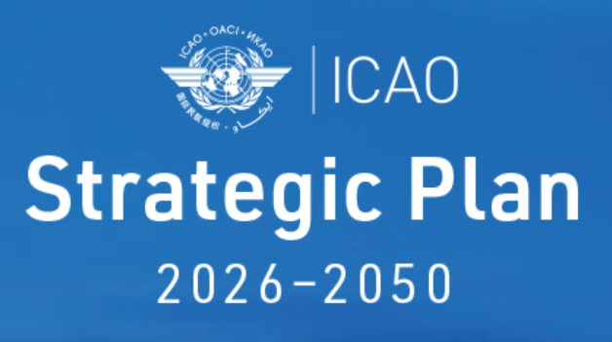
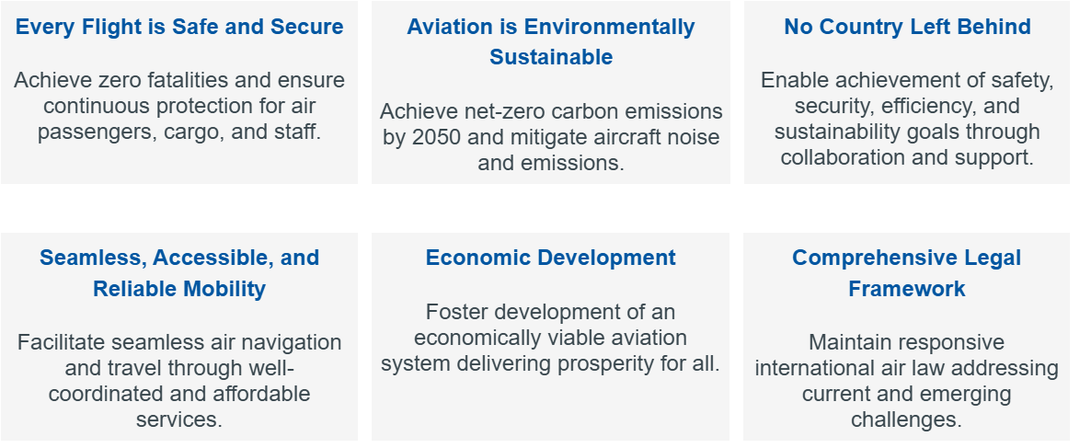

3

Slide 4
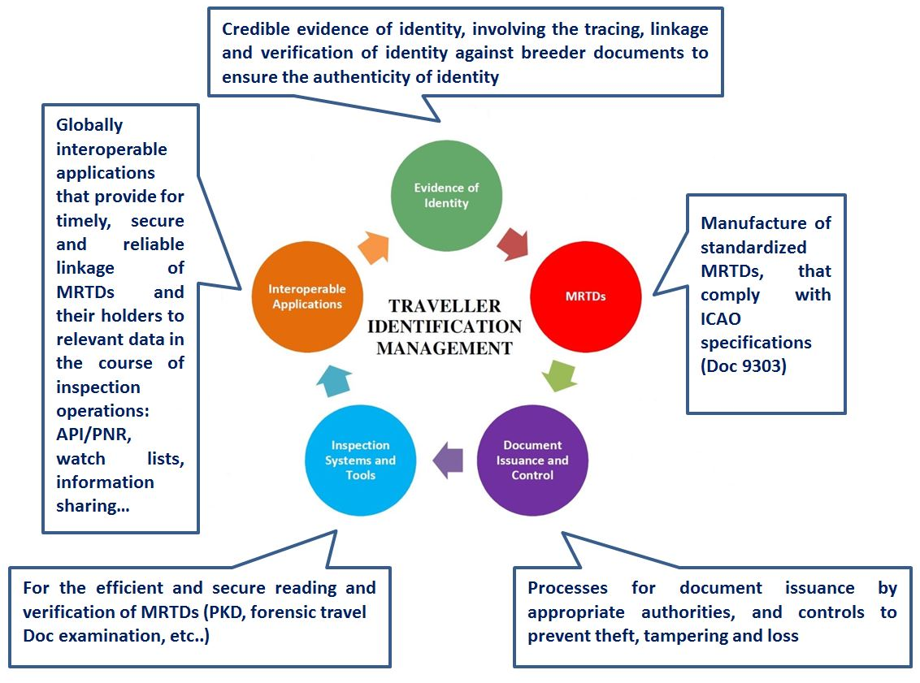
The ICAO TRIP Strategy
Approved by the Council and endorsed by the 38th Session of the ICAO Assembly (A38-WP/11, WP/397)
TRIP priorities and expected triennium outcomes endorsed by the 42nd Session of the ICAO Assembly (A42-WP/15)

Slide 5


TRIP Strategy & Priorities 2026-2028
developing and maintaining the MRTDs specifications in Doc 9303, in particular for the Digital Travel Credential (DTC);
harmonizing terms between Doc 9303 and Annex 9;
supporting the global expansion and enhanced implementation of Advance Passenger Information (API) and Passenger Name Record (PNR) systems;
enhancing awareness and promoting the TRIP Strategy through global and regional engagement initiatives;
promoting coordination and cooperation among States, regional and international organizations and the private sector for the provision of the appropriate level of expertise in TRIP-related matters; and
providing assistance to States, as required, through webinars, workshops and training to enhance their TRIP-capacity building, under the Strategic Goal - No Country Left Behing (NCLB).

Slide 6
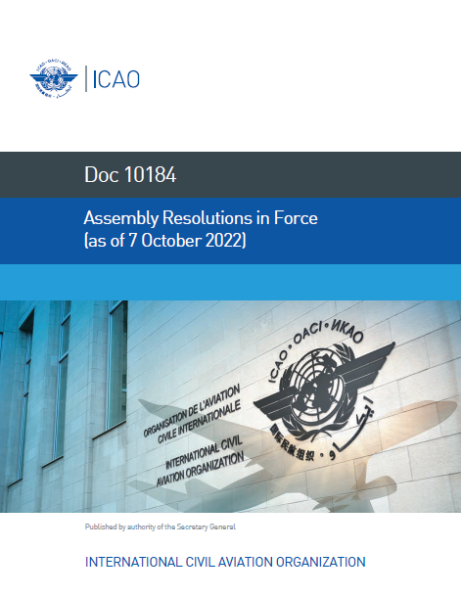
Assembly 42 Resolution 12/1: Consolidated statement of continuing ICAO policies related to Facilitation
Appendix A: Development and implementation of Facilitation provisions
Appendix B: National and international action in ensuring the security and integrity of traveller identification and border controls
Appendix C: National and international action and cooperation on Facilitation matters
Appendix D: Passenger Data Systems
Appendix E: Global Commitment to ensure that aviation delivers, reliable, accessible seamless mobility for all

Slide 7
New Resolutions A42-xx: Consolidated Statement of Continuing Policies related to Facilitation:
Appendix B: National and international action in ensuring the security and integrity of traveller identification and border controls
Main changes to A41-17
- Urges Member States to ensure that when issuing travel documents for refugees and stateless persons (Convention Travel Documents (CTDs)), these CTDs travel documents are machine readable, in accordance with the specifications of Doc 9303;
- Urges all Member States to issue machine-readable passports in accordance with Doc 9303 and to respect the implementation deadlines for the secondary document type indicator;
- Encourages Member States issuing eMRTDs to ensure full compliance with ICAO standards and to incorporate digital travel credentials where feasible;
- Urges all Member States issuing eMRTDs to deprecate Basic Access Control (BAC) and implement Password Authenticated Connection Establishment (PACE), as well as to update their facial
7

Slide 8
New Resolutions A42-xx: Consolidated Statement of Continuing Policies related to Facilitation:
E: Global commitment to ensure that aviation delivers reliable, accessible and seamless mobility for all
Directly related to TRIP:
3- Urges Member States to actively engage in the development of relevant international legal and administrative frameworks that support … the areas of civil registration, digital identity, biometric recognition, advance passenger information (API), passenger name record (PNR) data, and seamless passenger and crew processing
19- Requests the Council to strengthen ICAO’s leadership role in the ongoing implementation and evolution of the ICAO Traveller Identification Programme (TRIP) Strategy, including the development of advanced technical specifications for travel documents and digital credentials ensuring data interoperability, and mechanisms for their efficient validation;
20- Requests the Council to support the ICAO Public Key Directory (PKD) and its active use internationally, advocating for its use in both governmental and private sectors to provide the foundation for the verification of travel documents and related digital credentials globally;
8

Slide 9
New Resolutions A42-xx: Consolidated Statement of Continuing Policies related to Facilitation:
E: Global commitment to ensure that aviation delivers reliable, accessible and seamless mobility for all
Additional supportive resolutions related to TRIP:
2- Encourages a forward-looking vision addressing technological advancements – broadly aligned with TRIP’s innovation agenda.
12- Promotes interoperability in passenger processing, which underpins TRIP’s goals related to seamless travel and digital credentials.
13- Urges Member States to take measures and/or actions to address air transport Facilitation issues related to inadmissible persons, refugees and stateless persons by partnering with national and international human rights institutions.
15- Urges Member States to take a strategic, proactive and collaborative approach to the implementation of innovative technologies that can improve all aspects of air transport facilitation, including border control
9

Slide 10

Key Highlights from WP/325 by Airports Council International (ACI)
Challenges in Border Management
ACI highlighted fragmented border processes causing inefficiencies and inconsistent passenger handling and security.
Digital Integration Barriers
Uneven adoption of digital tools among states hinders seamless and secure travel experiences worldwide.
Recommendations for Digital Travel
ACI urges accelerated implementation of Digital Travel Credentials and interoperable frameworks across borders.
Collaborative Multi-Stakeholder Task Force
Proposal for a task force to align stakeholders, share best practices, and innovate digital travel solutions.
Assembly referred ACI’s proposed actions to TAG/TRIP for further consideration and follow-up

Slide 11

Challenges and Recommendations from WP/285
Challenges in Crew Identification
Crew identification lacks standardized procedures and consistent certificate recognition, causing delays and inefficiencies.
Need for Harmonized Approach
IATA advocates for a unified, digital approach to crew identification aligning with ICAO standards for efficiency and security.
ICAO's Leadership Role
ICAO is encouraged to lead adoption of digital crew member certificates and integrate them into border management systems.
Collaboration and Implementation
Recommendations referred to TAG/TRIP for evaluation, promoting cooperation among states and stakeholders for secure digital IDs.
The Assembly acknowledged the importance of these recommendations and referred the proposed actions to the Facilitation Panel and the Technical Advisory Group on the Traveller Identification Programme (TAG/TRIP) for further evaluation and implementation.
This referral signifies ICAO’s commitment to addressing crew identification challenges and fostering collaboration among member States and industry stakeholders to develop interoperable and secure digital identification frameworks.

Slide 12
Annex 9: 39 Standards & 20 RPs
behind the TRIP Strategy
Evidence of Identity
MRTDs
Document Issuance and Control
Inspection Systems and Tools
Interoperable Applications
Regulatory Framework set up by Annex 9 – Facilitation (Chapters 3, 5, 8, 9 and 10)
All TRIP elements are enhancing both Facilitation and Security
All TRIP elements: 2 STD + 0 RPs (2 audited)
Evidence of Identity: 0STD + 1 RP
MRTDs: 6 STD + 1 RPs (3 audited)
Document Issuance and Control: 11 STD + 0 RPs (5 audited)
Inspection Systems and Tools: 1 STD + 6 RPs (1 audited)
Interoperable Applications: 19 STD + 12 RPs (10 audited)
12
Notes:
12

Slide 13
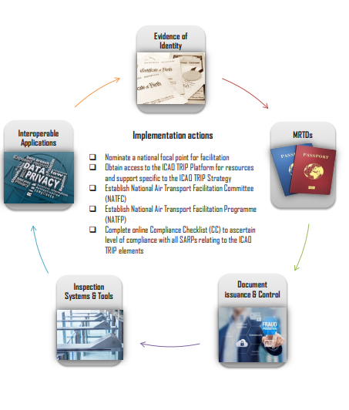
TRIP Roadmap Overview
TRIP Roadmap Overview
ICAO TRIP roadmap aims to provide target milestones for the implementation by States of the ICAO TRIP Strategy.
At the national level, coordinated action would be required between many government and industry entities.
In the international context, the aim is to systematically collaborate with all interested stakeholders to implement each element of the TRIP Strategy.
https://www.icao.int/Security/FAL/TRIP/Pages/Publications.aspx

Slide 14
Audited TRIP-related Standards
Sub-Area | Annex 9 Standards | Results for the audited States
Programme and Coordination | 8.13 8.15 | 62% have approved National Air Transport Facilitation Programme (NATFP) based on the requirements of Annex 9 (of 181 States audited); and 40% have an established and functioning NATF Committee and/or Airport Facilitation Committees, or similar coordinating bodies (of 181 States audited).
Security of Travel Documents | 3.7 3.6 3.5 | 89% have incorporated security features in current travel documents that are regularly updated (of 180 States audited); 79% have effective safeguards against theft of blank travel documents (of 178 States audited); and 88% have established appropriate controls over the entire travel document application, adjudication and issuance processes (of 179 States audited).
Security of Travel Documents | 3.8 | 82% have established a policy to report to INTERPOL (of 171 States audited); 73% developed guidelines for reporting information about stolen, lost, and revoked travel documents to INTERPOL (of 171 States audited); and 68% have reported stolen, lost, and revoked travel documents to INTERPOL for inclusion in the SLTD database (of 167 States audited).

Slide 15
Sub-Area | Annex 9 Standards | Results for the audited States
Security of Travel Documents | 3.10 3.11 3.68 3.70 | 97% issue only machine readable passports (of 180 States audited); and 84% (based on USAP-CMA results only) issue Convention Travel Documents (“CTDs”) for refugees and stateless persons in machine readable form (of 116 audited States where it was applicable). Of 181 States audited, 34 States are applicable. From these 24 States are issuing standardized CMCs, a compliance rate of 70.59%. Of 181 States audited, 34 States are applicable. From these, 30 States are conducting background checks on CMC applicants and maintaining integrity of the CMC issuance process, a compliance rate of 88.24%.
Entry Procedures and Responsibilities | 9.7 9.9 9.10 | 54%t have introduced an Advance Passenger Information (API) system (of 162 audited States where it was applicable); 66% have established appropriate legal authority consistent with internationally recognized standards for API (of 157 audited States where it was applicable); and 52% implementing API follow UN/EDIFACT PAXLST format (of 160 audited States where it was applicable).

Slide 16
Sub-Area | Annex 9 Standards | Results for the audited States
PKD | 3.15 | Audit data is not representative and may be out dated compared to the information in the PKD system.
Single Window Facility | 9.1 | Of 107 States audited: 57% have created a Passenger Data Single Window facility for API; and 46% have created a Passenger Data Single Window facility for PNR data.
PNR data | 9.22 | Of 107 States audited: 48% have established an appropriate legal and administrative framework for the collection, use, processing and protection of PNR data for flights to and from their territory; and 41% have defined and implemented PNR data requirements in accordance with ICAO Doc 9944 and PNRGOV message implementation guidance materials.

Slide 17
Sub-Area | Annex 9 Standards | Results for the audited States
PNR data | 9.23 | Of 107 States audited, 42% have identified in its legal and administrative framework the PNR data to be used in its operations, including the purposes for which PNR data may be used.
PNR data | 9.24 | Of 107 States audited: 45% have established in its legal and administrative framework penalties for misuse, unauthorized access, and unauthorized disclosure of PNR data; and 38% have established in its legal and administrative framework mechanisms to prevent unauthorized access, disclosure and use of PNR data.
PNR data | 9.26 | Of 107 States audited, 40% have ensured that the automated processing of PNR data is based on objective, precise and reliable criteria that effectively indicate the existence of a risk, without leading to unlawful differentiation.
PNR data | 9.27 | Of 107 States audited, 41% have designated one or more office(s) or entity(ies) as responsible for the independent oversight of PNR data protection.
PNR data | 9.29 | Of 107 States audited, 42% have established, in their legal and administrative framework mechanisms related to the retention of PNR data.

Slide 18

QUESTIONNAIRE ON THE IMPLEMENTATION OF NEWLY ADOPTED ANNEX 9 STANDARDS AND RELATED IMPLEMENTATION TIMELINES AND DEADLINES CONCERNING DOC 9303, MACHINE READABLE TRAVEL DOCUMENTS (MRTDS)
2 questions on harmonized second letter
3 questions on BAC vs PACE
4 questions on ISO 39794
As of 20 October 54 States replied

Slide 19
State Letters and Questionnaires
Passport Type Indicators
29 States already implementing
25 States plan to meet the deadlines

Slide 20
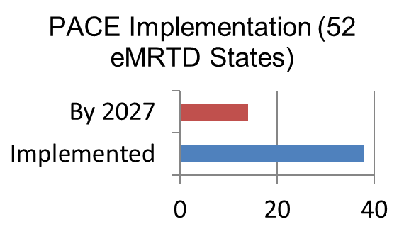
State Letters and Questionnaires
Deprecation of BAC
Status | Number of States
Already implemented | 38
To meet by 1 Jan 2027 | 14

Slide 21
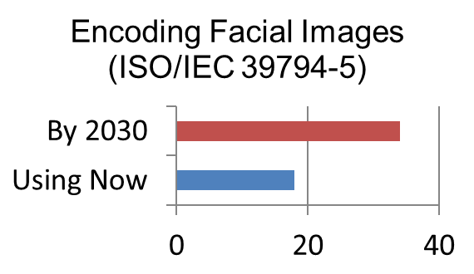
State Letters and Questionnaires
Facial image encoding and decoding
Status | Number of States
Already using | 18
Will meet by 1 Jan 2030 | 34
Status | Number of States
Already applying | 22
Will meet by 1 Jan 2026 | 27
Unable to meet | 3

Slide 22

QUESTIONNAIRE ON MACHINE READABLE TRAVEL DOCUMENTS (MRTDS) FOR REFUGEES AND STATELESS PERSONS
As of 20 October, 51 States replied

Slide 23
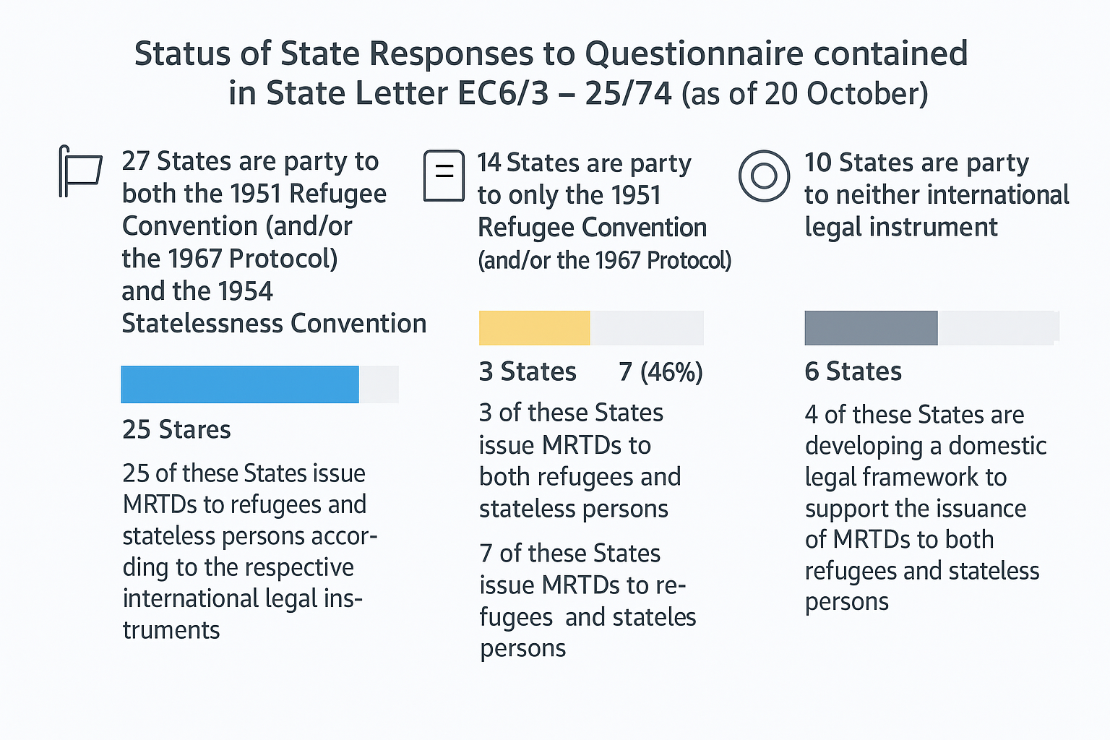
State Letters and Questionnaires
MRTDs for refugees and stateless persons

Slide 24
API/iAPI/PNR status by region
Region | API/iAPI | PNR
Asia and Pacific (APAC)* | 16 | 12
Eastern and Southern African Office (ESAF) | 8 | 3
European and North Atlantic (EUR/NAT) | 39 | 37
Middle East (MID) | 9 | 6
North American, Central American and Caribbean (NACC) | 21 | 5
South American (SAM) | 10 | 5
Western and Central African (WACAF) | 4 | 3
Total | 107 | 71
*Hong Kong (China) and Macao (China) are not counted as ICAO Member States, however they do issue ePassports

Slide 25
Promotion, Capacity Building, Guidance and Training courses

Slide 26
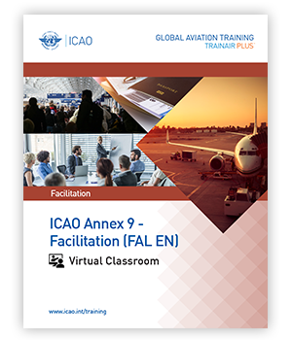


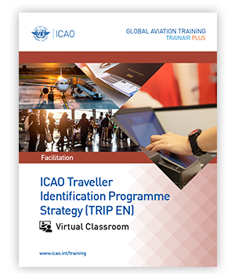
ICAO Annex 9 - Facilitation
The ICAO Annex 9 – Facilitation is virtual classroom course that develops competencies relevant to staff from Civil Aviation Authorities (CAA) and border control authorities to deal collectively, in an inter-agency manner, with Annex 9’s facilitation provisions.
Assistance to Aircraft Accident Victims and their Families
This course will provide CAA representatives, other government officials, aircraft and airport operators and non-governmental organization with the competencies to effectively support aircraft accident victims and their family assistance efforts, in accordance with ICAO Policy.
Visible Digital Seals for Travel-Related Public Health Proofs
This course provides State authorities with the competencies required to implement a national Visible Digital Seal for Non-Constrained Environments (VDS-NC) solution for travel health proof, in accordance with ICAO Doc 9303, Machine Readable Travel Documents, Parts 9-13.
Traveler Identification Programme (TRIP) Strategy
The course provides to the target audience the competencies to implement the five key elements of the ICAO TRIP strategy, ensuring interoperability and internal cooperation, in accordance with Annex 9.
https://igat.icao.int/ated/TrainingCatalogue/Browse?TrainingAreaId=11&TrainingSubareaId=27

Slide 27
Capacity Building since TAG/TRIP/4
8 TRIP Strategy Courses in physical and virtual formats
National specific for Sri Lanka (twice), Nigeria and Uganda
Regional formats hosted by
ICAO Secretariat
ICAO North American Central American & Caribbean (NACC)
ICAO European and North Atlantic (EUR/NAT) and
ICAO Asia and Pacific (APAC) offices.

Slide 28
Capacity Building since TAG/TRIP/4
ICAO Facilitation Conference (FALC 2025) took place under the theme “Facilitating the Future of Air Transport: Collaboration, Efficiency, Inclusivity” in Doha, Qatar, from 14 to 17 April 2025.
Doha Declaration in line with ICAO’s new Strategic Goal: Aviation Delivers Reliable, Accessible and Seamless Mobility for All
Regional TRIP Symposia in Kazakhstan (December 2023).
TRIP briefings were also delivered during the ICAO Facilitation 2024 Global Summit in Saudi Arabia (May 2024) and the ICAO Facilitation Global Forum 2024 in Colombia (October 2024), Cameroon (March 2025) and Mongolia (July 2025)

Slide 29
TENTATIVE PROGRAMME OF MEETINGS
2026
TRIP Regional Seminar (NACC region) May 2026
FALP/14 April 2026
TRIP Symposium (TRIP/21) week of 21 September 20226
2027
TAG/TRIP/6 Week 21 June 2027
TRIP Symposium (TRIP/22) October 2027

Slide 30

ICAO TRIP Strategy
Relevant documents and guidance materials
ICAO Doc 9303, Machine Readable Travel Document, 8th Edition;
ICAO Annex 9 SARPs;
ICAO TRIP Strategy Compendium, 2017;
ICAO TRIP Implementation Roadmap for Member States;
ICAO Guidance:
on Evidence of Identity, 2018;
on Border Control Management, 2018;
for collection of best practices for acquisition of MRTD Goods and Services;
for Roadmap for Implementation of New Specifications;
for Assessing Security of Handling and Issuance of Travel Document;
ICAO TAG/TRIP Technical Reports
https://www.icao.int/Security/FAL/TRIP/Pages/Publications.aspx

