Slide 2
Implementation of Standardized
2D Barcodes using the
ICAO Digital Authorization (DTA)
ICAO Secretariat

Slide 3
Current Situation – Lack of Global Interoperability
For many years already, States have issued so-called “eVisas” that are not globally interoperable.
These solutions deploy non-standardized barcodes following national specific trust frameworks.
These barcodes can only be verified by the issuing/ receiving State, and not by States of transit and aircraft operators.

Slide 4
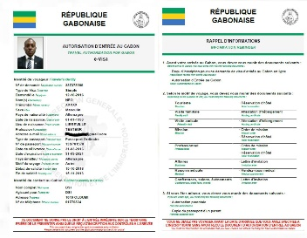
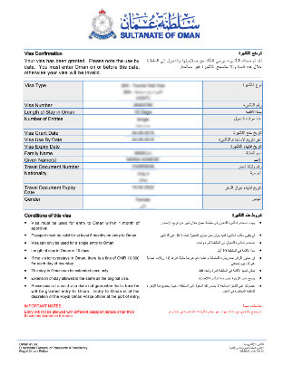
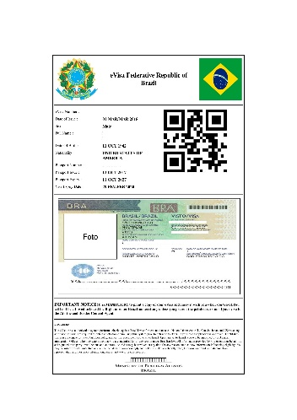
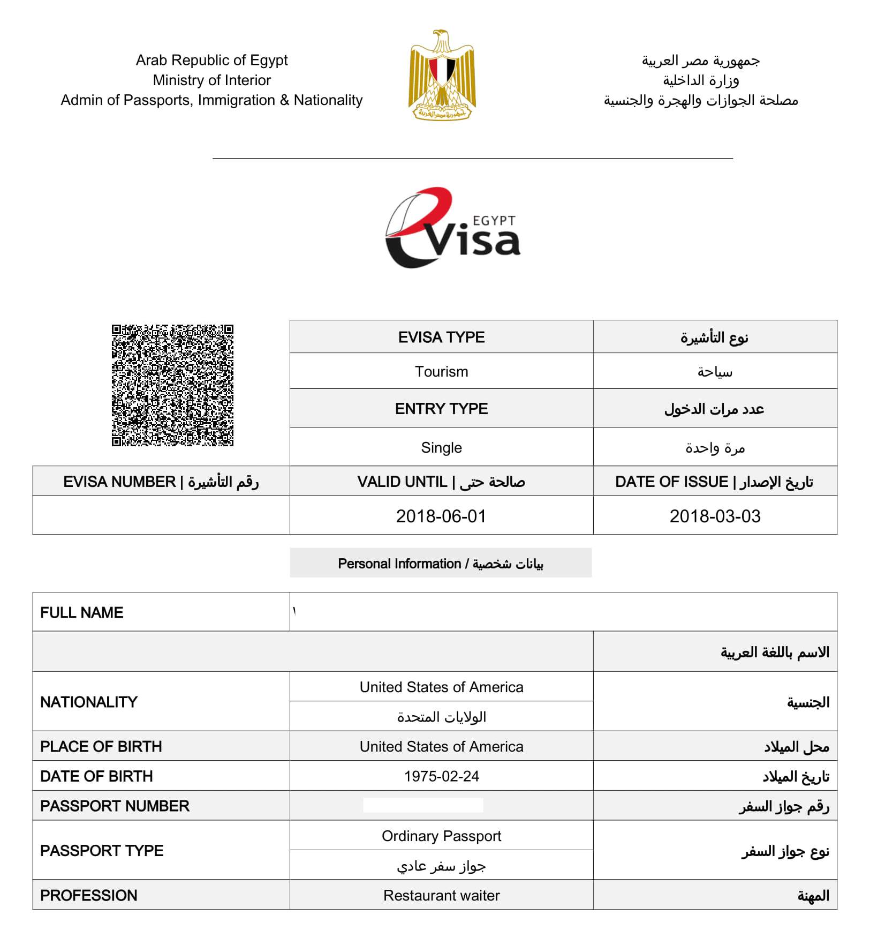
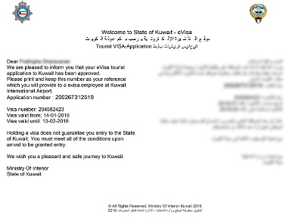
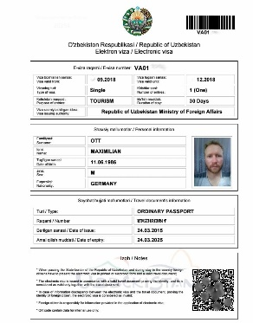
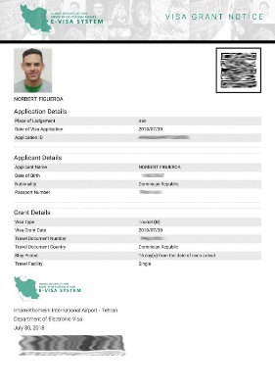
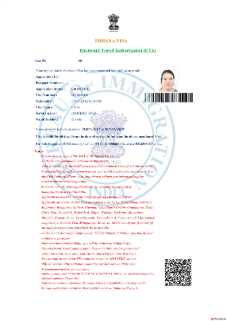
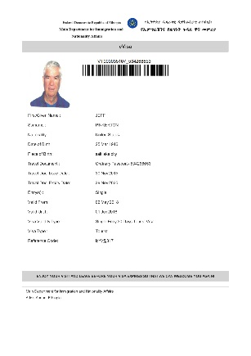
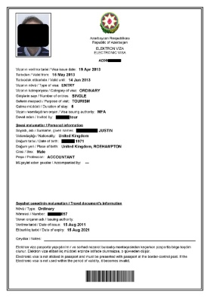
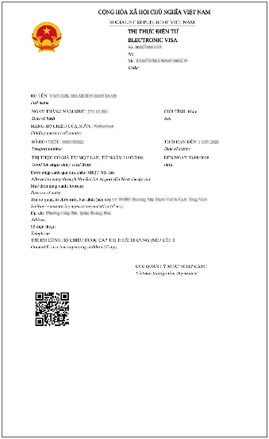
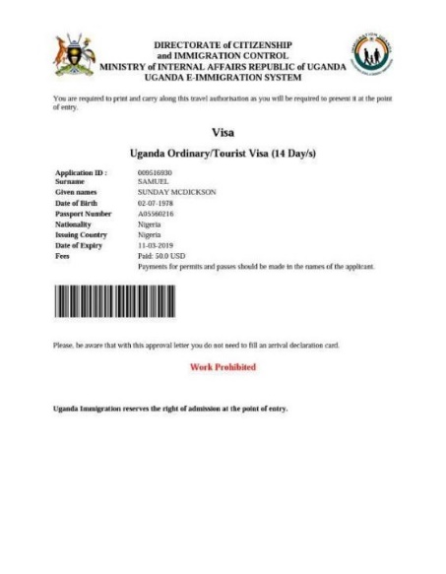
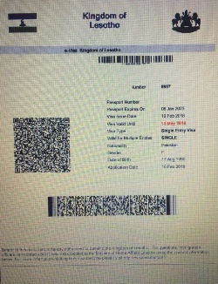
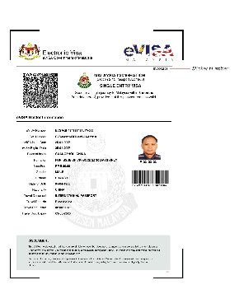
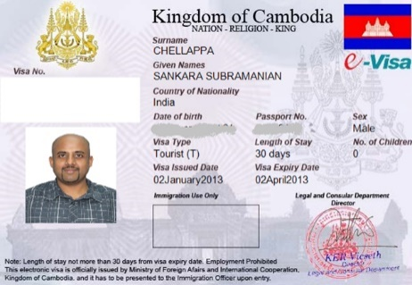
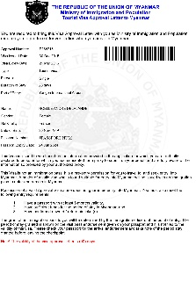
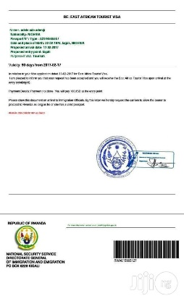
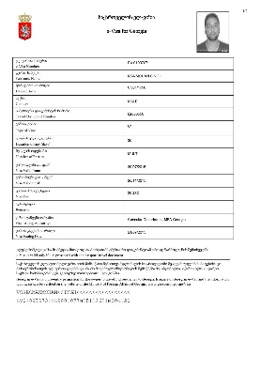
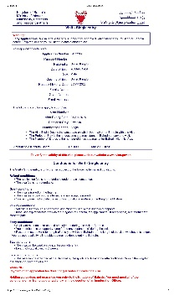
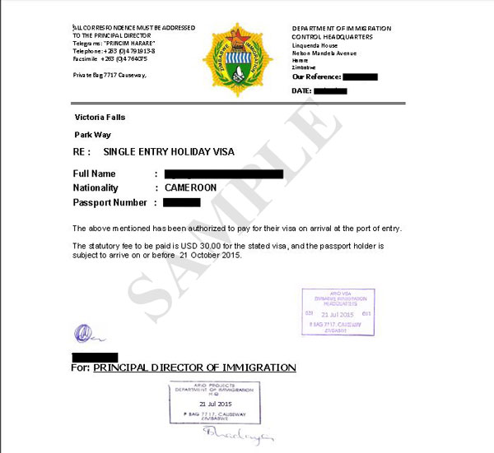
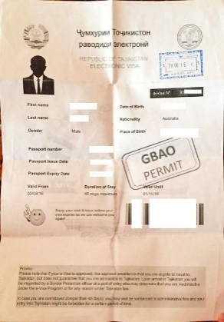
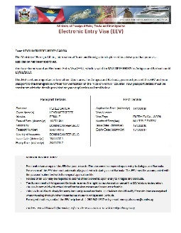
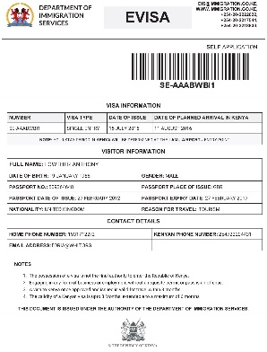
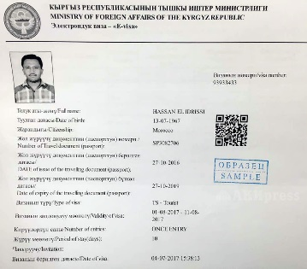
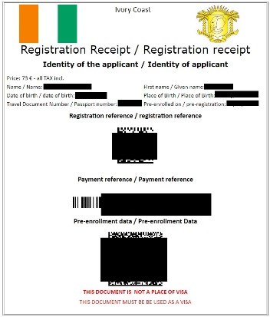
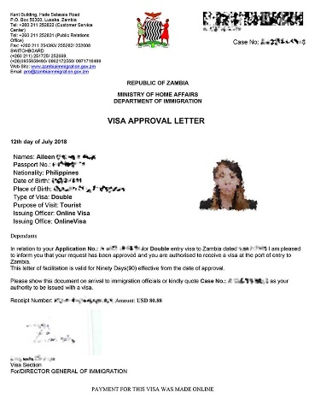
“eVisas” – The Challenge

Slide 5
Counter Measure – promoting global interoperability
Introducing an Annex 9 Recommended Practice encouraging States to issue standardized DTAs.
This will promote adherence to Doc 9303 and improve global interoperability in an important field.
Globalization and standardization of “eVisa” system.

Slide 6
Proposal for an Annex 9 Recommended Practice
CHAPTER 3: ENTRY AND DEPARTURE OF PERSONS AND
THEIR BAGGAGE
D. Travel documents
3.16.2 Recommended Practice.— When issuing barcode-based travel authorizations, Contracting States should issue these as Digital Travel Authorizations (DTA), (as specified in Doc 9303).
Note.— The specifications for Digital Travel Authorizations (DTAs) are found in the ICAO MRTD Technical Report ICAO Datastructure for Barcode, version 1.1.

Slide 7
Additional Slides in case of questions

Slide 8
Visas and Travel Authorizations
    ICAO Doc 9303 and Annex 9 set the framework for visas and authorizations to travel, and related verification processes:
    Credentials are in Chapter 3
    Machine Readable Visas (MRV)
    Digital Travel Authorizations (DTA)
    Validation Process using passenger data in Chapter 9
    Electronic Travel Systems (ETS)
Notes:
Additional information on the last point
The primary challenge is for aircraft operators and States of Transit to verify visas.
An issuing State should be able to verify its own visa pretty easily.

Slide 9

Electronic Travel Systems (ETS)
    ETS is not a visa or a credential
    ETS describes a validation process
    Aircraft operator transfers passport data via interactive API to the receiving State, which conducts system-based checks against records they hold in their databases
    ETS falls within Annex 9 RPs for Passenger Data Systems (Ch. 9)
    Traditional example is validating Electronic Travel Authorizations (ETA)
    ETA designed for online application and notification of approval to travel for visa waiver nationals
    In this scenario no barcode is issued
    A barcode can also be added to an ETA as a back-up, to support States of transit and in case interactive API messaging fails
    A DTA or an MRV can also be validated through ETS using iAPI.

Slide 10

Interactive API environment
FACILITATION GLOBAL FORUM 2024
    Provides States with a framework to conduct pre-travel verification of their records, the Electronic Travel System (ETS).
    ETA use case – there is a systems-based check of the record in the State’s database using the passport sent by iAPI.
Aircraft Operator
Receiving / Issuing State
Electronic Travel Authorization
Interactive API Messaging
Notes:
The MRV and the DTA are also compatible with interactive API

Slide 11
Interactive API environment – expanded ETS capability
FACILITATION GLOBAL FORUM 2024
    States can also use their iAPI systems to check other records they hold, as part of pre-travel verification checks.
    Including physical MRVs & DTAs.
Consular MRV
Aircraft Operator
Receiving / Issuing State
Electronic Travel Authorization
Digital Travel Authorization
Interactive API Messaging
Notes:
The MRV and the DTA are also compatible with interactive API

