Slide 1

ICAO GLOBAL AVIATION TRAINING
International Air Law Course
The International Air Law course aims to enable representatives of Civil Aviation Administrations, Civil Aviation Authorities, Airports and Air Navigation Service Providers to support their organization in compliance with international air law, through application of appropriate knowledge and advocacy.
Upon completion of the course, participants will be able to accomplish the following:
learn the concepts and rules of international air law;
explain the relevance of the rules and procedures of international air law for their own role and functions in their organization; and
apply their knowledge and understanding to assist their national administration in improving implementation.

Slide 2
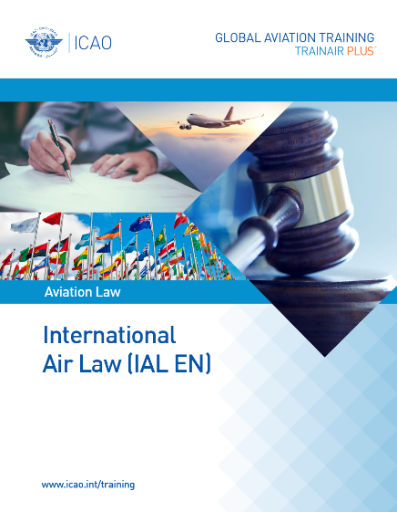
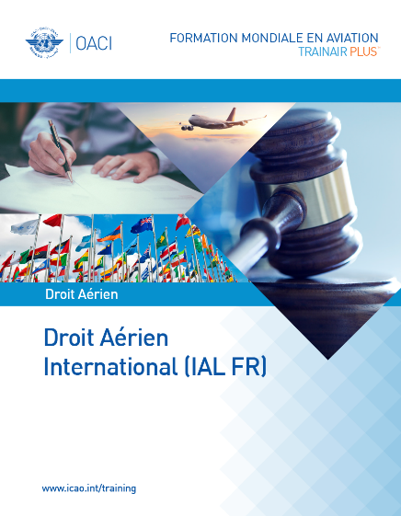
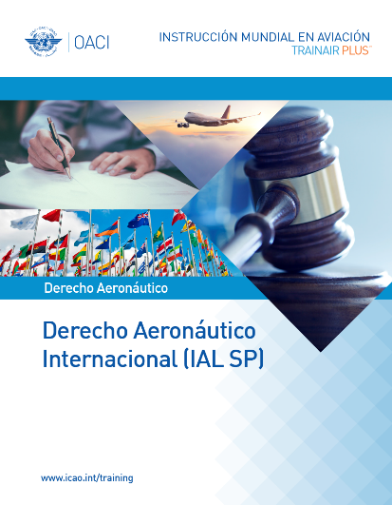
ICAO Global Aviation Training
International Air Law Course is offered in English, French and Spanish, in both face-to-face and virtual formats.
Learn more
Apprendre plus
Aprende más
Delivered sessions: 35
Total Trainees: 528
Delivered sessions: 3
Total Trainees: 27
Delivered sessions: 13
Total Trainees: 173
Upon successful completion of the course, participants will receive an ICAO certificate.
Notes:
IAL catalogue link: https://bit.ly/3s9vND3

Slide 3
2022 Upcoming Training Sessions
Course Title | Training Institution | State | From | To
Droit Aérien International (IAL FR): Classe Virtuelle | Académie Tunisienne de Formation en Sûreté de l’Aviation Civile (AFSAC) | Tunisia | 18-Apr | 22-Apr
 |  |  | 03-Oct | 07-Oct
International Air Law (IAL EN): Virtual Classroom | United for Aviation Technology Services (United ATS) | Egypt | 27-Mar | 31-Mar
 | JAA Training Organisation (JAA TO) | Netherlands | 28-Mar | 01-Apr
 | Académie Tunisienne de Formation en Sûreté de l’Aviation Civile (AFSAC) | Tunisia | 04-Apr | 08-Apr
 |  |  | 26-Sep | 30-Sep
 | International Civil Aviation Organization (ICAO) | Canada | 11-Apr | 15-Apr
 | Civil Aviation Training Center (CATC), Thailand | Thailand | 25-Apr | 29-Apr
 | Nigerian College of Aviation Technology (NCAT) | Nigeria | 16-May | 20-May
 | Loumed Cabin Crew Training Center (LCCTC) | Morocco | 23-May | 27-May
 | Egyptair Training Academy | Egypt | 20-Jun | 24-Jun
 | Civil Aviation Training Center (CATC), Thailand | Thailand | 01-Aug | 05-Aug
 | Singapore Aviation Academy | Singapore | 21-Nov | 25-Nov
View all upcoming sessions
Notes:
IAL catalogue link: https://bit.ly/3BXlYeI

