Slide 1

Dominican Republic Air Transport and Civil Aviation Case Study
ICAO World Aviation Forum
Ing. Betty Castaing
Director of Planning and Development

Slide 2
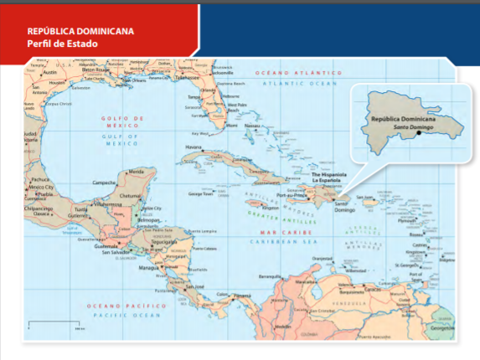

Slide 3



Small Island Developing States (SIDS)
Small Island Developing States (SIDS) consist of 38 maritime developing countries, including Dominican Republic (and 20 non-UN Members
and Associate Members) facing specific social, economic and environmental vulnerabilities.
Small domestic markets with heavy dependence on foreign markets
High costs for energy, infrastructure, transportation and communication
Little resilience to natural disasters and fragile natural environments
Long distances from major trading and tourist-generating markets
Low and irregular international traffic volumes

Slide 4
Introduction
Policy and Regulation
Safety Audit Results
Air Connectivity and the State of Air Transport
Economic Benefits and Job Contribution

Slide 5
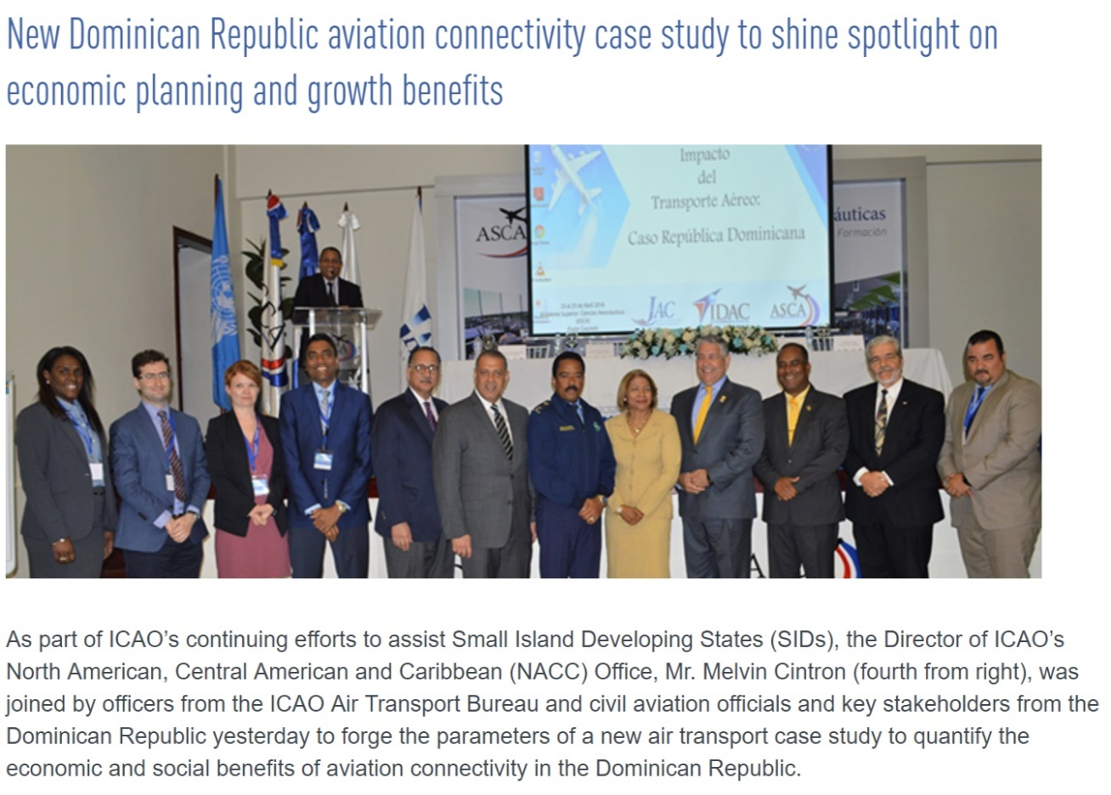
RO NACC and ATB to Conduct Case Study

Slide 6
Objectives of the Study
Demonstrate that a country’s political will and commitment to establishing aviation as a national priority can drive economic development to the country
Quantify the economic and social benefits from civil aviation to Dominican Republic, using data and analysis of the past two decades
Provide a more relevant and accurate representation of the “before” and “after” effects on the economies and sustainable developments of Small Developing Island States (SIDS)

Slide 7
Study Outline
Introduction
State of air transport
Connectivity
Policy and regulation
Navigational scenarios in the Dominican Republic
Safety audit results
Direct and indirect economic and job contributions of civil aviation to the Dominican Republic’s economy
Policies that could further enhance economic contribution of civil air transport

Slide 8
Introduction
Policy and Regulation
Safety Audit Results
Air Connectivity and the State of Air Transport
Economic Benefits and Job Contribution

Slide 9
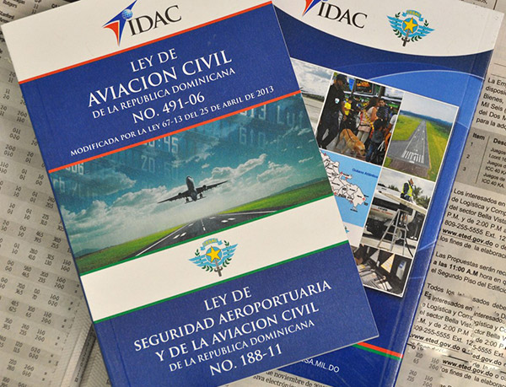
Aviation as Priority
Policy and Regulation
DECISION & POLITICAL WILL
Dominican Republic chose to make aviation a priority sector in their national development planning and policies
Civil Aviation Law No.491-06
(promulgated 28 December 2006)
Strengthen the role of the civil aviation authority and separated it from the civil aviation board and its specific mandate for negotiations of the freedom rights, along with the Commission of Investigation of Incidents and Accidents of Aviation.
Source: IDAC/JAC

Slide 10
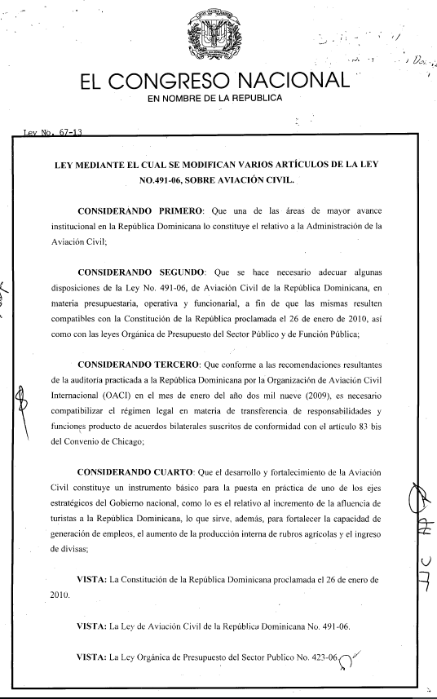
Aviation as Priority
Policy and Regulation
Modifications for higher degree of liberalization
2013 – Law 67-13 (amending Law 491-06)
Relaxation of ownership requirements for national operators (company with foreign capital (up to 100%) can be considered as a national air operator, provided, that the investment is from an internationally known airline)
Allows for more flexibility for foreign operators
2018 – Law 29-18 (amending Law 491-06)
Risk Management of Safety regarding Fatigue
(supporting SSP Regulation
20XX– Law XX-XX (Pending Approval)
Safety Information Data Protection
Source: IDAC/JAC

Slide 11
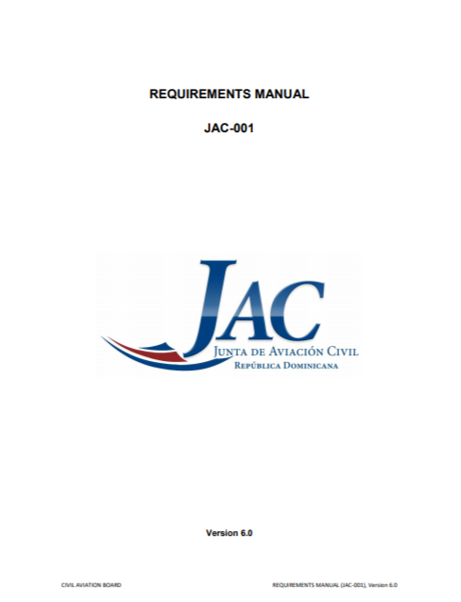
Aviation as Priority
Policy and Regulation
JAC Requirement Manual
(Version 6.0)
Regulatory framework for the Civil Aviation Board
Reviewing established commercial air transport policies coming from the late 40’s.
(protectionist government policy, route schedule constraints and capacity constraints). This approach provided weak and poor country connectivity.
Guidance of ATConf/5, “Challenges and Opportunities of Liberalization” new Air Services Agreements are adopted, including clauses with increasingly liberal approaches.
(Includes regulatory framework for charter and special permits, more flexible requirements for the issuance of Operating Permits were introduced and simplified gradually)
Source: JAC

Slide 12
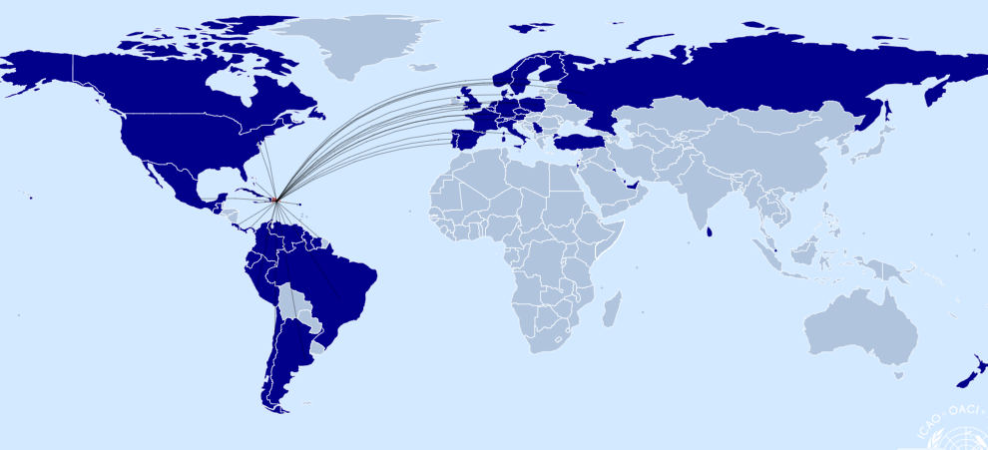

Air Services Agreements
Bilateral Agreements:
Total number: 60
incl. 5th freedom: 54
incl. 6th freedom: 17
incl. 7th freedom: 19
(all cargo)
Multilateral Agreements:
Air Transport Agreement of Association of Caribbean States (ACS)
(rubricated February 2004, final signature pending)
Multilateral Agreement of Open Skies among the Member States of the Latin American Civil Aviation Commission (LACAC)
(signed November 2011)
Source: ICAO WASA-Traffic Map (2017 traffic data)

Slide 13
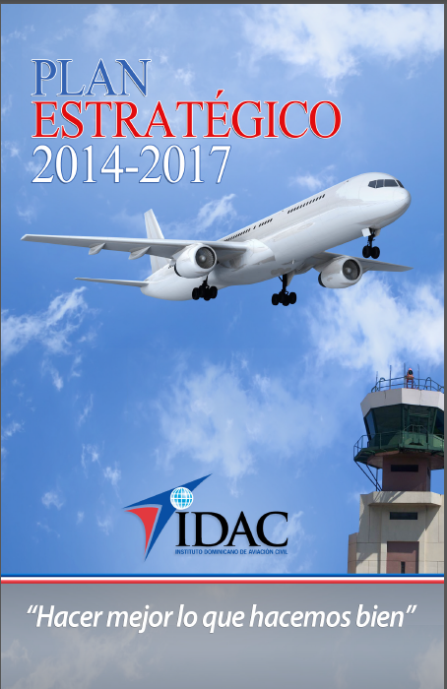
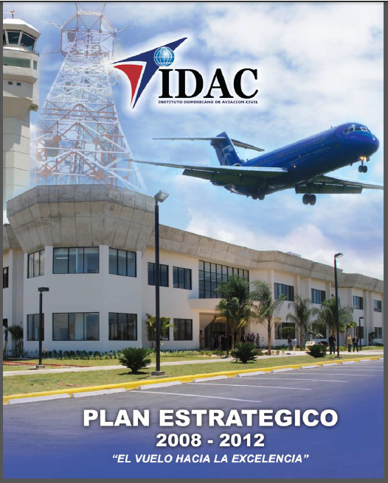
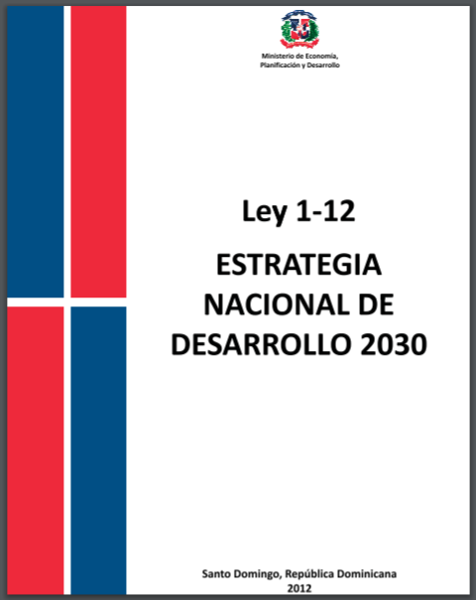
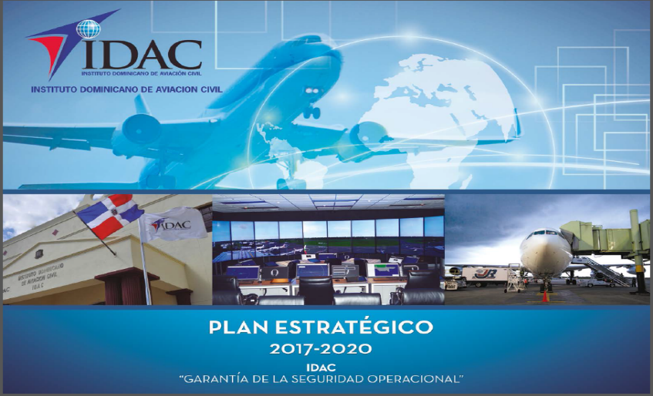
Aviation as Priority
Policy and Regulation
Strategic Planning and Project Management
Strategic framework alignment with the Government Master Plan
Law 1-12, National Strategy of Development
Aligned with Sustainable Development Goals (SDGs)
Specific line of action for civil aviation

Slide 14
Article 9. Third Axis, which seeks a Sustainable, Integrative and Competitive Economy.-
General Objective 3.3. Competitiveness and innovation in a favorable environment to cooperation and social responsibility.
Specific Objective 3.3.6. To expand the coverage and improve the quality and competitiveness of the infrastructure and transport and logistics services, orienting them to the integration of the territory, to the support of the productive development and to the competitive insertion in the international markets
Line of Action 3.3.6.11 Implement programs for the promotion and sustainable development of Dominican civil aviation, in accordance with the dynamics of the markets.

Slide 15
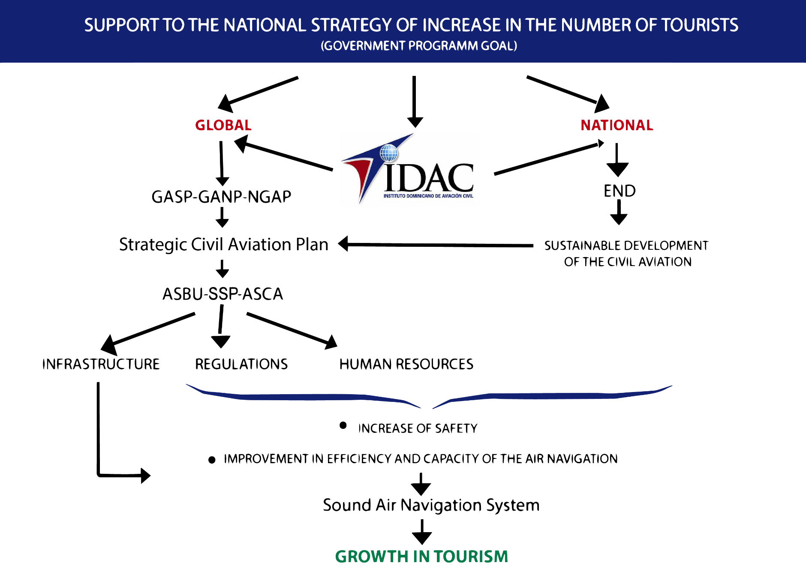

Slide 16

Introduction
Policy and Regulation
Safety Audit Results
Air Connectivity and the State of Air Transport
Economic Benefits and Job Contribution

Slide 17
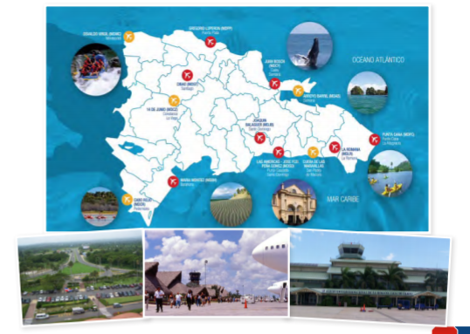

Slide 18
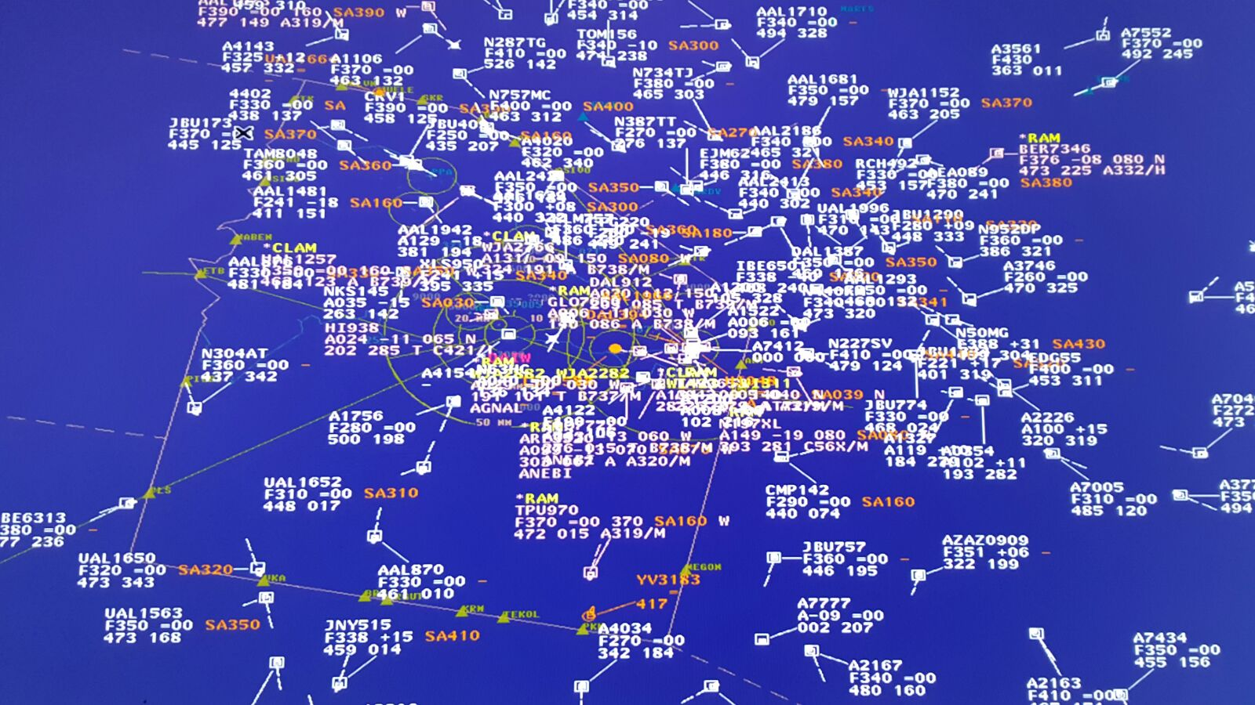

Slide 19
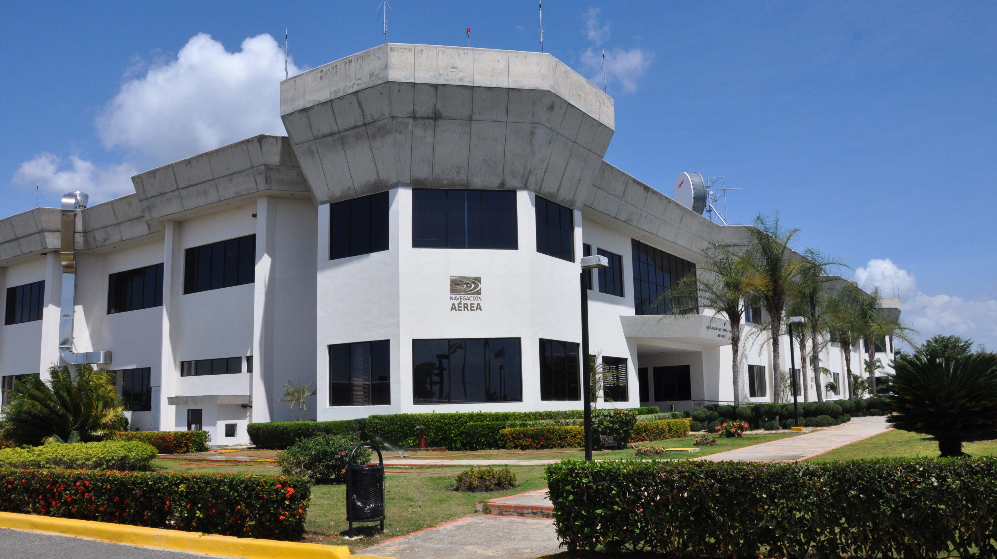






Slide 20
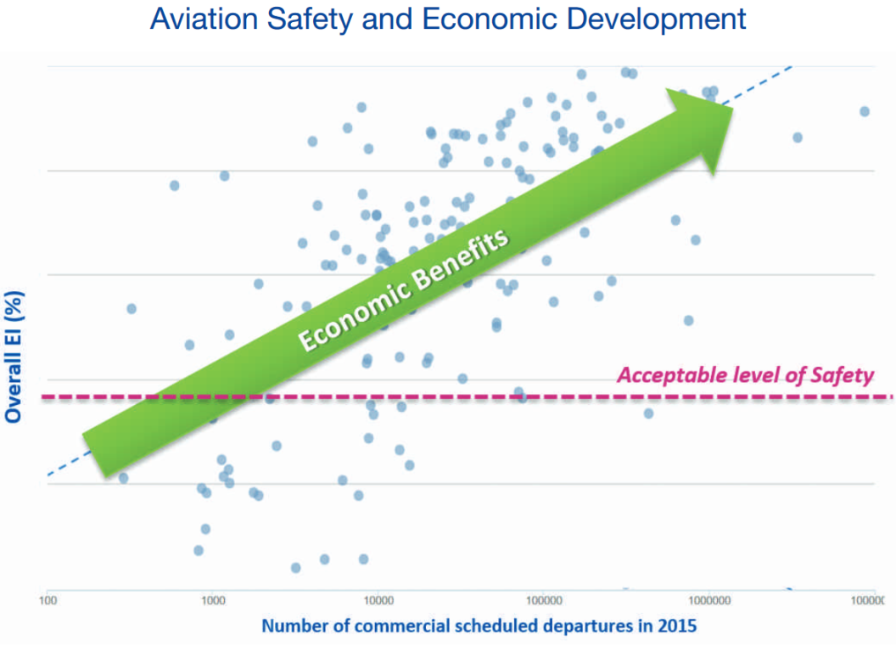
How Safety Affects Air Traffic
Safety reputation might affect travelers' choice of destination and airlines
Accidents and incidents might lead to an immediate decline of demand to travel with a particular airline
Using an econometric model, it is estimated that 10 per cent improvement of the effective implementation of a State’s safety oversight system might generate, on average, an additional 1.8 per cent of aircraft departures from the State concerned
Source: Aviation Benefits report, 2017, ICAO

Slide 21
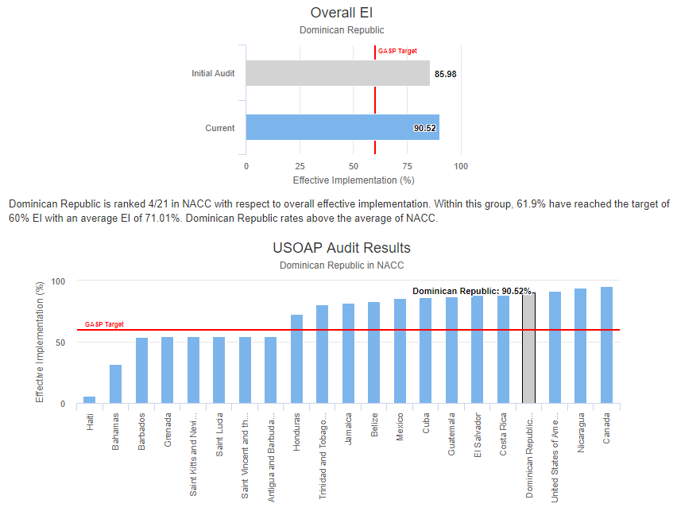
Safety Audit Results
Dominican Republic improved Effective Implementation (EI) from 85.98% (2009) to 90.52% (world average is 66.32%), ranking the country 4 of 21 in NACC region
Dominican Republic reached the Global Aviation Safety Plan (GASP) Targets
Source: ICAO

Slide 22
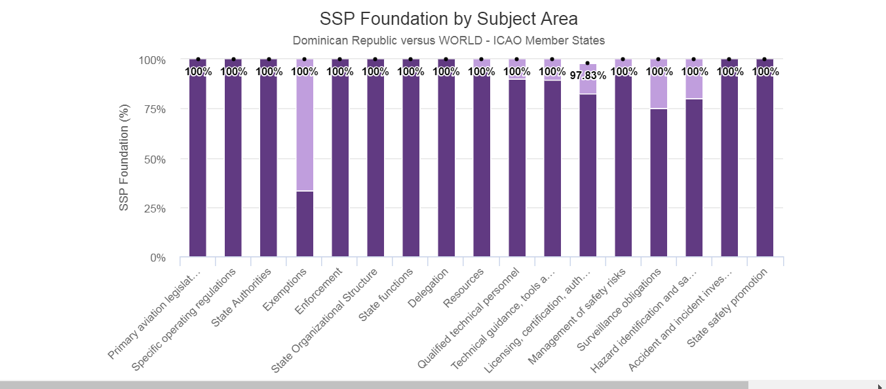
State Safety Program Implementation Results
Source: ICAO

Slide 23
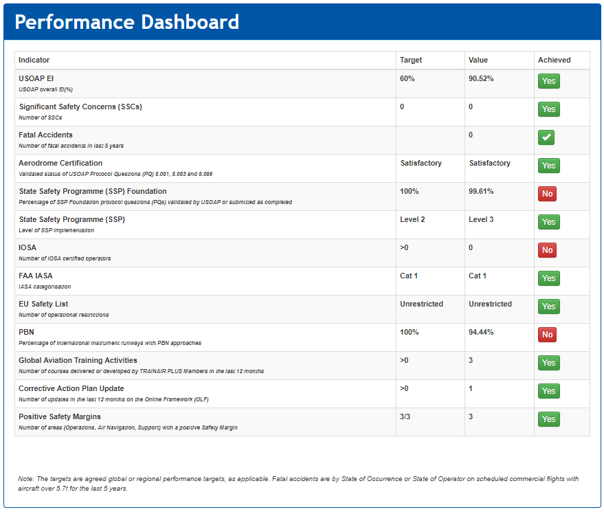
Safety Audit Results
Dominican Republic Performance Dashboard based on ICAO Safety Audits
Green indicates that the State exceeds the target set by ICAO
Source: ICAO

Slide 24

Introduction
Policy and Regulation
Safety Audit Results
The State of Air Transport and Air Connectivity
Economic Benefits and Job Contribution

Slide 25
Definition of Air Connectivity
Movement of passengers, mail and cargo involving the minimum of transit points
which makes trip as short as possible
with optimal user satisfaction
at the minimum price possible
Market Access
Airline Activities
Inter-modality
Facili-tation
Optimal Use of Airport Systems
Optimal Use of Aircraft
Optimal Use of ANS

Slide 26
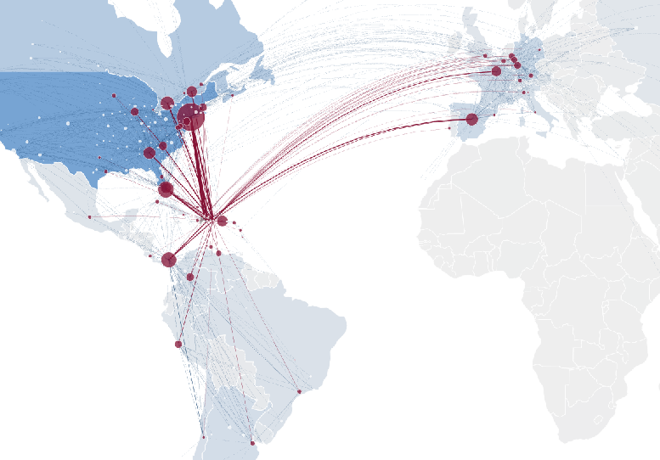
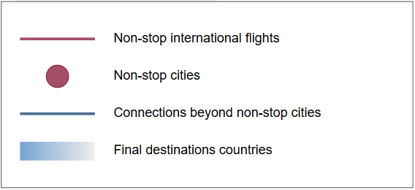
The State of Air Transport Dominican Republic
Over 99.9% of traffic is international
More than 90% of tourists arrive by air
80% of passengers originating in Dominican Republic depart from Punta Cana and Santo Domingo airports
Half of passengers departing from Dominican Republic fly to United States
Eight out of the top 10 outbound routes are to United States
More than 20% of passengers departing from Dominican Republic travel to New York/Newark
2017
Source: ICAO-ICM

Slide 27
Measurement of Air Connectivity
Global Air Connectivity Index
Departure | Share of 2016 Pax | 0 stop (Direct) | 1 Stop 2016 | 2 Stops 2016 | Weighted average Stops 2016
United States | 7.87% | 47.0% | 46.3% | 6.8% | 0.60
United Kingdom | 7.06% | 84.3% | 14.6% | 1.1% | 0.17
Germany | 5.12% | 75.5% | 22.7% | 1.8% | 0.26
Spain | 4.94% | 83.9% | 14.5% | 1.6% | 0.18
China | 4.49% | 73.7% | 24.6% | 1.7% | 0.28
Italy | 3.76% | 75.2% | 22.6% | 2.2% | 0.27
France | 3.65% | 77.7% | 20.7% | 1.6% | 0.24
Japan | 2.91% | 75.1% | 22.3% | 2.5% | 0.27
Republic of Korea | 2.33% | 86.2% | 12.7% | 1.1% | 0.15
Thailand | 2.17% | 75.3% | 22.4% | 2.3% | 0.27
United Arab Emirates | 2.16% | 86.2% | 13.1% | 0.7% | 0.14
Canada | 2.05% | 54.5% | 38.8% | 6.6% | 0.52
India | 2.00% | 51.1% | 43.8% | 5.2% | 0.54
Hong Kong, SAR, China | 1.77% | 87.6% | 11.9% | 0.5% | 0.13
Taiwan Province of China | 1.68% | 89.5% | 9.5% | 1.0% | 0.12
The World Bank uses this connectivity index in it’s major report which focuses on understanding the role of connectivity in economic growth and development
(ranks 47th by share of 2016 pax)
Dominican Republic | 0.43% | 61.1% | 36.6% | 2.4% | 0.41
Source: MIDT Big data

Slide 28
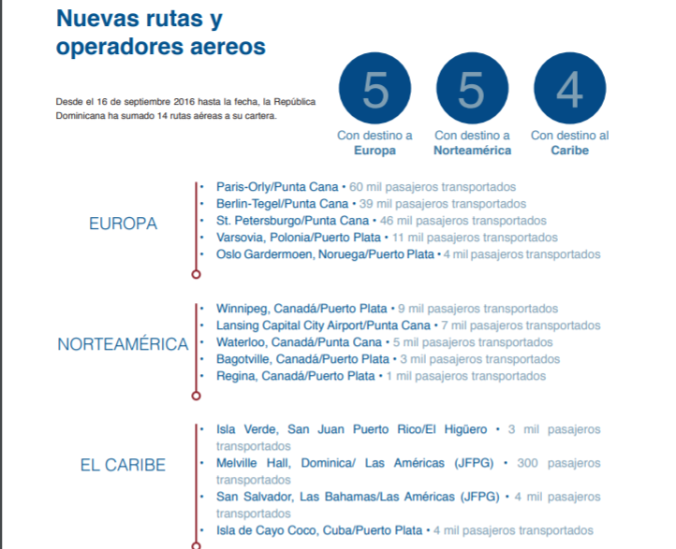

Slide 29
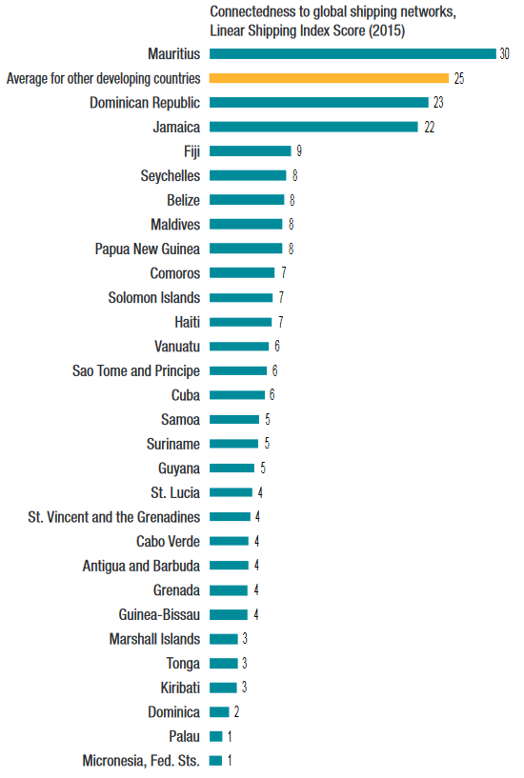
Measurement of Shipping Network Connectivity
The score of Dominican Republic (23) is close to the average for other developing countries (25)
Source: Making Development Co-operation work for Small Island Developing States, OECD

Slide 30
Passenger Arrivals
2006
Source: JAC, Dominican Republic

Slide 31
Number of Flights
2006
Source: JAC, Dominican Republic

Slide 32
Introduction
Policy and Regulation
Safety Audit Results
Air Connectivity and the State of Air Transport
Economic Benefits and Job Contribution

Slide 33
Economy of Dominican Republic Some Key Facts
Dominican Republic has enjoyed strong economic growth in recent years and a significant reduction in poverty, although the country remains vulnerable to natural disasters such as hurricanes (World Bank Group)
Small Island Developing State (SIDS)
Upper middle-income developing country (by World Bank Group)
99th in Ease of Doing Business Ranking 2018 (by World Bank Group)
104th in Global Competitiveness Index 2017-2018 (by World Economic Forum)
76th in Travel & Tourism Competitive Index 2017 (by World Economic Forum)
Source: ICAO

Slide 34
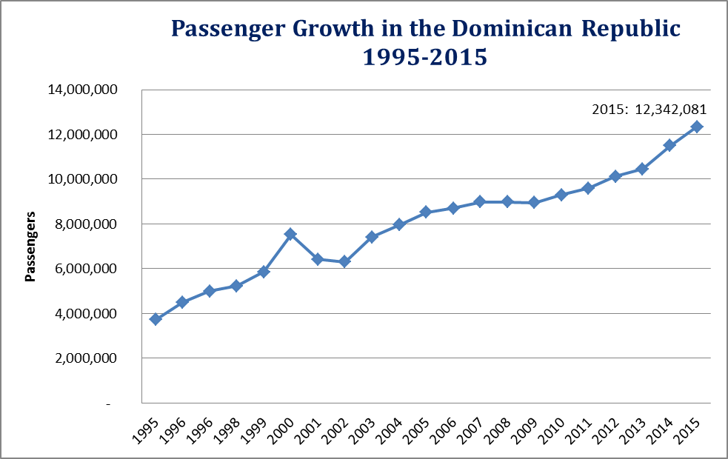
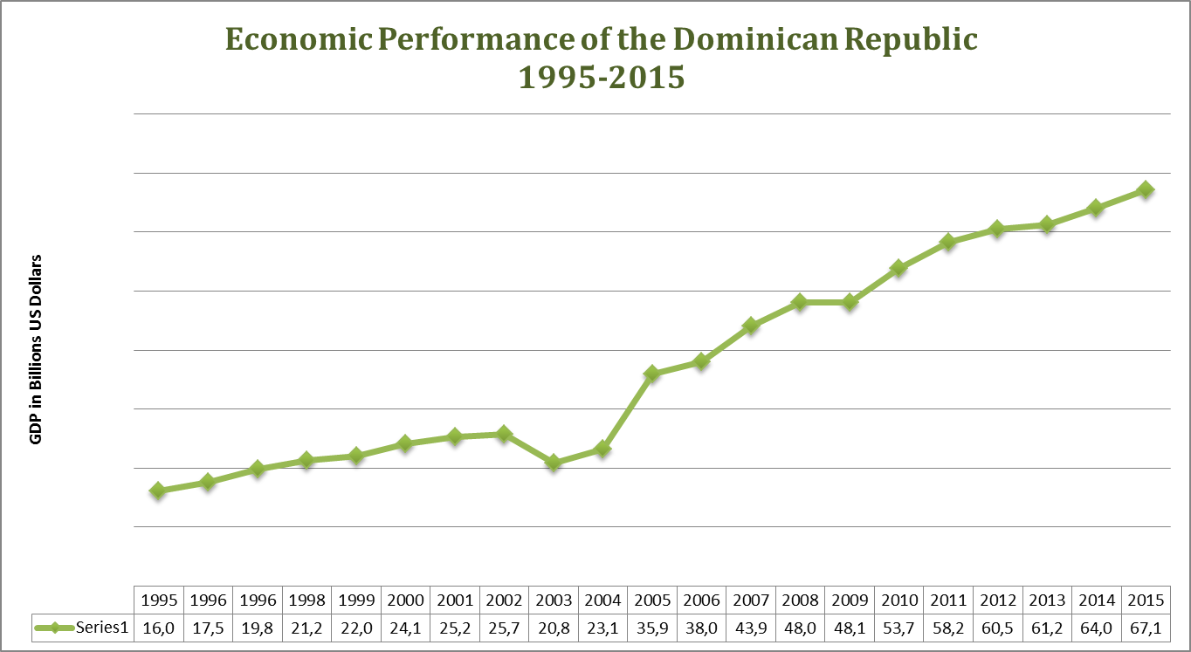
Impact of Aviation in the Economic Development of DR
1995: 3,727,539

Slide 35
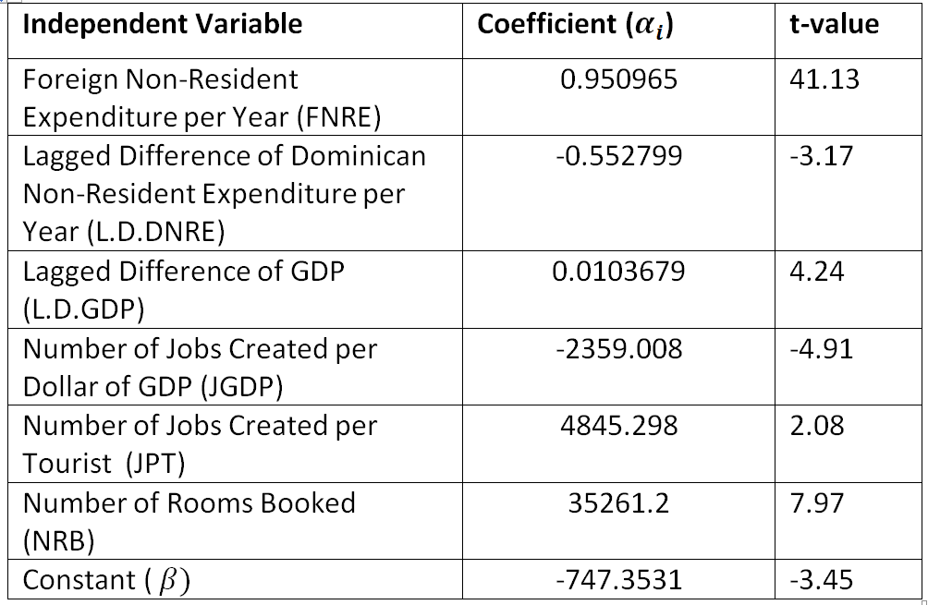
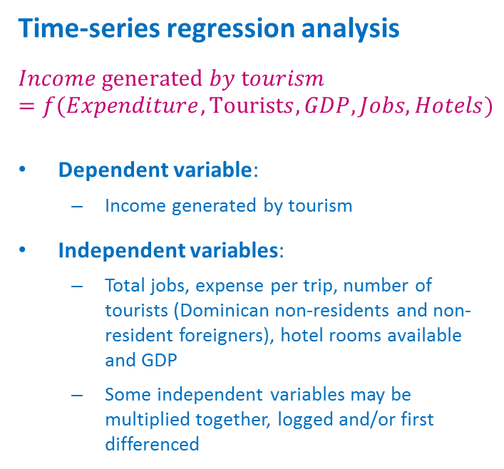
Quantification of Policy Change Impact
Preliminary Analysis
Time-series regression analysis
$$Income generated by tourism=f(Expenditure,Tourists, GDP, Jobs, Hotels)$$
Dependent variable:
Income generated by tourism
Independent variables:
Total jobs, expense per trip, number of tourists (Dominican non-residents and non-resident foreigners), hotel rooms available and GDP
Some independent variables may be multiplied together, logged and/or first differenced

Slide 36
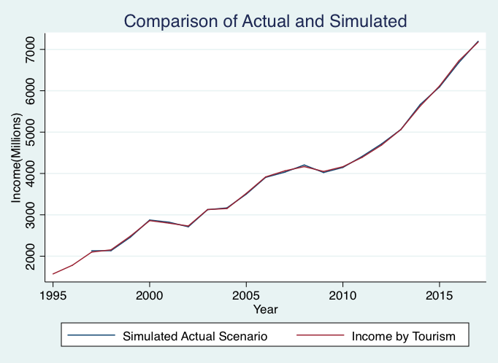
Quantification of Policy Change Impact
Preliminary Analysis
Simulated Actual Scenario
Use the estimated coefficients and the actual values of each independent variables for simulation
Can be a good approximation to the actual results (income generated by tourism), which endogenously reflect the policy change to make aviation a priority in 2006

Slide 37
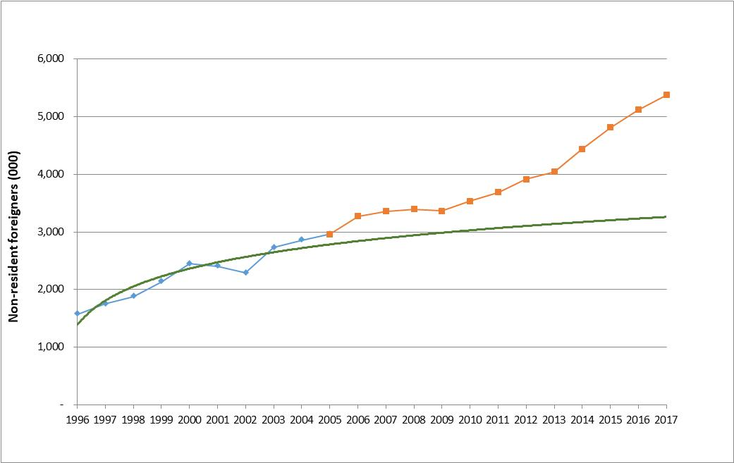
Quantification of Policy Change Impact
Preliminary Analysis
Hypothetical Scenario that assumes no aviation policy change in 2006
Use the coefficients estimated in the regression analysis
Use the adjusted number of tourists from 2006 to 2017 (Dominican non-residents and non-resident foreigners) for 3 independent variables
Forecast “after 2006 period” by extending the trend line of “prior to 2006 period”
Add 0.9% difference in air traffic compound annual growth rate observed at the global level between the two periods
Can yield the “hypothetical” income generated by tourism after 2006 if the tourist volume increased at the same rate as prior to 2006

Slide 38
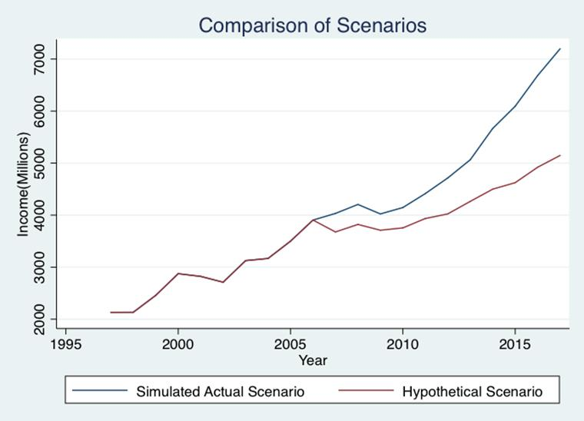
Quantification of Policy Change Impact
Preliminary Analysis
The simulated actual scenario and the hypothetical scenario are compared to estimate an overall effect of aviation policy change on income generated by tourism over time

Slide 39
Quantification of Policy Change Impact
Preliminary Analysis
This preliminary analysis indicates that aviation policy change in 2006 contributed to approximately USD 10 billion (i.e. 17.5% more) cumulative income from tourism from 2007 to 2017

Slide 40
Real GDP and Population of Dominican Republic
2006
Source: World Bank national accounts data, and OECD National Accounts data files

Slide 41
Income Generated by Tourism in Dominican Republic
2006
Source: Hotels & Tourism Association of the Dominican Republic and Central Bank of the Dominican Republic

Slide 42
Quantification of Policy Change Impact
Preliminary Analysis
This preliminary analysis indicates that aviation policy change in 2006 contributed to approximately USD 10 billion (i.e. 17.5% more) cumulative income from tourism from 2007 to 2017

Slide 43
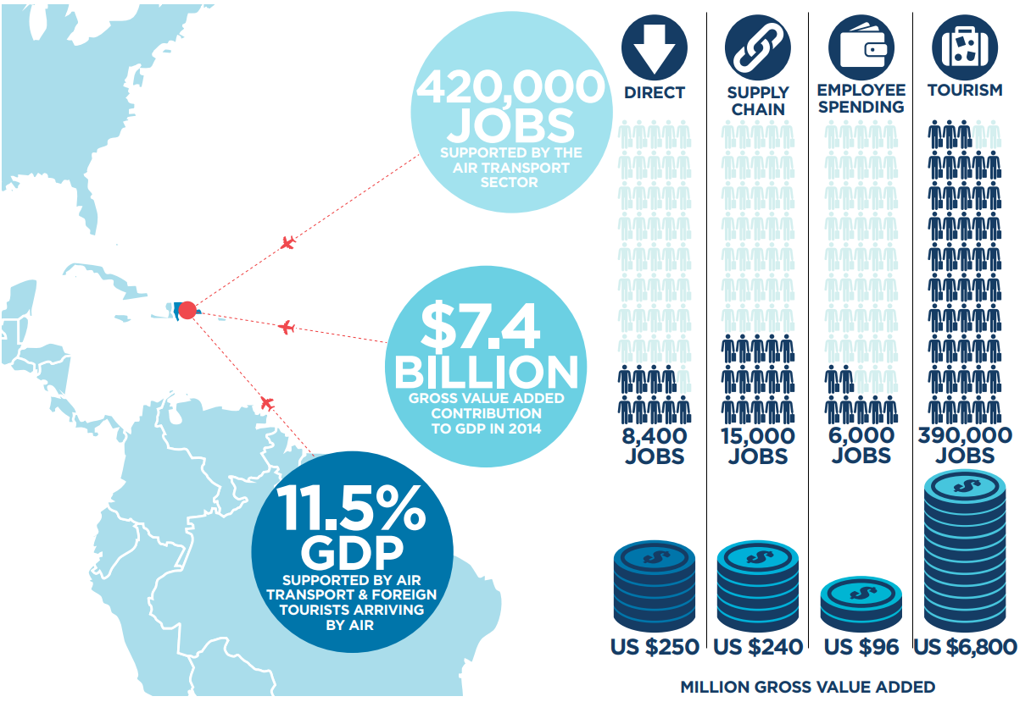
Quantification of Policy Change Impact
Preliminary Analysis
In 2014,
15.8% of total gross value added by aviation (i.e. USD 1.2 billion out of USD 7.4 billion)
1.8% of Dominican Republic’s GDP
can be attributed to aviation policy change made in 2006
Source: IATA and ICAO estimates

Slide 44


FUTURE CHALLENGES
This Photo by Unknown Author is licensed under CC BY-NC-ND
COMPETITIVENESS

Slide 45
Airlines of Dominican Republic
1995: Dominicana de Aviación ceased all operations
2001-2004: Massive drop of domestic capacity partly due to the increased road connectivity within the State
2003: PAWA Dominicana was founded
2005: Aerolíneas Mas was founded
2012: End of scheduled domestic services
2012-2014: PAWA Dominicana temporarily ceased scheduled flights, only offering non-scheduled flights
2015: Aerolíneas MAS ceased all operations
2018: PAWA Dominicana ceased all operations
Source: ICAO

Slide 46
Safety and Security
Infrastructure
Regulations

Slide 47

CONNECTIVITY
This Photo by Unknown Author is licensed under CC BY-SA

Slide 48
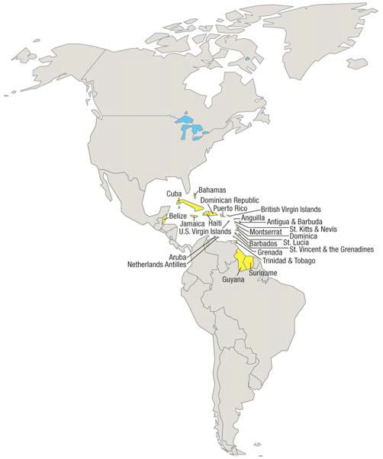
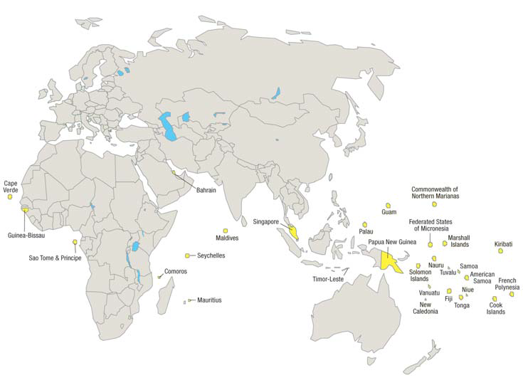
This study might serve as a template for other SIDS to consider in order to optimize their own air transport benefits
Source: United Nations

Slide 49

THANK YOU!!

Slide 50
Appendix

Slide 51
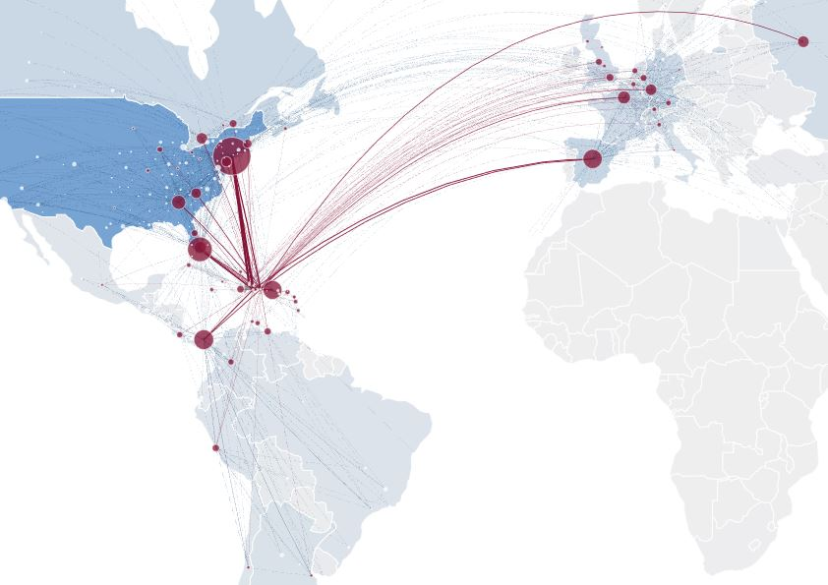
Air Connectivity of Dominican Republic
2011
2017
Source: ICAO-ICM

Slide 52
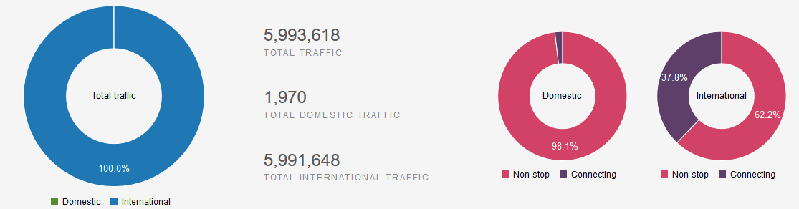
Passenger Traffic Composition of Dominican Republic in 2017
ICAO-ICM Global Air Transport Diagnosis using Marketing Information Data Transfer (MITD) Data
Source: ICAO-ICM

Slide 53
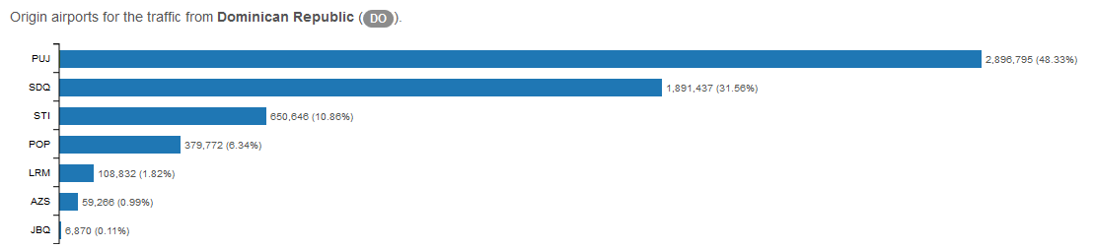
Origin Airport Traffic
80% of passengers originating in Dominican Republic departed from Punta Cana (PUJ) and Santo Domingo (SDQ) airports in 2017
Source: ICAO-ICM

Slide 54
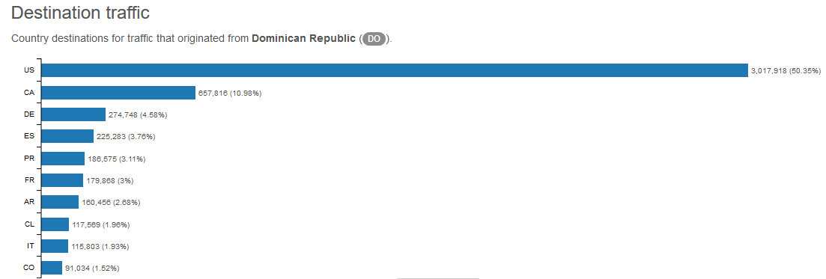
Top 10 Destination Countries
Half of passengers departing from Dominican Republic flew to United States
Source: ICAO-ICM

Slide 55
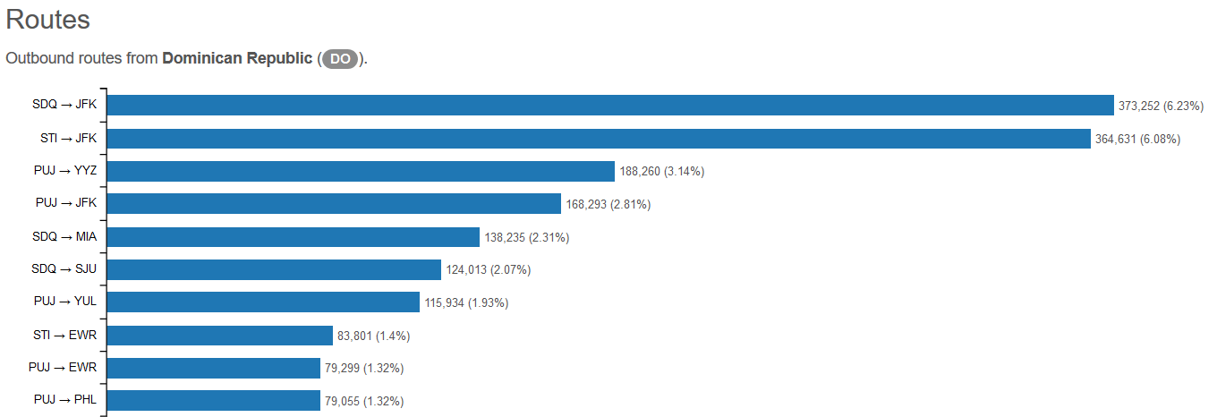
Top 10 Outbound Routes
Eight out of the top 10 outbound routes from Dominican Republic are to United States in 2017
Source: ICAO-ICM

Slide 56
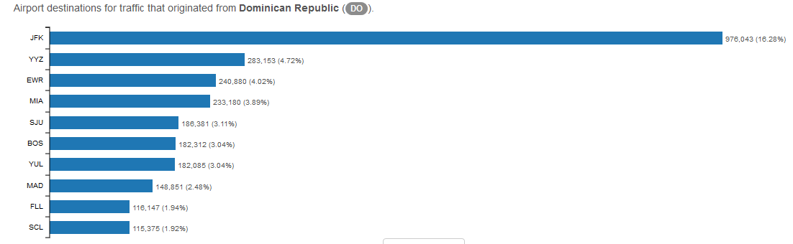
Top 10 Destination Airports
More than 20% of passengers departing from Dominican Republic travel to New York
(JFK or EWR) in 2017
Source: ICAO-ICM

Slide 57

Passenger Arrivals
2006
2006
Source: JAC, Dominican Republic

Slide 58
Passenger Arrivals
Passengers by Region of Origin: Scheduled Flights to Dominican Republic
Source: JAC, Dominican Republic

Slide 59
Passenger Arrivals
Passengers by Region of Origin: Non-scheduled Flights to Dominican Republic
Source: JAC, Dominican Republic

Slide 60
Number of Flights
2006
2006
Source: JAC, Dominican Republic

Slide 61
Number of Flights
Flights by Region of Origin: Scheduled Flights to Dominican Republic
Source: JAC, Dominican Republic

Slide 62
Number of Flights
Flights by Region of Origin: Non-scheduled Flights to Dominican Republic
Source: JAC, Dominican Republic

Slide 63
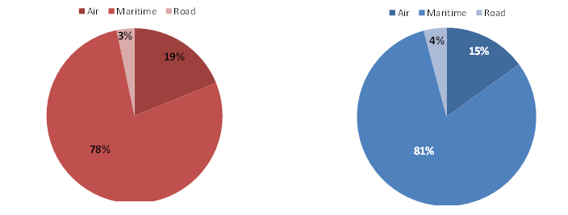
Trade by Mode of Transport
2017
2013
Source: Dirección General de Aduanas (DGA). Departamento de Estadísticas.

Slide 64
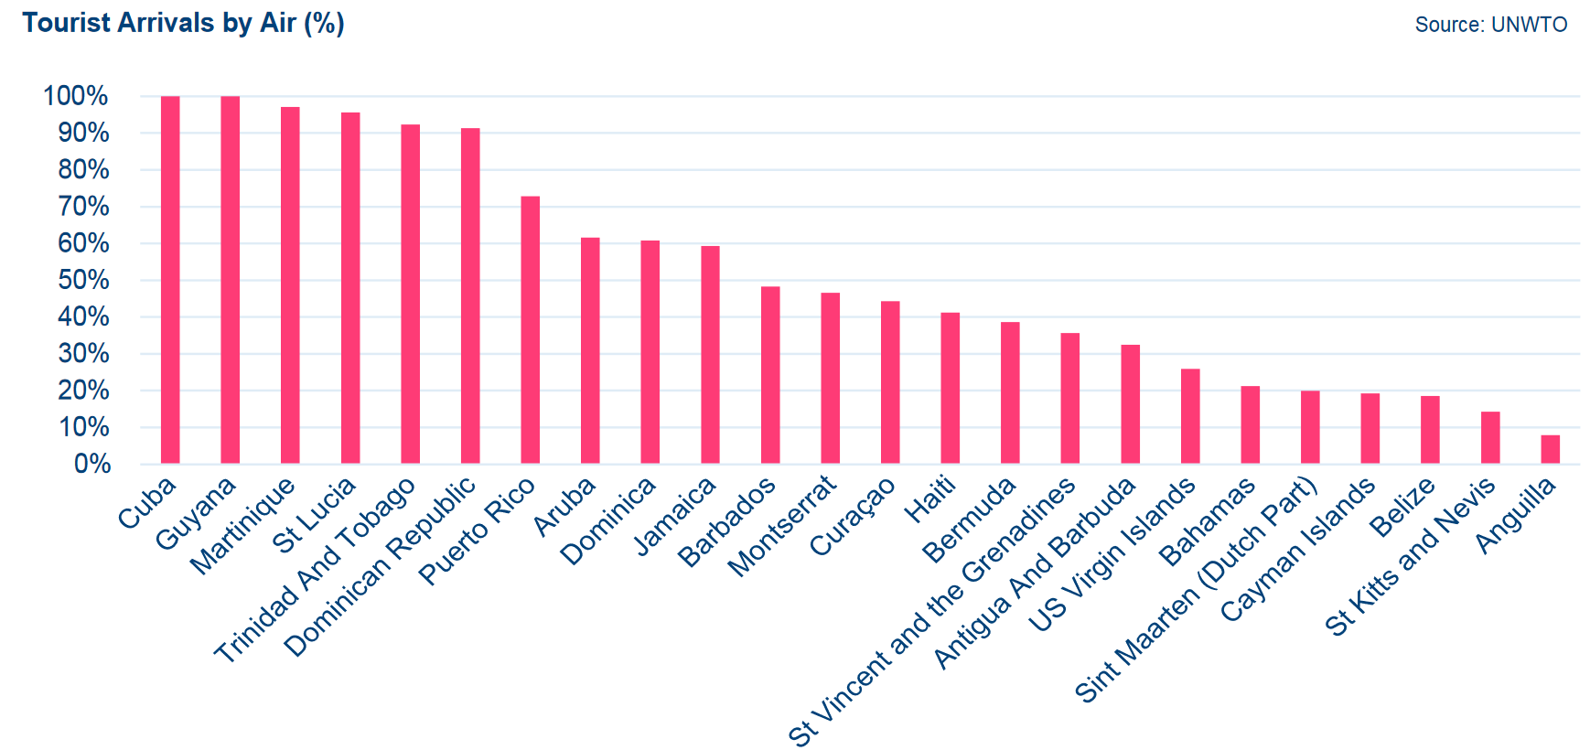
Tourist Arrivals by Air
In Dominican Republic, more than 90% of tourists arrive by air
Source: UNWTO

Slide 65
Expenditure and Duration of Stay
2006
Source: Dominican Republic

Slide 66
Expenditure and Average per Night
2006
Source: Dominican Republic

Slide 67
Expenditure per Stay
2006
Source: Dominican Republic

Slide 68
Hotel Room Units and Load Factor
2006
Source: Hotels & Tourism Association of the Dominican Republic and Central Bank of the Dominican Republic

Slide 69
Jobs Generated by Hotels in Dominican Republic
2006
Source: Hotels & Tourism Association of the Dominican Republic and Central Bank of the Dominican Republic

Slide 70
Long-term Traffic Forecasts
Revenue Passenger Kilometres (RPK) departing from Dominican Republic
2006
Source: ICAO

Slide 71
Long-term Traffic Forecasts
Number of flights and load factor departing from Dominican Republic
2006
Source: ICAO

Slide 72
What is Satellite Account?
The System of National Accounts (SNA) is the internationally agreed standard set of recommendations on how to compile measures of economic activity in accordance with strict accounting conventions based on economic principles
A Satellite Account is to provide more depth on measuring economic activities and social behavior of certain economic sectors that are not defined as industries in national accounts
Examples of existing Satellite Accounts:
Tourism Satellite Account
Health Satellite Account
Unpaid household activity

Slide 73
Need of Aviation Satellite Account (ASA)
Aviation Satellite Account (ASA)
Difficult to quantify contribution of aviation to economy
Incremental impact of investments in aviation in different sectors is unclear
Importance of aviation industry is often felt underestimated
No existing standard framework to measure the economic impact of civil aviation activities
Aviation Satellite Account

Slide 74
What does ASA Framework Measure?
ASA Framework
Aviation contribution to GDP
Ranking of aviation GDP compared to other sectors
Number of jobs created by aviation
Taxes and charges generated by aviation
Aviation consumption
Impact of aviation on balance of payments
The ASA will provide State an articulated framework measuring all aviation related economic activities

Slide 75
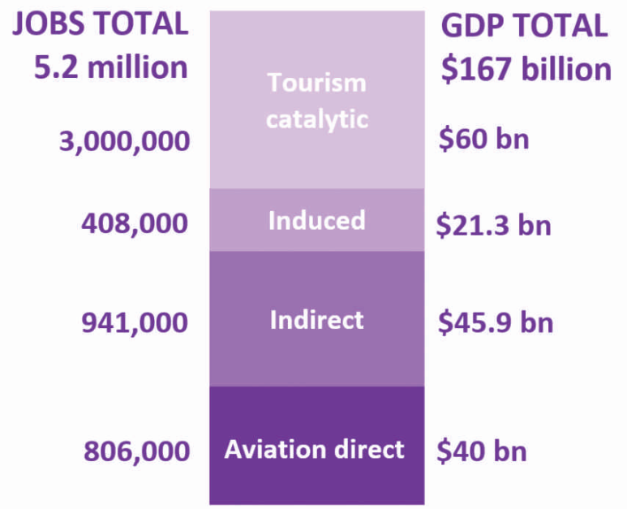
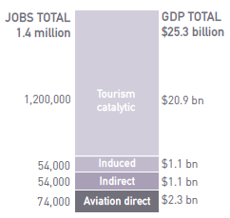
Aviation’s Economic Contribution
Latin America and the Caribbean (2014)
SIDS (2014)
Source: Aviation Benefits Beyond Borders 2016, ATAG

