Slide 1


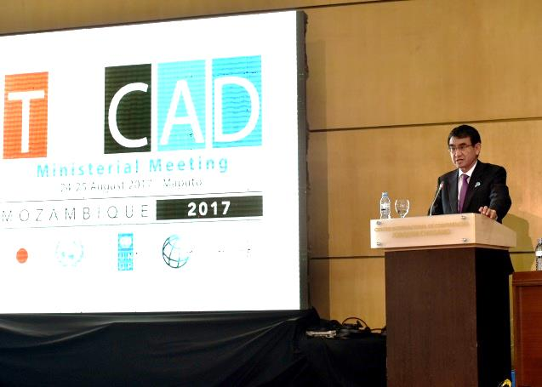
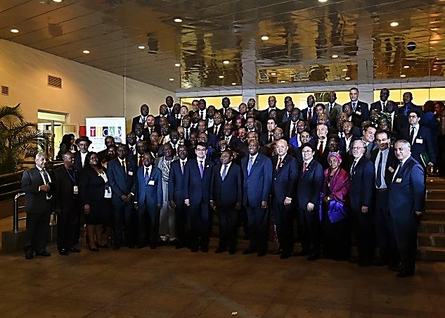
TICAD Ministerial Meeting
24-25 August (Maputo, Mozambique)
August 2017
African Affairs Department
Participants
Representatives of 51 African countries (16 foreign ministers, 9 other ministers, 12 minister-level officials), development partners including Asian countries, international and regional organizations, and civil society, etc.
Mr. Taro Kono, Minister for Foreign Affairs, Mr. Manabu Horii, Parliamentary Vice-Minister for Foreign Affairs , and Mr. Arata Takebe, Parliamentary Vice-Minister of the Environment participated from Japan.
Overview of the Meeting
[Opening Session] Foreign Minister Kono referred to the “Free and Open Indo-Pacific Strategy” announced by Prime Minister Abe on the occasion of TICAD VI, emphasizing the importance of strengthening connectivity between Asia and Africa through quality infrastructure investment and a maritime order based on the principles of international law, such as the freedom of navigation reflected in the United Nations Convention on the Law of the Sea (UNCLOS). He also introduced that Japan is advancing negotiations for investment agreements in order to develop an environment to encourage private sector investment in Africa.
[Plenary Session 1: Overview of Progress since TICAD VI] Foreign Minister Kono explained that Japan has implemented initiatives worth approximately 5 billion USD in line with the three pillars of the Nairobi Declaration (economic diversification and industrialization, health, and social stability) since 2016, and that the total value of the initiatives had reached 26.7 billion USD between 2013 (TICAD V) until 2016. He also stressed the importance of further efforts to encourage private sector investment.

Slide 2
Overview of the Meeting（Continued.)
[Plenary Session 2: Economic Transformation for Africa’s Growth] Parliamentary Vice-Minister for Foreign Affairs Manabu Horii presented the progress of initiatives to encourage private sector investment including industrial human resources development through the ABE Initiative and financing from government agencies into projects by private sector companies, etc.
[Plenary Session 3: Promoting Human Security and Resilient Society] Parliamentary Vice-Minister for Foreign Affairs Manabu Horii introduced initiatives to achieve sustainable and inclusive development such as (1) cooperation in the health field including capacity-building to fight against infectious diseases and promotion of universal health coverage (UHC), and (2) contributions for social stability in the areas of agriculture, food security and vocational training for youth.
“TICAD Progress Report 2017” and “Japan’s Initiatives 2017” were presented to the Ministerial Meeting.
Co-chairs’ Summary was produced to record the main points of the discussion in each session.
Japan’s Assistance in the Aviation Field (Recent developments)
Japan has recently signed the agreement on aviation-related infrastructure assistance with African countries such as:
  Egypt (“Borg El Arab International Airport Extension Project”)
  Mauritania (“Economic and Social Development Program”)
  Malawi (“Project for Expansion of the Terminal Building at Kamuzu International Airport”)
In addition to the provisions of infrastructure and materials, Japan has carried out trainings for personnel engaged in the area of aviation from different African countries every year (e.g. capacity building for officers in charge of airport security, customs and immigration, etc. )

