Slide 2

Luis Angel Osorio Ph.D.
Woxsen University, India
April 10, 2025

Slide 3
The Digital Transformation Opportunity in Air Cargo
Key Trends
Disruption from digital commerce integration and sustainability demands.
Shift from shipment-centric to consumer-centric logistics.
Full visibility is required from order placement to delivery.
Strategic Shift:
Interconnected ecosystems and real-time logistics.
Opportunity:
A tech-enabled value chain integrating commerce, routing, analytics, and tracking

Slide 4

Intelligent Data & Decision Architecture
Conceptual Framework:
Data Sources: IoT sensors, order data, cargo logs, aircraft diagnostics.
Integration Layer: Real-time ingestion, normalization, governance.
AI & ML Engine: Predictive maintenance, cargo optimization, forecasting.
Decision Support: Dashboards, alerts, path recommendations.
Key Output: Real-time, prescriptive insights optimizing cost, time, and sustainability.

Slide 5
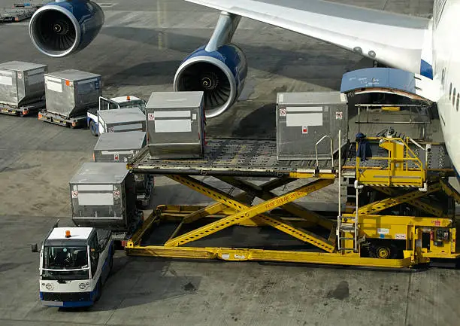
Operational Optimization Roadmap
Step-by-Step Digital Flow:
1. Digital Order Reception
2. Automated Pre-Screening
3. AI-driven Cargo Allocation
4. Automated Flight Routing
5. Tracking & Tracing (IoT + Blockchain)
6. Last-Mile Coordination
Tech Stack Examples: AI routing, cargo matching, blockchain for customs.
Impact: Faster delivery, less idle load, better asset utilization.

Slide 6


Technology Pillars & Sustainable Innovation
Key Digital Pillars:
AI & ML: Smart predictions and optimization.
Blockchain: Cargo traceability and integrity.
IoT: Real-time cargo monitoring.
Digital Twin: Operational simulations.
Cybersecurity: Securing digital logistics.
Sustainability Agenda:
Hydrogen propulsion and green routing.
Fuel and cargo load optimization.

Slide 7
Vision for a Smart & Connected Air Cargo Ecosystem
From Fragmented to Unified Logistics:
-Door-to-door digital integration and orchestration.
Multi-Layer Ecosystem:
-Order Mgmt → Cargo Matching → Flight Optimization → Compliance → Tracking → Delivery
What Success Looks Like:
-24/7 cargo traceability, predictive maintenance, and eco-efficiency.
Call to Action:
-Leverage AI, commerce platforms, and connected logistics.

