Slide 2
Supporting Capacity Development and Implementation
Middle East Region
Eighth Meeting of the Directors General of Civil Aviation-Middle East Region
(Doha, Qatar, 26 - 28 October 2016)
Fabio Rabbani
Director, Capacity Development and Implementation Bureau
International Civil Aviation Organization

Slide 3
ICAO STRATEGIC PLAN · 2026–2050
Operationalizing ICAO's NCLB Strategic Goal
STRATEGIC GOAL IN FOCUS
No Country is Left Behind
No Country is Left Behind
Aviation is Environmentally Sustainable
Every Flight is Safe & Secure
Ensures States benefit from ICAO’s implementation support and resource mobilization activities, which are designed to promote the effective implementation of policies, standards and recommended practices.
Helps overcome resource limitations that impact infrastructure, training, supply chain access and coordination, especially in developing countries
ICAO's Strategic Goals
2026–2050
Economic Prosperity & Societal Well-being for All
Reliable, Accessible & Seamless Mobility for All
Legal & Regulatory Framework for Every Challenge
Notes:
Aviation demand is projected to more than double by 2050, creating significant opportunities while increasing pressure on safety, infrastructure, air navigation systems, and workforce capacity, particularly in developing States.
To address these challenges, ICAO's 2026-2050 Strategic Plan provides a long-term framework focused on safe, sustainable, accessible, and resilient aviation growth.
At the heart of the Plan is No Country Left Behind (NCLB), ICAO's commitment to ensuring all Member States, especially developing countries, benefit from implementation support and resource mobilization.
NCLB helps States implement ICAO policies and Standards while strengthening their ability to meet growing aviation demands.
The initiative also addresses critical capacity gaps in areas such as infrastructure, training, supply chains, and coordination.
The Bureau's work in South America is focused on translating NCLB into practical action, helping States build the capabilities needed for sustainable aviation development.

Slide 4
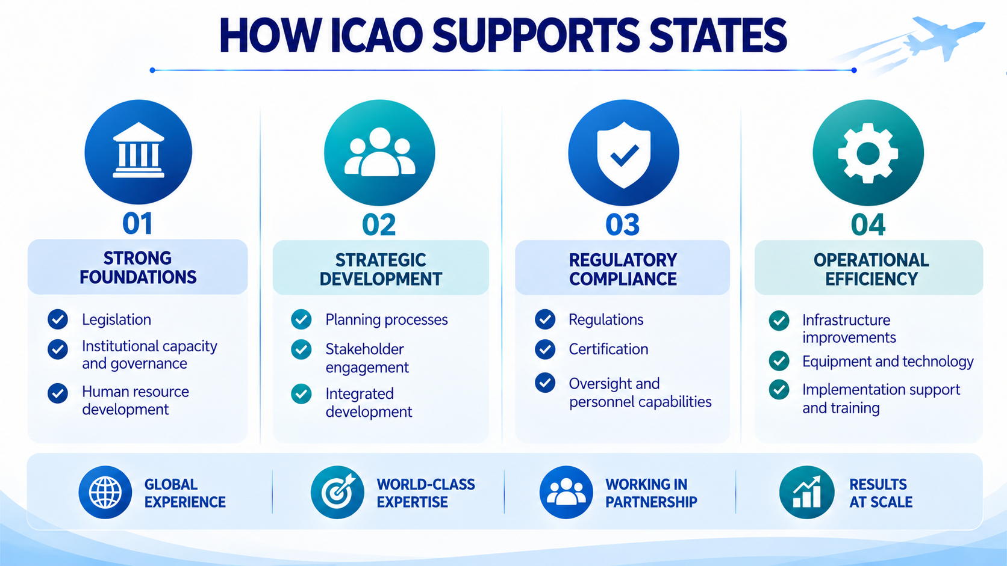

Slide 5
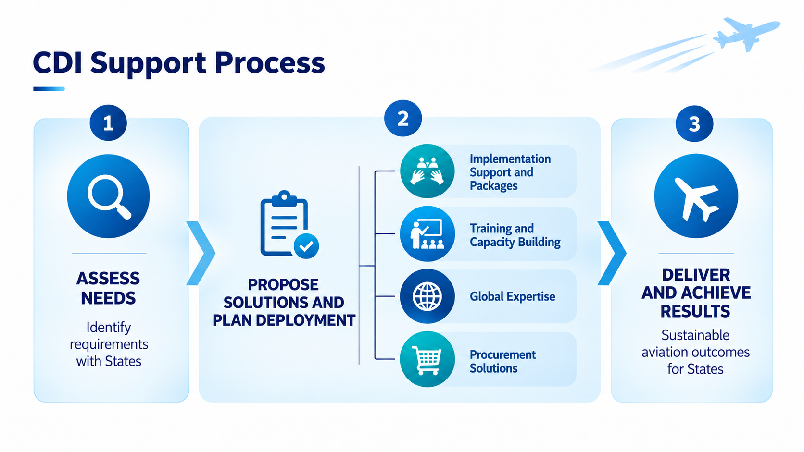
Notes:
CDI’s support process has three broad stages. First, we assess needs and identify requirements with the State. Second, we propose a solution and plan deployment, drawing on implementation support packages, training and capacity building, global expertise and procurement solutions. Third, we deliver and work towards measurable, sustainable aviation outcomes. This process helps connect identified needs to practical support and lasting results.

Slide 6
MID - ONGOING PROJECTS
Mediterranean Sea
PROJECT STATUS
Egypt
Airspace restructuring assistance
Lebanon
Iraq
Iraq
OPAS assistance, Tal Afar and Erbil
Kuwait
Kuwait
Long-standing OPAS assistance
Libya
Egypt
Lebanon
National professionals; ATM procurement
Saudi Arabia
Libya
Civil Aviation Master Plan for LYCAA
Saudi Arabia
OPAS in all domains; King Salman Airport
Sudan
OPAS assistance; civil aviation restart
Sudan
REGIONAL PROJECTS
CASP-MID
Cooperative Aviation Security Programme
MID-FPP
MID Region Flight Procedure Programme
Arabian Sea
MID-RMA
Middle East Regional Monitoring Agency
*The map provided in this Slide may not reflect actual boundaries and should not be used as a reference for navigational or any other purposes; it does not imply the expression of any opinion whatsoever on the part of ICAO concerning the legal status of any country or territory or of its authorities or concerning the delimitation of its frontier or boundaries".
Notes:
This map shows the breadth of our engagement across the region, alongside CASP-MID, the Flight Procedure Programme and the Regional Monitoring Agency.
The activities range from airspace planning and expert assistance to national staffing and airport development.
The important qualification is that these projects are at different stages, in maturity, scope and progress. Some have been in place for years as long standing partnerships, we are very proud of, and others are more surgical in nature, where we come in for a short period, execute the mandate and make sure the local capacity is brought along.
These are all projects that are managed by the CDI team in Montreal but closely coordinated with the MID Regional Office, our eyes and ears in the field.

Slide 7




SUCCESS STORIES IN THE MIDDLE EAST
Country partnerships advancing aviation implementation through CDI support
Iraq CAA
Oman CAA
SKILLS FOR STRONGER AVIATION
EXPERTISE FOR SAFETY OVERSIGHT
Targeted training turns identified needs into stronger skills for Iraq’s civil aviation workforce.
ICAO supported the Oman CAA in pre-audit preparations, helping increase the EI score.
500+ trainees to date
400 additional planned in 2027
Lebanon
Saudi Arabia
LONG-STANDING PARTNER
LONG-STANDING PARTNER
PEOPLE BEHIND ESSENTIAL SERVICES
BUILDING CAPACITY FOR AVIATION DEVELOPMENT
Support for national professionals and air navigation services helps Lebanon sustain its civil aviation expertise and operational capacity.
Expert support to enhance regulatory capability and to promote infrastructure development, including at King Salman International Airport
Notes:
These examples show several ways that country partnerships support aviation implementation, from developing professional skills to maintaining essential expertise and strengthening oversight.
In Iraq, we’ve trained more than 500 trainees to date, with 400 additional trainees planned for 2027.
We conducted a Training Needs Analysis for the Iraq CAA and identified training as a priority in many area, alongside the airworthiness, personnel licensing and aerodrome expertise already in place
In Oman, ICAO’s Experts support helped the Authority prepare for its audit and contributed to the improvement in effective implementation score and we have since been working with Oman on future avenues of collaboration, where capacity development is needed.
Lebanon also stands out as a long time CDI partner where we’ve hired National Professionals, implemented Training and supported in various Procurement activities.
We are also supporting Lebanon in their Flight Calibration activities, coordinating the full exercise in some challenging times and ensuring the implementation is carried out.
Saudi Arabia illustrates a long-standing partnership that continues to develop. Both the Operational Experts project and the King Salman International Airport project are under implementation, with expert deployed in various areas. We want to thank the kingdom for their trust in CDI

Slide 8


ICAO Training: Building Sustainable Capabilities
01
IDENTIFY
02
BUILD
03
IMPLEMENT
04
SUSTAIN
Needs & gaps
Competencies
iPacks & expertise
State capability
• Needs assessment
• State-specific capacity gaps
• 500+ ICAO courses
• Classroom
• Online
• Competency-based training
• Training + expert support
• Guidance & practical tools
• Implementation assistance
• Knowledge transfer
• Institutional capacity
• Continuous improvement
ONE TAILORED OFFER
Tailored to each State’s priorities and implementation needs.
Notes:
Training is most effective when it is connected to implementation.
1. IDENTIFY — Understand States’ training needs
We work with States to identify competency gaps and training priorities.
Our approach helps align training with national aviation priorities, operational challenges and areas requiring improvement.
2. BUILD — Highlight our ICAO training courses
ICAO Training offers a portfolio of 500+ courses covering key areas of civil aviation.
Our courses are delivered through instructor-led classroom training, virtual learning and online programmes.
We provide specialized training in areas such as aviation safety, safety oversight, personnel licensing, airworthiness, flight operations, aviation security, air navigation and facilitation.
Our competency-based courses equip aviation professionals with the knowledge and practical skills needed to perform their functions effectively.
3. IMPLEMENT — Go beyond training
Through our iPacks, ICAO combines training with expert support, practical tools and implementation guidance.
This enables States to translate the knowledge gained through our courses into concrete actions and improvements.
Our experts help States address specific implementation challenges and strengthen their institutional capabilities.
4. SUSTAIN — Build lasting national capacity
Our objective is not simply to train individuals, but to help States develop sustainable aviation capabilities.
By strengthening professional competencies, transferring knowledge and supporting institutional development, ICAO Training contributes to continuous improvement in aviation oversight and implementation

Slide 9

ICAO Training Catalogue
AVIATION MANAGEMENT
500+ training packages available in face-to-face, online or hybrid formats across 11 strategic training areas, supporting the implementation of SARPs.
Global network of over 144 Training Organizations and Partners developing and delivering ICAO Training.
AIR NAVIGATION SERVICES
AERODROMES
ENVIRONMENT
www.icao.int/training
FLIGHT SAFETY AND SAFETY MANAGEMENT
SECURITY
FACILITATION
AIR TRANSPORT
TRAINING COMPETENCY DEVELOPMENT
AVIATION LAW
NEW
AVIATION NEW ENTRANTS
Notes:
Today, we offer more than 500 training packages, delivered in classroom, online, and hybrid formats, across 11 strategic aviation areas. And we are not doing this alone—this is made possible thanks to a global network of over 144 training organizations and partners contributing to the development and delivery of ICAO training worldwide.
If you are curious to explore further, you can simply scan the QR code or visit icao.int/training to discover the full catalogue and all available programmes.

Slide 10
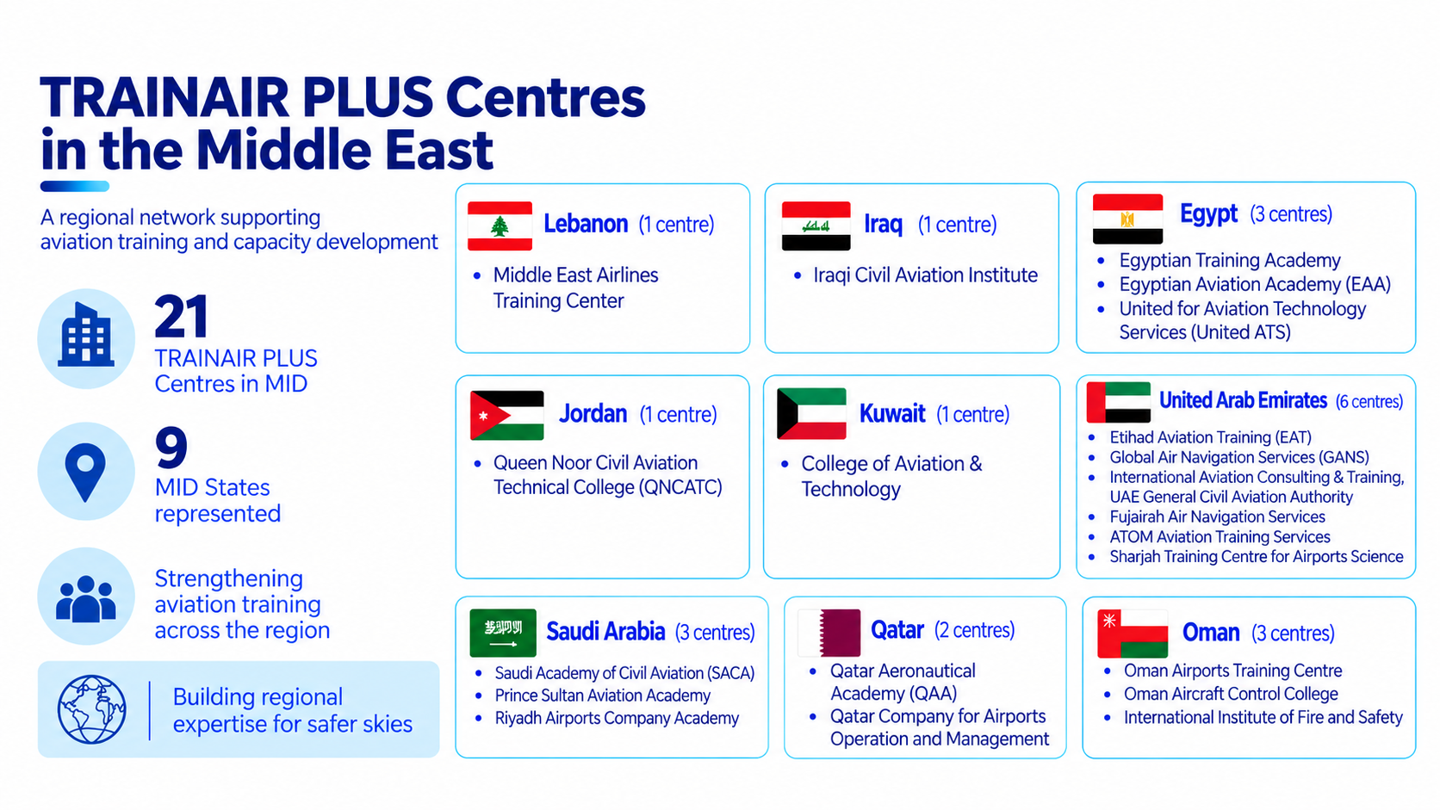
Notes:
The TRAINAIR PLUS network provides a regional foundation for aviation training and capacity development. The slide identifies 21 TRAINAIR PLUS centres across nine represented MID States, creating a network of institutions that can help expand access to aviation learning and strengthen local training capacity. The value is not only the number of centres, but the opportunity to build regional expertise, share capability and make training more accessible to States.

Slide 11
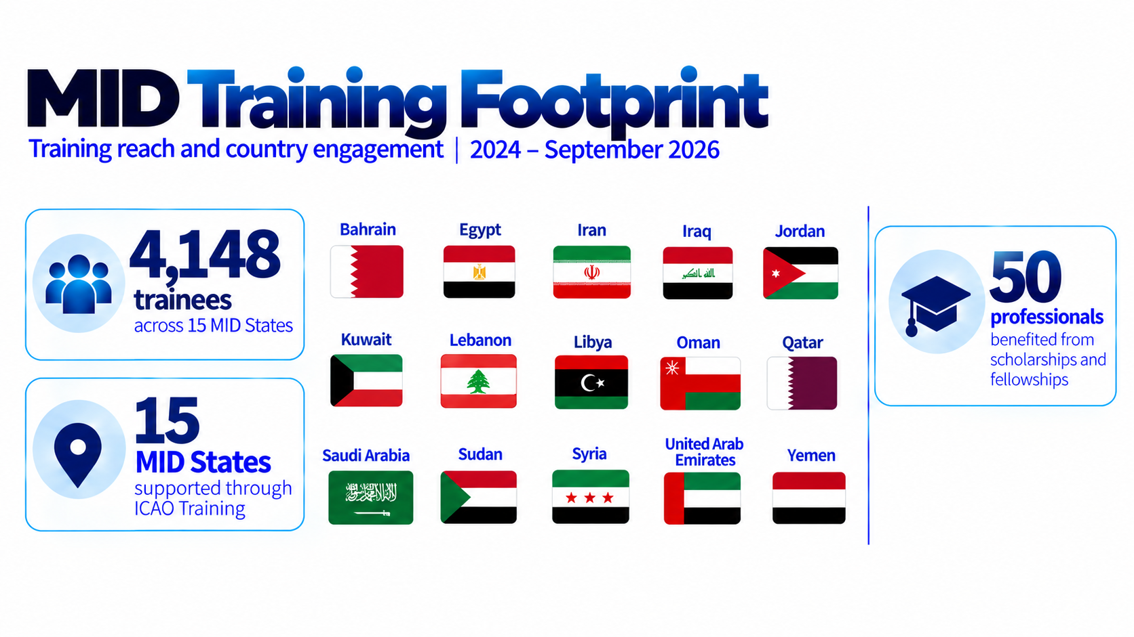
Notes:
From 2024 through September 2026, ICAO Training has recorded 4,148 trainees across the Middle East Region and training support reaching 14 MID States. It is also highlighted that 50 aviation professionals benefited from scholarships and fellowships provided by donor states. These figures illustrate the reach of ICAO Training and the importance of combining course delivery with opportunities that help States develop their workforce.

Slide 12

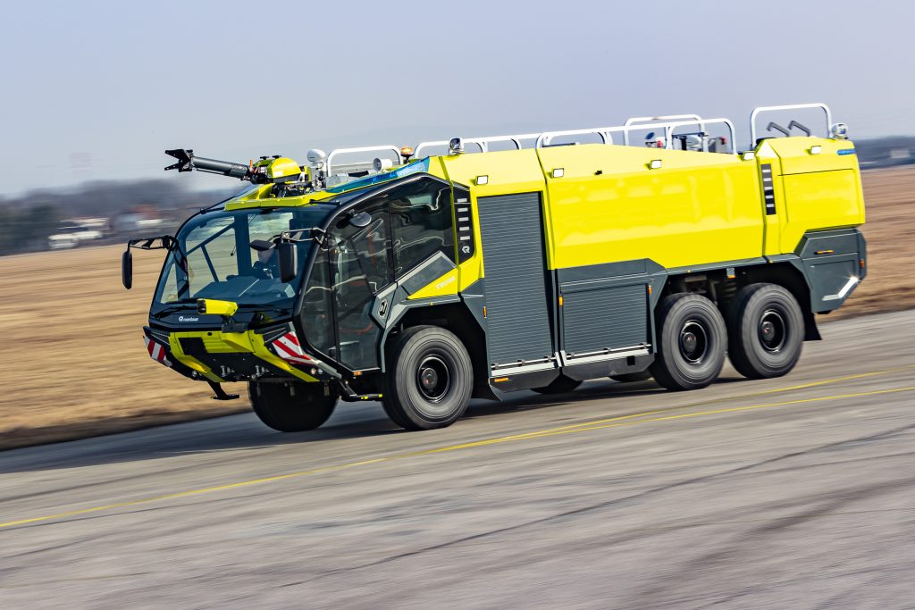
New Initiative: ICAO BUY
One portal for sourcing aviation solutions
AVAILABLE NOW
store.icao.int/en/icao-buy
WHAT IT DOES
Aircraft Rescue & Firefighting (ARFF)
01
Pre-qualified suppliers
Products sourced through competitive ICAO procurement.
02
Better value
Aggregated demand and long-term agreements help deliver competitive pricing.
03
Simpler purchasing
A streamlined route to aviation goods and services.
ARFF vehicles
SCBA
Protective equipment
Firefighter kit
Extinguishing agents
Pre-qualified, competitively sourced aviation solutions, with simpler access through ICAO BUY
Notes:
is a new implementation support initiative under No Country Left Behind, designed to help States access aviation goods and services through a more streamlined sourcing process.
Through internationally competitive tendering and pre-qualified suppliers, ICAO BUY can help States identify suitable solutions, benefit from potential economies of scale and simplify procurement, while maintaining quality and compliance with ICAO requirements.
The initial catalogue focuses on practical operational needs, including aircraft rescue and firefighting vehicles, protective equipment, Self contained breathing apparatus and Extinguished Agents. Additional products and services will be introduced progressively.
The key message is that ICAO BUY complements CDI’s capacity development and implementation support by helping States move from identifying an operational need to accessing a potential solution. It does not replace the need for States to assess their specific operational requirements and applicable regulatory obligations.

Slide 13
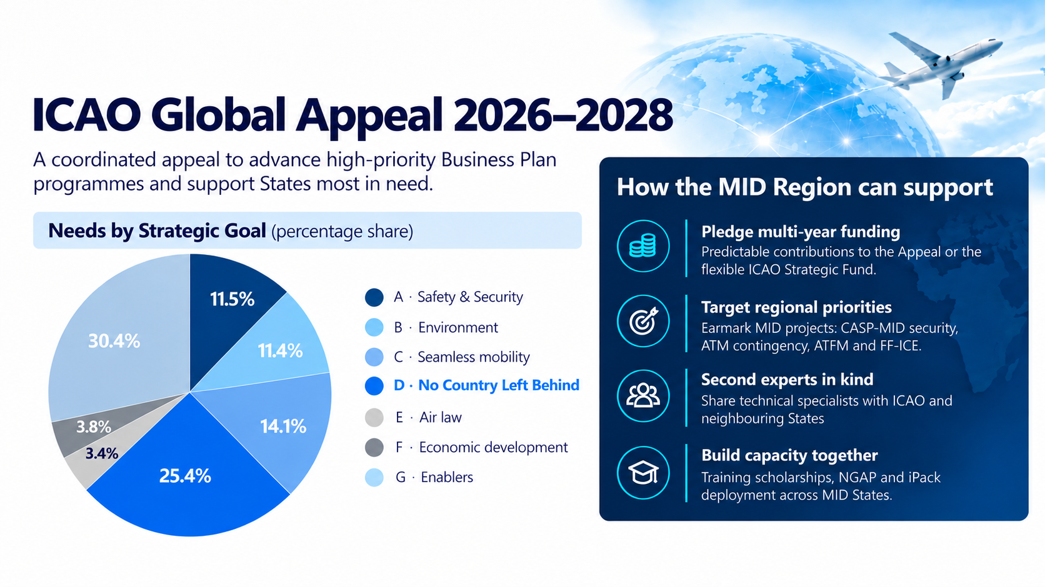

Slide 14
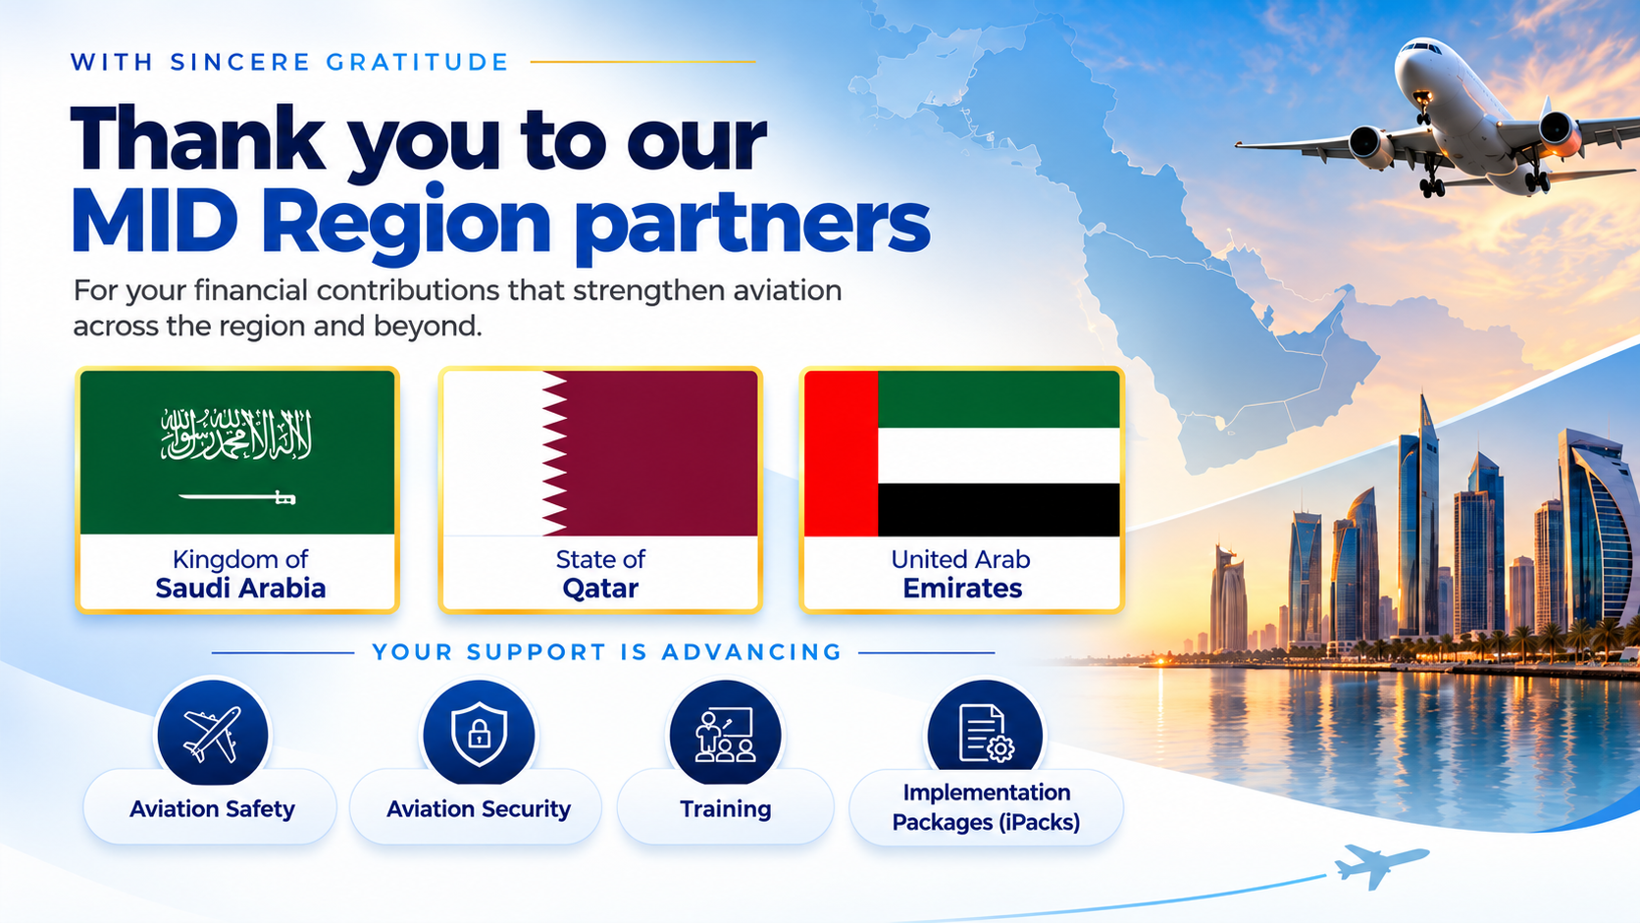

Slide 15
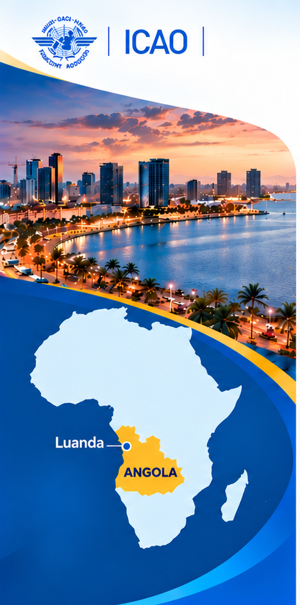


ICAO Global Implementation
Support Symposium (GISS) 2027
Luanda, Angola
Week of 24 May 2027
ESAF Region
KEY HIGHLIGHTS
Ministerial Call
to Action
Strong ICAO Council
participation
Exhibition showcased
practical solutions and innovation
2026
1,450+
101
27
39+
Participants
on-site
Member States
represented
Ministers engaged
in high-level discussions
Project signings &
announcements
Notes:
ICAO’s 6th Global Implementation Support Symposium 2027 will take place in Luanda, Angola, during the week of 24 May 2027. GISS is the flagship platform for turning global commitment into tangible action in support of No Country Left Behind. The previous highlighted outcomes include more than 1,450 on-site participants, representation from 101 Member States, 27 ministers engaged in high-level discussions, and more than 39 project signings and announcements. The symposium brings States, donors, industry and implementation partners together to identify solutions and advance cooperation. We look forward to welcoming the global implementation community to Angola.

