Slide 1

ICAO MID WORKSHOP ON GNSS AND PBN · CAIRO, EGYPT · 29 SEPTEMBER – 1 OCTOBER 2026
Managing GNSS Interference
in the Emirates FIR
Detection, ATC and airspace mitigations, and regional coordination
United Arab Emirates
General Civil Aviation Authority
Sheikh Zayed Air Navigation Centre, Abu Dhabi
Ahmed Basaleeb, Senior Specialist – Airspace Section · Hassan Abdulla, Specialist – Air Traffic Operations

Slide 2
INTRODUCTION
Purpose and scope of this presentation
This presentation summarises the United Arab Emirates' operational experience of GNSS radio frequency interference (RFI) affecting the Emirates FIR, the mitigations applied across ATC, airspace design, CNS and AIM, and the coordination model used with civil, military and industry stakeholders.
1
2
3
What we observed
What we did
What we propose
Analysis of ATC occurrence records for the Emirates FIR, October 2024 to June 2026, correlated with ground-based CNS monitoring.
A four-layer mitigation model: ATC procedures, airspace and procedure design, CNS resilience, and aeronautical information provision.
Practical actions for the MID Region on reporting, common metrics, resilient navigation networks and cross-FIR coordination.
Scope note: this presentation addresses en-route and terminal operations within the Emirates FIR and its interfaces with adjacent FIRs. It does not address the source or attribution of interference.

Slide 3
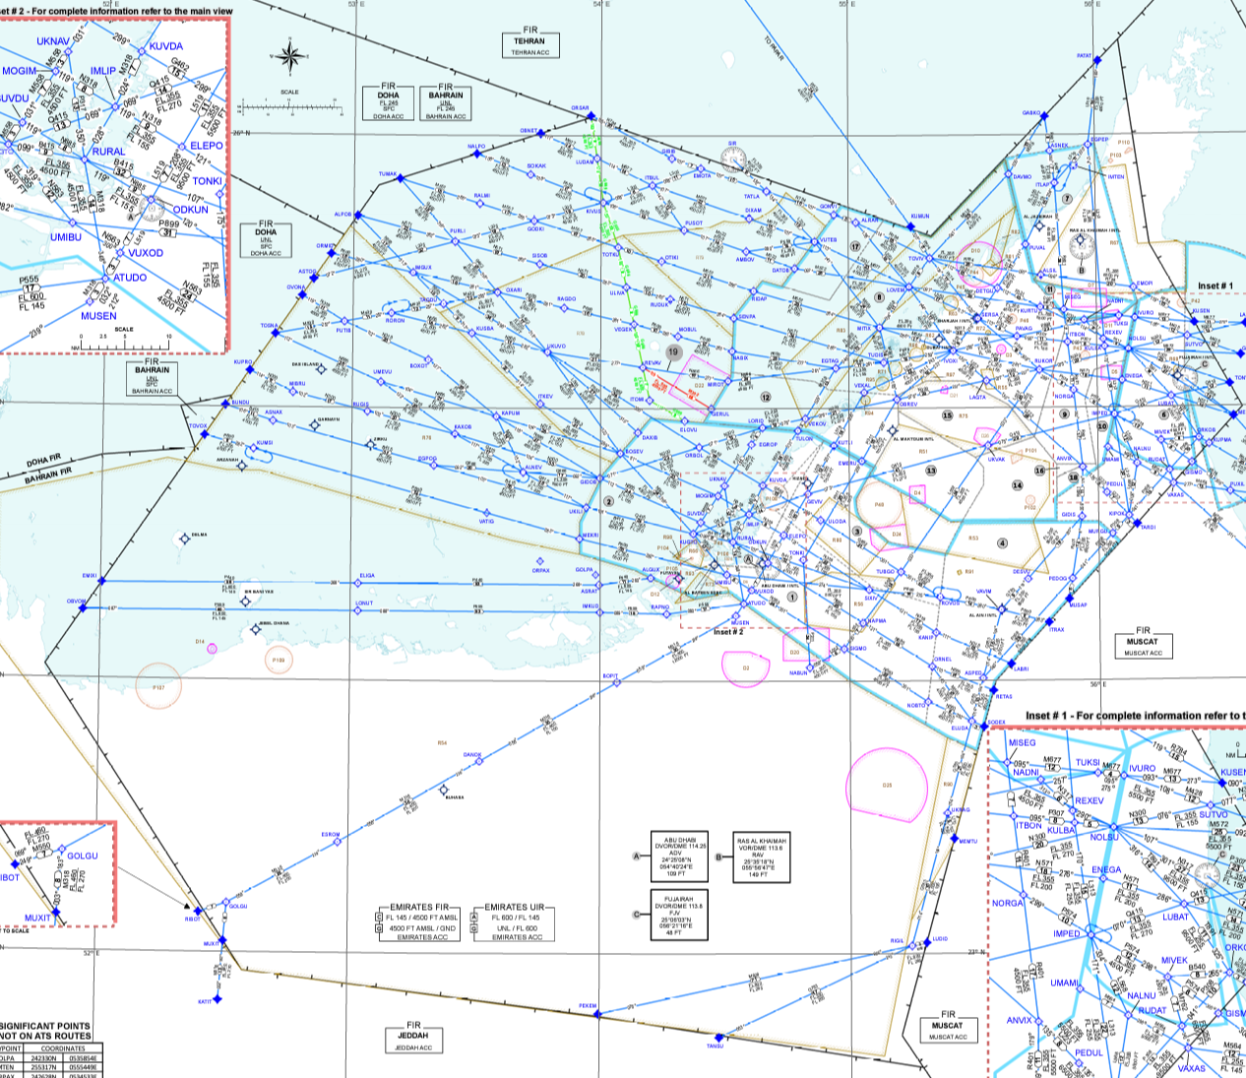
CONTEXT
Operating environment — Emirates FIR
FL600
21
upper limit of the
Emirates UIR (Class A)
months of ATC records
analysed (Oct 24 – Jun 26)
5
7
adjacent FIRs
OOMM · OBBB · OIIX · OTDF · OEJD
international aerodromes
within the FIR
Why this FIR is exposed
– Dense, highly connected traffic across a compact FIR
– Multiple international hubs with closely spaced terminal areas
– Boundaries with FIRs subject to sustained conflict-zone advisories
– Route and terminal structure heavily dependent on PBN
Emirates FIR ATS route network, with adjacent FIR boundaries.
Emirates FIR: surface to FL145 · Emirates UIR: FL145 to FL600 · RNAV 1 mandatory on the en-route network. Source: UAE AIP.

Slide 4
CONTEXT
What GNSS underpins in our operation
Interference does not affect navigation alone. A single RFI event propagates across navigation, surveillance, timing and flight-deck systems simultaneously.
Navigation
RNAV/RNP ATS route network, PBN SIDs, STARs and approach procedures
Surveillance
ADS-B position reporting and dependent ATM automation functions
Timing
Synchronisation of CNS/ATM ground systems and data recording
Flight deck
Hybrid IRS/GNSS position, EFB ownship depiction, terrain and traffic alerting
Operation
Separation minima applicability, sequencing, flow and controller workload

Slide 5
REGULATORY BASIS
The ICAO framework we are working within
Assembly Resolution A42-8, Appendix C
AN-CONF/14 Recommendation 2.2/2
Resilience of CNS/ATM systems and services. Urges States to refrain from jamming and spoofing affecting civil aviation, and to ensure sufficient resilient terrestrial CNS capability remains available.
Addressing GNSS interference — provision of operationally relevant interference information to operators, and acceleration of complementary PNT and signal authentication work.
Doc 9849 — GNSS Manual
NAV RON and C-PNT
Reporting of GNSS RFI occurrences and the mechanism for raising operational awareness of affected geographical areas through regional planning bodies.
Resilient Navigation Operational Network and Complementary PNT as the ICAO-endorsed direction for sustaining operations during RFI events.
References: ICAO Assembly Resolution A42-8, Appendix C (42nd Session, 2025) · AN-CONF/14 Recommendation 2.2/2 · ICAO Doc 9849, GNSS Manual. Verify edition and amendment status before publication.

Slide 6
Part one
What we observed
Analysis of 1,429 ATC occurrence records, October 2024 to June 2026, of which 575 were inside the Emirates FIR

Slide 7
METHOD
How the occurrence picture was built
1
2
3
4
Extract
Filter
Classify
Correlate
ATC occurrence and watch-supervisor log entries, Emirates FIR, 1 Oct 2024 – 13 Jun 2026
Records containing GNSS, GPS, RAIM, UNABLE RNAV, position discrepancy and equivalent terms
By phase of flight, sector, reported effect, and jamming or spoofing characteristics
Against ground-based CNS interference monitoring and airline reports
LOG RECEIVED
ATC occurrence log received and analysed
1,429 records analysed: 575 inside the Emirates FIR. Classified by phase of flight, reporting location and reported effect. Filter terms: GNSS, GPS, RAIM, unable RNAV/RNP, position discrepancy, spoofing, jamming, interference.
The review also told us where to strengthen our own recording — position and narrative capture in particular — and that work is now in hand. A structured record is what made the analysis possible in the first place.

Slide 8
FINDINGS
Occurrence picture — October 2024 to June 2026
1,429
occurrences logged in total
575
inside the Emirates FIR (40%)
355
inside the FIR in June 2025 alone
58
records in the Feb–Jun 2026 window
SOURCE: SZC ATC LOG
The June 2025 peak, and the decline that follows, is the finding. Occurrences inside the FIR rose from single figures per month to 355, then fell back. The Feb–Jun 2026 window holds 58 records in total, 40 of them inside the FIR.
Source: SZC ATC occurrence log, 1 Oct 2024 – 13 Jun 2026. Anonymised; no operator, flight or individual identified. Confirm clearance for external release.

Slide 9
FINDINGS
Where the interference is being experienced
What this tells us
Upstream FIRs are shown unnamed — this is an operational picture, not an attribution
An aircraft may enter the FIR already unable to fly the published arrival
This is why cross-boundary coordination, not national measures alone, is the answer
CNS ground monitoring is still needed to corroborate reported position
Source: SZC ATC occurrence log, Oct 2024 – Jun 2026 (1,429 records). CNS monitoring output to be added to corroborate the reported picture.

Slide 10
FINDINGS
Observed operational effects
Flight deck
Air traffic control
Loss or degradation of GNSS position
Unable RNAV / RNP downgrade reports
Spurious terrain and traffic alerting
Erroneous EFB ownship depiction
Increased R/T load and coordination
Requests for radar vectors and conventional routing
Re-clearance and re-sequencing workload
Reduced predictability of arrival flows
Surveillance and systems
Procedures and separation
ADS-B position anomalies
Time-stamp inconsistencies in downlinked data
Effects on dependent automation functions
Applicability of PBN-based separation questioned
Reversion to conventional navigation aids
Impact on RNP-based terminal procedures
Retain only the effects actually evidenced in the ATC log. Remove any category not supported by a record.
VERIFY

Slide 11
FINDINGS
Reported cases — what the events actually look like
Three categories of event, drawn from our operational log and our safety occurrence records, show why GNSS RFI is treated as a system-level safety issue rather than a navigation inconvenience.
DEGRADED ON ARRIVAL
FALSE ALERTING
FALSE RA
Interference acquired upstream
Spoofing driving terrain alerts
A resolution advisory with no conflict
Aircraft repeatedly lost GNSS in an upstream FIR while inbound to the UAE and entered the Emirates FIR already degraded. In 71 logged cases the crew was unable to fly the published arrival and required radar vectors.
An aircraft descending through FL165 received a terrain warning generated from a spoofed position, with no real terrain proximity. A second aircraft reported spoofing with a terrain warning four months later.
An aircraft on descent received a TCAS resolution advisory against traffic 2,000 ft below. The other aircraft received nothing. Spoofing is the suspected cause, and it is under investigation. Fifteen further occurrences record TCAS lost or intermittent.
Cases of this kind are the most effective content in a workshop presentation, and also the most sensitive. Describe the effect, never the flight.

Slide 12
EVIDENCE
From an ATC report to a registered hazard
Every occurrence follows a defined route through our safety management system. A controller’s report becomes a numbered record, a classification, and where warranted a registered hazard — the structure ICAO Annex 19 and Doc 9859 call for.
1
2
3
4
5
ATC report
ROSI occurrence
Classification
Hazard linkage
Investigation
The controller logs the event and notifies the watch supervisor
A numbered occurrence report is raised in the safety system
The occurrence is classified against a defined taxonomy
Where warranted, the occurrence is linked to a registered hazard
Preliminary investigation and follow-up action
A two-instrument evidence base
What our own review identified
– The operational log gives us volume. The safety record gives us severity.
– 41 occurrences escalated into formal safety reports, each one classified and tracked.
– Four are linked to a registered hazard, which is what makes trend action possible.
– We reviewed our own classification practice against the full occurrence record.
– One event type can attract more than one valid label, which limits comparison between States.
– A common MID taxonomy resolves this. It is our first proposal.
Source: SZC safety occurrence records (ROSI), December 2025 – June 2026. References: ICAO Annex 19 · ICAO Doc 9859 (Safety Management Manual).

Slide 13
Part two
How we responded
A layered mitigation model spanning ATC procedures, airspace design, CNS resilience and information provision

Slide 14
RESPONSE
A four-layer mitigation model
Each layer addresses a different part of the problem and operates on a different timescale — from the immediate tactical response through to infrastructure and information provision.
1
2
3
4
TACTICAL
STRUCTURAL
FOUNDATIONAL
ENABLING
ATC procedures
Airspace and procedure design
CNS infrastructure
Information provision
Immediate response by the controller to a reported or detected event
Route and procedure design that remains usable without GNSS
Detection, monitoring and a resilient conventional navigation network
Timely, accurate and consistent information to operators and crews
Underpinned throughout by safety management — hazard identification, risk assessment and monitoring under ICAO Doc 9859 and the ANS SMS.

Slide 15
RESPONSE
Layer 1 — Air traffic control procedures
Detection and recognition
Tactical handling
Communication and handover
Recognition of RFI indicators in pilot reports
Cross-check of position with independent surveillance
Watch supervisor notification threshold
Logging of every event to a single defined record
Radar vectoring where GNSS position is unreliable
Clearance via conventional navigation aids
Provision of ILS where RNP approach is not available
Consideration of increased separation where PBN-based minima are not assured
Standard phraseology for reported GNSS degradation
Information passed to following aircraft on the same routing
Coordination with adjacent sectors and adjacent FIRs
Handover briefing content during sustained events

Slide 16
RESPONSE
Layer 2 — What this means for airspace design
Interference does not change where aircraft need to go — it changes how they can get there. Our occurrence record points to four requirements that any airspace has to meet if it is to degrade gracefully.
It must exist in advance
It must not depend on GNSS
It must cross the boundary
It must be published
An aircraft already airborne and already degraded cannot wait for a routing to be designed. The alternative has to be in the published structure before the event.
An alternative requiring a navigation specification that depends on GNSS fails at the moment it is needed. Conventional navigability — DME/DME, VOR/DME, ILS — is what makes it real.
Sixty per cent of our occurrences were acquired outside our airspace. An alternative that stops at the FIR boundary does not help an aircraft that arrived already degraded.
Crews can only use what they can see. Design under PANS-OPS Vol II, the navigation specification justified per Doc 9613, assessed under SMS, and published with AIRAC lead time.
THE TEST
An alternative that depends on GNSS is not an alternative
In 71 logged cases the crew entered the Emirates FIR unable to fly the published arrival and required radar vectors. That is 71 times an alternative was needed by an aircraft that was already airborne, already degraded, and already inside a sequence. This is the test we would put to any airspace design: on the day GNSS is unavailable, is what remains actually flyable?
ICAO Doc 8168 (PANS-OPS) Vol II · Doc 9613 (PBN Manual) · Doc 9859 (SMS Manual) · Doc 9971 (Collaborative ATM) · Doc 7030 (MID Regional SUPPs).

Slide 17
RESPONSE
The DME/DME assumption behind RNAV 1
RNAV 1 route and terminal operations assume that DME/DME provides the fallback when GNSS is unavailable. That assumption only holds if the DME network is complete, serviceable and free of shielding.
Coverage gaps
DME/DME coverage is not continuous across the whole route structure, so the fallback is not available everywhere the RNAV 1 requirement applies.
Maintenance of the network
Some DME facilities are not being maintained to the standard the fallback assumes, while other procedures and routes depend on those same facilities.
Terrain shielding
Terrain reduces DME coverage in some areas, so the theoretical coverage assumed at design stage is not what is achieved operationally.
Regulatory oversight
This is a regulator matter as much as an ANSP matter. Confirmation is needed that the facilities underpinning the fallback are being maintained and monitored.
A resilient navigation network is only resilient if it is verified. This is the point at which the NAV RON concept becomes a maintenance and oversight obligation rather than an infrastructure inventory.

Slide 18
RESPONSE
Layer 3 — CNS infrastructure and timing resilience
1
What happened when timing went wrong
What CNS took from it
Our flight data processing system lost correlation, and both tracker chains became unavailable. NTP servers were running around two minutes ahead, and because of that offset the tracker rejected the sensors.
Protect critical timing sources — treat timing as critical infrastructure in its own right
Understand system dependencies — know which systems rely on timing, and what fails when it drifts
Build in layers — resilience is not a single fix
And the wider direction ICAO has set: NAV RON, complementary PNT, signal authentication, and spectrum protection with the national regulator
2
The engineering response
The timing path was isolated and the primary NTP connected directly to the anti-jamming unit. FDPS was re-synchronised to the NTP receivers. Radars reconnected and data was restored to operations.
3
A resilient timing architecture
GNSS
Anti-jamming
NTP 1
primary
NTP 2
NTP 3
Stable timing at the centre; remote sites synchronised.
Source: GCAA ANS Engineering. This work will be presented in full by our engineering colleagues at ICAO Air Navigation World – CNSS 2026.

Slide 19
RESPONSE
Layer 4 — Aeronautical information and operator awareness
NOTAM
Notification of GNSS RFI affecting the FIR, issued and maintained in accordance with the applicable ICAO template.
AIC
Standing guidance to operators on expected effects, reporting expectations and the conventional alternatives available.
Safety Information
Safety information issued to operators where an event or a pattern of events warrants direct notification.
AIP
The underlying navigation infrastructure, route requirements and reversion arrangements published in the AIP and referred to from the AIC.
Reporting to ICAO
Occurrences that cannot be resolved through routine national procedures reported to the ICAO Regional Office, per Doc 9849.
IN FORCE NOW
NOTAM A2883/26 — GNSS interference, Emirates FIR, surface to unlimited
"Pilots are advised that GNSS signal interference (including possible spoofing and jamming) has been reported within Emirates FIR. Unreliable GNSS signals may be experienced. Aircraft operators are advised to exercise caution and use alternative means of navigation when necessary. ATC should be informed of any observed anomalies."
ICAO Annex 15 · Doc 9849 · MIDANPIRG Conclusion 22/23 on publication of GNSS-related information.

Slide 20
RESPONSE
Coordination model and stakeholders
No single organisation holds all of the detection capability, the regulatory authority and the operational response. The UAE approach is built on a standing coordination model rather than event-driven contact.
GCAA
National
Regional and international
Air Traffic Control operations
Airspace Management
Communications, Navigation and Surveillance
Aeronautical Information Management
Air Navigation Safety and SMS
Safety regulation and oversight
Military and air defence authorities
Competent national regulatory bodies (spectrum)
Airport operators
Based and transiting operators
ICAO MID Regional Office and MIDANPIRG
MIDANPIRG sub-groups, including PBN SG and CNS SG
IATA and other international organisations
Adjacent ANSPs and FIRs
Equipment and avionics manufacturers
Coordination with military authorities and the national spectrum regulator is explicitly called for by ICAO Assembly Resolution A42-8, Appendix C.

Slide 21
ALIGNMENT
Mapping our measures to the ICAO framework
ICAO expectation
UAE / SZC measure
Layer
Refrain from and act against harmful interference (A42-8/C)
Coordination with military authorities and the competent national regulatory bodies
CNS / National
Maintain resilient terrestrial CNS capability (A42-8/C, NAV RON)
Retention and serviceability of DME, VOR and ILS supporting the core network
CNS
Provide operationally relevant interference information to operators (AN-CONF/14 Rec 2.2/2)
NOTAM and AIC provision, direct operator briefing, defined reporting route
AIM
Report occurrences and raise awareness of affected areas (Doc 9849)
Structured ATC occurrence logging, correlation with CNS monitoring, reporting to the ICAO Regional Office
ATC / CNS
Sustain safe operations during RFI events through contingency procedures
ATC tactical procedures and pre-designed contingency routing
ATC / Airspace
Contribute to regional harmonisation
Participation in the MID NAV-MON Action Group and regional GNSS RFI work
All
Confirm UAE participation status in the MID NAV-MON Action Group with CNS before presenting the final row.

Slide 22
OUTCOMES
What worked, and what we learned
1
A sustained record is the foundation
A structured, sustained record is what makes analysis possible at all. Reviewing 21 months of our own data showed us exactly where recording can be strengthened, and that work is now under way.
2
Reported position is not measured position
Only 40 per cent of logged occurrences were inside our own FIR. The rest were acquired upstream, so reported position alone cannot show where interference actually exists.
3
Reversion must be pre-designed
Conventional alternatives have to exist in the published structure before the event. Designing a workaround during a live event is not a mitigation.
4
Layered mitigation held the operation
Through the highest month on record the FIR continued to operate, and occurrences then fell back to single figures. Practised procedures, pre-designed reversion and published information carried that.
5
Coordination must be standing
Contact routes to military, spectrum and adjacent FIR counterparts have to be established in advance, not created during an event.

Slide 23
OUTCOMES
Open questions for the Region
No common regional metric
Reporting is uneven
Cost of conventional retention
States count and classify GNSS RFI occurrences differently, so figures cannot be compared across the region or aggregated meaningfully.
Crew reporting rates vary widely by operator, so occurrence counts reflect reporting behaviour as much as actual interference.
Maintaining a conventional navigation network runs against the rationalisation assumed in PBN transition planning.
Cross-boundary picture
Information currency
Long lead time on C-PNT
Interference does not stop at a FIR boundary, but monitoring data and occurrence records generally do.
Keeping published information aligned with a rapidly changing situation is difficult within normal publication cycles.
The standardisation and fleet equipage timescale for complementary PNT is long relative to the current rate of occurrences.
These are the questions we think the Region is best placed to answer together. The UAE is ready to contribute to any of them.

Slide 24
RECOMMENDATIONS
Proposals to the MID Region
1
A common occurrence taxonomy
Adopt a single MID classification and reporting form for GNSS RFI occurrences so that State figures become comparable and can be aggregated regionally.
2
Routine sharing of monitoring data
Establish a mechanism for States with ground-based detection to share affected-area information across FIR boundaries on a regular cycle.
3
A regional NAV RON baseline
Task the MID NAV-MON Action Group, under MIDANPIRG Decision 22/20, with defining the minimum conventional navigation network each State should retain to sustain operations during RFI.
4
Contingency coordination between adjacent FIRs
Include GNSS RFI scenarios explicitly in bilateral letters of agreement and in contingency planning between neighbouring units.
5
Harmonised information to operators
Align NOTAM and AIC practice for GNSS RFI across the region so that operators receive consistent information across adjacent FIRs.
The UAE is willing to share its experience, data and mitigation approach directly with any ANSP in the Region facing comparable conditions.
These proposals are submitted as a working paper to the PBN Sub-Group with a requested action. Confirm the route and GCAA approval before Cairo.

Slide 25
RECOMMENDATIONS
Way forward
Now
Near term
Medium term
Longer term
Sustain the layered mitigations and maintain the occurrence picture
Strengthen ground-based monitoring and complete cross-boundary coordination arrangements
Define and verify the national resilient navigation network, including DME maintenance assurance
Contribute to the regional NAV RON baseline through the MID NAV-MON Action Group
The UAE will continue to contribute to MID Region work on GNSS resilience, and welcomes bilateral engagement with any State facing comparable conditions.

Slide 26
Thank you
Questions and discussion
General Civil Aviation Authority — United Arab Emirates
Sheikh Zayed Air Navigation Centre, Abu Dhabi
Ahmed Basulaeb · Senior Specialist-Airspace Section · aahmed@szc.gcaa.ae

