Slide 2

[IRAQ/ERBIL] Experience in Managing GNSS Radio Frequency Interference (RFI)
ICAO MID GNSS/PBN Workshop
29th Sep – 1st Oct 2026
Presented by: ARAS KHALIL MAHMUD
Erbil International Airport (ORER)

Slide 3
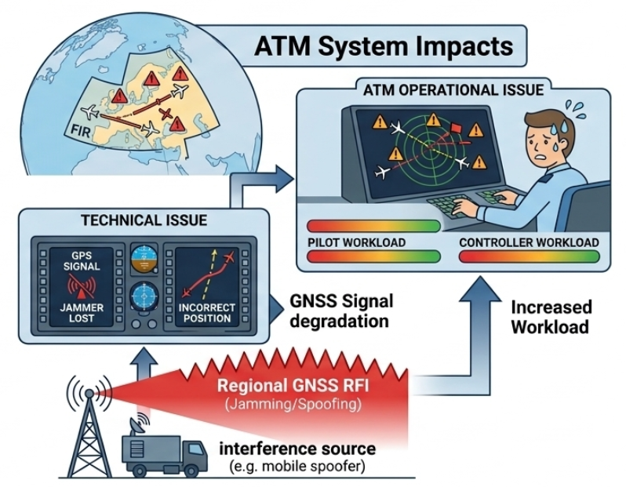

Regional GNSS RFI: From Navigation issue to ATM issue
Jamming vs. spoofing
ATC perspective, GNSS RFI, No longer a technical issue
Pilot and Controller workload
ATM operational issue

Slide 4
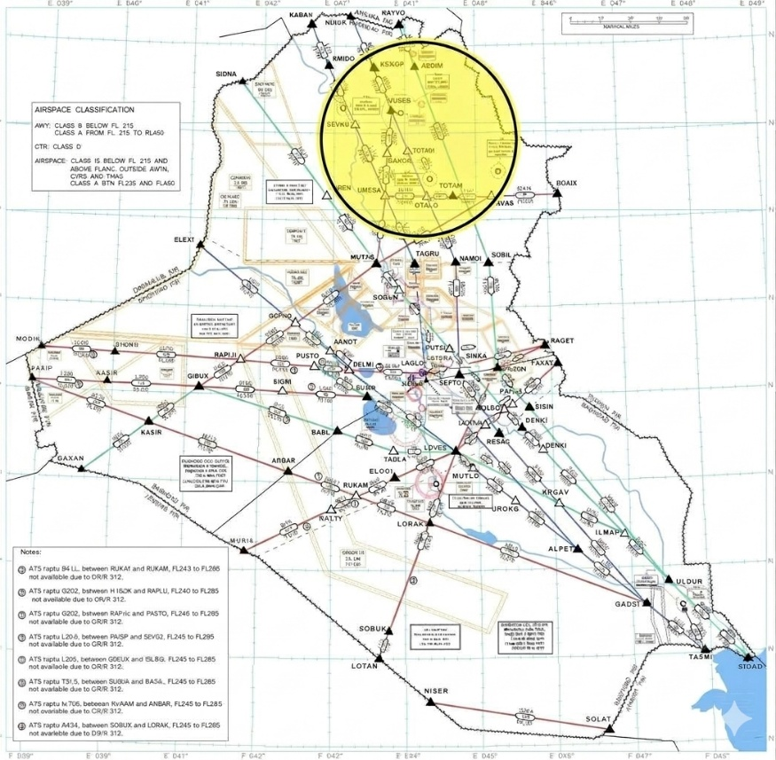
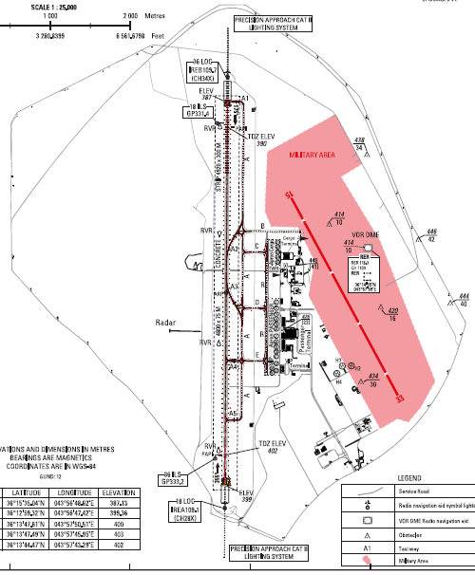
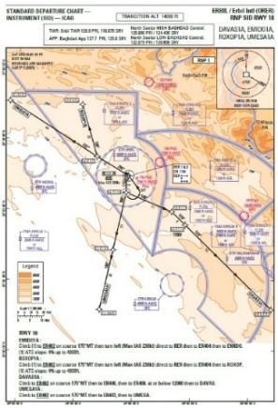
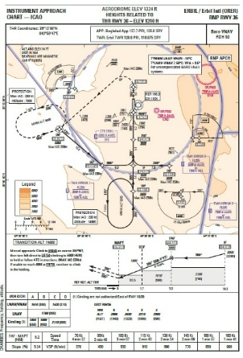
ERBIL and Its Operational Environment
International Civil Airport-Baghdad FIR
Civil/miliary mixed operating environment
Regional military zone

Slide 5
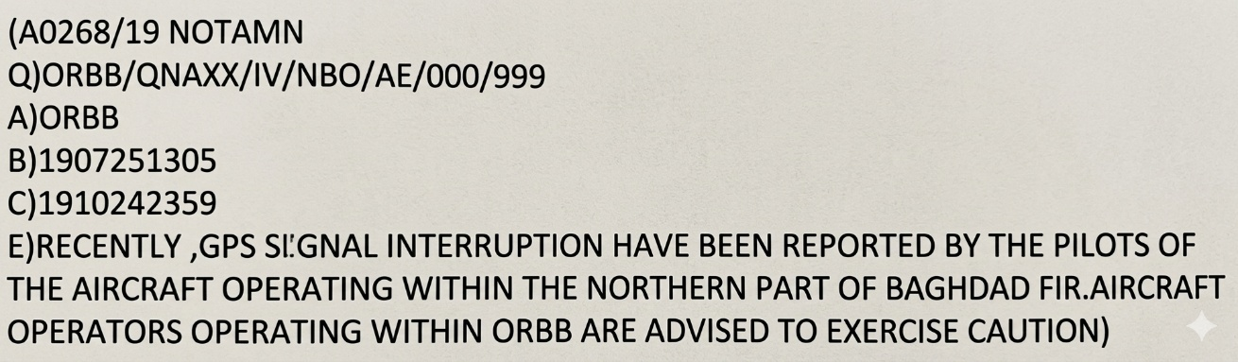
Reported GNSS RFI Environment at Erbil
GNSS RFI boundary as an operational observation
Reported degradation or loss
Reported terrain warnings
Duration, recurrence and diversion
July 2019
September 2023
Ongoing

Slide 6
Effects on ATC Operations
ATC response / Mitigation
Increased controller workload
Additional coordination with pilots
Increased need to establish aircraft position/intent
Greater reliance on conventional navigation and surveillance
Situational-awareness considerations especially with military operations to protect civil aviation
Obtain information from flight crew
Coordinate with adjacent ATS units and military LNO
Maintain separation with traffic in the vicinity
Provide appropriate vectors/instructions where required
Visual approach as an option whenever applicable

Slide 7
GNSS RFI Case Study at Erbil
Date | Time | Callsign | Type of Aircraft | Nature of Interference | Phase of Flight | Mitigation Action
July 9th, 2026 | 0812Z | ABY357 | A320 | GPS Lost | During ILS App. Y RWY18 | Radar Vector, ILS App. Y RWY36
November 22nd, 2025 | 2217Z | PGT816 | A21N | Altitude Warning | Short Final RWY36 | Visual Approach
September 4th, 2025 | 0444Z | PVV252 | B747 cargo | GPS Lost | Pushback | Delayed
May 19th, 2025 | 0010Z | TKJ7VC | B738 | Altitude Warning | Short Final RWY18 | Diverted

Slide 8
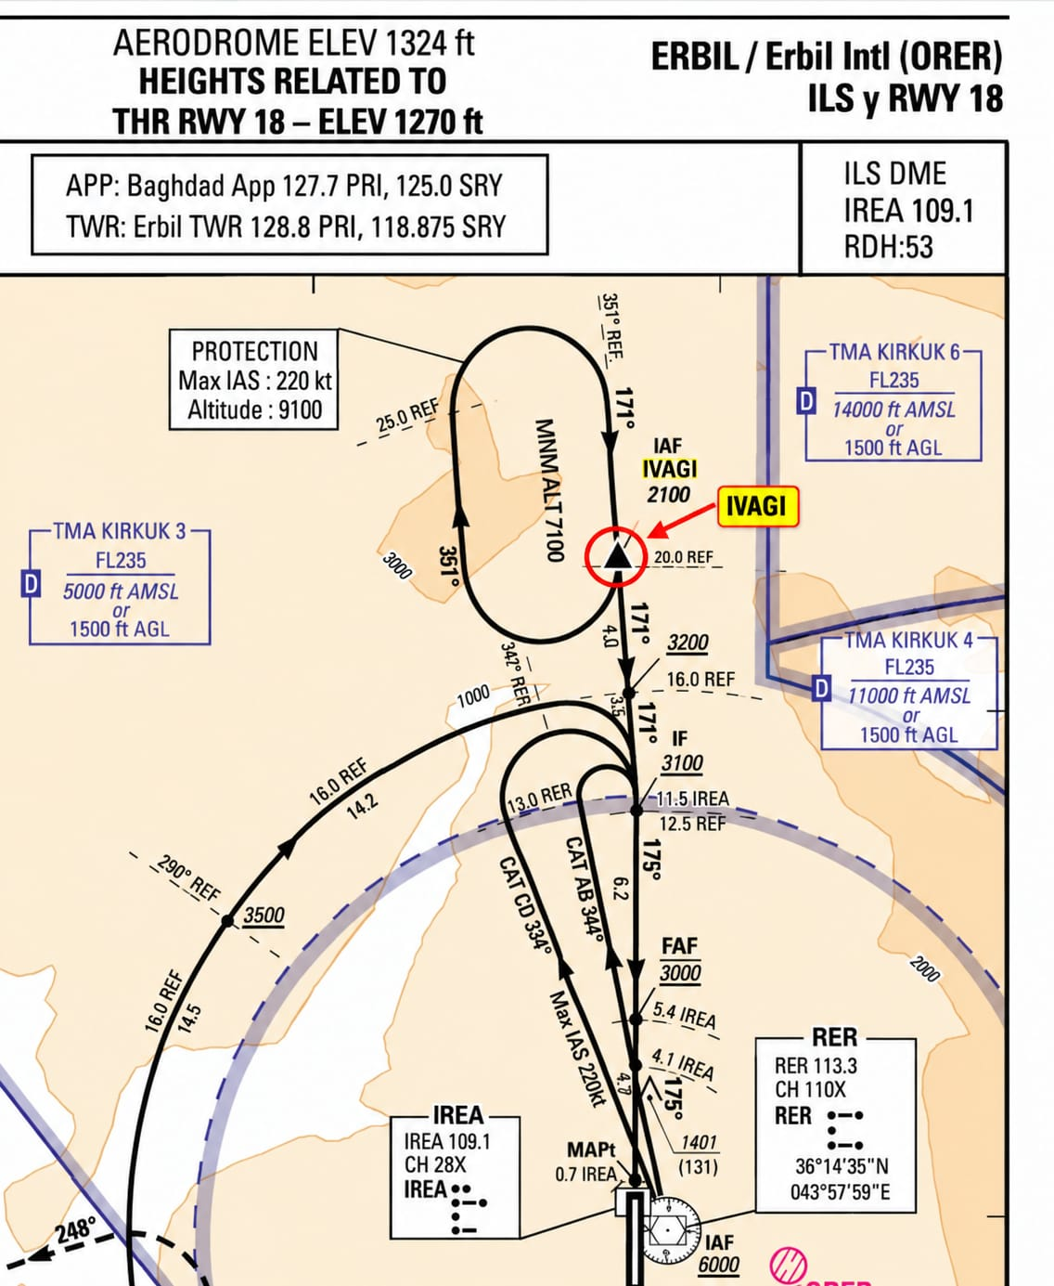
Case Study – H25B Approach Event
TC-NYK from LBSF at 1130Z / June 15th,2026
Heading to IVAGI
ILS approach Y RWY18
ATC Observation
Radar Screen
Shortly Pilot reports
Final RWY18, RWY not in sight
ATC warns pilot of
aircraft position
5 NM from extended
RWY centerline
About 15NM NW
Pilot asks for
Radar Vectoring
Landed
Visual Approach

Slide 9
Recommendations / Way forward
Establish/strengthen GNSS-RFI reporting procedures
Turn individual reports into useful data
Develop ATC guidance and contingency plan for GNSS interference events
Include GNSS-RFI scenarios in ATC refresher trainings
Strengthen conventional-navigation resilience
Develop REGIONAL information-sharing mechanisms

