Slide 2
Egypt’s Experience in Managing GNSS Radio Frequency Interference (RFI)
ICAO MID GNSS/PBN Workshop
29th Sep – 1st Oct 2026
Presented by: ATC Sector

Slide 3
Navigation specification by flight phase inside Cairo FIR
Note : (O) Optional; (M) Mandatory ; (SR) Subject ANSP Requirements
Navigation specification | Flight phase |  |  |  |  |  |  | NAVAIDS/SENSORS
 | En-route | Arrival | Approach |  |  |  | dep | GNSS |  | IRU | DME/DME | DME/DME/ IRU | VOR/DME
 |  |  | Initial | Inter. | Final | Missed
RNAV5 | 5 | 5 | N/A |  |  |  | N/A | O |  | O | O | O | O
RNAV1 | 1 | 1 | 1 | 1 | N/A | 1 | 1 | O | N/A |  | O | O | N/A
RNP1 | N/A | 1 | 1 | 1 | N/A | 1 | 1 | M |  |  | SR | SR
RNP APCH (LNAV) | N/A |  | 1 | 1 | 0.3 | 1 | N/A | M |  |  | N/A
RNP APCH APV (L/V NAV) |  |  | 1 | 1 | 0.3 | 1 |  | M

Slide 4
Navigation specification by flight phase inside Cairo FIR

Slide 5
Navigation specification by flight phase inside Cairo FIR

Slide 6

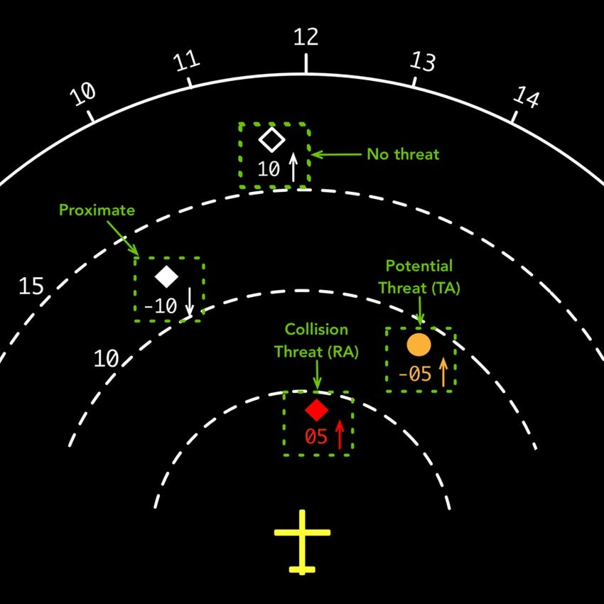
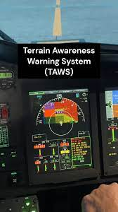
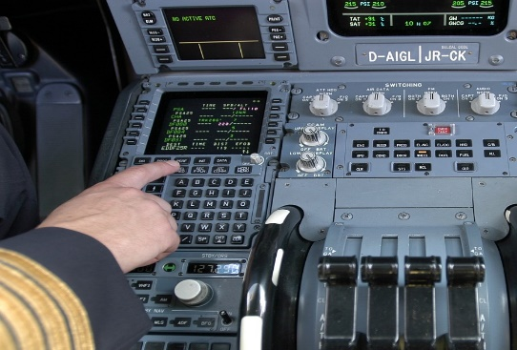
Operational Impact of GNSS RFI
Impact on flight operations
  GNSS supports positioning, navigation, and timing (PNT) applications. GNSS is the foundation of PBN, ADS-B, and ADS-C.
  Dependence on GNSS is increasing as it is used in various aircraft systems, including:
    Controller-Pilot Data Link Communications (CPDLC)
    Flight Management Systems (FMS)
    Terrain Awareness and Warning Systems (TAWS)
    Transponders
    Traffic Alert and Collision Avoidance Systems (TCAS)

Slide 7

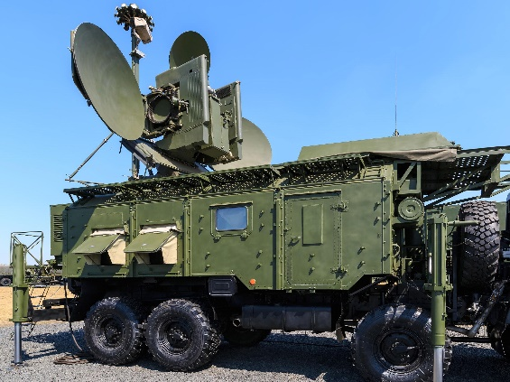
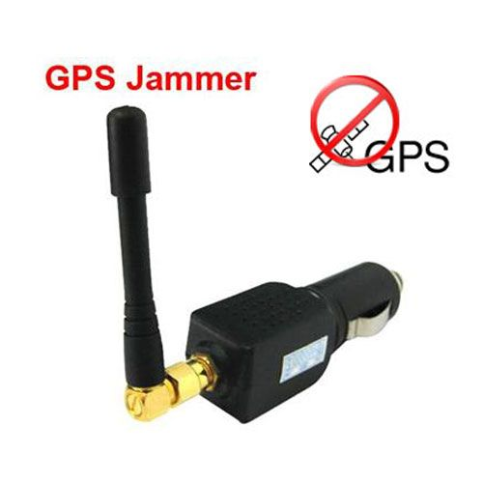
Operational Impact of GNSS RFI
There are two main types of interference:
  Jamming: This intentional interference blocks GNSS signals, preventing receivers from providing accurate position and time information. Avionics systems can usually detect jamming and alert the flight crew. GNSS jamming has caused several GNSS outages in the MID Region.
  Many GNSS interference issues are happening near conflict zones due to increased use of drones and electronic warfare.
  Recent conflicts worldwide have highlighted how vulnerable the weak GNSS signals from satellites are to jamming and spoofing.
  Intentional jamming can include everything from truck drivers using $10 GNSS jammers to military equipment used to disrupt drone missiles in conflict zones.

Slide 8
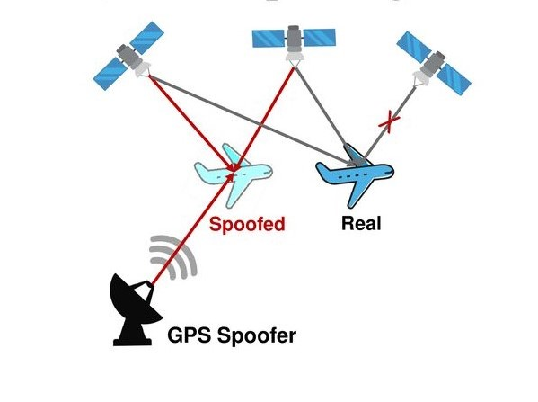
Operational Impact of GNSS RFI
There are two main types of interference:
  Spoofing: This intentional interference tricks GNSS receivers into providing incorrect position, navigation, and timing data. Unlike jamming, spoofing is harder to detect, and there's no automatic alert to the flight crew.
  Spoofing, causing large position jumps, has been reported since late 2023.
  Jamming causes the receiver to die, while Spoofing causes the receiver to lie.

Slide 9
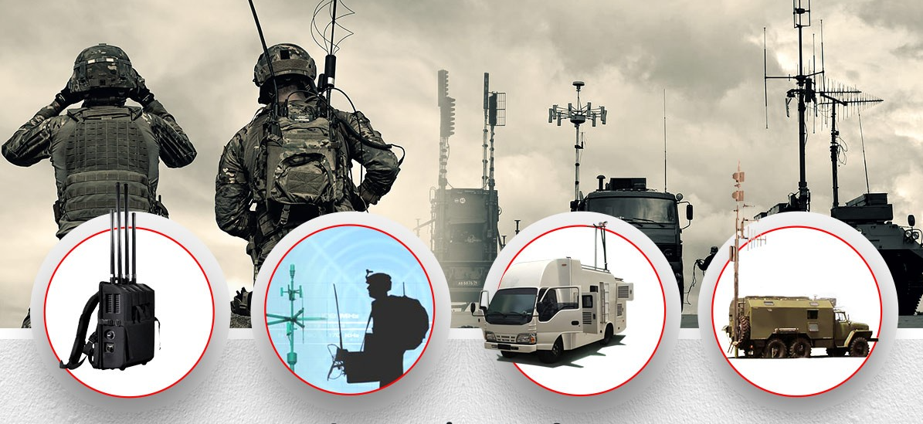
Operational Impact of GNSS RFI
  2) Iimpact on ground-based systems
    Spoofing takes jamming to a different level of disruption by confusing GNSS receivers into reporting an incorrect position.
    Since August 2023, crews have been reporting a new variety of GPS spoofing. The result is that within minutes, the IRS becomes unusable, and in many cases, all navigation capabilities on board are lost.
    “That means that the backup system is no longer reliable as a backup.”
    Sometimes the GPS receivers can't recover even after leaving the interference zone.

Slide 10
GNSS RFI Statistics

Slide 11
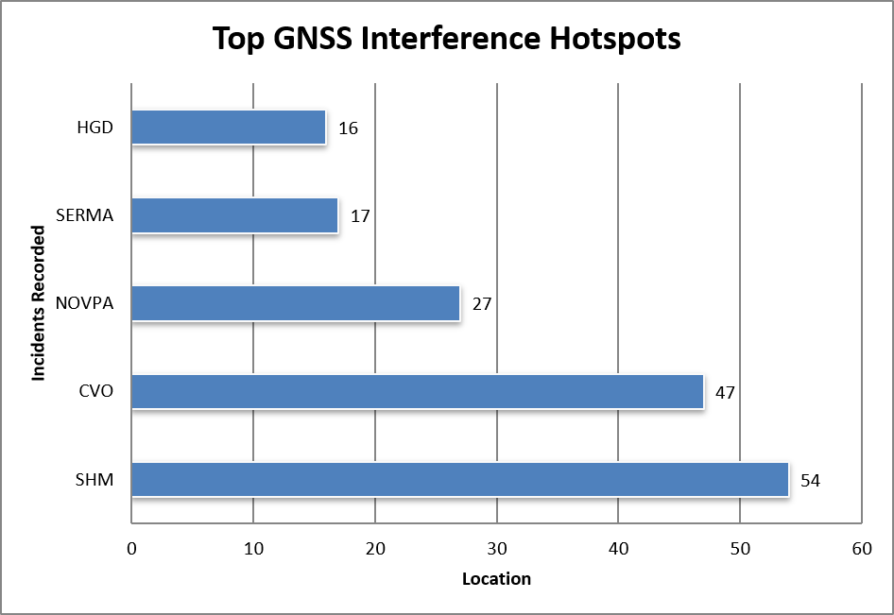
GNSS RFI Statistics

Slide 12
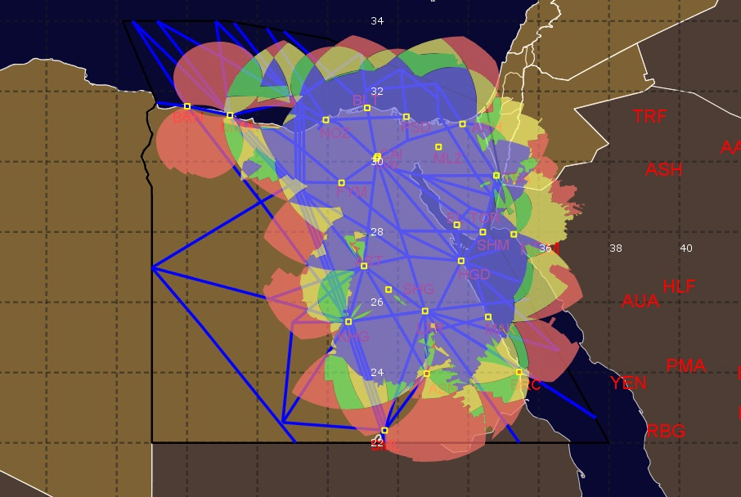
Mitigation Measures
Backup navigation facilities (NAV MON)
  NANSC conducted a study using EUROCONTROL's DEMETER tool to assess the feasibility of flying RNAV 5 routes using DME/DME sensor within Cairo FIR.
FL280
No Coverage..
No Redundancy..
Limited Redundancy..
Full Redundancy..
Excessive Redundancy..

Slide 13
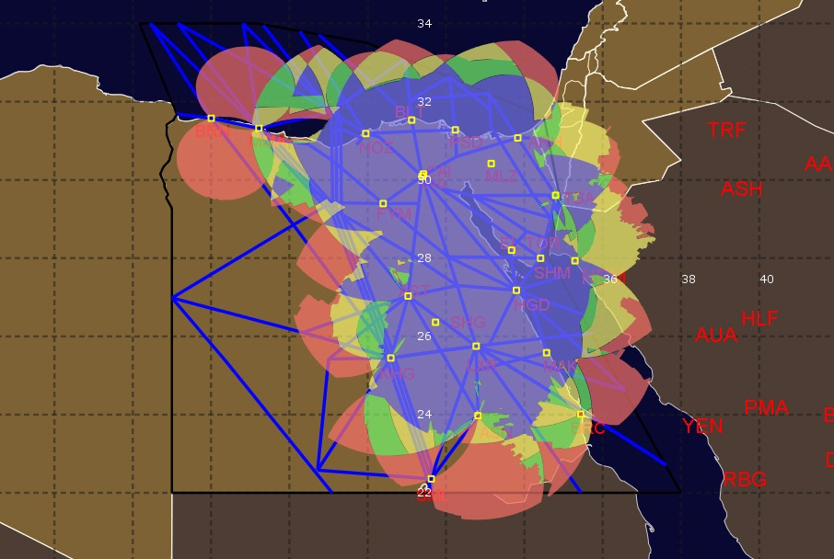
Mitigation Measures
Backup navigation facilities (NAV MON)
  NANSC conducted a study using EUROCONTROL's DEMETER tool to assess the feasibility of flying RNAV 5 routes using DME/DME sensor within Cairo FIR.
FL300
No Coverage..
No Redundancy..
Limited Redundancy..
Full Redundancy..
Excessive Redundancy..

Slide 14
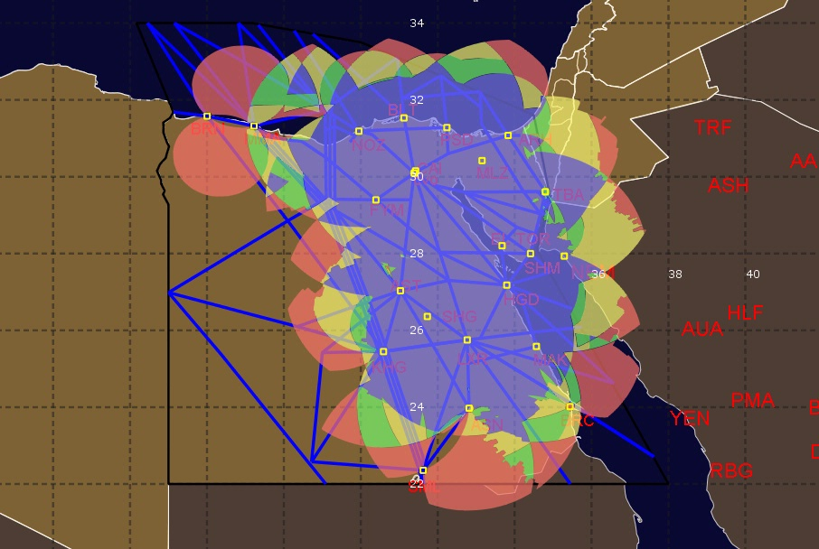
Mitigation Measures
Backup navigation facilities (NAV MON)
  NANSC conducted a study using EUROCONTROL's DEMETER tool to assess the feasibility of flying RNAV 5 routes using DME/DME sensor within Cairo FIR.
FL360
No Coverage..
No Redundancy..
Limited Redundancy..
Full Redundancy..
Excessive Redundancy..

Slide 15
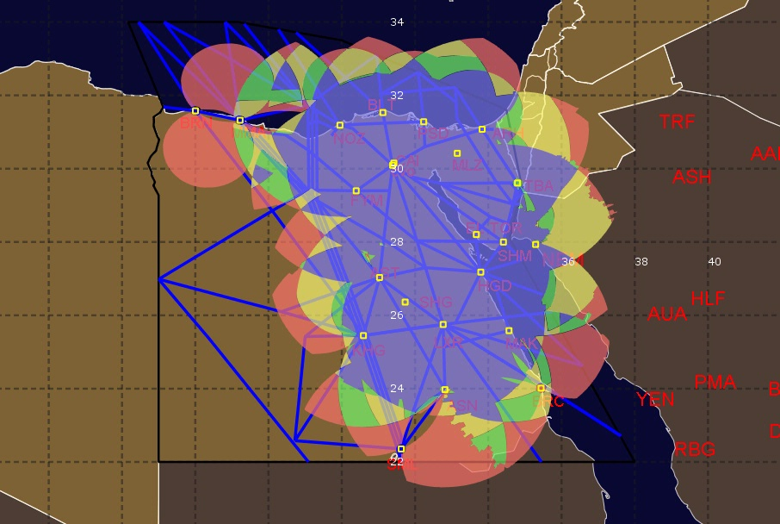
Mitigation Measures
Backup navigation facilities (NAV MON)
  NANSC conducted a study using EUROCONTROL's DEMETER tool to assess the feasibility of flying RNAV 5 routes using DME/DME sensor within Cairo FIR.
FL400
No Coverage..
No Redundancy..
Limited Redundancy..
Full Redundancy..
Excessive Redundancy..

Slide 16
Mitigation Measures
2) GNSS monitoring and detection
  Since October 2023, there has been a significant increase in GPS jamming and spoofing reports received by National air navigation service company (NANSC) from the airlines over the frequency while flying over Cairo FIR, in particular, the inbound traffic from Nicosia ,Jeddah and Amman FIRs.
  GNSS jamming and spoofing have been detected by pilots and air traffic control during various flight phases. In some cases, aircraft have deviated from their planned routes, and this was observed by the air traffic controllers.
  Jamming and spoofing pose a significant threat to PBN applications, particularly at airports in the Sinai Peninsula such as Sharm El Sheikh and Taba. These attacks can disrupt crucial flight procedures like SID and STAR and RNP APCH.

Slide 17
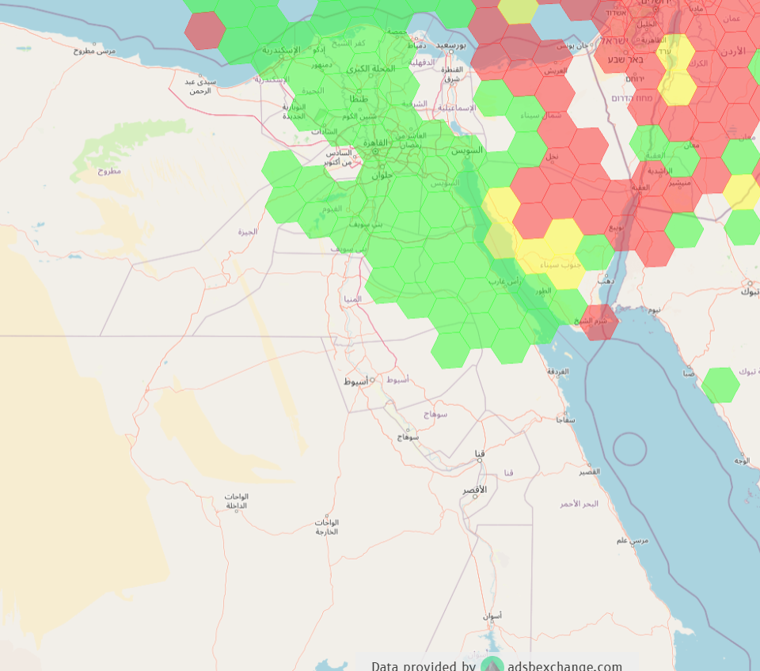
Mitigation Measures
The level of GPS interference
Low
Medium
High
Source: https://gpsjam.org - 2025

Slide 18
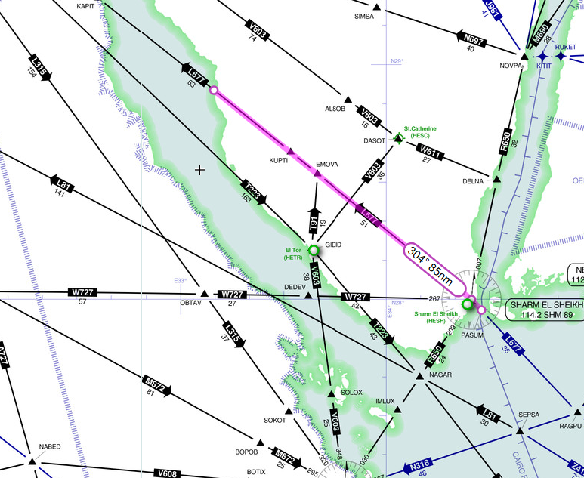
Mitigation Measures
2) GNSS monitoring and detection
  Cairo FIR’s affected airways by GPS interference
    The GNSS Interference affects the traffic from Jeddah FIR to Cairo FIR via Entry point PASUM.
    The pilots normally start reporting when they approach SHM and the interference last for 90 NM.

Slide 19
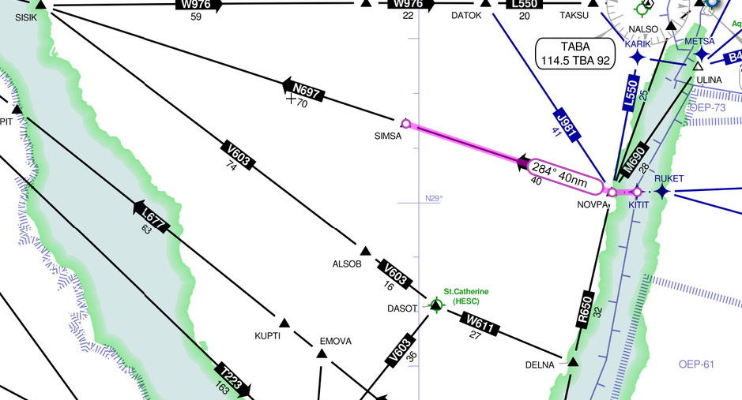
Mitigation Measures
2) GNSS monitoring and detection
  Cairo FIR’s affected airways by GPS interference
    The GNSS interference affects the traffic from Jeddah FIR to Cairo FIR via Entry point KITOT.
    The pilots normally start reporting when they pass KITOT heading to NOVPA and the interference last for 45 NM.

Slide 20
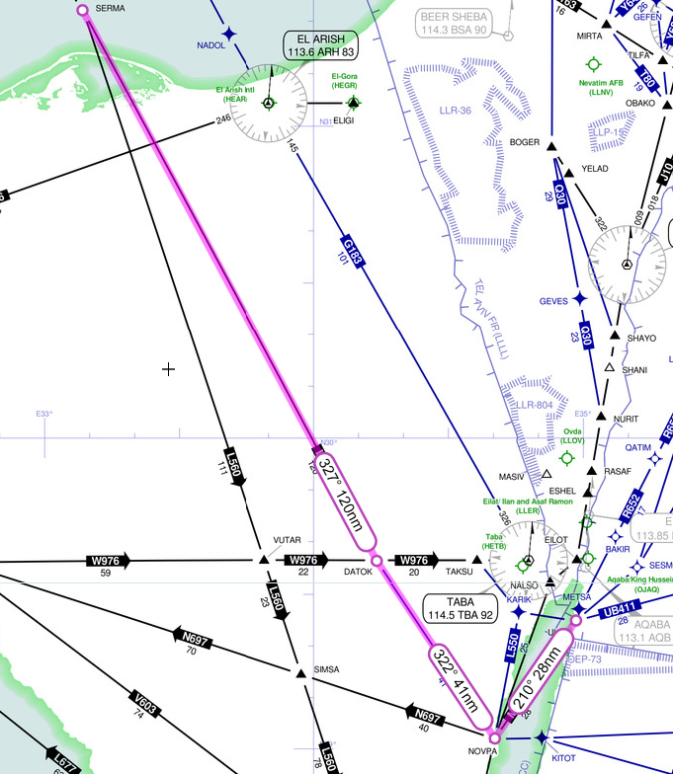
Mitigation Measures
2) GNSS monitoring and detection
  Cairo FIR’s affected airways by GPS interference
    The GNSS Interference affects the traffic from Amman FIR to Cairo FIR via Entry point ULINA.
    The pilots normally start reporting over ULINA or coordinate with Amman controllers to transfer the traffic in a proper Heading.
    The interference lasts for 190 NM from ULINA until waypoint SERMA.

Slide 21
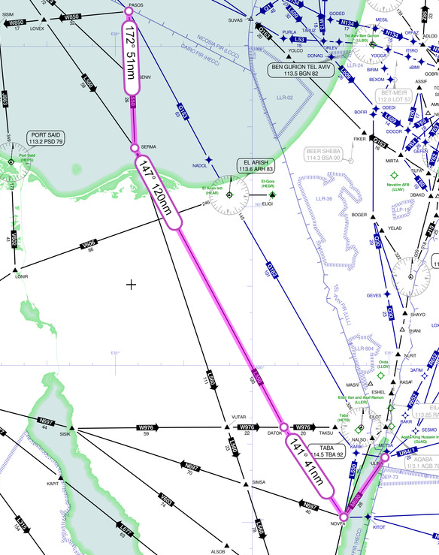
Mitigation Measures
2) GNSS monitoring and detection
  Cairo FIR’s affected airways by GPS interference
    The GNSS Interference affects the traffic from Nicosia FIR to Cairo FIR via Entry point PASOS.
    The pilots normally start reporting after passing PASOS or coordinating with Nicosia controllers to transfer the traffic in a proper heading.
    The interference lasts for 200:240NM from Entry point PASOS heading to Amman FIR via ULINA.

Slide 22
Mitigation Measures
4) Operational Contingency Measures
  Egypt started to assess the situation, and we figured out that :
    There is a deficiency in the phraseology in PANS-ATM, Doc 4444 to allow the pilots make an effective communication and reporting GNSS interference.
    No clear procedures for controllers after the pilot reports GNSS gamming or spoofing.
    The current GNSS reporting format used by ATC units is too complex, discouraging controllers from reporting jamming and spoofing incidents. As a result, many incidents are only reported orally to supervisors, leading to underreporting.
    The controllers need for awareness about the GNSS RFI.

Slide 23
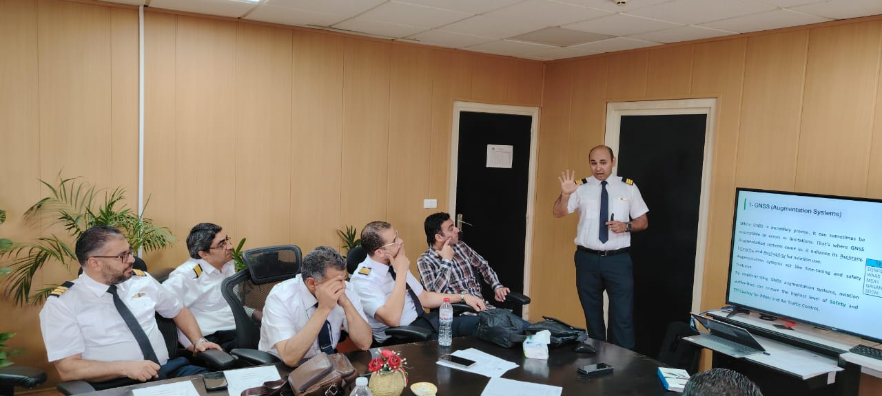
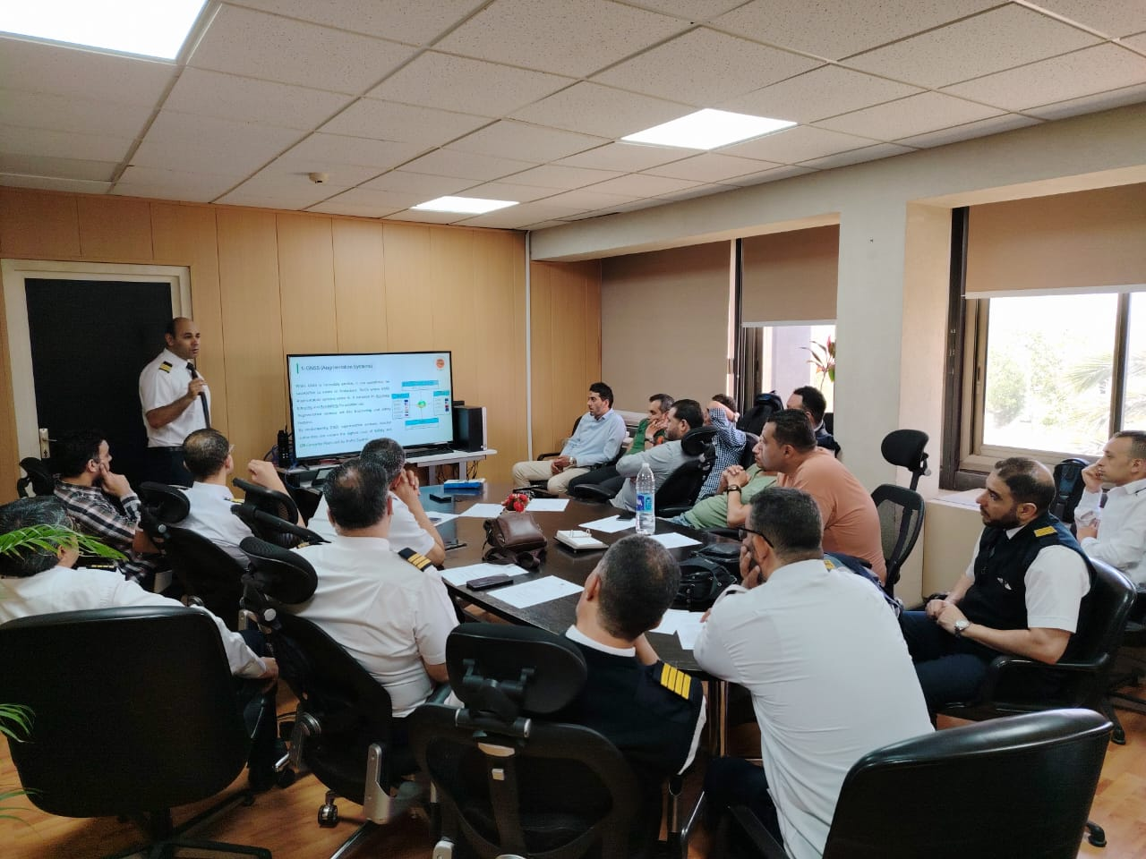
Mitigation Measures
4) Operational Contingency Measures
  NANSC conducted a comprehensive training sessions for Cairo ACC’s Air Traffic Controllers.
  This training focused on:
    PBN Basics: Introduction to Performance-Based Navigation.
    GNSS Technology: Global Navigation Satellite Systems.
    Jamming and Spoofing Threats: Understanding and mitigating these risks.
    PBN and Flight Planning: How PBN integrates with the flight plan.
    Pilot-ATC Communication: Real-world scenarios and phraseology.
  This training aimed to enhance awareness of potential threats and improve response strategies.
  An extensive awareness course was delivered virtually to the affected airports (Sharm El Sheikh, Hurghada, Taba, and Alexandria) via a Zoom meeting.

Slide 24

Mitigation Measures
4) Operational Contingency Measures
  NANSC issued Information bulletin aims to raise awareness about the potential risks of Global Navigation Satellite System (GNSS) Jamming and Spoofing issued in May 2024 and prepared by the Research and Development Department (R&D), distributed to Cairo ACC unit and all ATC units at the Egyptian Aerodromes.

Slide 25
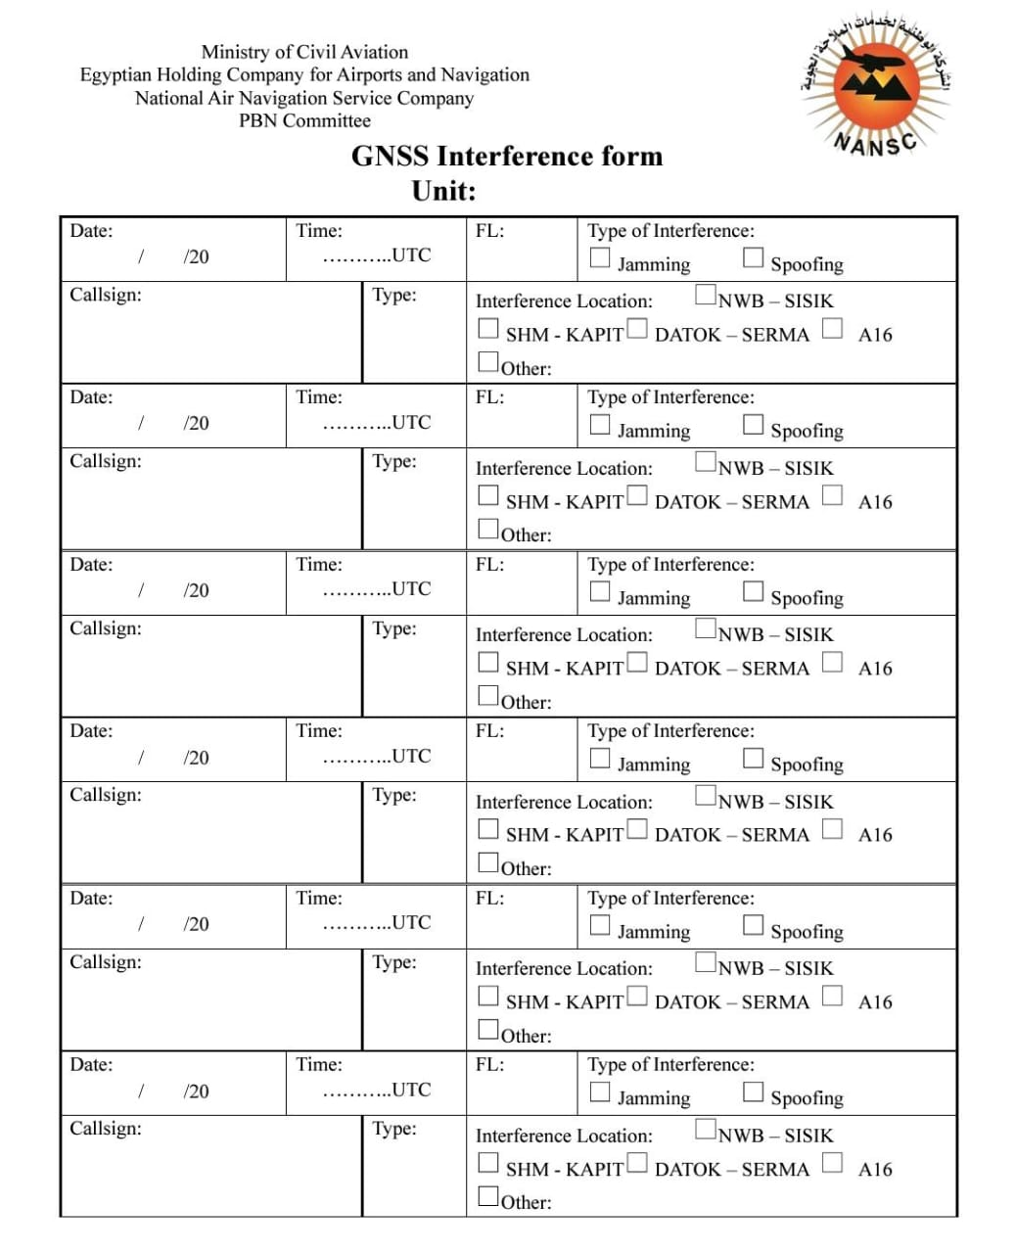
Mitigation Measures
4) Operational Contingency Measures
  A new GNSS interference reporting form was prepared by The Research and Development Department (R&D) and distributed to all the ATC units in Egypt. To allow the controllers to report the GPS Jamming and Spoofing incidents.
  Lesson learned: By providing a clear and concise form, you can encourage ATC units to report incidents promptly and accurately.

Slide 26
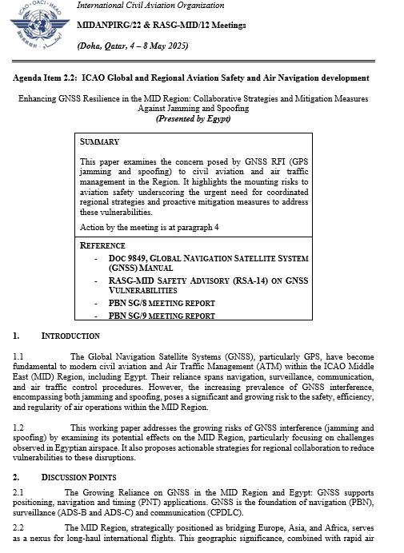
Mitigation Measures
4) Operational Contingency Measures
  Egypt presented a working paper at the MIDANPIRG 22 titled “Enhancing GNSS Resilience in the MID Region: Collaborative Strategies and Mitigation Measures Against Jamming and Spoofing” the working paper highlighted the following:
    The GNSS interference in the MID Region and its potential impact on aviation safety and efficiency.
    Acknowledge the need for standardized ICAO guidance for publishing alternative navigation sensors as backups for GNSS in AIP part 2 and 3 (ENR and Aerodromes) sections.
    Encourage Member States to prioritize the development and implementation of national GNSS interference mitigation strategies.
    Support initiatives aimed at enhancing regional collaboration and information sharing on GNSS interference events.

Slide 27
Recommendations and Lessons Learned
Recommendations
  Technological Countermeasures:
    Accelerate the installation of Controlled Reception Pattern Antenna (CRPA) technology to isolate authentic satellite tracking loops and reject counterfeit spoofing signals.
    Encouraging the adoption of dual/ multi constellation receivers within the aviation industry and ensure that future multi-constellation hardware is never deployed vulnerable; it must be reinforced with active, robust radio frequency (RF) signal-defense filtering from day one.
  Contingency procedures: Develop and implement Contingency procedures for situations where GPS signals are unavailable or compromised. These procedures should outline alternative navigation sensors like DME/DME.
  Collaboration and information sharing: Collaborate with other organizations and agencies to share information on GPS jamming and spoofing incidents and best practices.

Slide 28
Challenges and Lessons Learned
Lessons Learned
  Awareness and training: Raise awareness about GPS jamming and spoofing threats among pilots and ATCOs. Provide training on recognizing signs of interference, implementing mitigation strategies, and reporting incidents.
  By providing a clear and concise form, you can encourage ATC units to report incidents promptly and accurately.
  GNSS disruption severity depends entirely on onboard receiver sophistication. That means the aircraft response to electronic interference is non-uniform across differing aircraft generations.
  During reported GNSS RFI Keep spacing and sequencing conservative.
  Communication discipline (short, actionnable, consistent).

