Slide 1
GNSS Vulnerabilities and Emerging Threats
ICAO MID Workshop on GNSS / PBN
Cairo, Egypt, 29 September - 1 October 2026
Gerhard BERZ
Head of Navigation
gerhard.berz@eurocontrol.int

Slide 2
Important Notice
Information in these slides is NOT INTENDED FOR THE GENERAL PUBLIC
Goal of this sharing of sensitive information is to help aviation maintain safe operations
Workshop Particpants are requested to use the material with the necessary discretion, for aviation-internal SAFETY purposes ONLY

Slide 3
The GOOD NEWS FIRST
Core Satellite Constellation Internal Faults
Constellation Weakness (not enough satellites with good geometry)
Space / Solar Weather and Ionospheric Effects
Radio Frequency Interference (RFI)
Mitigated by over 2 decades of Augmentation System Design
GPS operating well above minimum constellation (24SV)
DFMC will have plenty satellites
Occasional issues in SBAS during solar peaks
DFMC will fix all first order effects
Current multi-sensor and independent CNS capabilities provide significant robustness (especially INS)
DFMC: L5/E5 signal is stronger, ARAIM will have redundant Single Frequency Modes (+other stuff)

Slide 4
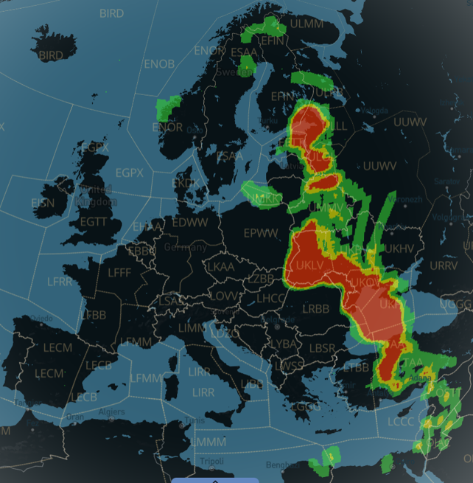
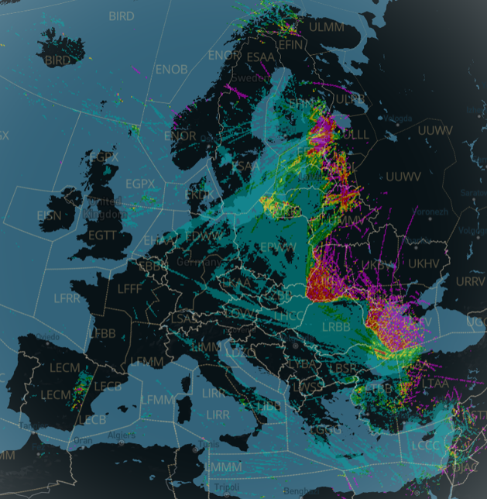
2025 RFI Situation – Sherlock / GRID Tool

Slide 5
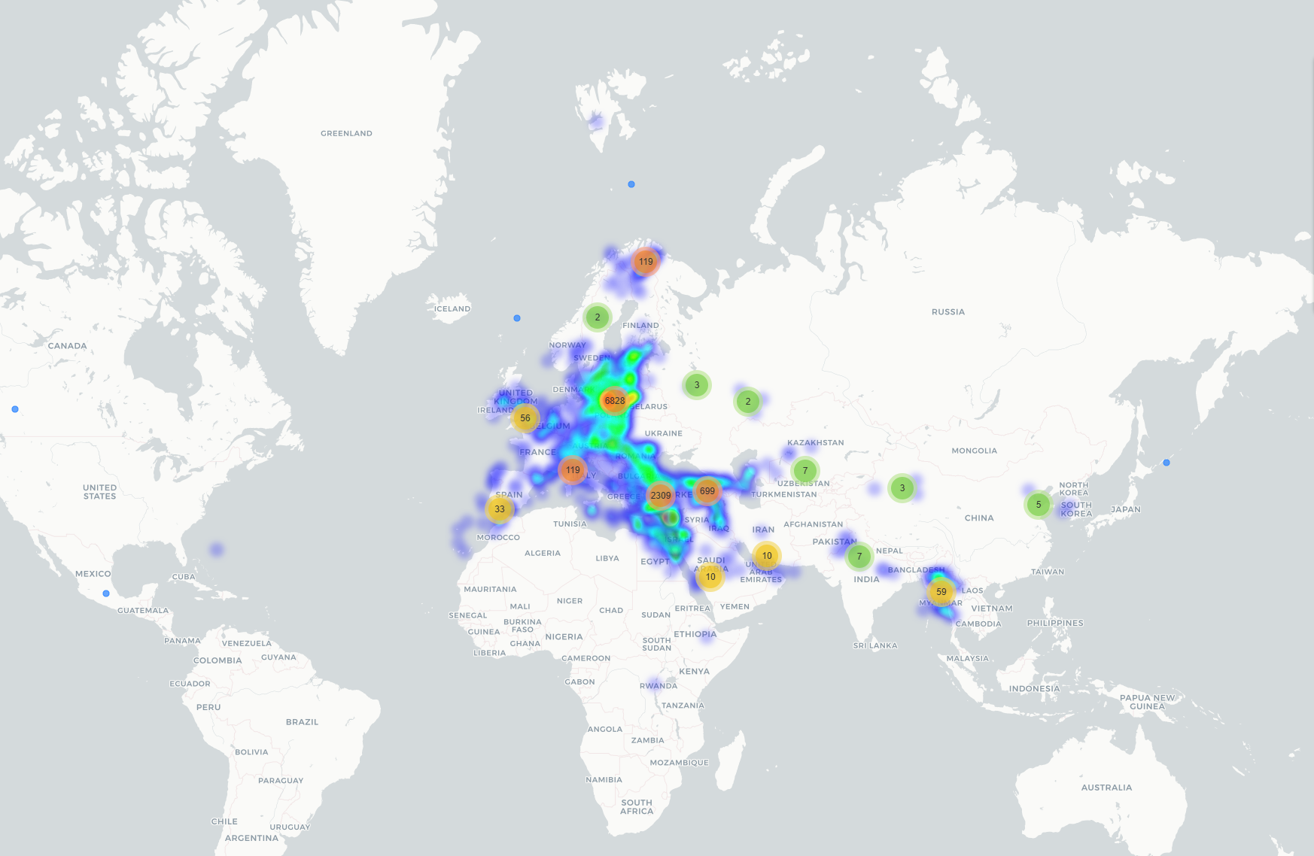
2024-2025 GNSS Jamming: Pilot Reports to EVAIR
EVAIR = EUROCONTROL Voluntary ATM Incident Reporting System

Slide 6
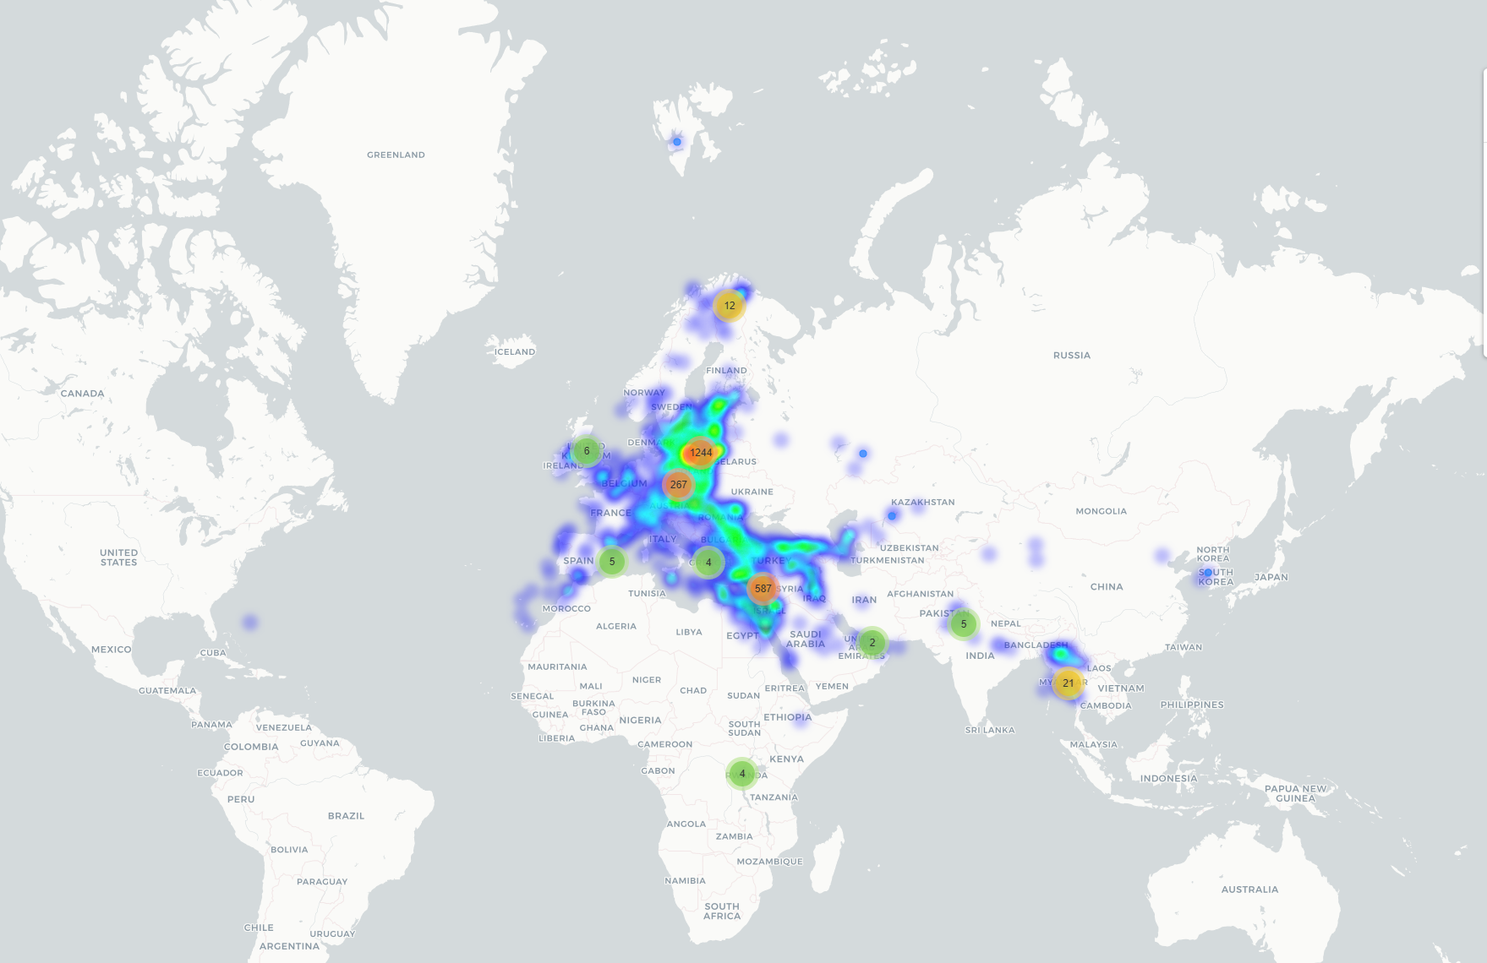
2024-2025 GNSS Spoofing: Pilot Reports to EVAIR
EVAIR = EUROCONTROL Voluntary ATM Incident Reporting System

Slide 7

GNSS RFI event reporting ratio

Slide 8
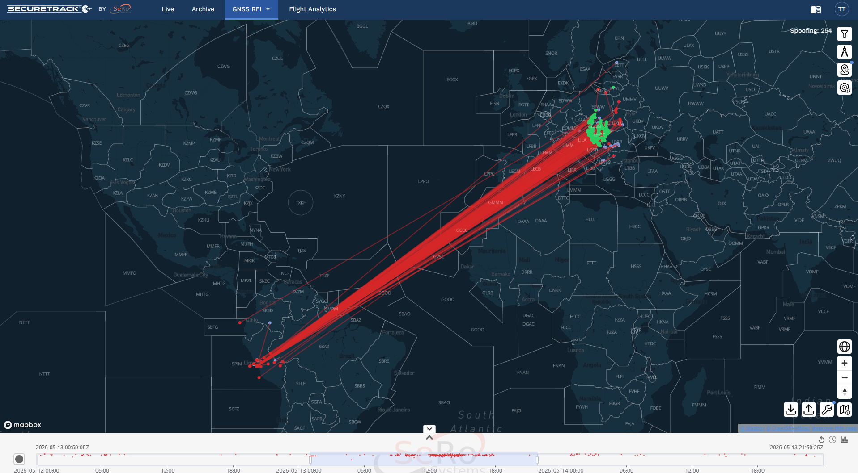
Post-event analysis: 13. May 2026
Source: SecureTrack developed by SERO GmbH.

Slide 9
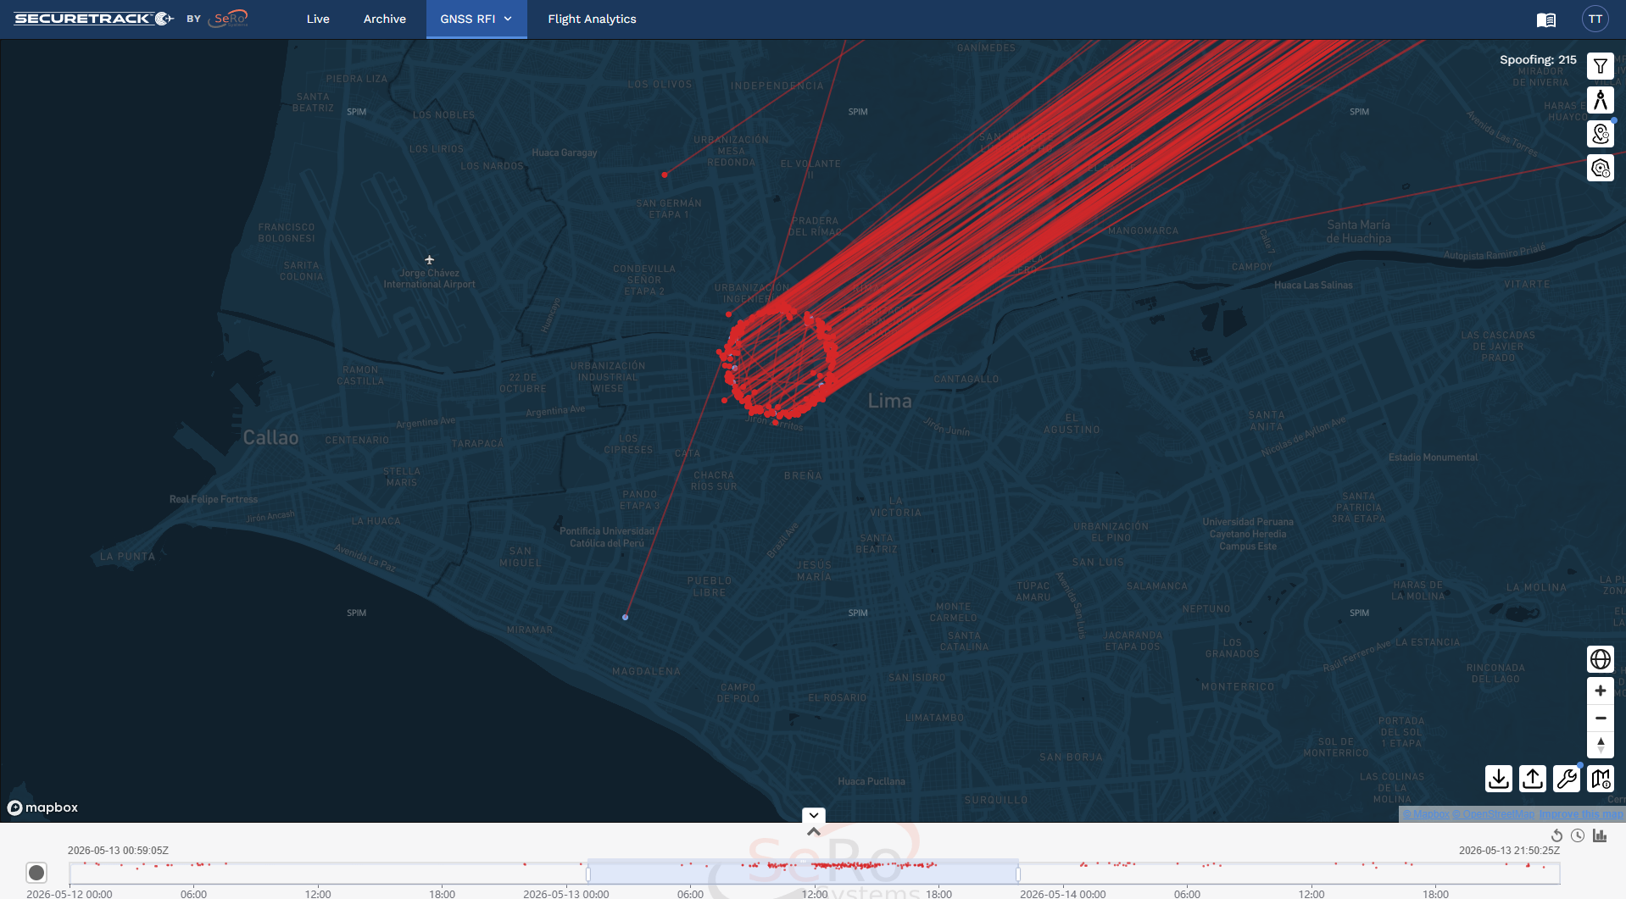
Post-event analysis: 13. May 2026
Source: SecureTrack developed by SERO GmbH.

Slide 10
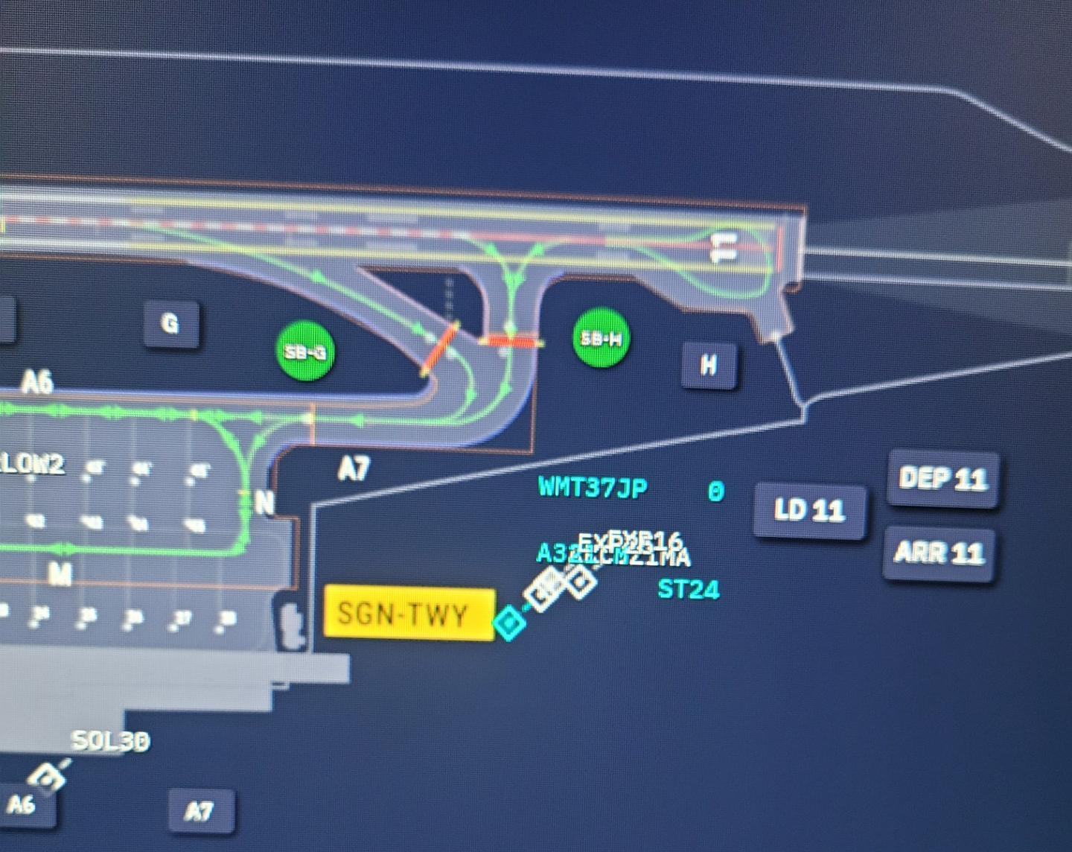
Typical workday snapshot

Slide 11
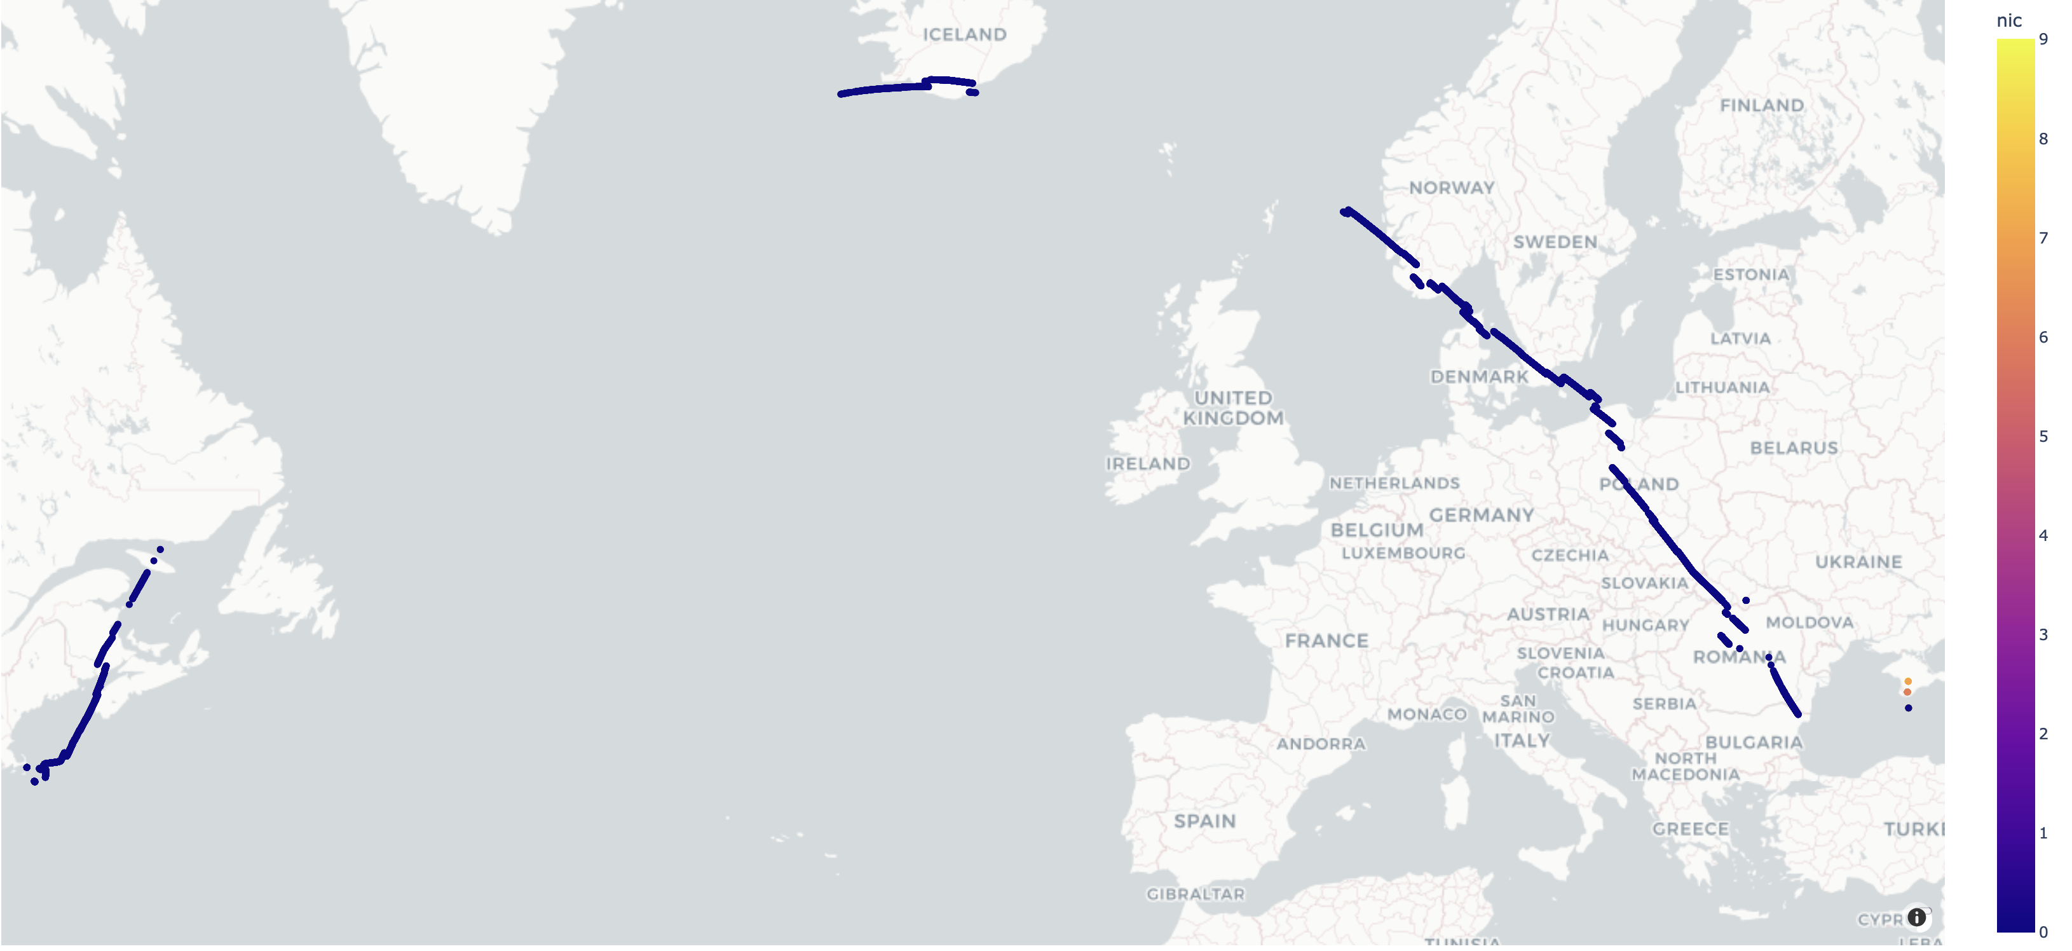

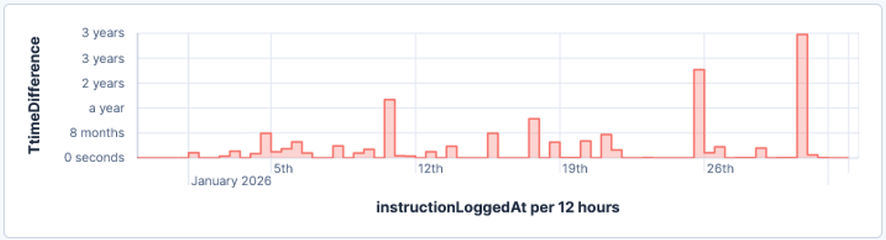
Persistent Impact of GPS Spoofing on Aircraft Navigation
Analysis of 397 transatlantic flights initially spoofed over the Black Sea:
≈74% broadcast a NIC ≥ 7 once they exited the jamming / spoofing area
≈10% were still broadcasting a NIC = 0 as they entered the Oceanic airspace
Remaining flights regained NIC ≥ 7 at various points over Europe
Provided by Skai Data Services (NSP JWG/13 IP15)
CPDLC Clock Shift Data:

Slide 12
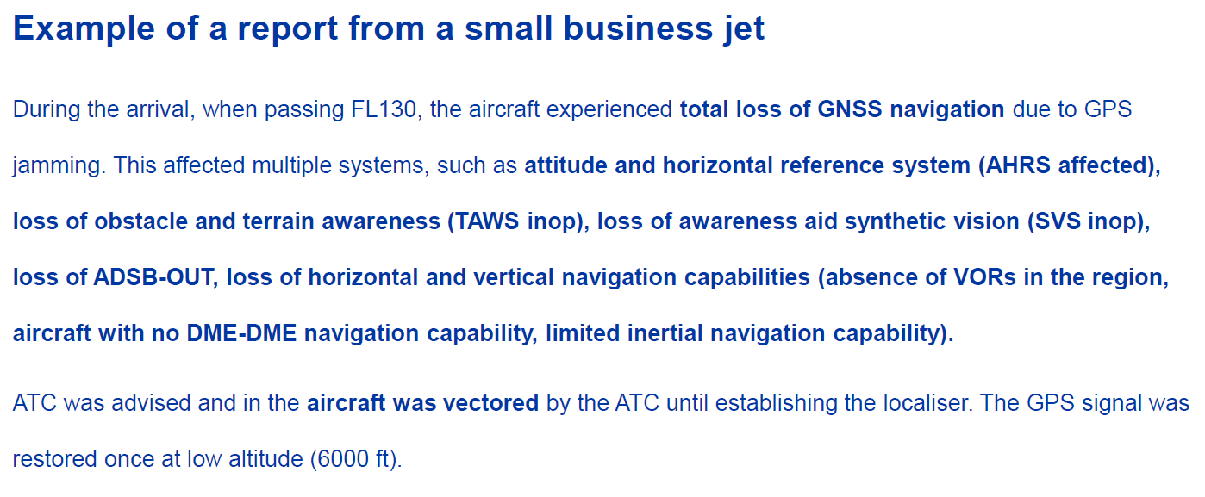
Taking it to the individual Cockpit level:

Slide 13
GNSS Interference Impact on Aircraft and Operations
GPS Receiver fail, FMS position fail, Clock fail: may remain
GPWS failure
Weather Radar failure
Position reporting failure (ADS-C)
Comms failures (CPDLC, SatCom)
Head Up Display (HUD) failure
Synthetic Vision System (SVS) failure
Runway Protection Systems failure (RAAS, ROPS)
Emergency Locator (ELT) reporting incorrect
Wind Display (ND) failure
ADS-B-out failure, ADS-B-in failure
Transponder failure, Navaid tuning failure
Unable to navigate normally (may need radar vectors to destination)
No longer RNP capable (cannot cross North Atlantic RNP4)
EGPWS false alerts, EGPWS system switched off
Go-Arounds in unexpected positions
Cascading system failures, complex and high workload approaches
Weather Radar: unable to detect thunderstorms (CB’s)
Loss of comms: CPDLC, SatCom
GPS receiver contamination possible
Unable to de-select GPS input to aircraft systems
Aircraft may be grounded pending hard reset of GPS receiver
Summary from OPSGROUP

Slide 14

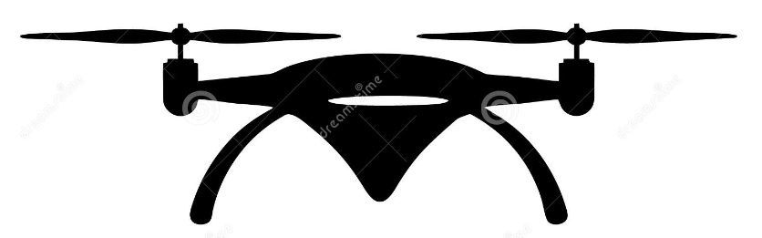
Why are civil aircraft so exposed to interference?
Jammer Power | Impact Radius on Aircraft at FL350¹ | Maximum Outage Duration at ENR Speed² | “Protection” against military GPS system near ground³
10W | 77NM | 20min | 20km
100W | 230NM | 1h | 60km
Air Transport Aircraft at En-Route Altitude
(no anti-jam capability)
1: Assuming -6dB antenna gain and 15dB tracking margin
2: ENR speed assumed 450 knots
3: Assuming a +20dB J/S capability (very modest!)
Drone with Anti-Jam Capability
Jammer Antenna

Slide 15
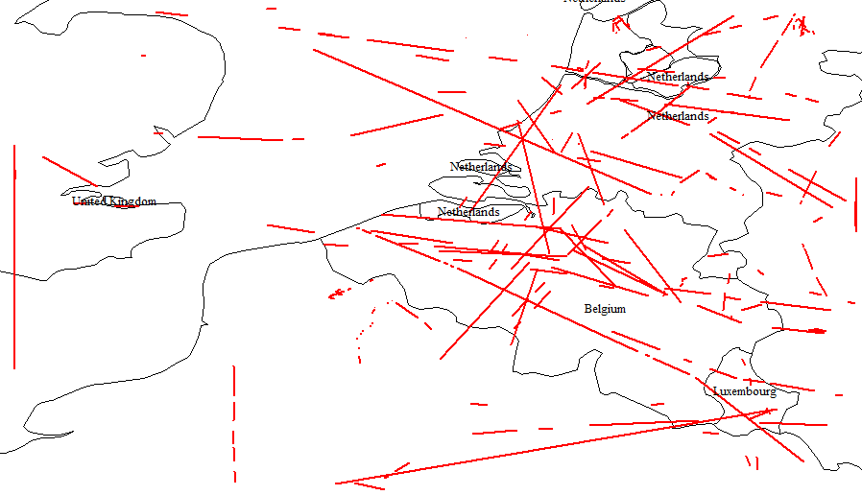
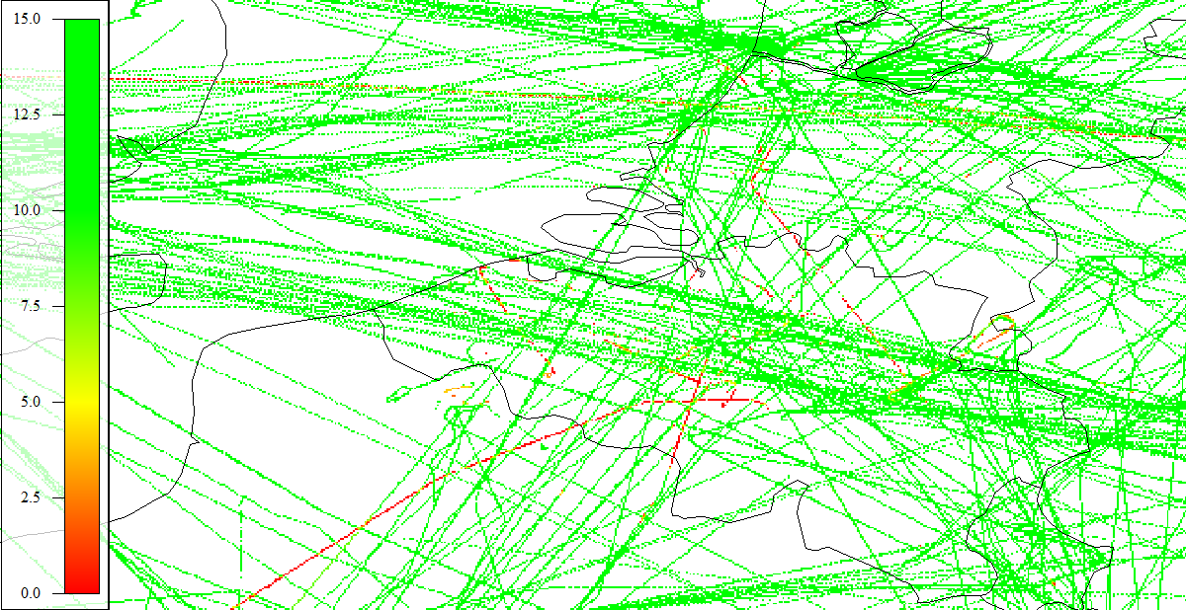
RFI May Not Be Limited to Conflict Zones Only…
End March 2021, 40W Anti-Paparazzi Drone Jammer on a Private Yacht
  Jammer accidentally turned on by maintenance personnel, Southwest NL
  Impacting air traffic in Netherlands, Belgium, France and MUAC for a few hours
Core European airspace with climbing and descending traffic from some major airports
  Info on affected flights could be quite critical, while large majority of flights sees no impact
ADS-B PIC, All Flights during event
ADS-B Gaps: 93 aircraft impacted, Multiple aircraft per sector

Slide 16
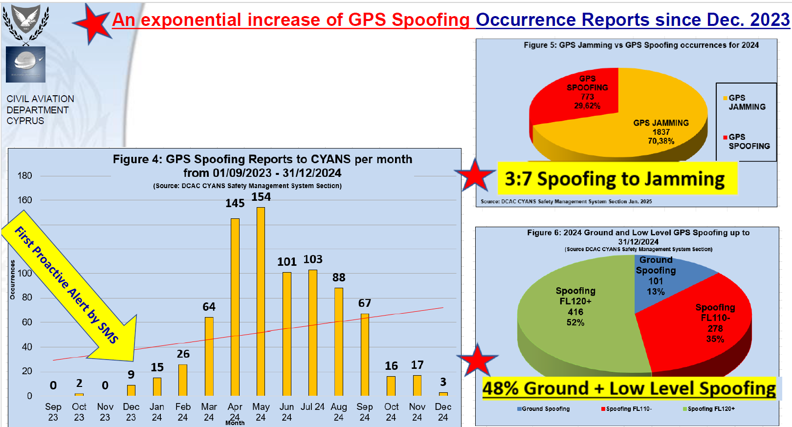

Slide 17
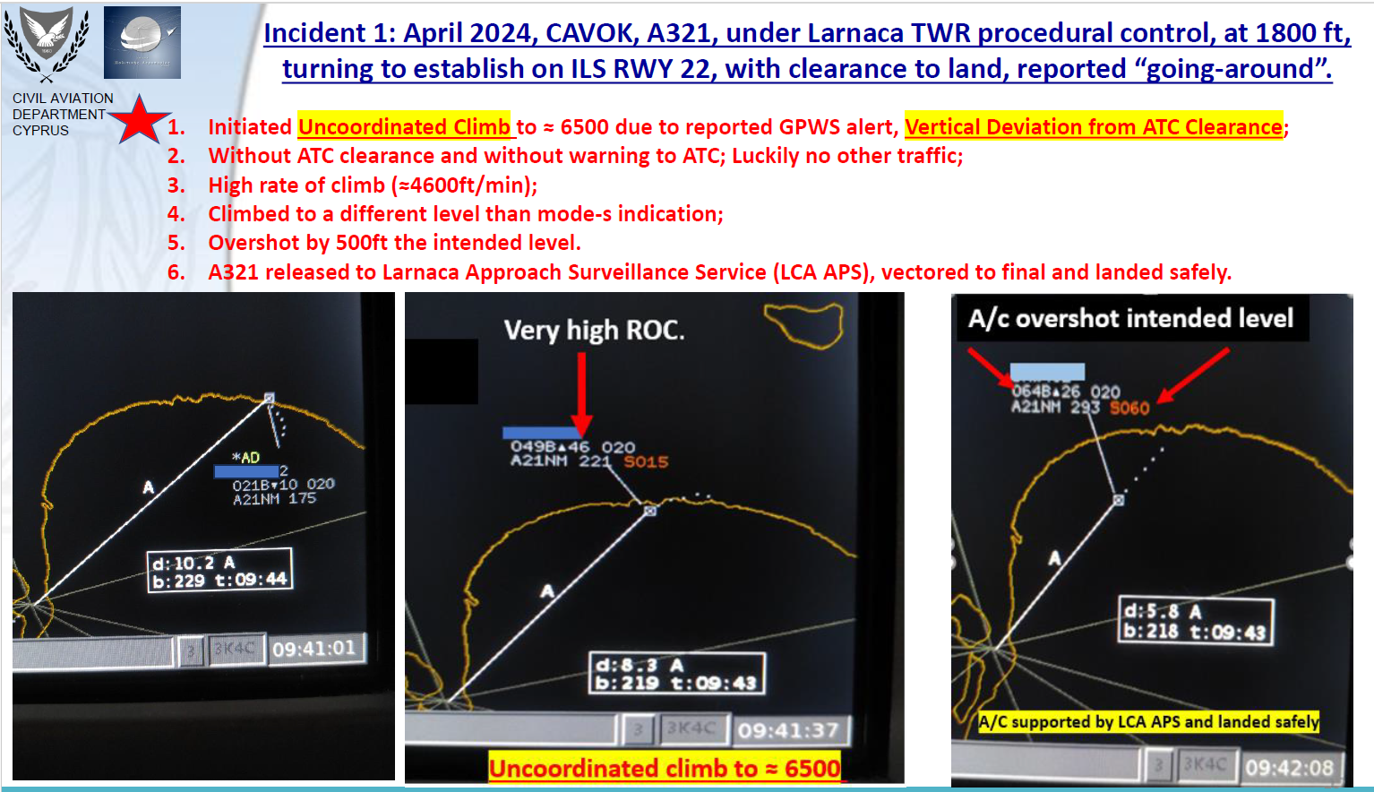

Slide 18
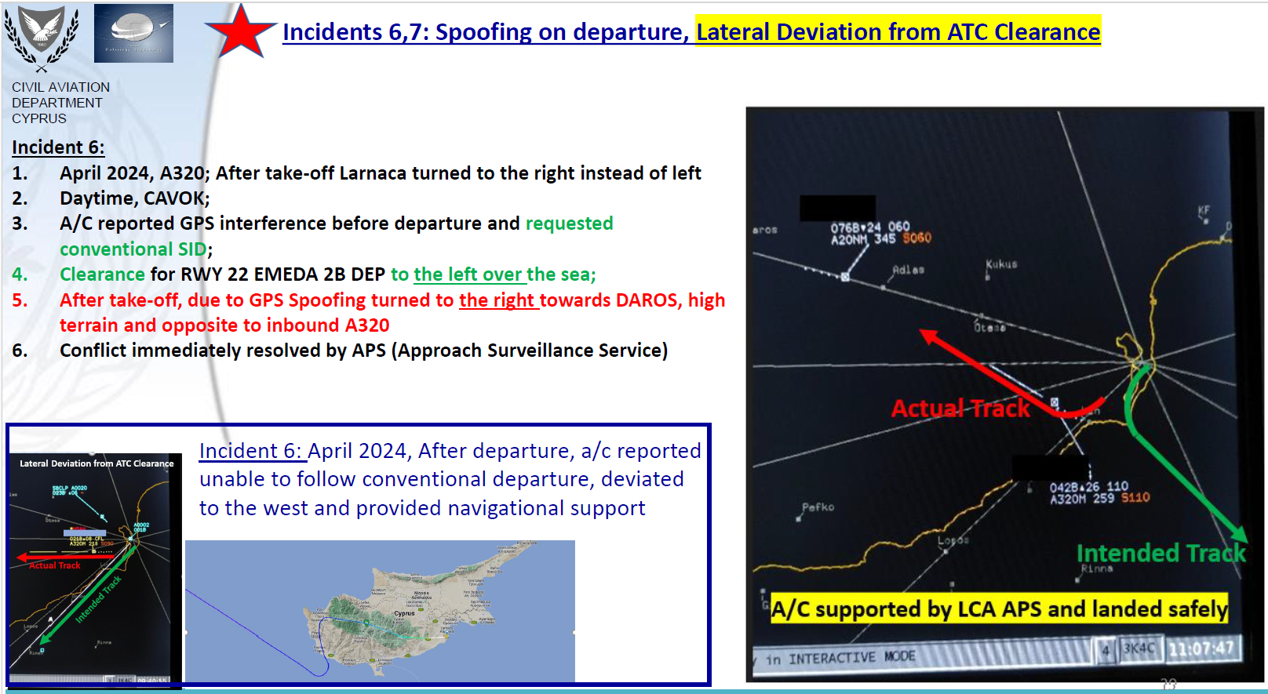

Slide 19
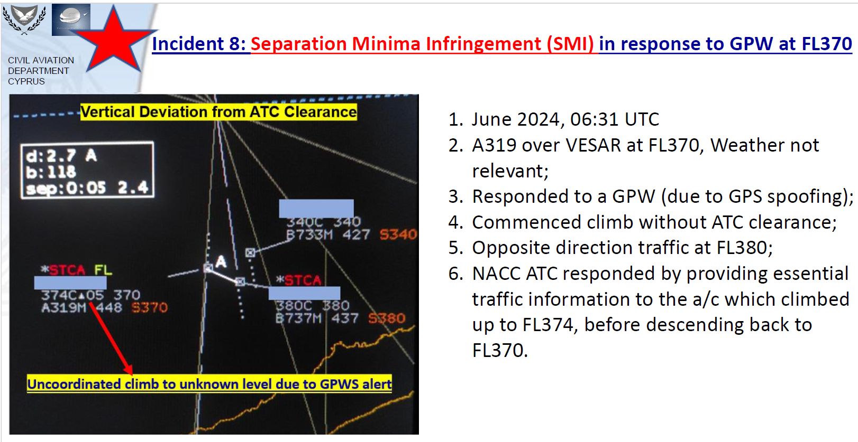

Slide 20
SUMMARY: GNSS RFI Impact
Impact on all CNS elements: PBN, ADS-B, CPDLC
  Plus large variety of cascading effects
  Difficult to predict actual operational impact
Most severe threat: Uncoordinated high-rate climb due to false Enhanced Ground Proximity Warnings (EGPWS / TAWS)
Fundamentally undermines today’s cockpit safety principles:
  Trust your instruments
  Follow Standard Operating Procedure (SOP)
In some airspaces, operation in presence of compromised GNSS has become NORMAL OPERATIONS!
  Extended Risk Exposure Time: Requires Independent CNS Elements to ALL WORK!
  Collateral Impact at extended ranges from zones of conflict

