Slide 1
EASPG/4 Report Appendix V
Air Navigation Performance Framework
Results from the 2021 data collection exercise
(reflecting State submissions up to 31 October 2022)
EASPG/04
Paris, France
29 November – 1 December 2022

Slide 2
Contents
Executive summary
Introduction
Contextual data (Table A)
Performance data (Table B)
Participation KPA

Slide 3
Executive Summary

Slide 4
Highlights on performance results
COVID19 response measures resulted in an unprecedented drop in air traffic in 2020 and 2021. The absence of demand had ripple effects on a variety of operational performance measures. The associated performance indicators for 2021 need to be evaluated in light of the recovery of air traffic.
On average an overall annual traffic reduction of 55-60% was observed in 2020 and increased up to 75% levels in some instances in 2021 throughout the EUR region. Traffic recovery showed a wave pattern and varied across States in 2021. Travel constraints on international traffic also applied to intra-regional traffic and affected the overall traffic /demand situation nationally and region-wide. Global inter-connectivity in 2021 was well below the pre-pandemic levels and reflected the overarching health measures to curb the spread of COVID.
The EUR region is characterised by a wide variety in the size of the airspace as well as of traffic density. The top 5 States included in the report cover 50% of the continental airspace; Two third of the continental airspace is served by a total of 8 States.
Traffic in 2021 increased in comparison to previous years in reaction with relaxing COVID19 travel constraints. However, across the year traffic levels varied in light of the local and global travel constraints About 50% of the total IFR flight hours were accrued by 9 States (while in 2019 8 States served 50% of the traffic). This shows that traffic levels vary from pre-pandemic network connections across the EUR region.

Slide 5
Highlights on performance results
7 States are accountable for more than 60% of all en-route ATCO hours on duty in the EUR Region while the top 8 States accounted for about 60% of all ATCOs in operations at Terminal Facilities, i.e. combined APP and Towers.
The average flight hours per IFR flight increased for the top 2 reporting States in 2021 (consistent with increase in overall traffic). For the other States, the average flight hours per IFR flight is broadly consistent with the previous year.
More than half of the States have a single continental FIR. A smaller number has 2 (often a division between upper and lower), while 7 reporting States have 3 or more FIRs. The number of FIRs is associated with volume of airspace and number of control unit.
A majority of States have a single ACC. 4 reporting States have established 2 ACCs, while 9 reporting States have 3 or more ACCs. The distribution is reflecting the airspace organisation (i.e. the number of FIRs).

Slide 6
Highlights on performance results
Traffic in 2021 increased in comparison to 2020, however, ranges still well below pre-pandemic levels. On average, the average flight hour per IFR flight across the EUR region is slightly increased (just under 0.5 min/flight) compared to 2019. On a per country basis, the observed average flight hour per flight, however, ranges in the same order of magnitude. This suggests that scale-related efficiencies took place (due the number of lower air traffic) while operating a similar network and the numerical increase is subject to the overall reduced number of flights.
A concentration of airport IFR movements is observable. A concentration of airport IFR movements is observable. 75% of all movements were observed within 9 reporting States. The average national number of IFR airport movements ranges around 225.000 while the top 3 States observed airport movement numbers of a factor of 5 more (+/- 1.000.000).
Just under two-third of all ATCOs in operations at ACCs are deployed in 7 reporting States within the EUR region. Oceanic service provision is handled by a small number of States within the EUR region (i.e. 3 States reporting).

Slide 7
Highlights on performance results
In light of the overall traffic decline due to COVID19 in 2020 and 2021, the total number of all causes en-route ATFM delay in the EUR region dropped in comparison to the pre-pandemic years. However, in 2021 a similar pattern is observed with the majority of en-route ATFM delay concentrated in a small number of States, i.e. top 3.
3 States account for just over 85% of the observed en-route ATFM delay in the EUR region.
The vast majority of States does not generate any significant delay.
Due to the decline in air traffic, ATFM delay at airports dropped significantly in comparison to previous years. Weather remains one of the main delay causes while other factors played only a minor/negligible role. In 2021, 2 airports triggered 60% of the delay, and the top 20 airports accounted for just under 90% of all observed airport ATFM delay (similar to 2020). Average arrival ATFM delay is low (under 0.05 min per flight). This needs to be seen in light of the overall traffic levels. Peak arrival ATFM delay was about 3.5 min per arrival.

Slide 8
Highlights on performance results
Flight efficiency followed broadly the pattern of the previous years. This suggests that – despite the traffic reduction – further efficiencies due to restructuring of the network, removal of operational/procedural constraints/routing have been limited. The overall total achieved IFR distance observed across the EUR Region in 2021 is still reduced as a function of the number of flights operated (i.e. lower km flown), but has increased in comparison to 2020.
Given the dimensions of the EUR region and the different airspace volumes, just under 60% of the total achieved IFR distances is measured for flights within 6 States
The data suggest that there is a variety of results in the ATCO productivity, a dozen of States perform better than the average while a dozen perform below the average. The overall spread needs to account for the varying traffic pattern serviced by the ATCO work force.
The participation of States and Stakeholders to the ICAO activities (e.g. workshops, meetings, reports) varies greatly. Due to the prevailing COVID19 situation and associated constraints, many in-person events had to be cancelled and online interactions became the primary interaction tool used also on a day-to-day basis.

Slide 9
Introduction

Slide 10
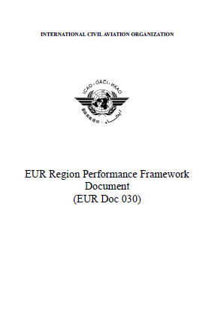
ICAO Performance Framework Document
ICAO EUR Doc 030 describes the performance Framework
(available in English/Russian language)
Introduction
Background
Relationship with ICAO Global developments
Relationship with the EU Performance Scheme
Geographical scope
Roles and responsibilities
KPAs/KPIs/Metrics
Monitoring and reporting at regional/national level
Guidance material

Slide 11

EUR Region Performance Framework
No longer Doc 030
Regional Safety reporting

Slide 12
ICAO Performance Framework Reporting Tables
Airspace
Continental Airspace
Traffic
ATC Facilities
ATCOs in Operations
Contextual
data
Table A – Contextual Data
Airspace
Oceanic Airspace
Traffic
ATC Facilities
ATCOs in Operations
No longer included
Safety
Capacity
Table B – Performance Data
Continental Airspace
Flight Efficiency
Performance
data
Environment
Cost Effectiveness
Table C – Participation Data
EUR Region Activities
Level of participation

Slide 13
Data flow for Doc 030 Reporting
Table A Contextual data
Year n-1
NM traffic data
EUROCONTROL:
creates pre-filled tables for 52 States EUROCONTROL:
provides pre-filled tables
to States upon request
States: review prefilled data;
accept or modify prefilled data; fill in own data when not prefilled;
Submit to ICAO
ICAO forwards submitted templates to EUROCONTROL
EUROCONTROL loads templates into single data file, produces graphs
COG PERF TF produces paper for EASPG
EASPG
Table A Contextual data
Year n-2
SEID reporting:
Contextual data; traffic data;
ATCO productivity
ACE data validation
Table B Cost Effectiveness
Year n-2
Table B Capacity
Year n-1
NM ATFM delay
Table B Flight Efficiency
Year n-1
NM FPL and actual trajectories
Computation of distances
Table B Environment
Year n-1
ICAO default
Fuel consumption

Slide 14
Level of participation in 2022
Status on 08-11-2022
27 submissions
ICAO EUR/NAT Office accreditation (56 States)
ICAO EUR Region (55 States)
ECAC (44) – Iceland (1) = 43 States
EUROCONTROL (41 States)
SES Performance Scheme RP3 (30 States)
EU (27 States)
Austria
Italy
Norway
Albania
Azerbaijan
Algeria
Iceland
MUAC
Belgium
Latvia
Switzerland
Armenia
San Marino
Andorra
Bulgaria
Lithuania
Bosnia and Herzegovina
Belarus
Croatia
Luxembourg
Georgia
Israel
Cyprus
Malta
North Macedonia
Kazakhstan
Czech Republic
Netherlands
Republic of Moldova
Kyrgyzstan
Denmark
Poland
Monaco
Morocco
Estonia
Portugal
Montenegro
Russian Federation
Finland
Romania
Serbia
Tajikistan
France
Slovakia
Turkey
Tunisia
Germany
Slovenia
Ukraine
Turkmenistan
Greece
Spain
United Kingdom
Uzbekistan
Hungary
Sweden
Ireland
ECAA Member
Pre-filled template available,
No support requested
Support requested, Pre-filled template provided
ACE data available
Template submitted

Slide 15
Level of participation 2016-2022
Participation varied over the past years
organisational changes during pandemic with ripple effects on staffing levels / priorities in post-pandemic setup
SES process for EU Member States
2022 participation: 27 submissions
States actively benefitting from support through prefilling (e.g. reduction of replication, consitency, quicker turnaround) → «thank you»
Potential to increase participation through targeting non-reporting States

Slide 16
Processing and presentation of results
Data is collected in one Excel reporting template per State
Data of individual States is collated into a single data set
Basis for graphical representation of results
Combination of prefilled and submitted data
Grey bars: data as submitted by the State
Red bars: prefilled data where available, for States which did not submit a template
In some cases the number of States in the graphs is smaller than the number of pre-filled + submitted templates. Reason: for some States the template is only partially filled.
Results are anonymised
But each State can see where it stands in comparison to all States in the Region
Each State knows its own values and can therefore position itself in the graphs

Slide 17
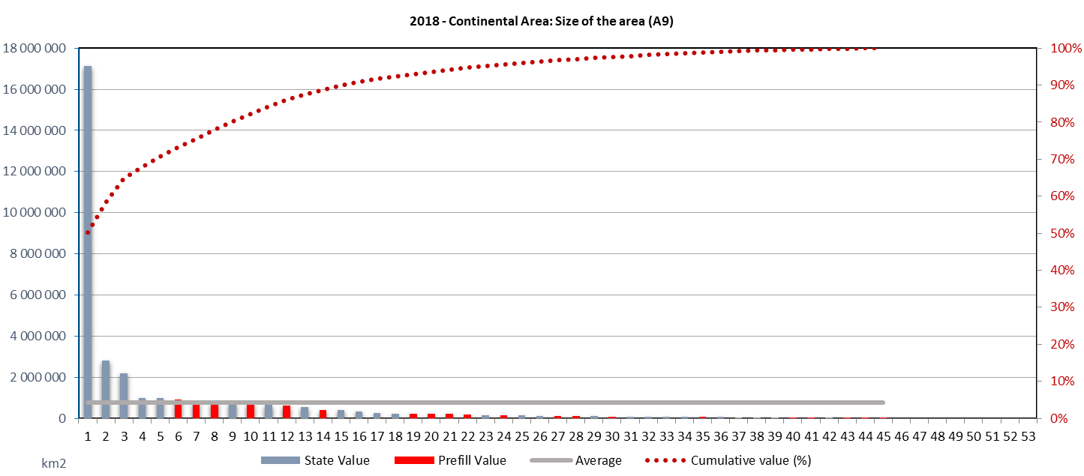
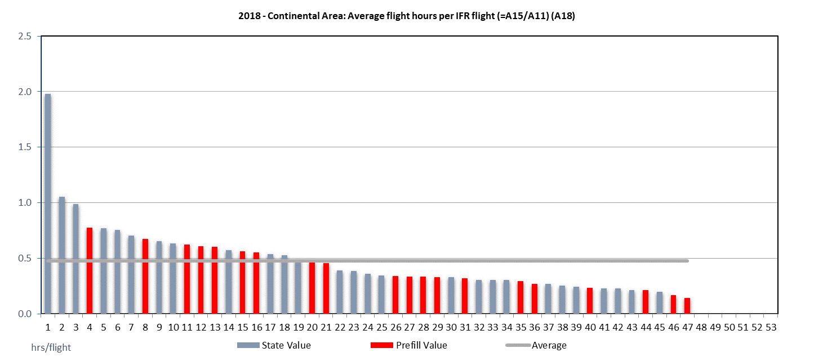
Explanation of graphs
Title
Identifies the data: year, scope (geographical and/or KPA), name of the data item, identifier code in the template
X-axis
The list of anonymised States for the State- and ANSP-based data items (MUAC included as an ANSP), and the list of anonymised airports for the airport-based data items (± 180 airports). Note that the labels are ranking numbers, not State/airport identifiers: in principle the mapping between numbers and States/airports is different for each graph.
Left y-axis
The value of the data item, with the measurement units in the bottom left corner (blank means it is simply a count).
Grey line
The average value (arithmetic mean), based on the number of States/ANSPs for which results are available for this data item (the length of the line indicates for how many States/ANSPs data is available). This value is a proxy for the regional average: it will change as data for more States/ANSPs is available.
A series of grey and/or red bars
The profile of individual State/ANSP/airport values in descending order. This provides a good picture of the differences within the region. The bars do not show the difference between a reported value of zero and the value not being reported, but this can be deduced from the brown line (absence of a bar below the grey line means value zero or a value too small to be visible in the graph).
A red dotted line
For data items which are aggregatable over States/ANSPs/airports: the cumulative profile of the blue bars in percent (see right-hand axis).

Slide 18
Contextual data (Table A)

Slide 19
Data items

Slide 20
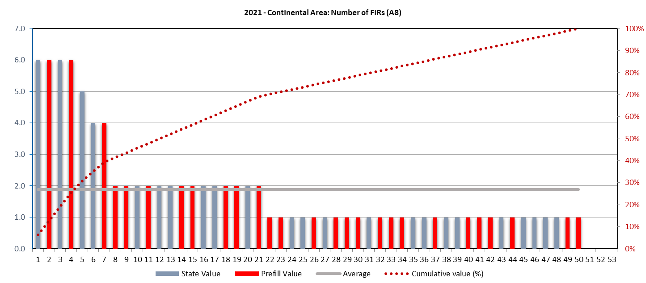
Data items A8
Continental airspace in the EUR region varies widely, including the organisation of service provision in terms of FIRs.
Smaller States / airspaces organise their air navigation service regions as a single FIR while larger nations (and associated airspace) is structured in a multitude of FIRs.
7 reporting states have 4 or more FIRs accounting for approximate 40% of all FIRs.
A high share of states operates 2 FIRs, while the majority (size-dependent) services 1 FIR

Slide 21
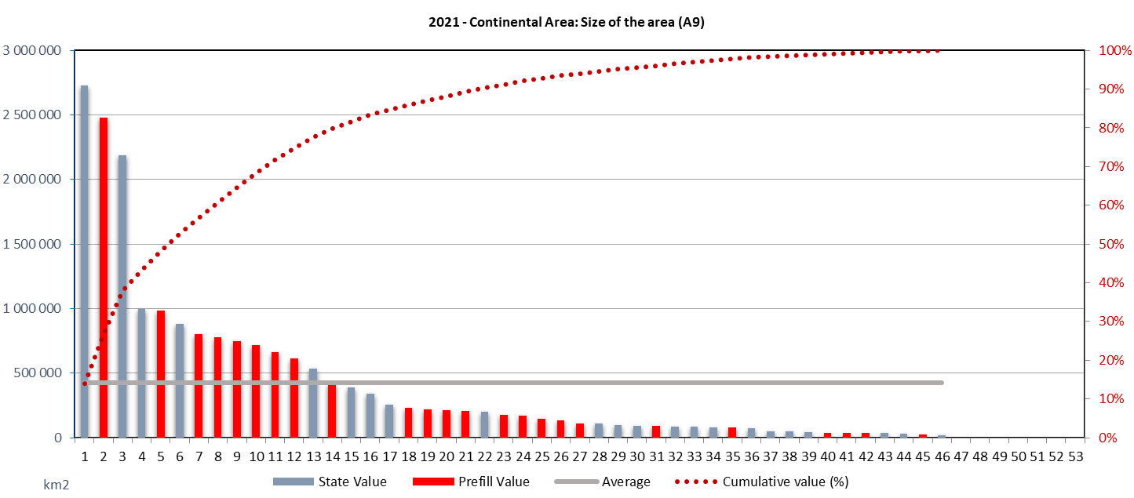
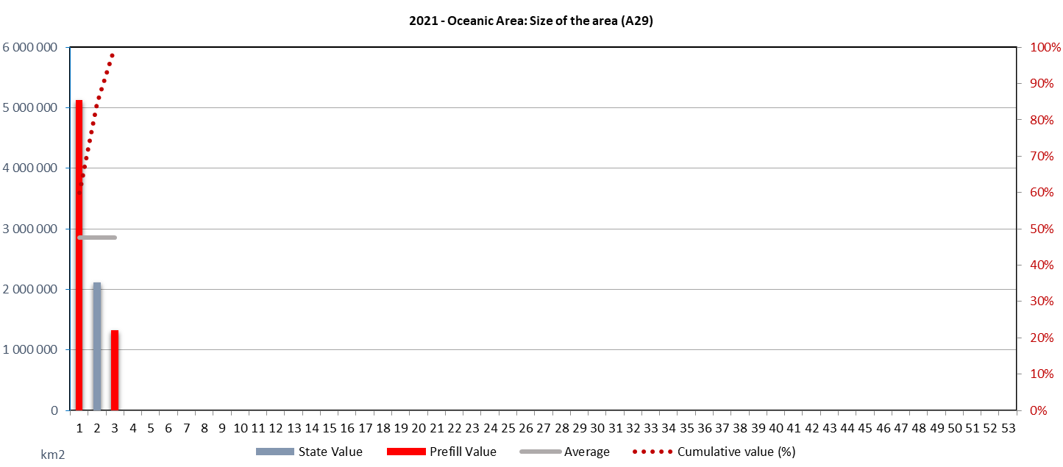
Data items A9 & A29
The top 5 States included in the report cover over 50% of the continental airspace. Two third of the continental airspace is served including another 3 States (= total 8 States).
Airspace sizes vary widely across the EUR region performance framework participants.
With 50% of the States, 95% of the continental airspace is covered.
The EUR region is characterised by a wide variety in the size of the continental airspace. Oceanic airspace and service provision is largely concentrated in a small number of States.

Slide 22
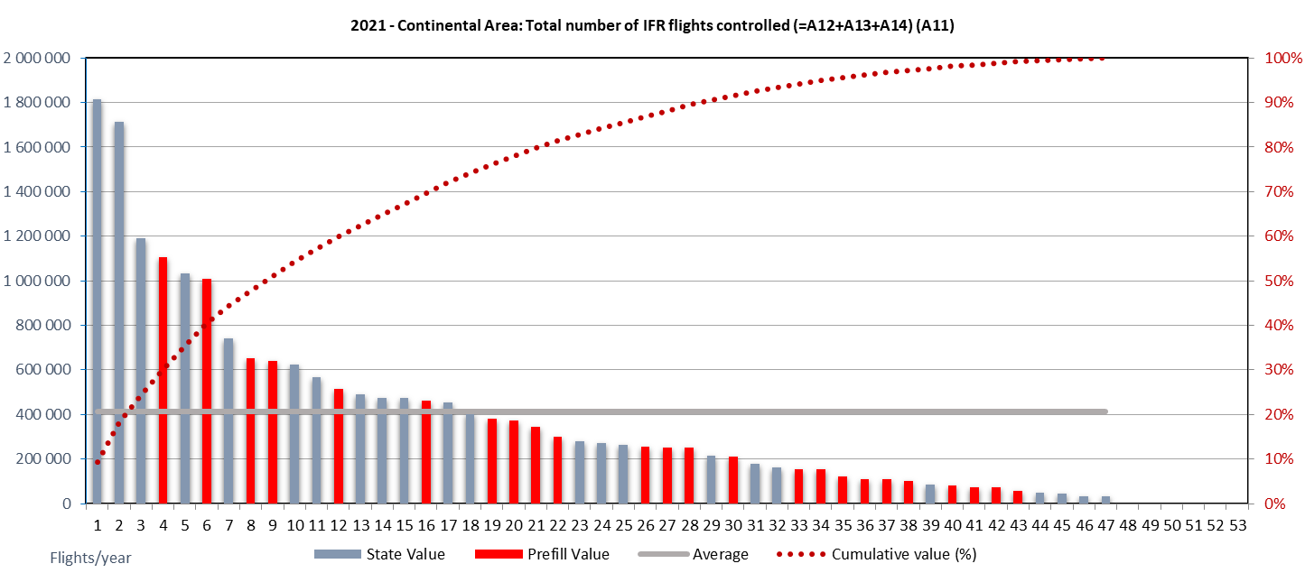
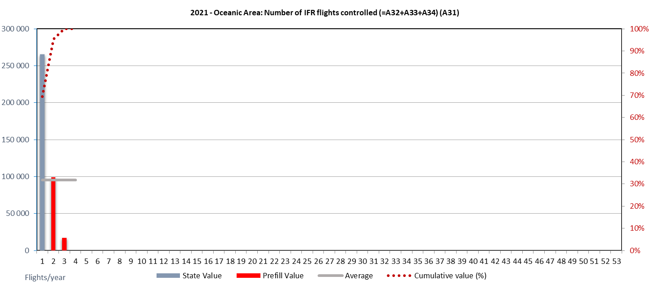
Data items A11 & 31
Traffic in 2021 increased in comparison to previous years in reaction with relaxing COVID19 travel constraints. However, across the year traffic levels varied in light of the local and global travel constraints
About 50% of the total IFR flight hours are accrued by 9 States (while in 2019 this was more centralised in 8 States).
Similar to the overall traffic share across the region, the share of the reduction is heavily dependent on the size of the continental airspace.
On average, the total annual traffic (controlled IFR flights varied between 40-75% of pre-pandemic levels. Oceanic traffic (primarily long-range) international traffic increased only slightly in 2021
There are nuances in different States with traffic decreasing at higher margins.

Slide 23
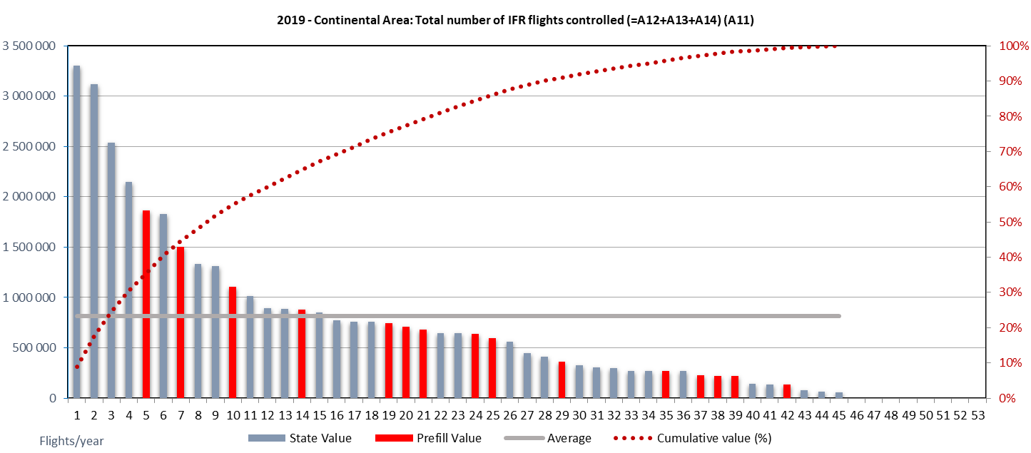
Comparing traffic levels in 2019 vs 2021, the overall pattern of traffic is broadly consistent.
While in 2019 traffic ranged from just under 3.4 million flights to under 100.000 flights; the level per state increased following the decline in 2020 in 2021.
Total annual traffic ranged on average 55-60% across the region.
This suggests, while the peak of the decline followed the WHO pandemic declaration in March 2020, and with different patterns of recovery throughout the remainder of 2020, traffic levels increased in 2021 across the region.

Slide 24
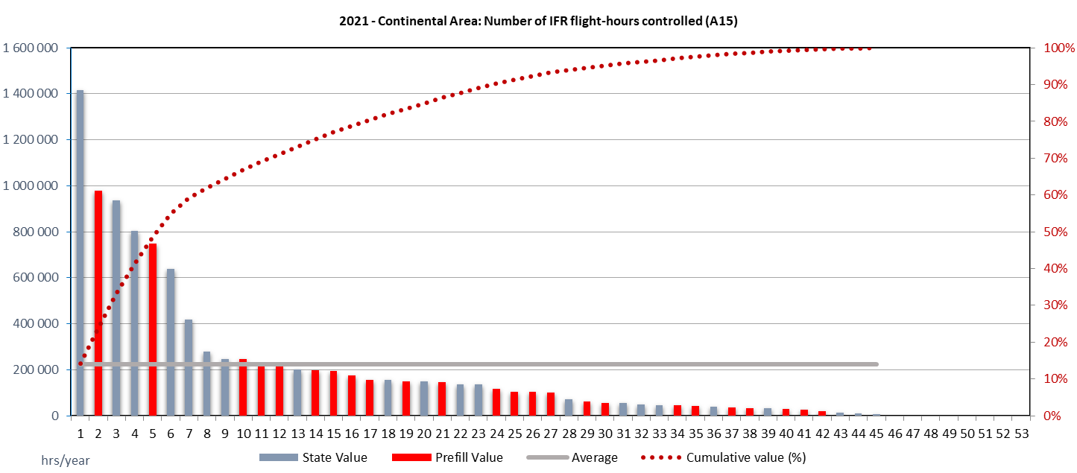
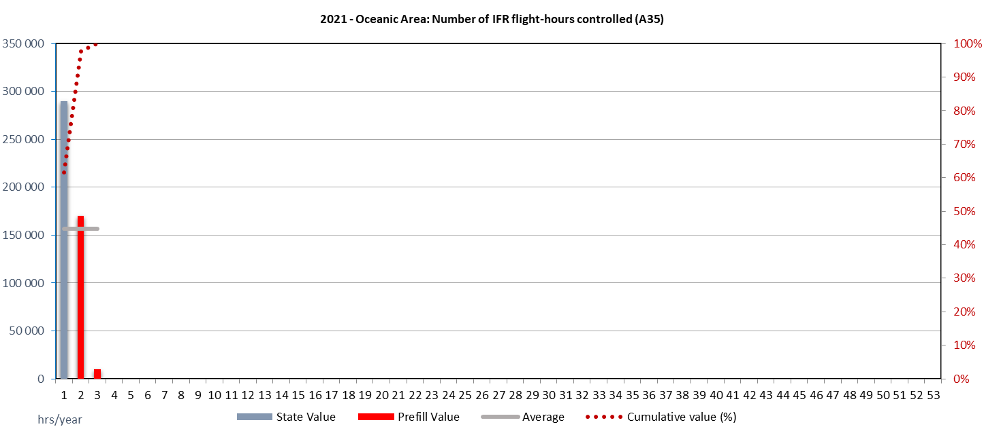
Data items A15 & A35
About 60% of the IFR flight hours within the continental airspace in 2021 is serviced by 7 participating States.
The majority of States serviced at or below 200k flight hours in 2021.
IFR hours are associated with the overall IFR traffic accounted by the States and the associated airspace (FIR) size
The oceanic traffic is primarily handled by 2 participating States.
Oceanic traffic served by 3 States was heavily impacted due to the travel constraints on international air traffic.

Slide 25
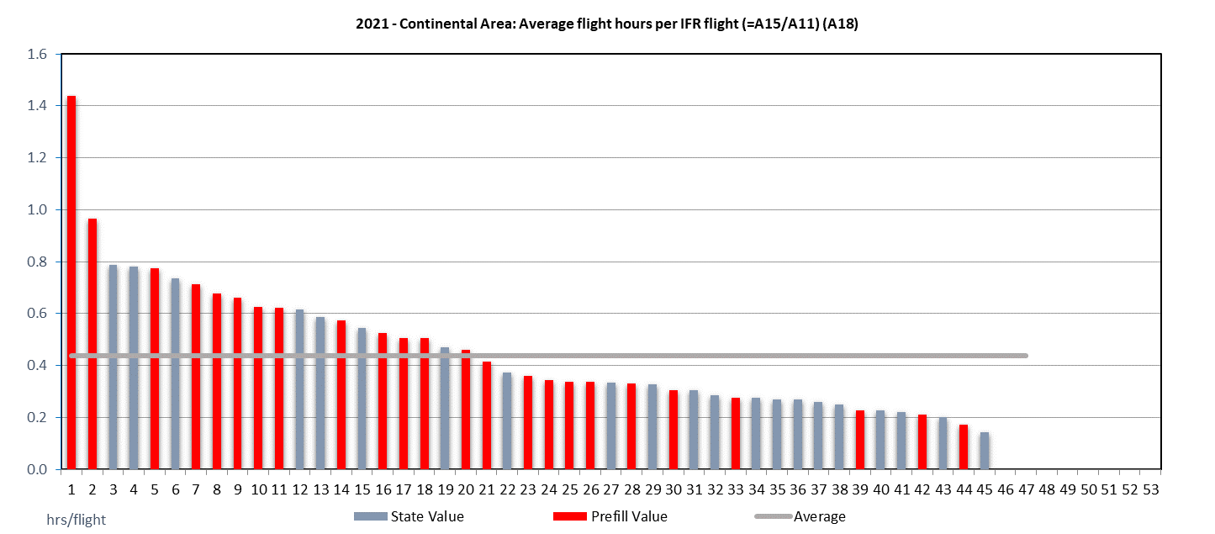
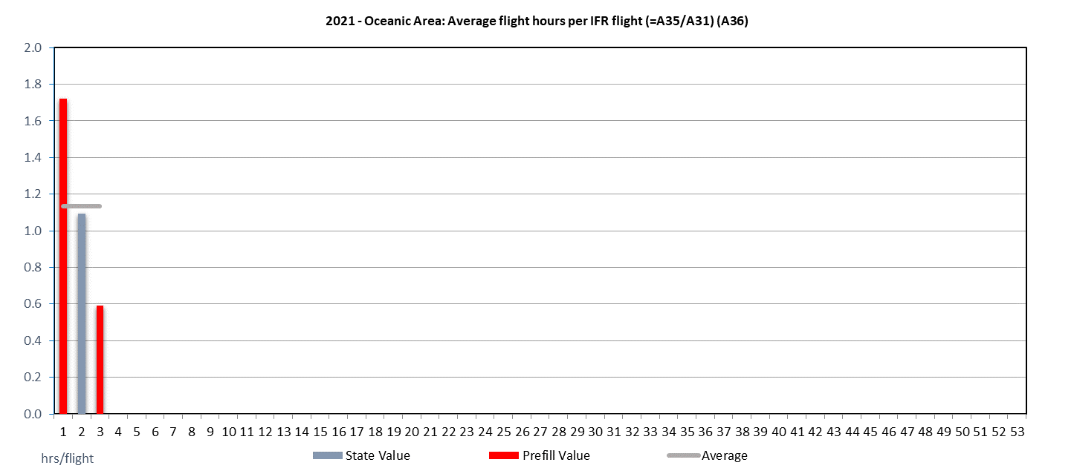
Data items A18 & 36
The average flight hours per IFR flight increased for the top 2 reporting States in 2021 (consistent with increase in overall traffic).
For the other States, the average flight hours per IFR flight is broadly consistent with the previous year.
The average flight hour per IFR flight remained constant in comparison to the previous reporting year (2019) and ranges now at just under 0.5 min per flight.
About half of the participating States observed an average flight hours per flight of under half an hour. This is strongly correlated with the size of the national airspace volume.

Slide 26
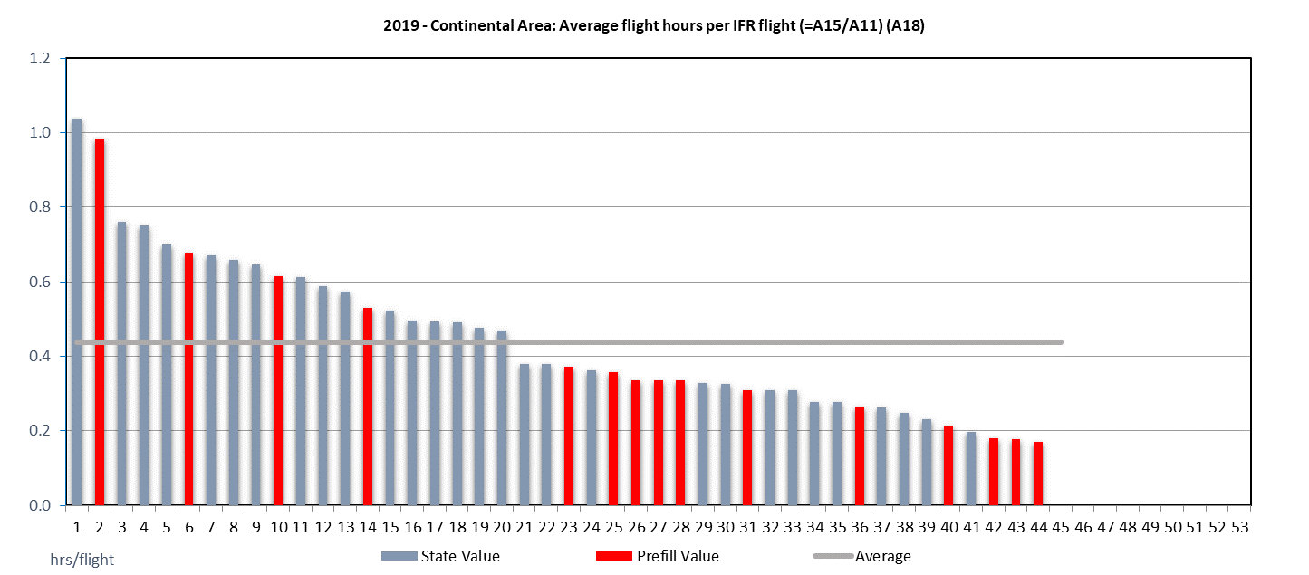
Data items A18
Comparing average flight hours per IFR flight in 2019 vs 2021 – and excluding the top 2 States in both years – average flight hours are consistent with the pre-pandemic years.
On average the average flight hour per IFR flight ranges just under 0.5 min/flight – similar to 2019.
On a per country basis, the observed average flight hour per flight, however, ranges in the same order of magnitude. This suggests that scale-related efficiencies took place (due the number of lower air traffic) while operating a similar network.

Slide 27
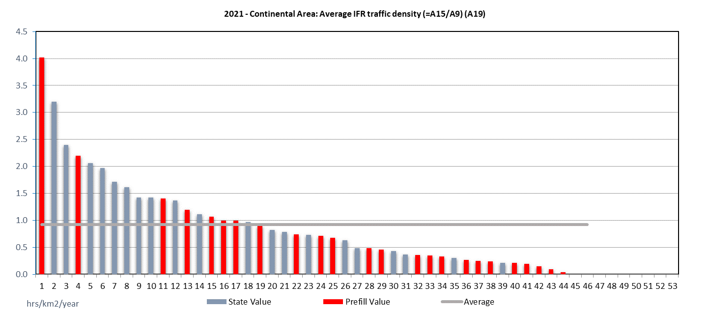
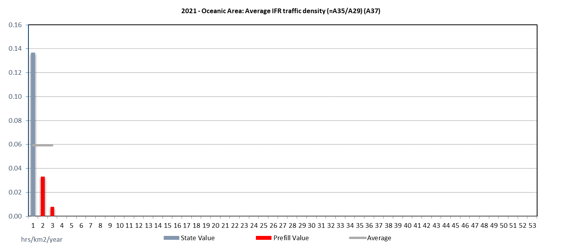
Data items A19 & A37
Density is associated to number of IFR traffic and airspace volume. Increased in 2021 for the top States in the region
Average IFR traffic density varies across the EUR region.
Oceanic traffic density increased slightly in 2021 vs 2020 – showing still distorted international traffic connections

Slide 28
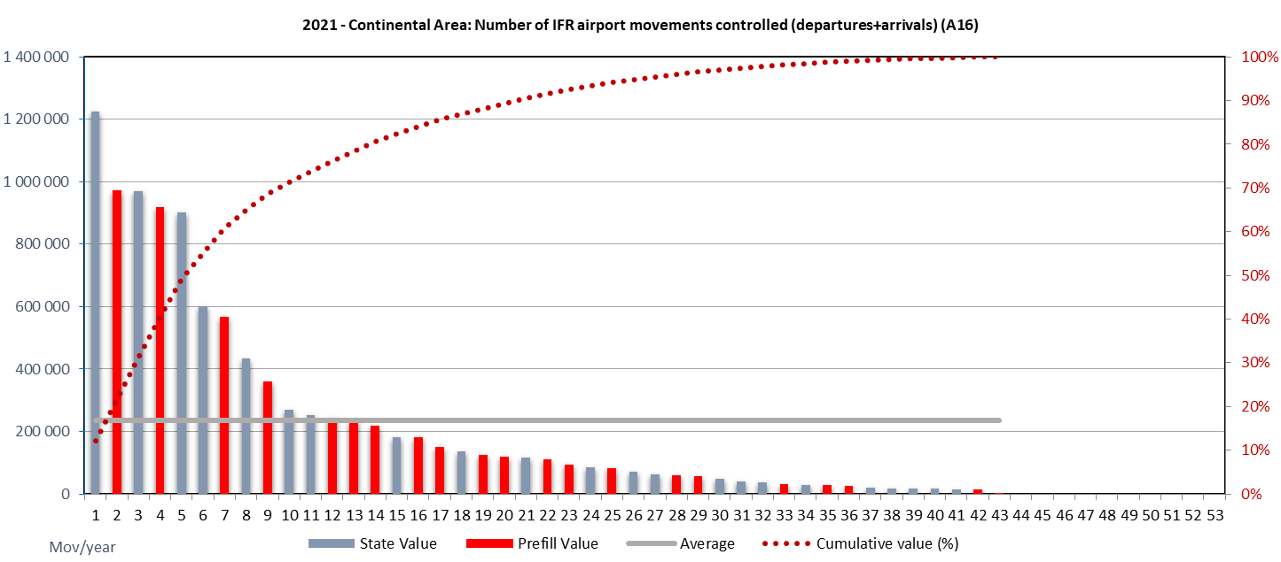
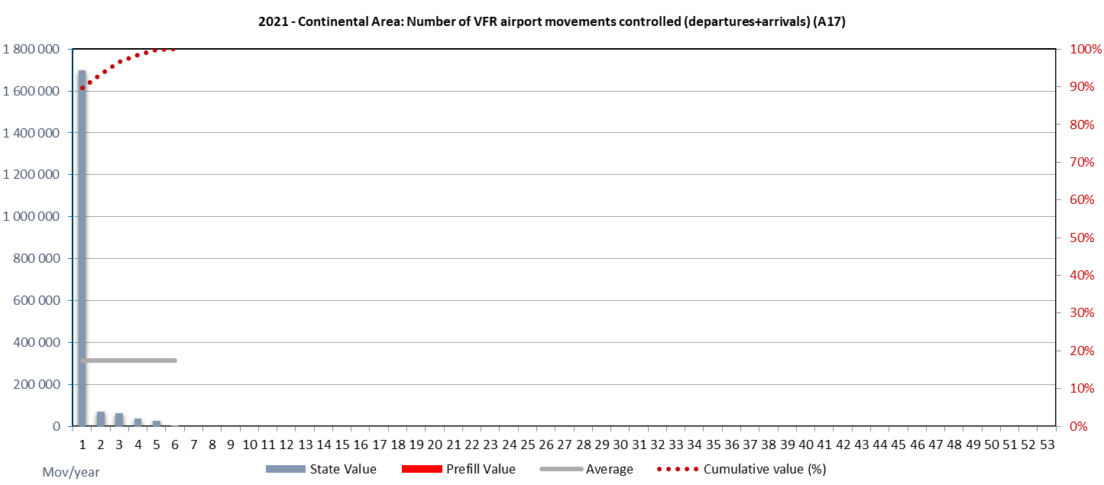
Data items A16 & A17
Traffic changes observed at the national airport level follow the overall traffic developments in 2021 vs 2020.
It is recognised that traffic levels may vary widely locally as traffic recovery at several airports, depends on various factors.
A concentration of airport IFR movements is observable. 75% of all movements were observed within 9 reporting States. The average national number of IFR airport movements ranges around 225.000 while the top 3 States observed airport movement numbers of a factor of 5 more (+/- 1.000.000).
VFR movements were concentrated within a smaller number of States within the European region.

Slide 29
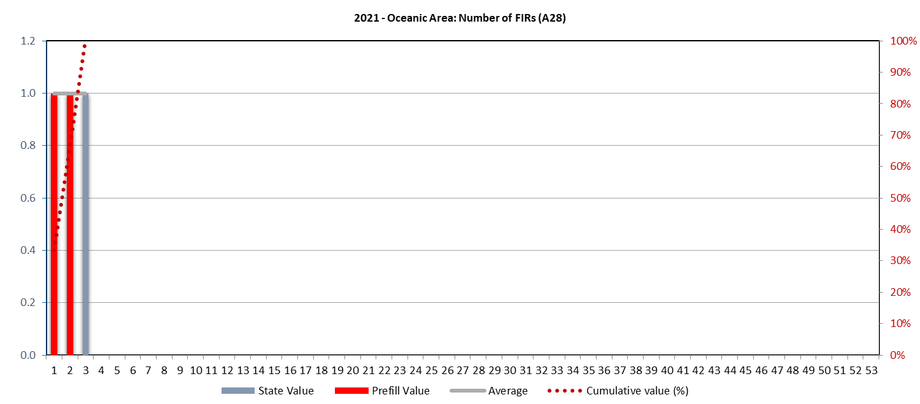
Data items A8 & A28
More than half of the States have a single continental FIR. A smaller number has 2 (often a division between upper and lower), while 7 reporting States have 4 or more FIRs.
The number of FIRs is associated with volume of airspace and number of control unit.
The number of FIRs servicing the oceanic airspace remained constant.

Slide 30
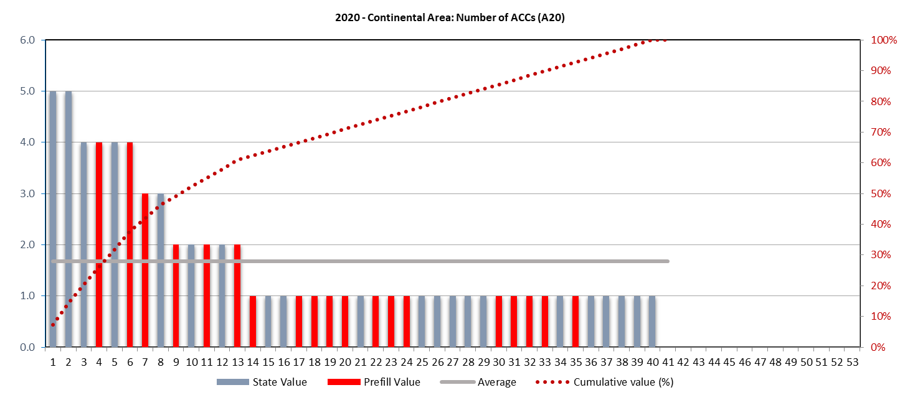
Data item A20
A majority of States have a single ACC. 4 reporting States have established 2 ACCs, while 8 reporting States have 3 or more ACCs. The distribution is similar to the number of FIRs.

Slide 31
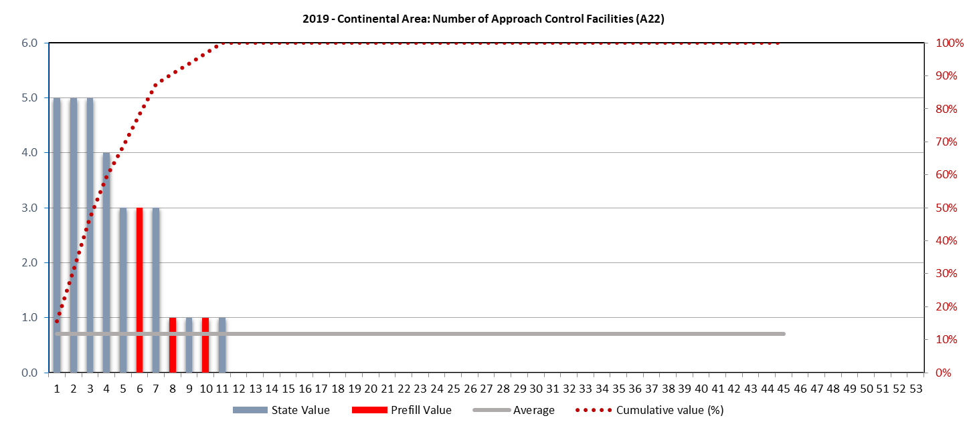
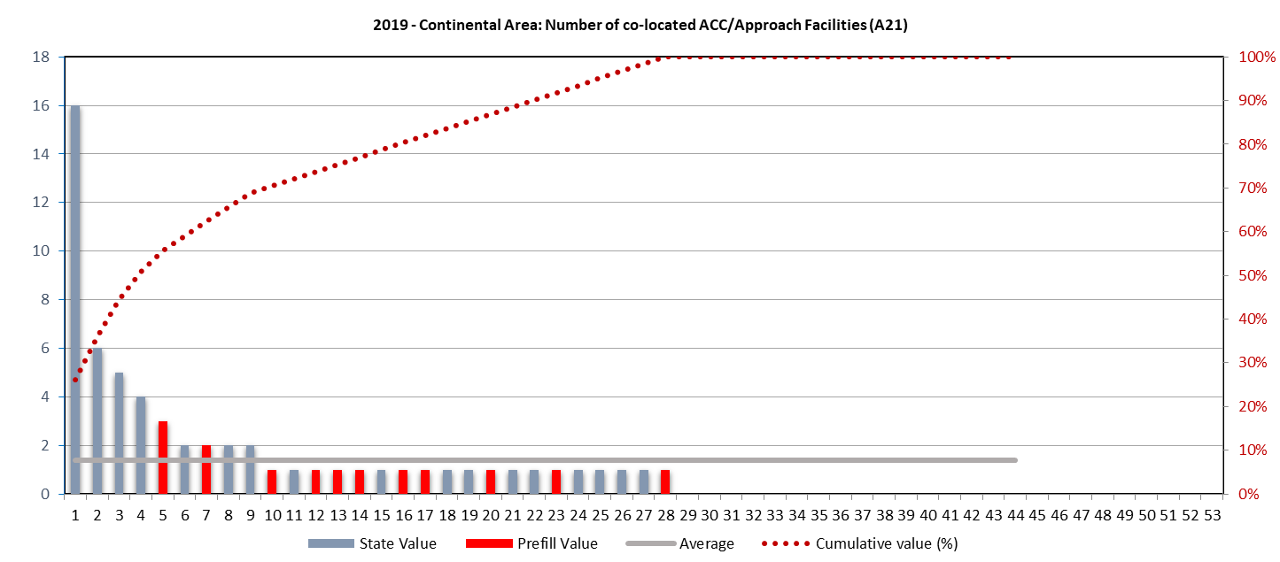
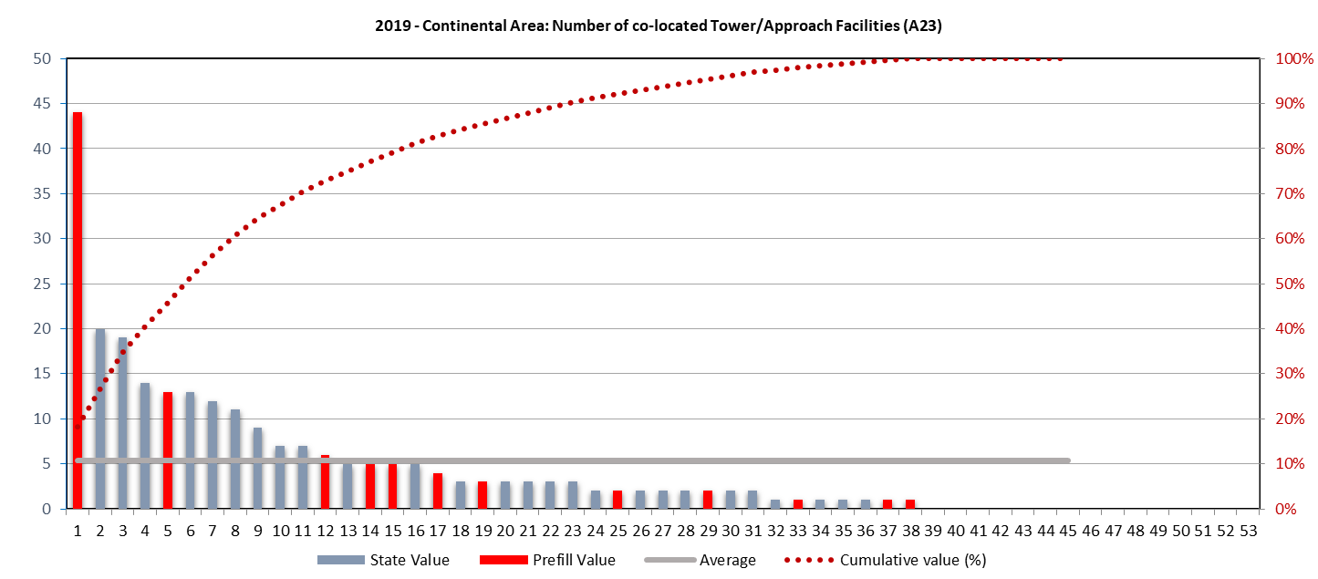
Data items A22, A21, A23
Several States deploy multiple stand-alone APP
APP units collocated with ACC/APP (item A21) commonly used across EUR.
Most small APP units are collocated with Towers (item A23).

Slide 32
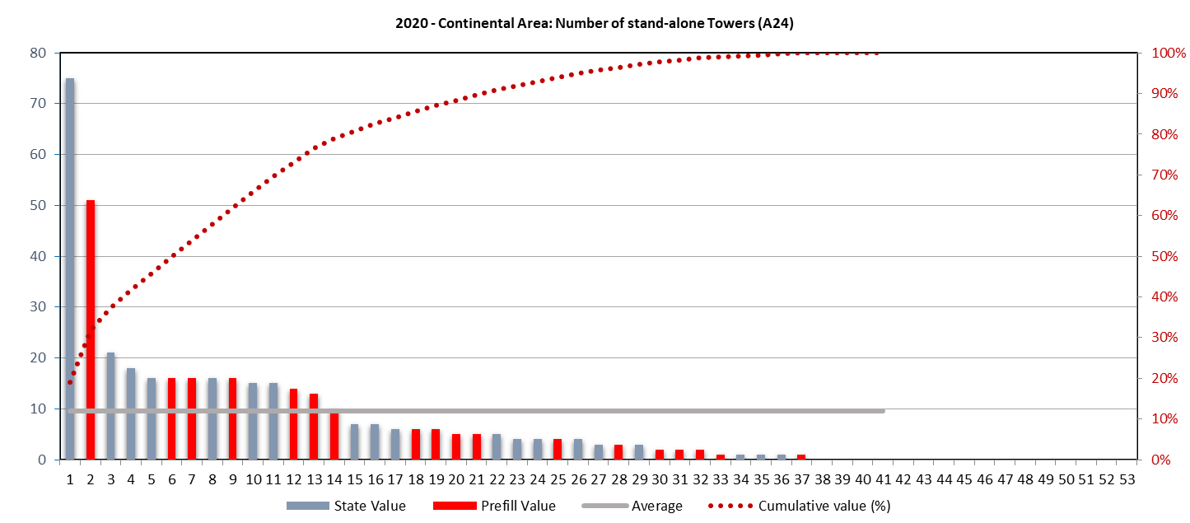
Data item A24
The top-6 States account for 50% of all Towers in the EUR Region.
The remaining States have 20 or less towers.
The average number of stand-alone towers per State is 10.

Slide 33
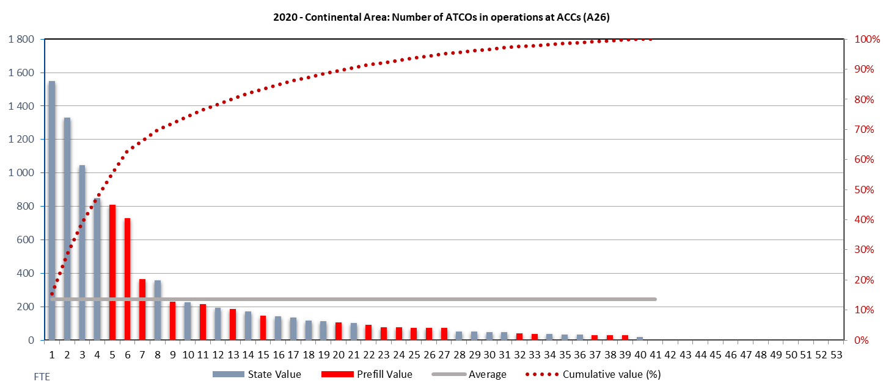
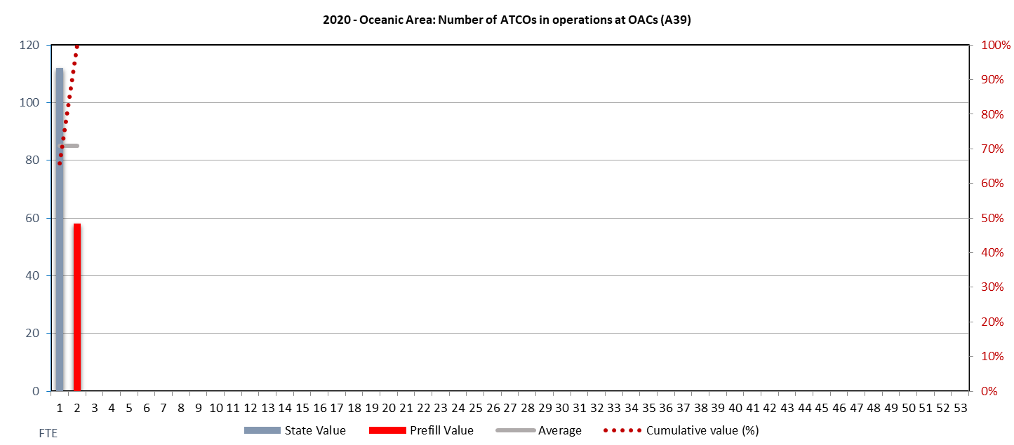
Data items A26 & 39
Just under two-third of all ATCOs in operations at ACCs are deployed in 7 reporting States.
There is only a small subset of States operating oceanic traffic with associated staffing levels.

Slide 34
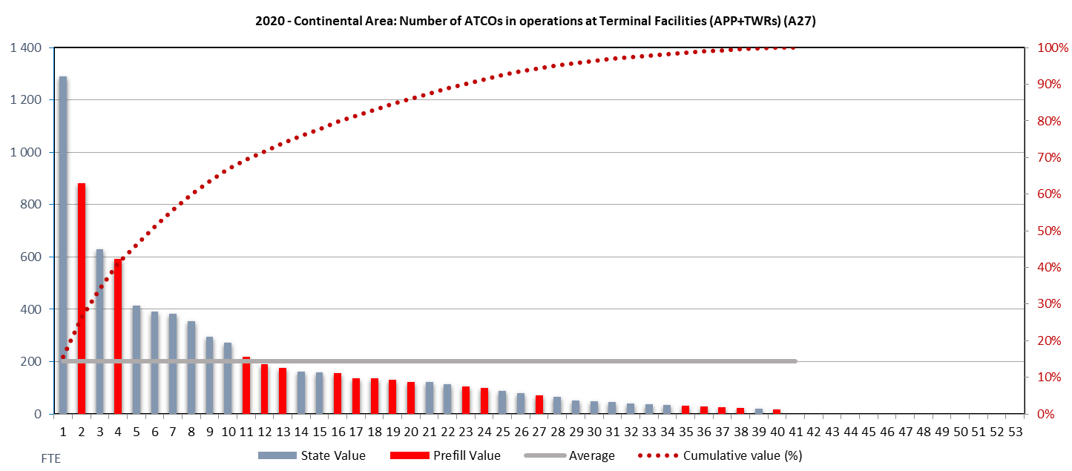
Data item A27
The top 8 States accounted for about 60% of all ATCOs in operations at Terminal Facilities, i.e. combined APP and Towers.

Slide 35
Performance data (Table B)

Slide 36
KPA | Capacity
Objective | Ensure that Air Navigation Service capacity meets demand in en-route airspace and at airports
Indicators | - Average ATFM delay per flight generated by the airspace volume (en-route) - Average ATFM delay per flight in the main airports (to be identified by States in advance and based on the regional relevance)

Slide 37
Please note
Indicators measure
The location where the problem (capacity bottleneck) is, not where the delay is taken (departure airport)
Performance of airspace volumes and airports, not flights
Despite the expression as a value “per flight”
Within the Capacity KPA
Demand/capacity imbalance
Not capacity itself
Limitations
Not designed to measure excess capacity
No data if airspace or airport does not participate in a centralised ATFM process

Slide 38
Data items

Slide 39
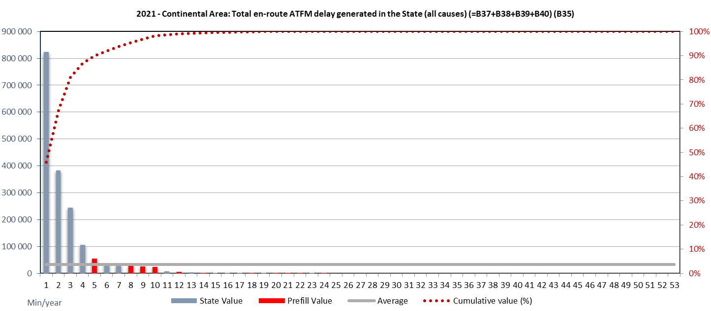
Data item B35
In light of the overall traffic decline due to COVID19 in 2020 and 2021, the total number of all causes en-route ATFM delay in the EUR region dropped in comparison to the pre-pandemic years.
However, a similar pattern is observed with the majority of en-route ATFM delay concentrated in a small number of States, i.e. top 3.
3 States account for just over 85% of the observed en-route ATFM delay in the EUR region.
The vast majority of States does not generate any significant delay.

Slide 40
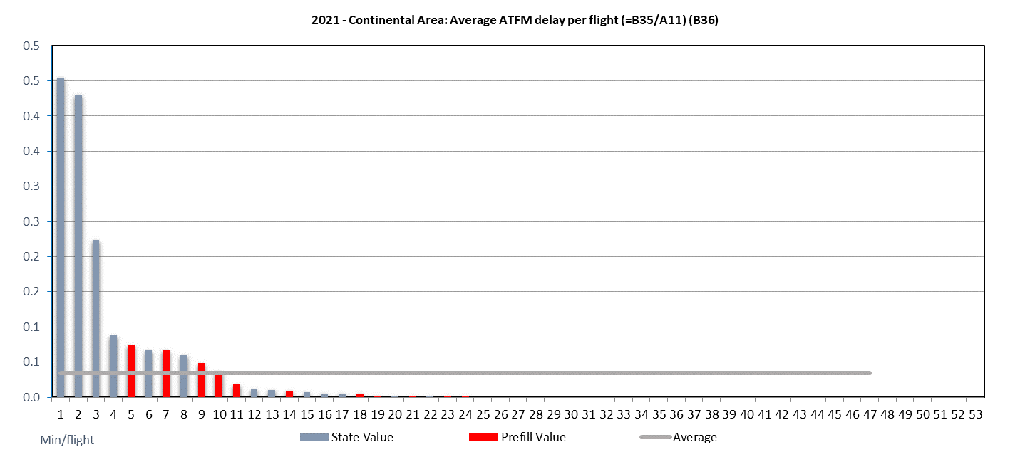
Data item B36
The COVID19 related traffic decline resulted in a very low indicator for average ATFM en-route delay across the EUR region.
The overall pattern across the EUR region is relatively constant over the years. This suggests systemic causes (e.g. general capacity / staffing situation, susceptibility to weather)
Looking at the indicator and the identified concentration of delay triggering airspace volumes, improvements should primarily focus on the 3 States with the highest value. However for prioritisation of improvements the total amount of delay (item B35) should be considered as well.

Slide 41
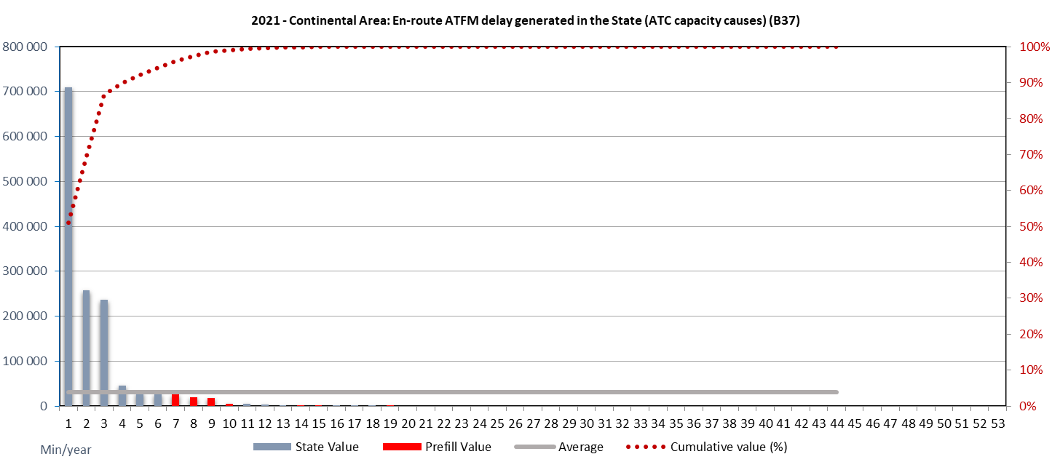
Data item B37
ATC causes (ATFM delay code) C (ATC Capacity)
S (ATC Staffing)
En-route ATFM delay increased in 2021 in light of the overall traffic recovery following the COVID19 related decline vs 2020.
En-route ATFM delay increased by a factor of more than 3 for the State with the most observed en-route ATFM delay in 2021 vs 2020. It doubled for the following 2 States.
Demand/capacity mismatch in en-route airspace due to ATC capacity problems are concentrated in a limited number of States. The top 3 States account for just under 90% of the observed en-route ATFM delay in 2021 with 1 State causes about half of all such delay.

Slide 42
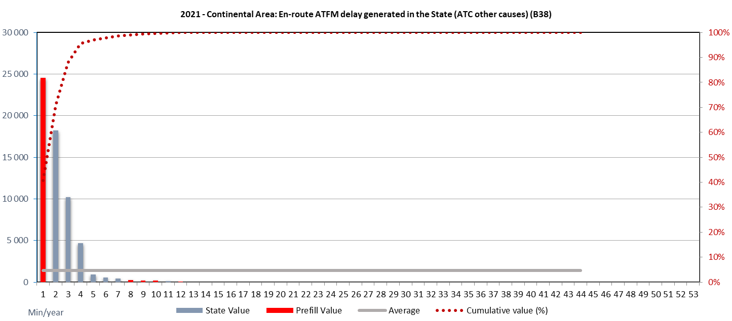
Data item B38
ATC causes (ATFM delay code) I (Industrial Action (ATC))
R (ATC Routeing)
T (Equipment (ATC))
V (Environmental Issues)
Demand/capacity mismatch in en-route airspace due to “ATC other causes” is a phenomenon taking place in a small number of States.
In 2021, 4 States accrued this type of delay. The occurrence in other States is negligible.

Slide 43
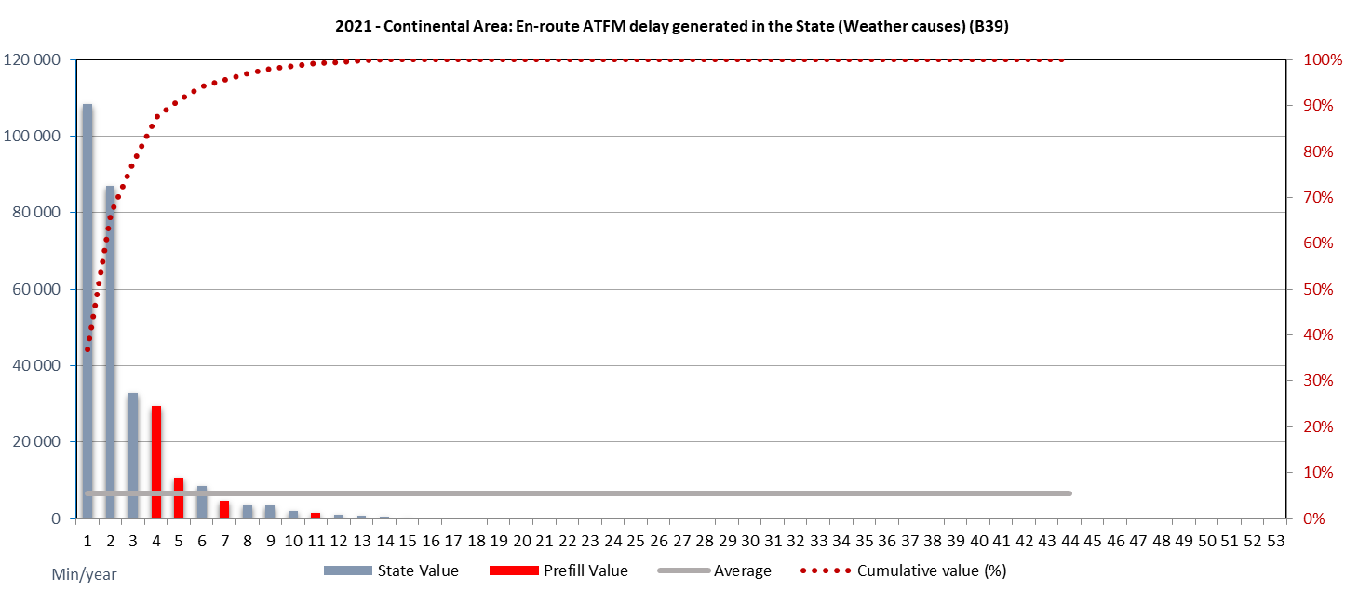
Data item B39
ATFM delay codes
D (De-icing)
W (Weather)
Demand/capacity mismatch in en-route airspace due to weather causes is somewhat more widespread, but not a factor in most of the States, i.e. the total amount of ATFM enroute delay accrued due to weather is relatively small.
About 90% of the weather related delay has been observed in a 4 States in the EUR region.

Slide 44
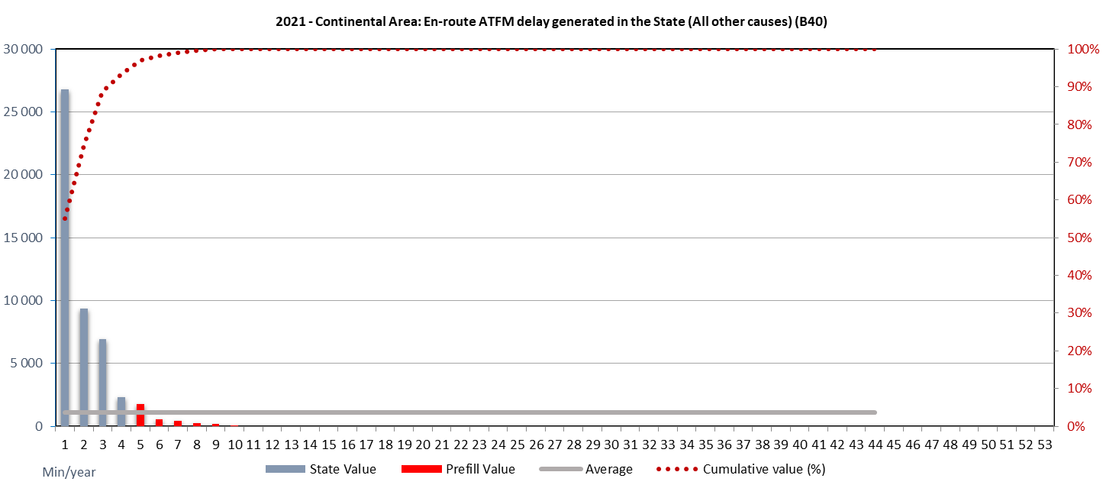
Data item B40
ATFM delay codes
A (Accident/incident)
E (Aerodrome Services)
M (Airspace Management)
N (Industrial Action (non-ATC))
P (Special event)
O (Other)
With the aforementioned caveat of the prevailing COVID19 situation, en-route “all other causes” were scarce and appear more frequently in 3 States.
Across the EUR region these other causes are of negligible nature.

Slide 45
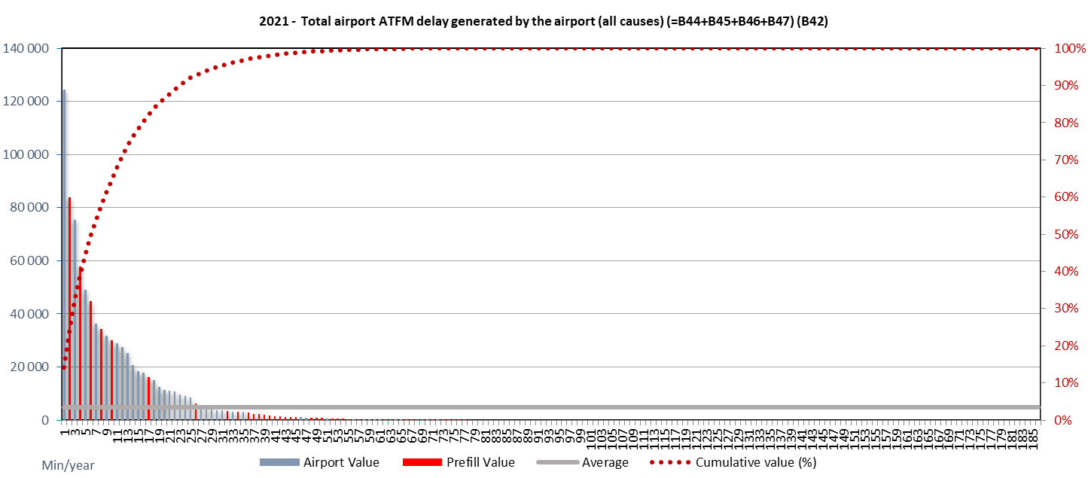
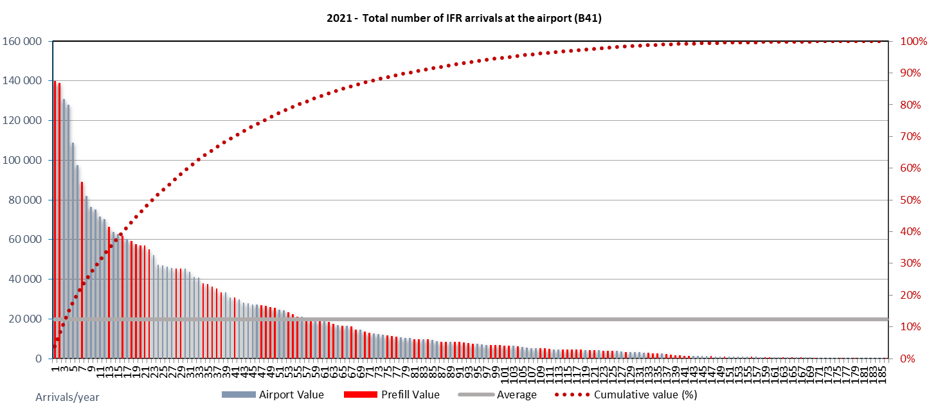
Data items B42 & B41
There exists a sub-set of airports that cause a significant share of all airport ATFM delay in the EUR Region.
In 2021, 2 airports triggered 60% of the delay, and the top 20 airports accounted for just under 90% of all observed airport ATFM delay (similar to 2020).
The overall reduction in air traffic reported above is also observed for IFR arrivals at airports within the EUR region. In comparison to the previous years, traffic levels are recovering.
The decline in traffic may vary locally dependent on they type of air services provided.
6 airports are causing 50% of all airport ATFM delay in the EUR Region.

Slide 46
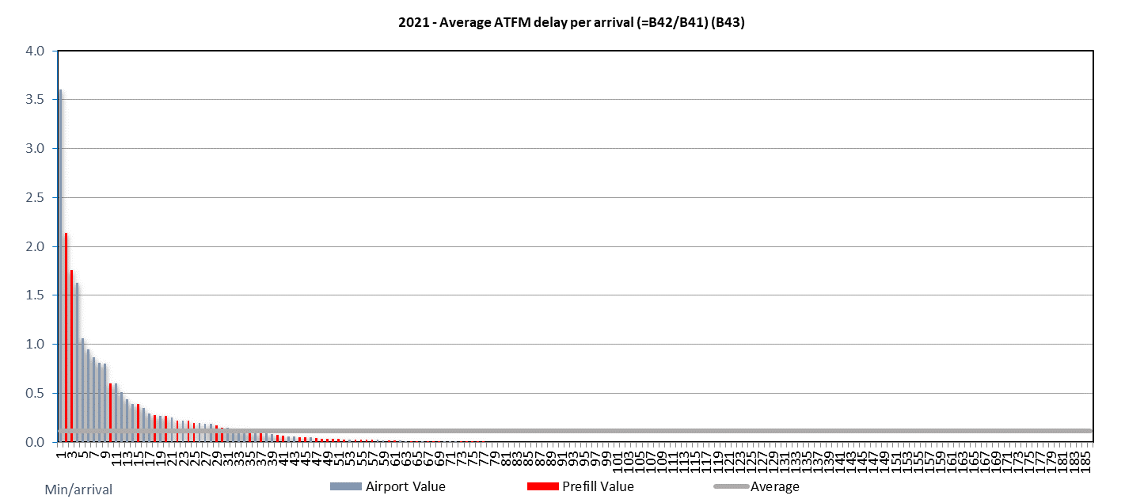
Data item B43
While the overall performance measure for average arrival ATFM delay ranges at the same level than in 2020, the lower average delay per arrival is primarily attributable to the lower traffic levels after COVID. This suggests a high scale effect on overall performance.
Despite the lower traffic, a similar pattern across the EUR region is observed. Looking at the indicator, improvements should primarily focus on the top10 airports with the highest value. However for prioritisation of improvements the total amount of delay (item B42) should be considered as well.

Slide 47
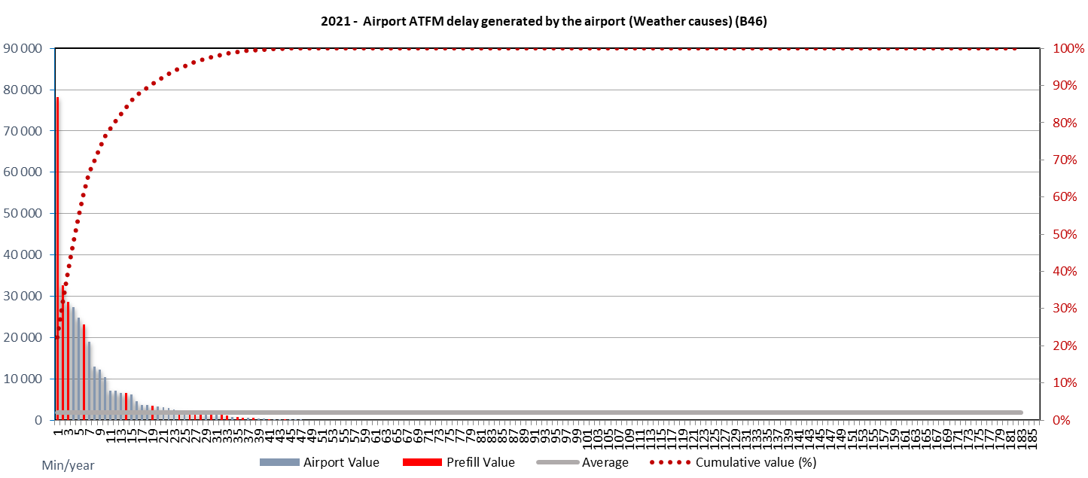
Data item B46
ATFM delay causes
D (De-icing)
W (Weather)
Weather causes have been a lower factor in 2021 in terms of airport ATFM delay.
While about 90% of all weather related airport ATFM delay is observed at the top 20 airports in terms of IFR movements, priority action could focus on the top 10 of the main contributing airports. This could be beneficial for the overall performance.
In 2021, the top 5 airports accounted for 50% of weather related airport ATFM delay.

Slide 48
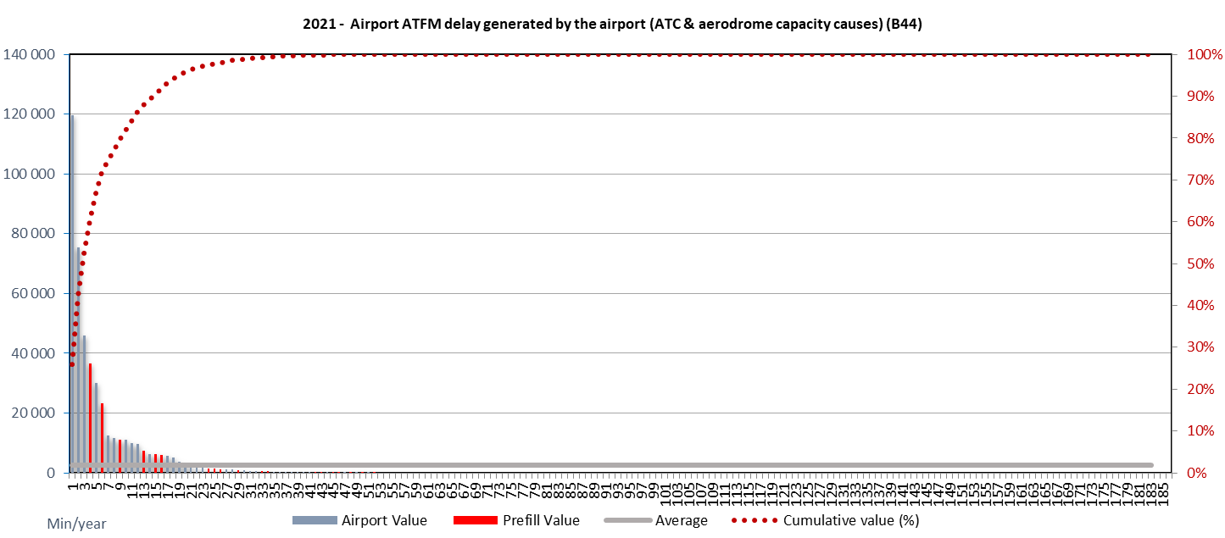
Data item B44
ATFM delay codes
C (ATC Capacity)
G (Aerodrome Capacity)
S (ATC Staffing)
The overall ATC and aerodrome capacity related ATFM delay increased in 2021 sharply in comparison to the low levels of traffic in 2020.
Over 70% of the observed capacity related arrival ATFM delay was observed at the top 6 airports in the EUR region.

Slide 49
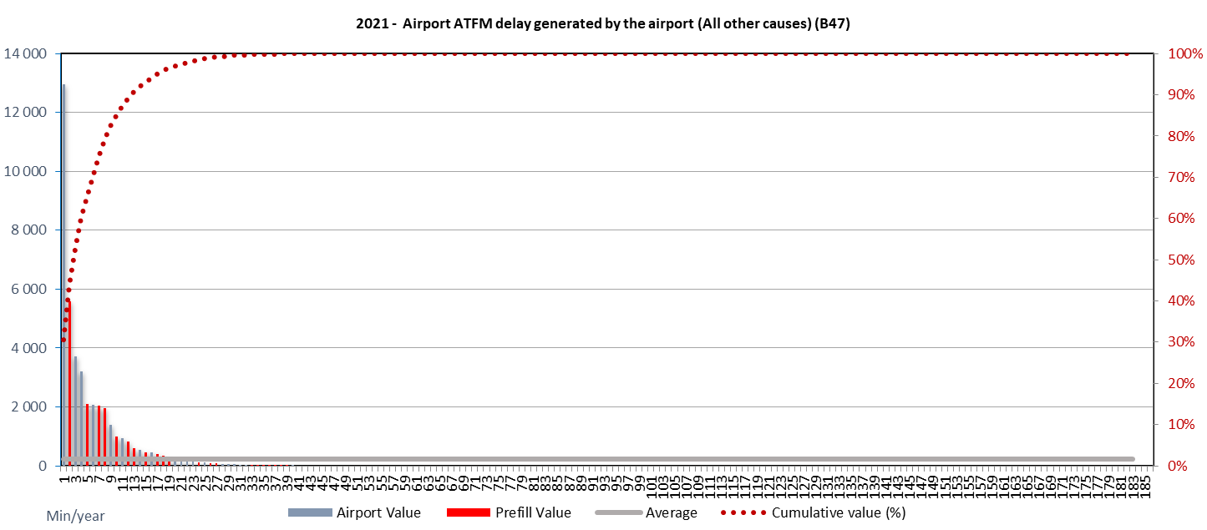
Data item B47
ATFM delay codes
A (Accident/incident)
E (Aerodrome Services)
M (Airspace Management)
N (Industrial Action (non-ATC))
P (Special event)
O (Other)
Overall, “other causes” were observed less in 2021 than in 2020.
For airport related ATFM delay attributable to “all other causes” there is a concentration on the top 2 airports. It needs to be noted that this delay category is – overall – a relatively small contributor

Slide 50
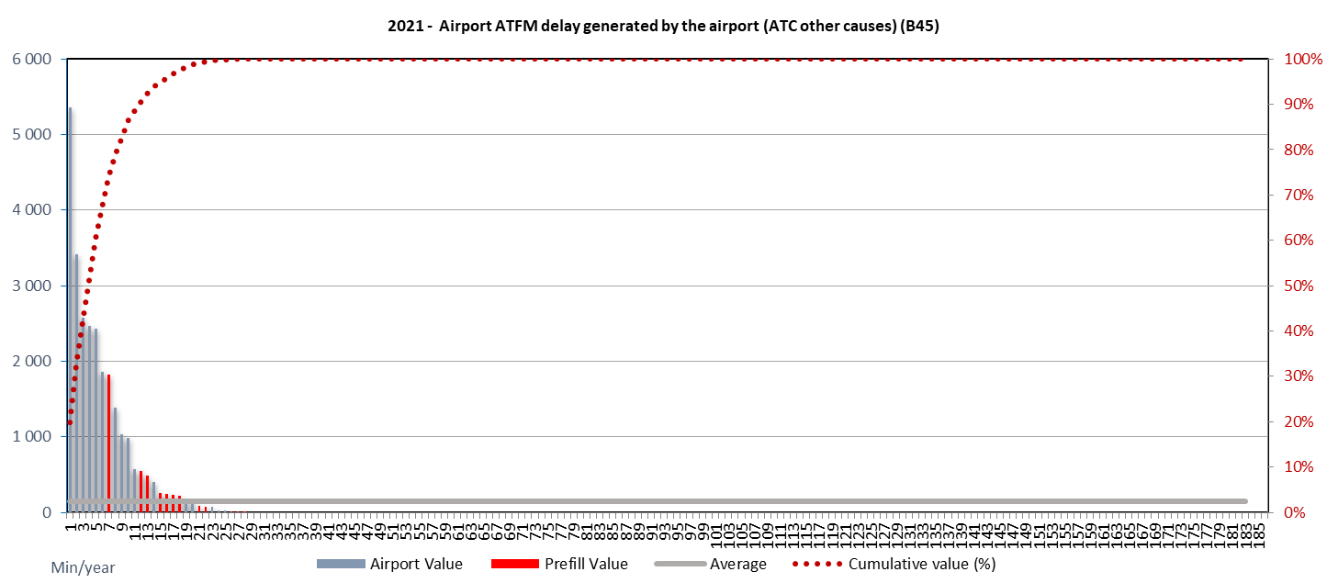
Data item B45
ATFM delay codes
I (Industrial Action (ATC))
T (Equipment (ATC))
V (Environmental Issues)
In light of the prevailing traffic conditions, negligible delay attributable to other ATC causes had been observed in 2021 at airport within the EUR region.
On average, ATC other causes is the smallest contributor to airport ATFM delay

Slide 51
KPA | Efficiency
Objective | Ensure that users [can?] use the most efficient routes – focussing on the horizontal flight-efficiency
Indicator | Average horizontal en route flight efficiency, defined as the difference between the length of the en route part of the actual trajectory (where available) or last flight planned route and the great circle.

Slide 52
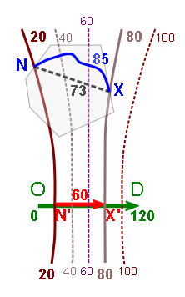
Notion of “Achieved Distance”
O, D, N, X: Origin, Destination, eNtry, eXit
“Corresponding portion of the great circle distance OD” = achieved distance N’X’ (needed to calculate the indicator at State level)
Iso-achieved-distance lines
In the example to the left:
Extra distance: 85 – 60 = 25
Inefficiency = 25 / 60 = 0.42 = 42%
Calculation of achieved distance N’X’ for flight segment NX: (distance-closer-to-destination + distance-away-from-departure)/2
D
Closer to dest.
X
Important properties
Sum of achieved distances of flight segments is always equal to total direct (great circle) distance from O to D
Actual, achieved and excess distances for flight segments are aggregatable (bottom-up from State level to regional level)
N
Away from dep.
OD line
O

Slide 53
Processing of domestic flights and overflights
Domestic flight
Overflight
Measured area (State FIRs)
Reference area (eg EUR region)
Airport B
TMA
Airport B
TMA
D
D
X
Actual or FPL
Actual or FPL
OD line
OD line
X
N
Required inputs: Trajectory and the coordinates of points O, D, N, X (Origin, Destination, eNtry, eXit)
Computed: Trajectory distance (NX), achieved distance (N’X’)
For the NX parts of all trajectories of IFR flights domestic, departing, arriving, or overflying IFR flights
O
Measured area (State FIRs)
Non-SES States can choose reference area
Min: State FIRs
Max: EUR region
N
O
40 NM
40 NM
Airport A
Airport A

Slide 54
Data items

Slide 55
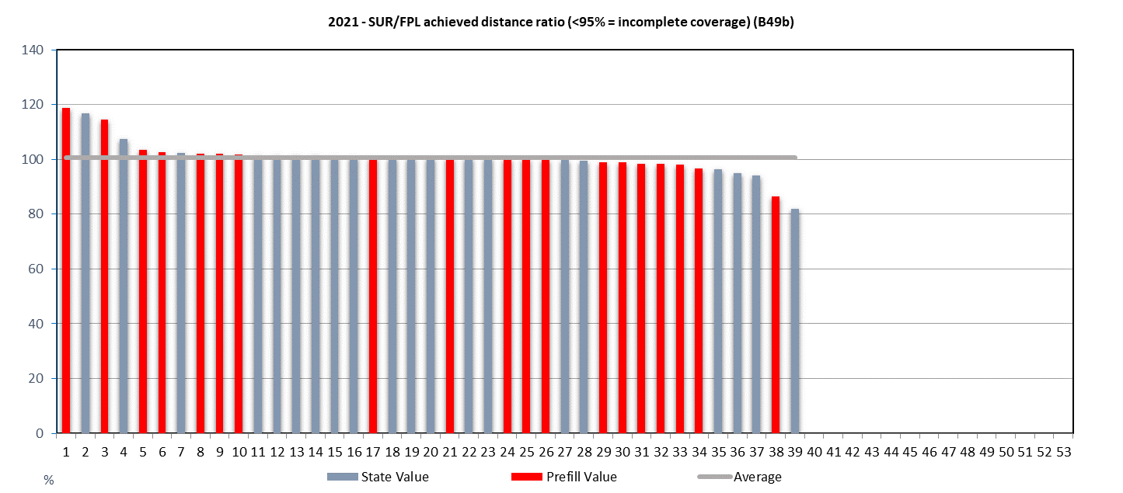
Data item B49b
Date Note: On the left side of the graph: for 4 States a number of FPL trajectories have been discarded for data quality reasons. This causes the SUR/FPL ratio to be > 100%, which is not an issue for performance measurement.
On the right side of the graph: for 2 States the SUR/FPL ratio is significantly < 100%, which is an indication of insufficient surveillance data coverage.
Across the EUR Region a high level of FPL achieved distance ratio is observed.
This suggests that FPLs are closely coordinated between air transport operators and air navigation service providers considering available capacity (on the day of operation) and related constraints.

Slide 56
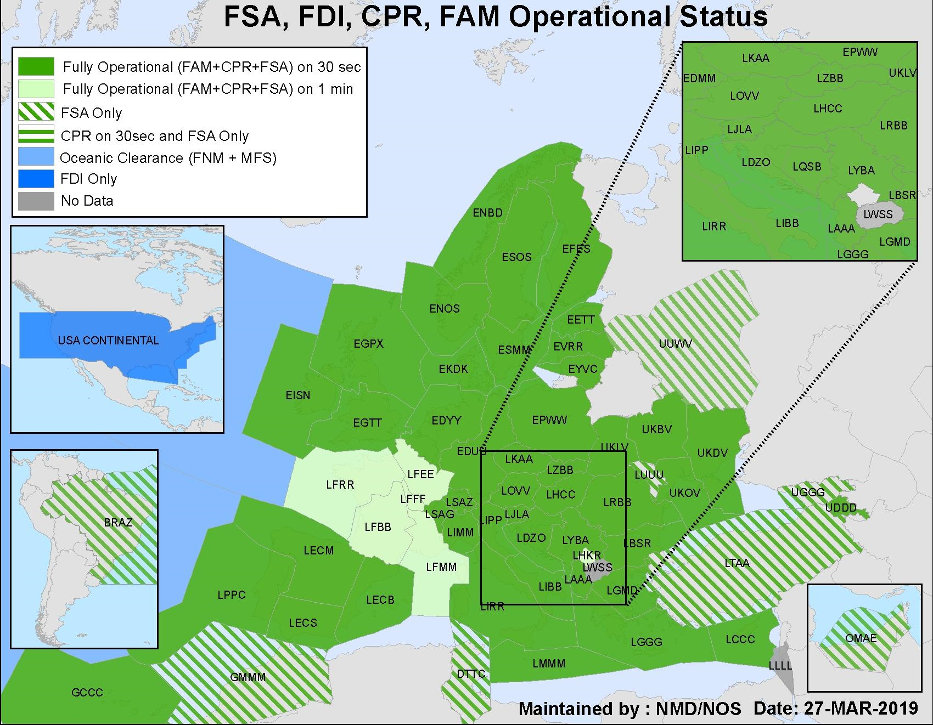
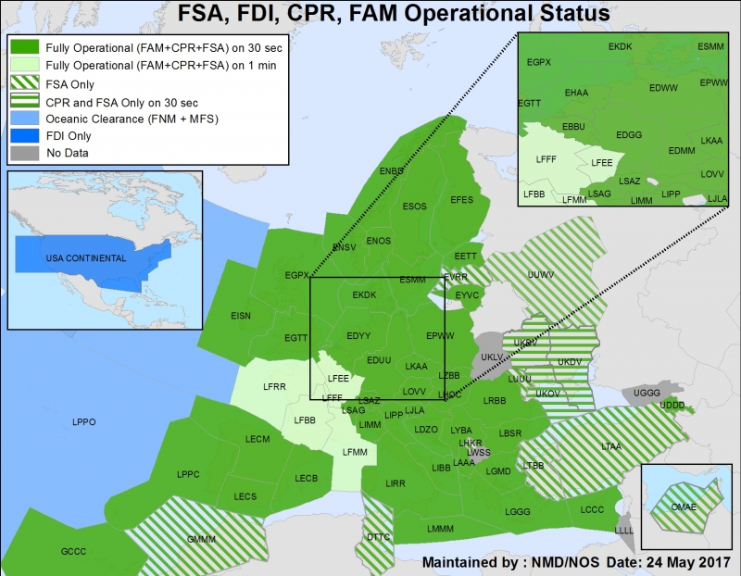
Surveillance data (CPR) coverage
2017
2019

Slide 57
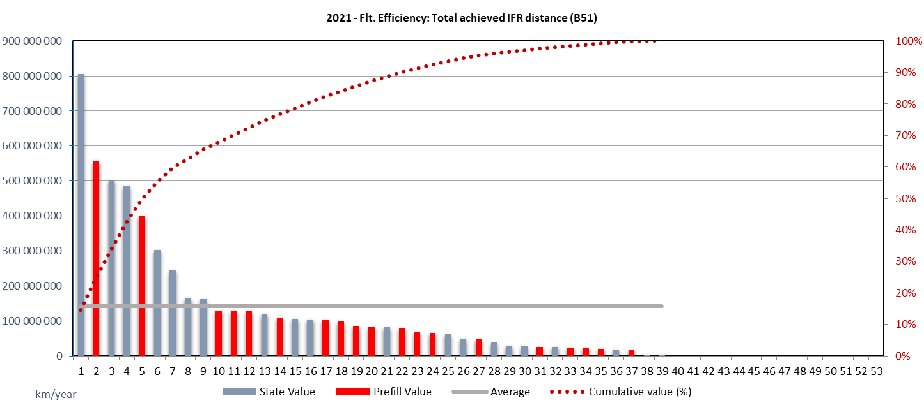
Data item B51
The overall total achieved IFR distance observed across the EUR Region is still reduced as a function of the flights operated (i.e. lower km flown), but has increased in comparison to 2020.
Given the dimensions of the EUR region and the different airspace volumes, just under 60% of the total achieved IFR distances is measured for flights within 6 States.
Note: Total achieved IFR distance := contribution to the great circle distance of the flights

Slide 58
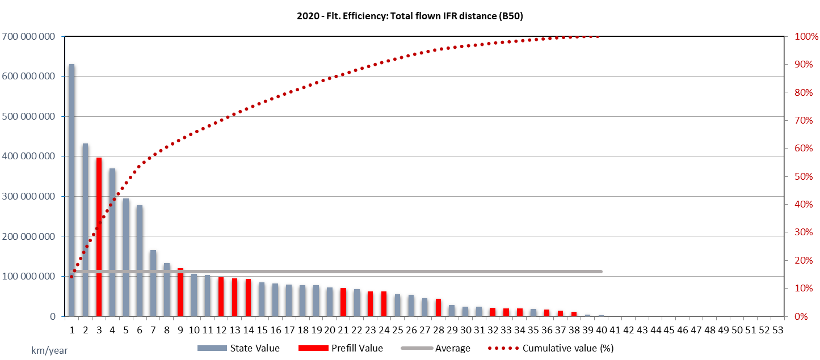

Data item B50
The overall total flown IFR distance increased in 2021 in comparison to 2021 in line with the overall traffic recovery.
Note: Total flown IFR distance (=actual distance) fused from SUR and FPL data sources and adjusted to compensate for insufficient surveillance data coverage.

Slide 59
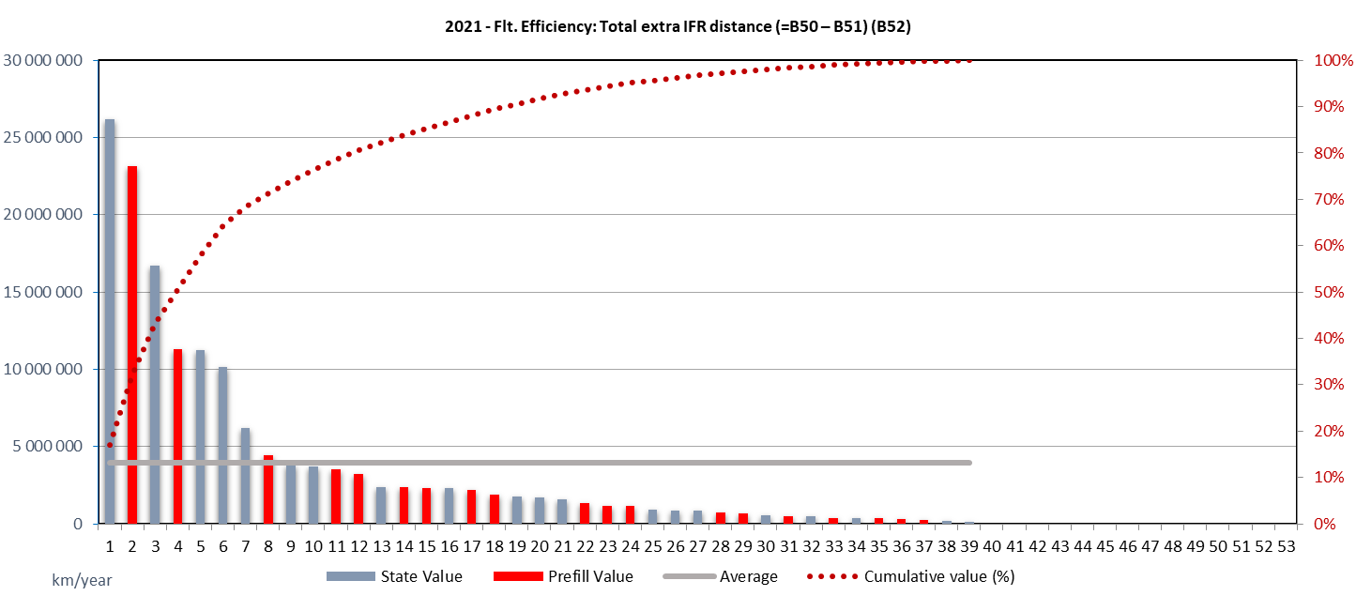
Data item B52
The top 4 States are accountable for 50% of all extra distance, the top7 for about 70%.
While the total extra IFR distance increased in comparison to 2020 with increasing traffic, the overall pattern remained constant.
Note: Total extra IFR distance (=excess distance flown) based on fused SUR and FPL data sources and adjusted to compensate for insufficient surveillance data coverage.

Slide 60
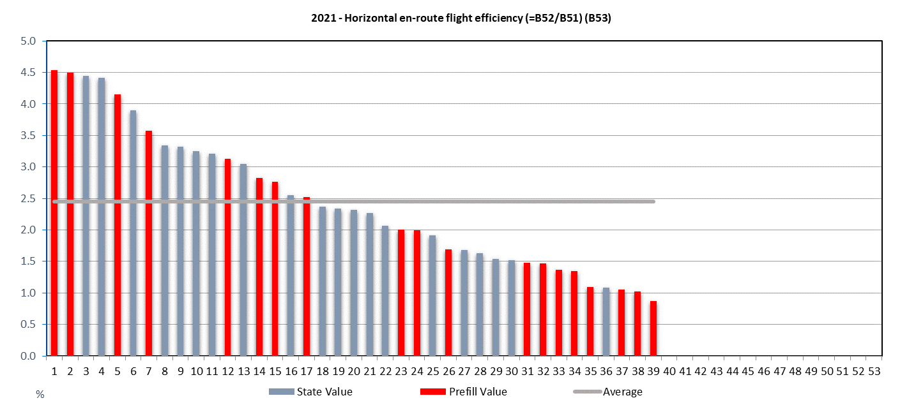
Data item B53
With traffic levels recovering from the COVID19 related decline, an immediate conclusion from the observed horizontal en-route flight efficiency performance cannot be drawn.
The overall pattern suggests that constraints on airspace users (e.g. procedural restrictions, routings) have been slightly removed, while at the same time it appears that no significant changes to the network and gained flexibility due to lower traffic were used on a widespread basis. The observed values for 2021 slightly increased vs 2020 in light of higher air traffic numbers.
Looking at the indicator, improvements should primarily focus on the 10 States with the highest value. However for prioritisation of improvements the total amount of extra IFR distance (item B52) should be considered as well.

Slide 61
KPA | Environment
Objective | Contribute to the protection of the environment – focussing on fuel savings and CO2 emission reductions
Indicator | CO2 emissions deriving from inefficiencies in flight efficiency (conversion of additional distance into CO2 emissions based on standard values formula)

Slide 62
Definition of indicator
Reference excess fuel consumption: Total additional distance flown in the airspace volume (i.e. State) multiplied by a standard fuel consumption factor (value chosen by each State)
Reference excess CO2 emission: Reference excess fuel consumption multiplied by 3.15 (net carbon content of kerosene)
Actual distance
Additional distance
Reference excess fuel consumption
Trajectory
Reference excess CO2 emission
Achieved distance
Standard fuel consumption
per km
Net carbon content of kerosene (3.15)

Slide 63
Remarks
Indicator
Has low data requirements and is therefore easy to implement
Because mostly based on “additional distance” already computed
Publishes an approximation of excess CO2 emission, resulting from horizontal flight inefficiency
The optimum indicator value is not equal to zero
Value is influenced by many different factors (including traffic volume, fleet characteristics etc.)
Indicator does not cover everything (missing: vertical flight efficiency, TMA inefficiencies, surface movement inefficiencies)
Hence the absolute value of the indicator should not be interpreted as representing the CO2 emissions caused by ANS.
Indicator to be used for “general purpose” and trend analysis only

Slide 64
Data items

Slide 65
B54 – Average en-route fuel consumption factor
State can choose method/value
Global standard value from ICAO
Average fuel burn per nautical mile (NM) of flight = 11 kg/NM = 5.9 kg/km
Source: Doc 9750 3rd ed. page App H-8
Used for the prefilling of the template
State-specific standard value: the standard kerosene consumption per kilometer of a typical jet aircraft type
States can select their own “typical aircraft type”, reflecting the composition of traffic in their airspace
State-specific measured value: a calibrated average fuel consumption per kilometre flown,
computed from the State’s average annual traffic composition in terms of aircraft types, vertical traffic distribution and distance flown
using the ICAO Fuel Savings Estimation Tool (IFSET)
or any other modeling tool, if available
recalibration needed every couple of years to take into account changes in traffic composition

Slide 66
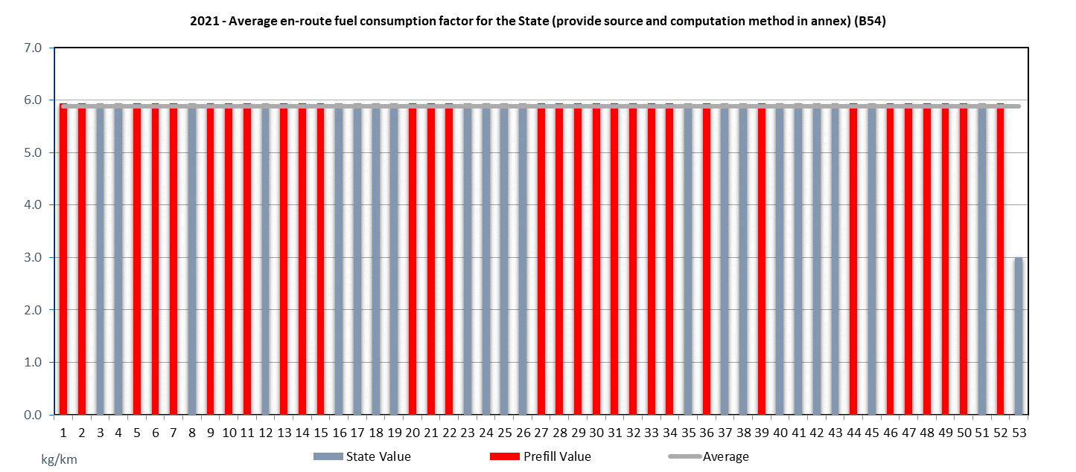
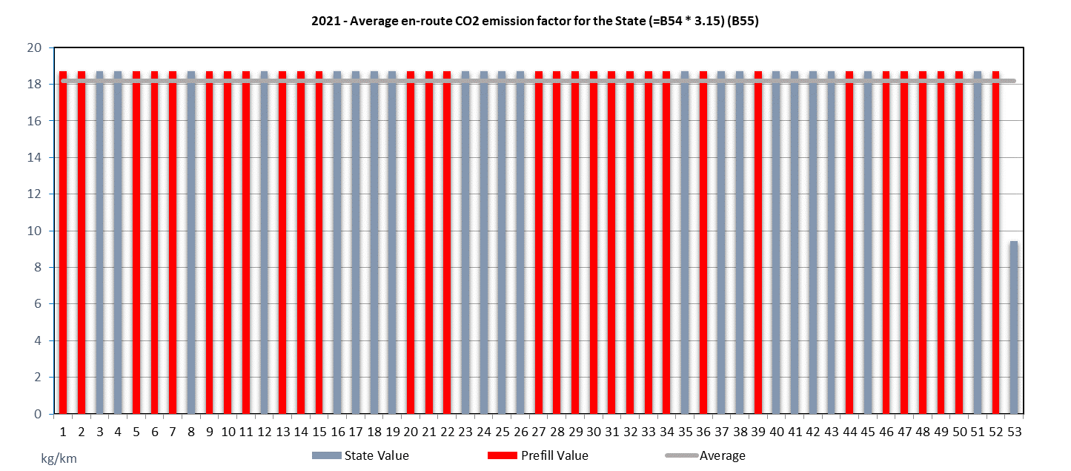
Data items B54 and B55
The average en-route fuel consumption factor for the participating States remained constant over the past years. This reflects the reported stability of the observed en-route flight efficiency benefit pool reported above.
The associated average en-route CO2 emission factor represents then the estimated emission per km flown, i.e. B54-factor * 3,15.
The EUR region network is characterised by a certain stability of the network traffic (in-)efficiency. Accordingly, the benefit pool for CO2 emissions – expressed per km flown – remained constant.

Slide 67

Addressing coverage issues
Indicator is an absolute value
Susceptible to coverage issues
Geographical, time, flight category filtering
Coverage checks & corrections
SUR data available
Sufficient match with FPL data (achieved distance comparison >95%)
Use additional distance from SUR data as is
Insufficient match with FPL data
Upscale additional distance from SUR data to 95% of additional distance from FPL data
SUR data not available
Use additional distance from FPL data

Slide 68

Data items B56
Previous results can be further converted into a CO2 emissions estimate per participating State.
These values vary with number of traffic and associated observed en-route (in-)efficiency.
Obviously, higher levels of total CO2 are emitted in the States servicing more traffic across the EUR region.
Theoretical CO2 emissions are linked to traffic density and “appear” to be concentrated in a subset of countries. This results needs to be addressed from an operational Efficiency perspective as a “total value” perspective is skewed. However, it provides a means to prioritise action.

Slide 69


Slide 70
Origin of indicators
EUR Region Framework
+ Flights controlled
Doc 9161 Figure 4-2

Slide 71
Remarks
Indicators
Focus on an important component of ANSP costs
However with the limitation that working hours per ATCO, employment cost per ATCO, and support cost are not covered
Reuse data reporting already in place for many States
Also reuse existing data definitions and terminology
EUROCONTROL Specification for Economic Information Disclosure (SEID)
Have relatively simple reporting requirements
Only traffic volume and ATCO hours on duty
Avoid entering into financial information disclosure issues for the initial implementation of the framework

Slide 72
Data items

Slide 73
Data item A26
En-route
Note: This graph is repeated here for ease of reference and comparison with the next graph (ATCO hours on duty).

Slide 74

Data item B57
En-route
In 2020, 5 States are accountable for more than 60% of all en-route ATCO hours on duty in the EUR Region.

Slide 75

Data item B59
En-route
In terms of number of movements handled per en-route ATCO hour on duty, there is a large variation but this does not take into account the average flight duration in the State.

Slide 76

Data item B60
Higher than average
lower than average
En-route
Item B60 is a better indicator for en-route ATCO productivity than item B59. The data suggest that about a dozen States at the tail end of the distribution need to work on improving their ATCO productivity.
Lessons can be learned from the dozen States on the left side of the graph which perform better than average.

Slide 77
Data item A27
Terminal & Aerodrome
Note: This graph is repeated here for ease of reference and comparison with the next graph (ATCO hours on duty).

Slide 78

Data item B58
Terminal & Aerodrome
4 States are accountable for 40% of all terminal & aerodrome ATCO hours on duty in the EUR Region.

Slide 79
Participation KPA

Slide 80
Examples of Participation in 2019
Subject/Meeting | # of invited States | # of States participating | Participation
ASBU Implementation Monitoring Report 2019 | 52/55 | 52/55 | 100 %
REG Performance Framework data provision 2019 | 55 | 27 | 49 %
CORSIA workshop, March 2019 | 55 | 31 plus 1 from outside of the EUR Region | 56 %
GRF workshop, July 2019 | 55 | 29 | 53 %
SAR workshop and SAREX, September 2019 | 55 | 20 | 36 %
RDGE/30 meeting, April 2019 | 24 | 22 plus 2 from outside of the EUR Region | 92 %
ENAVSECG/7 meeting, June 2019 | 56 | 30 | 55 %
METG/29 meeting, September 2019 | 55 | 44 plus 1 from outside of the EUR Region | 80 %
AWOG/26 meeting, October 2019 | 55 | 6 | 11 %
ANSISG/2 meeting, October 2019 | 26 | 14 | 54 %
FMG/25 meeting, October 2019 | 55 | 30 | 55 %
Avg. 56 %

Slide 81
The COVID19 pandemic limited the ability to conduct larger participation events in 2020 and 2021.
The WHO declared COVID19 a pandemic on March 2020. Associated measures to curb the further spread of the pandemic resulted in global, regional, and national constraints on mobility and person-to-person contact. The primary stakeholder interaction mechanism was through online/virtual events which was used on a widespread basis.
Note: submissions are cross-checked for comments on in-person or virtual events.

