Slide 1
SMS Implementation in CEA Beijing Branch
Safety Supervision Department and Flying Department’s Experience
Captain Chen Bin
25 May 2019
Notes:
Good morning, everybody. My name is Chen bin. I am a Captain on an A320 in CEA. My second job is to assist CTA Captain Wayne’s work in COSCAP-NA.

Slide 2

Outline
Cooperation
Introduction about China Eastern Airlines
Identified Opportunities for Improvement proposed by COSCAP-NA
Suggested Improvements proposed by COSCAP-NA
Success and Failure
What we plan to do next...
Notes:
I'd like to share with you China Eastern’ s experience with the implementation of our SMS. I will cover the following topics in my presentation…

Slide 3
Cooperation
CEA Beijing Branch cooperated with COSCAP-NA to promote the implementation of SMS in the department.
COSCAP-NA shared collective knowledge and experience. These in the past year will be presented in this presentation.
Notes:
(First slide，second note)I work in the Beijing Branch and am involved in the implementation of SMS in the Branch. Working in the COSCAP-NA office allowed me to share information regarding SMS and to discuss implementation issues with the COSCAP CTA.

Slide 4
Introduction about CEA
Organization
Notes:
(Note)This is the organizational structure of SMS in CEA, which has 3 levels of offices working on the sms implementation in different areas of the company. This presentation focuses on the two SMS offices : SMS office of flying department and SMS office of safety supervision department in this Branch.

Slide 5

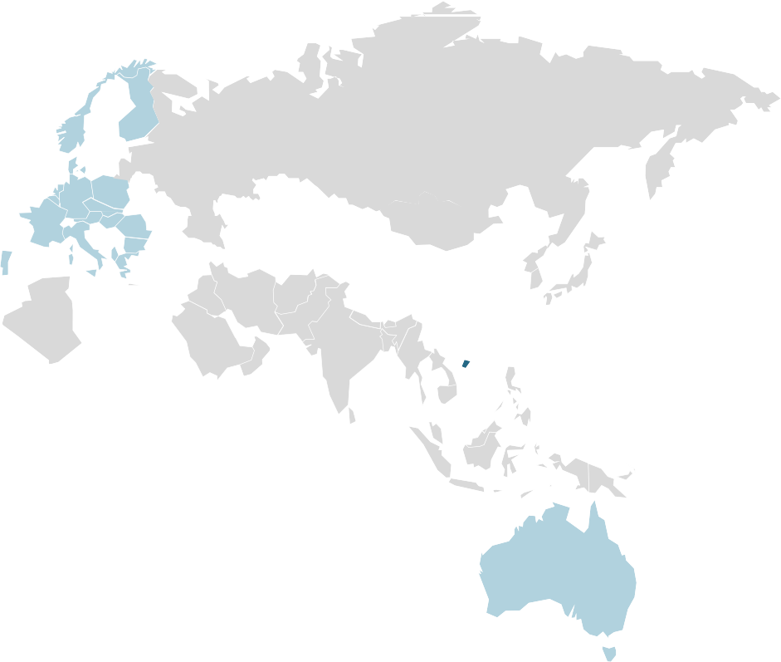
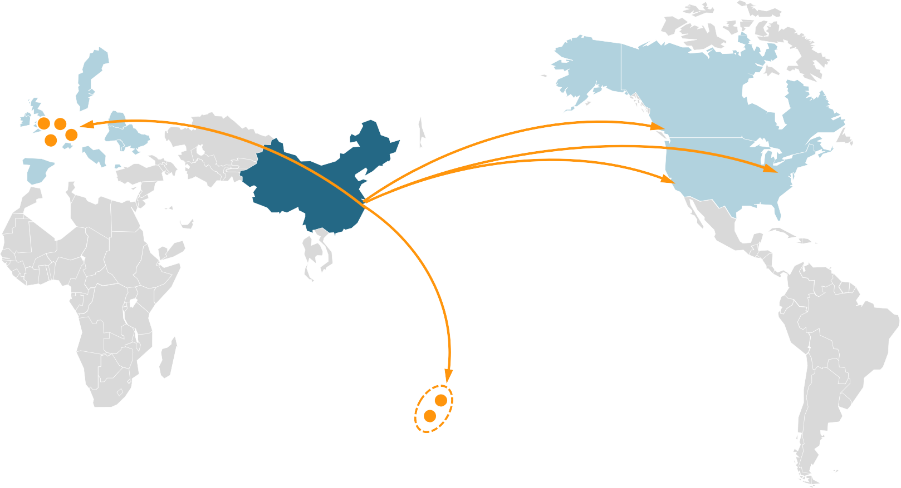



Introduction about CEA
GENERAL SITUATION
Aircraft 600+
Average age 5.5
To Europe
LHR
AMS
FRA
YVR
To CA
CDG
JFK
PVG
LAX
To US
To Central and South America
Total 154 months of safe flight
To MX
Total 15.79 million hours of safe flight
To Central America
To South America
To AU
SYD
To NZ
To Africa
MEL
MU Self Route
Code share Route
Notes:
As one of three main group of China civil aviation, CEA currently has 600 aircrafts, the average age of A/C is 5.53.

Slide 6

Introduction about CEA
SAFETY MANAGEMENT SYSTEM
Decision-making Mechanism
In 2010, As a carrier that strives for “world-class”, CEA tried to combine safety management with information technology to make up for the shortcomings of traditional management methods and strived to make safe operation more reliable.
Notes:
In May 2010, CEA got the CAAC operational certificate approval of the SMS.

Slide 7

Headquarters' Achievement
SAFETY MANAGEMENT SYSTEM
安全组织机构
Safety organization
安全绩效管理
Safety Performance Management
安全风险管理
Safety risk management
安全数据管理
Safety Data
Management
Notes:
This part on the headquarters’ achievement on SMS implementation is provided by Mr. Li Yan. It is going to focus on the following aspects. First one is the top-level design of SMS and how to make the organization framework match the SMS requirements. The second is about safety performance management, how to select suitable indicators and make the data connect with the indicators monitoring. The next one is about data management. How to realize data standardization [stændədaɪ'zeɪʃən]; How to develop the data processing procedure which can be used in different areas and data analysis tool introduction.

Slide 8
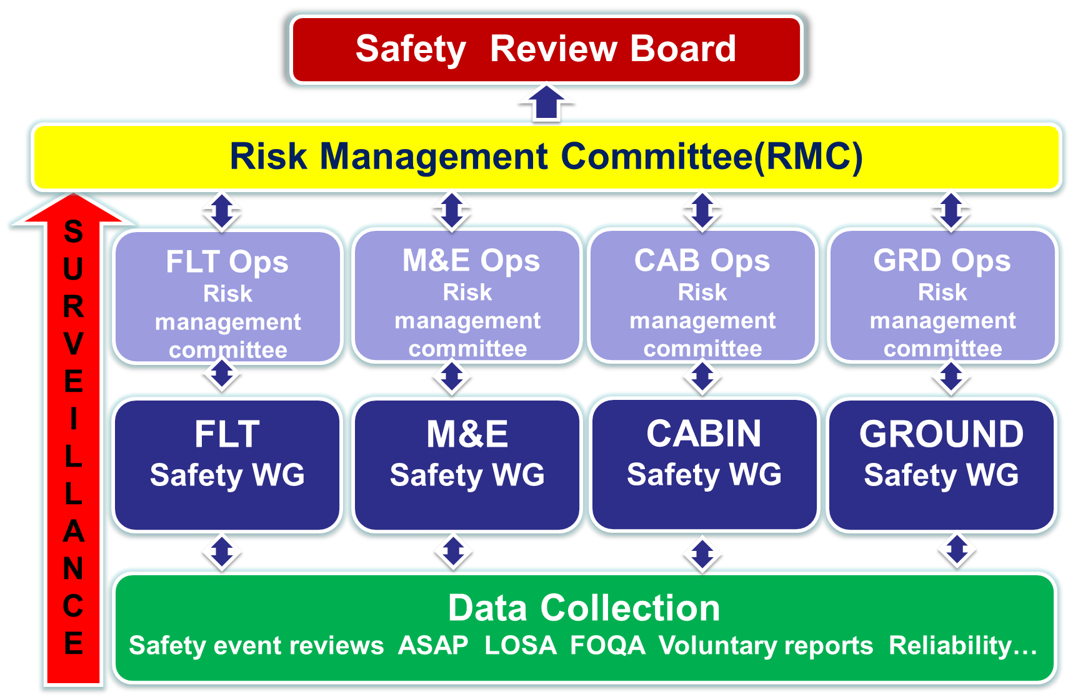
Headquarters' Achievement
SAFETY ORGANIZATION
Main responsibility, Supervision responsibility,
Leadership responsibility , Post responsibility
1
Notes:
First responsible person is general manager, The highest part of the safety management is the safety management committee(“committee”) , the committee directly responsible to the general manager, under the committee are the safety risk management committee, technology management and operational management committee

Slide 9
Headquarters' Achievement
TOP-LEVEL DESIGN
Framework, Responsibility，RMC, Toolbox, Exports team.
1
2
3
4
5
Framework
Quality operation, Independent safety supervision
R
E
S
P
O
N
S
I
B
I
L
I
T
Y
Establish functional department risk management ability
information communication mechanism
Change management
Training
R
M
C
Establish two- level risk management committee
Each operational unit has its own safety team
T
O
O
L
B
O
X
Setting significant performance indicators
Connecting the indicator sensors with data
Monitoring the indicator state and trend
E
X
P
O
R
T
S
Data analysis
Risk mitigation
System and process analysis
Investigation
Auditor
communicator
Notes:
In terms of safety responsibility, CEA readjusts the structure of the organization. First of all, we make safety supervision to be independent with the operation. All the functional departments and operational units have to take safety responsibilities by themselves and have the capability to identify the hazards, assess and mitigate the risk, in particularly, the change management capability. Through the RMC, we build bridges and platform to make different units to share information, exchange suggestion and take synchronous ['sɪŋkrənəs] action. The next question is how can the operational units to take their responsibility? They need tools. CEA provides the safety indicators monitors, the data analysis tool and risk prediction system etc. which can be used by all the operational units to control risks. It is important that the specialized safety persons for the system.

Slide 10
Headquarters' Achievement
SAFETY PERFORMANCE MANAGEMENT
Data-driven performance management
Private safety performance contract +
Management evaluation +
Key safety performance indicators(KPI) monitoring
2
Notes:
Based on the current fleet scale, quality of personnel and stage of development，CEA develops the data-driven performance management which provides an approach to monitor the dynamic trend, also contributes to having more clearly vision of the whole company safe. The safety performance system of CEA is divided into three main parts: private safety performance contract, management evaluation and key safety performance indicators (SPI) monitoring.

Slide 11
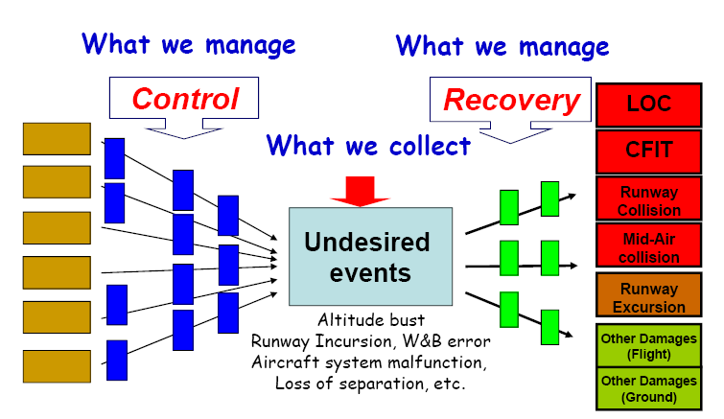
Headquarters' Achievement
TARGETS AND INDICATORS
Notes:
The third part is key performance indicators monitoring. According to the historical safety data, CEA summed up the ten significant events as the safety performance goals at present. CEA sets 80 primary performance indicators and 290 secondary performance indicators. Based on the BOW-TIE model, CEA establishes the logical relationship between objectives and indicators. The establishment of logic relationship takes advantage of numbers of occurrences that happened really. It can help us make indicators to meet the actual operation scenario. For example, in three years, the occurrence rate of MID-AIR collision is decreased 30% which is the short-term objective. We need to know what types of UAS can cause the MID-AIR collision and what kinds of factors can lead to the UAS. The answers are deduced from the events happened in the history. According to the logical relationship, we select the proper primary and secondary indicators.

Slide 12
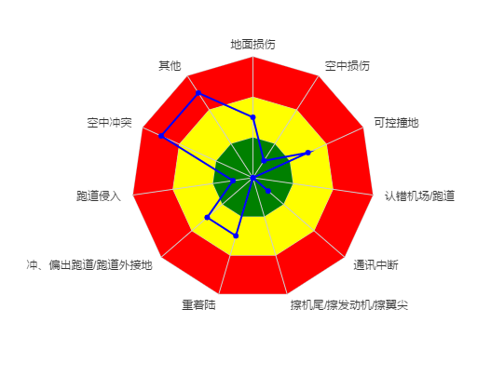
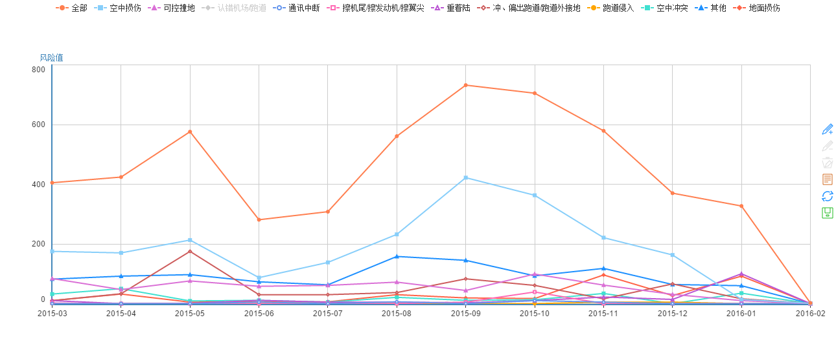
Headquarters' Achievement
MONITORING & PREDICTION
Monitoring
Prediction
Notes:
The performance management has two main functions: one is monitoring, the other is prediction. Based on the continuous 12 months rolling data, we set up the goals and relevant different level warning areas. With the data, CEA can achieve dynamically monitoring of the each performance goal. If there is a warning, we can immediately take measures. And we can predict the change of the each goal in the next period. Of course, the fulfillment of prediction needs the help of the algorithms ['ælgərɪð(ə)mz].

Slide 13
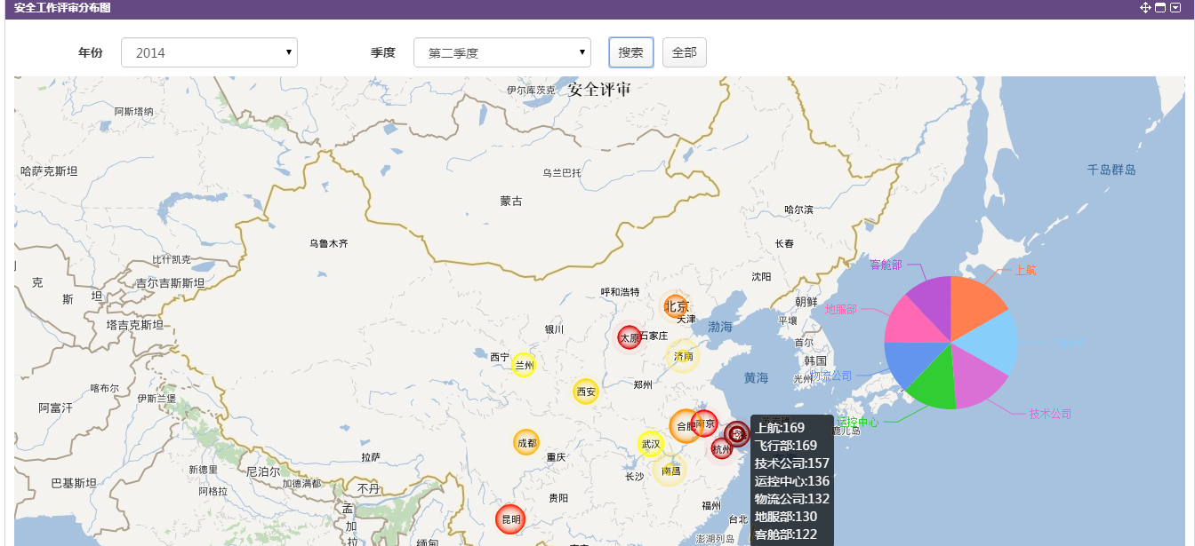
Headquarters' Achievement
PERFORMANCE MAPS
Notes:
CEA has totally 16 branches in China. The branches safety management is tough problem to us. Combining the data of management evaluation and key performance indicators monitoring, we can form a performance map for the whole company. Through this map, we obtain the information about safety condition of each branch and which operation units need to be paid more attentions. With the performance management, we make the following three questions clear: where we are right now (the safety condition); what is the gap between the reality and the goals (performance monitoring); and what kind of actions we should take (prediction and decisions).

Slide 14
Headquarters' Achievement
DATA MANAGEMENT
Without data, you only are the person has the another opinions.
3
Notes:
Data play key role in the safety management. Data-driven makes quantification and prediction become possible. CEA realizes the importance of analysis tool profoundly. The successful tool should contain three main functions. The data pool which has smooth channels, ensure that all kinds of data can be collected. The standard analysis model ensures the analysis unified. After accumulating a certain amount of data, we bring in the algorithms ['ælgərɪð(ə)m] to fulfillment the function of trend prediction. With these three functions, the transformation from reactive to proactive can be realized, which is also base of the predictive management.

Slide 15
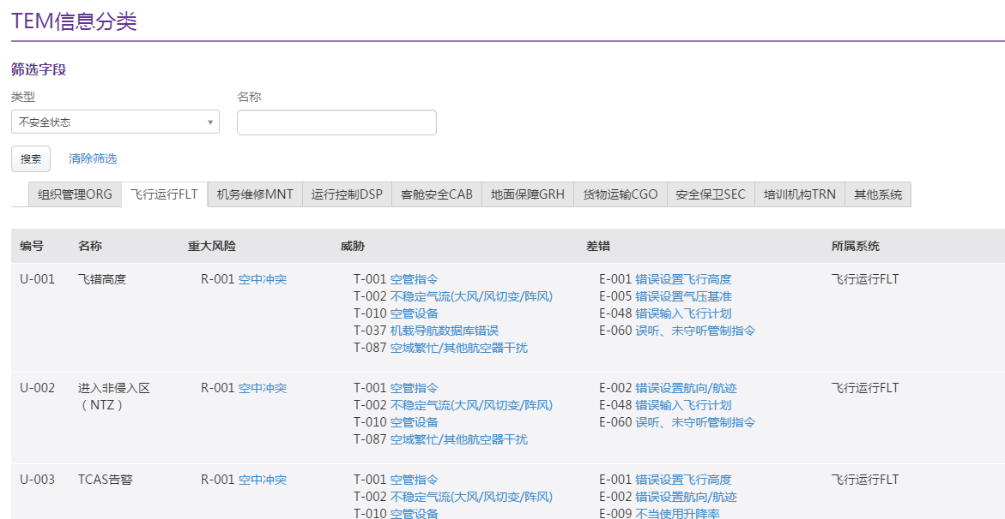
Headquarters' Achievement
DATA ANALYSIS MODEL
Notes:
China Eastern Airlines uses TEM model as the main analysis model. The data entry into system, which is decomposed according to unified approach. After the decomposition, the system automatically implements the statistics of each classification.

Slide 16
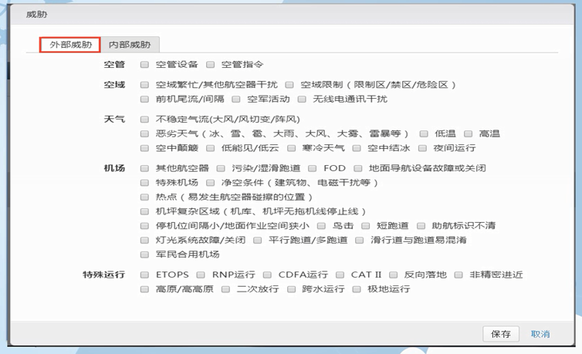
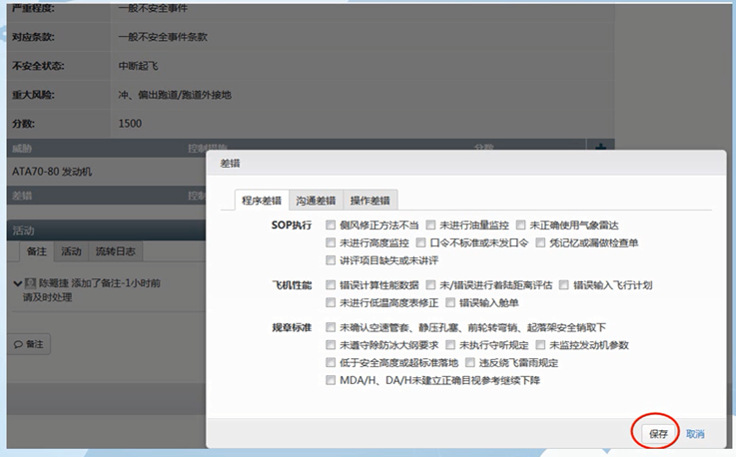
Headquarters' Achievement
STANDARDIZING TOOLS
HUMAN FACTOR
ENVIRONMENT, AIRPORT, ATC, WEATHER
Notes:
In order to ensure the consistency [kən'sɪst(ə)nsɪ] and the quality of data analysis, the process of analysis has been structured in CEA. All analysis personnel use standardized tool to process data from the perspective [pə'spektɪv] of threats and errors. Through this method, not only CEA solves the problem of standardization, but also enhances the efficiency of processing.

Slide 17
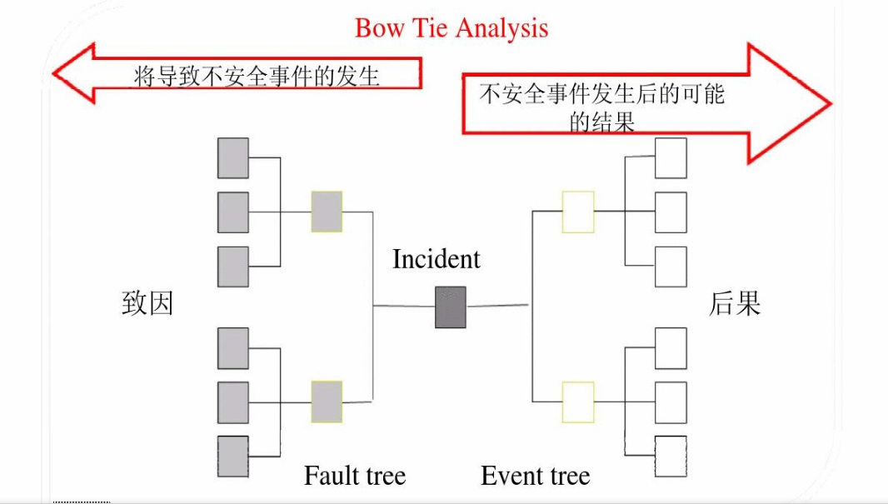
Headquarters' Achievement
DATA & PERFORMANCE INDICATORS
DATA
FACTORS
UAS
ACTUAL PRFORMANCE
SECONARY INDS
PRIMARY INDS
TARGETS
INDICATOR
Notes:
From the data driven point of view, the monitoring of safety performance and data analysis are inseparable [ɪn'sep(ə)rəb(ə)l]. Only establishment of the safety performance system, without the data entering into the system, is unable to achieve real-time monitoring the changes of indicators. Combining the data analysis model with the selection of safety performance indicators and making each indicator becomes unsafe state sensor. Finally, the quantitative state is presented through safety performance to support decision-making. That is a feasible way to realize procedural performance management.

Slide 18
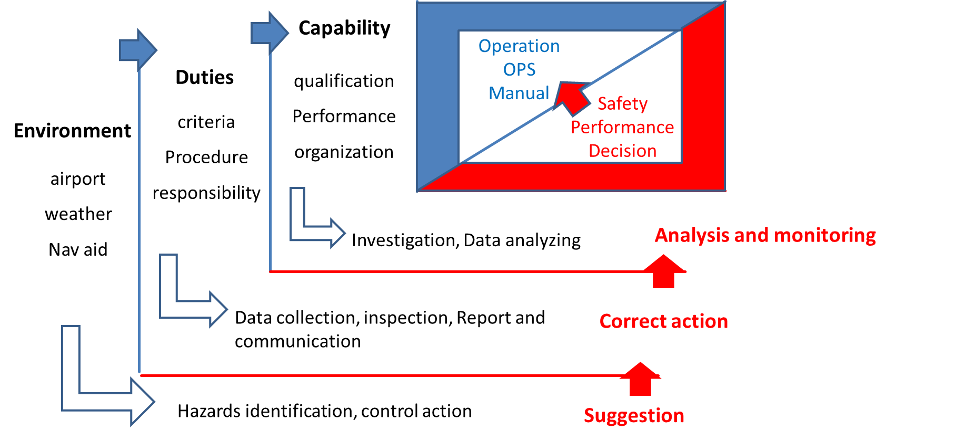
Headquarters' Achievement
RISK MANAGEMENT
Establish the environment-duty-capability risk management processes
4
Notes:
Risk management. Similarly, the implementation of risk management still needs to rely on the collection and analysis of data. On the one hand, we talk about the general risk management. There are three stages. In advance, environmental hazards are identified by the system and work analyzing. Through the safety observation, supervision and voluntary reports the deviations of the operation are found. Afterwards the hidden troubles are affirmed through the analysis of the operation data and the investigation.

Slide 19
Introduction about CEA
About the Beijing branch
The Beijing brach has two fleets (8 A321 and 9 A330).
It operates domestic and international flights.
Destination:
Shanghai, Guangzhou,Kunming, etc.
Sdyney, Saipan, Bangkok, Tokyo, Da Nang, etc.

Slide 20
Safety Risk Management
Identified Opportunities for Improvement proposed by COSCAP-NA
Some of the risk analysts (experts) in the risk management expert group were not well trained. Some of them could not take time off to do this work at all because of being busy with other work.
Effective safety management is “data driven”. However, the average quality and number of hazard reports in the Branch is not satisfied by the managers.

Slide 21
Safety Risk Management
Identified Opportunities for Improvement
3. The safety risk management procedure, especially for proactive method and predictive method is ambiguous.
4. Some inappropriate working ideas of some managers on SRM cause serious side effect. Take an example: Once the mitigation measure is published and even some measure is impossible to be implemented that is replied back by the implementer, it still could not be changed. Then the implementer have to turn in an ambiguous task report or unreal implementation result to the manager.

Slide 22
Safety Risk Management
Identified Opportunities for Improvement
5. Investigation into hazard(event) or making mitigation measures focus on the human factors overly . Organizational factors are often neglected or ignored.
6. The process of SRM is opaque in some steps. And the effect after the implementation of risk mitigation measure is often neglected or ignored.

Slide 23
Safety Risk Management
Identified Opportunities for Improvement
7. There is some problem with SPI tool used for operational units to keep high efficiency and good quality of SRM work.
8. The LOSA’s practical operation drifts away from the baseline.
9. Through FDA work, some hazards were found. However,no effective mitigation measure can be made because of lacking of constructively directive methodology.

Slide 24
Safety Risk Management
Suggested Improvements proposed by COSCAP-NA
1. Rebuild the Risk Management Expert Group and train the experts.
2. Redesign closed-loop safety risk management procedure.
3. Develop SRM worksheet used for SRM procedure involving the following ideas:
a) The SRM process is transparent. All of the related important SRM work is recorded into paper.
b) The SRM process is cyclical. If the first risk mitigation work fails, the next one will start from the investigation and analysis step and the process will not stop until risk mitigation work succeeds.

Slide 25
Safety Risk Management
Suggested Improvements proposed by COSCAP-NA
c) The evaluation work is divided into two parts: the evaluation of whether mitigation measure is implemented well and the evaluation of the effect after implementation.
4. The SPI ‘s improvement focuses on urging operational units to promote high efficiency and quality of SRM.
5. Put forward improving proposals for the work of supervision , LOSA and FDA/QAR .

Slide 26
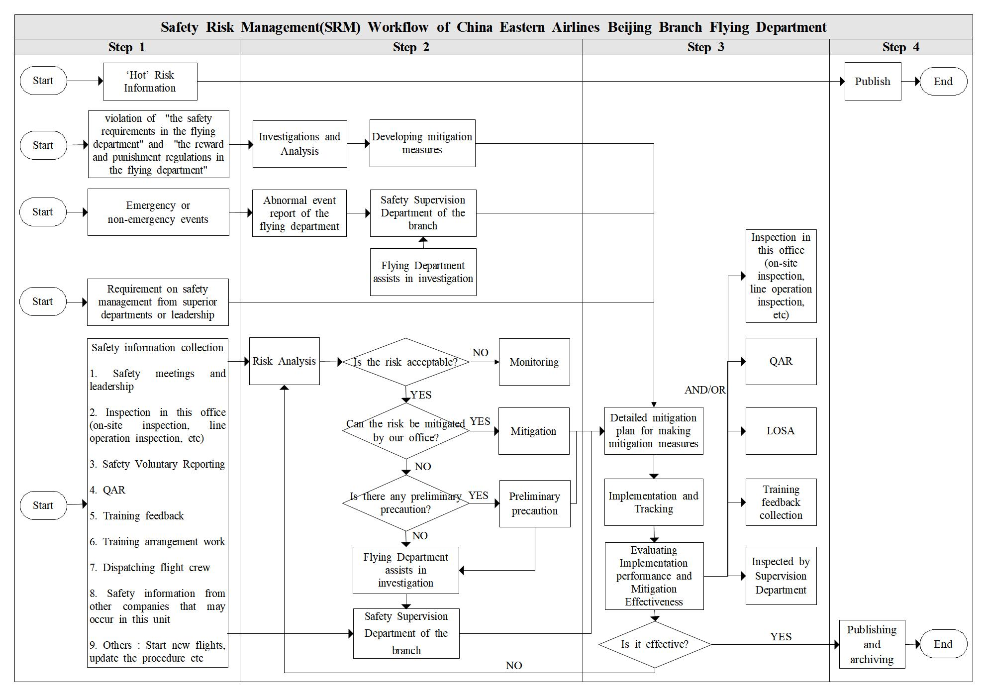
Success and Failure
New SRM procedure is operating in flying department.
Notes:
The new Risk Management Expert Group was rebuilt. New members joined the group and was trained.
The SMS Workflow in flying department was updated. This picture is the latest workflow chart including 4 steps: collection, assessment and mitigation, management, dissemination. In the left column, there are 9 reporting channels used for collecting hazards.

Slide 27
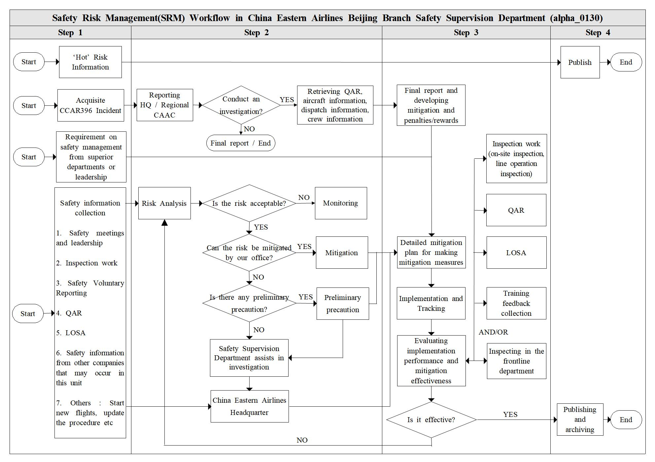
Success and Failure
New SRM procedure is operating in safety supervision department.
Notes:
This is the updated SMS Workflow in safety supervision department. This workflow is only involved in flight operation field, not involved in cabin, engineer, cargo transportation and so on.

Slide 28
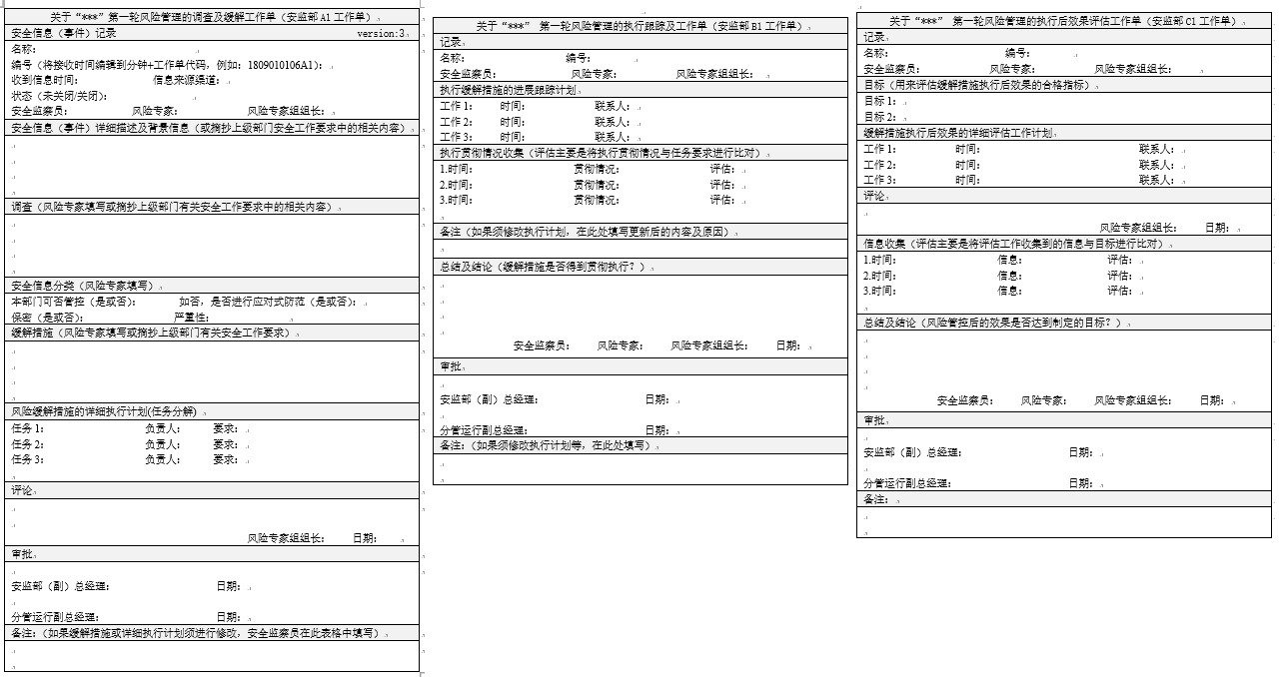
Success and Failure
New SRM worksheet is working
Notes:
The SRM worksheet is accepted by the managers and it has been used.

Slide 29
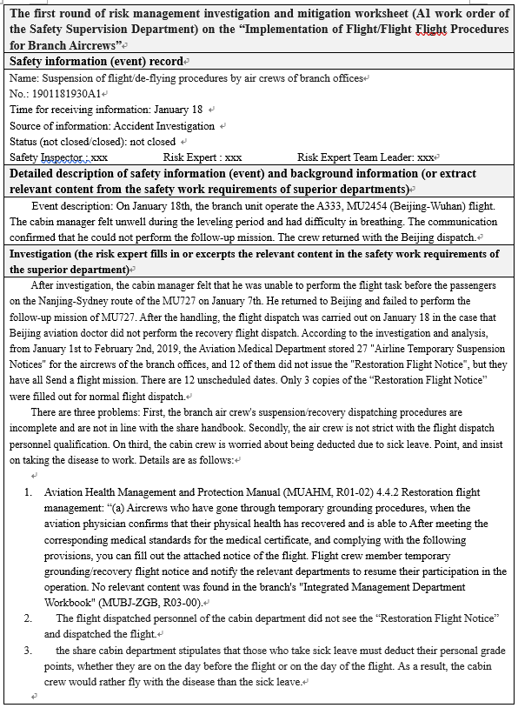
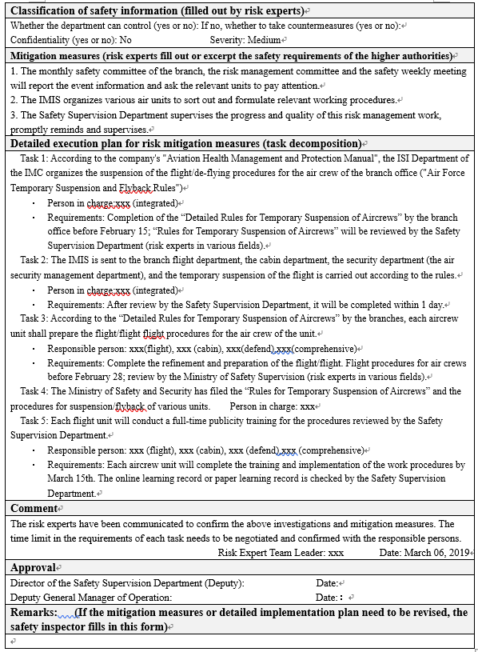
Success and Failure
Examples of the SRM procedure in practice.
Example 1：The crew resume flying after a sickness leave.

Slide 30
Success and Failure
Example 2：For the flight ‘Beijing-Ningbo (Lanzhou) -Beijing-Nagoya ’,there exist a risk of excessive fatigue operation for one set of flight crew.
Example 3：Some crew changed the RAMP fuel in Luoyang airport without informing the flight despatcher.

Slide 31
Success and Failure
Failure experience :
1. No effective mitigation measure invented for some tough hazards such as that some crew do not do checklist occasionally that was observed by LOSA observer.
2. The proposals for SPIs is not put into practice, although it is accepted by the safety supervision department. The more detailed improvement plan of SPIs need to be developed.
Notes:
The supervision department said the fairness factor is taken into account mainly. Except for flying department, other departments such as cabin department, security department have not used the new SRM procedure.

Slide 32
What we plan to do next...
1. Developing detailed improvement plan of SPIs for the Branch. Promote the efficiency of SRM procedure.
2. Put forward improving scenario for LOSA operation , FDA/Qar work and supervision work.
This improvement will enhance the work flows of the SMS. There is room for improvement in SMS in the Branch. Improving the efficency of the SMS work is a matter of utmost urgency.

Slide 33

THANK YOU !
tony.chen@coscap-icao.org
Notes:
That is all.

