Slide 1

North Asia COSCAP
Cooperative Development for Operational Safety and
Continuous Airworthiness Program.
Beijing China
Chief Technical Advisor
Captain Wayne Loe

Slide 2




2003
Trust Fund
COSCAP-NA
To enhance the safety and efficiency of air transport operation
Notes:
This programme was instituted in 2003, initially for a period of five years, as a cooperative agreement between, the People’s Republic of China, the DPRK, Mongolia and the ROK executed by the ICAO by means of a trust fund, and aimed at enhancing the safety and efficiency of air transport operations in the North Asia region.

Slide 3



Notes:
[PIC1] Providing a regional forum for addressing, regulatory matters with a view toward the harmonization of associated regulatory policies and procedures
[PIC2] Facilitating a coordinated, shared approach to the utilization of safety-oversight related technical assistance to avoid duplication of effort and to ensure that the maximum benefit is derived from resources which are made available.
[PIC3] Enhancing the professional knowledge and qualifications of inspectors by providing formal and on-the-job training.

Slide 4

The continued technical assistance to implement ICAO SARPs for all safety related Annexes.
The implementation of respective State Safety Programmes (SSP) and assisting with the SMS implementation.
The implementation of corrective actions arising from the ICAO comprehensive USOAP activities
Phase Ⅳ
The support of the USOAP Continuous Monitoring Approach (CMA) activities.
Continued training of civil aviation personnel.
Notes:
Member States and Administrations recognizing the benefits and effectiveness of the Programme agreed to a Phase IV for an additional 5 year period commencing from 1 February 2018.
Hong Kong China and Macau China joined the programme in Phase IV

Slide 5

Monitor NARAST activities and promote the implementation of interventions emanating from the APAC Regional Aviation Safety Group (RASG).
Monitor the project, determine priorities and the work programme and training requirements on the basis of needs and available resources.
The CTA/PC review regularly the funding of the project and undertake timely follow-up with project participating governments and donors in this regard.
The Programme Steering Committee
Notes:
The Minister of the CAAC was chosen as the Programme Chairman of the Steering Committee for the duration of the Programme.
Following a re-organization of the CAAC, in 2010 the Deputy Administrator of the CAAC has fulfilled the role of Chairman.
Functionally, the position is further delegated to Chief Pilot CAST (Centre of Aviation Safety Technology of the CAAC)

Slide 6

Programme Objectives
To contribute to the social and economic development of the Participating States.
Improving their capability to maintain suitable, harmonious and efficient airworthiness, flight operations, aerodrome, air traffic control and other safety related regulatory systems.
ICAO USOAP CMA
ICAO
ANNEX

Slide 7
1
Ensuring the safety oversight capabilities to meet international requirements and the deficiencies identified by the ICAO USOAP Audit have been fully corrected.
2
Establishing a forum for coordination and cooperation with the aim of the harmonization of regulations, policies and procedures about safety oversight, improving safety standards, and applying accident prevention measures.
3
Establishment of a systematic programme for the inspection of air operators and maintenance organizations where Civil Aviation Authorities currently lack the capability to do so independently.

Slide 8
4
Safety oversight inspectors and technical personnel are qualified and sufficient for undertaking surveillance, inspection, certification and regulation of flight operations, airworthiness and personnel licensing.
5
Member States and Administrations have established effective Safety Management Systems in the area of Aircraft Operations, Aerodromes and Air Traffic Management
6
States and Administrations have implemented an SSP commensurate with the size and complexity of the State’s aviation system.

Slide 9





Programme Partners

Slide 10





COSCAP Programme Members
People’s Republic of China
Hong Kong China
Macau, China
Republic of Korea
Mongolia
Democratic People’s Republic of Korea

Slide 11


COSCAP-NA Training Data 2003 - 2018
Training Course Statistic
Course Evaluation

Slide 12
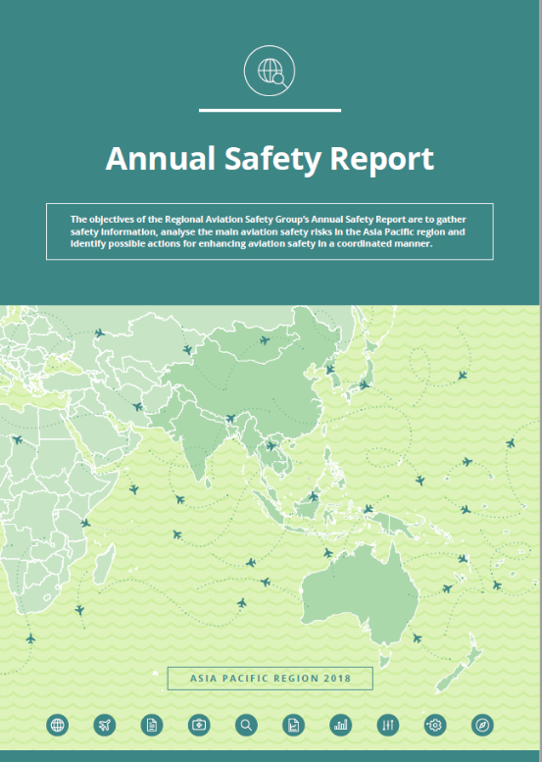
ICAO Annual Safety Report 2018

Slide 13





ICAO’s Strategic Objectives

Slide 14








Slide 15
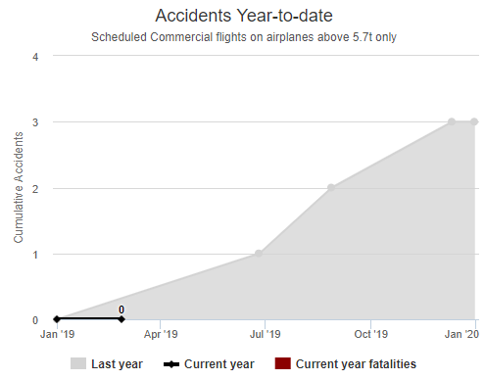
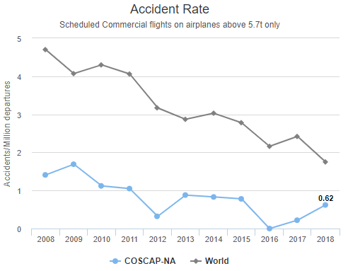
COSCAP-NA Safety Data

Slide 16
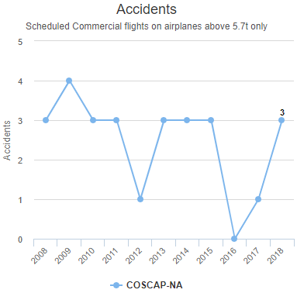
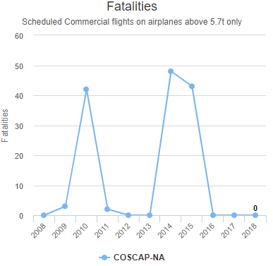
COSCAP-NA Safety Data

Slide 17
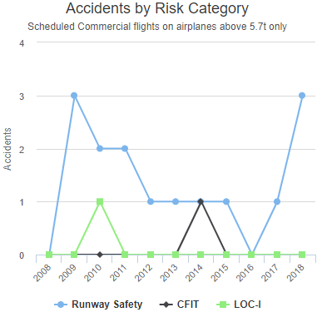
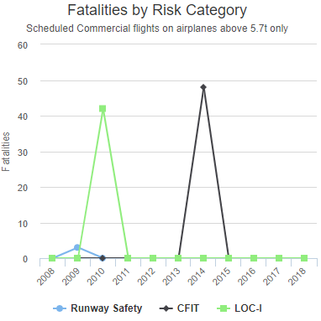
COSCAP-NA Safety Data

Slide 18


Slide 19
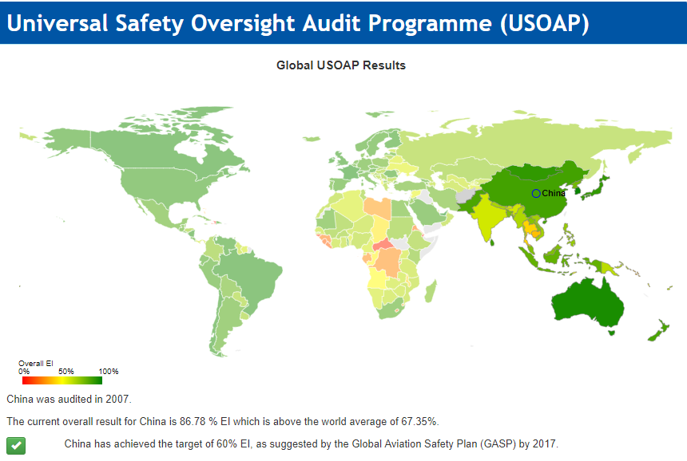
China

Slide 20
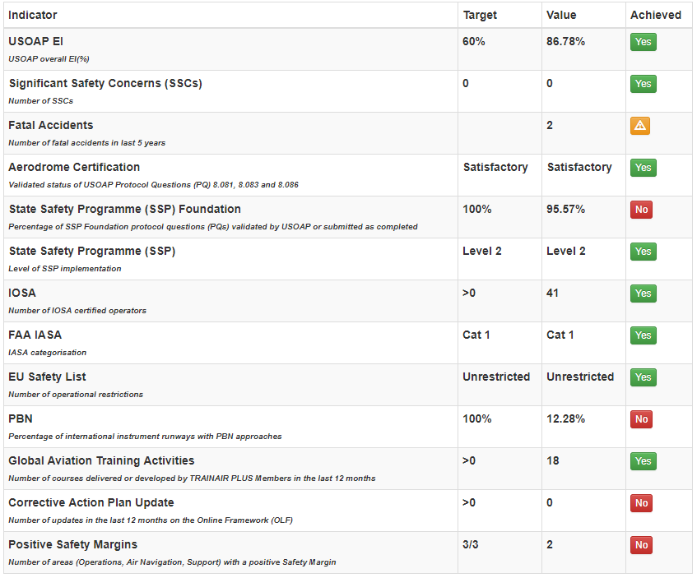
Performance Dashboard (China)

Slide 21
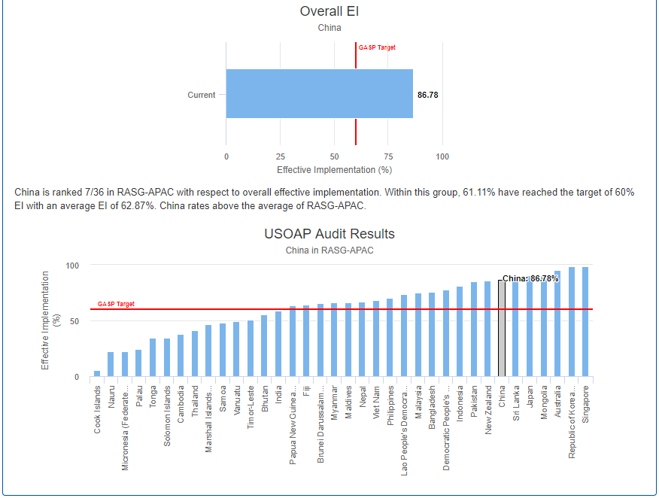
China

Slide 22
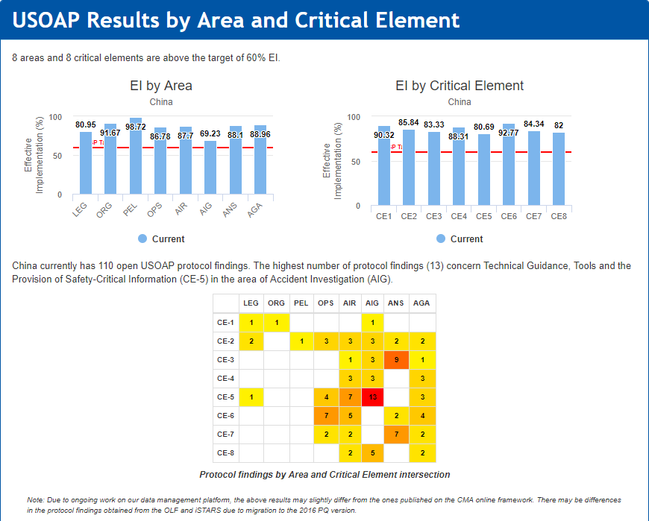
China

Slide 23
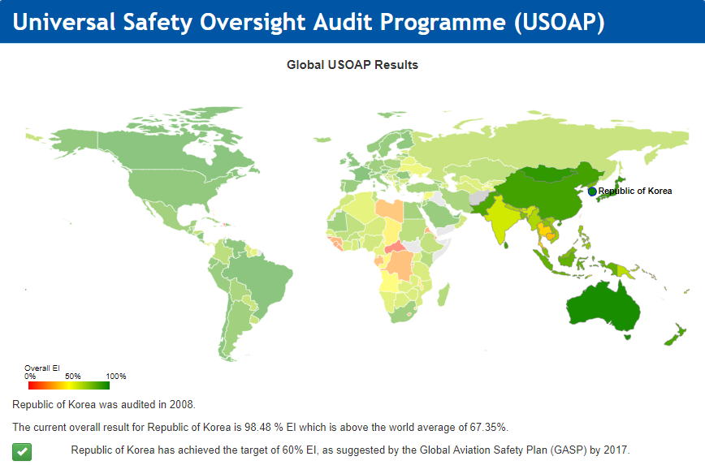

ROK

Slide 24
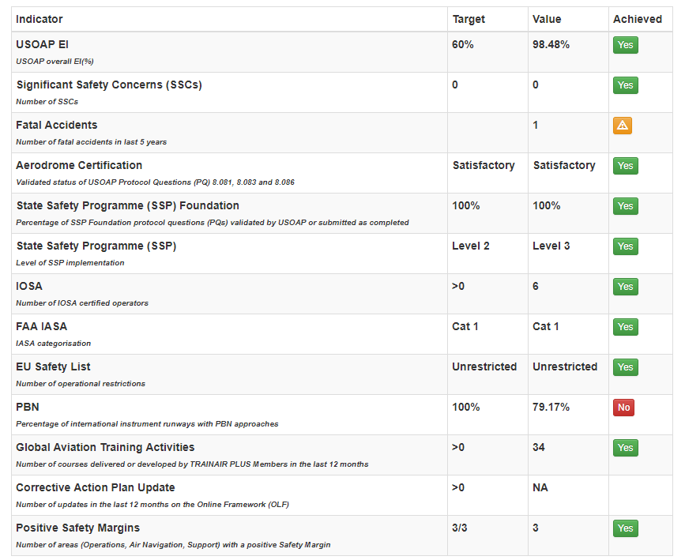
Performance Dashboard (ROK)

Slide 25
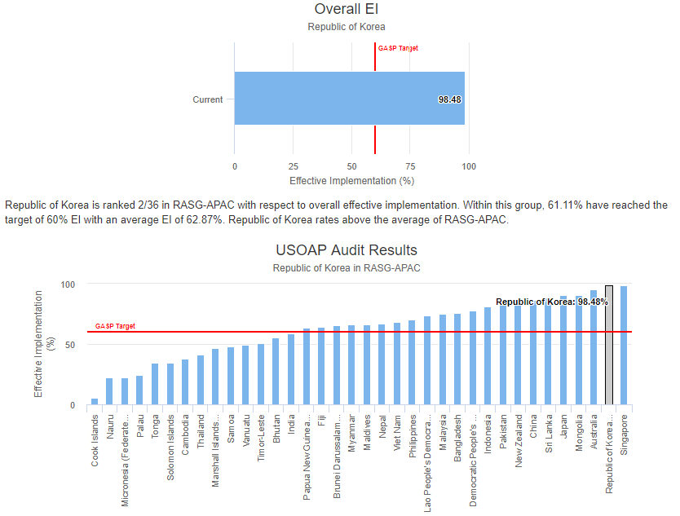
ROK

Slide 26
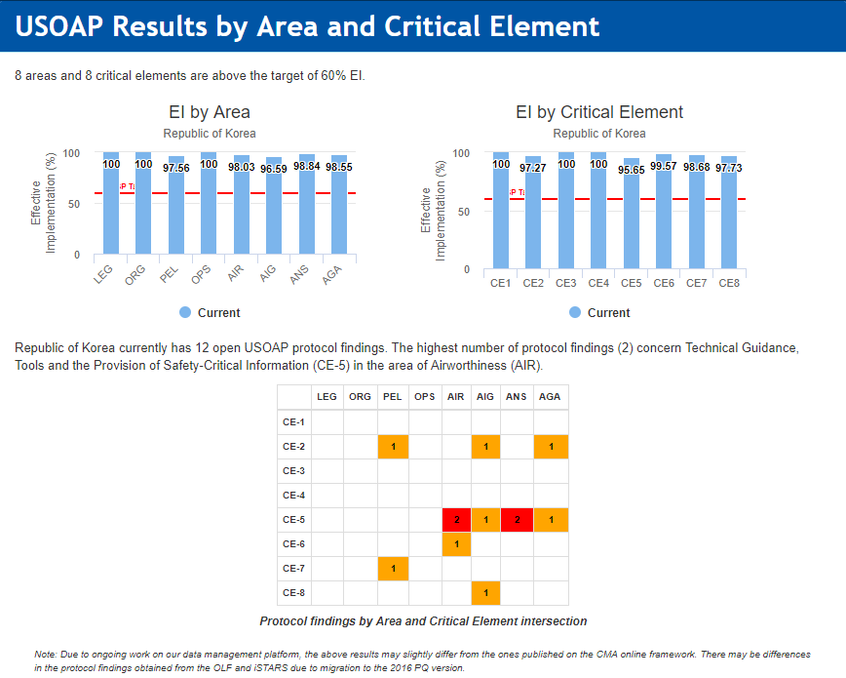
ROK

Slide 27
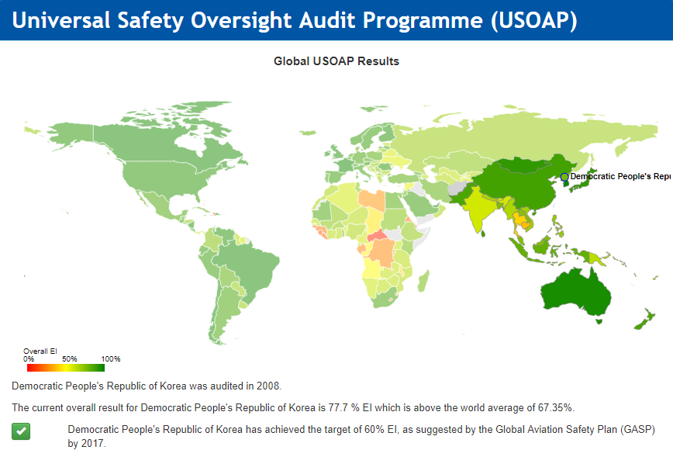
DPRK

Slide 28
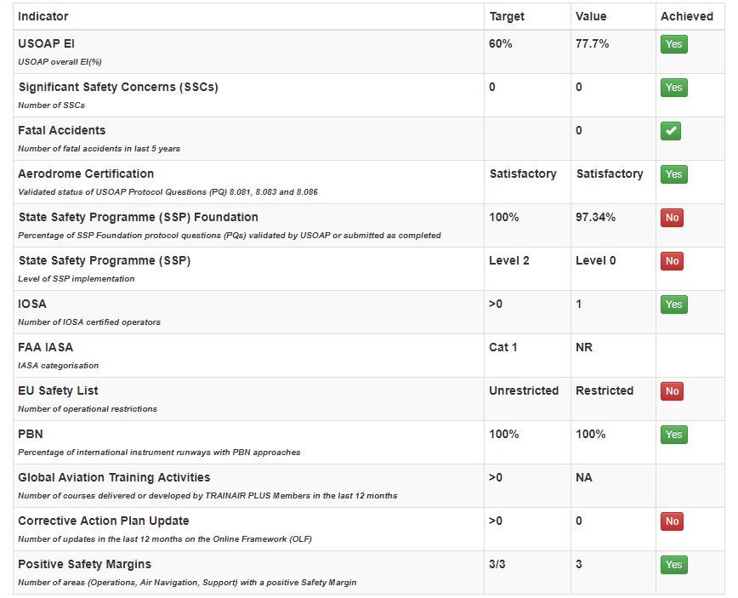
Performance Dashboard (DPRK)

Slide 29
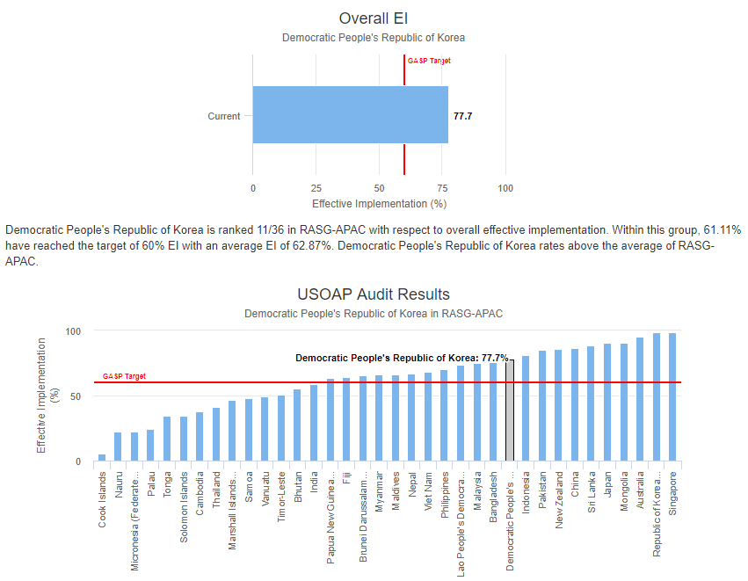
DPRK

Slide 30
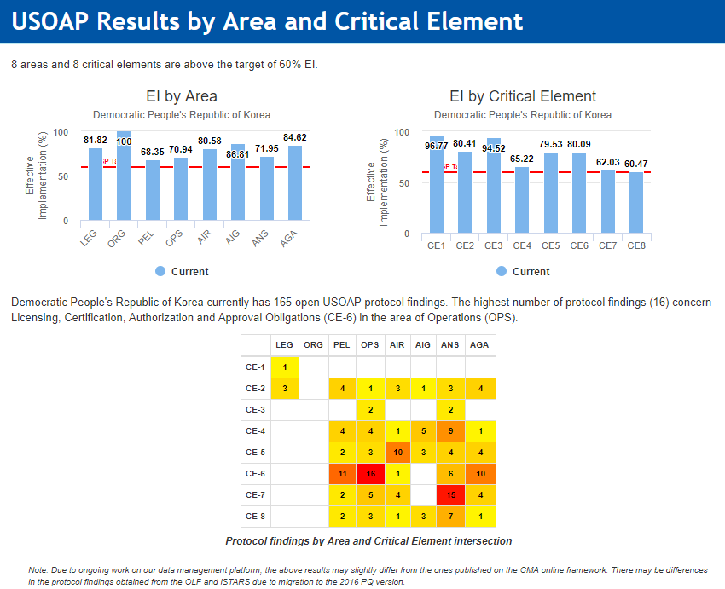
DPRK

Slide 31
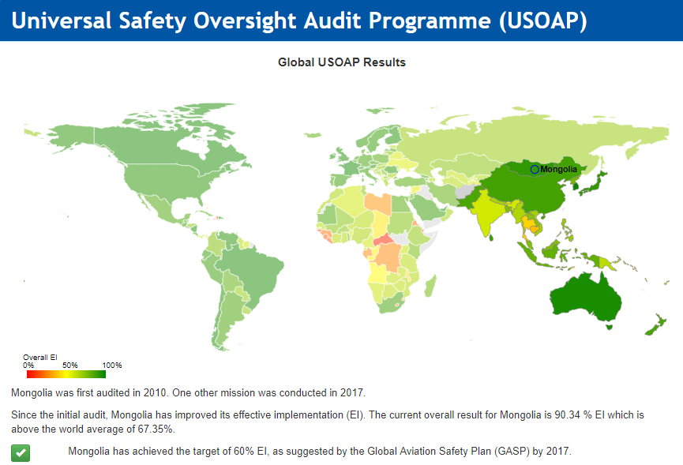
Mongolia

Slide 32

Performance Dashboard (Mongolia)

Slide 33
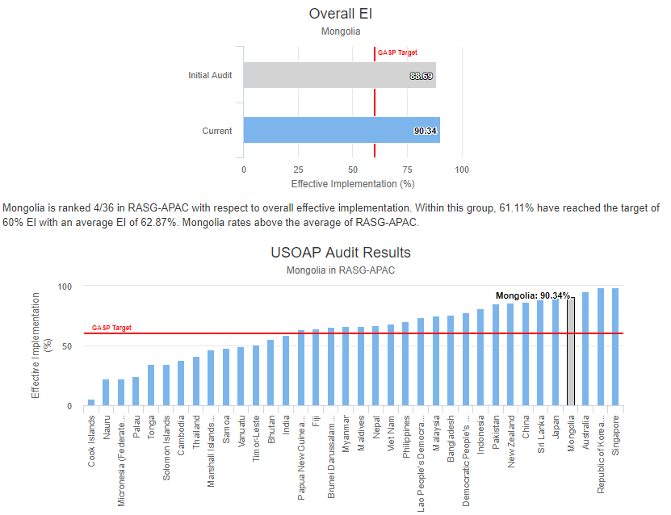
Mongolia

Slide 34
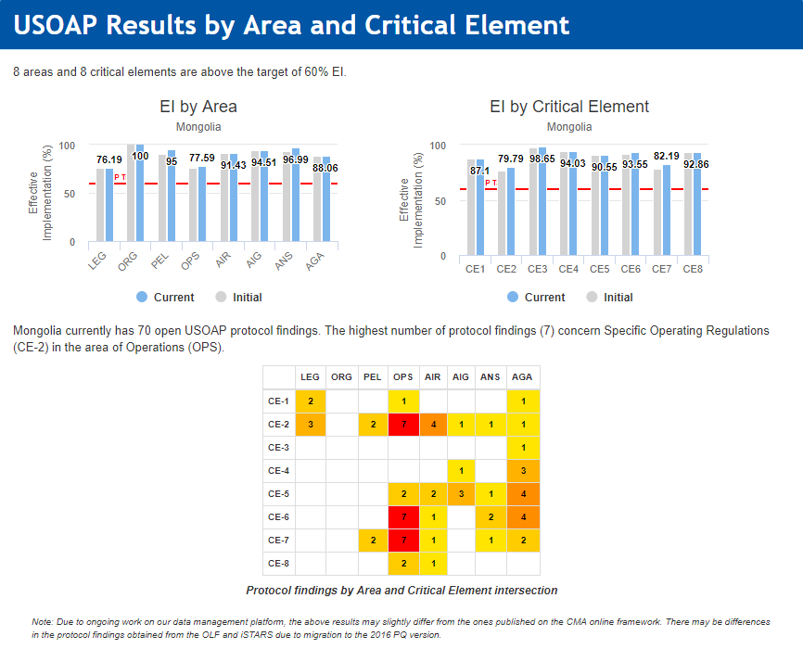
Mongolia

Slide 35
Thank you

