Slide 1

North Asia COSCAP
Cooperative Development for Operational Safety and
Continuous Airworthiness Program.
Beijing China
Chief Technical Advisor
Captain Wayne Loe

Slide 2




2003
Trust Fund
COSCAP-NA
To enhance the safety and efficiency of air transport operation
Notes:
Brief Description: This programme was instituted in 2003, initially for a period of five years, as a cooperative agreement between, the People’s Republic of China, the DPRK, Mongolia and the ROK executed by the ICAO by means of a trust fund, and aimed at enhancing the safety and efficiency of air transport operations in the North Asia region with the objective of:

Slide 3



Providing a regional forum for addressing, regulatory matters with a view toward the harmonization of associated regulatory policies and procedures.
Facilitating a coordinated, shared approach to the utilization of safety-oversight related technical assistance to avoid duplication of effort and to ensure that the maximum benefit is derived from resources which are made available.
Enhancing the professional knowledge and qualifications of inspectors by providing formal and on-the-job training.
Notes:
Brief Description: This programme was instituted in 2003, initially for a period of five years, as a cooperative agreement between, the People’s Republic of China, the DPRK, Mongolia and the ROK executed by the ICAO by means of a trust fund, and aimed at enhancing the safety and efficiency of air transport operations in the North Asia region with the objective of:

Slide 4

The continued technical assistance for them to implement ICAO SARPs for all safety related Annexes.
The implementation of respective State Safety Programmes (SSP) and assisting with the SMS implementation of Aircraft Operations, Aerodromes and Air Traffic Management.
The implementation of corrective actions arising from the ICAO comprehensive USOAP activities; the continued development and harmonization of aviation safety regulations and procedures.
Phase Ⅳ
The support of the USOAP Continuous Monitoring Approach (CMA) activities.
Continued training of civil aviation personnel.
Notes:
Member States and Administrations recognizing the benefits and effectiveness of the Programme agreed to a Phase IV for an additional 5 year period commencing from 1 February 2018. Hong Kong China and Macau China joined the programme in Phase IV

Slide 5

Monitor the project, determine priorities and the work programme, including the annual mission programme to States, and training requirements on the basis of needs and available resources.
Monitor NARAST activities and promote the implementation of interventions emanating from the APAC Regional Aviation Safety Group (RASG) deemed appropriate for the North Asia sub-region.
The CTA/PC review regularly the funding of the project and undertake timely follow-up with project participating governments and donors in this regard.
The Programme Steering Committee
Notes:
The Minister of the CAAC was chosen as the Programme Chairman of the Steering Committee for the duration of the Programme. Following a re-organization of the CAAC, in 2010 the Deputy Administrator of the CAAC has fulfilled the role of Chairman. Functionally, the position is further delegated to Chief Pilot CAST (Centre of Aviation Safety Technology of the CAAC)

Slide 6

COSCAP-NA Programme
Objectives
To contribute to the social and economic development of the Participating States.
By improving their capability to maintain suitable, harmonious and efficient airworthiness, flight operations, aerodrome, air traffic control and other safety related regulatory systems.
ICAO USOAP CMA
ICAO
ANNEX

Slide 7
1
Ensuring the safety oversight capabilities to meet international requirements and the deficiencies identified by the ICAO USOAP Audit have been fully corrected.
2
Establishing a forum for coordination and cooperation with the aim of the harmonization of regulations, policies and procedures about safety oversight, improving safety standards, and applying accident prevention measures.
3
Establishment of a systematic programme for the inspection of air operators and maintenance organizations where Civil Aviation Authorities currently lack the capability to do so independently.

Slide 8
4
Safety oversight inspectors and technical personnel are qualified and sufficient for undertaking surveillance, inspection, certification and regulation of flight operations, airworthiness and personnel licensing.
5
Member States and Administrations have established effective Safety Management Systems in the area of Aircraft Operations, Aerodromes and Air Traffic Management
6
States and Administrations have implemented an SSP commensurate with the size and complexity of the State’s aviation system.

Slide 9



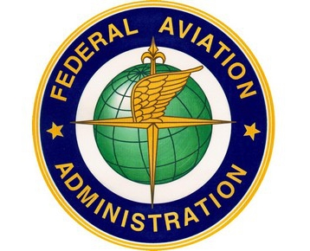

Programme Partners

Slide 10


COSCAP Programme Members
People’s Republic of China
Hong Kong China
Macau, China
Republic of Korea
Mongolia
Democratic People’s Republic of Korea

Slide 11


COSCAP Training 2003 - 2018

Slide 12
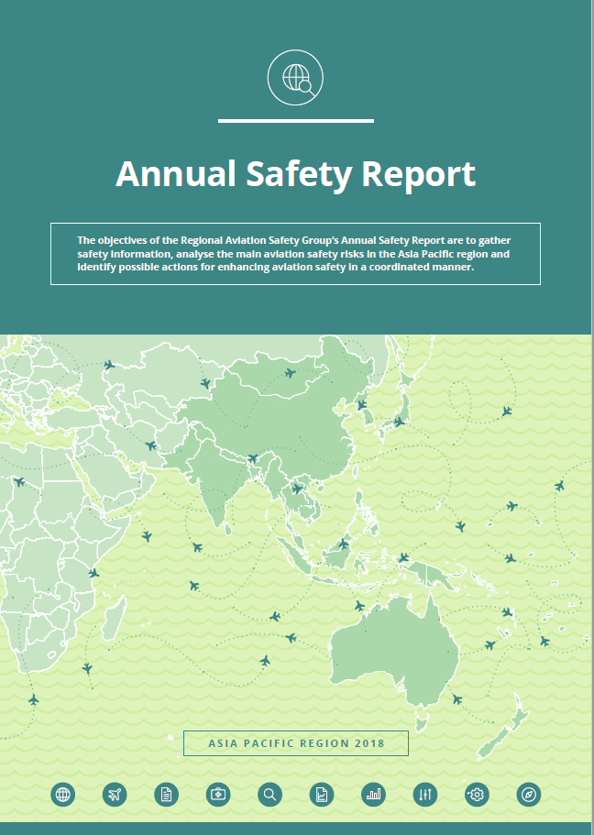
ICAO Annual Safety Report 2018

Slide 13

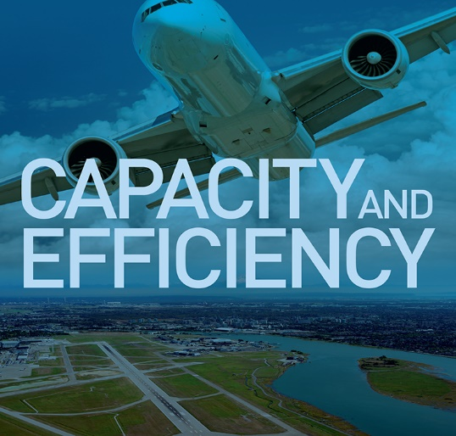
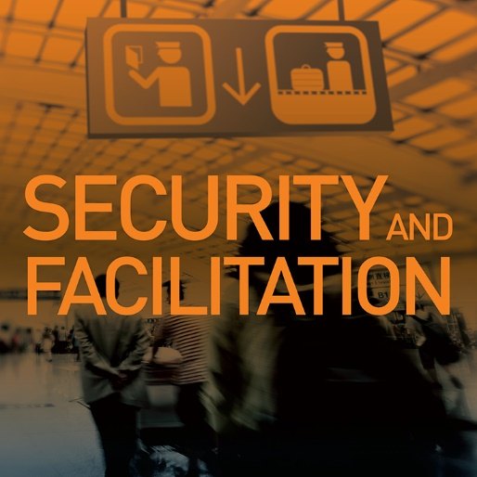


ICAO'S Strategic Objectives

Slide 14
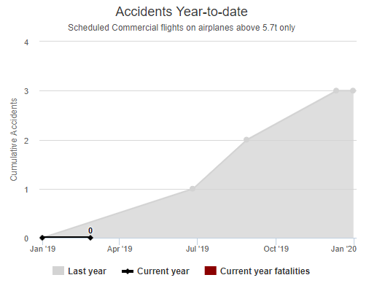
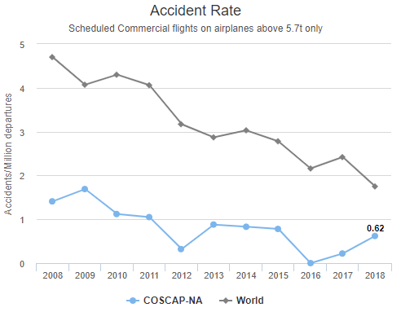

Slide 15
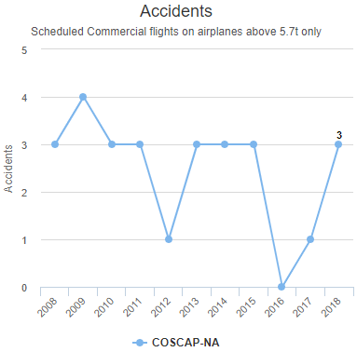
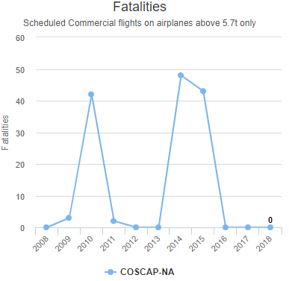

Slide 16
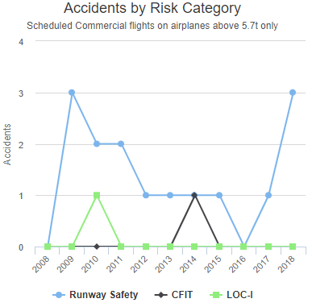
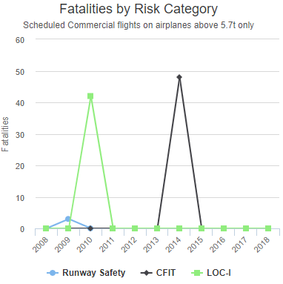

Slide 17
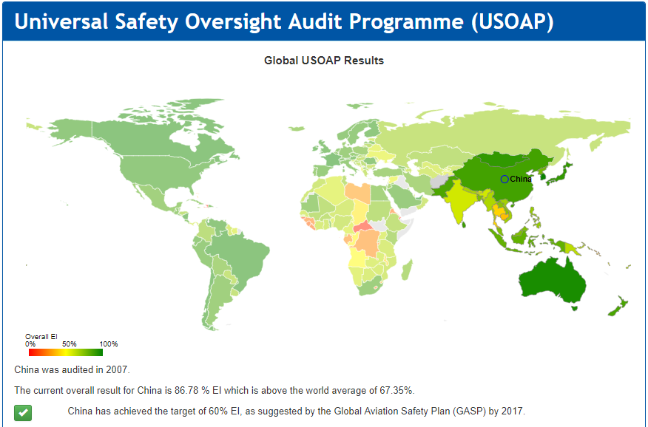
China

Slide 18
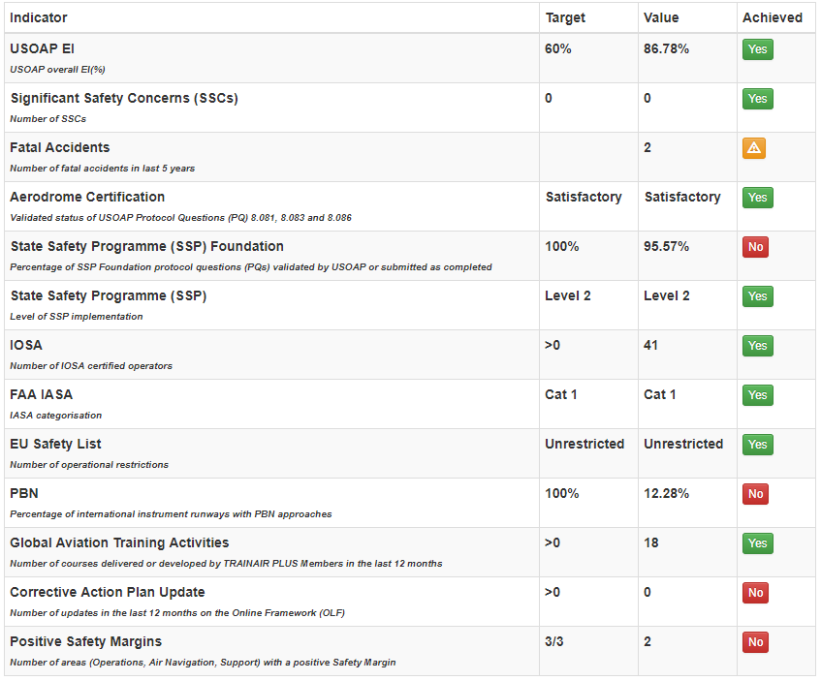
Performance Dashboard (China)

Slide 19
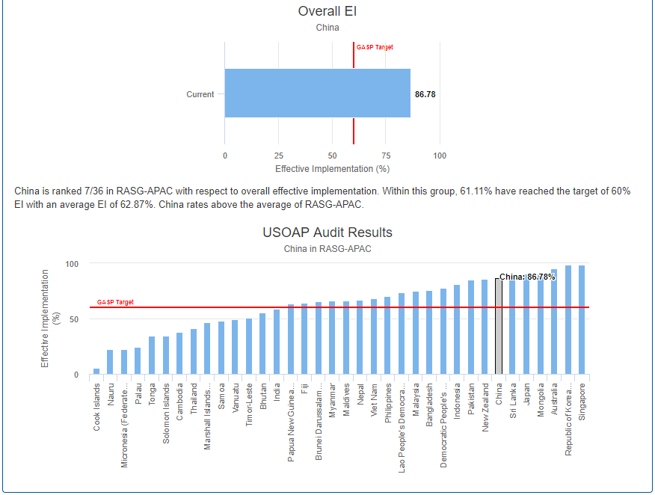
China

Slide 20
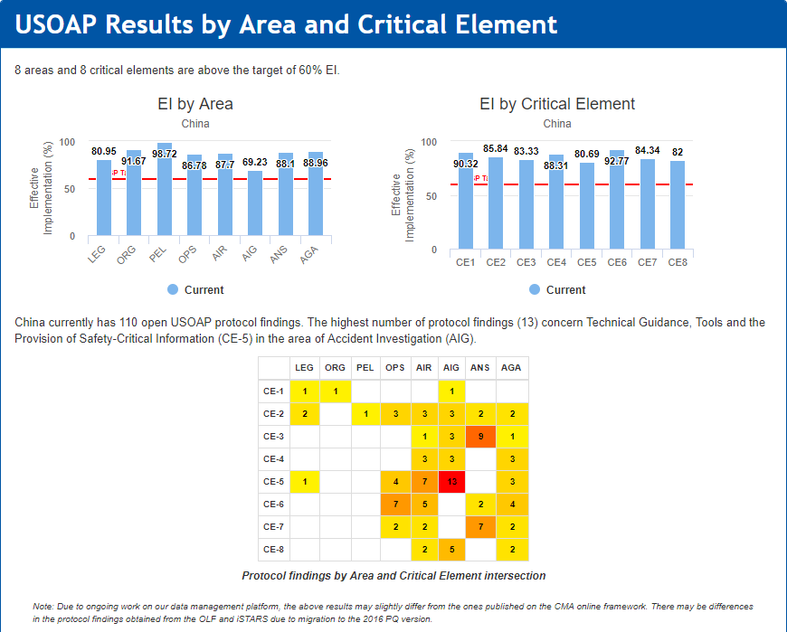
China

Slide 21
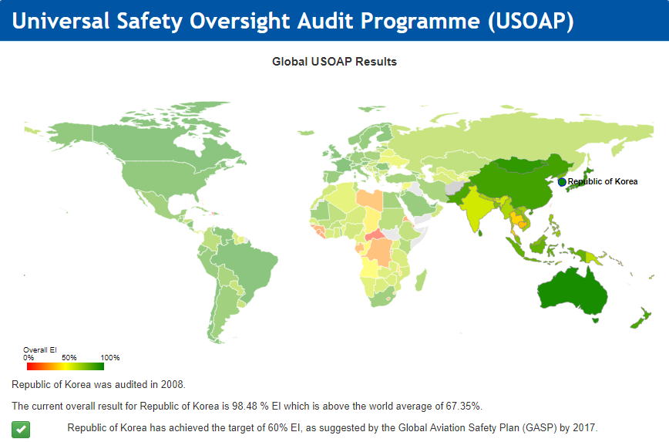
ROK

Slide 22
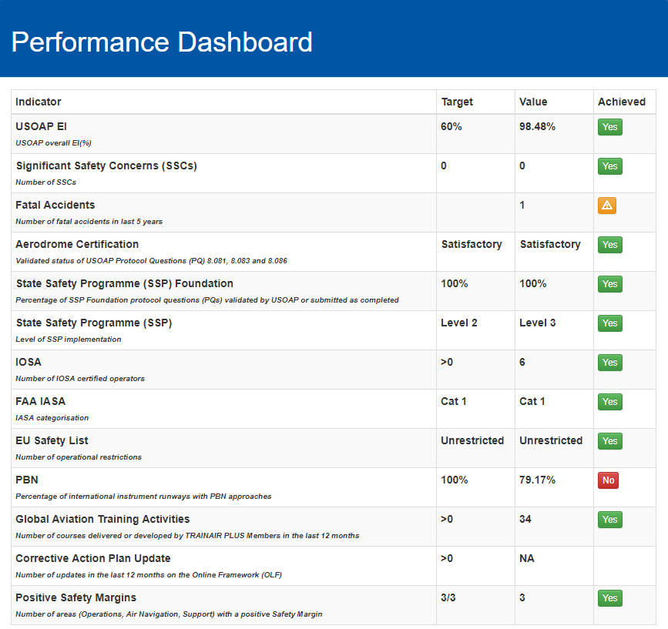
Performance Dashboard (ROK)

Slide 23
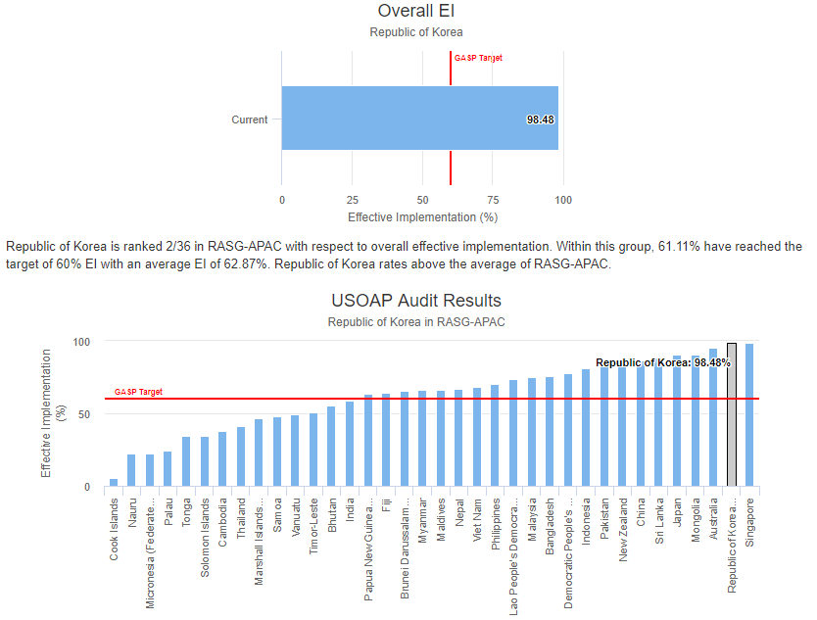
ROK

Slide 24
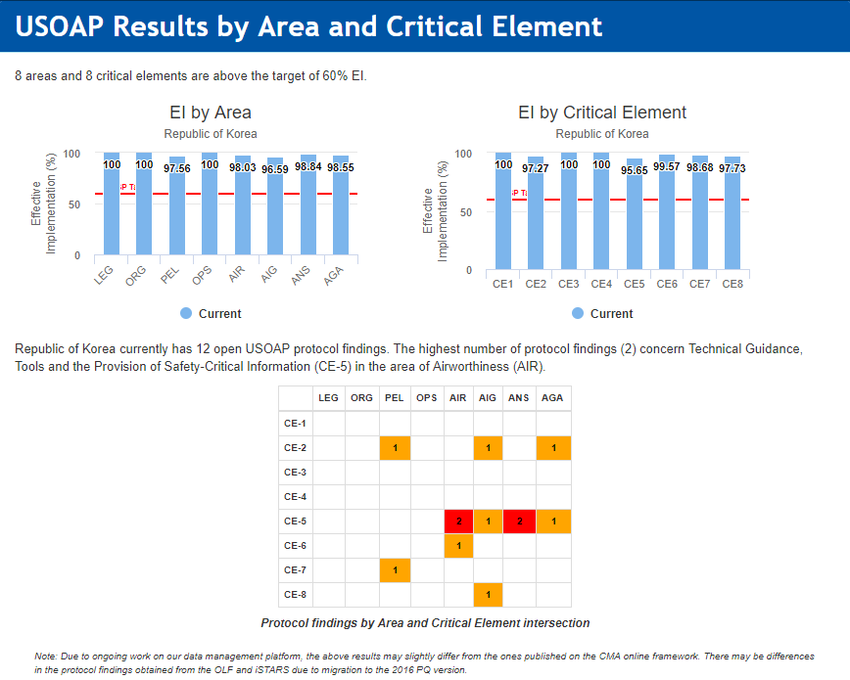
ROK

Slide 25
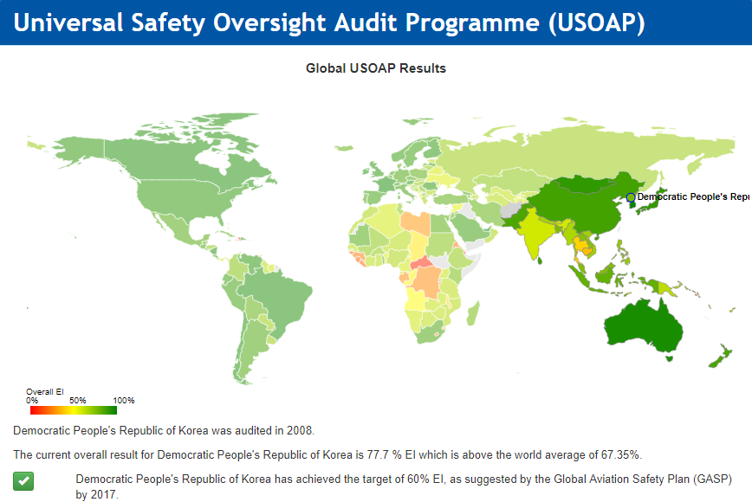
DPRK

Slide 26
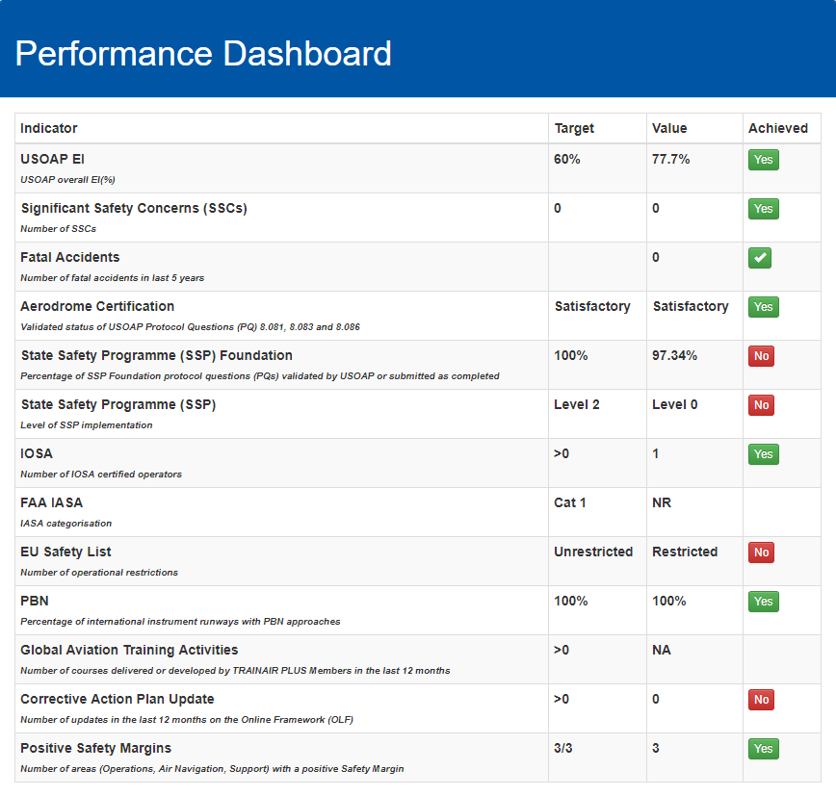
Performance Dashboard (DPRK)

Slide 27
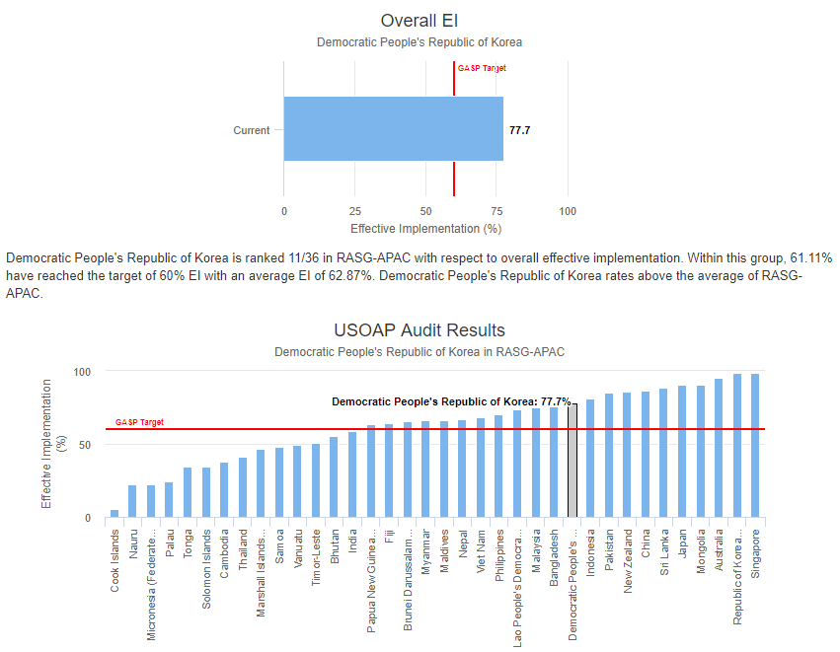
DPRK

Slide 28
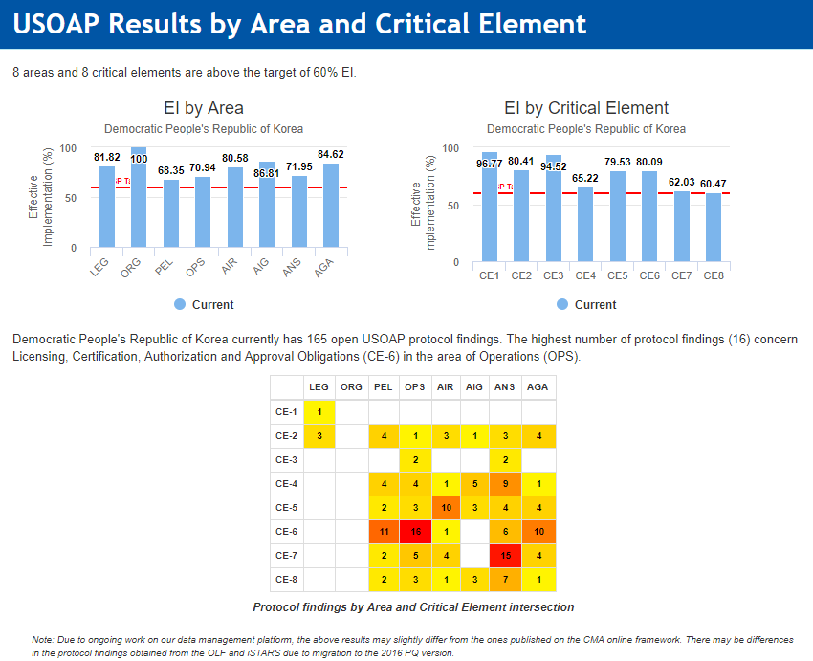
DPRK

Slide 29
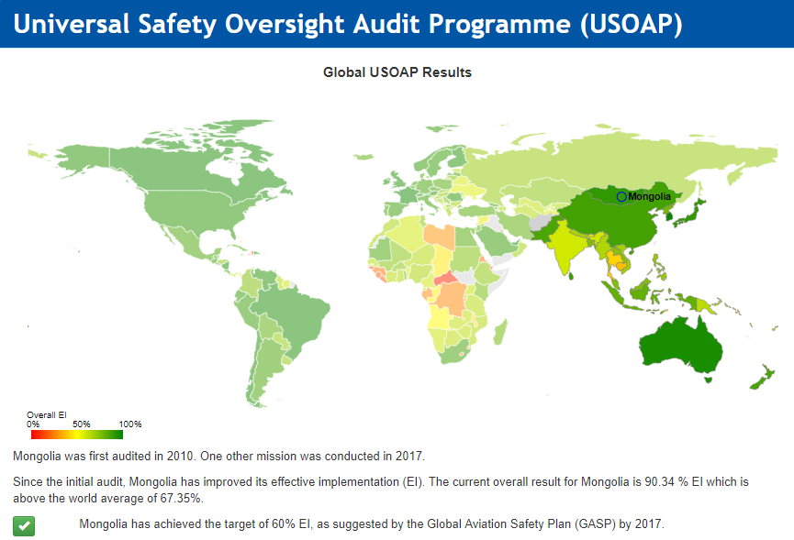
Mongolia

Slide 30

Performance Dashboard (Mongolia)

Slide 31
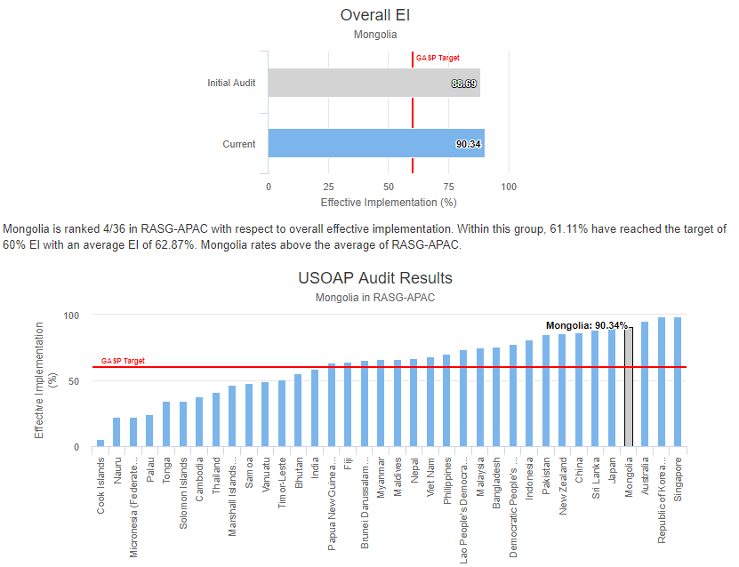
Mongolia

Slide 32
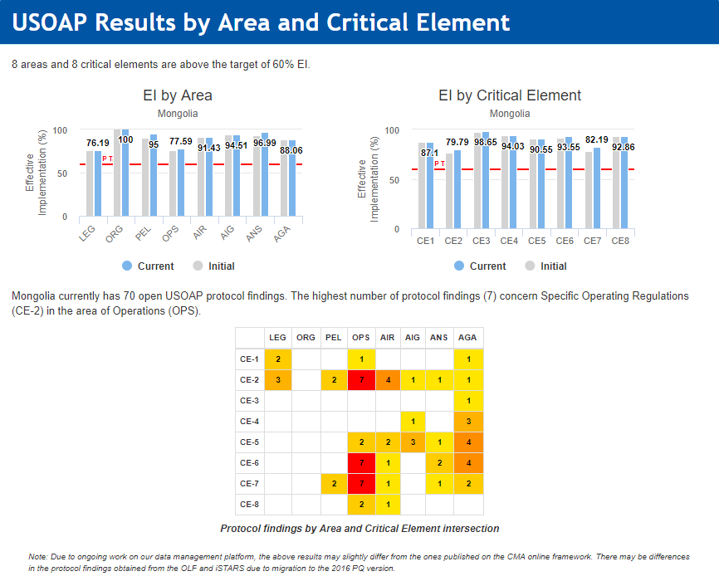
Mongolia

Slide 33
Thank you

Slide 34
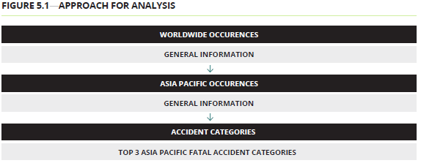
Reactive information analysis
Proactive information analysis
The number of accidents attributable to States/Administrations in the RASG-APAC region in 2017 was 19¹, up from 17 in 2016. In terms of fatalities, there was one fatal accident in 2017, down from two in 2016. The fatal accident resulted in two fatalities, down from 50 in 2016.
The top two most frequent accident categories for RASG-APAC region in 2017 were:
Runway Safety (runway excursion, incursion, hard landings and tailstrikes on landing)
Ground Collision
The RASG-APAC region had an overall USOAP Effective Implementation (EI) score of 61.96 per cent in 2018, up from 59.26 per cent in 2017. However, this result is lower than the global level of 66.05 per cent.
In terms of Critical Element (CE), the APAC region had lower EI scores for all categories compared to the global average. By CE, CE-4 on Technical personnel qualifications and training and CE-8 on Resolution of safety concerns (CE-8) had the lowest EI scores within RASG-APAC, at 47.82 and 50.59 per cent respectively. By area, Accident and Incident Investigation (AIG) and Aerodrome and Ground Aids (AGA) had the lowest EI scores of 47.79 per cent and 56.26 per cent respectively.

Slide 35
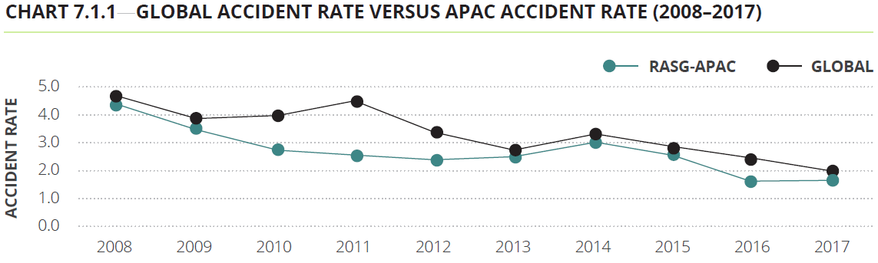
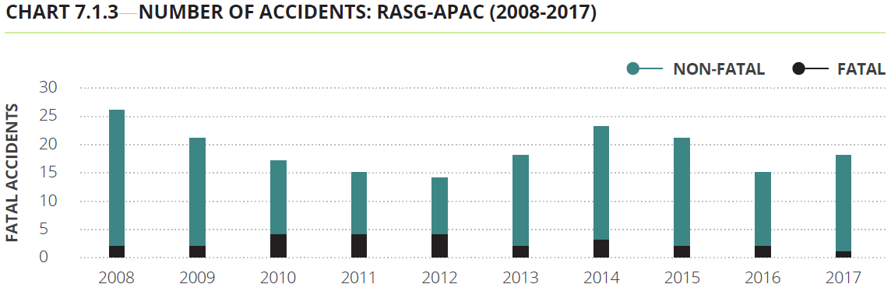

Slide 36
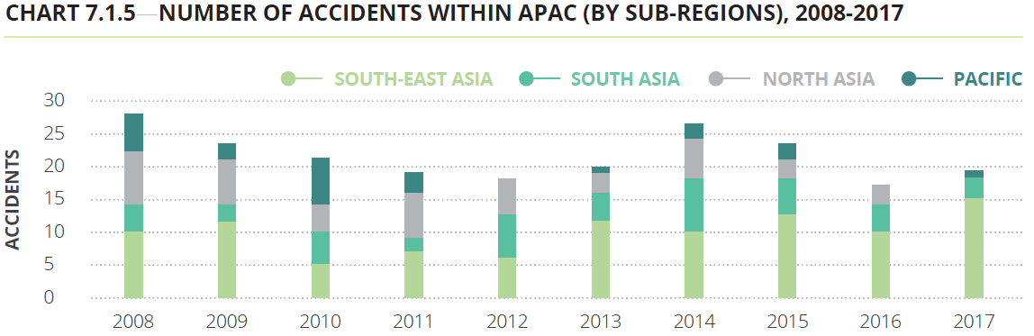
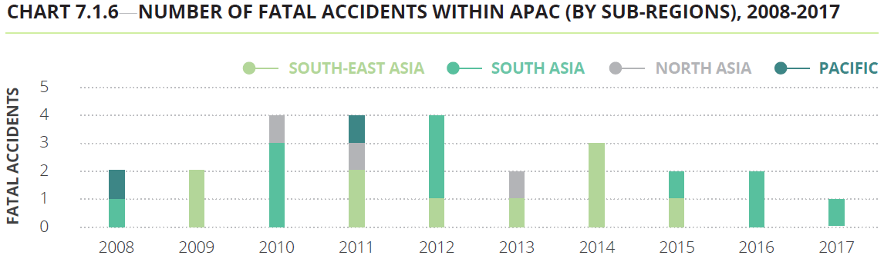

Slide 37
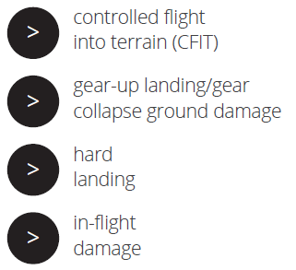
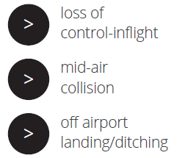
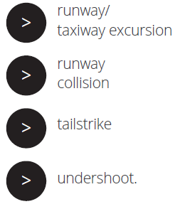

Only accidents of the following categories form part of the database:

Slide 38
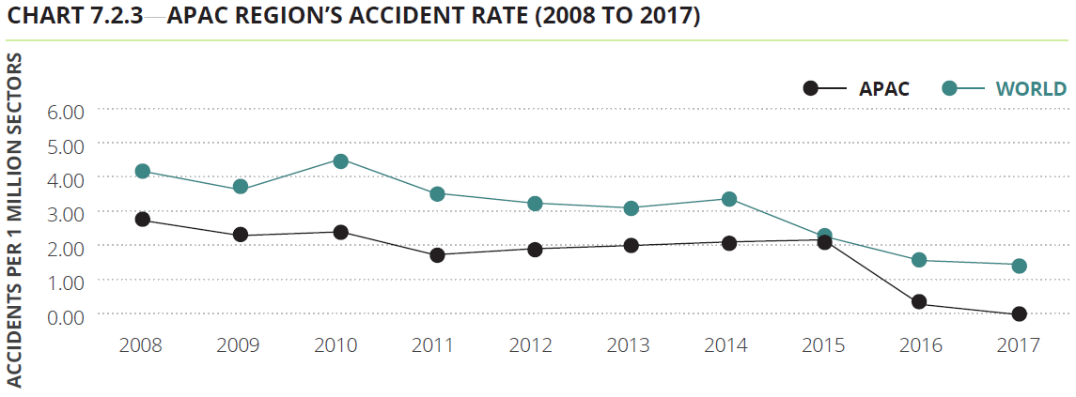
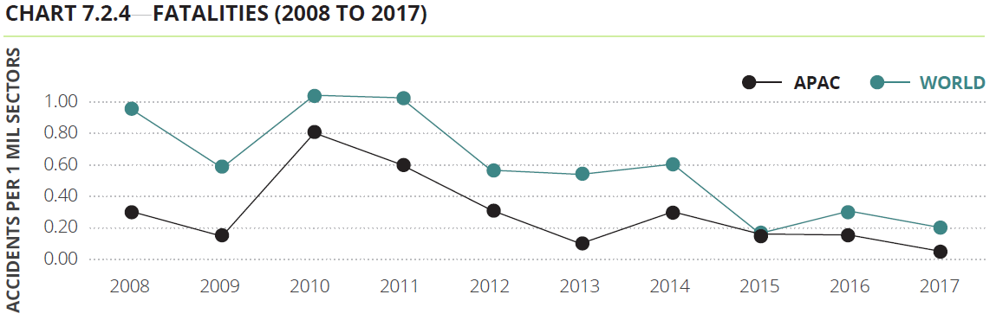
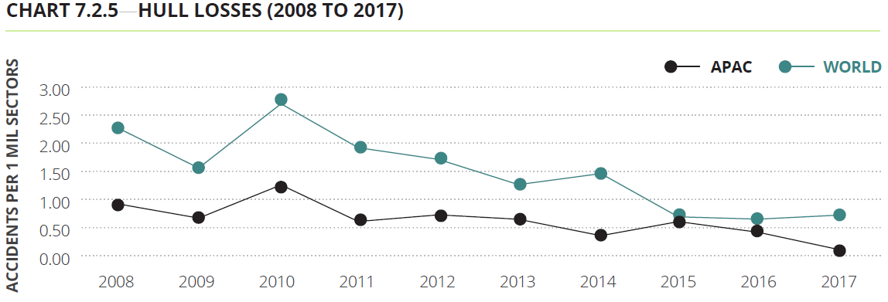

Slide 39
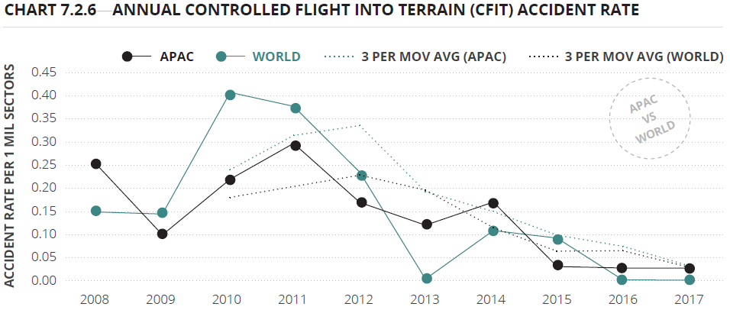
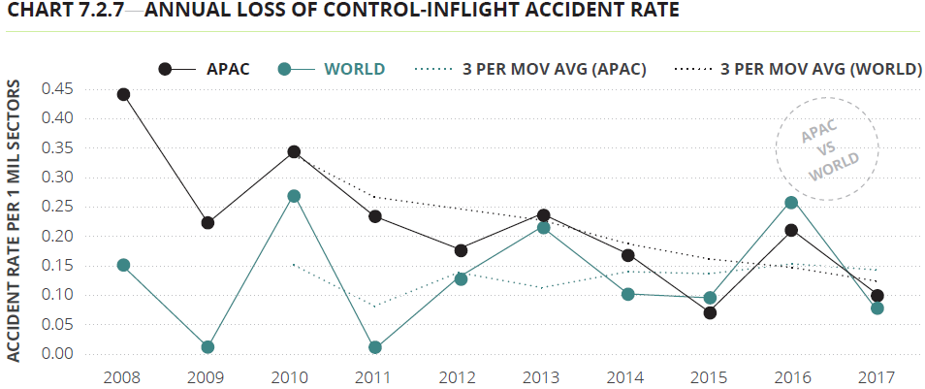
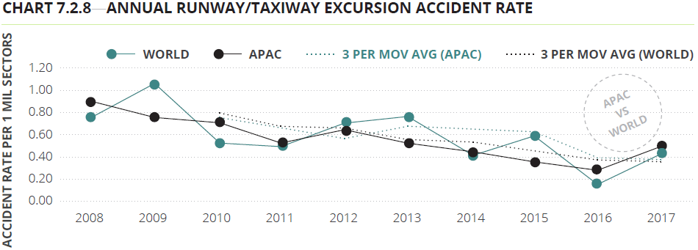

Slide 40
High-risk accident categories
Controlled flight into terrain (CFIT), loss of control-inflight (LOC-I) and runway/taxiway excursion have been identified by IATA as the top three accident categories globally.
Some of key findings linked with the APAC region for these categories include:
There were no accidents attributable to CFIT in 2017
Accidents attributable to LOC-I recorded a decrease in 2017 compared to 2016. The rate of occurrence in 2017 was 0.08 accidents per million sectors, down from 0.25 accidents per million sectors in 2016.
Runway/taxiway excursions recorded an increase in 2017 compared to 2016. In 2017, there were 0.40 accidents per million sectors, up from 0.18 accidents per million sectors in 2016.

Slide 41
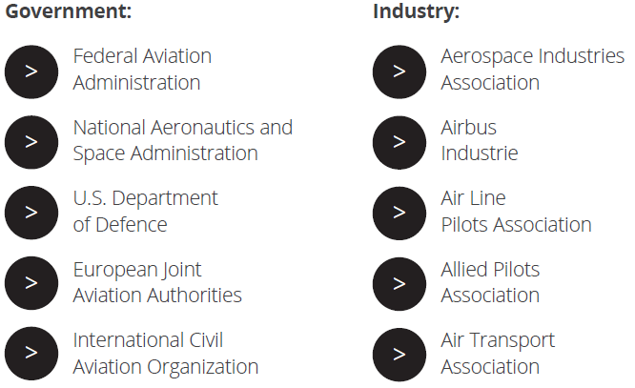
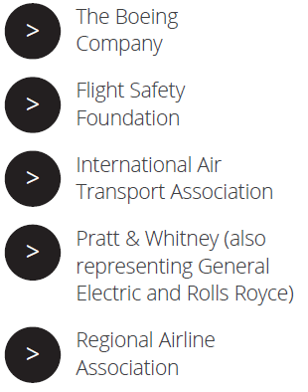
7.3 Asia Pacific Accident Information: CAST

Slide 42
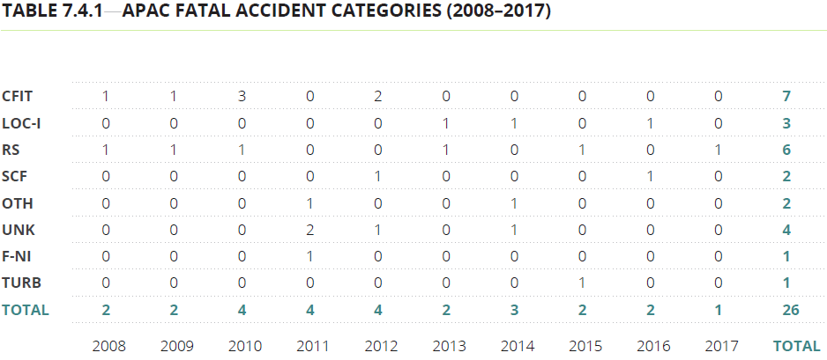
7.4 Most frequent accident categories within Asia Pacific: ICAO iSTARS
RS, CFIT, LOC-I were the top three fatal accident categories in the APAC region.

Slide 43
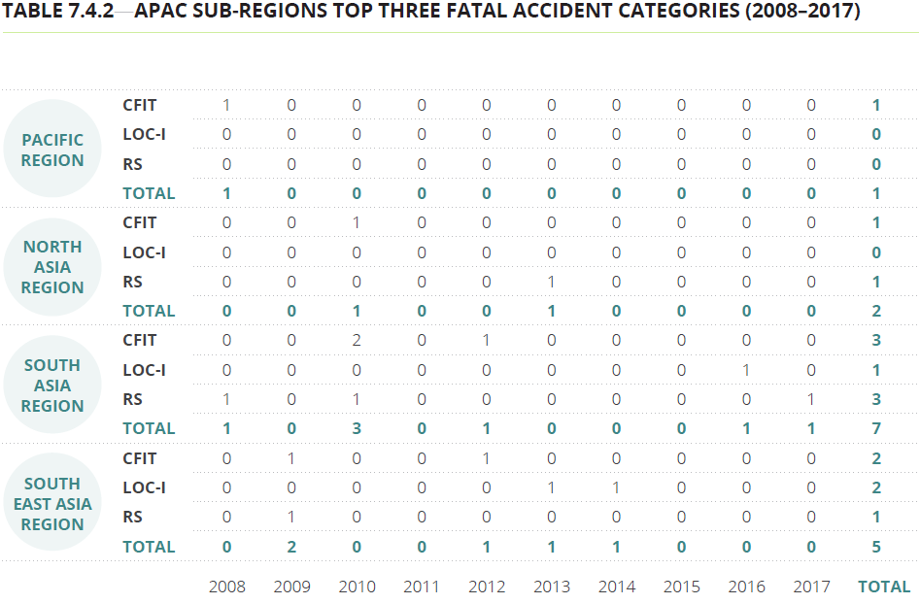

Slide 44
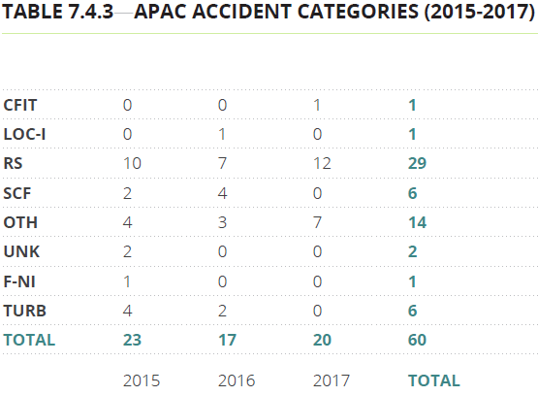
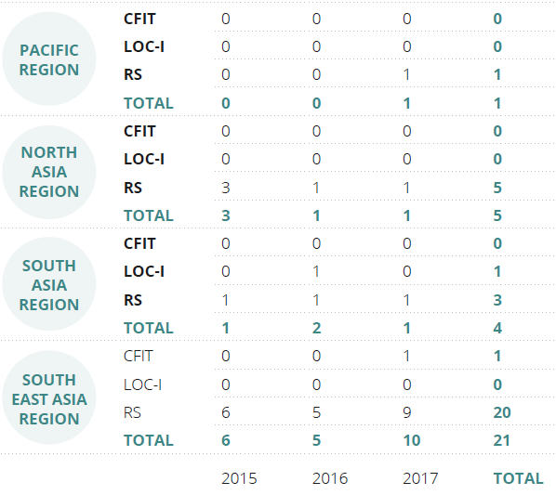
The top three accident categories
for the APAC region in 2017 were:
Runway Safety
Ramp which is classified under others(OTH)
Ground Collision

Slide 45
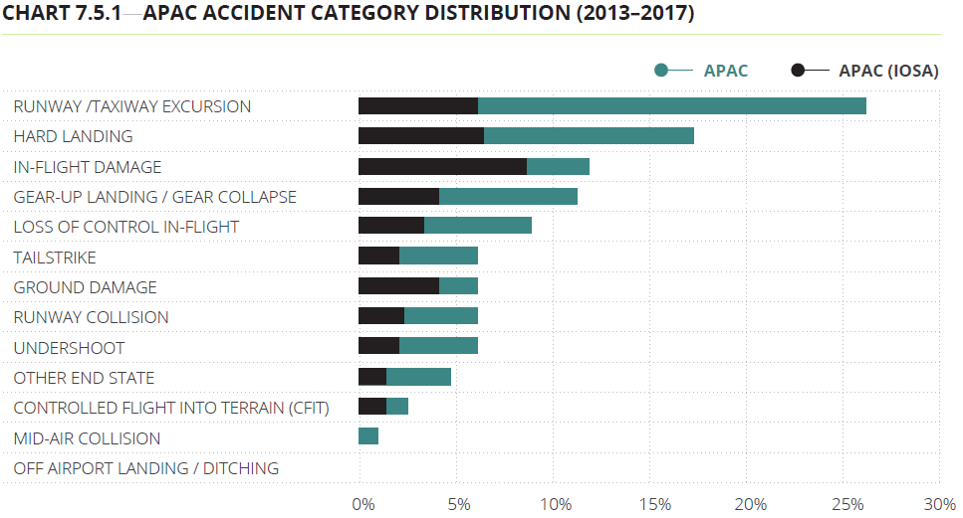
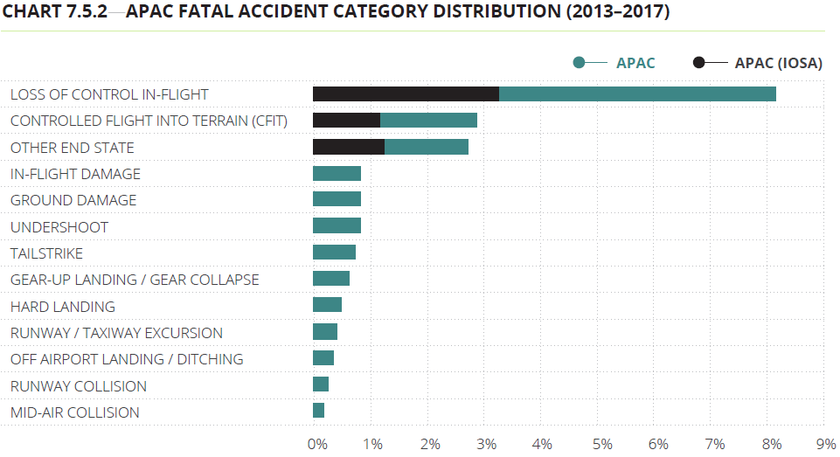
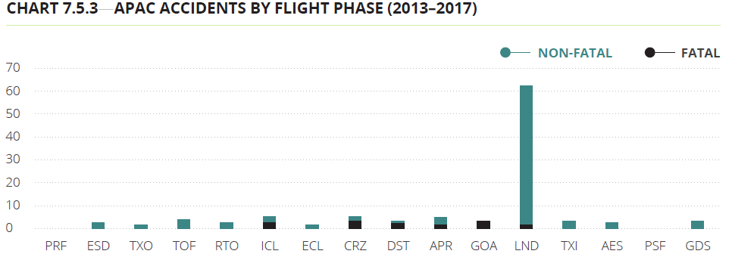

Slide 46
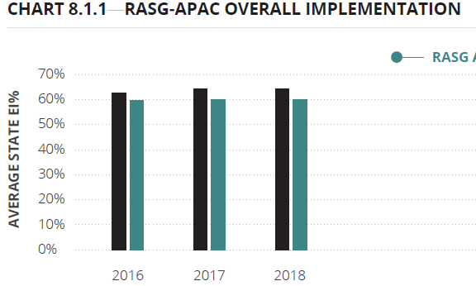
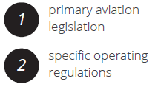

8.1 ICAO universal oversight audit program
continuous monitoring approach (USOAP CMA)

Slide 47


Slide 48



