Slide 1


Beijing
Declaration

Slide 2
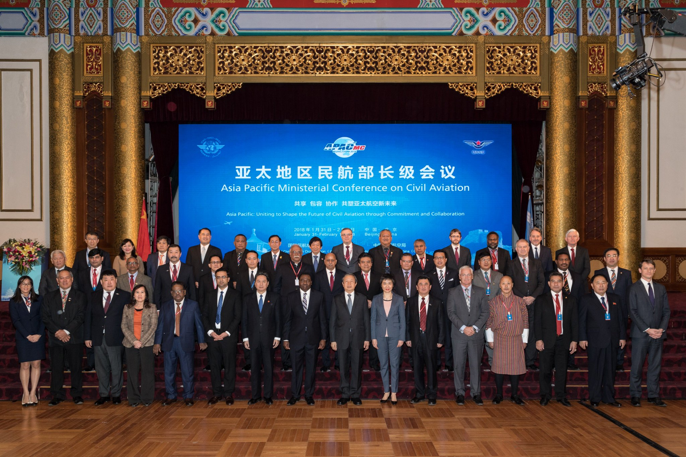
Beijing Declaration
Beijing Declaration
First Asia/Pacific Ministerial Conference on Civil Aviation
Held in Beijing, China from 31 January to 1 February 2018.
Organized by ICAO and hosted by the CAAC.
Attended by 32 APAC Region Members States, 4 Member States (France, Russian Federation, United Kingdom and United States) of other Regions and representatives of 6 international organizations.
Highlights
Main challenges in aviation safety and air navigation capacity and efficiency in the Region were highlighted.
Main outcome was the endorsement of the ‘Declaration on Asia Pacific Ministerial Conference on Civil Aviation’.
Unanimously agreed by all the Delegations.
Declaration of Asia Pacific Ministerial Conference on Civil Aviation
Beijing, China from 31 January to 1 February 2018

Slide 3
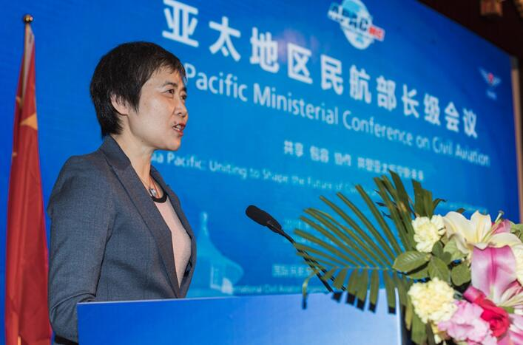
Beijing Declaration
Beijing Declaration
Contents of Declaration
Part 1 – Preamble
Part 2 – Commitments
1. Aviation Safety
2. Air Navigation Services
3. Accident Investigation
4. Human Resource Development
Intended Benefits of the Declaration
First high-level Regional Commitment on Safety & ANS.
Benchmark for States to assess progress.
Strong support to the Civil Aviation Authorities.
Demonstrate High level commitment to public, industry and investors.
Recognizing the importance of human resource development to meet the growth.
ICAO Secretary General, Dr. Liu Fang, gave the opening keynote address

Slide 4

Beijing Declaration
Beijing Declaration
2. Air Navigation Services
Commit to implementation by 2022, of the Asia Pacific Seamless Air Traffic Management (ATM) Plan to enhance ATM capacity and harmonization in the region.
Transitioning from Aeronautical Information Service (AIS) to Aeronautical Information Management (AIM) System;
(b) Performance Based Navigation (PBN) implementation;
(c) Common ground/ground telecommunication infrastructure to support Air Navigation Services (ANS) applications;
(d) An enhanced level of civil/military cooperation;
(e) Enhanced surveillance capability including Automatic Dependent Surveillance-Broadcast (ADS-B) technology;
(f) Air Traffic Flow Management/Collaborative Decision Making (CDM) implementation for high density airports.
1. Aviation Safety
Commit to:
(a) Progressively enhance safety oversight capability to achieve a high USOAP EI score or equal to the global average by 2022;
(b) Implement an effective SSP by 2025; and
(c) Certify all aerodromes used for international operations by 2020.

Slide 5
Beijing Declaration
Beijing Declaration
Monitoring and Annual Reporting of the Commitments
Secretariat to make efforts to monitor and report.
Request RASG-APAC and APANPRIG to establish relevant goals and targets to monitor progress.
• RASG-APAC and APRAST on Aviation Safety, Accident Investigation, and Human Resources Development; and
• APANPIRG and its contributory bodies on Air Navigation Services and Human Resources Development.
Follow-up action
Secretariat will:
Review Beijing Declaration objectives in 2020 to reflect
Any resolutions agreed to by 2019 ICAO Assembly, including endorsements of the new versions of the GASP and GANP.
Accordingly, initiate organization of the Second Asia/Pacific Ministerial Conference on Civil Aviation in 2020 or thereafter.
3. Accident Investigation
In accordance with the Chicago Convention, commit to:
- establish an accident investigation authority, independent from State aviation authorities and other entities that could interfere with the conduct or objectivity of an investigation or
where appropriate develop a bilateral, sub-regional or regional partnership to support the establishment of accident investigation capabilities to serve the Region or Sub-region or State.
4. Human Resource Development
Commit to:
- Establish access to quality training
- Encourage sharing of resources bilaterally and/or multilaterally as well as with industry partners.

