Slide 1
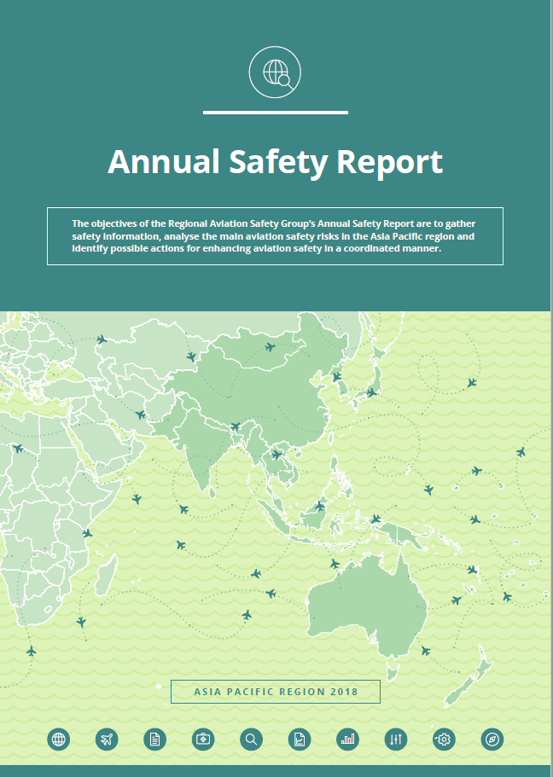
ICAO Annual Safety Report
Asia Pacific Region 2018

Slide 2
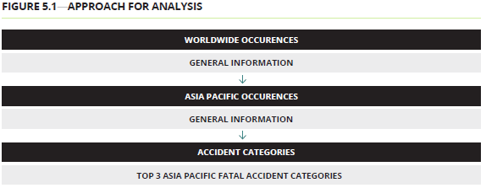
Reactive information analysis
Proactive information analysis
The number of accidents attributable to States/Administrations in the RASG-APAC region in 2017 was 19, up from 17 in 2016. In terms of fatalities, there was one fatal accident in 2017, down from two in 2016. The fatal accident resulted in two fatalities, down from 50 in 2016.
The top two most frequent accident categories for RASG-APAC region in 2017 were:
Runway Safety (runway excursion, incursion, hard landings and tail-strikes on landing)
Ground Collision
The RASG-APAC region had an overall USOAP Effective Implementation (EI) score of 61.96 per cent in 2018, up from 59.26 per cent in 2017. However, this result is lower than the global level of 66.05 per cent.
In terms of Critical Element (CE), the APAC region had lower EI scores for all categories compared to the global average. By CE, CE-4 on Technical personnel qualifications and training and CE-8 on Resolution of safety concerns (CE-8) had the lowest EI scores within RASG-APAC, at 47.82 and 50.59 per cent respectively. By area, Accident and Incident Investigation (AIG) and Aerodrome and Ground Aids (AGA) had the lowest EI scores of 47.79 per cent and 56.26 per cent respectively.

Slide 3
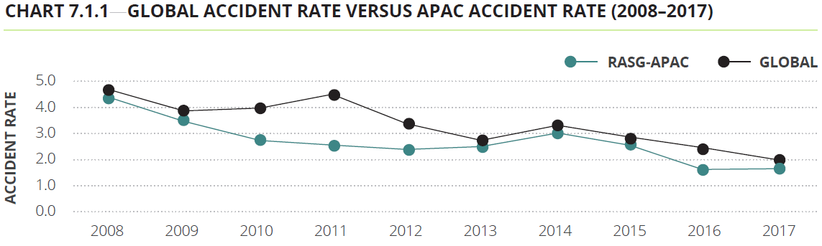
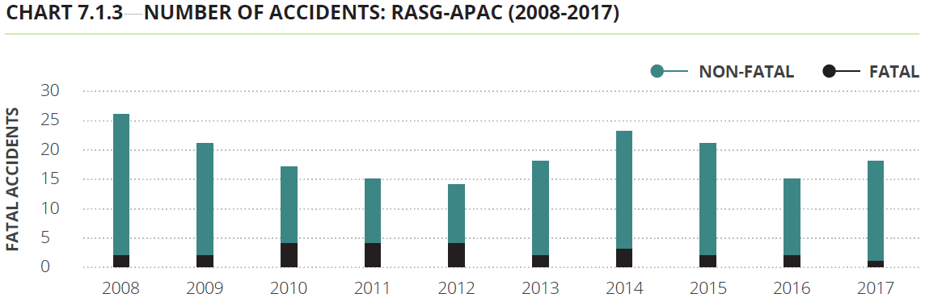

Slide 4
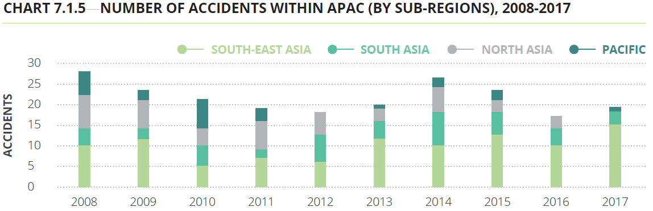
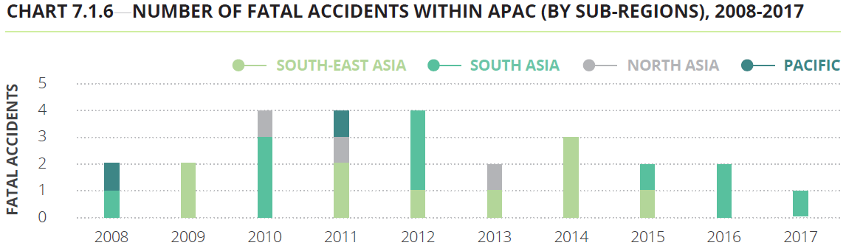

Slide 5
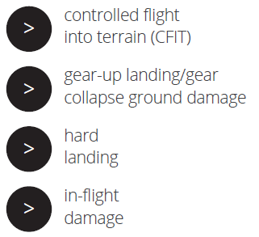
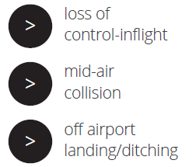
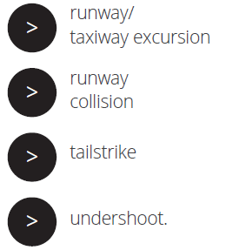

Only accidents of the following categories form part of the database:

Slide 6
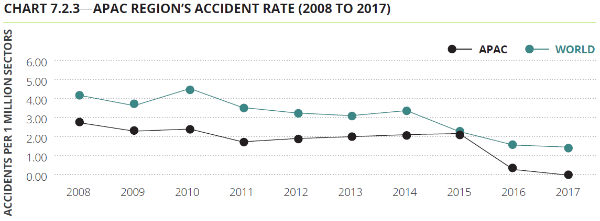
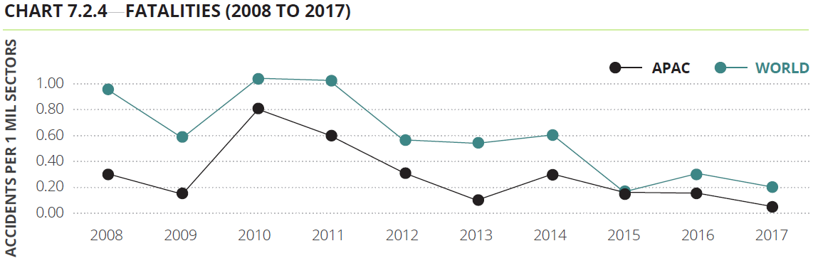
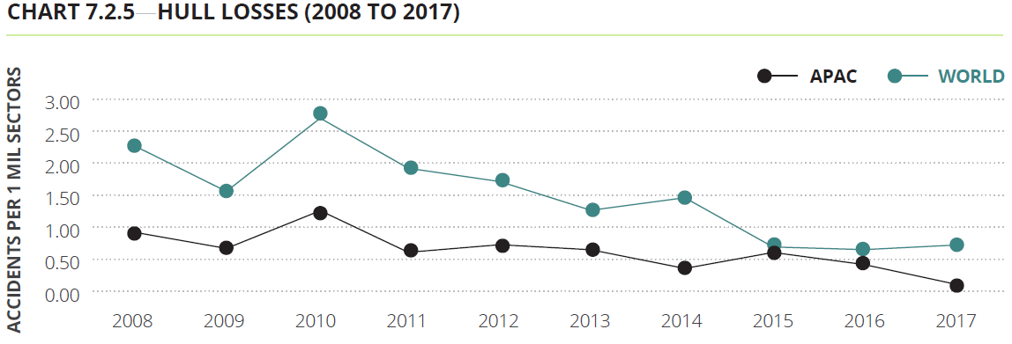

Slide 7
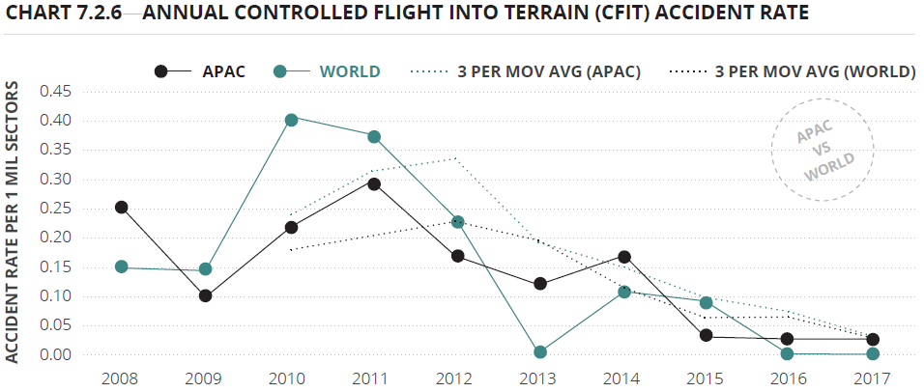
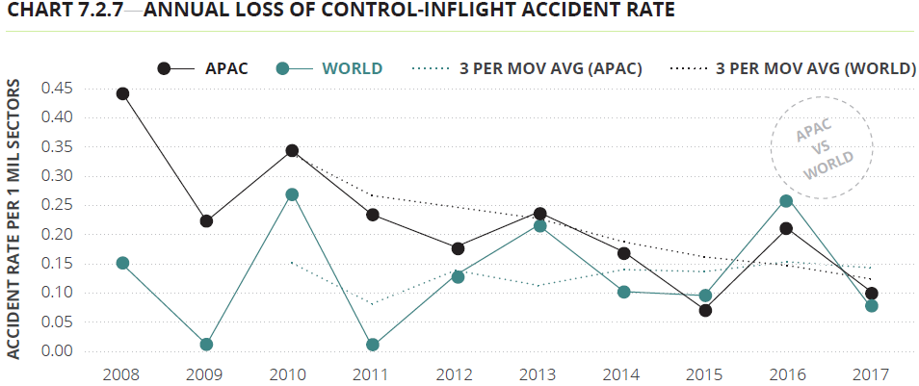
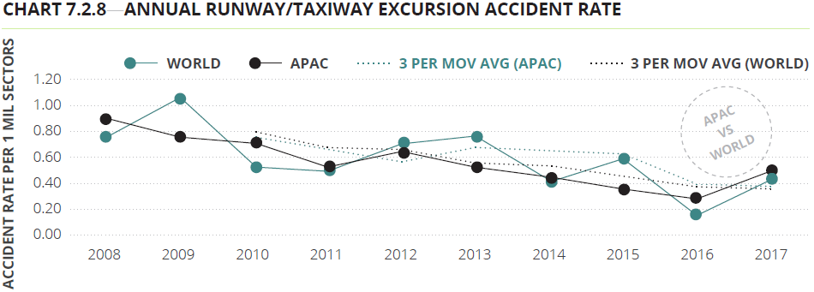

Slide 8
High-risk accident categories
Controlled flight into terrain (CFIT), loss of control-inflight (LOC-I) and runway/taxiway excursion have been identified by IATA as the top three accident categories globally.
Some of key findings linked with the APAC region for these categories include:
There were no accidents attributable to CFIT in 2017
Accidents attributable to LOC-I recorded a decrease in 2017 compared to 2016. The rate of occurrence in 2017 was 0.08 accidents per million sectors, down from 0.25 accidents per million sectors in 2016.
Runway/taxiway excursions recorded an increase in 2017 compared to 2016. In 2017, there were 0.40 accidents per million sectors, up from 0.18 accidents per million sectors in 2016.

Slide 9
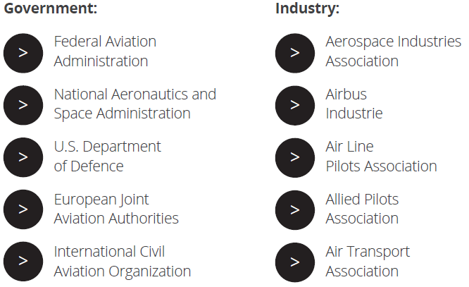
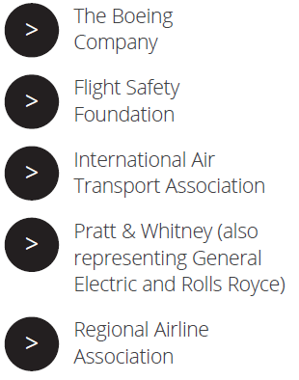
7.3 Asia Pacific Accident Information: CAST

Slide 10
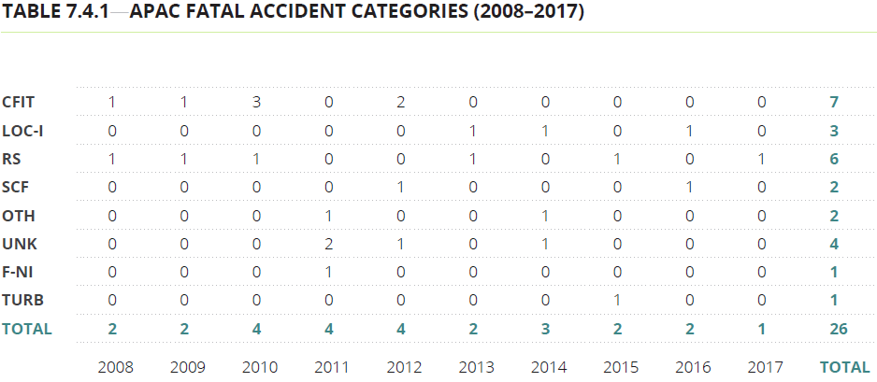
7.4 Most frequent accident categories within Asia Pacific: ICAO iSTARS
RS, CFIT, LOC-I were the top three fatal accident categories in the APAC region.

Slide 11
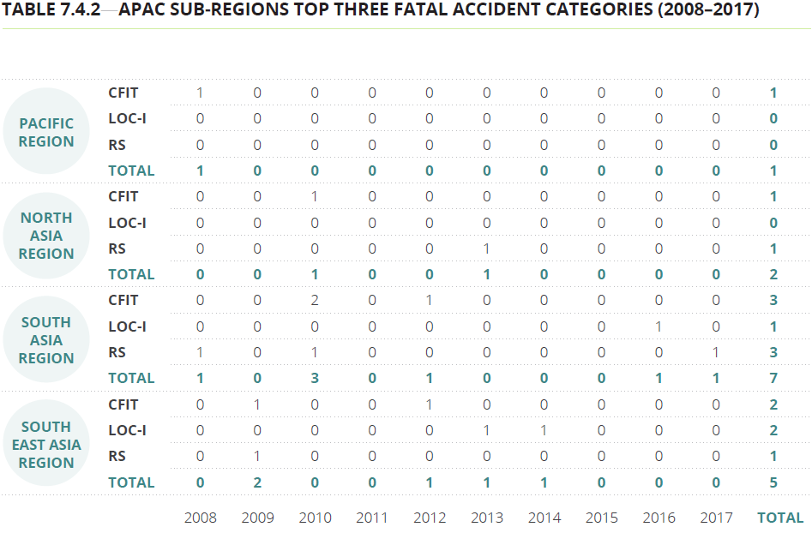

Slide 12
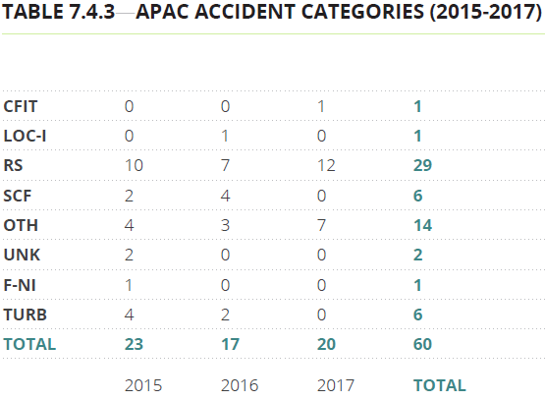
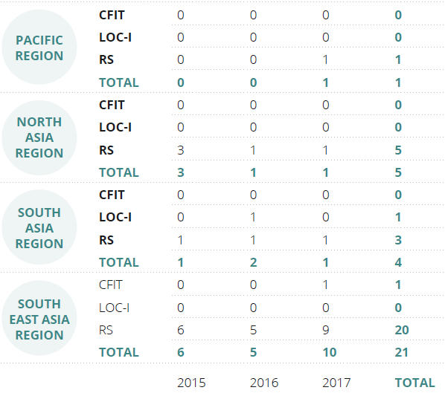
The top three accident categories
for the APAC region in 2017 were:
Runway Safety
Ramp which is classified under others(OTH)
Ground Collision

Slide 13
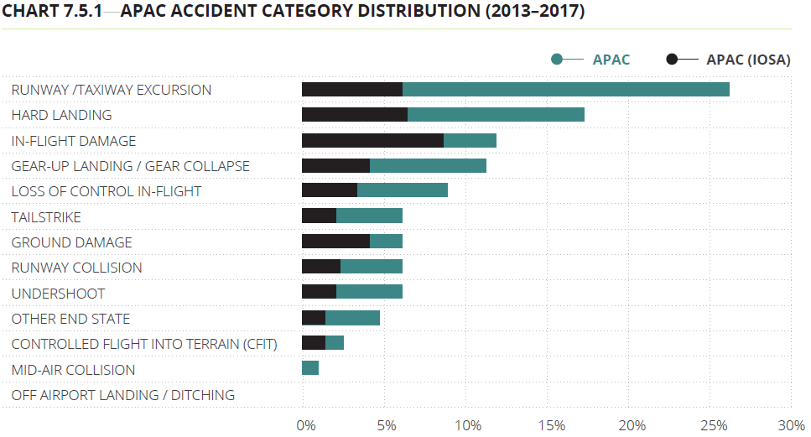
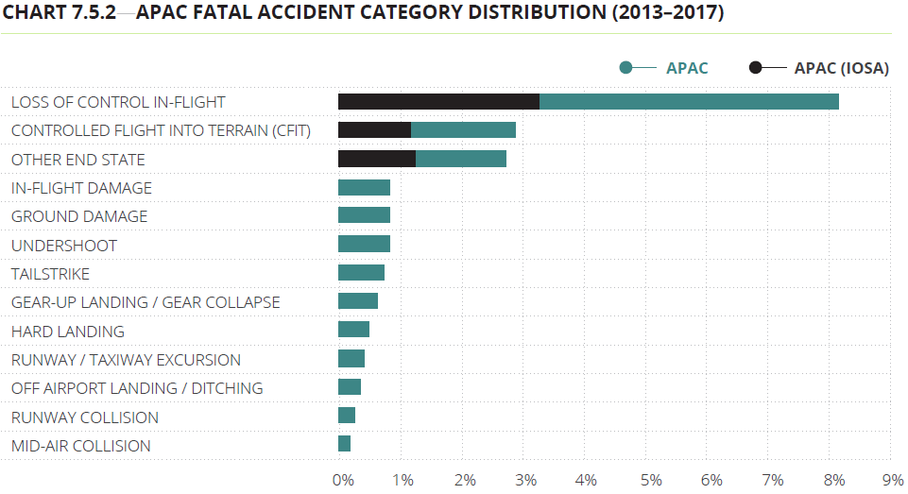
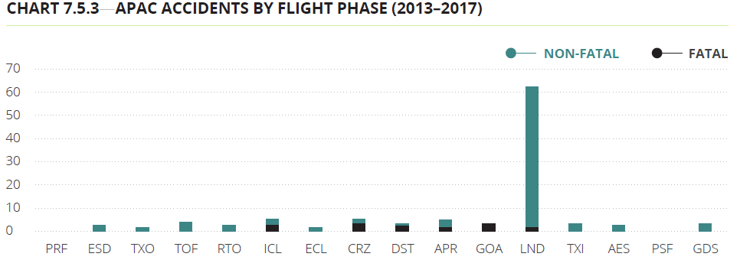

Slide 14
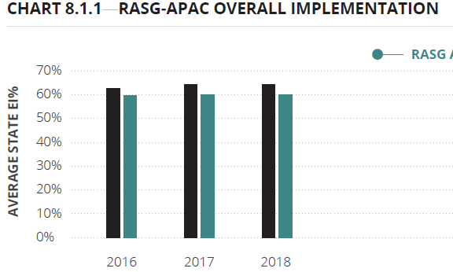
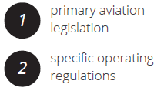
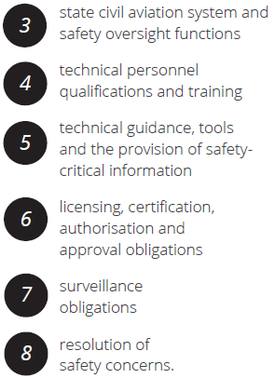
8.1 ICAO universal oversight audit program
continuous monitoring approach (USOAP CMA)

Slide 15
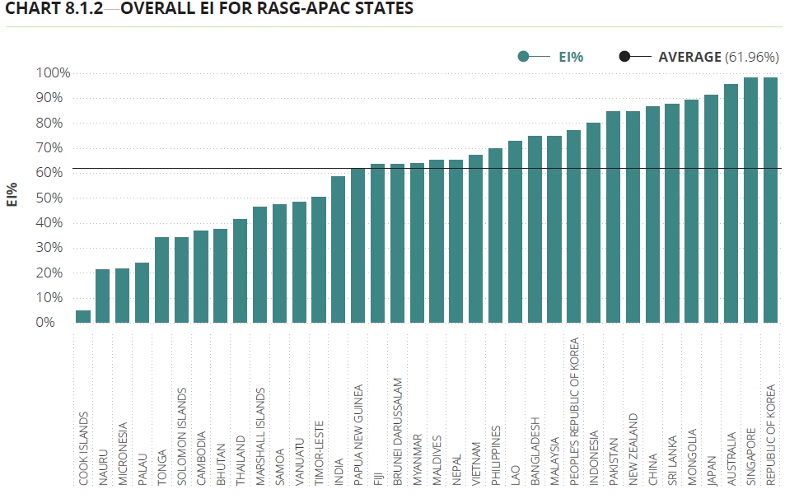

Slide 16
