Slide 1

Agenda Item 9a: Beijing Declaration – Follow up and way forward
Status of APAC States vis-à-vis Beijing Declaration Commitments
Breakout workshop
Raphael Guillet
Chief of ICAO Asia and Pacific Regional Sub-Office (APAC RSO)
Kathmandu, Nepal, 21 August 2019

Slide 2

Choose a rapporteur
Which State would accept to report the discussion during this breakout workshop to the plenary session ?
A first draft ppt is proposed here

Slide 3
Timing
11.35 : Aviation Safety
a) USOAP Effective Implementation (EI) Michiel
c) Significant Safety Concerns (SSCs)
b) State Safety Programme (SSP) Wayne
d) Certification of international aerodromes Punya
12.25 : Accident Investigation Nicolas
a) Independent accident investigation authority
12.35 : Air Navigation Services Raphael
a) Aeronautical Information Management (AIM)
b) Performance Based Navigation (PBN)
c) Ground telecommunication infrastructure
d) Civil Military cooperation
e) Surveillance capability
f) Air Traffic Flow Management (ATFM) / Collaborative Decision Making (CDM)
g) National Air Navigation Plan
13.25 : Review of the ppt for the plenary session
13.30 : Closure

Slide 4

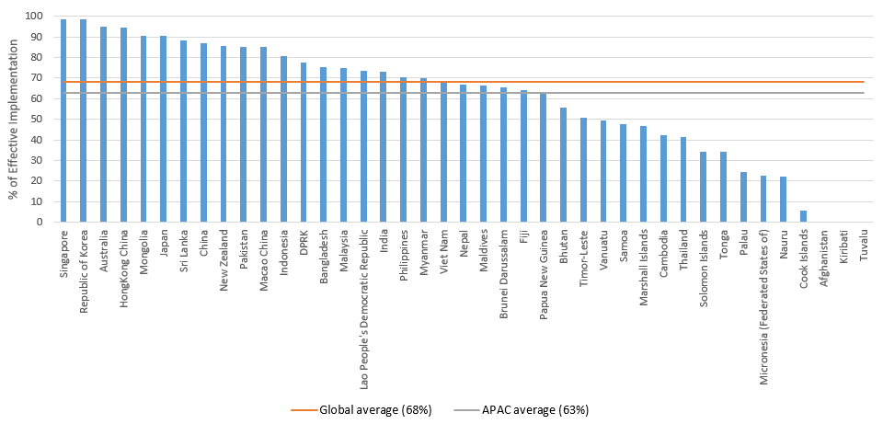

Aviation Safety
a) USOAP Effective Implementation (EI)
USOAP EI ≥ global average by 2022
iSTARS (USOAP Data Tables Implementation Indicators)

Slide 5
Aviation Safety
a) USOAP Effective Implementation (EI)
State / EI % | Jan 2018 | Jun 2019 | USOAP conducted
Bhutan | 39.1 | 55.6 | Aug 2018
Cambodia | 37.6 | 42.4 | Dec 2018
India | 65.7 | 72.9 | Nov 2018
Myanmar | 65.9 | 70.0 | Dec 2018
Papua New Guinea | 51.1 | 63.3 | Mar & Aug 2018
Sri Lanka | 87.4 | 88.4 | Jun 2018
Progress since January 2018 :
EI Global average :
from 65% to 68%
EI APAC average :
from 60% to 63%
Note : Thailand : ICVM completed in May 2019. Report not published.

Slide 6
Aviation Safety
c) Significant Safety Concerns (SSCs)
Endeavour not to have any Significant Safety Concerns (SSCs) under the USOAP Continuous Monitoring Approach (CMA), and to resolve any future SSCs within the time frame agreed with ICAO
Only one State has a SSC
No SSC in Jan 2018

Slide 7
Aviation Safety
a) USOAP Effective Implementation (EI)
Main challenges for States which have negligible progress:
Aviation safety/compliance is not visible to & prioritised by Gov’t
Unawareness accident risk exposure & potential consequences
Legislation and regulations out-of-date & inadequate
Institutional instability & insufficient continuity – DG changes
Potential SSC & economic/reputational impact
Not using RSOOs or delegating safety oversight functions
Not engaged with & making use of ICAO RO

Slide 8
Aviation Safety
a) USOAP Effective Implementation (EI)
Main challenges for States which have minimal progress :
Financial and human resource shortcomings
Ineffective organisation and HR strategy
No separation between regulator and service provider
No legal provisions for enforcement
Potential SSC & economic/reputational impact
Not engaged with & making use of ICAO USOAP

Slide 9
Aviation Safety
a) USOAP Effective Implementation (EI)
Main challenges for States which have made significant progress:
Continued safety oversight system improvement
Growth, changes and complexity of industry
Frequent changes and complexity of international standards
Insufficient financial and human resources
Inadequate training programmes and plans
SSP implementation
Infrequent USOAP validation activities

Slide 10
Aviation Safety
a) USOAP Effective Implementation (EI)
Main challenges for States with high EI:
Complacency
Sustainability
Safety culture
Risk based surveillance
Infrequent USOAP validation activities

Slide 11
Aviation Safety
a) USOAP Effective Implementation (EI)
Recommendations :
Avoid SSC, IASA Cat 2, EU Safety List
Avoid fatal accident
Avoid withdrawal of air services
NASP & SSP – involve Ministry in development & approval
Regional collaboration in implementation
APAC RO, COSCAPs, RSOOs & GASOS
USOAP IVAs

Slide 12
Aviation Safety
a) USOAP Effective Implementation (EI)
Recommendations :
SSP implementation (Thailand)
regional & sub-regional cooperation by sharing resources (Nepal)
ICAO APAC CAT missions, Tech. Assist. and COSCAPs (Bangladesh)
ICAO USOAP enhancement - proportionate and risk-based (New Zealand)
Beijing Declaration commitments (Montreal Group)
…….

Slide 13
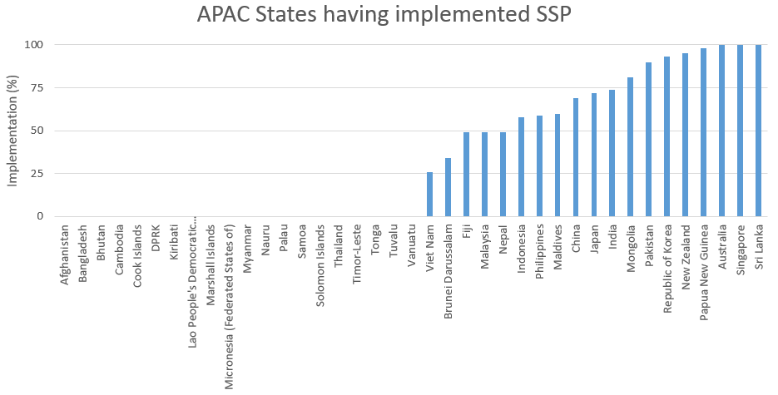
Aviation Safety
b) State Safety Programme (SSP)
Implement an effective SSP by 2025
iSTARS (SSP Gap Analysis - SMM 4th Ed.)

Slide 14
Aviation Safety
b) State Safety Programme (SSP)
Main challenges : DP8
Putting in place appropriate legislation and supporting mechanisms for the protection of safety data and safety information
Identifying appropriate safety performance indicators and targets
Addressing “commensurate with size and complexity” (scalability)
Properly managing interfaces between SSP and SMS, and between the SMS of service providers and between the SMS of service providers and other third party organizations
Identifying and addressing the safety management competencies needed across the organization

Slide 15
Aviation Safety
b) State Safety Programme (SSP)
Main challenges :
SSP requires coordination among multiple authorities responsible for the aviation functions of the State. Commitment by States Senior management
Some safety management activities require new competencies: conducting safety risk assessments, performing safety data analysis, evaluating SPIs … technical training
Limited resources to start and implement project. Establishing a suitable coordination group.

Slide 16
Aviation Safety
b) State Safety Programme (SSP)
Main challenges :
Enforcement policy that supports and encourages a positive safety culture. Applicable Service Providers to implement SMS
Relationship between a State and its Service Providers needs to evolve beyond just compliance and enforcement
Independent Accident Investigation group

Slide 17
Aviation Safety
b) State Safety Programme (SSP)
Recommendations : DP8
ICAO Regional office may promote more CAT missions for the post audit and post ICVM activities to improve State’s safety oversight capability in the below mentioned two phases:
Developing regulations, manuals, checklists and other guidance material;
Developing corrective action plans (CAPs) to address USOAP Findings;
Developing of SSP and National Aviation Safety Plans(NASP) in line with the GASP and GANP;
Drawing up of a pool of inspectors or experts.

Slide 18
Aviation Safety
b) State Safety Programme (SSP)
Recommendations : DP8
Providing training to inspectors;
Performing certification and surveillance tasks such as inspections, audits, or reviews, aeronautical studies, safety risk assessment, when so delegated and permitted by the State’s national Regulations.

Slide 19
Aviation Safety
b) State Safety Programme (SSP)
Recommendations :
Smaller States. Delegate some specific functions or tasks to another State, RSOO, or competent organization
Establish appropriate technical and administrative processes to ensure delegated functions are carried out… SSP implementation group within the CAA.
Ensure an effective Legislative framework with supporting specific operating regulations. RO assistance. Model SSPs. SMI website.

Slide 20
Aviation Safety
b) State Safety Programme (SSP)
Recommendations :
Use all available tools. iStars apps … State Safety Foundation, Gap analysis tools. SMS Manual interactive SMI resources.
Request targeted ICAO CAT (combined action teams) from RO BKK. Technical assistance including COSCAPs.
COSCAP capacity building matrix (SA developed)

Slide 21
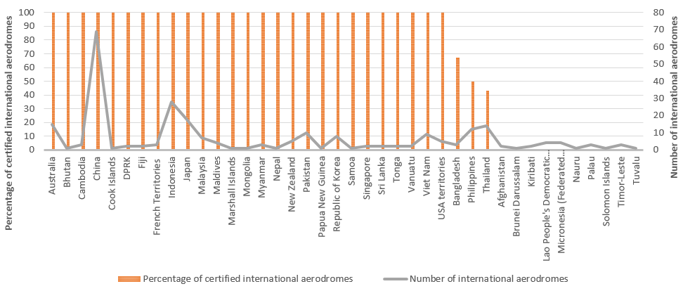
Aviation Safety
d) Certification of international aerodromes
Certify all aerodromes used for international operations by 2020
Aerodromes Operations and Planning Sub-Group (AOP/SG/3)
In January 2018, 83 % of aerodromes used for international operations were certified. Today it is 85%.

Slide 22
Outcomes of Break-out Session on Beijing Declaration Commitment on Aerodrome Certification at 55th DGCA Conference
Nadi, Fiji, 24 October 2018

Slide 23
Commitment on Aerodrome Certification
Establishment of an Aerodrome Certification Plan including:
Regulatory Framework
Qualified Technical Personnel
Certification of aerodromes with exemptions

Slide 24
Issue 1 – Regulatory Framework
Recommendation:
State (Ministry/CAA) | Promulgate effective Legislation and Regulations Ensure Procedures, Guidance Material and tools (inc. checklists, manuals) in place Consultation with Industry
Aerodrome Operator | Familiarity with Requirements and engagement with the Regulator Preparation of documentation Implementation of SMS
ICAO/COSCAPs/PASO/ IOs/Other Agencies | Monitor implementation (CMA and Missions) Provide assistance

Slide 25
Issue 2 – Qualified Technical Personnel
Recommendation:
State (Ministry/CAA) | Provision of high level commitment and sufficient budget Effective recruitment, training, qualification and retention programmes Request support from external organisations
Aerodrome Operator | Provision of sufficient budget Effective recruitment, training, qualification and retention programmes Request support from external organisations
ICAO/COSCAPs/PASO/IOs/ Other Agencies | Provision of training, technical assistance, and experts (in support of staff development or to support operational activities as delegated)

Slide 26
Issue 3 – Certification of aerodromes with exemptions
Recommendation:
State (Ministry/CAA) | Review, accept and enforce safety assessment mitigation measures for non-compliances (e.g. elimination of deficiency, operational restrictions, introduction of new procedures, training, etc.) Promulgate and implement runway safety programmes
Aerodrome Operator | Implement effective SMS and runway safety teams Conduct safety assessments for non-compliances Maintain compliance
ICAO/COSCAPs/ PASO/IOs/ Other Agencies | Provide assistance with the implementation of the mitigation measures Provide training and support

Slide 27
Action Item 42 of the 55th DGCA Conference
Recognising the Ministers’ commitment to certify all aerodromes used for international operations by 2020 through the Beijing Declaration, the Conference urged:
Aerodrome operators to prepare, apply for and maintain the certification for all aerodromes used for international operations;
States to establish an Aerodrome Certification Plan, in accordance with their national regulations, incorporating the identification of gaps and implementation of solutions to overcome those gaps, including the safety risk assessment and development of mitigation measures in areas of non-compliance, and allocate the necessary resources to implement the plan to meet the 2020 target;
States, if and when required, to request ICAO (Regional Office, COSCAPs, TCB and GAT) and PASO support for the implementation of the aerodrome certification plan of their respective States including training and technical assistance in aerodrome certification; and
International Organizations, Champion/Volunteer States, Industry and other Aviation Agencies to support States and aerodrome operators in the implementation of the Aerodrome Certification Plans.

Slide 28
Aviation Safety
d) Certification of international aerodromes
Main challenges :
States’ efforts – CAA and Airports
Aerodrome regulatory framework
Qualified aerodrome regulatory technical personnel
Joint use aerodromes
Certification with exemptions
Resolutions of major findings

Slide 29
Aviation Safety
d) Certification of international aerodromes
Recommendation:
States that have yet to certify aerodromes used for international operations to implement the Action 42 of the 55th DGCA Conference;

Slide 30
Accident Investigation
a) Independent accident investigation authority
PQ 6.005 (CE-1): Does the primary legislation provide for the independence of the investigation process and of the authority in charge of conducting aircraft accident and serious incident investigations?
PQ 6.101 (CE-3): Has the State established an investigation authority with a clear and documented structure and in a manner that ensures independence from State aviation authorities and other entities that could interfere with the conduct or objectivity of an investigation?
In accordance with the Chicago Convention, commit to establish an accident investigation authority that is independent from State aviation authorities and other entities that could interfere with the conduct or objectivity of an investigation or where appropriate develop a bilateral, sub-regional or regional partnership to support the establishment of accident investigation capabilities to serve the region or sub-region
iSTARS

Slide 31
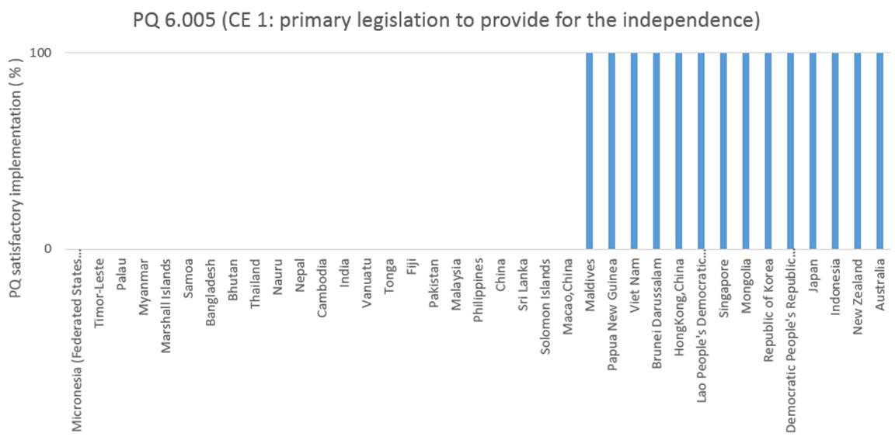
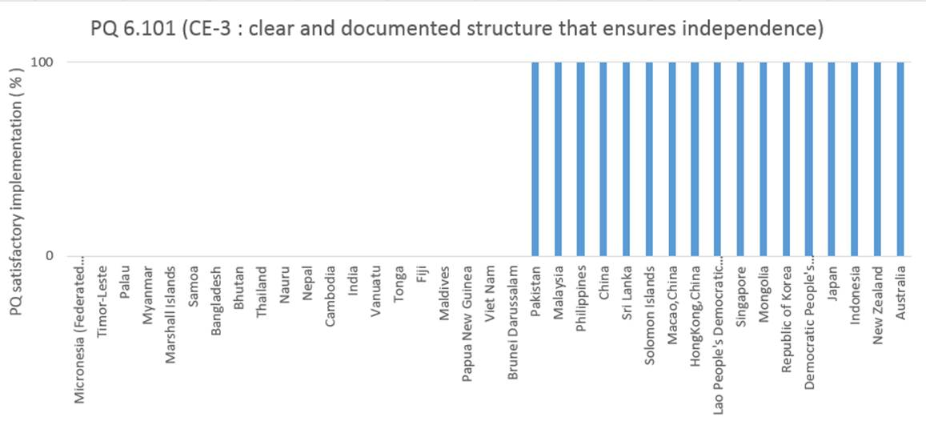
Accident Investigation
a) Independent accident investigation authority

Slide 32
Accident Investigation
a) Independent accident investigation authority
Main challenges :
Understanding the need to have a separate and independent AIG.
Training of investigators, especially in participation of actual accident investigation.
Providing adequate resources for an AIA considering the extreme and unpredictable operating environment.

Slide 33
Accident Investigation
a) Independent accident investigation authority
Recommendations :
Consider collaboration between States or establishing a RAIO.
Enhancing communications between AIAs to improve familiarity, collaboration and assistance amongst AIAs.
Establish a resource database of resources and equipment for possible sharing amongst AIAs.

Slide 34
Air Navigation Services
a) Aeronautical Information Management (AIM)
Phase I (Consolidation existing SARPS)
immediate implementation
current status = 73 % ( last year 71%)
Phase II (Going Digital)
target November 2019
current status = 40 % ( last year 35%)
Then Phase III (including SWIM, November 2025)
Transitioning from
AIS to AIM
by 2022
( Phase I and II )
AIS-AIM Implementation Task Force
(AAITF/13 & 14)

Slide 35
Air Navigation Services
a) Aeronautical Information Management (AIM)
Main challenges :
Poor understanding of the criticality of AIS to Air Navigation
Lack of understanding of the need for transition to the digital world (AIM)
Lack of organizational understanding/policy
They (regulator/ANSP/management) don’t listen to AIS
No law says airport operator – data originator have to comply

Slide 36
Air Navigation Services
a) Aeronautical Information Management (AIM)
Recommendations :
Develop Legislation and Regulation to cover ALL originators of aeronautical data and their interaction with the AIS
Funding to AIM is essential
Better education of senior management on the importance of AIS to AIM
Create a framework for AIM‐Go‐Teams

Slide 37
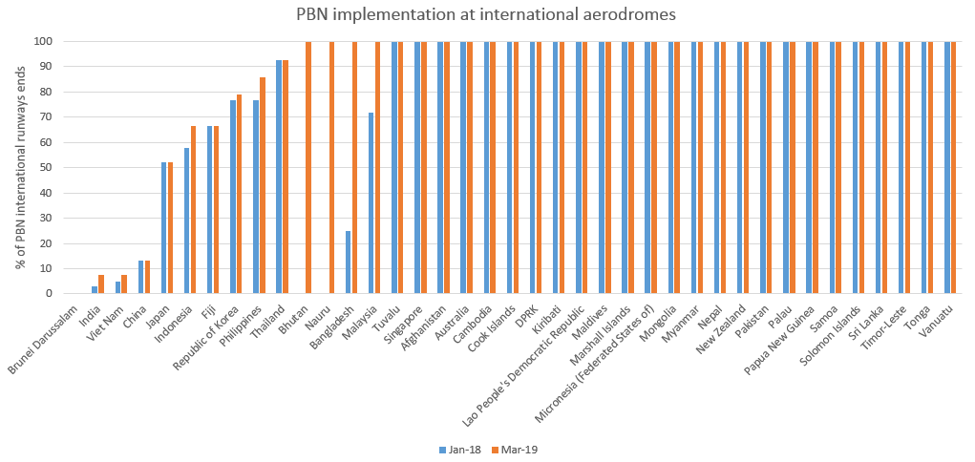
Air Navigation Services
b) Performance Based Navigation (PBN)
PBN implementation
by 2022
% PBN intl runway ends
iSTARS and Jeppesen (March 2019)

Slide 38
Air Navigation Services
b) Performance Based Navigation (PBN)
ICAO is focusing on Intl a/p but PBN can bring benefits to all a/p
Main challenges (PBNICG6):
Validation of instrument flight procedure, Flight validation, Charting, Obstacle survey
Operational approval, Safety assessment, PBN training for ATC especially on the mix of traffic

Slide 39
Air Navigation Services
b) Performance Based Navigation (PBN)
ICAO Recommendations :
Appoint a national coordinator
Update national regulatory material
Local meeting with all stakeholders
High quality aeronautical information is CRITICAL

Slide 40
Air Navigation Services
c) Ground telecommunication infrastructure
12 cities in 7 States/Administrations have implemented operations of the Common aeRonautical VPN private network (CRV): Australia, Fiji, Hong Kong China, Japan, New Zealand, Philippines and USA;
Singapore is currently conducting installation;
Republic of Korea signed service contract on 19 Aug.19;
Additional 5 States (Bhutan, China, PBN, Thailand and India) have plan to join CRV in 2019;
Another 3 States/Administration (France-New Caledonia and Polynesia, Indonesia and Malaysia) have plan to join CRV in 2020.
Common ground/ground telecommunication infrastructure to support ANS applications by 2022
CNS Meeting updates received
Notes:
Updated information was received on 19th August 2019 from PCCWG

Slide 41
Air Navigation Services
c) Ground telecommunication infrastructure
Main challenges :
It would be costly to keep both CRV and legacy circuits operational during the transition period. Some Administrations joined earlier are required to keep the traditional circuits with those partners who join CRV later;
Cost of benefit would be minimum for those States/Administrations with low traffic and least developed telecommunication Infrastructure.
Notes:
For those locations where the infrastructure or the traffic do not justify to establish new or additional Points of Presence (POPs) of PCCW Global, it might not challeging compaired to charges they pay today. However, harmonized ground/ground communication infrastructure for the Region is required to cope with new requirement.

Slide 42
Air Navigation Services
c) Ground telecommunication infrastructure
Recommendations :
The transition period to CRV from 2018 to 2020 should be harmonized as much as possible between stakeholders in order to achieve the benefits of CRV implementation; States/Administrations are urged to join CRV per Action Item 54/20 resulted from DGCA Conf/54;
work out practical solutions with the service provider and to achieve harmonized implementation with counterparts as much as possible.
Notes:
Although Beijing Declaration specify the date of implementation by 2022 with other identified items.
DGCA Conference called for early regional implementation by end of 2020 to cope with new requirements such as IWXXM format traffic requirement from November 2020.

Slide 43
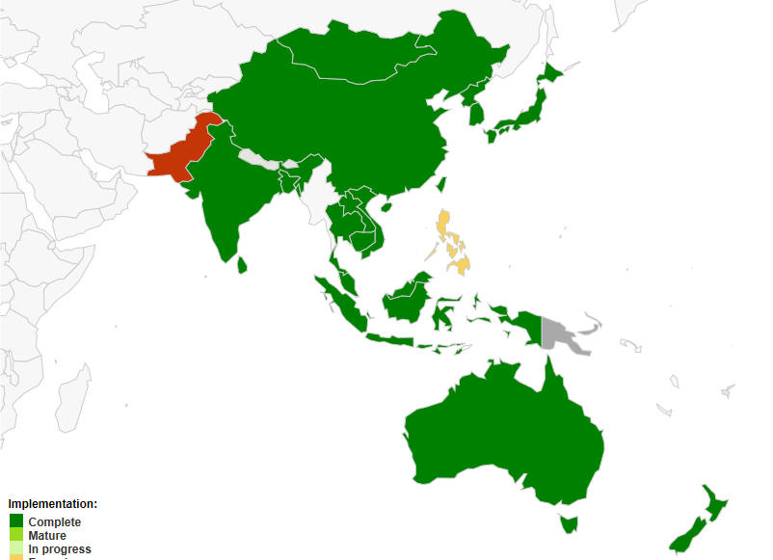
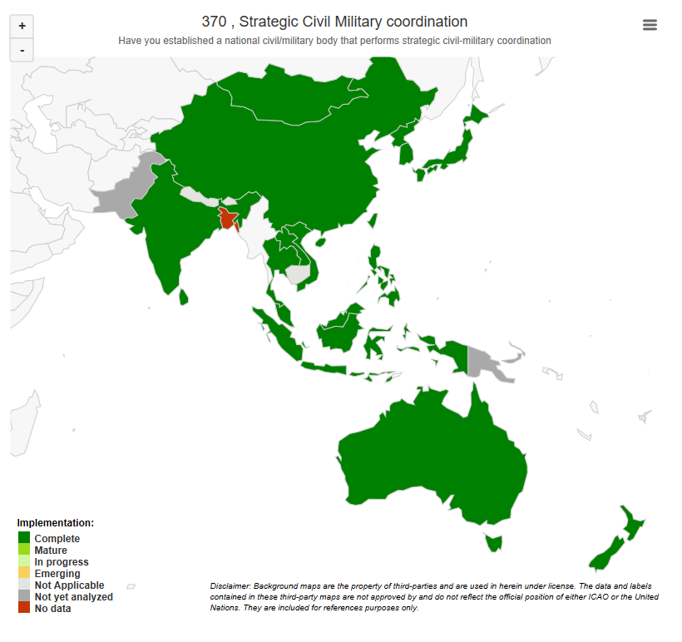
Air Navigation Services
d) Civil Military cooperation
An enhanced level of civil/military cooperation by 2020
Strategic and Tactical
Seamless ATM reporting
Given that lack of civil/military cooperation is a significant factor in the Asia/Pacific’s relatively poor ATM efficiency compared to more developed areas of the world, the regional progress is well behind expectation for these elements.

Slide 44
Air Navigation Services
d) Civil Military cooperation
Main challenges :
Diversified levels and needs in APAC Region
Lack of effective and efficient national mechanism
Military involvement is low
Absence of mechanism for regular meeting
Low degree of common training and procedures

Slide 45
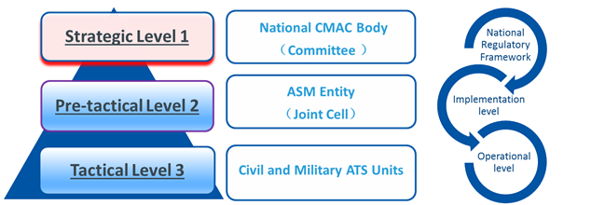
Air Navigation Services
d) Civil Military cooperation
Recommendations :
Strong political will to promote civil/military cooperation
Note-1: Please refer to ICAO Cir330-Civil and Military Cooperation in ATM, which will be upgraded to new ICAO Doc10088 later

Slide 46
Air Navigation Services
e) Surveillance capability
26 States/Administrations installed ADS-B ground stations and
10 States issued ADS-B mandate
4 States used ADS-B for separation and
others for awareness, gap filling and redundancy.
Enhanced surveillance capability including ADS-B technology by 2022
iSTARS / Seamless ATM reporting

Slide 47
Air Navigation Services
e) Surveillance capability
Main challenges :
Integration of ADS-B data into the ATM automation system for air traffic controllers and technical and operational training;
Conducting Safety case if it is used for separation even guidance is given;
Need to monitoring the performance of ADS-B avionics and sharing findings with solutions.

Slide 48
Air Navigation Services
e) Surveillance capability
Recommendations :
To mandate the equipage in the airspace in following up the APANPIRG’s conclusions to achieve benefits;
To participate in the SURICG and CNS SG meetings/activities and share the information on the experience gained and lesson learned on the implementation of ADS-B in the APAC Region.
Notes:
SURICG = Surveillance Implementation Coordination Group / CNSSG : COM/NAV/SUR Sub-group of APANPIRG

Slide 49
Air Navigation Services
f) Air Traffic Flow Management (ATFM) / Collaborative Decision Making (CDM)
Two indicators have been selected:
Number of international high density airports with Airport-CDM implemented, and
High density FIRs and FIRs supporting Major Traffic Flows and high density aerodromes with ATFM/CDM implemented
ATFM/CDM implementation for high density airports by 2022
Seamless ATM reporting (80), APAC A-CDM Implementation Survey and APA-CDM/TF/4 Meeting

Slide 50
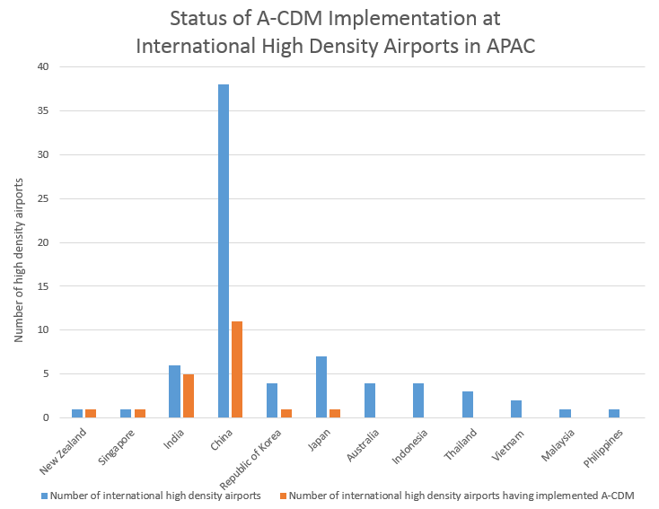
Air Navigation Services
f) Air Traffic Flow Management (ATFM) / Collaborative Decision Making (CDM)
Total number of international high density airports = 72
In Jan 2018, 15 of them had implemented A-CDM. Now, it is 20.
24 have planned to implement
A-CDM before end of 2020.

Slide 51
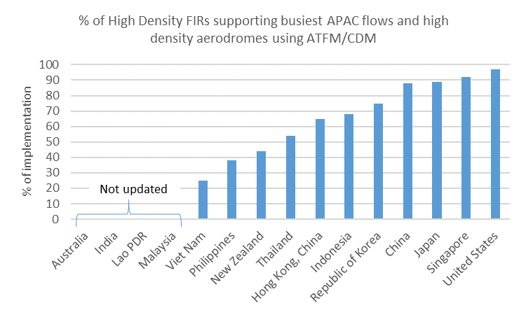
Air Navigation Services
f) Air Traffic Flow Management (ATFM) / Collaborative Decision Making (CDM)

Slide 52
Air Navigation Services
f) Air Traffic Flow Management (ATFM) / Collaborative Decision Making (CDM)
Main challenges :
ATFM/CDM
Harmonization of sub-regional ATFM initiatives
Traditional tactical ATC restrictions
Lack of information exchange (e.g. DEP message)
Lack of Post Operations Analysis
A-CDM
Local constraints and requirements
Harmonization of A-CDM process and/or operation

Slide 53
Air Navigation Services
f) Air Traffic Flow Management (ATFM) / Collaborative Decision Making (CDM)
Recommendations :
ATFM/CDM
Increase capacity is fundamental necessity
Reform: from traditional tactical ATC restrictions to ATFM
Post Operations Analysis is essential for better ATFM
A-CDM
Harmonized implementation process and/or procedures
Integration with ATFM

Slide 54
Air Navigation Services
g) National Air Navigation Plan
Few States have reported to the Regional Office having developed a National Air Navigation Plan (NANP) :
Indonesia, Lao PDR, Hong Kong (China), Singapore, Thailand, Myanmar, Vietnam and Philippines.
Include air navigation in national planning frameworks such as National Development Plans (NDPs) supported by National Air Navigation Plans by 2022
Survey in 2019

Slide 55
Air Navigation Services
g) National Air Navigation Plan
Recommendations :
Use the template provided at the last ATM/SG

Slide 56
rguillet@icao.int

