Slide 1


Electronic Aviation Safety Tool: SMIS
SARPs Management & Implementation System
Danielle MinJoo CHUNG

Slide 2
Contents
Ⅰ. Introduction to SMIS
Ⅱ. Background: IT Development Cooperation
Ⅲ. Progress of Development
Ⅳ. Assistance Information

Slide 3
Introduction to SMIS
Ⅰ

Slide 4

Introduction to SMIS
SARPs Management &
Implementation System: SMIS
SMIS is:
a Web-Based system designed for Civil Aviation Authorities(CAAs) to manage overall frameworks in compliance with ICAO Standards and Recommended Practices(SARPs);
a Comprehensive tool for managing all required data for preparation of USOAP CMA activities with data exchange module between ICAO OLF and SMIS;
a) Compliance Checklists (CC);
b) State Aviation Activity Questionnaire(SAAQ); and
c) Protocol Questions(PQ);
an effective and efficient tool to process ICAO state letters;
4

Slide 5




Introduction to SMIS
Main Features
SMIS enables timeline management of the ICAO state letters and archiving the them for records purpose.
State Letter
Inter-connectivity with ICAO OLF & SMIS allows the most effective management of SARPs data.
(Data exchange with ICAO OLF)
SARPs
Regulation menu is to manage your national aviation regulation data. it can be referred when you working on implementing international Standard.
Regulation
SAAQ data for USOAP-CMA can be managed more conveniently with SMIS.
(Data exchange with ICAO OLF)
SAAQ
PQ data can be monitored continuously by each personnel in charge in your CAA.
(Data exchange with ICAO OLF)
PQ
5

Slide 6

Introduction to SMIS & SOMS
Data Exchange Module in Brief
6

Slide 7
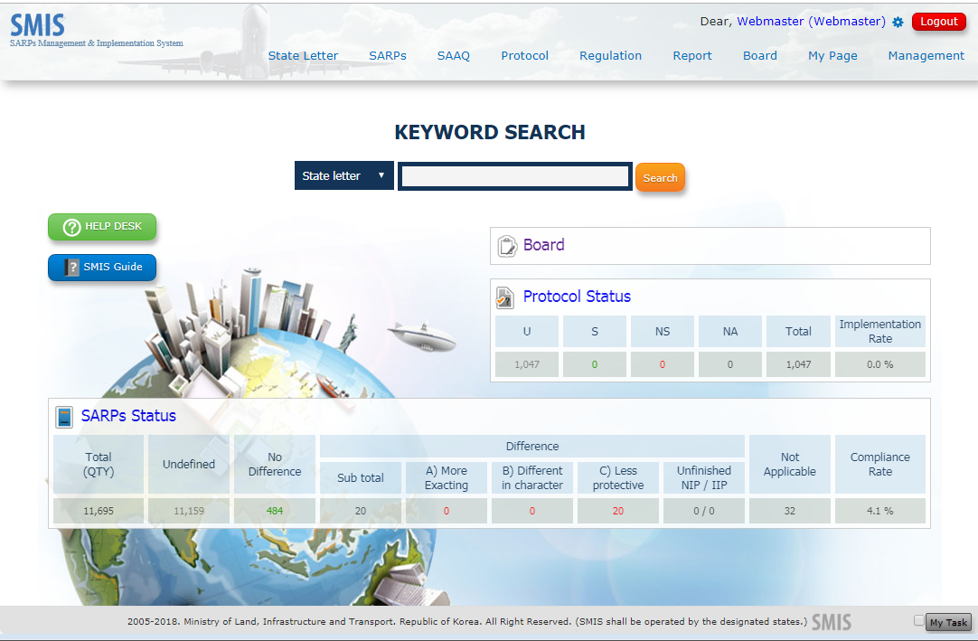
Introduction to SMIS
SMIS Trial
Main page of SMIS
7

Slide 8
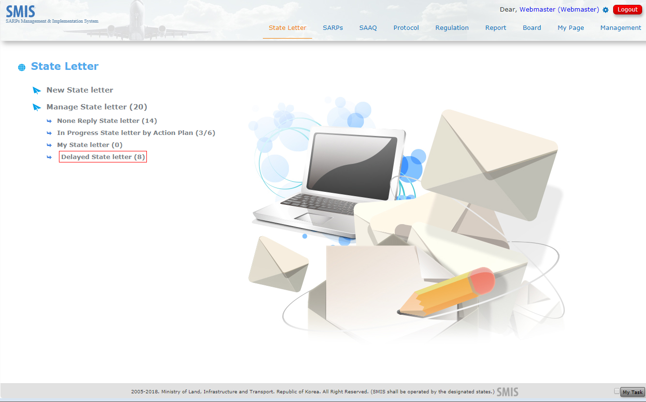
Introduction to SMIS
SMIS Trial – State Letter
8

Slide 9
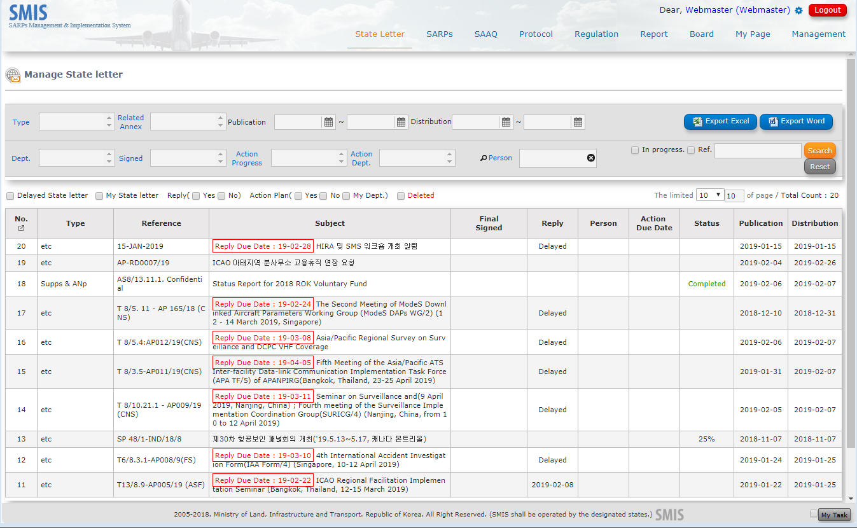
Introduction to SMIS
SMIS Trial – State Letter
9

Slide 10
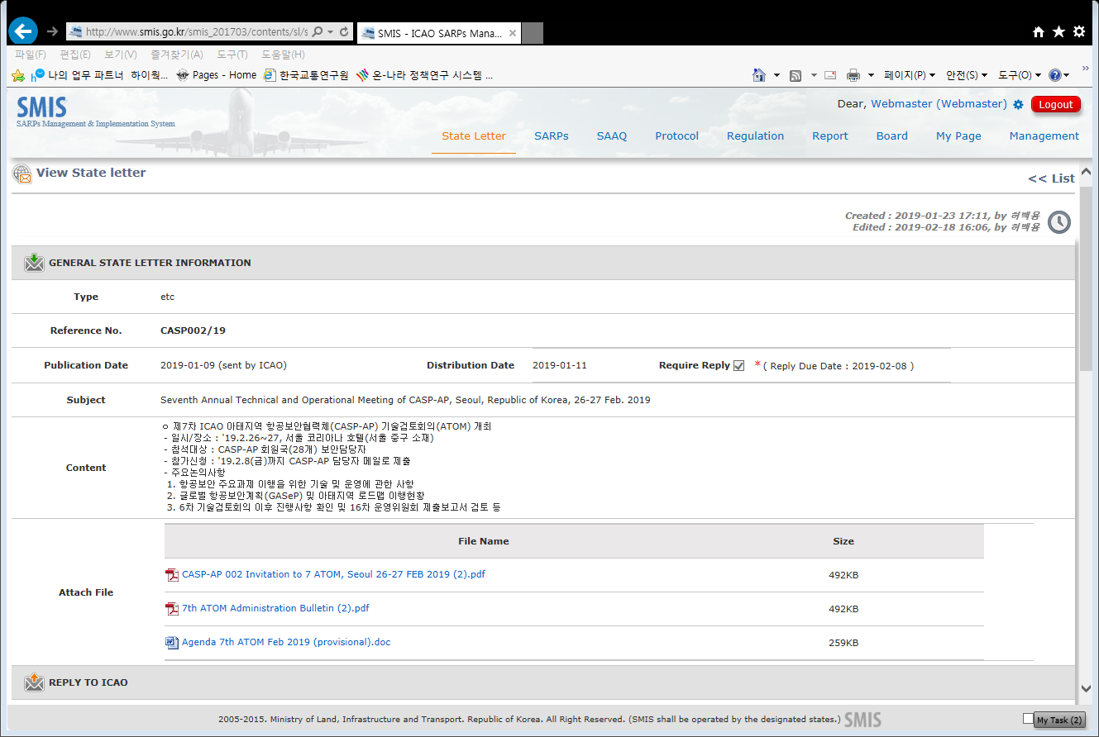
Introduction to SMIS
SMIS Trial – State Letter
10

Slide 11
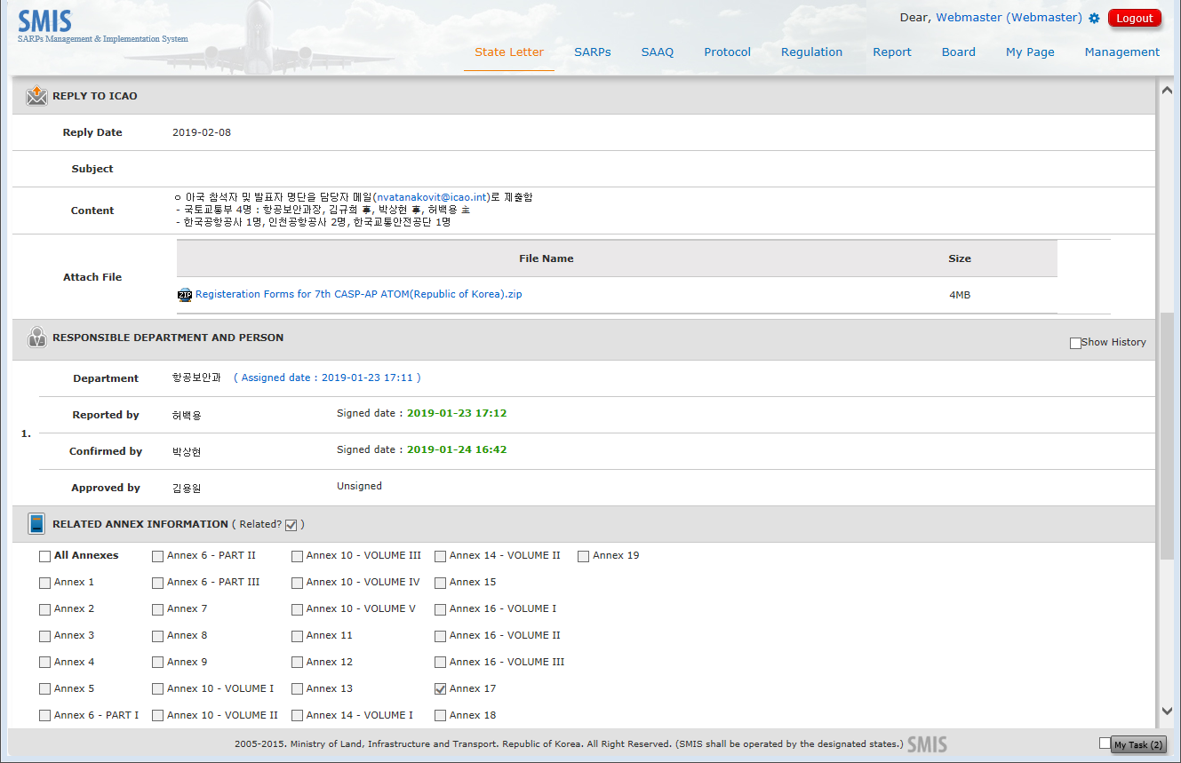
Introduction to SMIS
SMIS Trial – State Letter
11

Slide 12
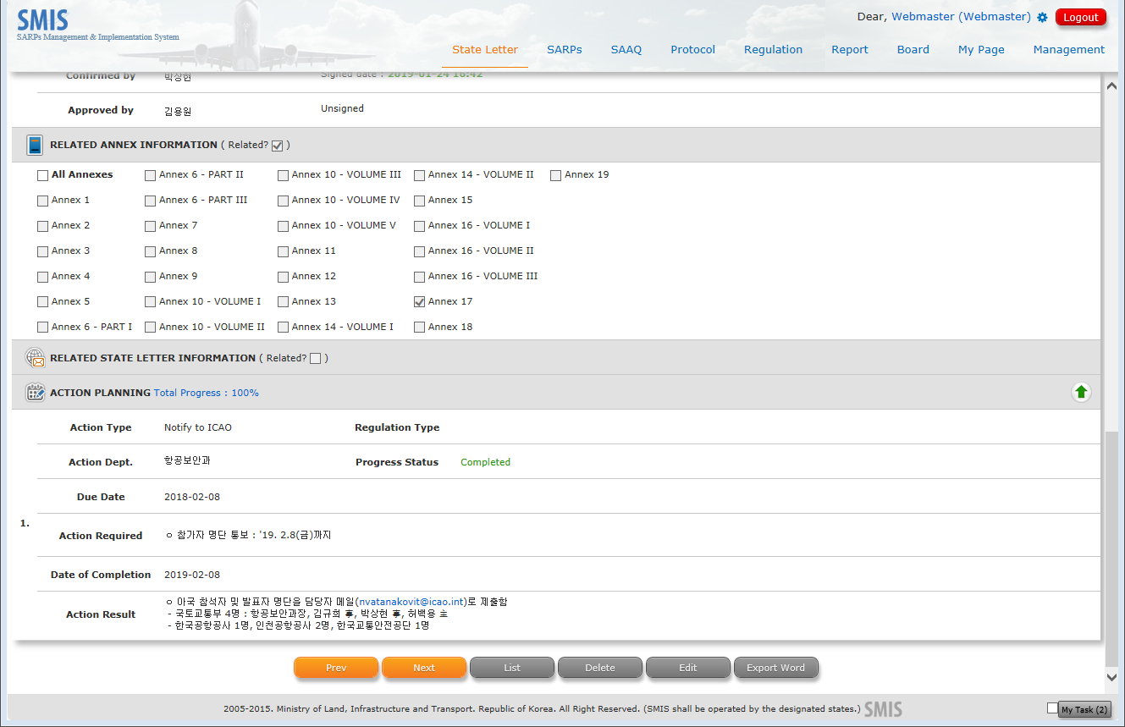
Introduction to SMIS
SMIS Trial – State Letter
12

Slide 13
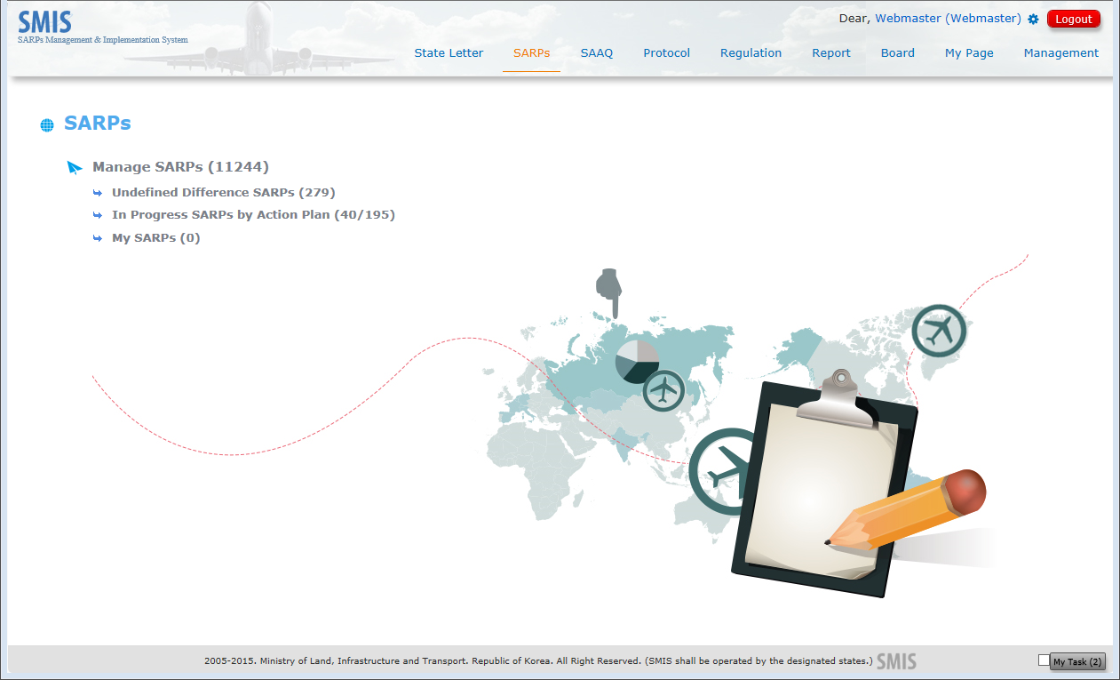
Introduction to SMIS
SMIS Trial - SARPs
13

Slide 14
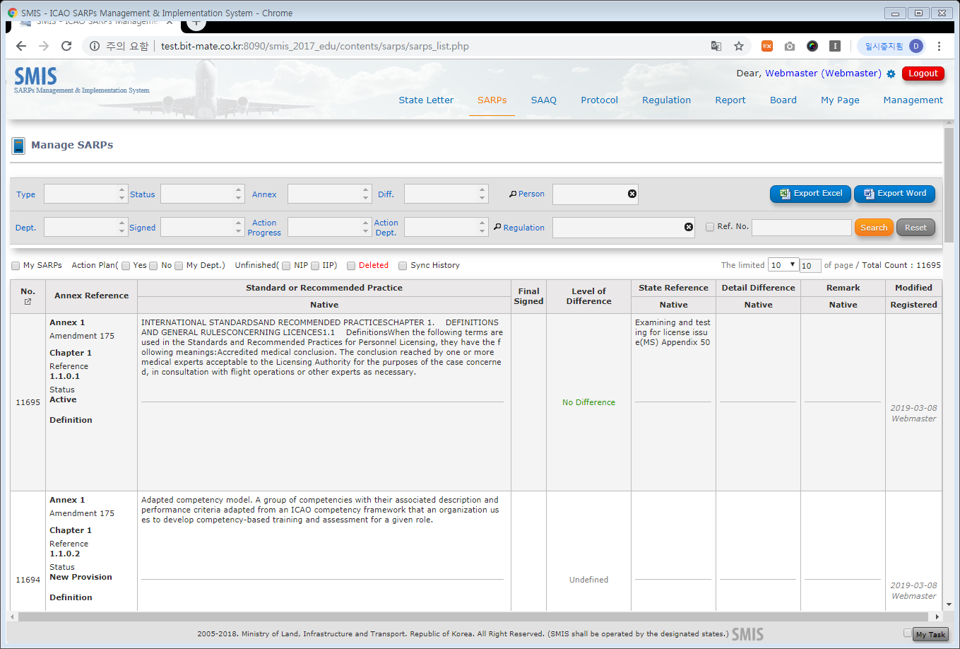
Introduction to SMIS
SMIS Trial - SARPs
14

Slide 15
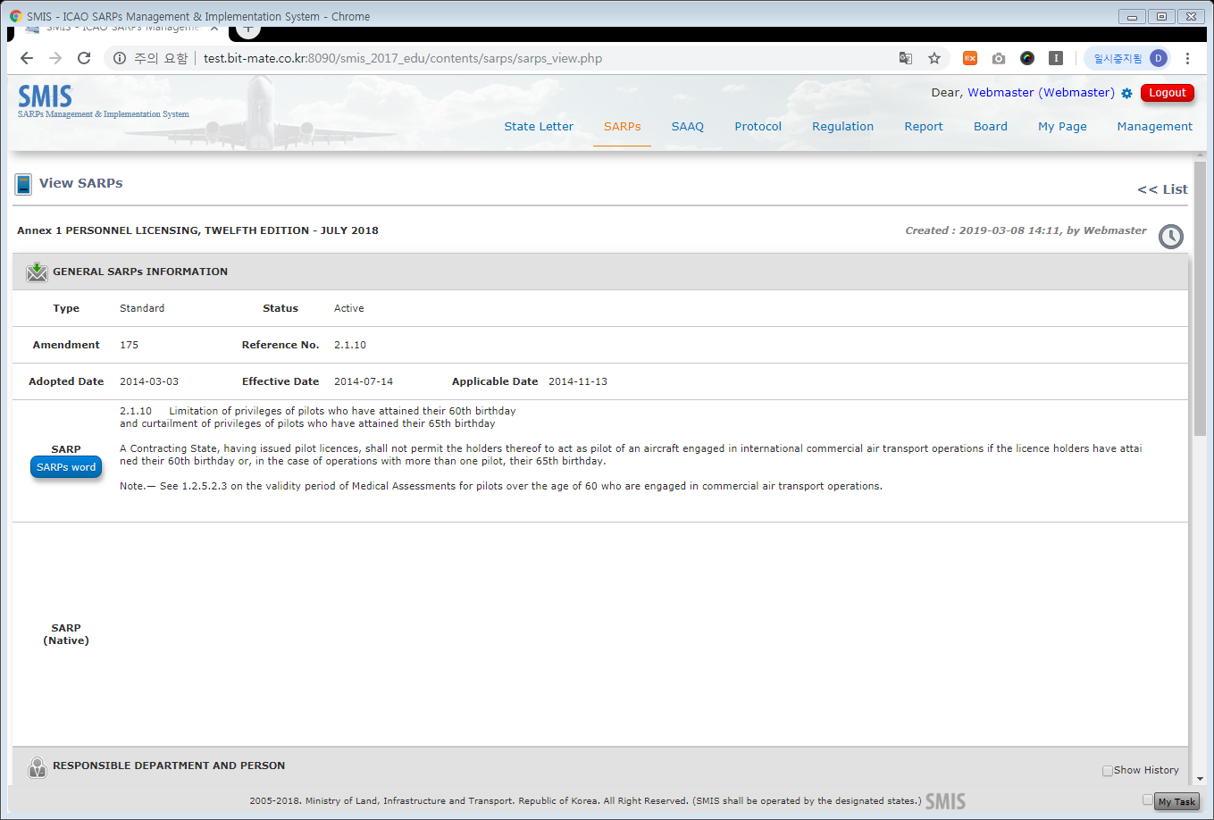
Introduction to SMIS
SMIS Trial - SARPs
15

Slide 16
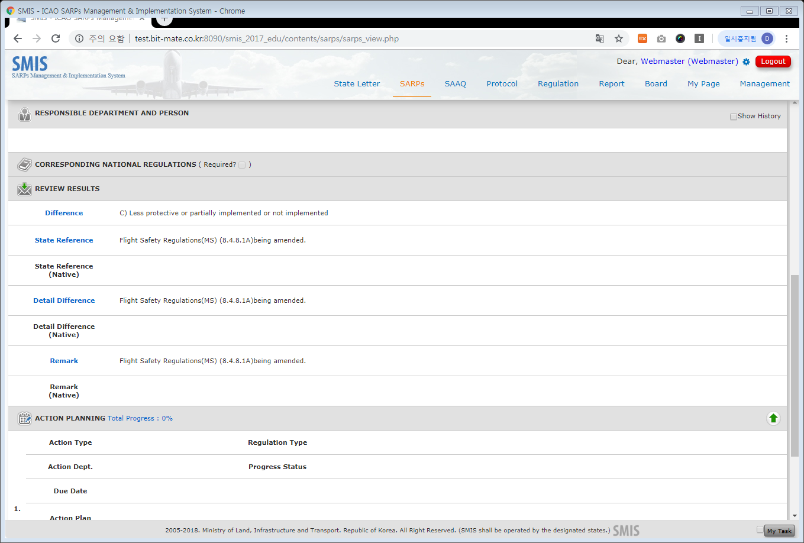
Introduction to SMIS
SMIS Trial - SARPs
16

Slide 17
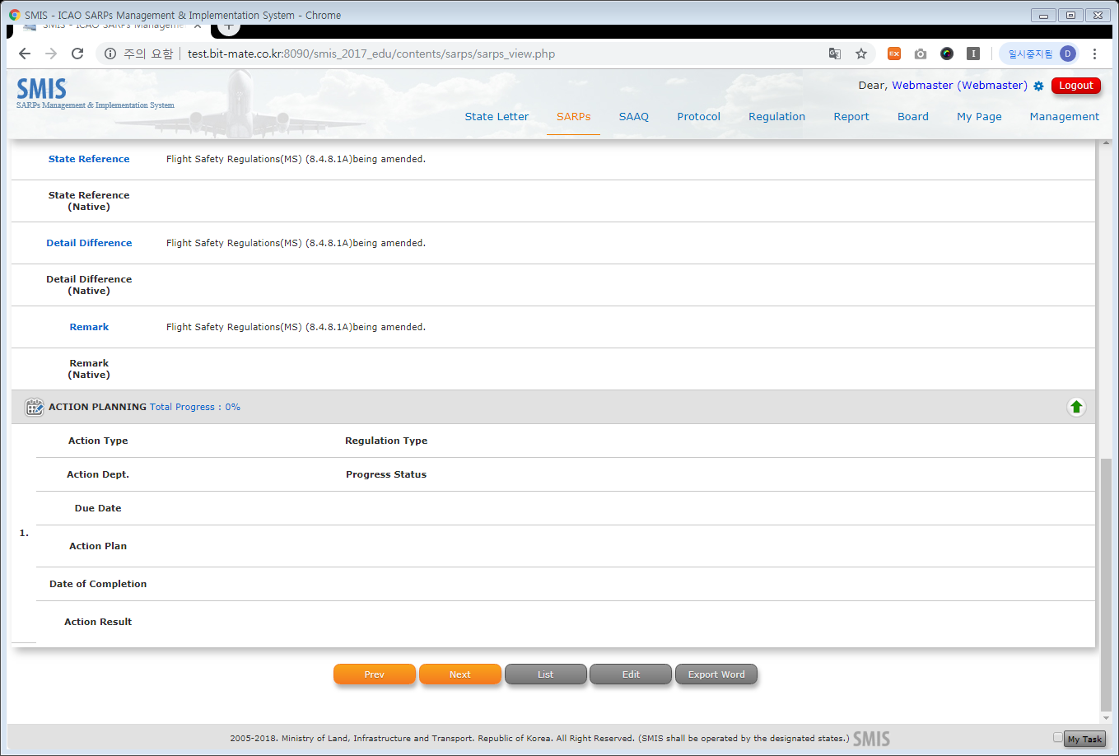
Introduction to SMIS
SMIS Trial - SARPs
17

Slide 18
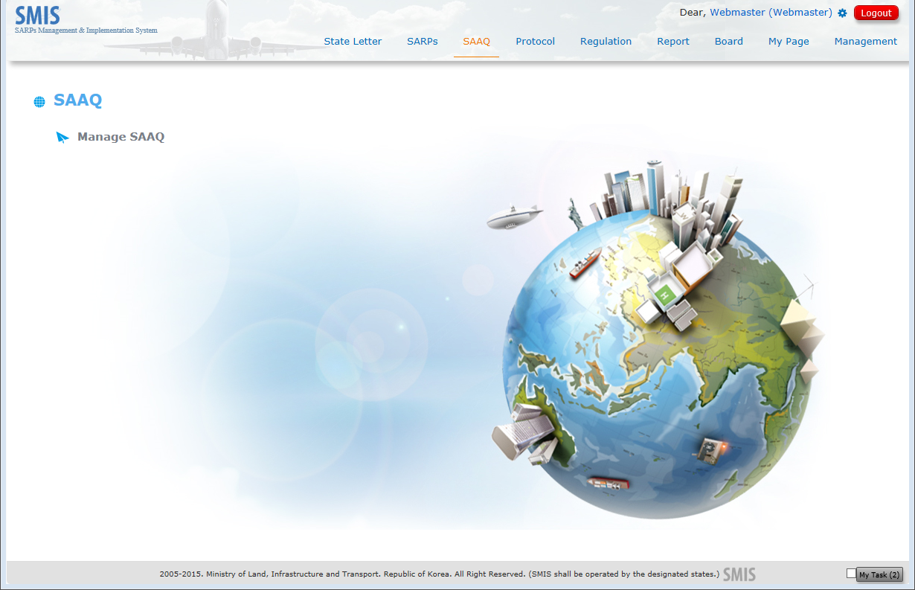
Introduction to SMIS
SMIS Trial - SAAQ
18

Slide 19
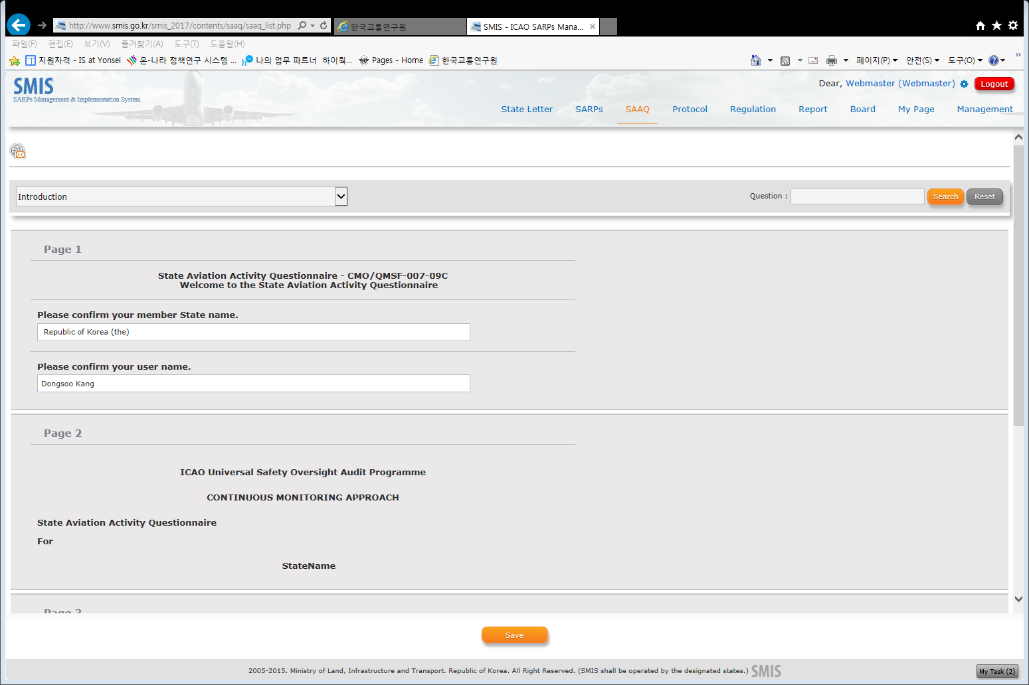
Introduction to SMIS
SMIS Trial - SAAQ
19

Slide 20
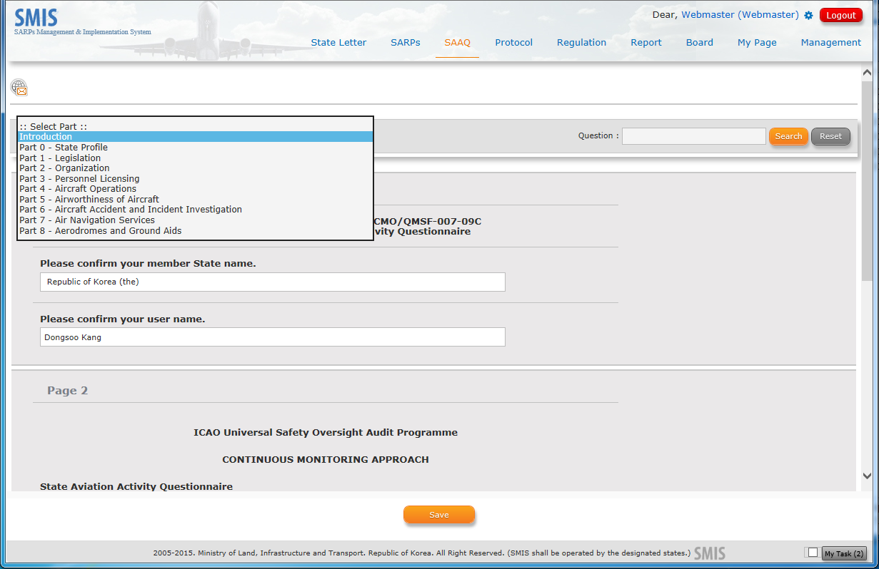
Introduction to SMIS
SMIS Trial - SAAQ
20

Slide 21
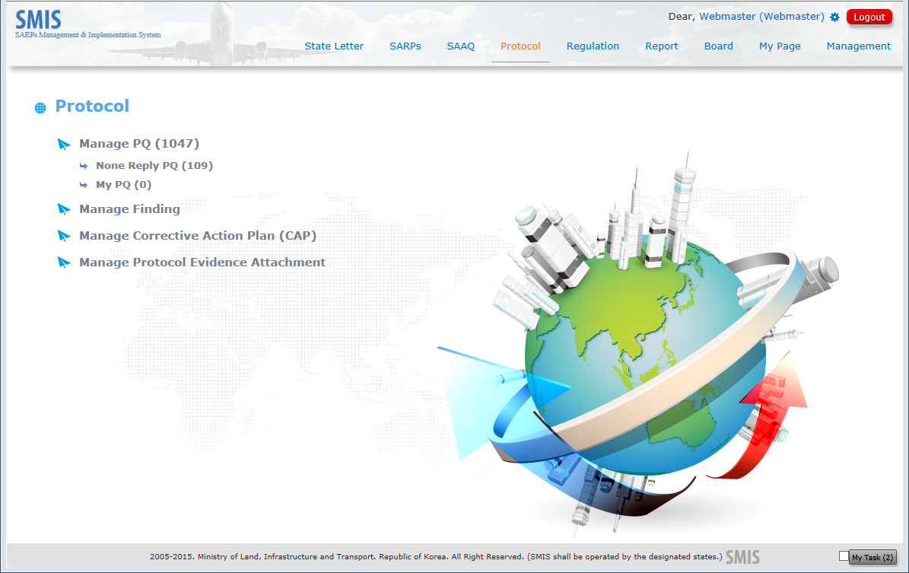
Introduction to SMIS
SMIS Trial - PQs
21

Slide 22
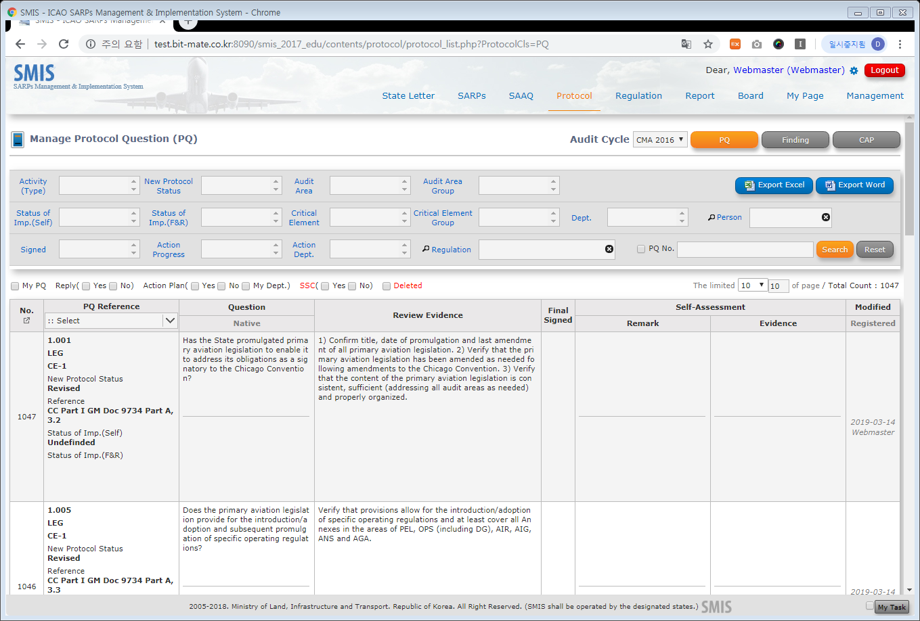
Introduction to SMIS
SMIS Trial - PQs
22

Slide 23
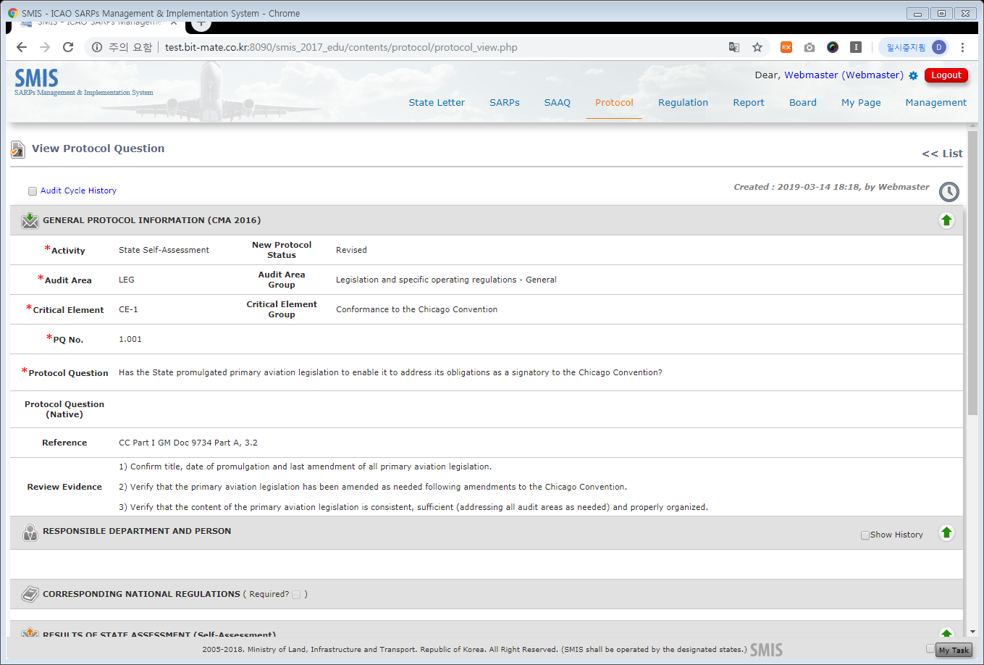
Introduction to SMIS
SMIS Trial - PQs
23

Slide 24
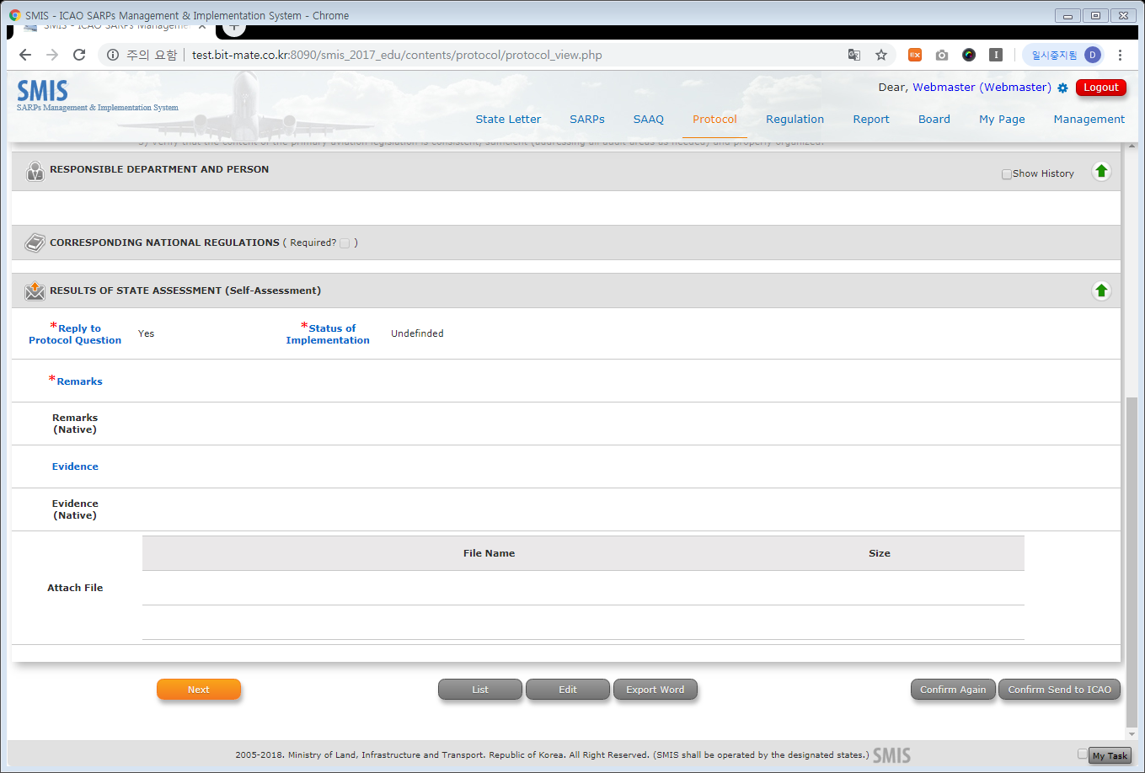
Introduction to SMIS
SMIS Trial - PQs
24

Slide 25
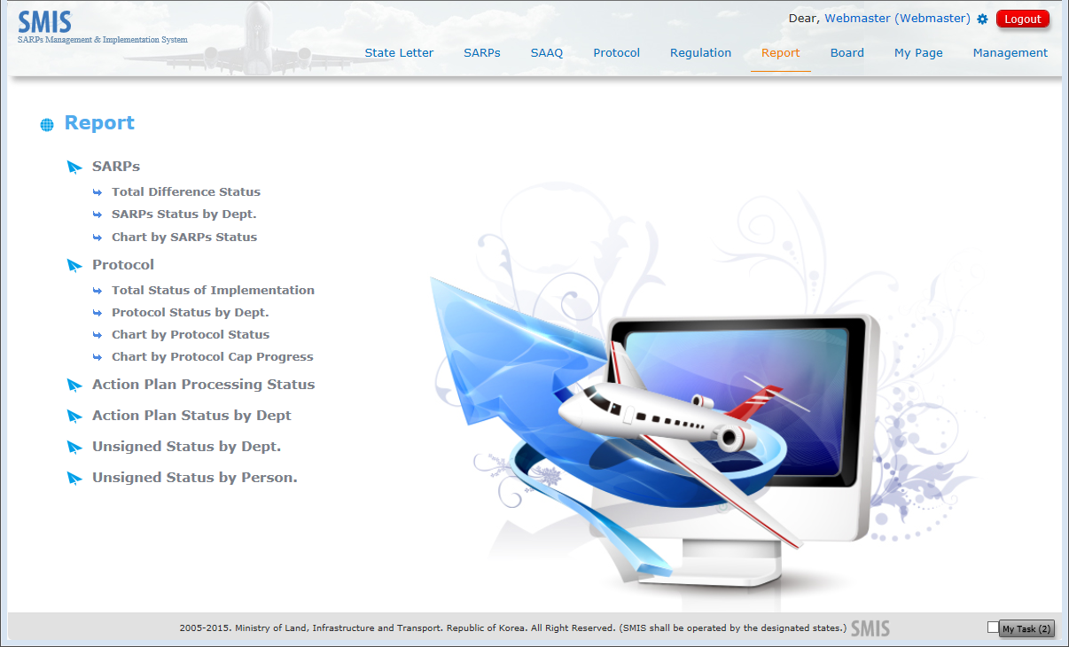
Introduction to SMIS
SMIS Trial - Report
25

Slide 26
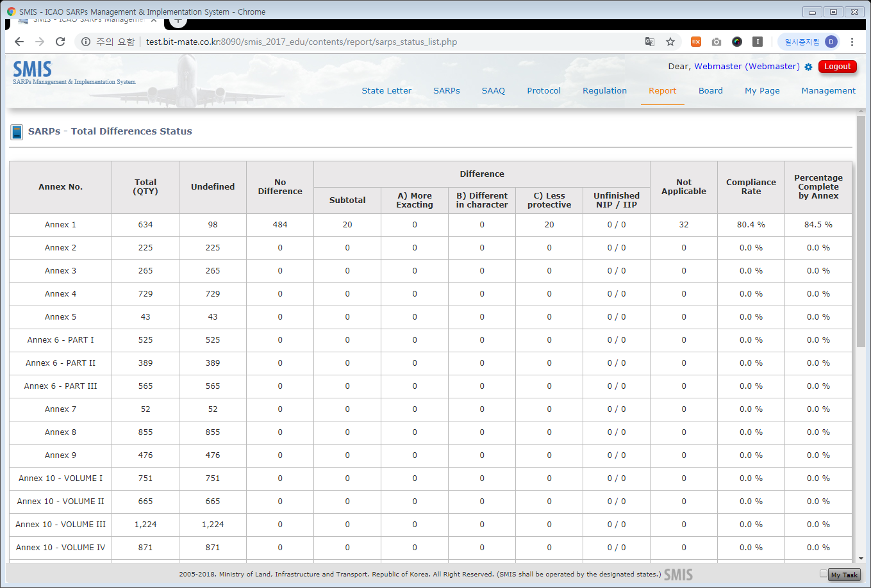
Introduction to SMIS
SMIS Trial - Report
26

Slide 27
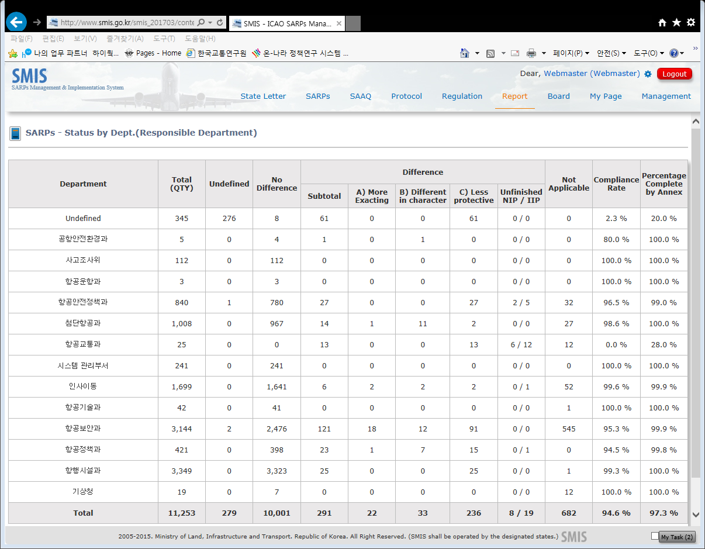
Introduction to SMIS
SMIS Trial - Report
27

Slide 28
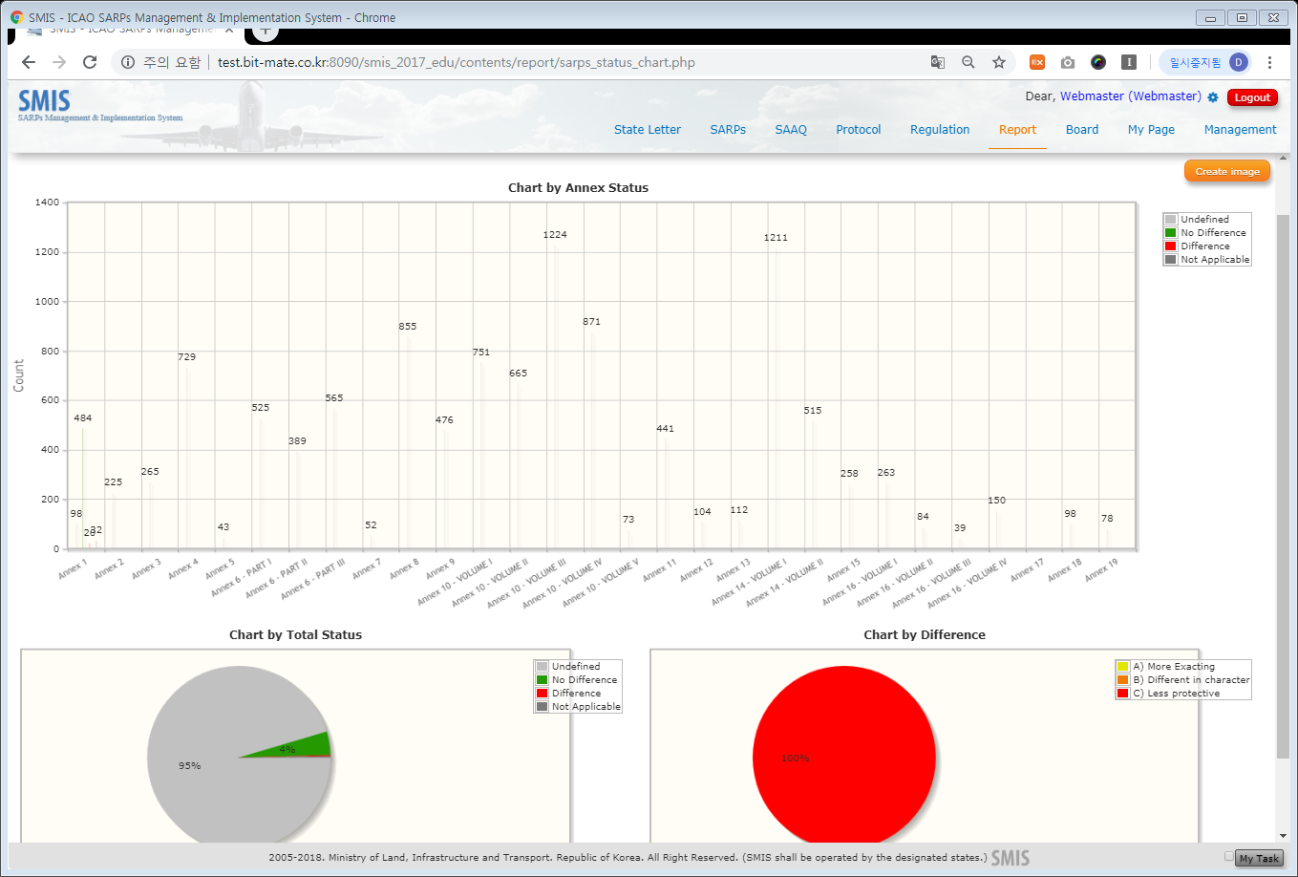
Introduction to SMIS
SMIS Trial - Report
28

Slide 29
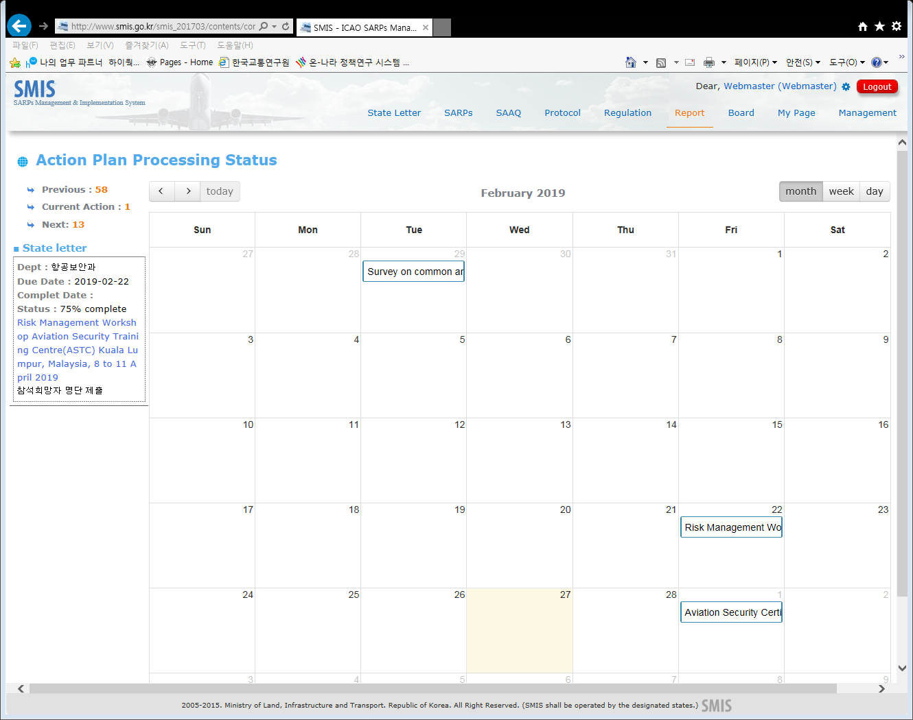
Introduction to SMIS
SMIS Trial - Report
29

Slide 30
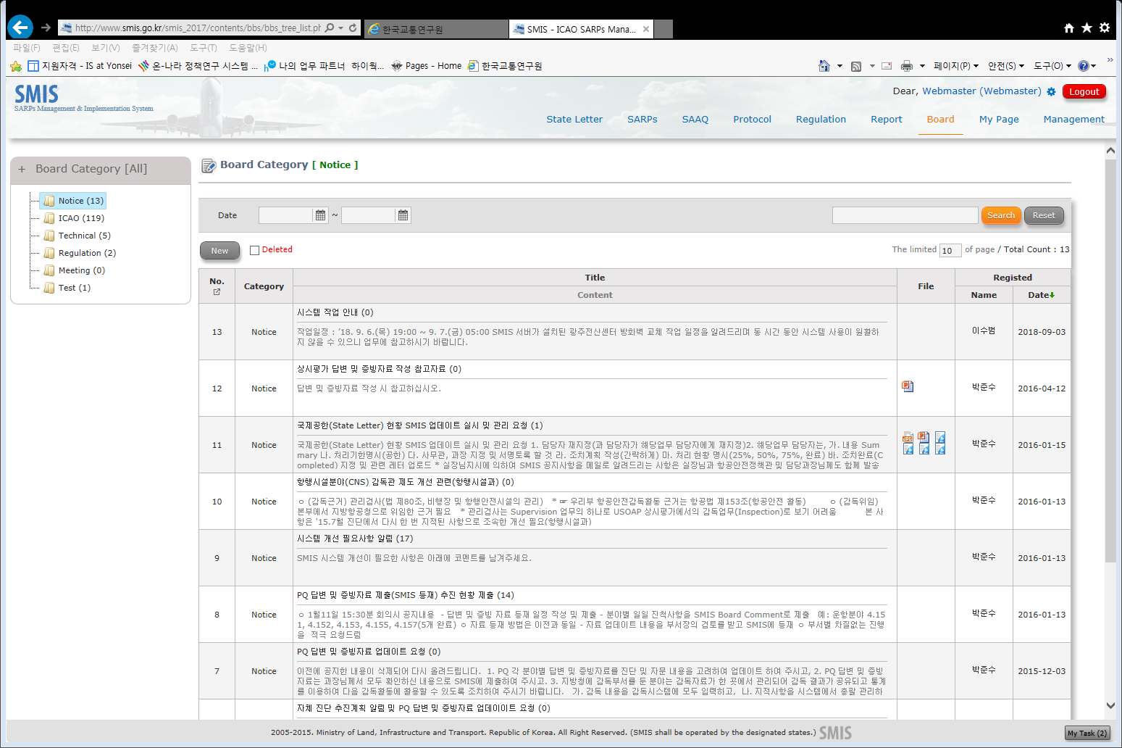
Introduction to SMIS
SMIS Trial - Board
30

Slide 31







Introduction to SMIS & SOMS
Data Exchange Module
Connect OLF Data to SMIS Server
Review Data
Sync Data
Complete
ICAO Server
ICAO Server
ICAO OLF
ICAO OLF
SMIS Server
SMIS Server
SMIS Server
SMIS Server
SMIS
SMIS
SMIS
SMIS
31

Slide 32
Introduction to SMIS & SOMS
Data Exchange Module
Connect SMIS
Data to ICAO OLF
Review Data
Confirm Data
Complete
ICAO Server
ICAO Server
ICAO Server
ICAO Server
ICAO OLF
ICAO OLF
ICAO OLF
ICAO OLF
SMIS Server
SMIS Server
SMIS
SMIS
32

Slide 33
Background: IT development Cooperation
Ⅱ

Slide 34
Background: IT Development Cooperation
Global IT Cooperation
In, 2005
Korea Office of Civil Aviation(KOCA) developed the software(SMIS) to alleviate their work. The SMIS has been launched in 2006, and it has shown its effectiveness.
In, 2009
KOCA began to promote and share the SMIS with member states who are interested in, and planned for next phase of upgrade
In, 2013
KOCA developed data exchange module with ICAO OLF(Completed in 2016), It lead much conveniences for users.
34

Slide 35

Background: IT Development Cooperation
Co-development with ICAO
ICAO Online Framework
Aircraft Registration Network
KOCA volunteered to participate in co-
developing ICAO OLF at the 37th ICAO
Assembly. KOCA is still co-developing
ICAO OLF with ICAO since 2011.
ARN is new project planned in 2019. The recognized for technical competence
based on OLF co-developing made us to have another honour to participate ICAO co-developing project once again.
35

Slide 36
Progress of Development
Ⅲ

Slide 37


Background: IT Development Cooperation
History
Initiated development of ‘TOMS’
Released English version of ‘SMIS’
Opened helpdesk webpage service to assist member states using SMIS and TOMS
Initiated development of Korean version of ‘SMIS; SARPs Management & Implementation System’
ENG Ver. of SMIS
Developed ‘TOMS’
Developed ‘SMIS’
2009
2006
2010
2011
Distribution
2012
SMIS for CMA
TOMS to SOMS
Data Exchange Module
(Phase 1)
Made SMIS&TOMS package(English version, CD, manual etc. included) and distributes to member states.
Renewed TOMS to SOMS
Updated SMIS for preparing for ICAO USOAP CMA
Continued distribution and started remote assistance
Released Promotion Video and brochure
Initiated development of Data Exchange module with ICAO OLF
1st workshop for SMIS and SOMS for 12 member states in Korea
37

Slide 38

Background: IT Development Cooperation
History
Upgrade ICAO OLF-SMIS data exchange module upon ICAO OLF’s upgrade
Develop Attachment Management function
Stabilized Data Exchange Module between ICAO OLF and SMIS
Alert service for SMIS duty assignment
Data Exchange Module
(Phase 3)
Advanced SMIS
2016
2017
2018
SMIS JAVA service
Developed with Java service
Upgraded ICAO OLF-SMIS data exchange UI
Renewed Helpdesk UI
Alert service for SOMS duty assignment
2014
Data Exchange module
(Phase 2)
Upgrade SMIS & SOMS
Developed Data exchange module between ICAO OLF and SMIS
Developed Data exchange module between ICAO FAOSD and SOMS
38

Slide 39
Assistance Information
Ⅳ

Slide 40


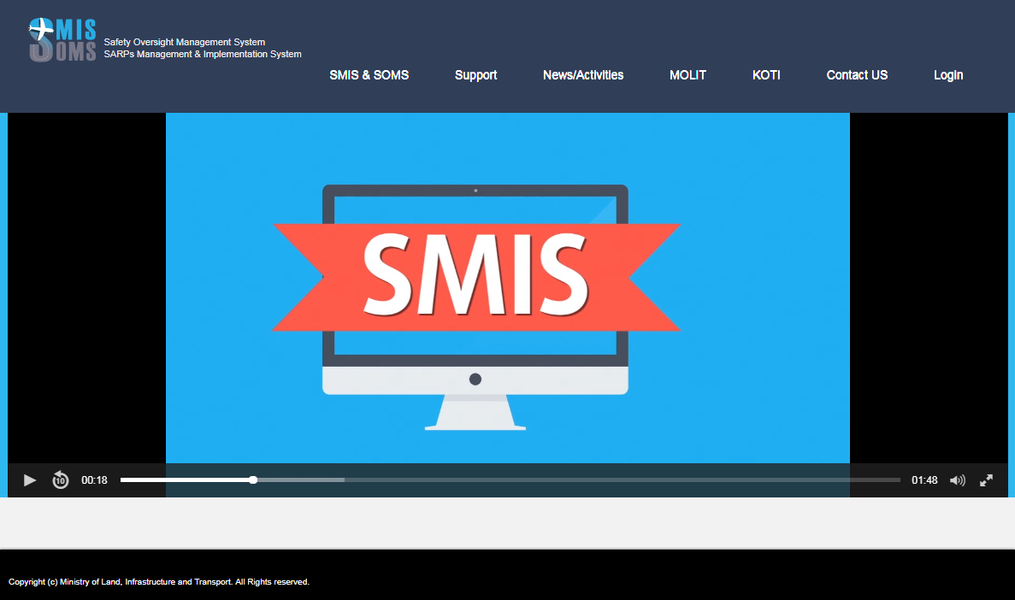




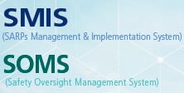


Background: IT Development Cooperation
Application
How to apply for SMIS & SOMS?
State A
Access to SMIS Helpdesk webpage(www.kocahelp.com) and download the application
Fill in the application and email
the copy smishelp@smishelp.com
You will be able to receive the SMIS&SOMS download link from smishelp@smishelp.com
Once KOCA authorise
the release of SMIS&SOMS,
KOCA review the application.
It can take few days in case.
40

Slide 41
Background: IT Development Cooperation
On-site Workshop
We provide on-site workshop upto two or three times a year since 2016.
SMIS workshop had been held in following countries; Ghana(2016), Cambodia(2016), Mongolia(2017), Indonesia(2017), Turkey(2018)
COSCAP-SEA Workshop(2019),
ICAO Pacific Member States Workshop(2019)
Member States held SMIS workshops
Republic of Korea
41

Slide 42

Assistance Information
Technical Assistance
Remote Assistance
The SMIS&SOMS Technical Support Team is providing Remote assistance with ‘Chrome Remote Desktop’
The Created PW from Chrome Remote Desktop is available only once, it will be no longer available after the disconnection of the access.
Data
Safety
Connectivity
You can watch all process what the technician doing on your computer or server while the technician is working on .
If you do not want remote assistance any more, or if you see any suspicious action during assistance you can just disconnect the access by one clicking any time.

Slide 43



Have your say
Assistance Information
HELPDESK
For more Enquiries, Tutorials, Workshops, Technical Issues, Please Do Not Hesitate to Contact Us;
Homepage: www.kocahelp.go.kr
Email: smishelp@smishelp.com
Tel: +82-(0)44-211-3039

Slide 44
Thank you

