Slide 1

ICAO Frequency Finder Updates
SIXTH MEETING OF SPECTRUM REVIEW WORKING GROUP (SRWG-06)
2 March 2022
Fabiola Chouha – ICAO

Slide 2


About the Frequency Finder tool
How did it all start?
How was it developed?
What does it do?
Calculation of interference areas, assessing compatibility between frequency assignments /searching for compatible II /SI codes
Frequency Finder has been developed with FileMaker 13 Pro Advanced
.
Implementation of Frequency assignment planning criteria
Visualize Mapping
Graphical interface with Google Earth
Plotting interference
as per the ICAO Handbook
on Radio Frequency Spectrum Requirements, Volume II

Slide 3
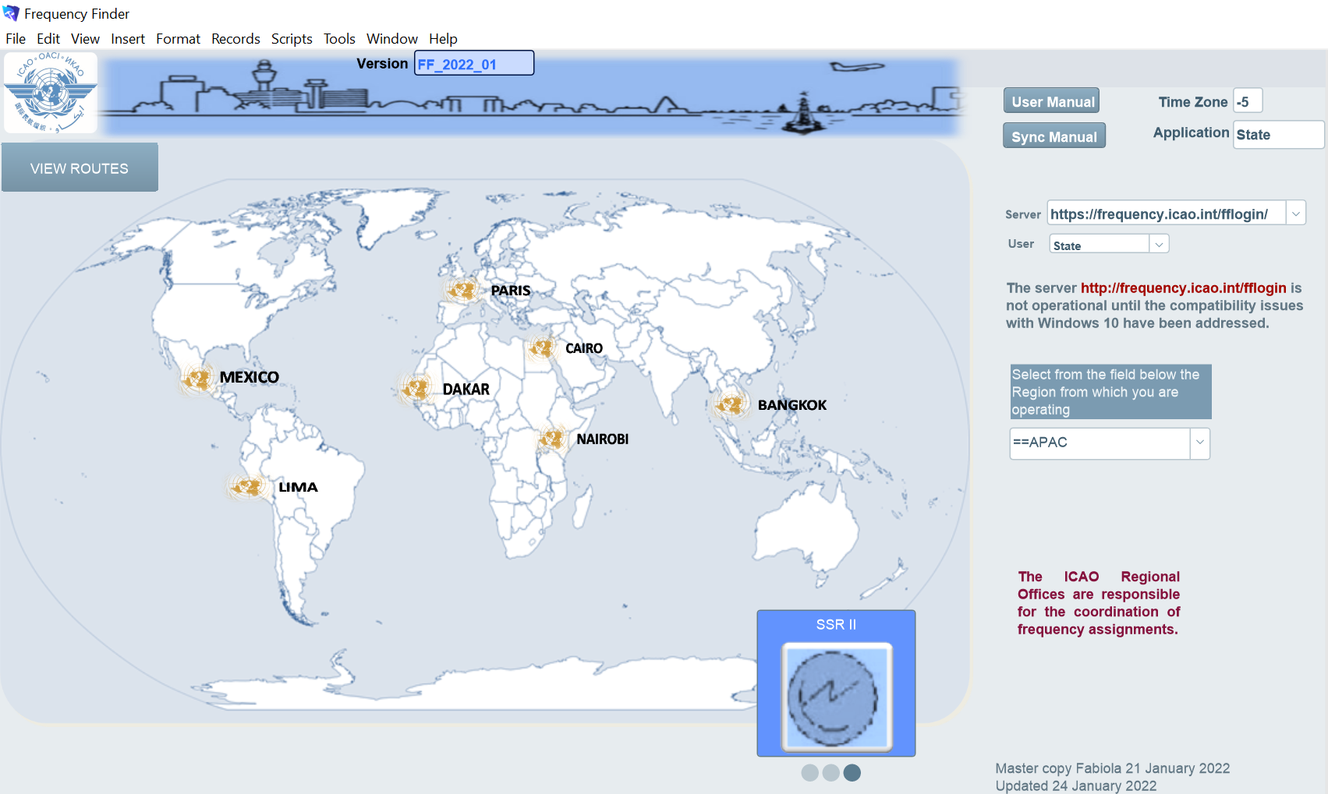


Start page of Frequency Finder
Selection of Modules

Slide 4

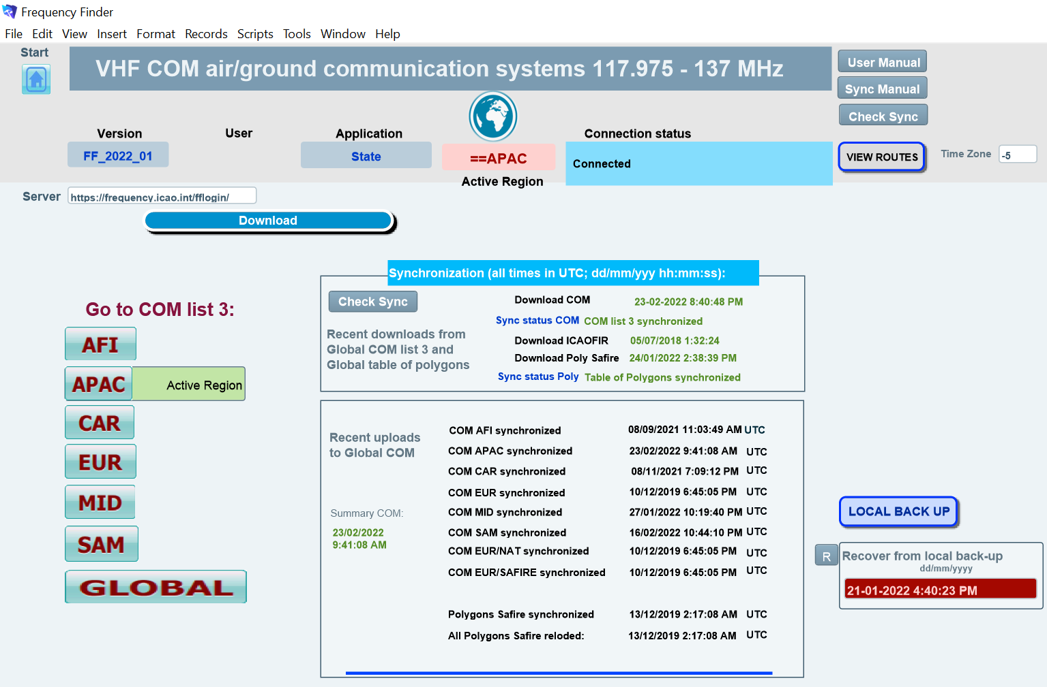
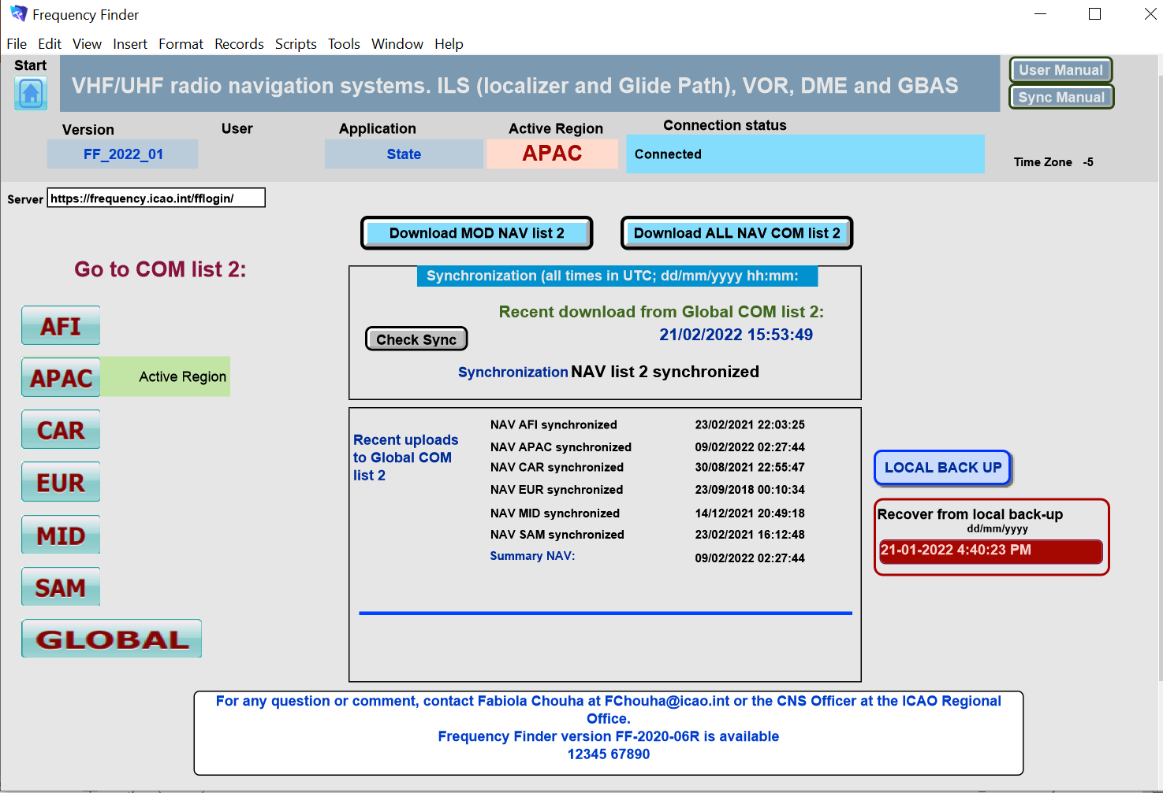
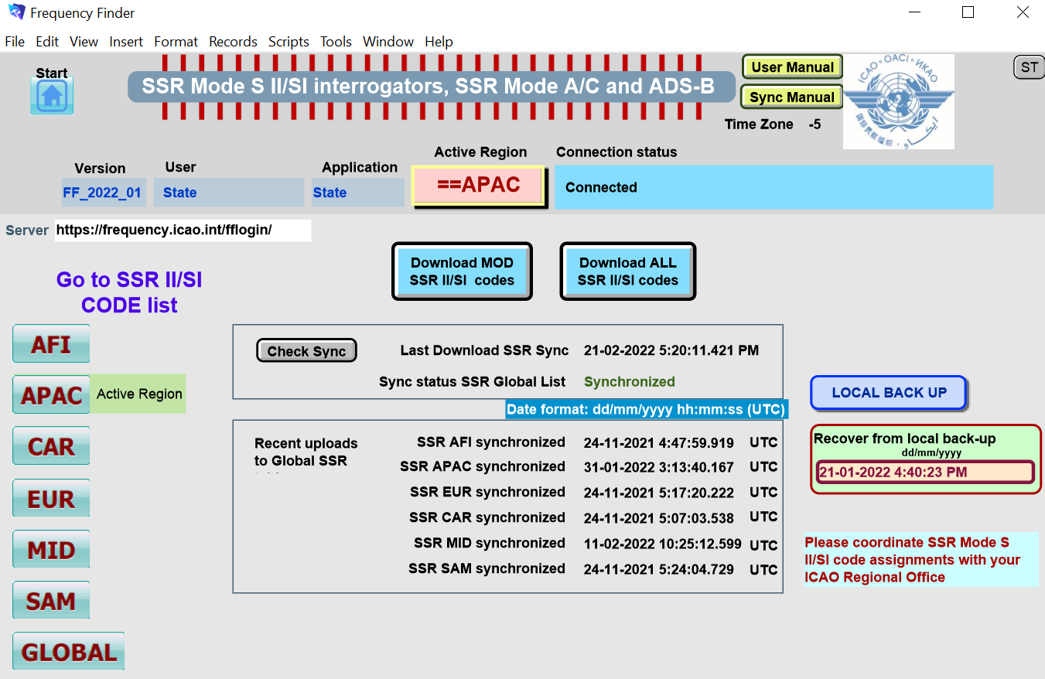
Home pages of the VHF COM, NAV and SSR modules

Slide 5
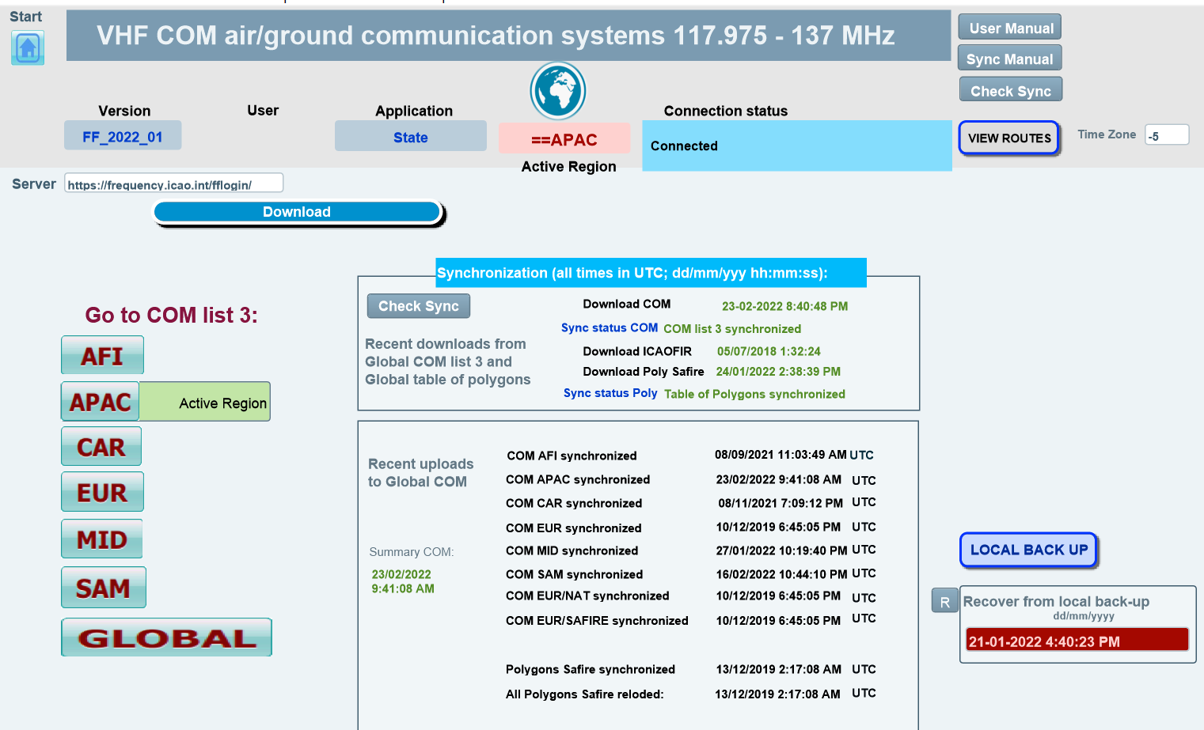

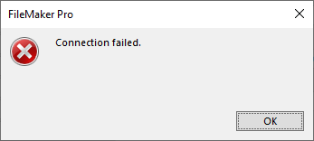

Home page of the VHF COM air/ground communications systems module
Exploration of the main functions (cont’d)

Slide 6






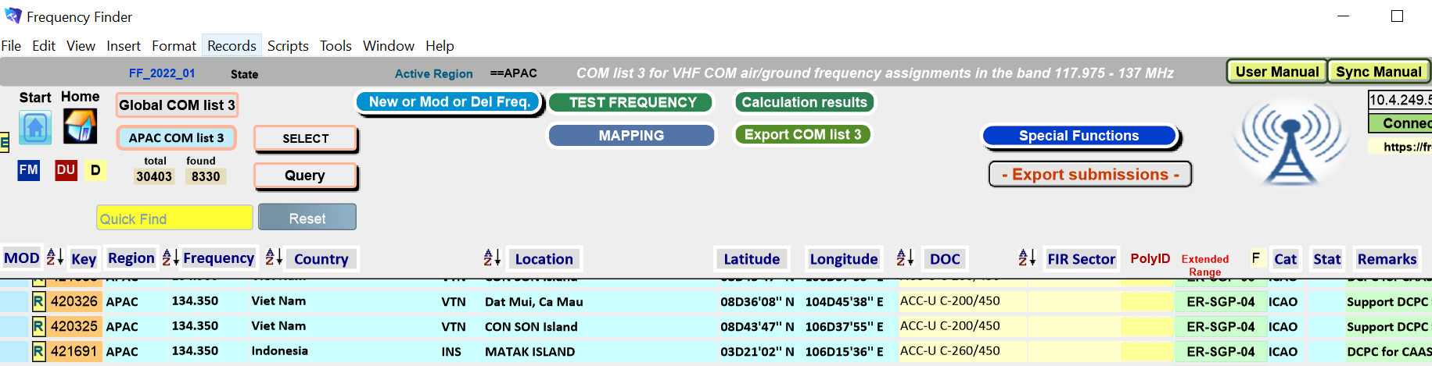
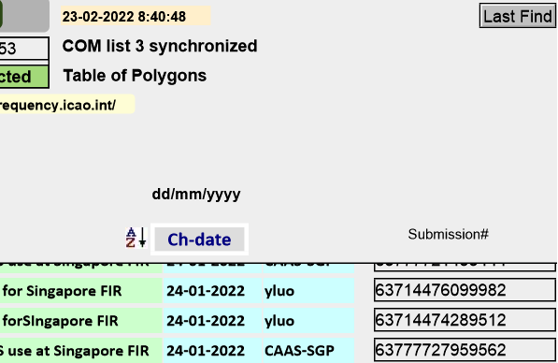

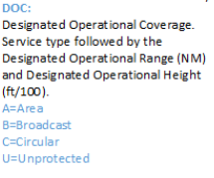
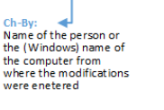




VHF-COM module
Exploration of the main functions – Buttons of COM List 3

Slide 7
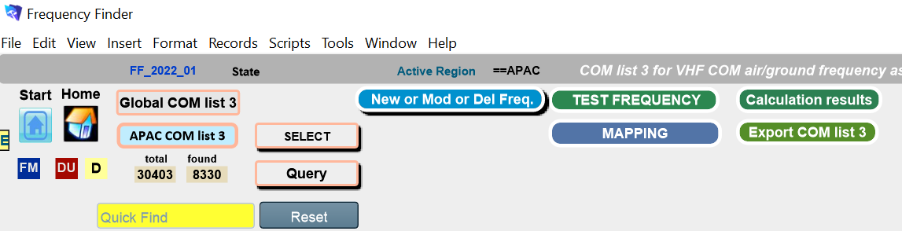
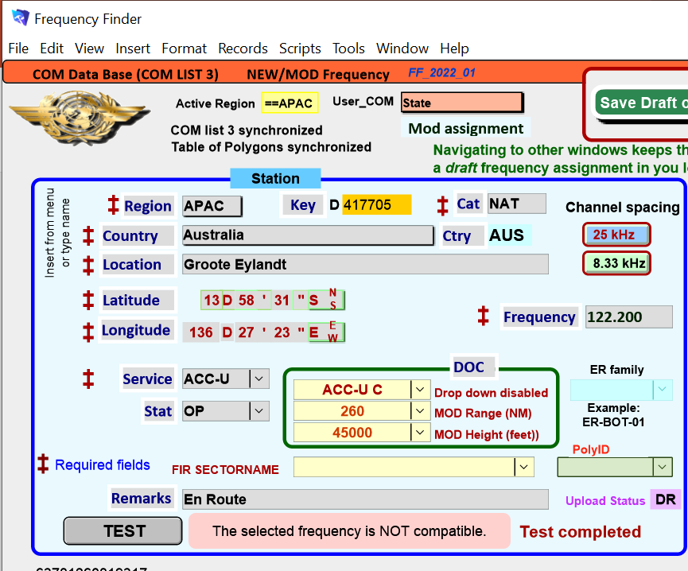
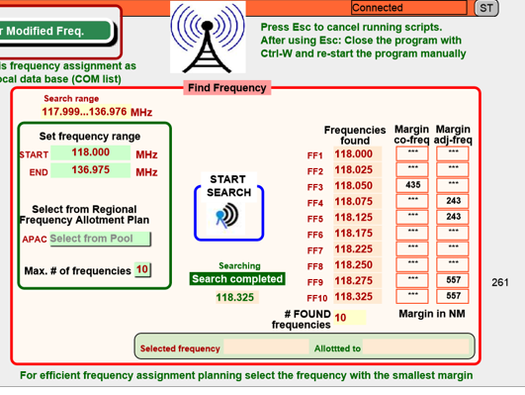

VHF-COM module
Exploration of the main functions – Introducing a new/modify an existing/delete a frequency assignment
With the search function, you can search for compatible frequencies
In this example, modify:
Frequency : 122.200
Service: ACC-U
Test result is displayed.
In this example, it said that : The selected frequency is not compatible

Slide 8
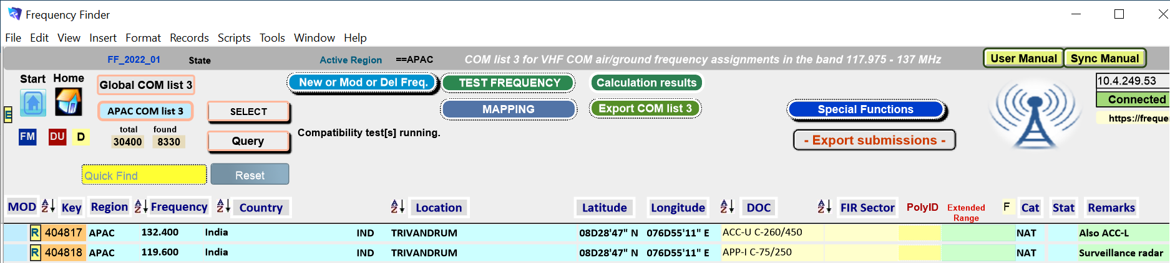

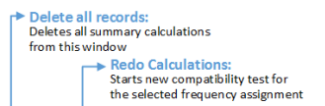
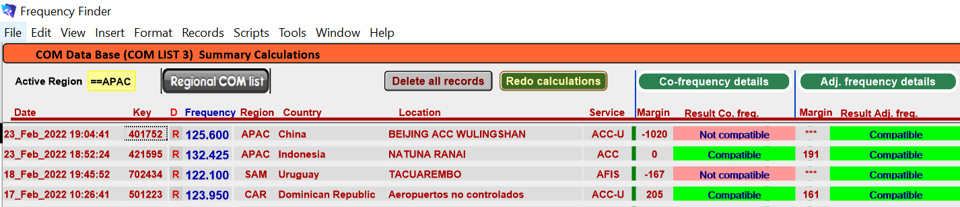

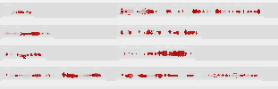
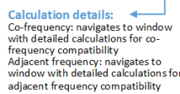
VHF-COM module
Exploration of the main functions – Summary Calculations

Slide 9
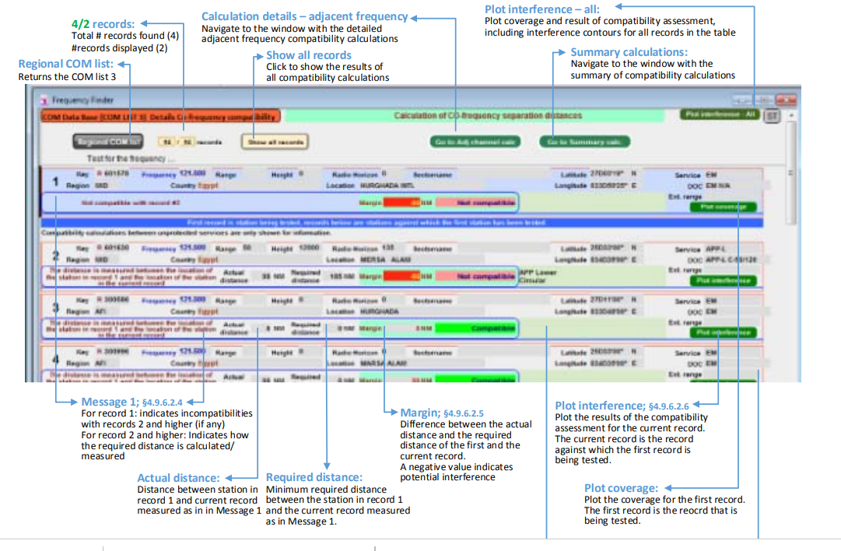





VHF-COM module
Exploration of the main functions – Summary Calculations – Calculation of co-frequency separation distance

Slide 10
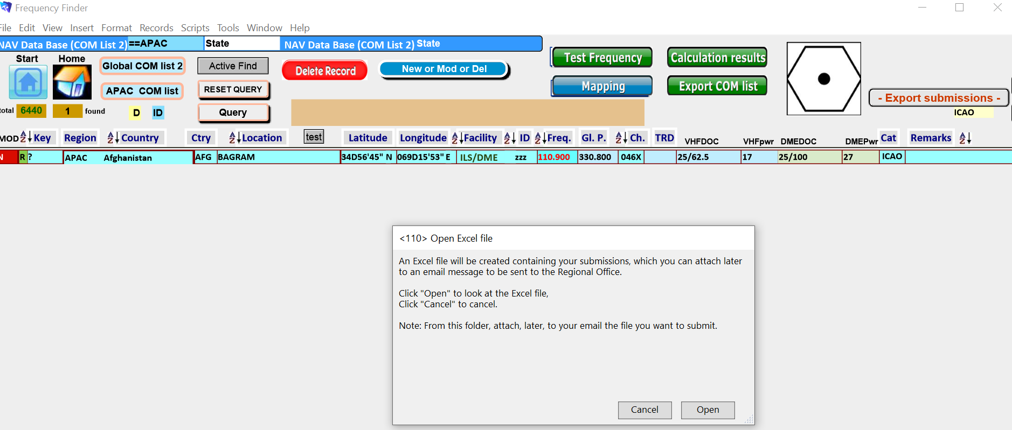
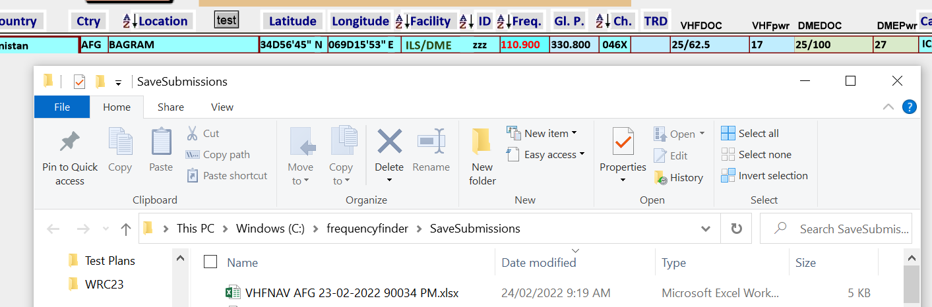
VHF-COM module
Exploration of the new/improved functions – Export submission

Slide 11
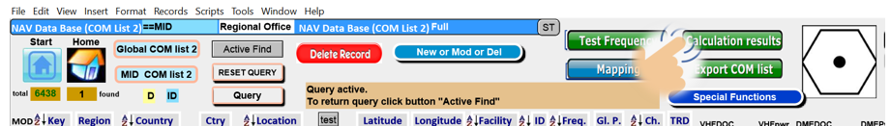
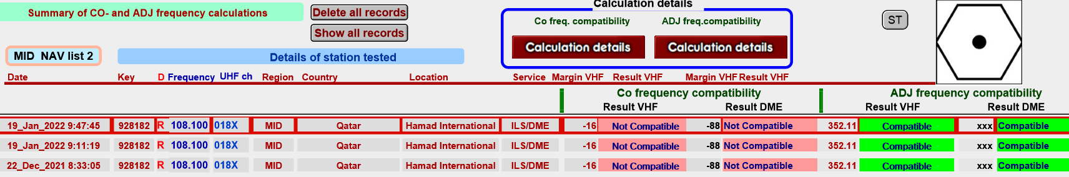

Other ongoing improvements (cont’d)
NAV module – plotting interference contours

Slide 12
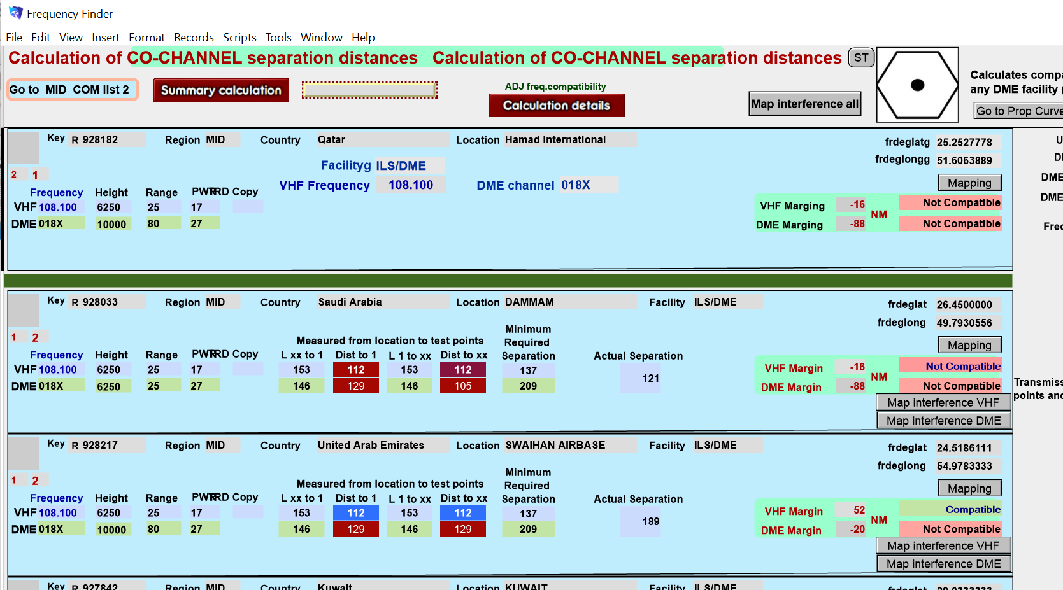

Other ongoing improvements (cont’d)
NAV module – plotting interference contours
Minimum transmission loss between the location of the facility in that record and the facility in record 1
This field calculates the minimum transmission loss between the location of the facility in record 1 and the facility in record 2
The fields Dist to 1 and Dist to xx present the minimum separation distance between any undesired facility to the edge of the DOC of the desired facility

Slide 13
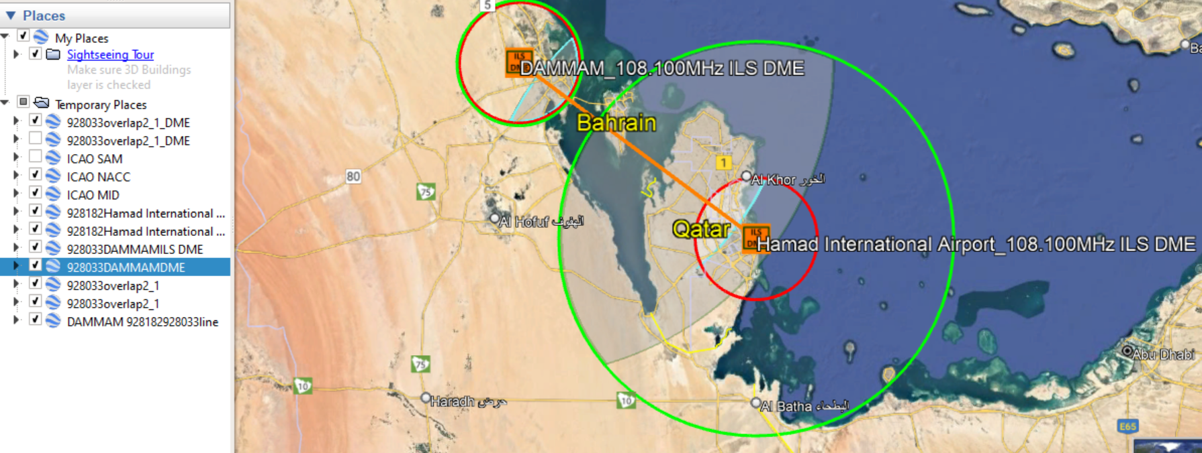
Other ongoing improvements (cont’d)
NAV module – plotting interference contours – Map interference VHF and DME

Slide 14
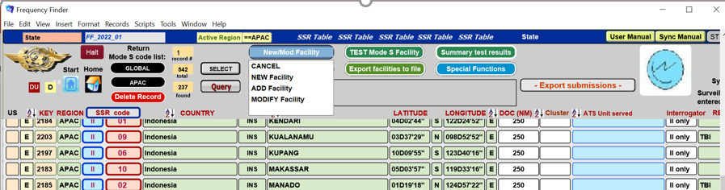

Main functions on the window SSR Table
Regular and new functions – NewMod Facility and Test Mode Facility
NEW

Slide 15
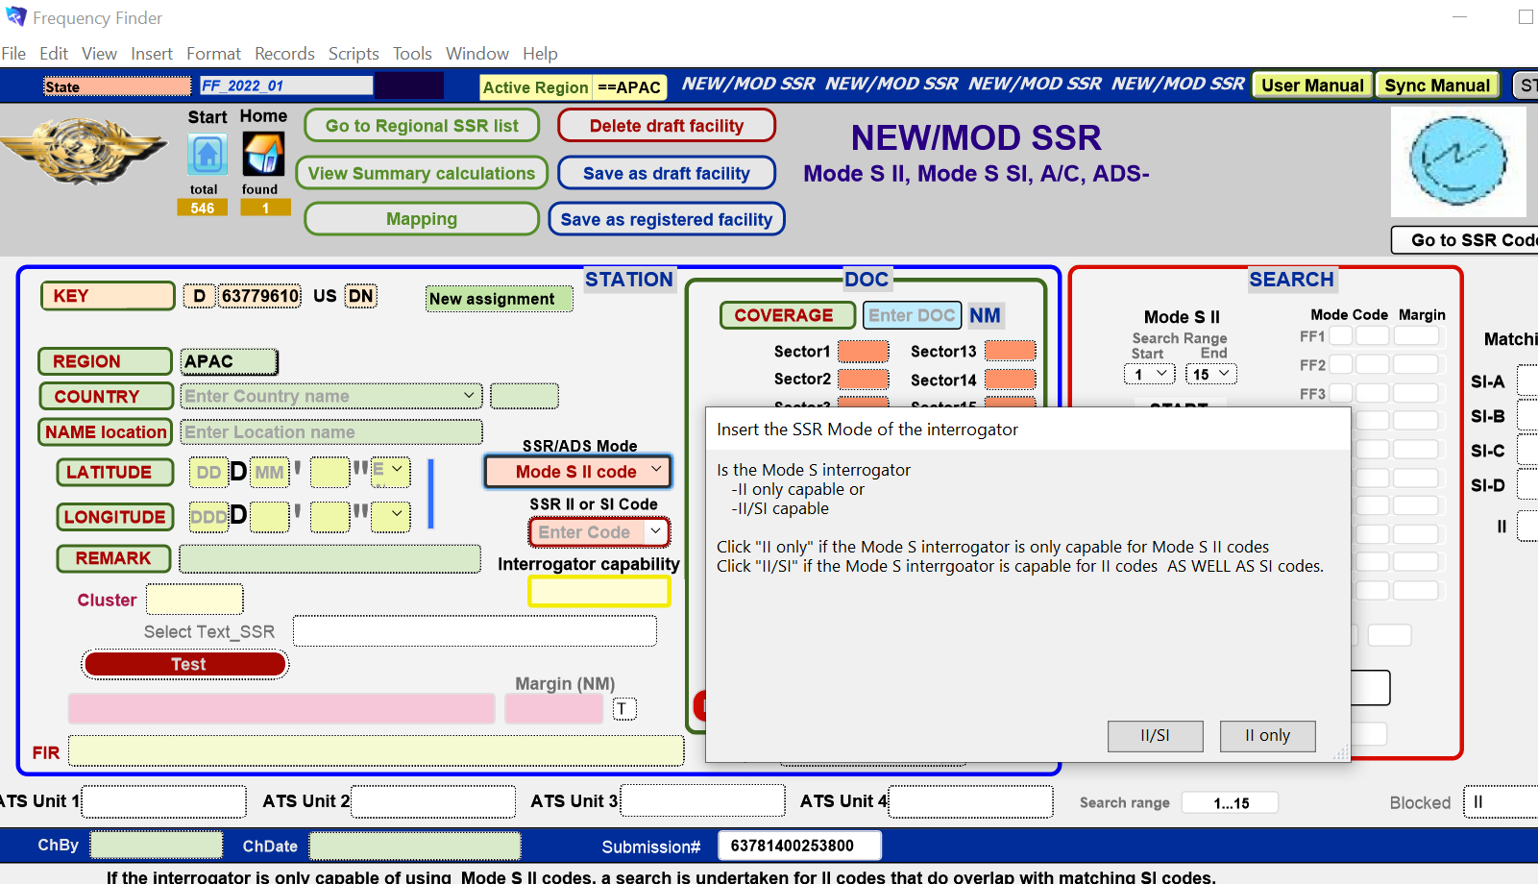




Main functions on the window SSR Table
Regular and new functions – New facility

Slide 16
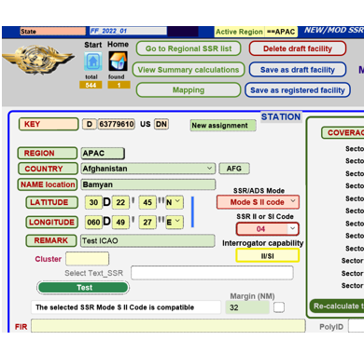

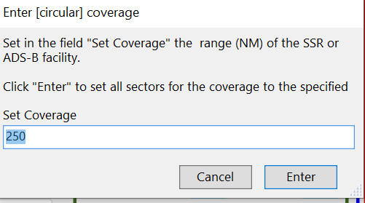

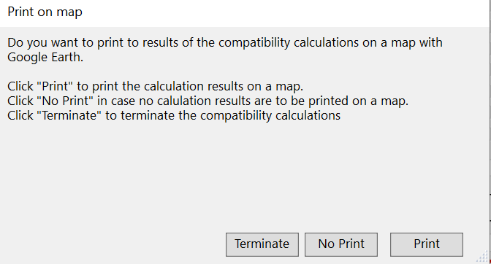
Main functions on the window SSR Table
Regular and new functions – New facility
5
6

Slide 17
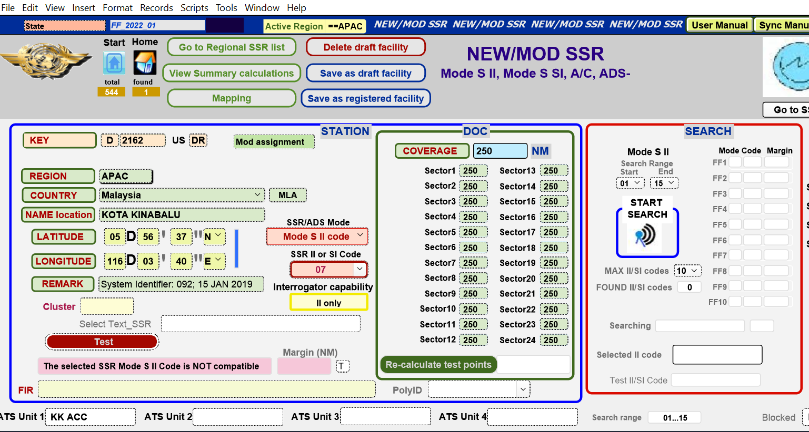
Main functions on the window SSR Table
Regular and new functions – Mod / Add Facility

Slide 18
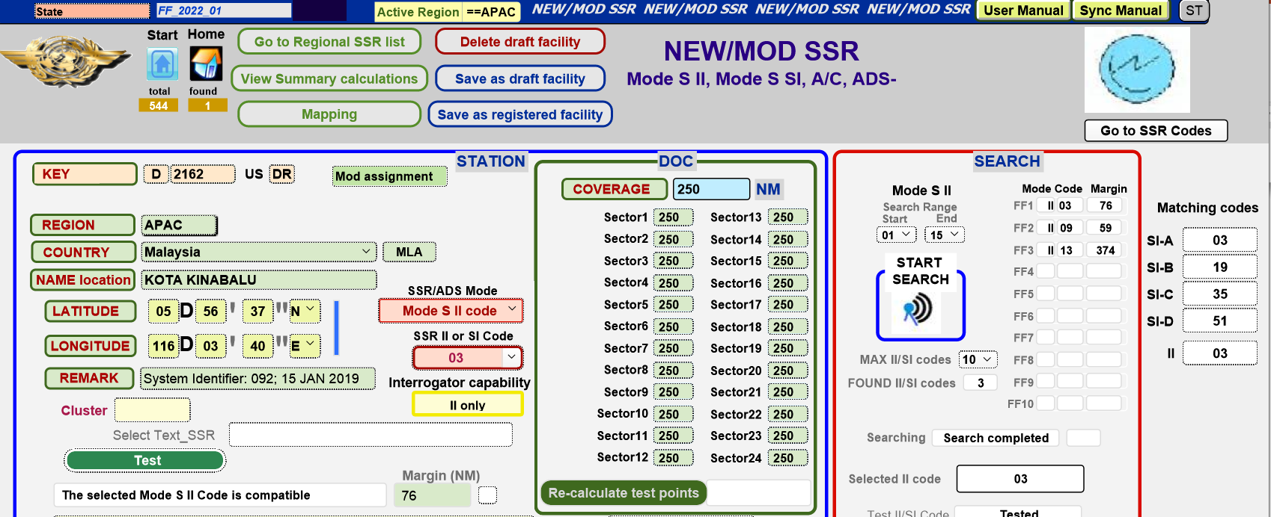
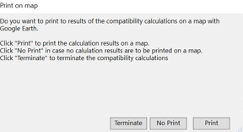
Main functions on the window SSR Table
Regular and new functions – Mod / Add Facility
6
5

Slide 19
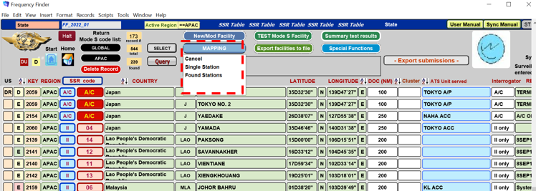
Main functions on the window SSR Table (cont’d)
Regular and new functions - Mapping

Slide 20
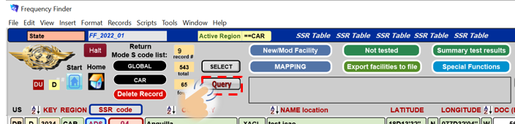
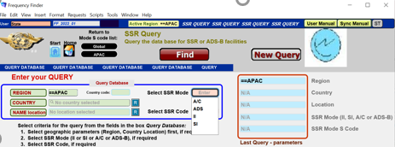
Main functions on the window SSR Table (cont’d)
Regular and new functions - Query

Slide 21
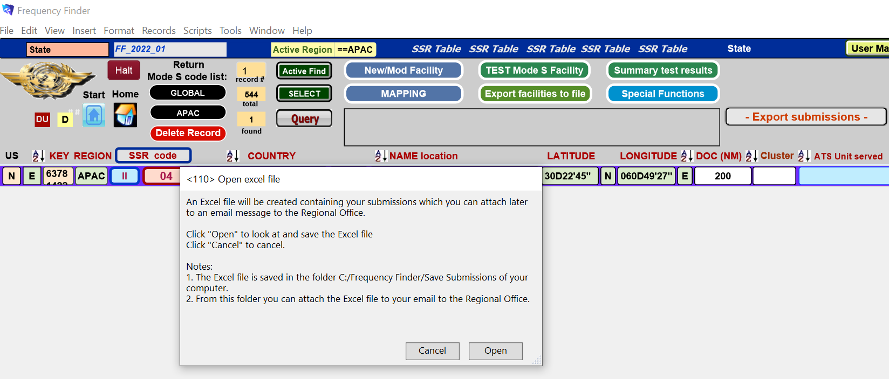
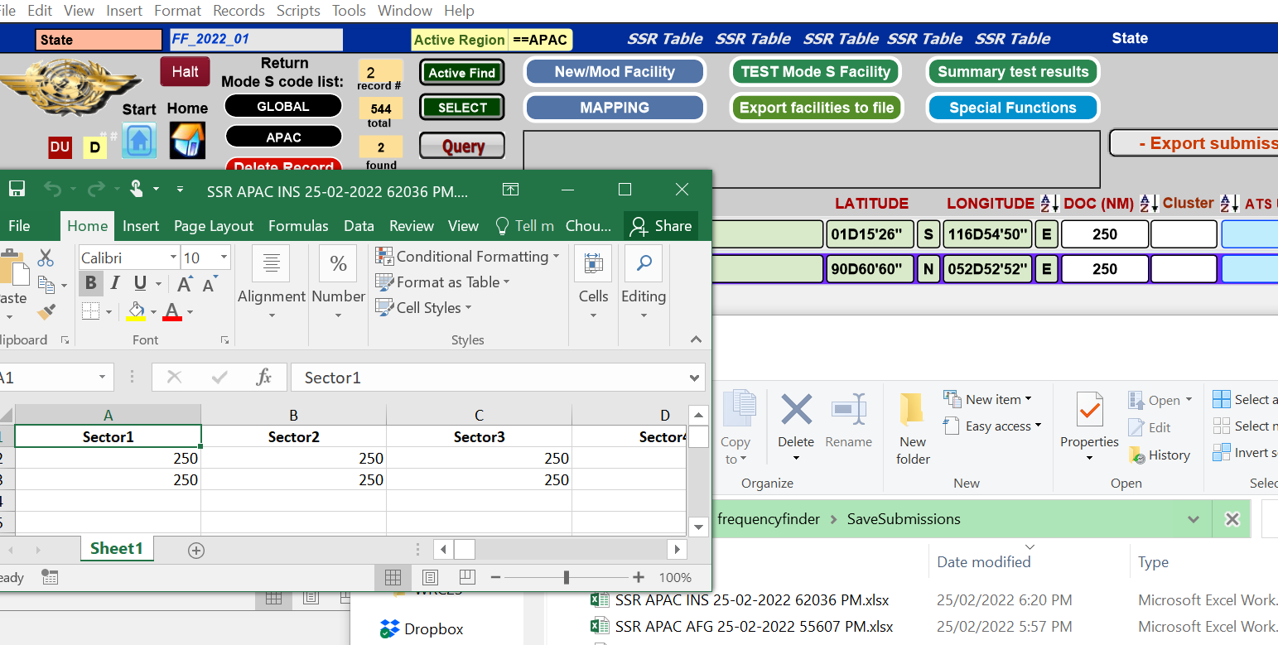
Main functions on the window SSR Table (cont’d)
Regular and new functions – Export submissions

Slide 22
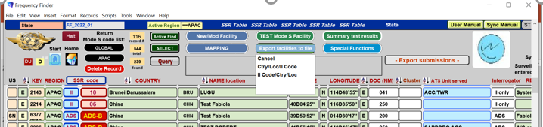
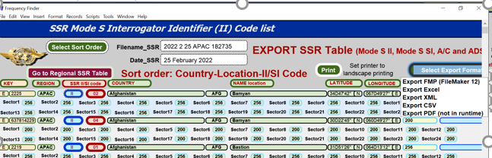
Main functions on the window SSR Table (cont’d)
Regular and new functions – Export facilities to file

Slide 23
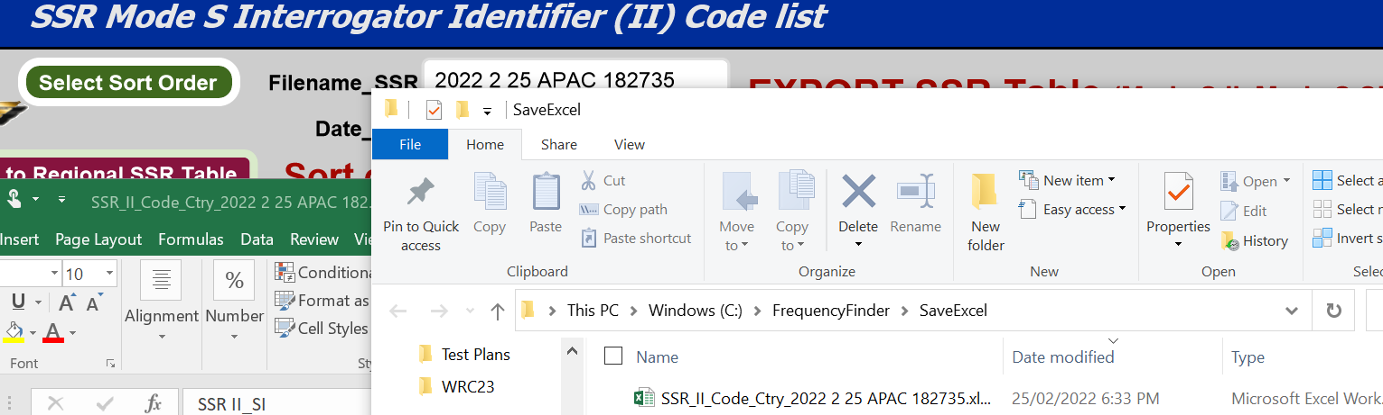
Main functions on the window SSR Table (cont’d)
Regular and new functions – Export facilities to file

Slide 24

Questions

