Slide 1
Introduction to Mode S
Secondary Surveillance Radar System
CHEN Yang (Isaac)
CAAC ATMB
isaac21@qq.com

Slide 2
Content
1. Mode S operations
  Dialogue between Mode S Interrogator and Transponder
  II & SI code
  Acquisition and Lockout protocols
  Mode Interlace Pattern &Optimal interrogation sequence
  Time and Power constraint of the interrogator
2. ELS & EHS
  Operational requirements of ELS & EHS
  Register introduction
  Optimal register extraction
3. Mode S transponder
  Basic electrical specification
  Interrogation acceptance & Lockout protocols
4. Flight inspection for a Mode S radar
5. APAC’s proposed modifications to Doc. 9924

Slide 3
Mode S operations

Slide 4
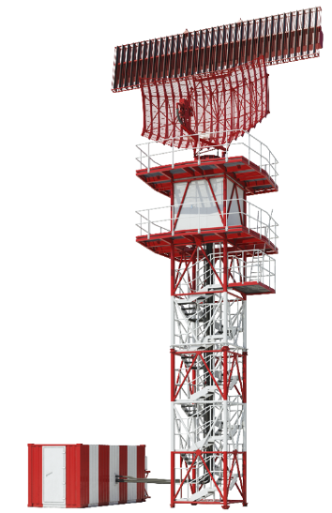
Mode S operations-- Dialogue between Mode S Interrogator and Transponder
History & Advantage
1940S
IFF
(Identification Friend or Foe )
1960S
Conventional Mode A/C SSR
(civilian application)
1970S
COSSOR
Adsel ( Address SELective System)
Lincoln Laboratory
DABS（Discrete Address Beacon System)
1990S
Mode S Surveillance Radar
Surveillance + Communication
The advantage
Compatible to the secondary surveillance radar (SSR)
Better performances in degarbling & defruit
Protection against transmission errors by a cyclic redundancy check
Enhanced communication to collect on board information (BDS Information)
Notes:
Secondary radar is based on the communication between radar and the transponder.
It appeared during the world war two to recognize the friendly planes, IFF (Identification Friend or Foe).This system was improved and applied to civilian application since the 60s (radar SSR + transponder)

Slide 5
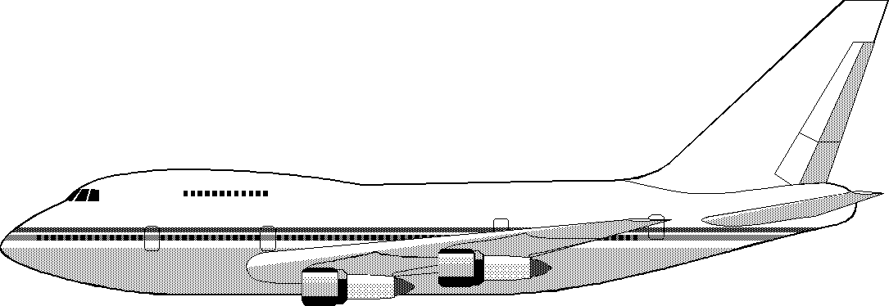
Mode S operations-- Dialogue between Mode S Interrogator and Transponder
Mode AC Interrogation
Mode A/C
Reply: MODE A OR C
MODE A: 8 μS
0.8 μS
MODE C: 21.0 μS
Mode s
P1
P3
Reply: MODE A OR C
2 μS
0.8 μS
ISLS CONTROL
TRANSMISSION
P2
0.8 μS
Interrogation | Mode AC Transponder | Mode S transponder
P1-P3 8μS | Mode A | Mode A
P1-P3 21μS | Mode C | Mode C

Slide 6
Mode S operations-- Dialogue between Mode S Interrogator and Transponder
Inter-Mode Interrogation
Mode A/C
MODE A: 8 μS
0.8 μS
MODE C : 21μS
2 μS
Mode s
P1
P3
P4
2 μS
0.8 μS
0.8 μS
Reply: Depend on P4
1.6 μS
ISLS CONTROL
TRANSMISSION
P2
0.8 μS
Interrogation | Mode AC Transponder | Mode S transponder
Mode A/C/S all-call P4 =1.6μS | Mode A/C | DF11 with II=0 & AA
Mode A/C-only all-call P4 =0.8μS | Mode A/C | No reply

Slide 7
Mode S operations-- Dialogue between Mode S Interrogator and Transponder
Mode S Interrogation
Mode A/C
Reply: No Reply
2.0 μS
2.75 μS
0.5 μS
0.5 μS
1.25 μS
0.25 μS
P6
56 or 112 data bits
Mode s
P1
P2
SYNC PHASE
Reply: Mode S reply or No
0.8 μS
0.8 μS
REVERSAL
0.4 μS
PHASE REVERSAL
POSITION
SLS CONTROL
P5
1
St data bit
last data bit
TRANSMISSION
0.8 μS
Interrogation | Mode AC Transponder | Mode S transponder
Mode S | No Reply | Mode S reply or No Reply

Slide 8
Mode S operations-- Dialogue between Mode S Interrogator and Transponder
Interrogation Modulation and Coding Design
2.0 μS
2.75 μS
0.5 μS
0.5 μS
1.25 μS
0.25 μS
P6
56 or 112 data bits
P1
P2
SYNC PHASE
0.8 μS
0.8 μS
REVERSAL
0.4 μS
PHASE REVERSAL
POSITION
St data bit
1
last data bit
SLS CONTROL
P5
TRANSMISSION
0.8 μS
Uplink design philosophy
P1—P2 pulse ---------- suppression of Mode A/C transponder.
56-112 bit information. P6=16.25 –30.25 ＜ 35μS
Mode S data lie within in the Mode A/C suppression interval(35μS).
1bit/0.25μS → 4MHz + BDPSK → 8MHz Bandwidth.
2MHz ---------Need two segments, 8MHz-----Not compatible with receiver bandwidth.

Slide 9
Mode S operations-- Dialogue between Mode S Interrogator and Transponder
Reply Modulation and Coding Design
Preamble
8 µs
Data block
56 µs or 112 µs
4.5 µs
(
1 µs = 1bit )
0.5
0.5
0.5 µs
0.5
0.5
0.5 µs
Data bit format
1 µs
1 µs
1
1
0
0
1
0
0
0
1
0
Downlink design philosophy
The four pulse preamble is designed to be easily distinguished from Mode AC replies.
PPM : The absence of interference results in received energy in only one half of the interval. Thus energy in both halves indicates that an interfering pulse was received at the same time.
PPM : results in a constant number of pulses in each reply, assuring sufficient pulses for an accurate monopulse angle estimate.

Slide 10
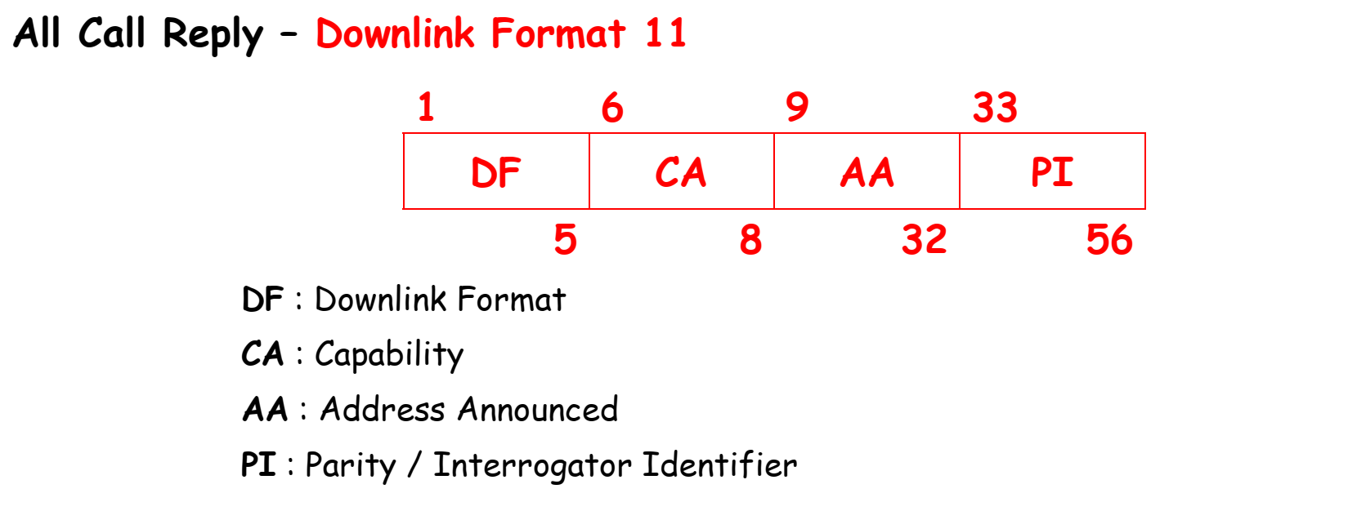
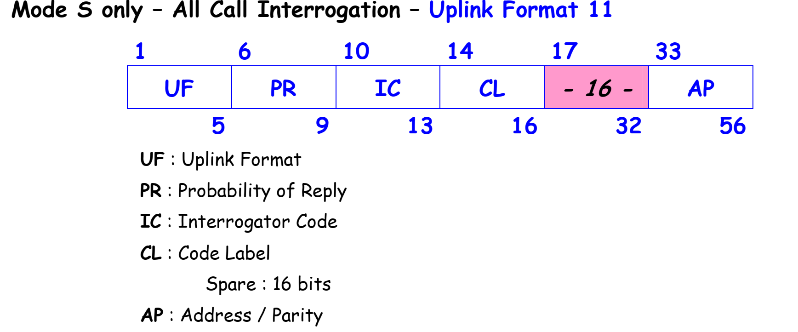
Mode S operations-- Dialogue between Mode S Interrogator and Transponder
Mode S acquisition

Slide 11
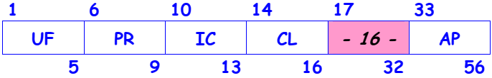
Mode S operations-- Dialogue between Mode S Interrogator and Transponder
UF11
UF = uplink format (01011; Decimal value 11)
PR = probability of reply (related to Stochastic acquisition & Lockout Override）
IC = interrogator code:
CL = code label
AP = address/parity:

Slide 12
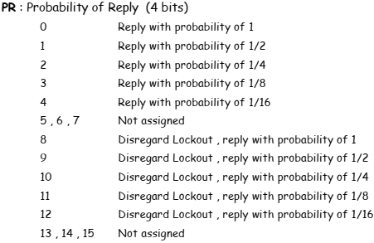
Mode S operations-- Dialogue between Mode S Interrogator and Transponder
UF11 PR
Stochastic Acquisition
For example, if PR =1, the transponder generate a random number between 0 and 1 and will reply only if:
a) a lockout condition does not apply; and
b) the generated random number is less than or equal to 0.5
If PR =9,
the transponder generate a random number between 0 and 1 and will reply if
a)Disregard the lockout state, generated random number is less than or equal to 0.5
Lockout Override
Notes:
Stochastic acquisition :
For example, if the PR code specifies a reply probability of 1/2 (PR=1), the transponder will generate a random number between zero and ten and will reply only if:
a) a lockout condition does not apply; and
b) the generated random number is less than or equal to 5
Lockout override
For example, if the PR = 9 the transponder will generate a random number between zero and ten and will reply only if:
a) the generated random number is less than or equal to 5, regardless of whether it is locked to the II or SI code.

Slide 13

Mode S operations-- Dialogue between Mode S Interrogator and Transponder
UF11 PR
or
or
or
1-（1-0.25)^{N}
PR=0.5, P_{d}=1-0.75^{N},
N＞8 → P_{d} ＞90%

Slide 14
Mode S operations-- Dialogue between Mode S Interrogator and Transponder
UF11 PR
 | Acquisition Stochastic probability
Number of aircraft in garble zone | 0.5 | 0.25 | 0.125
2 | 16 | 22 | 40
3 | 35 | 31 | 46
4 | 72 | 41 | 53
5 | ＞100 | 56 | 61
6 |  | 76 | 70
7 |  | ＞100 | 80
8 |  |  | 93
9 |  |  | 105
10 |  |  | 121
This table from Appendix H ICAO Doc 9924, 3rd Edition shows the number of all-call interrogations required for 99 percent probability of acquisition.
For a Mode S all call, the size of the garble zone is 5.18 Nm according to the length of the DF11 reply.

Slide 15
Mode S operations-- Dialogue between Mode S Interrogator and Transponder
UF11 IC & CL
IC (interrogator code):
The 4 bits contain the interrogator identifier or the last four bits of the surveillance identifier (SI).
CL = code label :
If CL = 000, the information in the IC field is the interrogator identifier.
If CL = 001 to 100 (decimal value 1 to 4), the information in the IC field contains the last four bits of the SI.
II 0-15/ SI 1-63
Note：A Mode S II-only transponder will ignore the CL field. A Mode S II-only interrogator cannot set the CL field and defaults to “000”

Slide 16
Mode S operations-- Dialogue between Mode S Interrogator and Transponder
UF11 AP
For a UF11, the address consists of 24 one’s, on which the parity is overlaid.
The bits in AP (Address/parity )field are calculated by the first 32 information bits of UF11, broadcast aircraft address and generator polynomial. For the all-call interrogation, the aircraft address here use 24 ones.

Slide 17
Mode S operations-- Dialogue between Mode S Interrogator and Transponder
UF11 AP
Up Link AP Coding
M(x)=Message A(x)=Aircraft Address =ICAO 24-bit Address
G(x)=1 + x³ + x¹⁰ + x¹² + x¹³ + x¹⁴ + x¹⁵ + x¹⁶+ x¹⁷ + x¹⁸ + x¹⁹ + x²⁰ + x²¹ + x²² + x²³ + x²⁴
x²⁴ M(x)/G(x)=m(x)+R(x)/G(x) → R(x)=remainder{x²⁴ M(x)/G(x)}
A(x) G(X)/ x²⁴=Q(x)+ r(x)/x²⁴ → r(x)=remainder{A(x) G(X)/ x²⁴}
AP(X)= R(x)+A(x) G(X)/ x24 +r(x)/ x24
T(X)=x²⁴ M(x)+R(x)+A(x) G(X)/ x²⁴ +r(x)/ x²⁴
Decoding
x²⁴ T(X)/G(X)= x²⁴ 【x²⁴ M(x)+R(x)+A(x) G(X)/ x²⁴ +r(x)/ x²⁴】/G(X)
= x²⁴ m(x)+A(x)+ r(x)/G(X)
low order bits-the last 24bits
High order bits

Slide 18
Mode S operations-- Dialogue between Mode S Interrogator and Transponder
UF11 AP
Example :
The task: Transmission 1011001, G(x)=X^4+X^3+1, AA(X)=1001
M(x)=1011001→x^6+x^4+x^3+1;
G(x)=11001=x^4+x^3+1=G(x) ------- CCITT CRC-4
R{x^4*M(x)/G(x)}= x^3+x= 1010→Remainder
AA(x)=1001=x³+1 AA(x)G(x)/ x^4=Q(x)+r(x) /x^4=(x^3+x^2+1)+1/x^4
Transmission: T(X) = x⁴ M(x)+R(x)+AA(x) G(X)/ x⁴ +r(x)/ x⁴
= x^10+x^8+x^7+x^4+x^2+x+1
=10110010111

Slide 19
Mode S operations-- Dialogue between Mode S Interrogator and Transponder
UF11 AP
Receive: x⁴ T(X)/G(X) = x⁴ 【x⁴ M(x)+R(x)+A(x) G(X)/ x⁴ +r(x)/ x⁴】/G(X)
= x⁴ m(x)+A(x)+ r(x)/G(X)
= x¹⁰+x⁹+x⁷+x⁵+x³+1+1/(x^4+x^3+1)
1001
Summary: The A(x) is modulo 2 with G(x), then take the high 24 bits, perform modulo 2 operation with the remainder of M(x) divided by G(x) to obtain AP.

Slide 20
Mode S operations-- Dialogue between Mode S Interrogator and Transponder
UF11 Interrogation Rate
The interrogation repetition rate for the Mode A/C/S all-call, used for acquisition, shall be less than 250 per second. This rate shall also apply to the paired Mode S-only and Mode A/C-only all-call interrogations used for acquisition in the multisite mode.
------3.1.2.11.1.1.1 ICAO Annex 10 Volume 4, Fifth Edition
A Mode S interrogator shall not trigger, on average, more than 6 all-call replies per period of 200 ms and no more than 26 all-call replies counted over a period of 18 seconds.
------3.1.2.11.1.1.2 ICAO Annex 10 Volume 4, Fifth Edition
4-second per scan, beam width=2.4°（3dB）, All-Call rate ≤225 Hz；
4-second per scan, beam width=4° （ effective beam width） All-Call rate ≤135 Hz

Slide 21
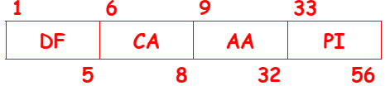
Mode S operations-- Dialogue between Mode S Interrogator and Transponder
DF11
DF = downlink format (01011; decimal value 11)
CA = Capability (airborne or on ground , level 1 or above, DR ≠0 ?, FS alert →FS=2,3,4 or 5)
AA = ICAO 24 bits
PI = IC/parity

Slide 22
Mode S operations-- Dialogue between Mode S Interrogator and Transponder
DF11
PI =17 zero + CL (3 bits） + IC （4 bits）=PI（x）
Transponder --- Transmission: T(x)=x^24 M(x) + R(x)+ PI(x)
Radar---Reception : [x^24 M(x) + R(x)+ PI(x)]/G(x) = Q(x) + 0+ [PI(x)/G(x)]
The remainder = PI(x)

Slide 23
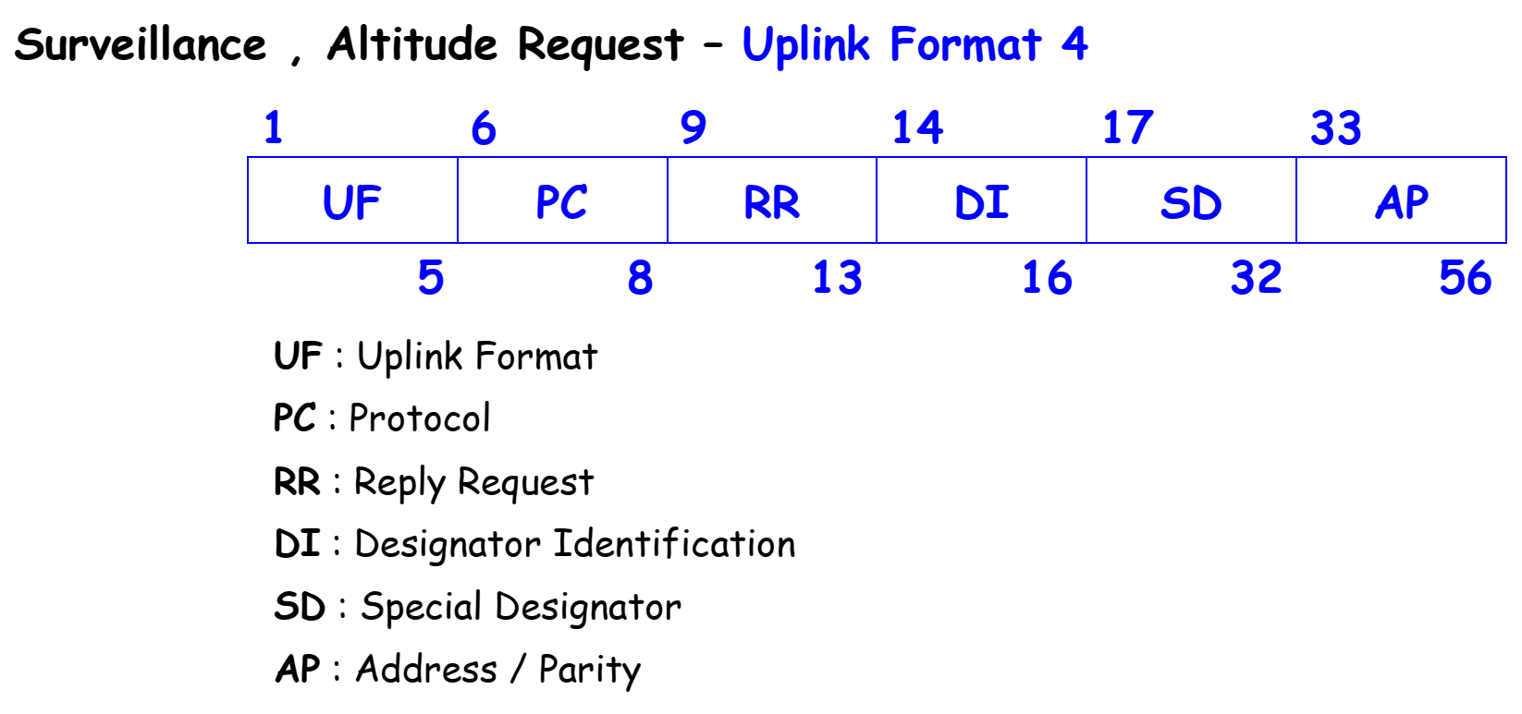
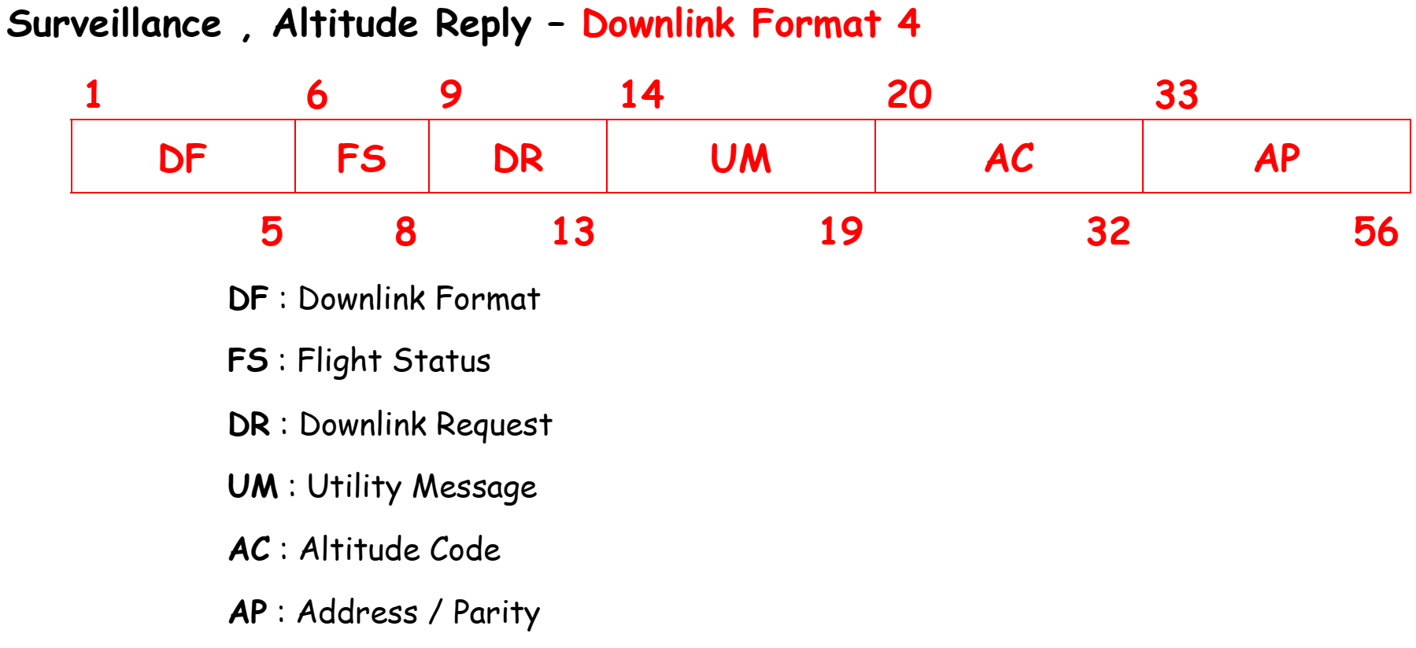
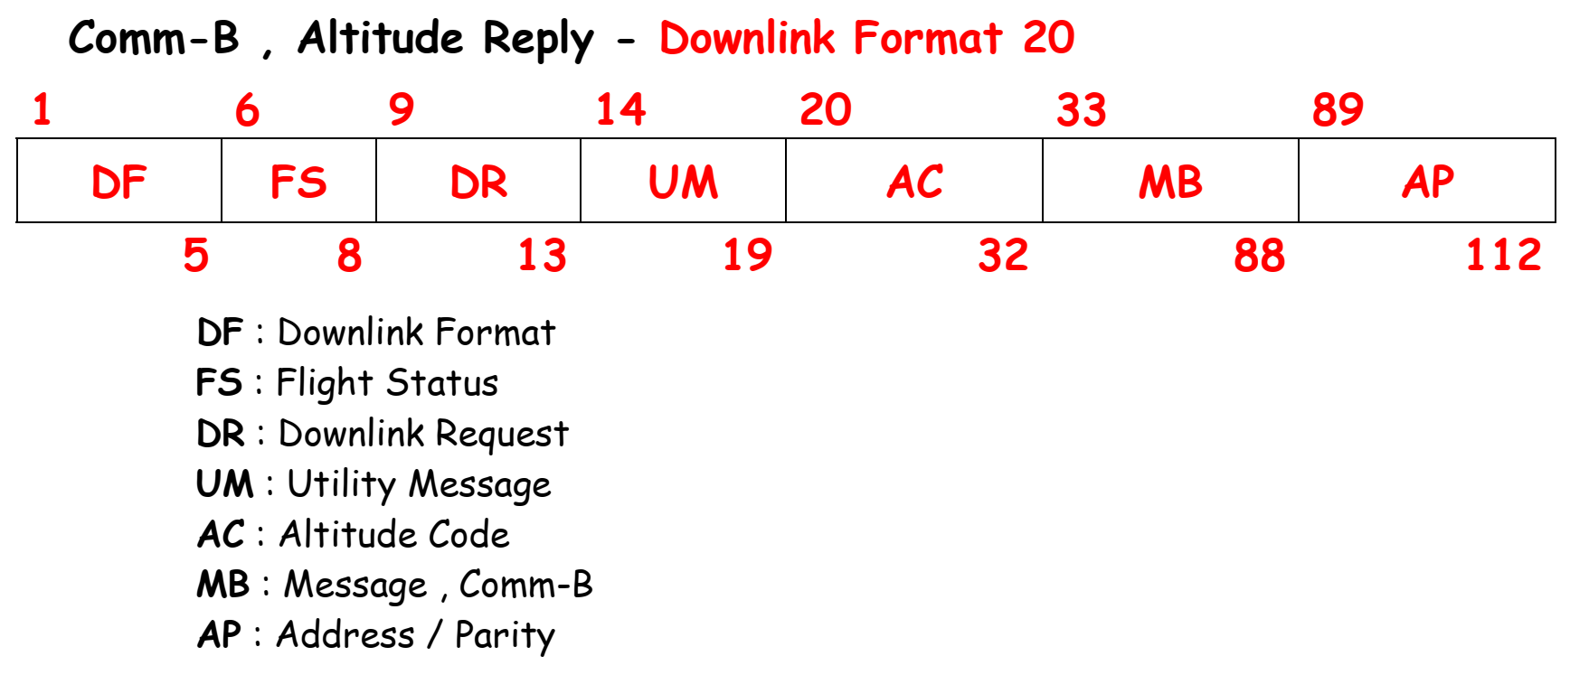
Mode S operations-- Dialogue between Mode S Interrogator and Transponder
UF4 DF4 DF20
Up link AP
Lockout command
RR=0-15
RR=16-31
Up link AP
Up link AP
BDS information
RR=18 BDS 2,0
RR=17 BDS 1,0
RR=16 AICB
Others：RR+RRS(subfield in SD)
Comm-B broadcast or AICB Application
Downlink AP coding is different from Uplink, but similar to PI. Just replace PI (X) with A(X).

Slide 24
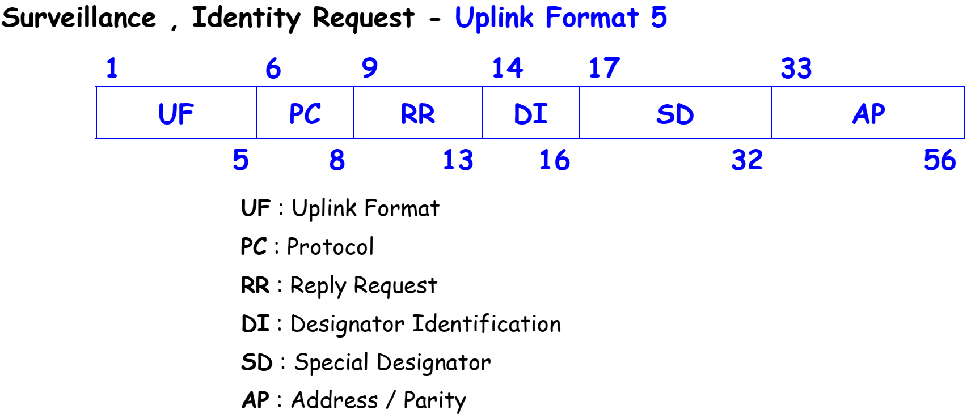
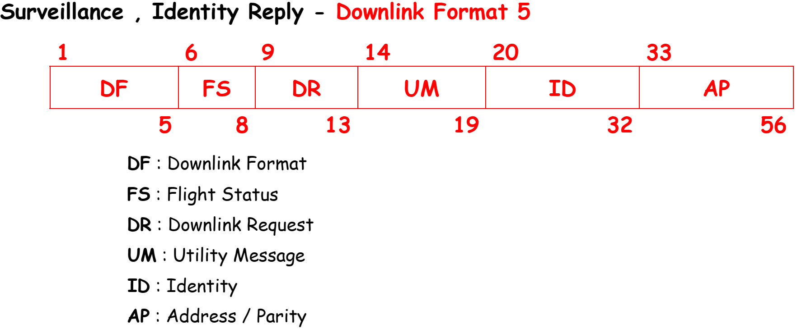
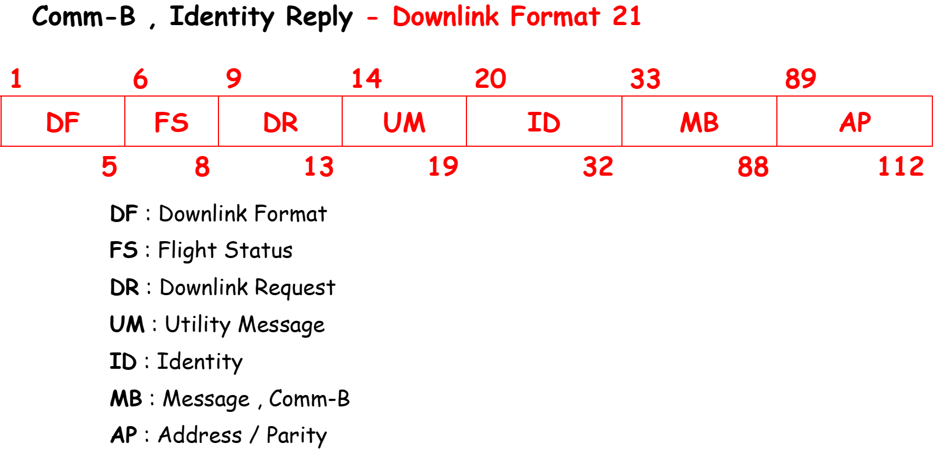
Mode S operations-- Dialogue between Mode S Interrogator and Transponder
UF5 DF5 DF21

Slide 25
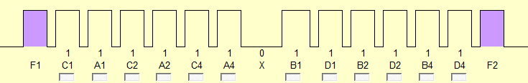
Mode S operations-- Dialogue between Mode S Interrogator and Transponder
Generation Polynomial
G(x) = x^24 + x^23 + x^22 + ... + x^13 + x^12 + x^10 + x^3 + 1
It can detect any 24-bit error burst over any length of the bits-window.
Hamming Distance=6, It can correct random error of length smaller than 5.
It can correct burst-error of length 12.or 12 burst-error in any 24 bits window.
12 = 4 PULSE A + 4 PULSE B +4 PULSE C +4 PULSE D
Related to the interval between the F1 pulse and the SPI pulse of the MODE AC reply （24.65 μS）

Slide 26
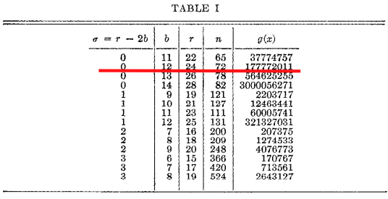
Mode S operations-- Dialogue between Mode S Interrogator and Transponder
Generation Polynomial
G（x）was first discovered by Kasami in 1964. It was then applied to Mode S radar by MIT Lincoln Laboratory.
<<Some Efficient Shortened Cyclic Codes for Burst-Error Correction>>
---- TADAO. KASAMI
Dept. of Electronics
University of Osaka

Slide 27
Mode S operations-- Dialogue between Mode S Interrogator and Transponder
II & SI Code
In order to avoid ambiguity :
 for each Mode S interrogator is allocated an Interrogator Code (IC) to protect it from interference by other
Mode S interrogators operating in overlapping airspace.
If CL = 000, IC =II.
If CL = 001 to 100 (decimal value 1 to 4), IC=last four bits of the SI code
2 types of Interrogator Code (IC) are used :
 the Interrogator Identifier (II) code,0-15, 0 is used for non-selective
 the Surveillance Identifier (SI) code,1-63, multisite surveillance and the limited data link functions
(It shall not be used with the multisite uplink or down link ELM protocols)

Slide 28
Mode S operations-- Dialogue between Mode S Interrogator and Transponder
II & SI Code
Not all transponders are capable of operating with SI code.
Mode S II-only capable transponder will ignore CL field.
    Transponders which have not been upgraded to handle SI code, by default, consider the content of the IC field as being an II code value.
    So, if CL is not equal to zero (meaning that the IC field contains SI code), the II only capable transponders encode the parity sequence of the reply using the "matching“ II code rather than the SI code contained in the interrogation.

Slide 29
Mode S operations-- II & SI Code
The interrogator operation with SI code, which will receive Mode S-only all-call replies encoded with the “matching” II code will normally reject these replies. The consequence is that Mode S II-only transponders which have not been upgraded to handle SI codes will not be detected by the interrogator operating with an SI code.
The Mode S II/SI capable interrogator that supports the use of II/SI code operation, if operating with an II code, must be configurable by the user to either:
a) not lockout Mode S transponders that do not report the SI capability in Register 10 or cannot report Register 10
b) use intermittent lockout for transponders that do not report the SI capability in Register 10 or cannot report Register 10
The Mode II/SI capable interrogator that supports the use of II/SI code operation, if operating with an SI code, must be configurable by the user to either:
a) acquisition the transponder on “matching” II code ;
b) not lockout non-SI capable transponders on the "matching" II code; or
c)use intermittent lockout for this "matching" II code.

Slide 30
Mode S operations-- II & SI Code
Allocation principle
The IC has to be unique :
It cannot be used in a coverage overlapping with other (non-connected) interrogators using that same II or SI code.
The II only interrogator can not have overlapping coverage with the interrogator with it’s matching SI code.

Slide 31
Mode S operations-- Acquisition & Lockout
Acquisition
Mode S Acquisition: Obtain aircraft’s ICAO 24bits address and approximate position information for next roll-call activity.
Multisite acquisition: Using the Mode S-only all-call UF11. The transponder replies DF11 to this interrogation if it is not in a lockout state to that specific IC. (II=1-15,SI=1-63)

Slide 32
Mode S operations-- Acquisition & Lockout
Lockout
Lockout: Once acquired, the Mode S transponder should be locked out from replying to subsequent Mode S all-call interrogations form specific IC code Mode S radar in order to minimize all-call synchronous garbling.
This lockout condition is controlled by the Mode S radar through Roll-Call interrogation. If for any reason an aircraft ceases to receive roll-call interrogations containing a lockout command for a period of 18 seconds, the lockout state will lapse so that the aircraft can be reacquired by Mode S acquisition.
II CODE LOCK OUT, II ≠0
II CODE LOCK OUT, II ≠0
SI CODE LOCK OUT

Slide 33
Mode S operations—Progressive Interaction Between Interrogator and Transponder
By-ISAAC
(UF11+DF11)*N
BDS2,0+BDS3,0
LOCKOUT
BDS6,0
BDS4,0+BDS5,0
LOCKOUT
(UF11+DF11)*N
AA+Range+Azimuth=plot
(UF11+DF11)*N
AA+Rang+Azimuth+
Speed Vector=Track
(UF11+DF11)*N
BDS1,0+BDS1,7
BDS6,0
BDS4,0+BDS5,0
LOCKOUT
3rd Scan
4th Scan
5th Scan
2nd Scan
6th Scan
1ST Scan

Slide 34
Mode S operations—Mode Interlace Pattern

Slide 35
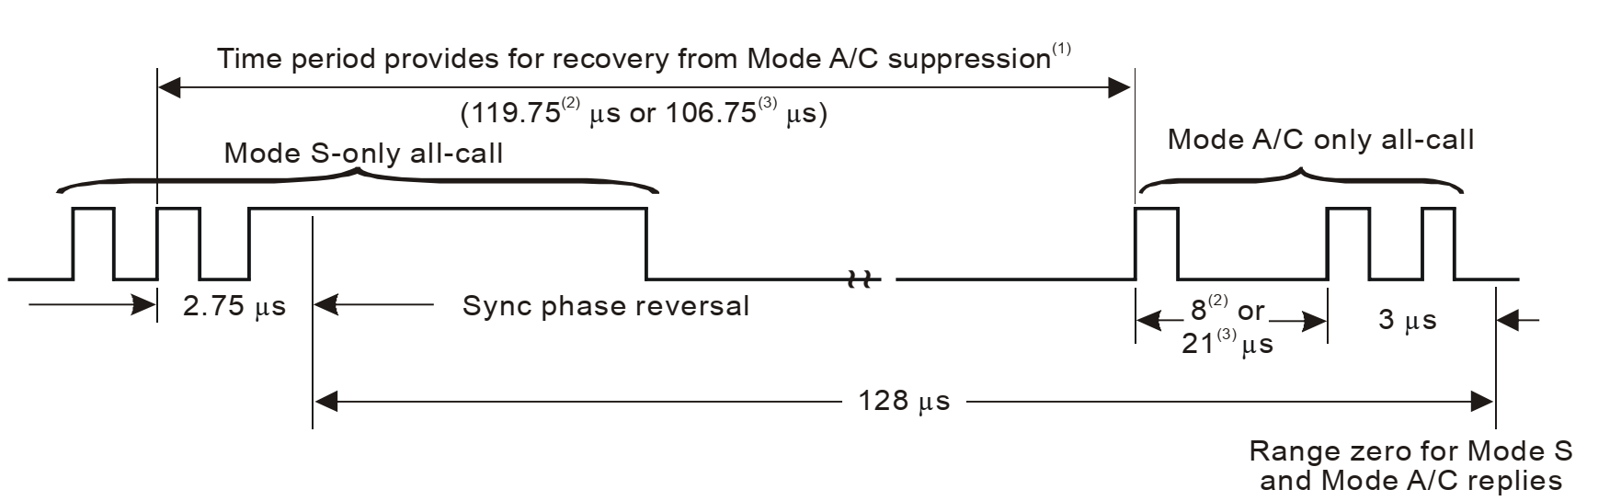
Mode S operations—Mode Interlace Pattern
128μs…Why？
It is desirable to provide at least 45 microseconds spacing between the interrogations to ensure that Mode A/C transponders recover from the suppression caused by the Mode S interrogation preamble. The spacing shown is the maximum possible without interfering with the receipt of zero range Mode S all-call replies.
The transponder suppression shall be for a period of 35 plus or minus 10 microseconds.
--3.1.1.7.4.2 ICAO Annex10 Volume IV 5th Edition
If STC is to be used, the spacing of 128 microseconds must be used to provide an identical range zero point for Mode S and SSR replies.
Notes:
2. If gain time control is to be used, the spacing of 128 microseconds must be used to provide an identical range zero point for Mode S and SSR replies.

Slide 36
Mode S operations—Mode Interlace Pattern
Interleaving for Mode S Roll-Call
Scheduling of Mode S roll-call interrogations and replies occurs under the following principles:
a) Mode S interrogations are addressed only to aircraft within the antenna beam;
b) channel time is allocated to each Mode S interrogation and reply based upon a prediction of aircraft range;
c) the ground station is able to interrogate an aircraft more than once while it remains in the beam.
-----3.2.3 ICAO Doc 9924 Appendix J, 3rd Edition

Slide 37
Mode S operations—Mode Interlace Pattern
Interleaving for Mode S Roll-Call
Although the time of transmission and reception periods of any roll call- reply transaction can’t be interleaved, but with the proper scheduling, the TL (listening window) of two or more roll call- reply transactions can be interleaved by scheduling the transmission and/or receive time intervals of one transaction in the wait phase of another transaction to save the restricted beam dwell time.
The Uplink roll-call and downlink reply contain ICAO 24-bit address, So the pairing of the interrogation and reply can be completed without ambiguity.

Slide 38
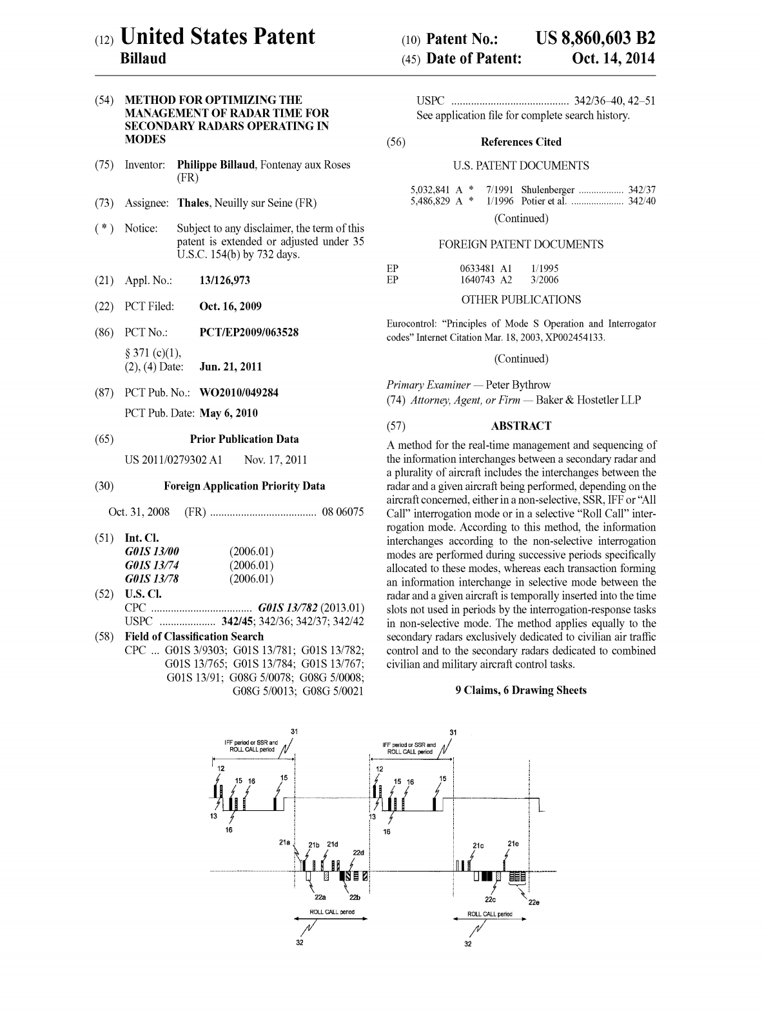
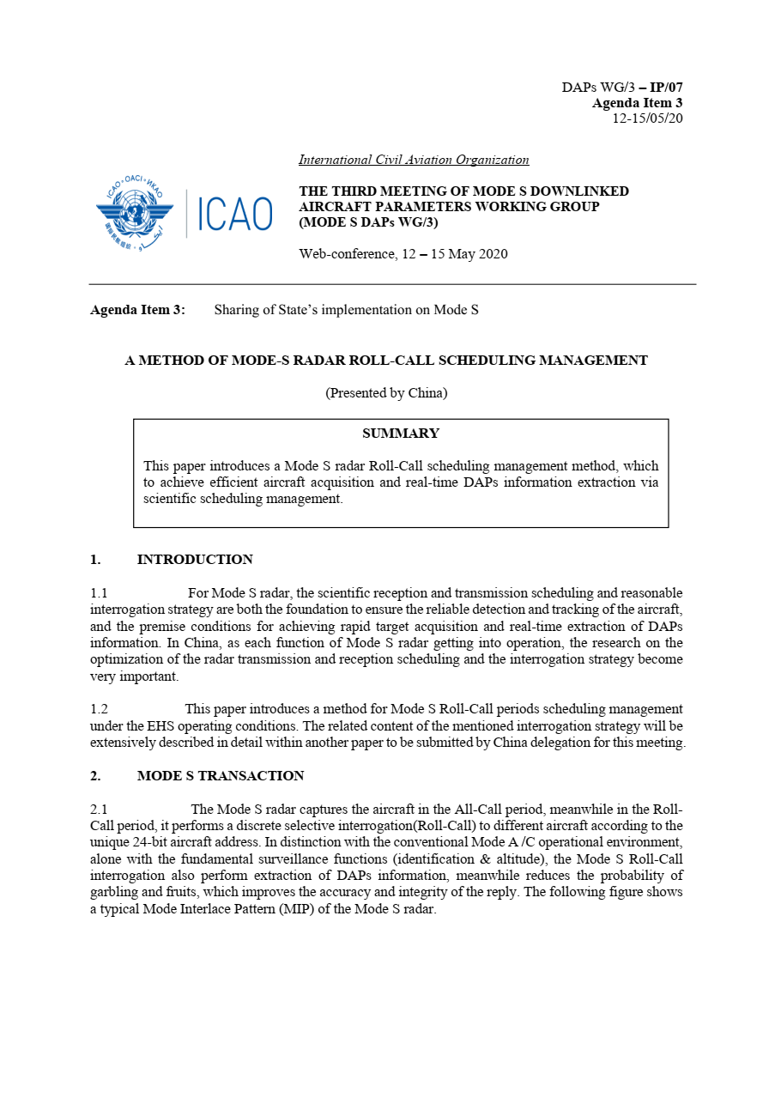
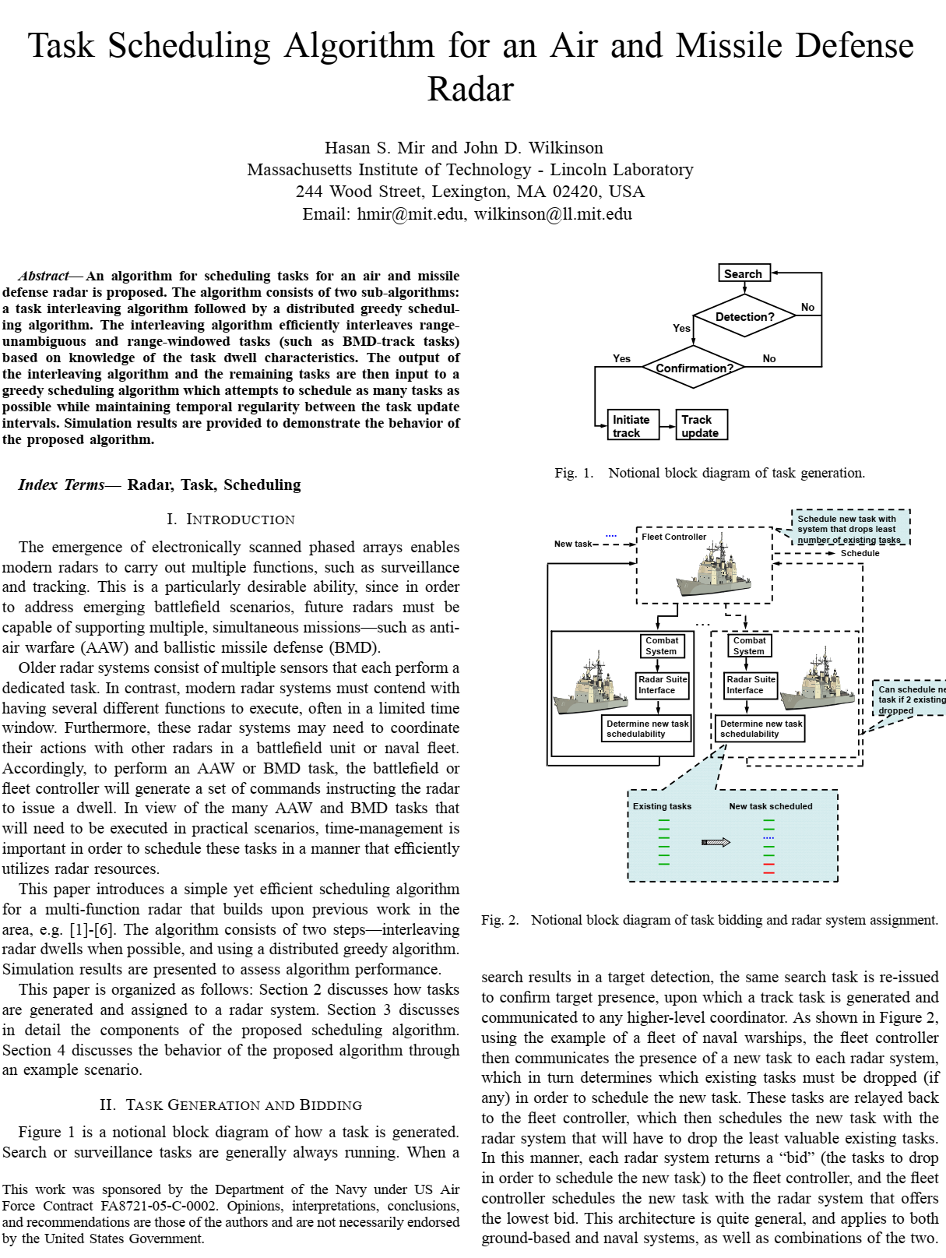
Mode S operations-- Mode Interlace Pattern
Interleaving for Mode S Roll-Call
Method for optimizing the management of radar time for secondary radars operating in Mode S
---------Philippe Billaud
Thales patent
A Method of Mode-S Radar Roll-Call Scheduling Management
-----IP/07 ICAO APAC DAPs WG/3
Task Scheduling Algorithm for an Air and Missile Defense Radar
------Hasan S. Mir and John D. Wilkinson
MIT Lincoln Laboratory

Slide 39

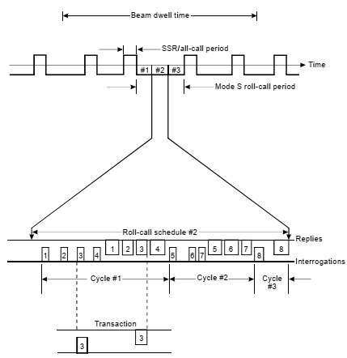

Mode S operations– Time Constraint

Slide 40
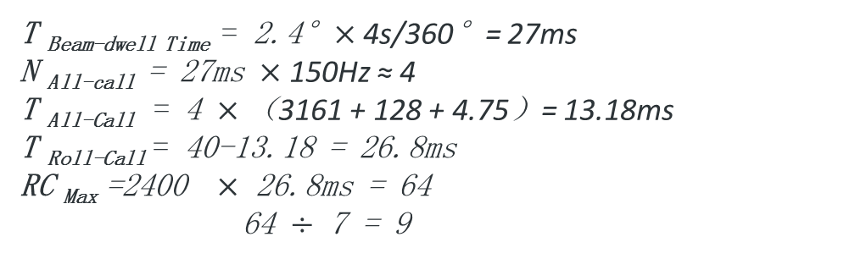
By-ISAAC
Mode S operations-- Time constraint
Scenario:
PRF =150Hz
Beam Width =2.4°
Rotation =4 S
Instrument Range=250nm
T _{Beam-dwell Time} = 2.4°$×$ 4s/360°= 27ms
N _{All-call} = 27ms $×$ 150Hz ≈ 4
T _{All-Call} = 4 $×$ （3161 + 128 + 4.75）= 13.18ms
T _{Roll-Call} = 40-13.18 = 26.8ms
RC _{Max} =2400 $×$ 26.8ms = 64
64 $÷$ 7 = 9
For all Mode S interrogators, the transmission rate for selective interrogations shall be:
a) less than 2 400 per second averaged over a 40-millisecond interval; and
b) less than 480 into any 3-degree sector averaged over a 1-second interval.
---- 3.1.2.11.1.3.1 ICAO Annex10 Volume IV, 5th Edition

Slide 41
Mode S operations-- Power constraint
The interrogation repetition rate for the Mode A/C/S all-call, used for acquisition, shall be less than 250 per second. This rate shall also apply to the paired Mode S-only and Mode A/C-only all-call interrogations used for acquisition in the multisite mode.
-----3.1.2.11.1.1.1 ICAO Annex10 Volume IV, 5th Edition
The minimum time between the beginning of successive Comm-C interrogations shall be 50μS.
-----3.1.2.11.1.2.2 ICAO Annex10 Volume IV, 5th Edition
As a minimum, the transmitter shall be capable of operating at a peak duty cycle of 63.7% over 2.4ms length of time. It is expected that the above requirement can be repeated every 24ms.
------Surveillance Mode S European Mode S Functional Specification
Eurocontrol

Slide 42
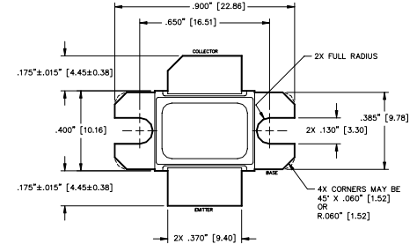
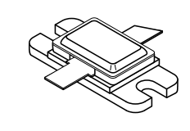
Mode S operations-- Time constraint
2.0 μS
2.75 μS
0.5 μS
0.5 μS
Comm-C Pulse-Time
=0.8+0.8+1+1.25+112*0.25=31.85μS
peak duty cycle
31.85μS/50μS = 63.7%
1.25 μS
0.25 μS
P6
112 data bits
P1
P2
SYNC PHASE
0.8 μS
0.8 μS
REVERSAL
PHASE REVERSAL
POSITION
Requires the capability of 48 consecutive COMM-C TRANSMISSION in 2.4 ms.
MDS60L/MDS500L:ELM Burst: 32µSec ON/ 18µSec OFF x 48, repeated at 23mSec

Slide 43
ELS and EHS

Slide 44
ELS & EHS-- Operational requirements
In Mode S ELS implementation, requirements of the aircraft and ground Mode S system
Selective interrogation.
Use of ICAO Aircraft Address.
Automatic reporting of ACID.
Report of transponder capability.
Altitude reporting with a resolution of 25ft (subject to aircraft capability).
Provision of flight status to indicate airborne or on-the-ground (subject to aircraft capability).
Report of SI Code capability; and
ACAS active resolution advisory report (when equipped with TCAS)
Mode S EHS implementation
includes all the features of Mode S ELS
BDS 4,0
BDS 5,0
BDS 6,0

Slide 45
  ELS & EHS-- Benefits
Improve tracking accuracy through the use of DAPs information (track, turn, speed and heading of the aircraft) in the track calculation.
Improve the accuracy of safety nets, e.g., Short-Term Conflict Alert (STCA), through the provision of more accurate aircraft tracks, and Medium-Term Conflict Detection (MTCD), Minimum Safe Altitude Warning (MSAW), through the provision of the earlier judgment of vertical movement.
Allow the implementation of new safety nets in ATM automation system for cross-checking selected aircraft vertical intention (i.e., Selected Altitude) with ATC controllers’ instruction as well as verifying the barometric pressure setting applied in the aircraft with QNH setting in ATM automation system.
Improve situational awareness of ATC controllers by enabling the direct access of aircraft parameters in ATM automation system, e.g., Indicated Air Speed, Mach speed, Selected Altitude, Barometric Pressure Setting, etc.
Progressive reduction of R/T workload per aircraft.

Slide 46
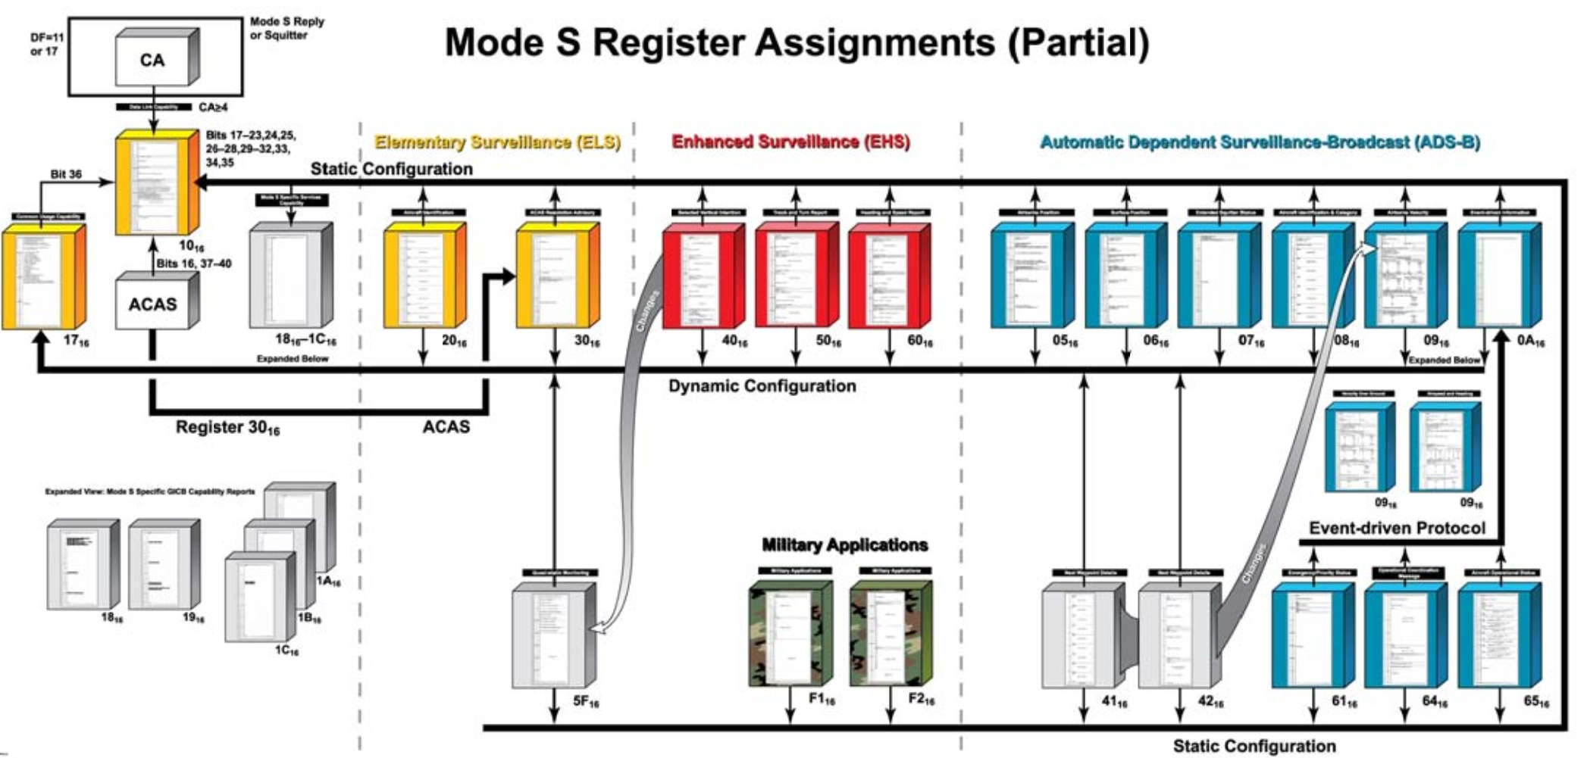
  ELS & EHS-- Register Introduction

Slide 47
  ELS & EHS-- Register Introduction
Register | Name | Usage
BDS code 1,0 | Datalink Capability Report | To report the data link capability of the Mode S transponder/data link installation.
BDS code 1,7 | Common Usage GICB Capability Report | To indicate common usage GICB services currently supported.
BDS code 2,0 | Aircraft Identification | To report aircraft identification to the ground.
BDS code 3,0 | ACAS Resolution Advisory Report | To report ACAS active resolution advisory
Register | Name/Downlink Aircraft Parameters |  | Usage
BDS code 4,0 | Selected Vertical Intention | MCP/FCU Selected Altitude | To provide information about the aircraft’s current vertical intentions
 |  | FMS Selected Altitude
 |  | Barometric Pressure Setting
 |  | MCP/FCU Mode
 |  | Target Altitude Source
BDS code 5,0 | Track and Turn Report | Roll Angle | To provide track and turn data to the ground systems.
 |  | True Track Angle
 |  | Ground Speed
 |  | Track Angle Rate
 |  | True Air Speed
BDS code 6,0 | Heading and Speed Report | Magnetic Heading | To provide heading and speed data to ground systems.
 |  | Indicated Air Speed
 |  | Mach Number
 |  | Barometric Altitude Rate
 |  | Inertial Vertical Velocity
More details in ICAO Doc 9871, 2nd Edition and ICAO APAC Mode S Daps IGD, Edition 3.0.

Slide 48
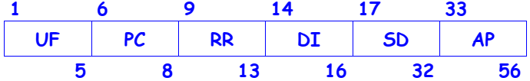

  ELS & EHS-- Optimal register extraction
  GICB
Extraction: Insertion of BDS 1 and BDS 2 codes into roll-call ( UF 4, 5, 20, 21) to read out aboard BDS data
BDS 2
BDS 1
BDS information

Slide 49
  ELS & EHS-- Optimal register extraction
  Comm-B Broadcast
Initiation: To Insert DR codes 4, 5 into roll-call reply DFs 4, 5, 20, 21 and starting the B-timer (18 s).
Extraction: To extract the broadcast message, an interrogator shall extract BDS0,0
RR = 16 and DI ≠to 7 or RR = 16 and DI = 7 with RRS = 0 in a next roll call interrogation.
Interruption: AICB activity can interrupt a Comm-B broadcast cycle. If a broadcast cycle is interrupted, the B-timer
shall be reset, the interrupted broadcast message shall be retained.
Currently, only registers of register BDS 1,0 and BDS 2,0 make use of the Comm-B Broadcast.
BDS 0,0 Extraction
DR=4 OR 5
Broadcast information
Notes:
On receipt of the above DR codes, interrogators may extract the broadcast message by transmitting RR=16 with DI≠3 or 7, or with DI=3 or 7 and RRS=0 in subsequent roll-call. When the B-timer runs out after 18 ±1 seconds, the transponder will reset the DR codes as required, will discard the previous broadcast.

Slide 50
  ELS & EHS-- Optimal register extraction
  Air-Initiated Downlink of RA Report
Initiation: To insert code 2,3,6,7 in the DR field to announce the presence of active Resolution Advisory (RA) message .
Extract: Interrogator shall transmit a request for a Comm-B message reply in a subsequent roll-call with RR and RRS for BDS 0,0.
Finish: DR=2, 3, 6 or 7 shall remain set for 18 ±1 seconds following the end of the RA unless superseded by a new ARA.
DR=2,3,6,7
Extraction BDS0,0
ACAS information + DR=2,3,6,7
Notes:
On receipt of the above DR codes, interrogators may extract the broadcast message by transmitting RR=16 with DI≠3 or 7, or with DI=3 or 7 and RRS=0 in subsequent roll-call. When the B-timer runs out after 18 ±1 seconds, the transponder will reset the DR codes as required, will discard the previous broadcast.

Slide 51
  ELS & EHS-- Optimal register extraction
  AICB
Initiation: The transponder insert code 1 (1,3 RTCA) in the DR field to announce the presence of an AICB message .
Extract: The interrogator shall transmit a request for a Comm-B message reply in a subsequent roll-call with RR and RRS for BDS 0,0.
Finish: After a Comm-B closeout has been accomplished, the message shall be cancelled and the DR code belonging to this message immediately removed.
DI = 0, 1 or 7
IIS = assigned interrogator identifier
PC = 4 (Comm-B closeout)
Extraction BDS0,0
AICB information + DR=1
DR=1
DI = 1
IIS = assigned interrogator identifier
MBS = 2 (Comm-B closeout)
DR=0
Notes:
On receipt of the above DR codes, interrogators may extract the broadcast message by transmitting RR=16 with DI≠3 or 7, or with DI=3 or 7 and RRS=0 in subsequent roll-call. When the B-timer runs out after 18 ±1 seconds, the transponder will reset the DR codes as required, will discard the previous broadcast.

Slide 52
  ELS & EHS– Optimal register extraction
Reg. 10₁₆,20₁₆,17₁₆,30₁₆ are the static or semi-static registers and do not need to be extracted all the time.
Any changes in the contents of the Reg. 10₁₆, 20₁₆, or 30₁₆ triggers a downlink message via the Comm B broadcast or Air-Initiated Downlink of RA Report including the updated register contents.
The changed state might result in interruption of certain Mode S data link functions.
A change in the value of the common-usage GICB report bit in the data link capability report (Reg. 10₁₆) would cause the application to re-extract the contents of the common-usage GICB capability report (Reg. 17₁₆).

Slide 53
Mode S Transponder

Slide 54
  Mode S transponder-- Basic electrical specification
Operating at altitudes above 15000 ft, or have a maximum cruising true airspeed in excess of 175 kt (324 km/h)----Class I
Operate at altitudes not exceeding 15000 ft, and have a maximum cruising true airspeed not exceeding 175 kt (324 km/h)------Class II
RF Peak Power：
The RF peak output power of each pulse of each reply at the terminals of the antenna shall be as follows.
a. CLASS I Equipment
Minimum RF peak power: 51.0 dBm (125 W).
Maximum RFpeak power: 57.0 dBm (500 W).
b. CLASS II Equipment
Minimum RF peak power: 48.5 dBm (70W).
Maximum RF peak power: 57.0 dBm (500 W).
Notes:
On receipt of the above DR codes, interrogators may extract the broadcast message by transmitting RR=16 with DI≠3 or 7, or with DI=3 or 7 and RRS=0 in subsequent roll-call. When the B-timer runs out after 18 ±1 seconds, the transponder will reset the DR codes as required, will discard the previous broadcast.

Slide 55
  Mode S transponder-- Reply Capability
  Mode AC
Mode AC
All Transponders The transponder shall be able to continuously generate at least 500 Mode A/C 15-pulse replies per second.
CLASS 1 Equipment shall be capable of a peak reply rate of 1200 Mode A/Creplies per 1S for a 15-pulse coded reply for a duration of 100 milliseconds
CLASS 2 Equipment shall be capable of a peak reply rate of 1000 Mode A/Creplies per 1S for a 15-pulse coded reply for a duration of 100 milliseconds
Notes:
On receipt of the above DR codes, interrogators may extract the broadcast message by transmitting RR=16 with DI≠3 or 7, or with DI=3 or 7 and RRS=0 in subsequent roll-call. When the B-timer runs out after 18 ±1 seconds, the transponder will reset the DR codes as required, will discard the previous broadcast.

Slide 56
  Mode S transponder-- Reply Capability
  Mode S
The total reply rate over each time interval, shall be the sum of the individual Mode A/C replies at an average rate of 500 per second and the Mode S reply rate over that interval.
a. Short DF Reply Rates
(1) 50 Mode S replies in any one-second interval;
(2) 18 Mode S replies in a 100-millisecond interval;
(3) 8 Mode S replies in a 25-millisecond interval;
(4) 4 Mode S replies in a 1.6-millisecond interval.
b. Long DF Reply Rates
A transponder shall be able to transmit as long replies;
(1) at least 16 of the 50 Mode S replies in any one-second interval;
(2) at least 6 of the 18 Mode S replies in a 100-millisecond interval;
(3) at least 4 of the 8 Mode S replies in a 25-millisecond interval;
(4) at least 2 of the 4 Mode S replies in a 1.6-millisecond interval.
Notes:
On receipt of the above DR codes, interrogators may extract the broadcast message by transmitting RR=16 with DI≠3 or 7, or with DI=3 or 7 and RRS=0 in subsequent roll-call. When the B-timer runs out after 18 ±1 seconds, the transponder will reset the DR codes as required, will discard the previous broadcast.

Slide 57
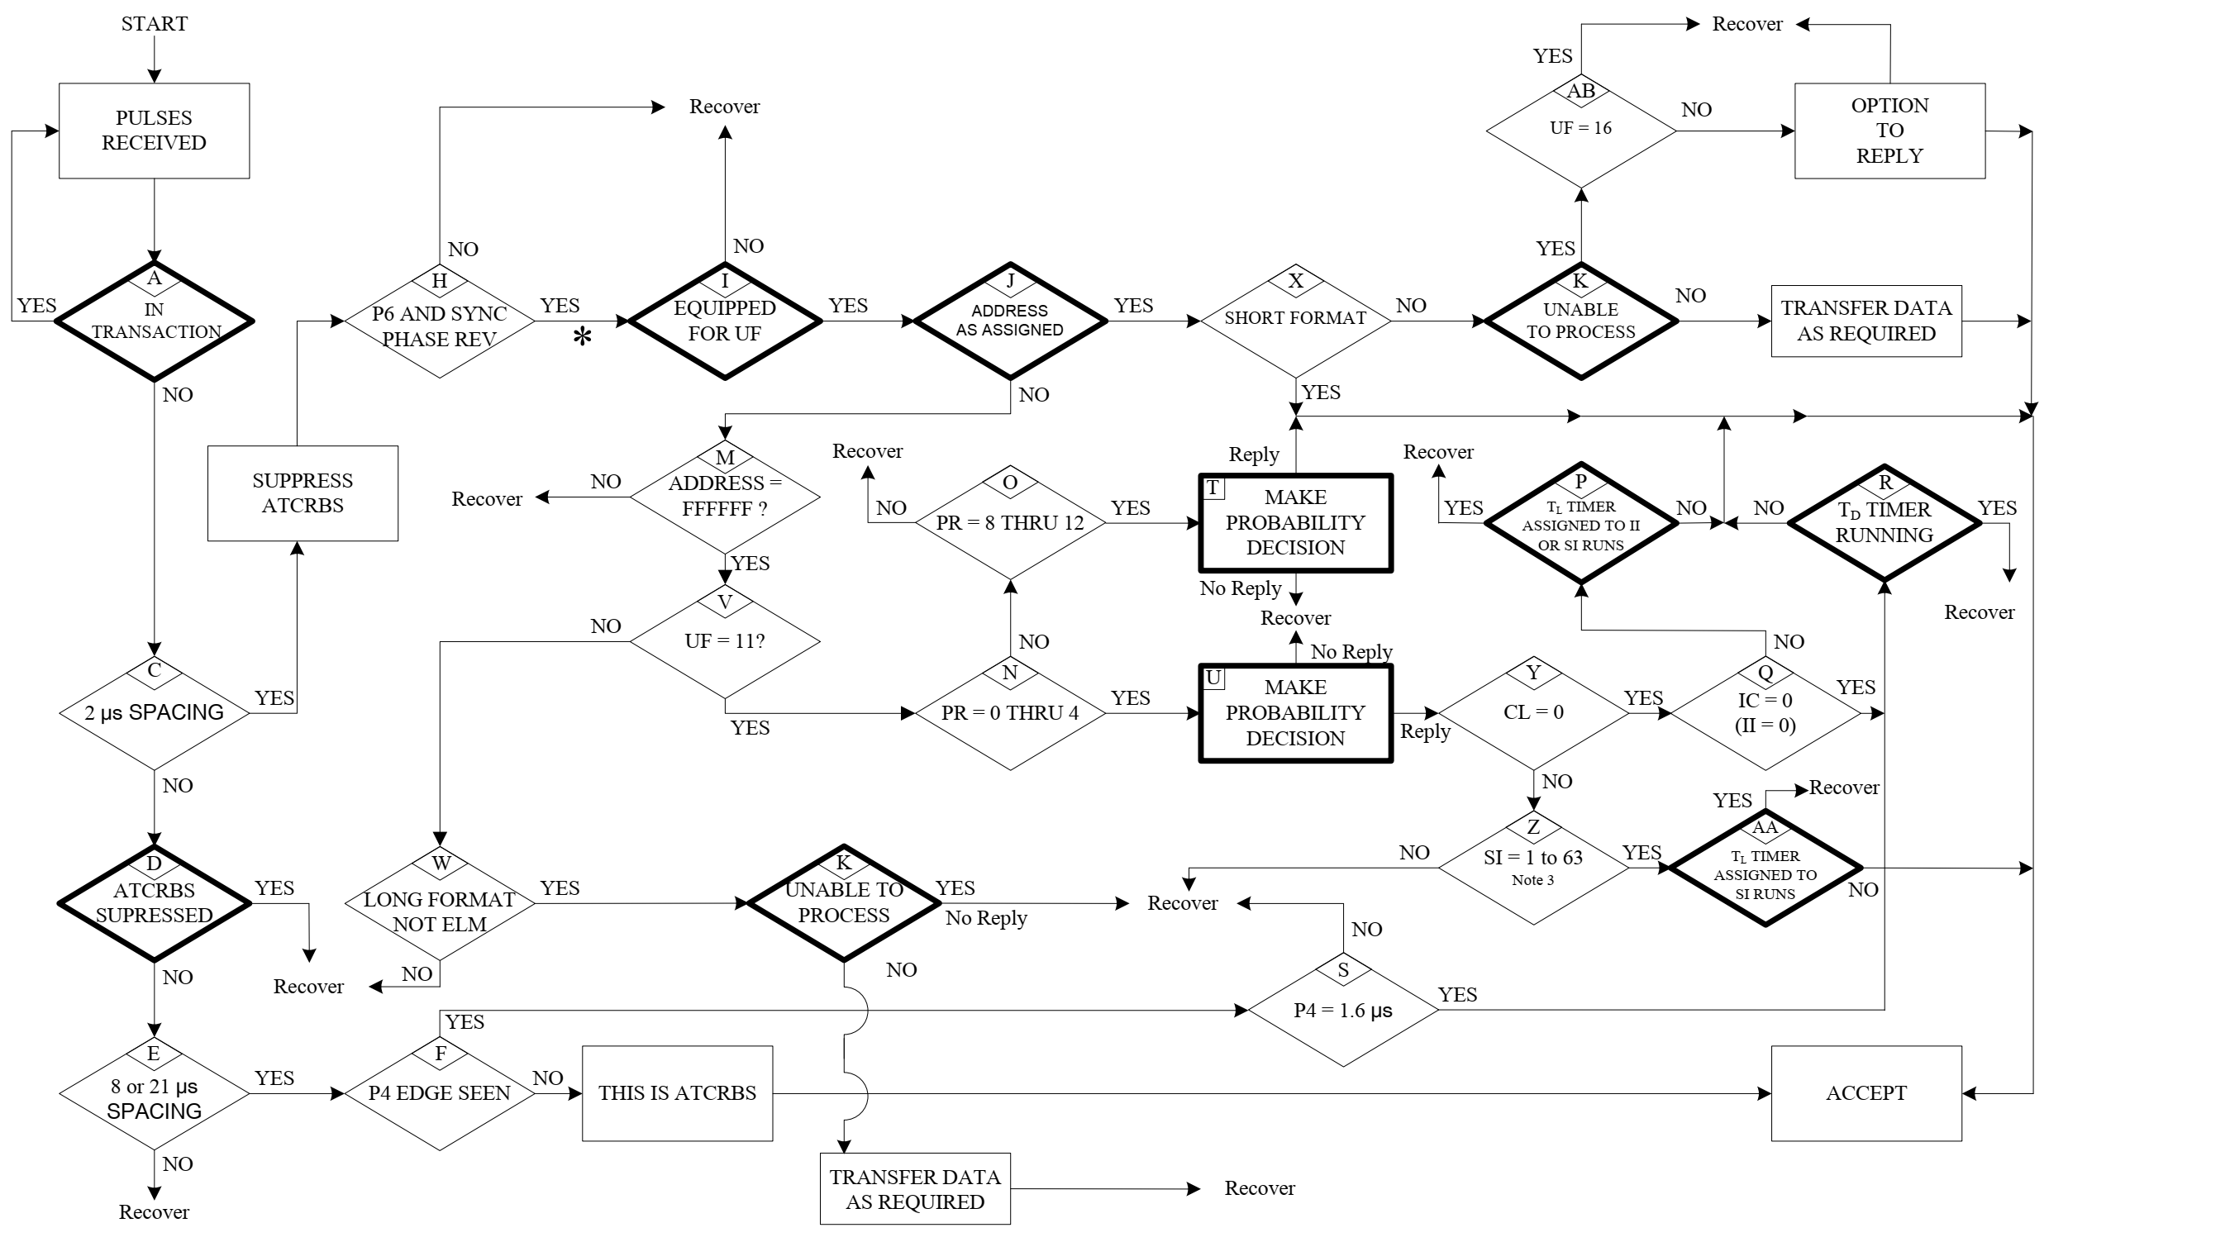
By-ISAAC
  Mode S transponder---Interrogation acceptance
  II/SI Capable Transponder
ACAS
Lockout override
Lockout Timer for II code
Non-selective lock-out 18S
UF11or Not
Stochastic acquisition
II OR SI Judgement
Silence Judgment
Lockout Timer for SI code
SP4 OR LP4 Judgement
P4 ?
Notes:
On receipt of the above DR codes, interrogators may extract the broadcast message by transmitting RR=16 with DI≠3 or 7, or with DI=3 or 7 and RRS=0 in subsequent roll-call. When the B-timer runs out after 18 ±1 seconds, the transponder will reset the DR codes as required, will discard the previous broadcast.

Slide 58
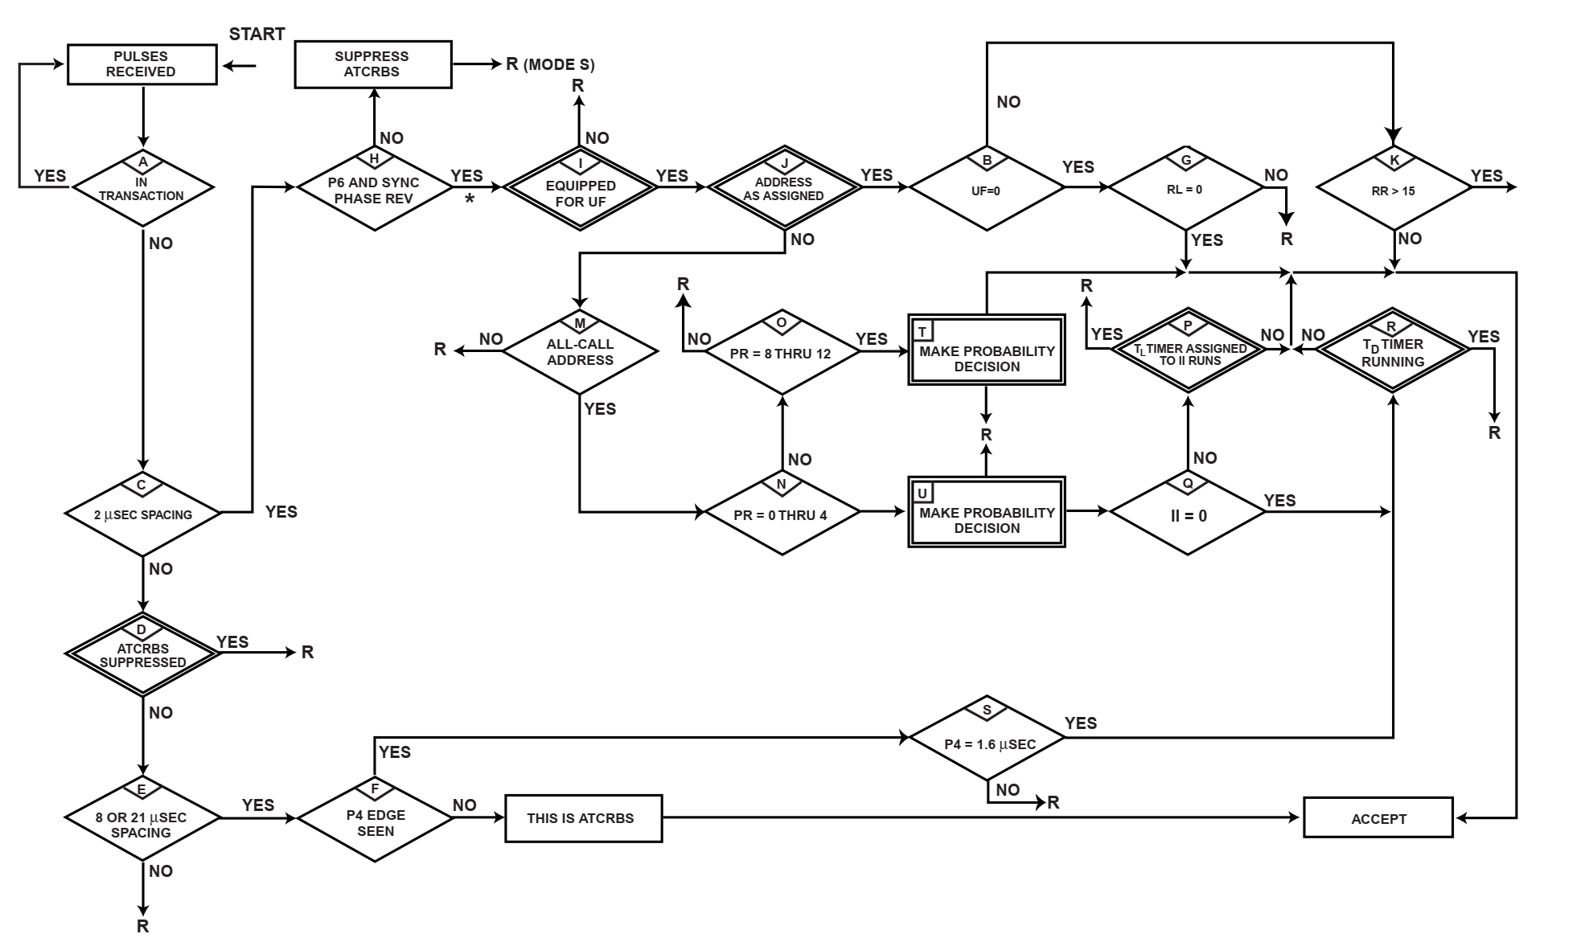
By-ISAAC
  Mode S transponder---Interrogation acceptance
  II Only Capable Transponder
Notes:
On receipt of the above DR codes, interrogators may extract the broadcast message by transmitting RR=16 with DI≠3 or 7, or with DI=3 or 7 and RRS=0 in subsequent roll-call. When the B-timer runs out after 18 ±1 seconds, the transponder will reset the DR codes as required, will discard the previous broadcast.

Slide 59
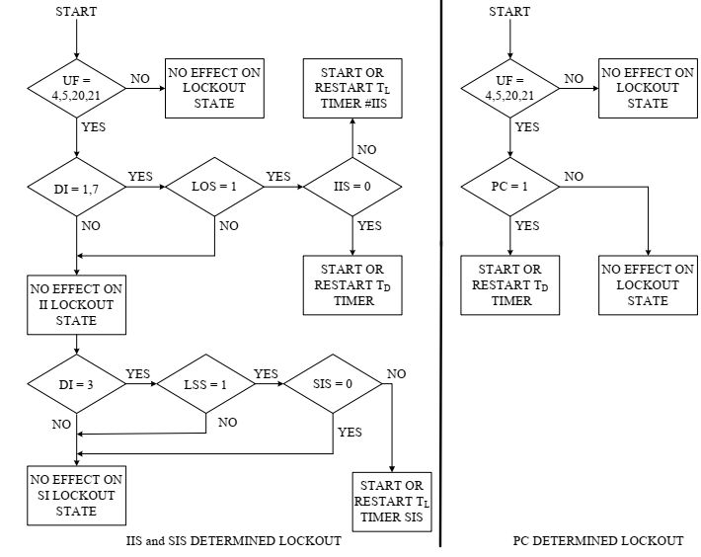
By-ISAAC
  Mode S transponder--- Lockout Protocol
  II/SI Capable transponder
Notes:
On receipt of the above DR codes, interrogators may extract the broadcast message by transmitting RR=16 with DI≠3 or 7, or with DI=3 or 7 and RRS=0 in subsequent roll-call. When the B-timer runs out after 18 ±1 seconds, the transponder will reset the DR codes as required, will discard the previous broadcast.

Slide 60
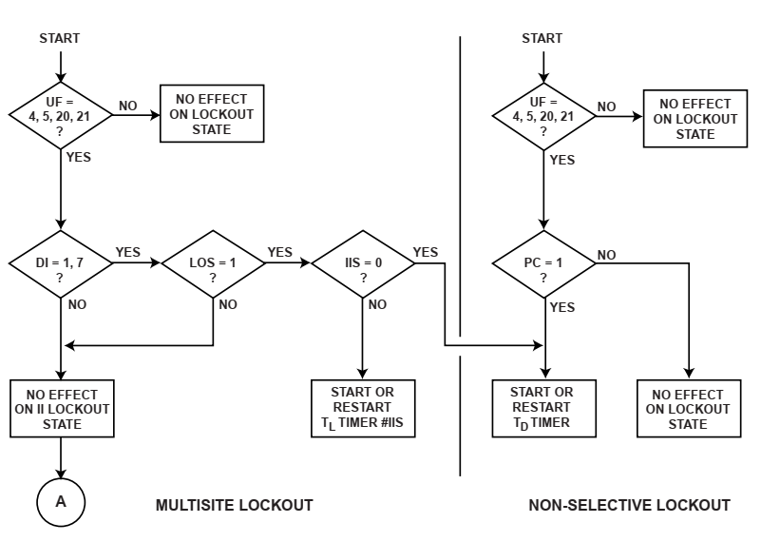
By-ISAAC
  Mode S transponder--- Lockout Protocol
  II Only Capable transponder
Notes:
On receipt of the above DR codes, interrogators may extract the broadcast message by transmitting RR=16 with DI≠3 or 7, or with DI=3 or 7 and RRS=0 in subsequent roll-call. When the B-timer runs out after 18 ±1 seconds, the transponder will reset the DR codes as required, will discard the previous broadcast.

Slide 61
Flight Inspection for a Mode S Radar

Slide 62
By-ISAAC
  Flight inspection for a Mode S radar
At present, many ANSPs require GICB, COMM-B broad-related capabilities in the technical specifications when purchasing Mode S radars. Flight Inspection is recommended for the following capabilities which have not been mentioned in ICAO Doc 8071 2nd Edition:
Prior to commissioning,
It is recommended for a verification of the GICB, COMM-B broadcast protocols in the flight inspection.
It is recommended to perform stochastic acquisition and lockout override tests in the flight inspection.
It is recommended to perform II and SI operation in the flight inspection.
Notes:
On receipt of the above DR codes, interrogators may extract the broadcast message by transmitting RR=16 with DI≠3 or 7, or with DI=3 or 7 and RRS=0 in subsequent roll-call. When the B-timer runs out after 18 ±1 seconds, the transponder will reset the DR codes as required, will discard the previous broadcast.

Slide 63
APAC’s proposed modifications to Doc. 9924

Slide 64
By-ISAAC
  APAC’s proposed modifications to Doc. 9924
Existing Doc 9924 Appendix H provided information on acquisition and lockout protocols
Improvements are made to:
Explain II and matching SI codes.
Provide elaboration on the II/SI code operation where the interrogator acquires both II and SI transponders, but intentionally only lock out SI transponders and not lock out II only transponders.
Existing Doc 9924 Appendix J provided information on II code assignments
Improvements are made to:
Provide guidance on code assignment when there is a mixture of II and SI code interrogators in an environment where II only transponders still exist.
Explain the conditions when the radar coverage can overlap safely.
Notes:
On receipt of the above DR codes, interrogators may extract the broadcast message by transmitting RR=16 with DI≠3 or 7, or with DI=3 or 7 and RRS=0 in subsequent roll-call. When the B-timer runs out after 18 ±1 seconds, the transponder will reset the DR codes as required, will discard the previous broadcast.

Slide 65
