Slide 1
8.33kHz VCS Implementation
Implementation progress report
EUR/NAT MID Preparatory Workshop
Jacky Pouzet
HOU - CFC
Network Manager

Slide 2
Summary
Regulatory framework
Implementation status and planning
Analysis supporting the Network Impact Assessment
8.33kHz VCS NM implementation support

Slide 3
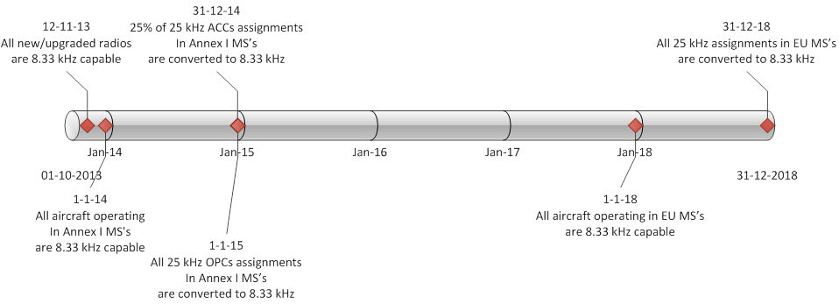
(EU) IR 1079/2012 - VCS Regulation

Slide 4
Area concerned
IR

Slide 5
Who is affected?
General Air Traffic (GAT)
All categories of aircraft operating below FL195 within ICAO EUR region where EU MS are responsible for providing ATS
Exemptions possible under certain circumstances
ANSPs
State aircraft
Transport/non-transport state aircraft operating below FL195 (Military, police, customs, civilian aircraft operating as military, police, etc.)
Ground vehicles
Aerodromes
IR

Slide 6
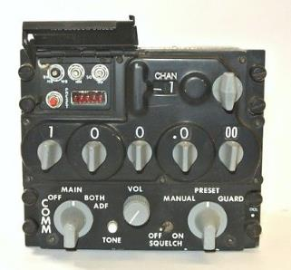
Equipment
All radios on EU market (VHF band) past 2013 are 8.33VCS capable
All equipment put into service after 2013 is 8.33VCS capable
All new airworthiness certificate past 2013 requires 8.33VCS equipment
IR

Slide 7
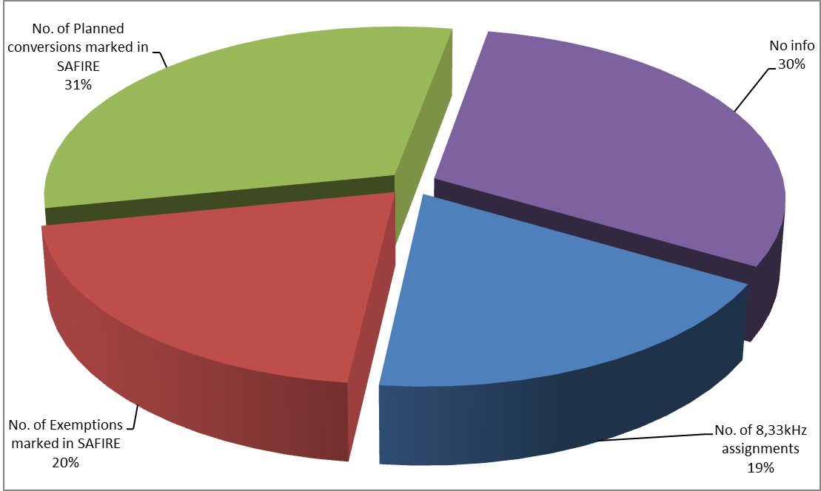
Regulatory framework
Implementation status and planning
Analysis supporting the Network Impact Assessment
8.33kHz VCS NM implementation support

Slide 8
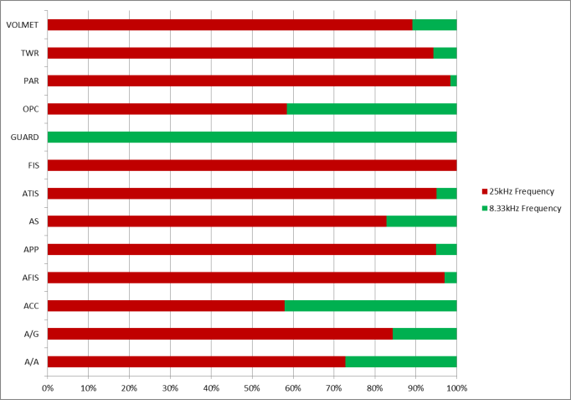
8.33VCS Implementation Status
Based on SAFIRE information April 2017 for Switzerland, Norway and EU MS
Only operational and assigned frequency assignments
Excluding frequencies excepted from conversion by VCS Regulation (CLIMAX, ACARS, VDL, EMG, SAR)
Service | 25kHz | 8.33kHz | Total Assignments
A/A | 16 | 6 | 22
A/G | 1560 | 290 | 1850
ACC | 696 | 506 | 1202
AFIS | 774 | 24 | 798
APP | 1020 | 54 | 1074
AS | 625 | 130 | 755
ATIS | 380 | 20 | 400
FIS | 117 |  | 117
GUARD |  | 1 | 1
OPC | 1092 | 774 | 1866
PAR | 128 | 2 | 130
TWR | 968 | 59 | 1027
VOLMET | 49 | 6 | 55
Grand Total | 7425 | 1873 | 9298

Slide 9
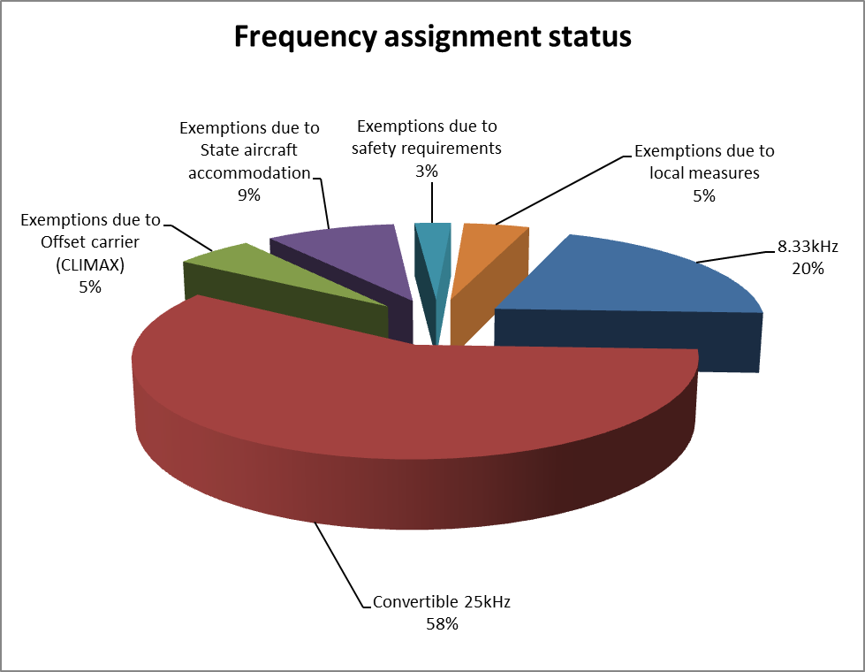
8.33VCS Implementation planning
 | 25kHz | Exemptions due to Offset carrier (CLIMAX) | Exemptions due to State aircraft accommodation | Exemptions due to safety requirements | Exemptions due to local measures | Total Exemptions | Convertible 25kHz
No. Assignments | 7425 | 505 | 830 | 233 | 421 | 1989 | 5436
Note: these figures are in continuous evolution while states are finalising their strategy for conversion

Slide 10
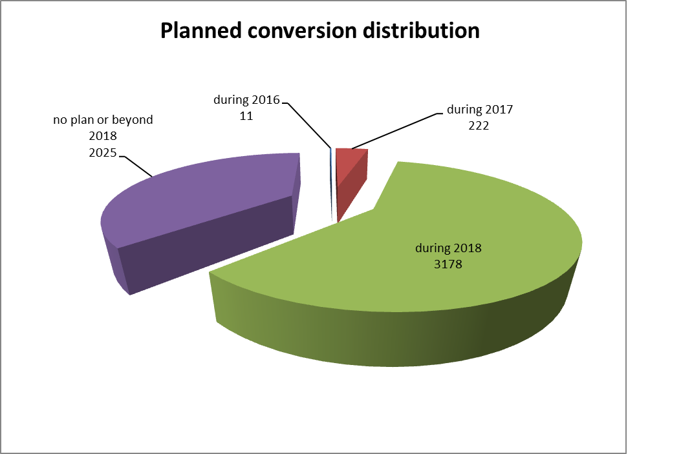
8.33VCS Implementation planning
 | during 2016 | during 2017 | during 2018 | no plan or beyond 2018
No Assignments planned for conversion | 11 | 222 | 3178 | 2025

Slide 11
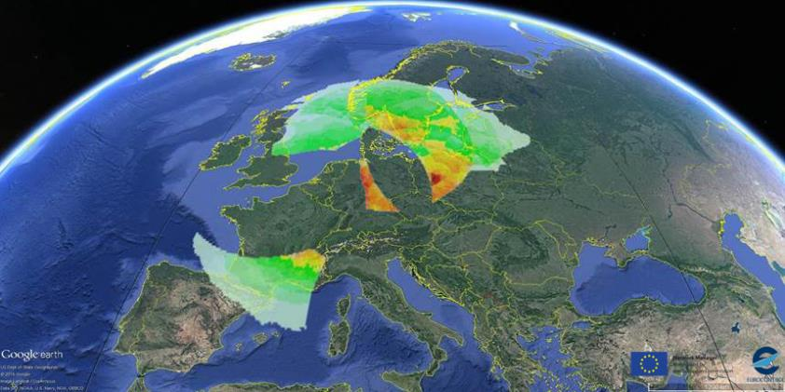
Summary
Regulatory framework
Implementation status and planning
Analysis supporting the Network Impact Assessment
8.33kHz VCS NM implementation support

Slide 12
Assessment Objective
Evaluate the impact of local measures granting exemptions on the VHF spectrum availability
As an individual (isolated) effect (State level)
Global effect (EU level)
Analyse the availability of frequency assignments in the future considering:
The forecasted frequency demand for all States
Other known constraints (e.g. frequency demand in “non 8.33 States”)
The Network Impact is defined by the probability of success in the process of allocating new frequency assignments, taking into account the forecasted demand.
A limited Network Impact can be considered in the case in which the future frequency demand can be satisfied without significant delays.

Slide 13
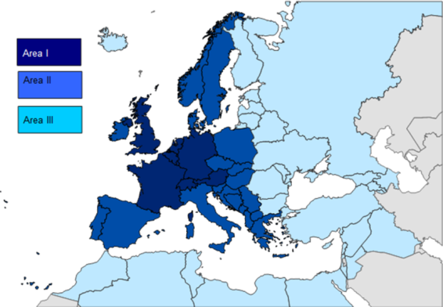
Data availability and assumptions
Assessment is performed based on frequency assignment allocation data:
Available in SAFIRE
VHF frequency
Service
Designated Operational Coverage (DOC)
8.33 planning (i.e. conversion or exemption)
For all states
EU Member States (28+2)
Non-EU Member States participating in SAFIRE
Current frequency congestion & forecasted frequency demand
For 25kHz assignments
For 8.33kHz assignments
In 3 separate areas (Area1, 2 and 3) based on current spectrum congestion
$e<Ref>
$d(DDMMYY)
$es
$ec
$em

Slide 14
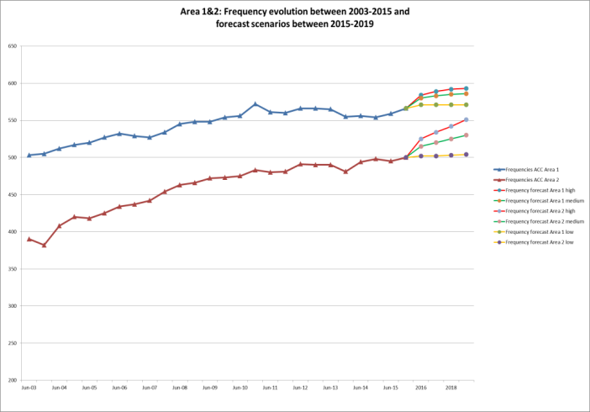
Frequency demand forecast data
The forecast of future demand is based on
Analysis of past frequency demand evolution,
Known planned developments of the ATM infrastructure as covered by the Network Operations Plan
Validation and extrapolation of demand trends based on the current situation
Agreed by the States
Specific distribution of the demand was considered depending on the geographical position
Different trend
Different demand
Different ratio between 25kHz and 8.33kHz assignments demand*
*Normally a 80%-20% ratio between 8.33kHz/25kHz assignments demand is considered for all services in Area 1&2, while a 20%-80% ratio is considered for Area 3. This is due to States in Area 3 not being covered by the VCS Regulation

Slide 15
Methodology(ies)
Based on frequency demand satisfaction over a period of years (up to 2036)
Measured by assessing the rate of success in finding frequency assignments for the forecasted demand
rate of success above 95%
rate of success below 95%
Dependent on the number of “shifts” allowed
Based on the number of frequencies available in a geographical location
Analysing the contribution of a proposed exemption to the reduction of the number of frequency assignments available in a certain area
Qualifying the impact based on the number of frequencies available at the geographical location where the loss takes place (i.e. a loss of 10 potential new assignments in a location where 100 frequencies are available has not the same impact as having a similar loss in a location where only 11 are available)
for 2018 (conservative case: minimum conversions vs. maximum no of exemptions)
Global impact
Individual impact

Slide 16
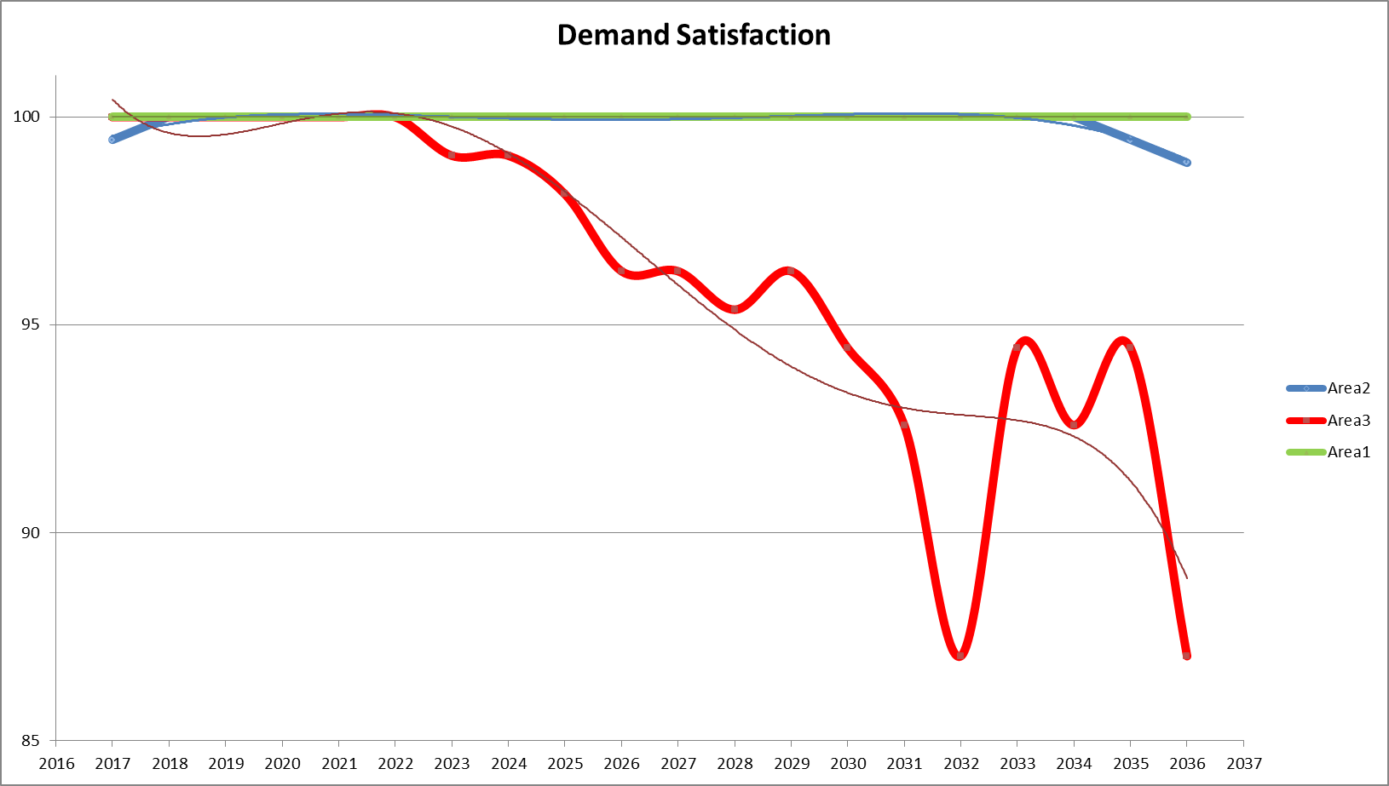
Frequency demand satisfaction
Nominal potential implementation scenario
The forecasted frequency demand is satisfactory fulfilled (above 95% satisfaction rate) for Area 1 and 2 States
A maximum of 2 frequency shifts are allowed in order to allocate a solution
Until 2028 for Area 3 all the demand is satisfied above 95%

Slide 17
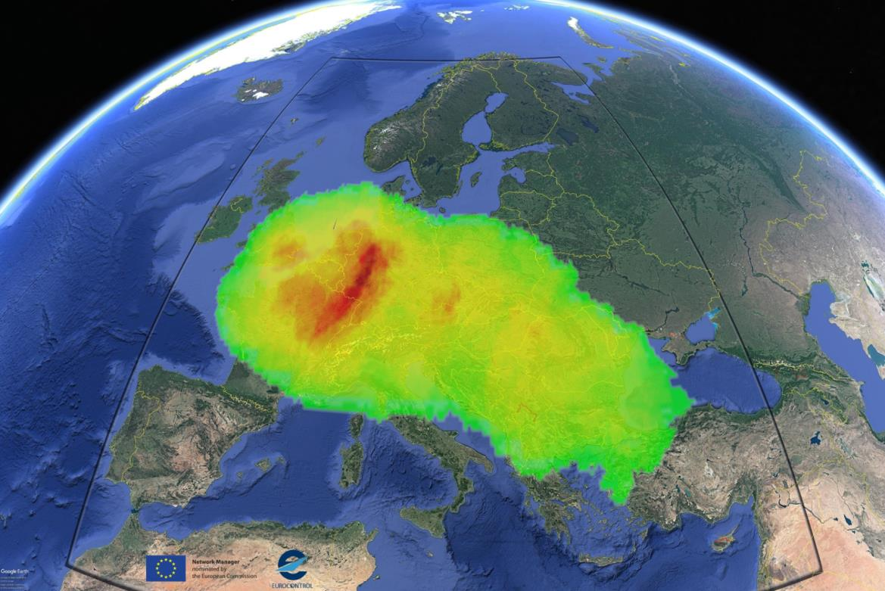
Frequency Congestion - estimated for end of 2018
No. of available 8.33kHz channels based on an ACC 50NM radius/FL450 service

Slide 18
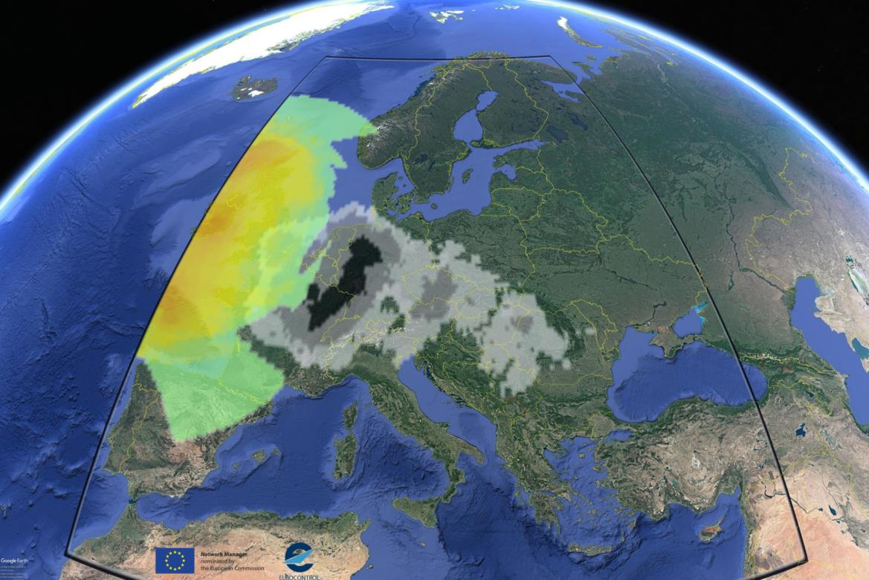
Example of exemption spectrum contribution for end 2018
No. of 8.33kHz assignments contributing to the spectrum reduction, based on an ACC 50NM radius/FL450 service

Slide 19
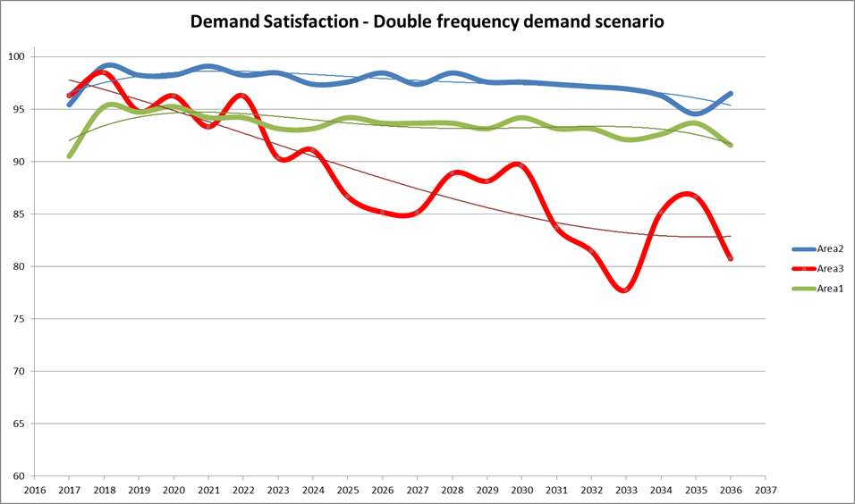
Frequency demand variations
Double frequency demand (2 shift)
The satisfaction rate trend for the States in Area 1 is constantly below 95%
The satisfaction rate for the States in Area 2, shows a tendency to decrease through the end of the considered time interval
The satisfaction rate for the Area 3 is constantly below 95% and on a decreasing trend

Slide 20
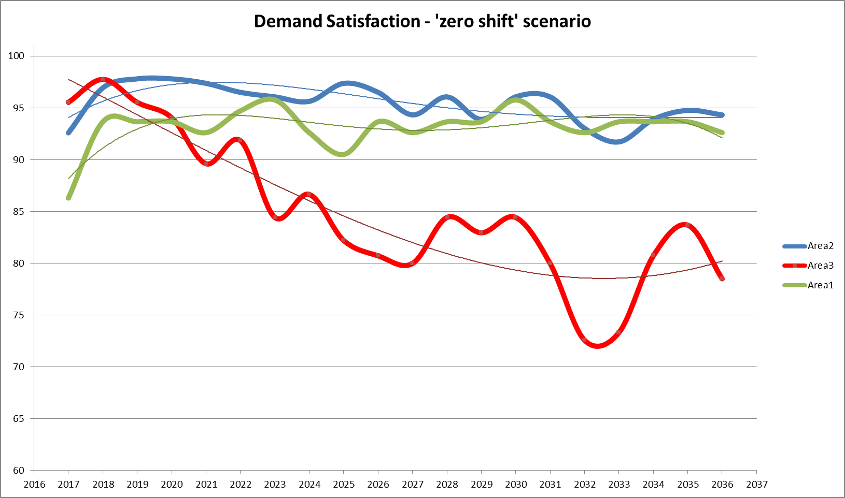
Frequency demand variations
Nominal Frequency demand (0 shift)
The satisfaction rate trend for the States in Area 1 is constantly below 95%
The satisfaction rate for the States in Area 2, while above 95% for the first 9 years of the assessment, decreases and remains below this threshold after 2027
The satisfaction rate for the Area 3 States is constantly below 95% and on a decreasing trend

Slide 21
Frequency congestion evolution forecast
Comparison of the 8.33kHz channel congestion in Europe
Nominal potential implementation scenario in 2018 vs.
2025 with the forecasted demand added
Note: the reduction of the frequency congestion in core Europe is due to most of the local measures granting exemptions being lifted. The increase in congestion in the East European States is due to
- the lack of complete planning information from Bulgaria, Greece, Cyprus,
- numerous exemptions for State aircraft accommodation (e.g. Romania)
- the demand in 25kHz assignments from the States not participating in 8.33 programme (e.g. Turkey)

Slide 22
Frequency Congestion – estimated end 2018
No. of available 8.33kHz channels based on an ACC 50NM radius/FL450 service

Slide 23
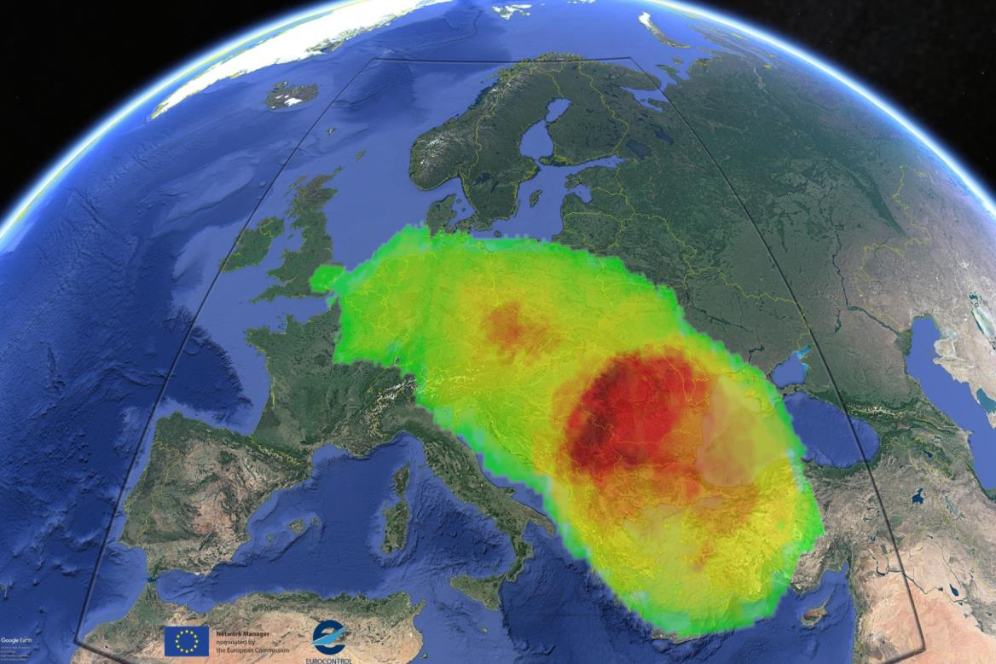
Frequency Congestion – estimated 2025
No. of available 8.33kHz channels based on an ACC 50NM radius/FL450 service

Slide 24
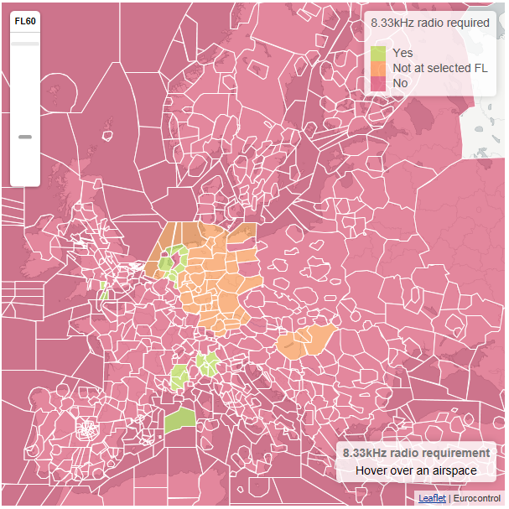
Summary
Regulatory framework
Implementation status and planning
Analysis supporting the Network Impact Assessment
8.33kHz VCS NM implementation support

Slide 25
NM Implementation Support Project
Monitoring & Steering implementation
Data collection for conversion planning, exemption, equipment inventory and implementation status
SAFIRE
Direct reporting
VHF Radio Testing Campaign
GA aircraft and equipment repository (833radio.com)
Coordination of exemptions/derogations
Network Impact Assessment analysis of exemptions
Exemption strategy analysis
Awareness and support to implementation
www.eurocontrol.int/833
Information dissemination preparation
833radio.com
Aero Friedrichshafen briefing (industry, pilots, fight schools, etc.)
Notes:
- there are 3 main directions of activities within the 8.33 Implementation Support Project:
- monitoring and steering
- Coordination of exemptions
- awareness and support to implementation
- note the tasks covered by each of the activities and note the new achievements:
- VHF radio testing campaign – KOM tomorrow in which it is intended to provide feedback to the industry on specific technical issues related to the available radio equipment (8.33)
- GA aircraft and equipment repository – a web based platform for voluntary registration of aircraft owners intended to increase the awareness of the pilots regarding the 8.33 deployment, obtain an up-to-date database of GA aircraft and equipment, provide a basis for eventual funding for retrofit
- Impact assessment simulation with the scope of assessment of planned exemptions by states and support the definition of coordinated, and harmonised exemption strategies

Slide 26
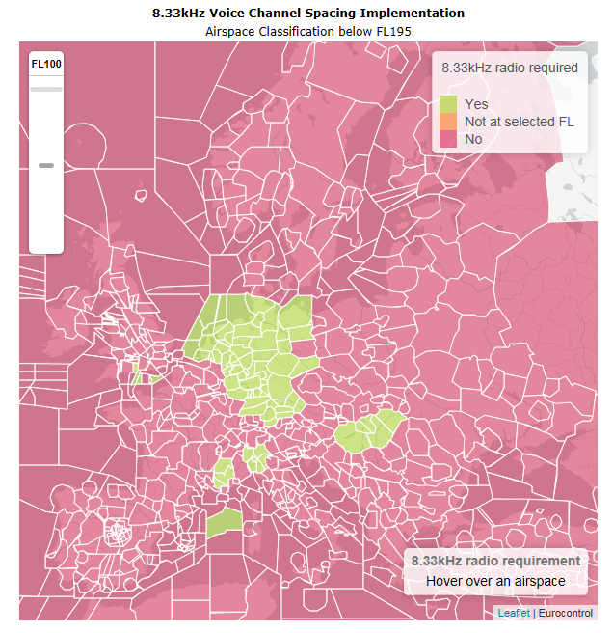
Implementation progress below FL195 EU ATC sectors
https://ext.eurocontrol.int/833/Airspace_8.33kHz_Radio.html
Notes:
- there are 3 main directions of activities within the 8.33 Implementation Support Project:
- monitoring and steering
- Coordination of exemptions
- awareness and support to implementation
- note the tasks covered by each of the activities and note the new achievements:
- VHF radio testing campaign – KOM tomorrow in which it is intended to provide feedback to the industry on specific technical issues related to the available radio equipment (8.33)
- GA aircraft and equipment repository – a web based platform for voluntary registration of aircraft owners intended to increase the awareness of the pilots regarding the 8.33 deployment, obtain an up-to-date database of GA aircraft and equipment, provide a basis for eventual funding for retrofit
- Impact assessment simulation with the scope of assessment of planned exemptions by states and support the definition of coordinated, and harmonised exemption strategies

Slide 27
Questions?

Slide 28
8.33kHz VCS Implementation
EUR/NAT MID Preparatory Workshop
Thank you!
8.33VCS Implementation Support
www.eurocontrol.int/833
8.33@eurocontrol.int

