Slide 1
Status of CEPT preparations for WRC-19
Stephen Parry, NATS UK
ICAO EUR/NAT MID Preparatory Workshop to ITU WRC-19
11/12 September 2017

Slide 2
Structure of CPG19
The Conference Preparatory Group (CPG19) of CEPT/ECC is responsible for developing the ECPs and Briefs for WRC-19 and RA-19
The CPG management team has been confirmed:
Chairman: Alexander Kühn, Germany
Vice-Chairmen: Gerlof Osinga, The Netherlands
Alexandre Vallet, France
Secretary: Karsten Buckwitz, Germany

Slide 3
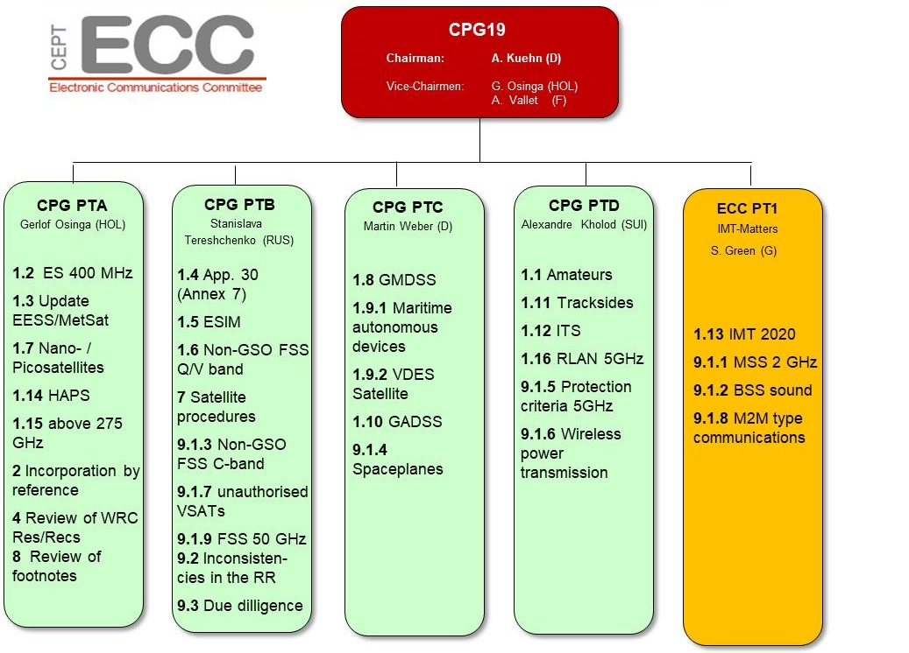
CPG19 Project Teams

Slide 4
CPG19 Deliverables
For both WRC-19 and the RA-19:
European Common Proposals (ECPs)
At least 10 administrations in support
No more than 6 opposing – as a general guideline
CEPT Briefs
Describe each agenda item
Contains the CEPT view – agreed by consensus at each stage
CEPT co-ordination in ITU-R meetings
Agreed contributions (also for non-WRC issues)
Co-ordination on lines to take

Slide 5
Agenda Item 1.10 (approved by CPG19#4)
Issue: to consider spectrum needs and regulatory provisions for the introduction and use of the Global Aeronautical Distress and Safety System (GADSS), in accordance with Resolution 426 (WRC-15);
Preliminary CEPT position:
CEPT recognises that the implementation of the GADSS concept would contribute to increasing the effectiveness of the current alerting of search and rescue services for civil aviation transportation.
Acting CEPT Coordinator: PTC chairman

Slide 6
Agenda Item 1.10 (approved by CPG19#4)
Issue: to consider spectrum needs and regulatory provisions for the introduction and use of the Global Aeronautical Distress and Safety System (GADSS), in accordance with Resolution 426 (WRC-15);
Preliminary CEPT position (continued):
CEPT is of the view
that systems contributing to the GADSS have to be identified in accordance with ICAO requirements or recommendations provided in SARPs, manuals or guidance material;
that any changes to the Radio Regulations should be determined on the basis of the GADSS concept developed by ICAO;
that systems identified to contribute to the GADSS may not necessarily require any additional frequency allocation nor any new or revised regulatory provisions
that additional regulatory actions for the introduction and use of GADSS, if any, should be identified ensuring sharing and compatibility with systems in incumbent radiocommunication services in the frequency bands proposed for GADSS introduction and in the adjacent frequency bands without imposing any additional constraints on the existing and planned systems.
that according to the process to implement the GADSS concept an extension of activities towards WRC-23 may need to be considered.
Acting CEPT Coordinator: PTC chairman

Slide 7
Agenda Item 9.1 Issue 9.1.4 (approved by CPG19#4)
Issue: to conduct studies to identify any required technical and operational measures, in relation to stations on board sub-orbital vehicles, that could assist in avoiding harmful interference between radiocommunication services;
Preliminary CEPT position:
CEPT is of the view that:
the ITU-R studies called for by Resolution 763 should be supported;
based on the results of those studies, what action is to be taken should be determined;
stations on board suborbital vehicles shall not cause harmful interference nor impose additional constraints on systems operating under the incumbent services.
suborbital vehicles need to be differentiated from current satellite launch vehicles.
CEPT Coordinator: Stephen Limb (United Kingdom)

Slide 8
Other agenda items
Agenda items that may have an impact on spectrum for aeronautical systems or services:
(1.7, 1.8, 1.9, 1.11, 1.12, 1.13, 1.14, 1.16, 4, 8, 9.1.3, 9.1.6, 10)

Slide 9
Agenda Item 1.7 (approved by CPG19#3)
Issue: to study the spectrum needs for telemetry, tracking and command in the space operation service for non-GSO satellites with short duration missions, to assess the suitability of existing allocations to the space operation service and, if necessary, to consider new allocations, in accordance with Resolution 659 (WRC-15);
Preliminary CEPT position:
CEPT supports additional allocations or upgrades of existing allocations to the space operation service for short duration mission satellites provided that:
Studies of spectrum requirements are based on satellite missions planned and constellation development.
Studies of spectrum requirements show the need for additional allocations or upgrades of existing allocations.
Studies show compatibility with existing services.
CEPT recognises that studies with regard to the bands 399.9-400.05 MHz and 401-403 MHz, if any, will have to take into account the considerations under Agenda item 1.2.
CEPT recognises that all allocations to the space operation service in the Earth-to-space direction below 1 GHz are subject to coordination under No. 9.21 and therefore not suitable for short duration NGSO satellites.
CEPT Coordinator: Mr Wouter Jan Ubbels (The Netherlands)

Slide 10
Agenda Item 1.7 (approved by CPG19#3)
Issue: to study the spectrum needs for telemetry, tracking and command in the space operation service for non-GSO satellites with short duration missions, to assess the suitability of existing allocations to the space operation service and, if necessary, to consider new allocations, in accordance with Resolution 659 (WRC-15);
Preliminary CEPT position: (continued)
CEPT is of the view that, before considering additional allocations to the space operation service in the Earth-to-space direction, there may be a need to consider modifying the current regulatory situation in the existing allocations.
CEPT is of the view that consideration of the frequency band 154-156 MHz as candidate for operation of non-GSO satellites with short duration missions is not feasible due to difficulties in sharing with the incumbent services (the radiolocation service).
CEPT is of the view that any consideration of bands for use under this agenda item must exclude the 406-406.1 MHz COSPAS-SARSAT band as well as its adjacent 405.9-406 MHz and 406.1-406.2 MHz bands (see resolves 1, Resolution 205 (WRC 15)).
CEPT Coordinator: Mr Wouter Jan Ubbels (The Netherlands)

Slide 11
Agenda Item 1.8 (approved by CPG19#4)
Issue: to consider possible regulatory actions to support Global Maritime Distress Safety Systems (GMDSS) modernization and to support the introduction of additional satellite systems into the GMDSS, in accordance with Resolution 359 (Rev.WRC-15);
Preliminary CEPT position:
Issue A: modernisation of GMDSS
TBD
Issue B: Regulatory action due to the introduction of additional satellite systems into the GMDSS by IMO
TBD
CEPT co-Coordinators: Talayeh Hezareh (Germany), Christian Rissone (France)

Slide 12
Agenda Item 1.9.1 (approved by CPG19#4)
Issue: to consider, based on the results of ITU-R studies: regulatory actions within the frequency band 156-162.05 MHz for autonomous maritime radio devices to protect the GMDSS and automatic identifications system (AIS), in accordance with Resolution 362 (WRC-15);
Preliminary CEPT position:
CEPT is of the view that the operation of autonomous maritime radio devices needs to be harmonized and regulated.
CEPT is of the view that the operation of autonomous maritime radio devices shall not reduce the integrity of AIS and of GMDSS.
CEPT supports the identification of spectrum for autonomous maritime radio devices within the frequency band 156-162.05 MHz.
CEPT Coordinator: Heinrich Peters (Germany)

Slide 13
Agenda Item 1.9.2 (approved by CPG19#4)
Issue: to consider possible regulatory actions, including spectrum allocations to the maritime mobile-satellite service (MMSS) Resolution 358 (WRC-12) to enable a new VHF data exchange system (VDES) satellite component in accordance with Resolution 360 (Rev.WRC-15);
Preliminary CEPT position:
CEPT supports sharing and compatibility studies between the proposed VDES satellite component and the systems in the radiocommunication services allocated in the same and in adjacent frequency bands.
CEPT is of the view that implementability of the VDES satellite component and feasibility of its sharing and compatibility with the systems in the radiocommunication services allocated in the same and adjacent frequency bands without imposing any limitations on those services shall be confirmed by appropriate study results.
Subject to the results of relevant studies, CEPT is considering two options:
the introduction of a new maritime mobile-satellite (space-to-Earth) service allocation within the frequency bands 160.9625-161.4875 MHz which is not channelized in RR Appendix 18 and the introduction of a new maritime mobile-satellite (Earth-to-space) service allocation for the channels 24, 84, 25, 85, 26 and 86 of RR Appendix 18
the introduction of a new maritime mobile satellite service for the channels 1024, 1084, 1025, 1085, 1026, 1086 (Earth-to-space) of RR Appendix 18 and for the channels 2024, 2084, 2025, 2085, 2026 and 2086 (space-to-Earth) of RR Appendix 18;
For both options the pfd mask defined in Recommendation ITU-R M.2092, applies to the satellite component of VDES in order to ensure protection of the terrestrial services.
Acting CEPT Coordinator: PTC chairman

Slide 14
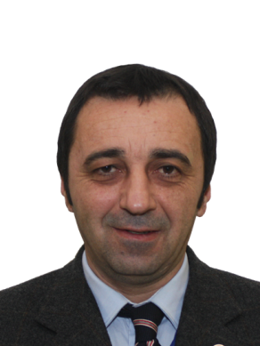
Agenda Item 1.11 (approved by CPG19#4)
Issue: to take necessary actions, as appropriate, to facilitate global or regional harmonized frequency bands to support railway radiocommunication systems between train and trackside within existing mobile service allocations, in accordance with Resolution 236 (WRC-15);
Preliminary CEPT position:
CEPT is of the view that the harmonized use of frequencies for RSTT within existing mobile service allocations serves current and future demands of railway organisations on all operational levels.
CEPT is of the view that no changes to the RR are needed in response to WRC-19 AI 1.11.
CEPT is of the view that harmonisation for RSTT can be achieved by the development of an appropriate non-mandatory ITU-R Recommendation containing its regional harmonisation measure. In this regard, CEPT highlights its existing framework for train radio RSTT on the basis of GSM-R, which enables interoperable cross-border railway operations.
In addition, CEPT is of the view that harmonisation under AI 1.11 is limited to spectrum for critical railway operations, while possible passenger data requirements are covered by IMT systems.
* RSTT systems considered by CEPT: train radio, train positioning, train remote, train surveillance
CEPT Coordinator: Zaza Gonjilashvili (Georgia)

Slide 15
Agenda Item 1.12 (approved by CPG19#4)
Issue: to consider possible global or regional harmonized frequency bands, to the maximum extent possible, for the implementation of evolving Intelligent Transport Systems (ITS) under existing mobile-service allocations, in accordance with Resolution 237 (WRC-15);
Preliminary CEPT position:
CEPT is of the view that its existing regional harmonisation measures for ITS in the bands 5 855-5 925 MHz and 63-64 GHz are sufficient and no changes to the RR are required in response to WRC-19 Agenda item 1.12.
CEPT is of the view that harmonisation measures for ITS on ITU-R level can be achieved through the development of an ITU-R Recommendation (and an ITU-R Report if needed).
CEPT co-Coordinators: Andrianilana Rakotondradalo (France), Tobias Vieracker (Germany)

Slide 16
Agenda Item 1.12 (approved by CPG19#4)
Issue: to consider possible global or regional harmonized frequency bands, to the maximum extent possible, for the implementation of evolving Intelligent Transport Systems (ITS) under existing mobile-service allocations, in accordance with Resolution 237 (WRC-15);
Preliminary CEPT position (continued):
CEPT is of the view that the requirements developed for ITS operations under the existing primary mobile allocation have already addressed the necessary sharing and compatibility requirements of the other primary services, and consequently do not impose additional constraints on primary services having allocations in the considered frequency bands.
CEPT is also of the view that harmonisation of ITS under WRC-19 Agenda item 1.12 is limited to the exchange of information to improve traffic management and assisting safe driving.
CEPT co-Coordinators: Andrianilana Rakotondradalo (France), Tobias Vieracker (Germany)

Slide 17
Agenda Item 1.13 (approved by CPG19#4)
Issue: to consider identification of frequency bands for the future development of International Mobile Telecommunications (IMT), including possible additional allocations to the mobile service on a primary basis, in accordance with Resolution 238 (WRC-15);
Preliminary CEPT position:
CEPT supports the results of the ITU-R studies on IMT spectrum needs in the range 24.25-86 GHz. CEPT supports sharing and compatibility studies for the bands listed in Resolves 2 of Resolution 238 (24.25-27.5 GHz, 31.8-33.4 GHz, 37-43.5 GHz, 45.5-50.2 GHz, 50.4-52.6 GHz, 66-76 GHz and 81-86 GHz), with the focus on the frequency bands 24.25-27.5 GHz, 31.8-33.4 GHz and 40.5-43.5 GHz. In addition, CEPT considers the band 66-71 GHz under this AI
CEPT intends to harmonise the 24.25-27.5 GHz band for Europe for 5G before WRC-19 through the adoption of a harmonisation decision and to promote it for worldwide harmonisation by an IMT identification. Hence the 24.25-27.5 GHz is a clear priority for immediate study within CEPT. Studies need to take into account the compatibility with and protection of all existing services, including their future deployments, in the same and adjacent frequency bands; in particular the protection of current and future EESS/SRS earth stations should be addressed.
CEPT Coordinator: Robert Cooper (United Kingdom)
coordination team: Vladislav Sorokin (Russian Federation), Sarunas Oberauskas (Lithuania)

Slide 18
Agenda Item 1.13 (approved by CPG19#4)
Issue: to consider identification of frequency bands for the future development of International Mobile Telecommunications (IMT), including possible additional allocations to the mobile service on a primary basis, in accordance with Resolution 238 (WRC-15);
Preliminary CEPT position (continued):
CEPT supports the identification of global bands for IMT among the bands listed in resolves to invite ITU‑R 2 of Resolution 238, taking into account the results of sharing and compatibility studies with existing services. Bands outside those listed in resolves to invite ITU-R 2 of Resolution 238 are not supported for consideration under this AI.
Note: CEPT has developed a roadmap on 5G (http://cept.org/ecc/topics/spectrum-for-wireless-broadband-5g#roadmap). In this respect it is noted that “Europe has harmonised the 27.5-29.5 GHz band for broadband satellite and is supportive of the worldwide use of this band for ESIM. This band is therefore not available for 5G”.
CEPT Coordinator: Robert Cooper (United Kingdom)
coordination team: Vladislav Sorokin (Russian Federation), Sarunas Oberauskas (Lithuania)

Slide 19
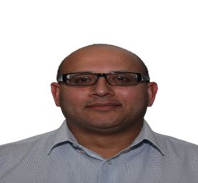
Agenda Item 1.14 (approved at CPG19#3)
Issue: to consider, on the basis of ITU-R studies in accordance with Resolution 160 (WRC-15), appropriate regulatory actions for high-altitude platform stations (HAPS), within existing fixed-service allocations
Preliminary CEPT position:
CEPT supports consideration of this Agenda item in accordance with Resolution 160 (WRC-15) while taking into account in particular:
the developments and requirements in HAPS in the fixed service and the associated spectrum sharing aspects
the need to ensure there is protection in place in order not to limit the possibility to use and develop existing services including other applications of the fixed service in the frequency bands identified and, as appropriate, in the adjacent bands.
CEPT has initiated studies on spectrum needs for broadband connectivity HAPS applications.
CEPT is of the view that any consideration of the frequency band 24.25-27.5 GHz under this Agenda item should not limit the possibility to identify the band for IMT on a global level under Agenda item 1.13.
CEPT Coordinator: Nasarat Ali (United Kingdom)

Slide 20
Agenda Item 1.16 (approved by CPG19#4)
Issue: to consider issues related to wireless access systems, including radio local area networks (WAS/RLAN), in the frequency bands between 5 150 MHz and 5 925 MHz, and take the appropriate regulatory actions, including additional spectrum allocations to the mobile service, in accordance with Resolution 239 (WRC-15);
Preliminary CEPT position:
CEPT supports studies to be performed under Agenda item 1.16 in accordance with Resolution 239 (WRC-15).
In the 5 150-5 350 MHz band, CEPT would support relaxing the access conditions applicable to WAS/RLANs, if results of studies show that sharing and compatibility can be achieved with EESS, radars, MSS feeder links, aeronautical radionavigation and aeronautical telemetry (see No 5.446C). However, CEPT noted that the current studies have shown difficulties in achieving co-existence with some incumbent services.
In the 5 350-5 470 MHz band, CEPT supports no change to the RR in this band.
CEPT Coordinator: Andrew Gowans (United Kingdom)

Slide 21
Agenda Item 1.16 (approved by CPG19#4)
Issue: to consider issues related to wireless access systems, including radio local area networks (WAS/RLAN), in the frequency bands between 5 150 MHz and 5 925 MHz, and take the appropriate regulatory actions, including additional spectrum allocations to the mobile service, in accordance with Resolution 239 (WRC-15);
Preliminary CEPT position (continued):
In the 5 725-5 850 MHz band, CEPT would support a new mobile allocation to accommodate WAS/RLANs use if sharing and compatibility studies can demonstrate the effectiveness of any new proposed interference mitigation techniques to ensure the protection of radars, fixed service (see No 5.455) and FSS space station receivers. It is to be noted that CEPT will take into account compatibility studies between RLAN and specific applications within CEPT (e.g. road tolling systems).
In the 5 850-5 925 MHz band, CEPT is still in discussion over its initial preliminary position for this band, taking into account the need to not impose any additional constraints on existing services such as FSS (particularly space station receivers) and existing applications under the mobile service such as ITS. However, CEPT noted that the current studies have shown difficulties in achieving co-existence with incumbent services.
CEPT Coordinator: Andrew Gowans (United Kingdom)

Slide 22
Agenda Item 4 (approved at CPG19#3)
Issue: in accordance with Resolution 95 (Rev.WRC-07), to review the resolutions and recommendations of previous conferences with a view to their possible revision, replacement or abrogation;
Preliminary CEPT position:
CEPT encourages the constant review of Resolutions and Recommendations from previous conferences and will follow activities, in particular of ITU, associated with this effort.
CEPT Coordinator: Karel Antousek (Czech Republic)

Slide 23
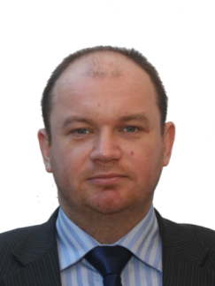
Agenda Item 8 (approved by CPG19#3)
Issue: to consider and take appropriate action on requests from administrations to delete their country footnotes or to have their country name deleted from footnotes, if no longer required, taking into account Resolution 26 (Rev.WRC-07);
Preliminary CEPT position:
CEPT is of the view that there is no need to change the Resolution 26 (Rev. WRC-07).
Issue A – Deletion of country footnotes or country names from footnotes
CEPT supports Administrations taking the initiative to review their footnotes and to propose the deletion of their country names or the deletion of country footnotes, if no longer required.
Issue B – Addition of country names into footnotes or new country footnotes
CEPT is of the view that this agenda item is not intended for adding country names into footnotes and the addition of new country footnotes.
CEPT is of the view that Conferences may continue to deal with requests to add country names to existing footnotes on a case by case basis, subject to the principle that proposals for the addition of country names to existing footnotes can be considered but their acceptance is subject to the express condition that there are no objections from the affected countries.
Furthermore CEPT is of the view that proposals for the addition of new country footnotes which are not related to agenda items of this Conference should not be considered.
CEPT Coordinator: Dmytro Protsenko (Ukraine)

Slide 24
Agenda Item 9.1 Issue 9.1.3 (approved by CPG19#3)
Issue: to study technical and operational issues and regulatory provisions for new non-geostationary-satellite orbit systems in the 3 700-4 200 MHz, 4 500-4 800 MHz, 5 925-6 425 MHz and 6 725-7 025 MHz frequency bands allocated to the fixed-satellite service;
Preliminary CEPT position:
CEPT supports the study of technical and operational issues and regulatory provisions for new non-geostationary-satellite orbit systems in the 3700-4200 MHz, 4500-4800 MHz, 5925-6425 MHz and 6725-7025 MHz frequency bands under the terms of Resolution 157 (WRC-15).
CEPT supports the protection of GSO/NGSO FSS, mobile and fixed services under these studies. No additional constrains should be applied to existing GSO and non-GSO FSS networks in the frequency bands 3 700-4 200 MHz (space-to-Earth) and 5 925-6 725 MHz (Earth-to-space). Furthermore, no additional constraint should apply to terrestrial services.
CEPT is of the view that when considering the Article 22 epfd↓ limits and epfd↑ limits applicable to non-GSO systems in the frequency bands 3700-4200 MHz (space-to-Earth), 5925-6425 MHz (Earth-to-space), 4500-4800 MHz (space-to-Earth) and 6725-7025 MHz (Earth-to-space) it is necessary to ensure the protection of GSO FSS networks from unacceptable interference pursuant to 22.2 RR as applicable, including the allotments of the Plan and assignments in the Appendix 30B List.
CEPT Coordinator: Ethan Lavan (France)

Slide 25
Agenda Item 9.1 Issue 9.1.3 (approved by CPG19#3)
Issue: to study technical and operational issues and regulatory provisions for new non-geostationary-satellite orbit systems in the 3 700-4 200 MHz, 4 500-4 800 MHz, 5 925-6 425 MHz and 6 725-7 025 MHz frequency bands allocated to the fixed-satellite service;
Preliminary CEPT position (continued):
CEPT is of the view that studies should take into account that the protection of mobile service is ensured regardless of the allocation status of the mobile service.
In the radio frequency band 3700-4200 MHz (space-to-Earth) CEPT does not object to a possible revision of Table 21-4 of Article 21 for non-GSO FSS satellites, while ensuring that existing primary services, i.e. the mobile service and fixed service, are protected and maintaining the existing Article 21 pfd limits for GSO networks.
When developing technical and operational conditions and regulatory provisions for new systems of non-GSO FSS, there is a need to ensure protection of existing terrestrial services in the frequency bands 4500-4800 MHz (space-to-Earth), 5925-6425 MHz (Earth-to-space) and 6725-7075 MHz (Earth-to-space).
CEPT Coordinator: Ethan Lavan (France)

Slide 26
Agenda Item 9.1 Issue 9.1.6 (approved by CPG19#4)
Issue: a) to assess the impact of WPT for electric vehicles on radiocommunication services;
b) to study suitable harmonized frequency ranges which would minimize the impact on radiocommunication services from WPT for electrical vehicles;
Preliminary CEPT position:
CEPT supports the studies concerning Wireless Power Transmission (WPT) for electric vehicles (EV) in particular, assessing the impact of WPT for electric vehicles on radiocommunication services. CEPT also supports the studies to find regionally or globally harmonised frequency ranges for use by WPT for EV which will serve to the aim of minimising the impact of WPT for EV.
CEPT is also of the opinion that the standards, being developed in various fora, such as ETSI, International Electrotechnical Commission (IEC), the International Organization for Standardization (ISO) and the Society of Automotive Engineers (SAE), intended to facilitate global and regional harmonization of WPT technologies for EV, should be taken into account in the studies to be conducted on WRC-19 AI 9.1 Issue 9.1.6.
CEPT is still in discussion over its initial preliminary position on potential candidate bands considered for WPT for EV, noting that there are no studies available yet.
CEPT is of the view that no further regulatory action to the RR will be required.
CEPT Coordinator: Fatih Yurdal (Turkey)

Slide 27
Agenda Item 10
Issue: to recommend to the Council items for inclusion in the agenda for the next WRC, and to give its views on the preliminary agenda for the subsequent conference and on possible agenda items for future conferences, in accordance with Article 7 of the Convention;
The work on Agenda item 10 will start after the 1st January 2018. CPG will then decide on the appropriate working method for this Agenda item.
CEPT Coordinator: Pasi Toivonen (Finland)
coordination team: Karsten Buckwitz (Germany), Wesley Milton (United Kingdom)

Slide 28
Next meetings
CPG #5 will meet
8-11 January 2018, Budapest, Hungary
26-29 June 2018, [TBD], Finland
its next project team meetings are:
PTB #4: 12-15 September 2017, Copenhagen (ECO), Denmark
PTD #4: 12-14 September 2017, Vilnius, Lithuania
PTC #4: 26-28 September 2017, Trondheim, Norway
PTA #3: 3-6 October 2017, Bucharest, Romania
ECC PT1 #57: 11-15 December 2017, ETSI, France
CEPT looks forward to welcoming representatives from the other regional organisations to these meetings

Slide 29
Useful links:
General information: http://www.cept.org/ecc
CPG page: http://www.cept.org/ecc/groups/ecc/cpg
Questions/Answers regarding CPG: https://cept.org/files/4200/CPG%20role%20in%20WRC%20preparation%20process%2011oct13.pdf
ECC PT1 page:
http://www.cept.org/ecc/groups/ecc/ecc-pt1
Coordinators:
http://www.cept.org/ecc/groups/ecc/cpg/page/list-of-cept-coordinators-wrc-19/
CEPT Briefs/ECPs:
http://www.cept.org/ecc/groups/ecc/cpg/page/cept-briefs-and-ecps-for-wrc-19

Slide 30
Thank you

