Slide 1
ITU Preparatory process towards WRC-19
EUR/NAT MID Preparatory Workshop to ITU World Radiocommunication Conference 2019 (WRC-19)
Paris, 11 – 12 September 2017
Nikolai Vassiliev
Chief, Terrestrial Services Department
Radiocommunication Bureau
International Telecommunication Union

Slide 2
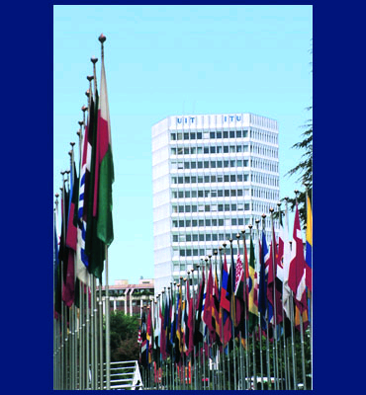
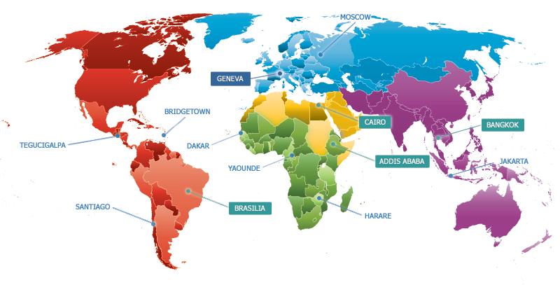
International Telecommunication Union
Based in Geneva, 12 regional and area offices, around 750 staff
staff from 80 countries, 6 official languages
3 ITU Sector:
  ITU-R - Radiocommunications – radio issues
  ITU-T - Standardization – standards for wired networks
  ITU-D – Development – assistance to developing countries
The basic ITU document dealing with radio is Radio Regulations

Slide 3
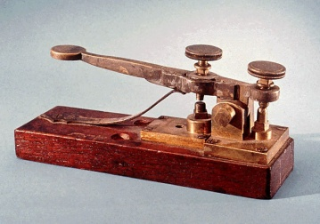
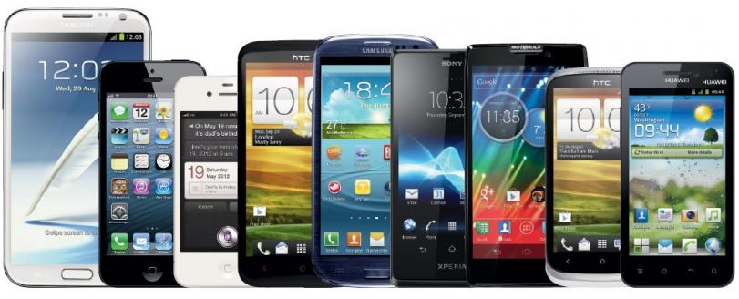
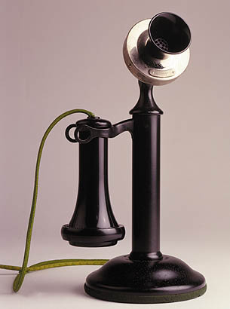
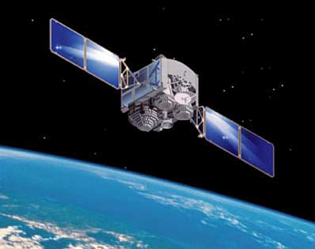
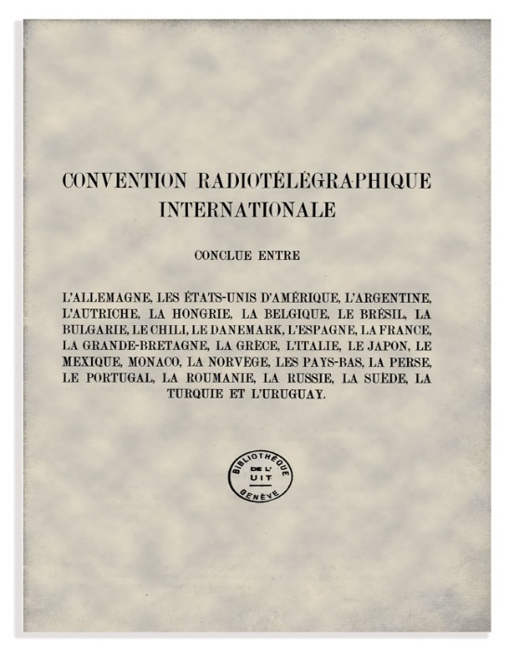
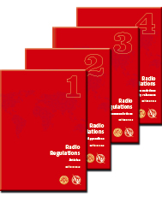
111 years of Radio Regulations
1906 2017
From the first International Radiotelegraph Convention, 1906 to the Radio Regulations, 2016
RR follow and anticipate technological advancements

Slide 4

Radio Regulations (RR)
RR - international rules governing the use of radio spectrum and satellite orbits
RR is intergovernmental treaty. Ratified by governments – mandatory for application
Define the rights and obligations of ITU Member States in respect of the use of spectrum/orbit resources. Provide long term commitment from regulators and governments worldwide for a stable regulatory environment
Main goals of the RR:
  interference free operation of stations
  harmonization of spectrum spectrum/orbit use
RR are updated every 3-4 years by World Radiocommunication Conferences - WRCs

Slide 5
Role of WRCs
Allocate spectrum/orbit resource for emerging radio applications, while protecting the existing usage (e.g. WAIC <->altimeters, FSS/UAS <-> fixed)
Maintain the right balance between the spectrum requirements of all radiocommunication services, including aeronautical services (justified and reasonable spectrum requirements)
Achieve global spectrum harmonization for economies of scale and interoperability of the equipment (e.g. maritime, aeronautical, IMT)
Create regulatory certainty for users, regulators and telecommunication industry in utilizing spectrum

Slide 6
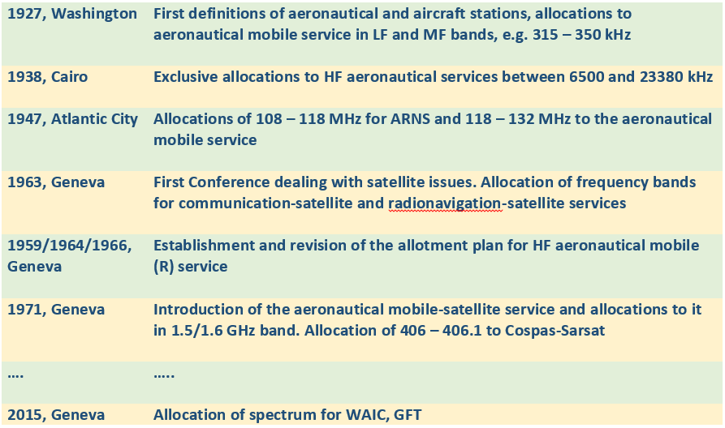
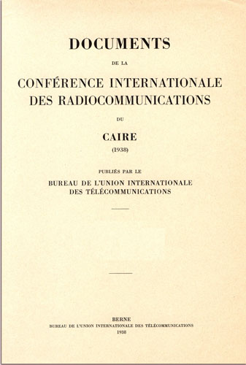
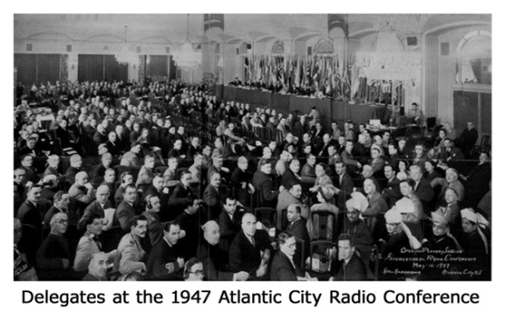
Some history of aeronautical issues at WRCs

Slide 7
WRC cycle
Develops agenda for the next WRC and preliminary agenda for subsequent WRC
3-4 years
WRC-n
1st Conference Preparatory Meeting (CPM)
organizes ITU-R preparatory studies to WRC
CPM-1
ITU-R studies
Develop technical, operational and procedural solutions for WRC
Consolidates results of studies and tries to reconcile regulatory solutions
CPM-2
Allocation/identification of bands, conditions
WRC-n+1

Slide 8
Main steps of WRC preparations
Agenda - WRC establishes draft agenda for next WRC, a preliminary draft agenda for subsequent WRC
  Agenda: important, stable, defines legal scope of discussions (e.g. AI 1.13 - IMT above 24 GHz)
ITU-R Studies- heart of WRC preparations, development of its technical/regulatory basis
  Crucial role of international organizations (ICAO, IMO, WMO) in studies of their specific issues
  Equal rights with administrations in discussions, except for approval decisions
CPM-2 – consolidates results of study and regulatory solutions in CPM Report to a WRC
  A key step in preparations – shaping proposals on spectrum allocations and operational conditions
  Virtually equal rights of international organizations and administrations at CPM
WRC – highest international decision making body on radio issues
  A treaty making Conference, so the final say remains with States
  Aviation experts participate either as Member States delegates, or observers. ICAO as observers in an advisory capacity

Slide 9
WRC-19 preparation milestones
Developed agenda for WRC-19 Resolution 809 (WRC-15)
WRC-15
1st Session of Conference Preparatory Meeting held on 30 Nov. – 01 Dec. 2015
We are here
CPM-19-1
ITU-R studies
ITU-R studies March 2016 – July 2018
2nd Session Conference Preparatory Meeting
Planned in Geneva, 18-28 Feb. 2019
CPM19-2
Final meetings of regional groups, preparation of proposals (country and common) to WRC-19
Proposals to WRC
RA-19: 21-25 Oct. 2019; WRC-19: 28 Oct. to 22 Nov. 2019, in Egypt or Geneva
WRC-19

Slide 10
ITU-R studies
The first session of CPM defined :
  Framework for WRC-19 preparations
  Structure of draft CPM Report
  Responsible ITU-R Groups and Concerned Groups (either contributing or interested)
There are: 16 ‘main’ agenda items, 6 standing agenda items and 9 issues under AI 9
The main aeronautical AIs are:
  1.10 – GADSS
  9.1.4 - Stations on board sub-orbital vehicles

Slide 11
Timetable towards WRC-19
Situation
as of today

Slide 12
Structure of draft CPM Report to WRC-19
Chapters of the Report
Chapter 1 - Land mobile and fixed services -Ms K. ZHU (CHN)
Chapter 2 - Broadband applications in mobile service -Mr J Arias Franco (MEX)
Chapter 3 - Satellite services – Mr N. Varlamov (RUS)
Chapter 4 - Science services – Mr V. Meens (F)
Chapter 5 - Maritime, aeronautical and amateur services - Mr El Sayed (EGY)
Chapter 6 - General issues – Mr P.N. Ngige (KEN)
Structure of texts
Executive summary
Background
Summary and analysis of ITU-R studies
Methods to satisfy Agenda Item
Regulatory and procedural considerations ()

Slide 13
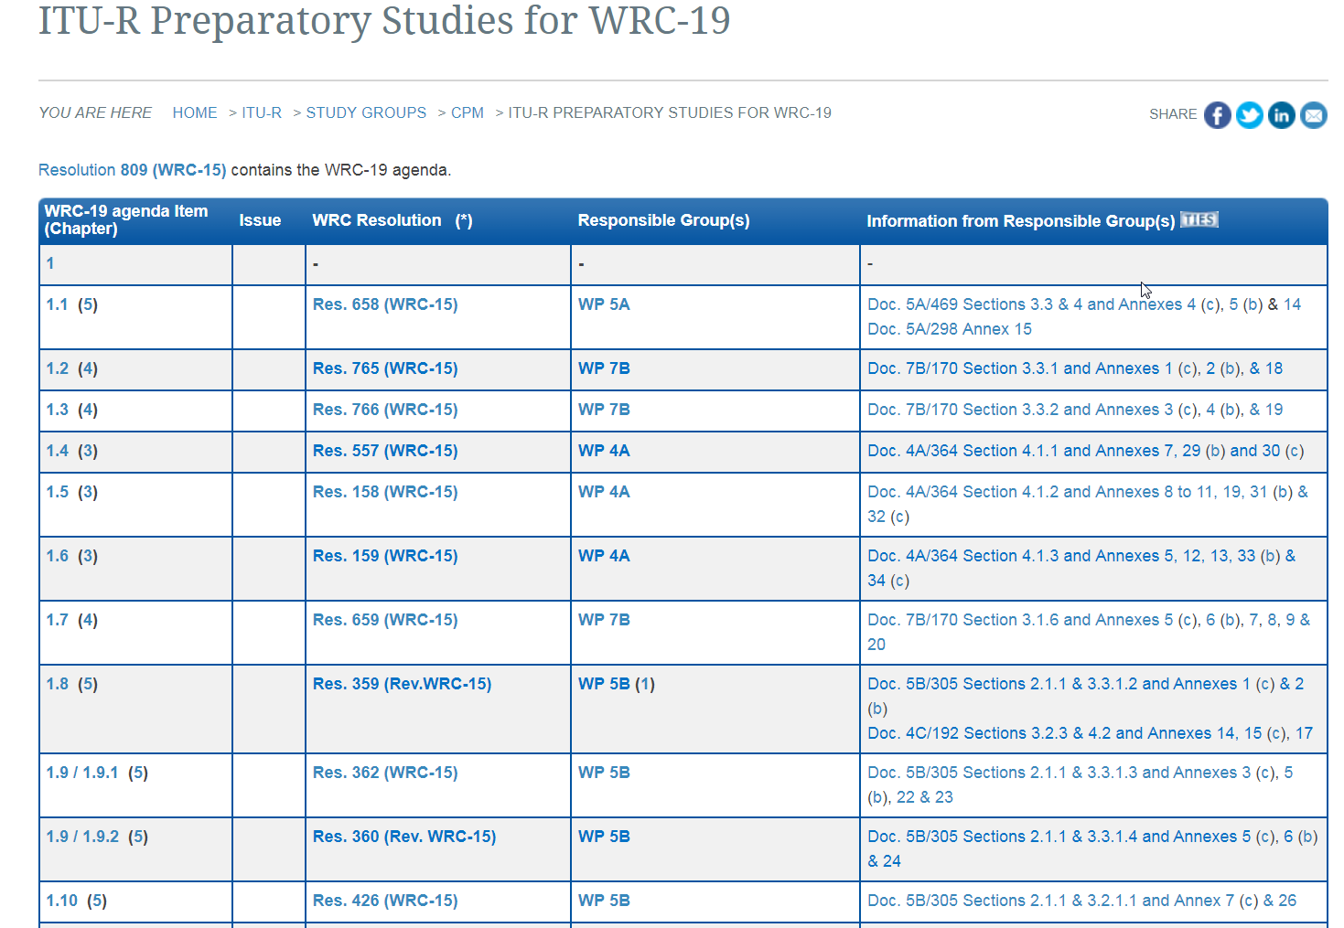
WRC-19 studies web page
http://www.itu.int/go/rcpm-wrc-19-studies
Agenda Item
WRC Resolution
ITU-R Responsible Group
Latest documents

Slide 14

Regional preparations
The role of the 6 Regional Telecommunication Organizations is constantly growing, both before and during WRCs
They consolidate views at regional level, assist in interregional discussions, facilitate reaching a common understanding, save time during WRCs (6 views instead of 193)
WRC-15 two thirds (66%) of 678 docs were common proposals
ITU Radiocommunication Bureau facilitates coordination between regions by organizing ITU Inter-regional Workshops
Role of the Regional Groups is described in WRC Resolution 72 dealing with world and regional preparations and originally developed at WRC-97

Slide 15
ITU Interregional workshops on WRC-19
1st Workshop: 21 – 22 November 2017
Presentation and review of the on-going preparatory studies of the ITU-R responsible groups for CPM-19
Presentation of regional groups, international organizations like ICAO, IMO, WMO on their positions
2nd Work shop: Q4 2018, few months prior to CPM19-2
Presentation of the Draft CPM Report to WRC-19 (explanation of the draft Methods)
Presentation of regional groups, international organiz. on positions & common proposals for CPM-2
3rd Workshop: Q3 2019, few months prior to WRC-19
Presentation of CPM & Director’s Reports to WRC-19
Presentation of regional groups, international organizations on positions, common proposals to WRC

Slide 16
National preparations
National preparations – starting point in WRCs process. Country activities result in adopting a national position for WRC, which is further tuned in regional and international discussions
    Regulator has to keep a balance between different applications to respond to the needs of the population and national objectives ->
    Trade-off between enabling emerging technologies and protecting incumbents, e.g. IMT vs. FSS in the band 3.4 – 3.6 GHz at WRC-15
    To protect the existing aeronautical usage and satisfy spectrum requirements for emerging technologies, aviation needs to actively participate in development of national positions.

Slide 17
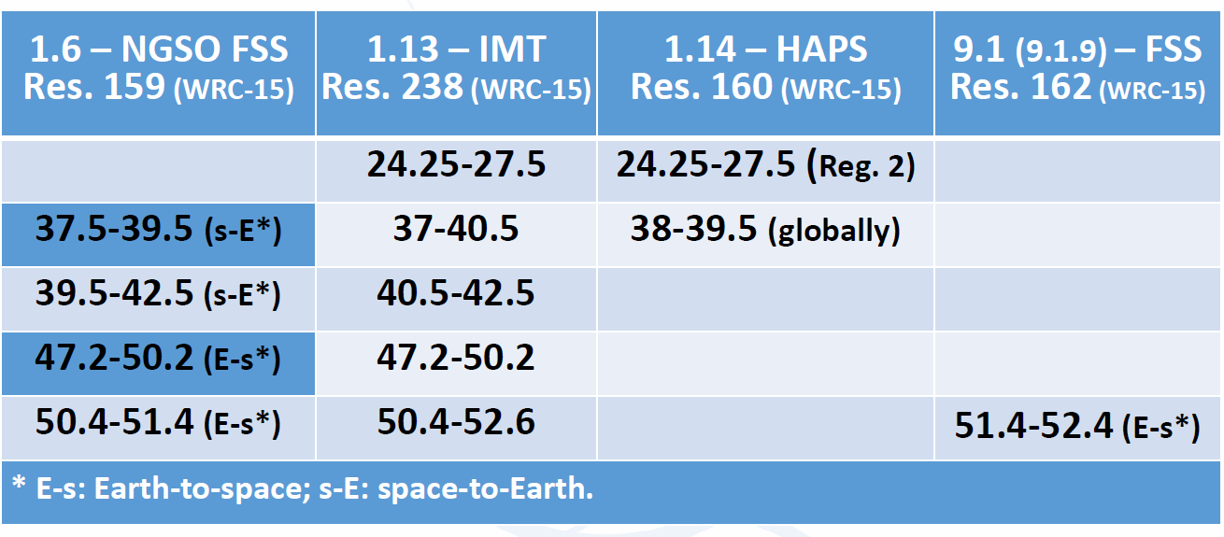
WRC-19 challenges
WRC-19 will considers virtually all radiocommunication services.
The main focus will be on broadband technologies provided by different platforms, e.g. GSO space, NGSO, IMT, HAPS, WiFi, etc.
Several technologies target the same bands -> need for studies between them
ICAO has 2 principle aeronautical AIs and has several other to follow and ensure protection

Slide 18
T h a n k y o u !

