Slide 1
You are requested to explore the key elements to establish the ATFM Service for DADA FIR taking into consideration the information provided in the following slides.
Use PowerPoint to present your results and Send your PPT to akaveh@icao.int and ekhoury@icao.int
To Note:
Lines on the chart represent traffic flows and not the ATS routes.
Consider that there is no lack in the number of supporting staff. The number of controllers number is provided in the slide.
All equipment are operating as normal.
All airspaces are fully covered by Surveillance and VHF COM.
AIDC/OLDI is in place between the 3 DADA, BIRI and LOLO ACCs.
Effective CIV-MIL cooperation in place
Weather is most of time CAVOK
No VFR only IFR
The 3 FIRs are under the responsibility of 3 different States.

Slide 2
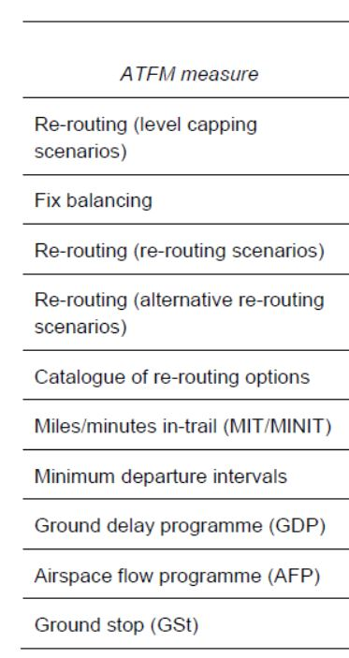
You may address the following:
CAA Regulations
Organizational Structure
Functions
System to use
Capacity Determination for airspace and airports
ATFM Daily Plan (ADP) at least the main elements
ATFM Measures to be used
FF-ICE
Stakeholders
Expected timeframe to establish the basic ATFM service for TATA
others

Slide 3
Your Airspace DADA
Overflight 800 Flights/day
Airport Alpha 500 ARR & DEP flights/day (400 International)
Peak period (01:00 to 04:00-30% and 16:00 to 20:00-40%)
Airport Bravo 100 ARR & DEP flights/day (Domestic)
Airport Charlie 20 ARR & DEP flights/day (Domestic)
1 ACC (3 Sectors) – 40 Controllers - Average Sector time 15min
1 APP unit – 15 Controllers
ATC provided at Alpha and Bravo airports, 10 controllers each
AFIS at Charlie 6 Flight Information Service Officer
Airspace LOLO
Overflight 500 flights/day (International)
Airport Delta 800 ARR & DEP flights/day
1 ACC (4 Sectors) -
1 APP units
ATC provided at Delta Int’l airport
NO FF-ICE
ATFM Unit BIRI provides ATFM service to Airspace LOLO
Airspace BIRI
Overflight 1500 flights/day
Airport Echo 300 ARR & DEP flights/day (250 International)
Airport Foxtrot 600 ARR & DEP flights/day (550 International)
2 ACCs (4 +4 Sectors)
1 APP units
ATC provided at Echo and Foxtrot
BIRI FF-ICE Unit Services established
ATFM Unit BIRI Established

Slide 4
LOLO
Delta Int’l
Bravo
Charlie
DADA
BIRI
Alpha Int’l
Echo Int’l
Foxtrot Int’l
BIRI
Major traffic flow
Medium traffic flow
Low traffic flow

