Slide 1
2019 World Radiocommunication Conference Agenda Item 9.1.4
Stations on-Board Sub-Orbital Vehicles
(Spaceplanes)
ICAO Regional Preparatory Group meeting
Paris, France 11-12 September 2017
John Mettrop
UK CAA

Slide 2
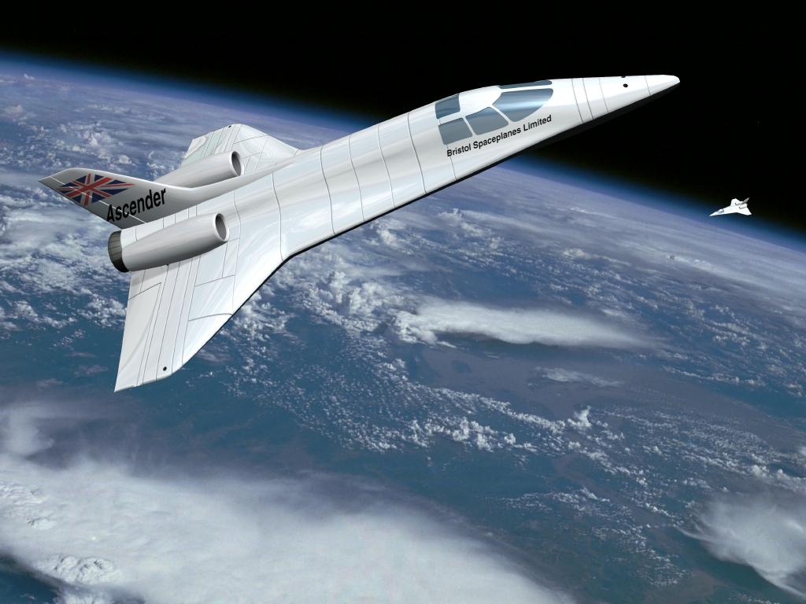
Agenda Item 9.1.4 – Resolution 763
resolves to invite the ITU Radiocommunication Sector
  to conduct studies to identify any required technical and operational measures, in relation to stations on board sub-orbital vehicles, that could assist in avoiding harmful interference between radiocommunication services;
  to conduct studies to determine spectrum requirements and, based on the outcome of those studies, to consider a possible future agenda item for WRC‑23;

Slide 3
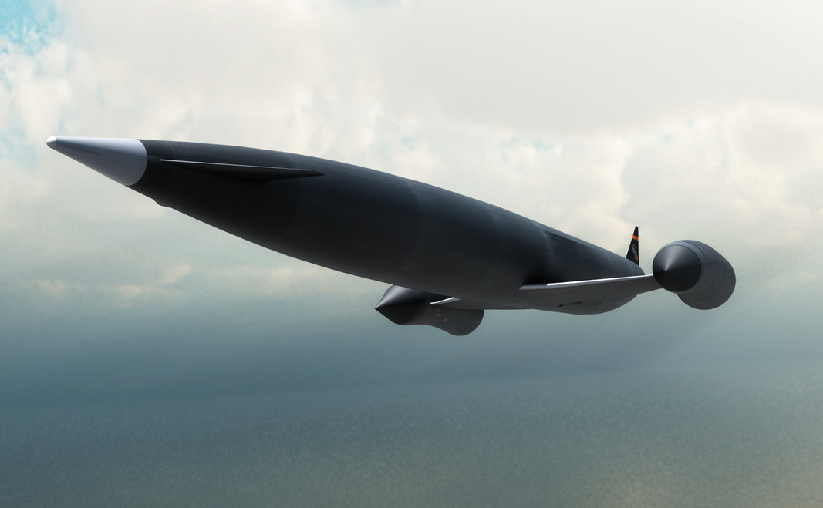
ITU-R Question 259/5
decides that the following Questions should be studied
  How will planes be operated including a description of the various phases of flight?
  During which phases of flight described in decides 1, will, if at all, need to be supported by air traffic control systems and what sort of systems are expected?
  What radio links will be required to support planes operations and under what radiocommunication service definition will they fall?

Slide 4
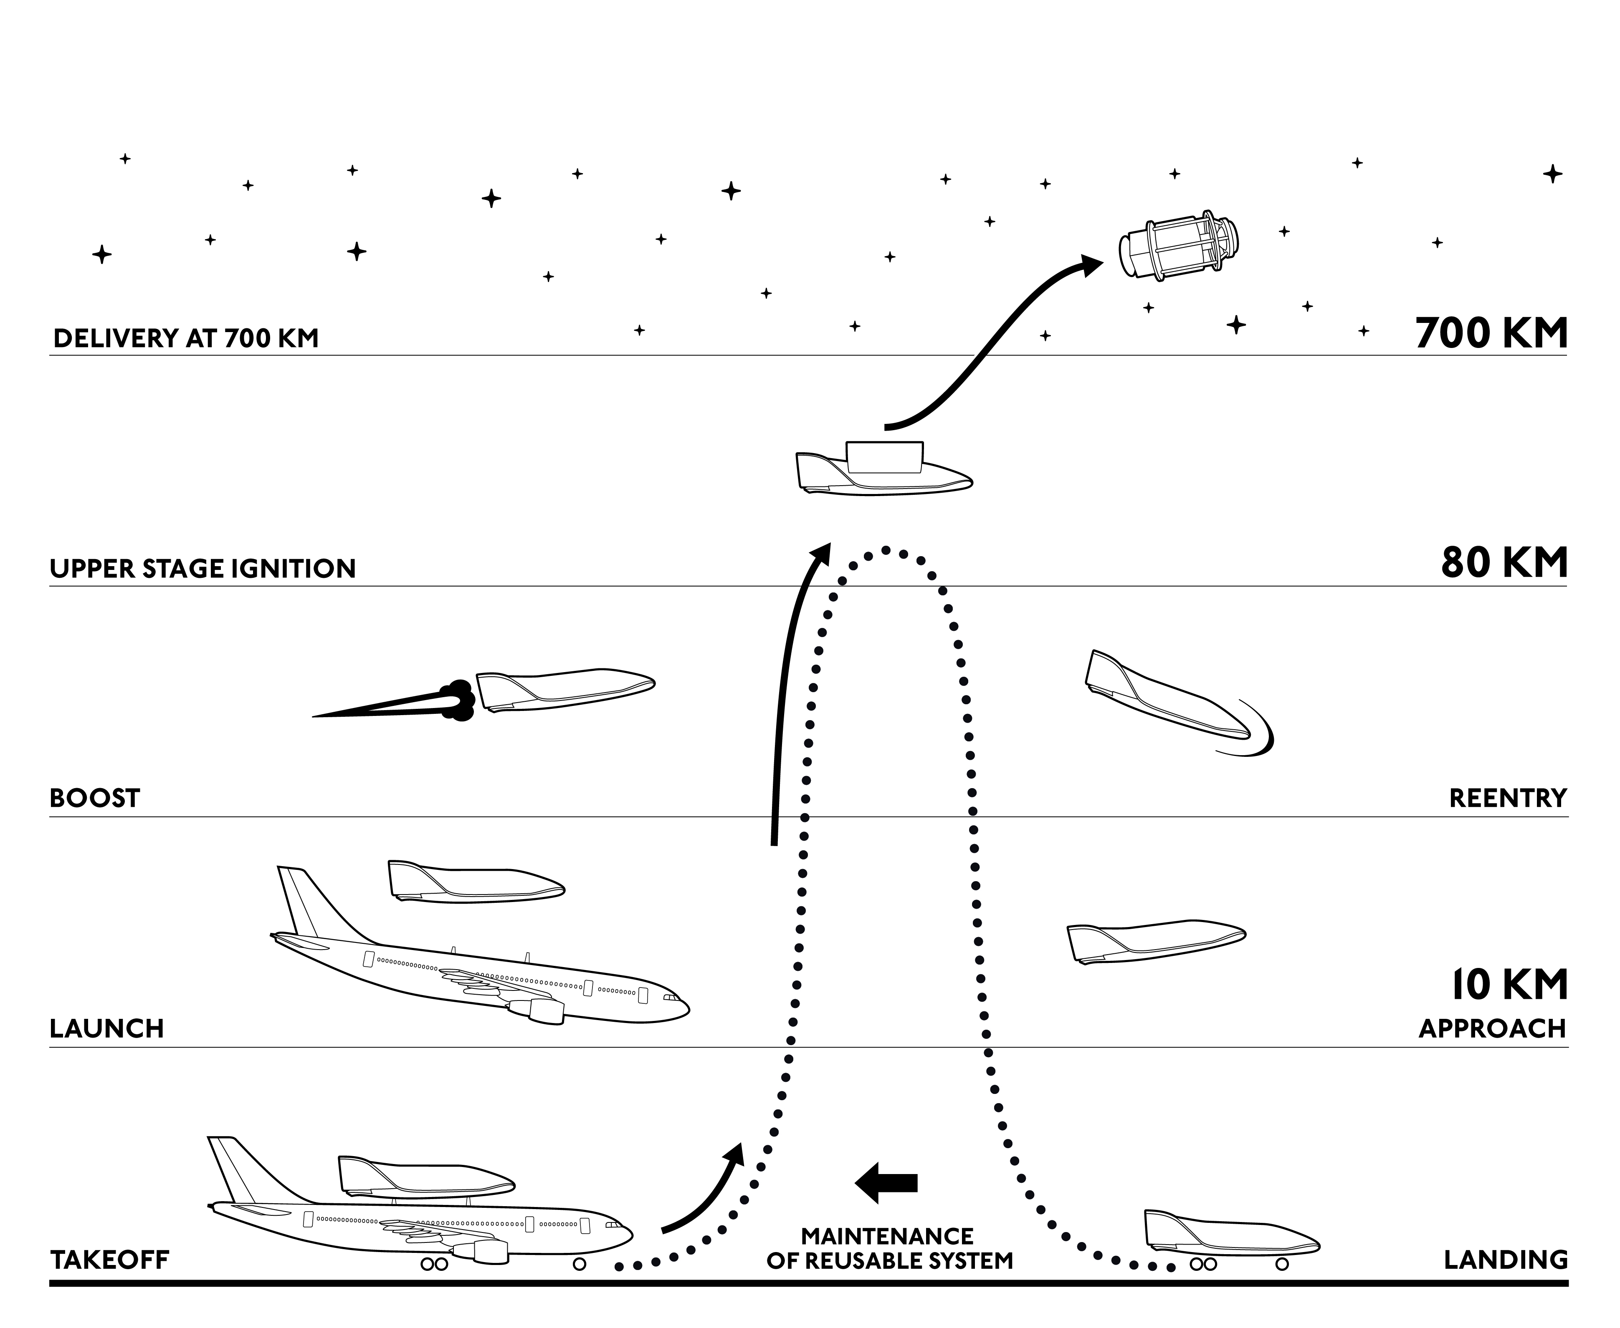
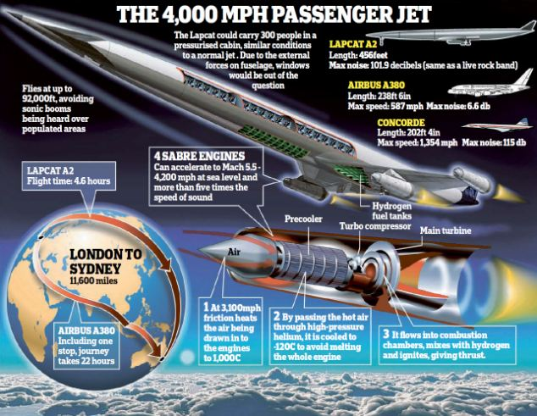
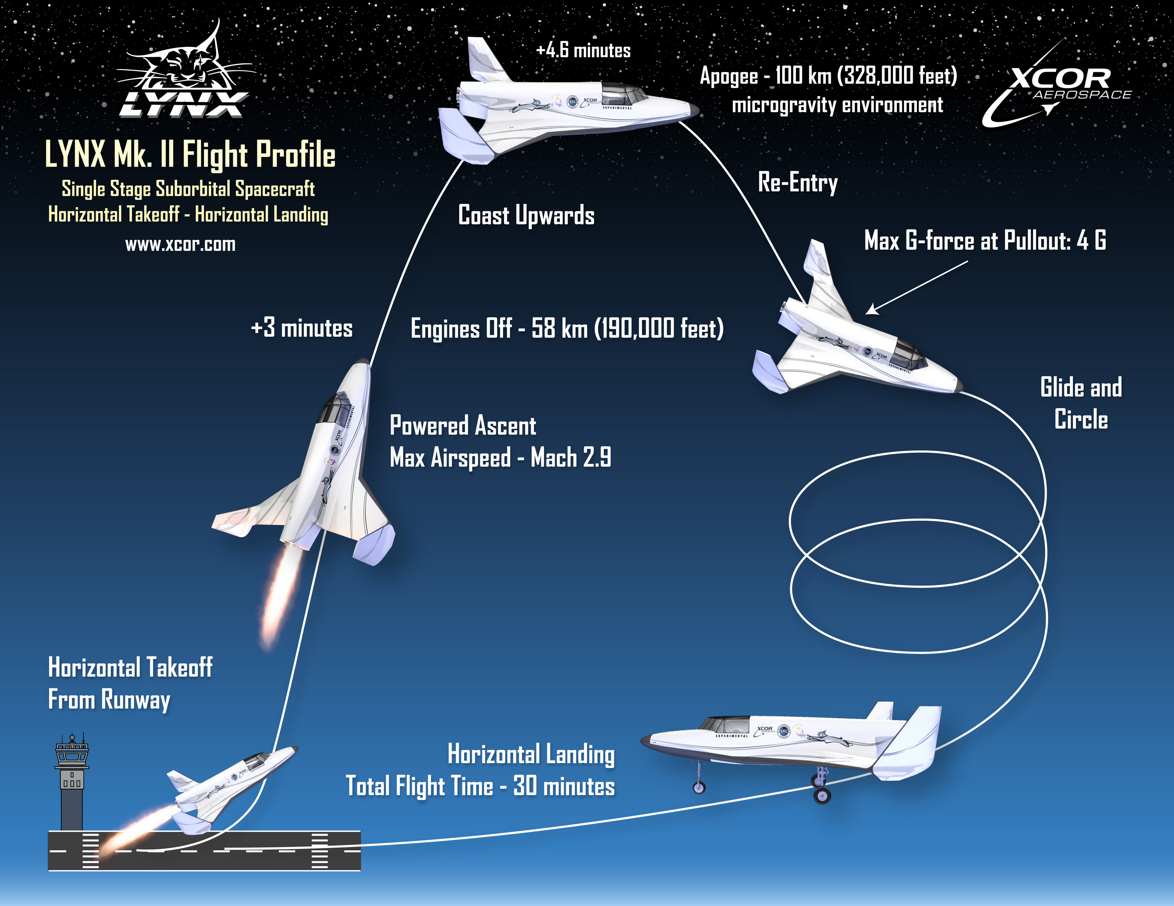
Space Plane Applications
Space tourism
Satellite Launch
Hypersonic Travel

Slide 5
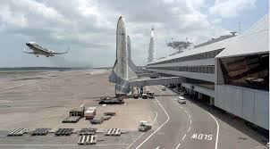
Aircraft or Spacecraft?
Aircraft: Any machine that can derive support in the atmosphere from the reactions of the air other that the reactions of the air against the Earth’s surface (ICAO)
spacecraft: A man-made vehicle which is intended to go beyond the major portion of the Earth's atmosphere. (ITU)

Slide 6

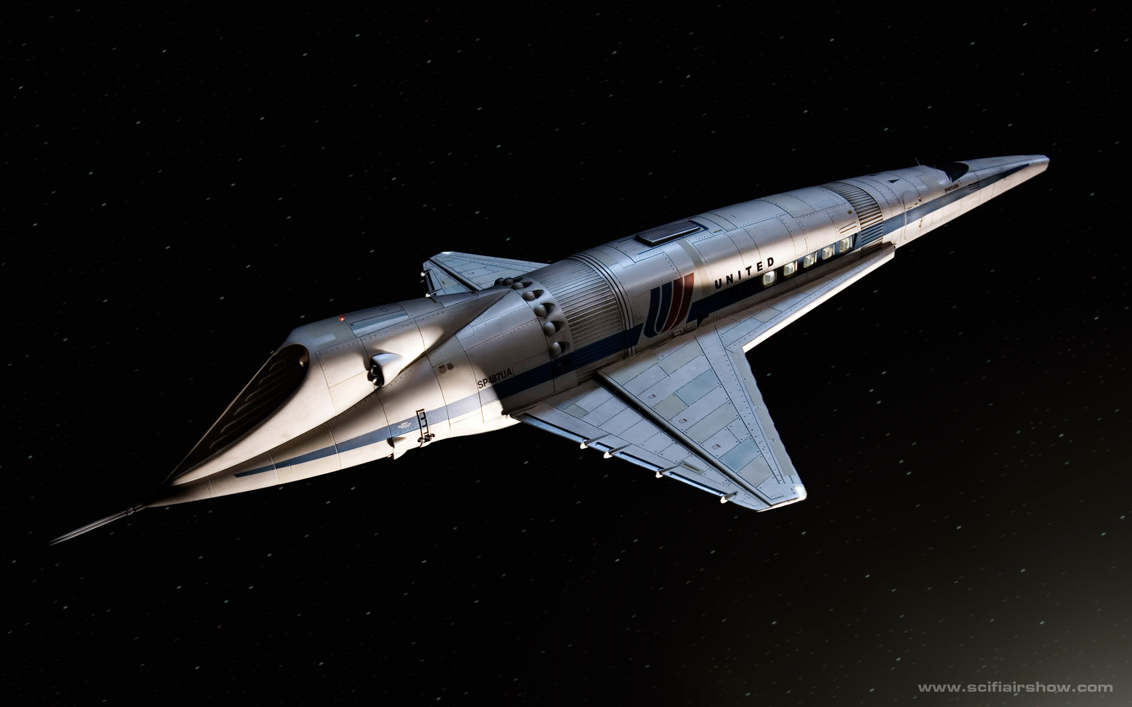
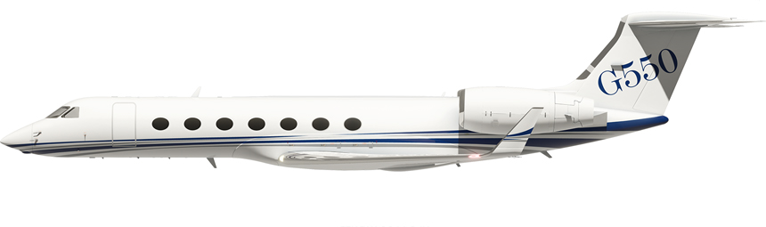
Issues with Respect to Aeronautical Spectrum
Height
Radio Horizon
  Link Budget
  Time in Sector
Speed
  Doppler Shift
Incompatible with current planning rules
Aeronautical system Capabilities e.g. ADS-B max
    height 131,072ft
    velocity 4096 knots
6,500 km/hr
120 km
1,000 km/hr
45,000 ft
522 NM
1,544 NM

Slide 7
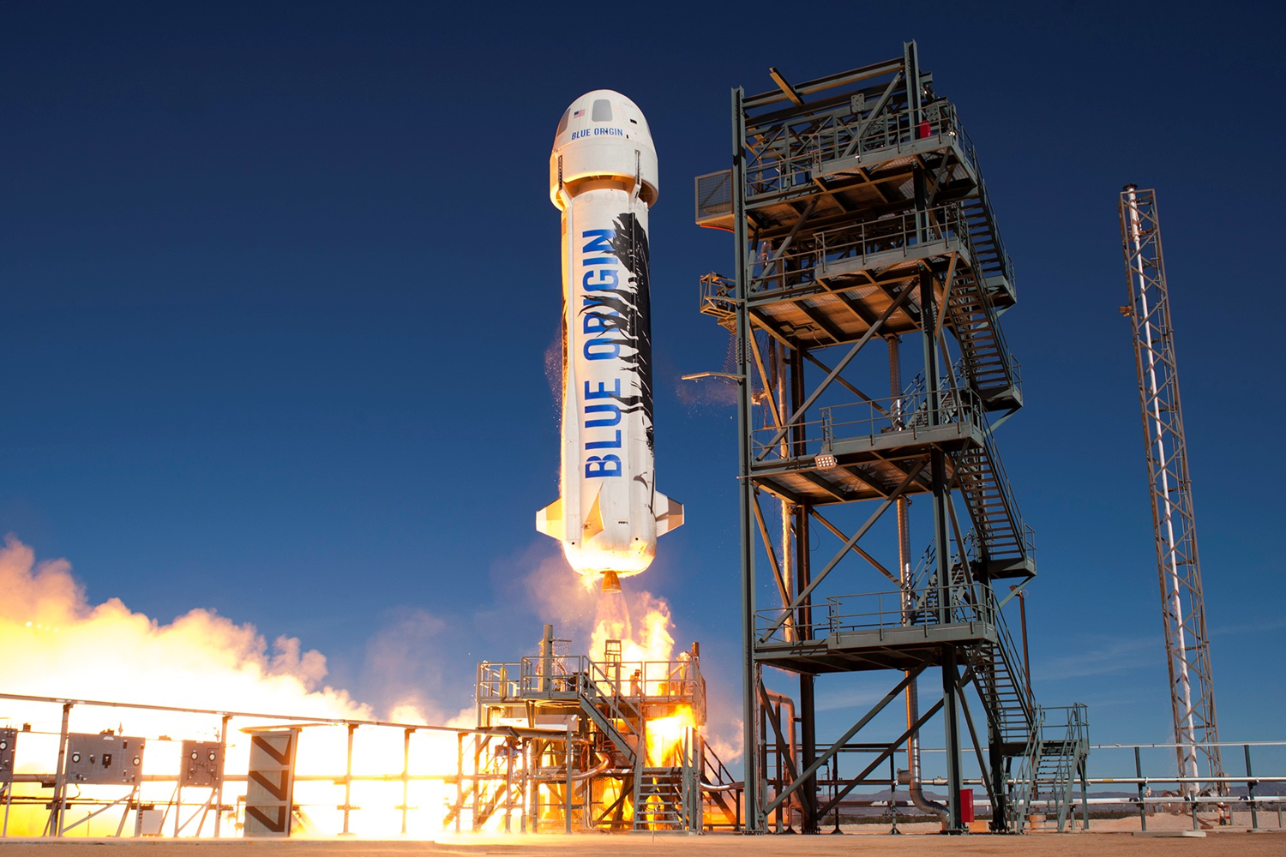
What Radio Service?
Amateur
Broadcasting
Aeronautical mobile (R)
Radiocommunication
Fixed
Aeronautical mobile
Aeronautical mobile (OR)
Meteorological aids
Land mobile
Port operations
Mobile Service
Maritime mobile
Ship movement
Radiodetermination
Radiolocation
Aeronautical radionavigation
Standard frequency & time signal
Radionavigation
Maritime radionavigation
Radio astronomy
Safety
Special
Space research
Space operation
Amateur
Broadcasting-Satellite
Earth exploration-satellite
Meteorological-satellite
Aeronautical mobile-satellite (R)
Fixed-Satellite
Aeronautical mobile-satellite
Aeronautical mobile-satellite (OR)
Inter-satellite
Land mobile-satellite
Mobile-satellite
Maritime mobile-satellite
Radiodetermination-satellite
Radiolocation-satellite
Aeronautical radionavigation-satellite
Standard frequency & time signal-satellite
Radionavigation-satellite
Maritime radionavigation-satellite

Slide 8
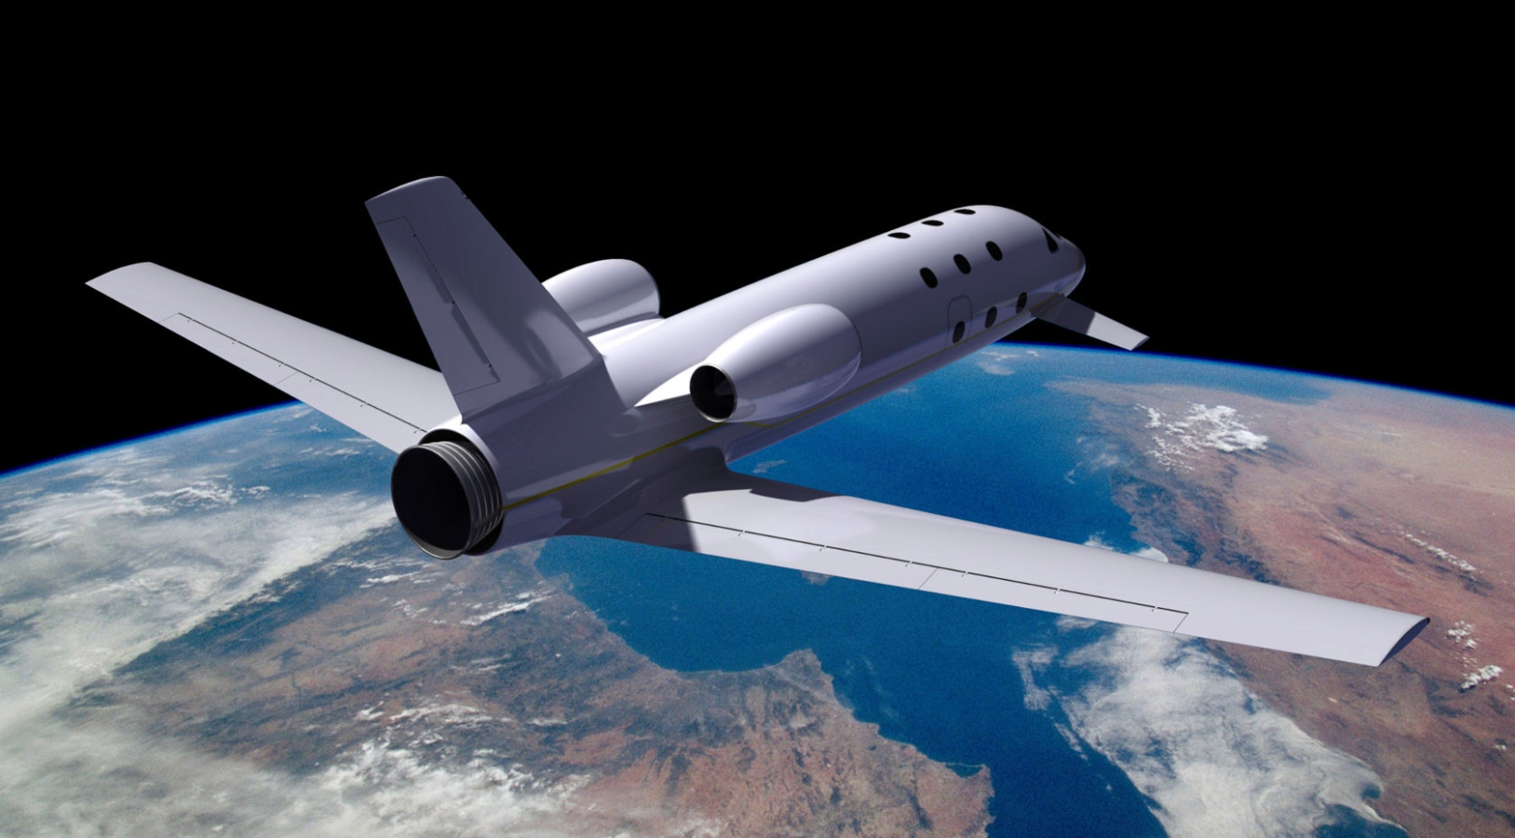
Summary
How Much Spectrum is Required?
Which Service?
Sufficient Spectrum Available?
Impact on Existing Aeronautical Services
  Standards
  Planning rules
  Sector Size
Support ICAO/ITU Studies

Slide 9

Questions

