Slide 1
On the methodologies to assign terrestrial C2 link frequency channels within the 5030-5091 MHz frequency band to a realistic UAS traffic
Florian RIBAUD (ENAC)

Slide 2
Organization of the presentation
Introduction and Scope of the study
Assumptions on the terrestrial C2 link system
Definition of the Static and Dynamic assignment processes
Results of the simulations
Conclusions and recommendations

Slide 3
Organization of the presentation
Introduction and Scope of the study
Assumptions on the terrestrial C2 link system
Definition of the Static and Dynamic assignment processes
Results of the simulations
Conclusions and recommendations

Slide 4


1. Introduction
1.1. Context
The 5030-5091 MHz frequency band will provide frequency allocations to both terrestrial and satellite aeronautical communication systems:
  In 2012, ITU WRC-12 provided Terrestrial allocation to Aeronautical Mobile Route Service (AM(R)S) in the 5030-5091 MHz band.
  ITU WRC-2012 Footnote No. 5.443D outlines the interest of 5030-5091 MHz band for Satellite allocation to the Aeronautical Mobile Satellite Route Service (AMS(R)S).
Example: Sharing of the 5030-5091 MHz proposed by RPAS Panel of the EUROCAE in FSMP WG/04 WP/09:
Guard bands
Guard bands
5030 MHz
5060 MHz
5091 MHz
SAT RTN
Terrestrial
SAT FWD
$$f$$
$$B_{LOS}$$

Slide 5
1. Introduction
1.2. Overview of ENAC study
The ENAC (French Civil Aviation School) is tasked by the DGAC (French Civil Aviation Organization) to study the compatibility between terrestrial and satellite systems in the 5030-5091 MHz band. A 3 step study has been proposed:
  Analyze and propose optimal methodologies to assign frequency channels to UAS (Unmanned Aircraft Systems) users on the terrestrial system.
  Analyze and propose optimal methodologies to assign frequency channels to UAS (Unmanned Aircraft Systems) users on the satellite system.
  Analyze the aggregation of both systems on the 5030-5091 MHz band.
The study presented in this presentation is dedicated to step 1.

Slide 6
1. Introduction
1.3. Context of terrestrial system study
NASA Phase 1 of the C2 (Command and Control) sub-project of the NASA’s UAS integration in the National Airspace (NAS) has been completed (2012-2016).
The results of Phase 1 provided development and testing of a prototype terrestrial C2 link system, in the MOPS DO-362.
1.4. Goal of the terrestrial system study
Main goal of the study: Using the prototype C2 link of MOPS DO-362 and fulfilling the required ICAO interference protection criteria, how many UAS (Unmanned Aircraft Systems) may receive C2 link frequency channel assignments on the terrestrial system, from the 5030-5091 MHz band ?
To achieve this main goal, 2 specific objectives will be addressed:
  Analyze and compare two methods of frequency C2 link channel assignment (Dynamic and Static).
  Estimate the number of UAS who could receive frequency channel assignments, on a given territory, depending on the assignment method considered (Static or Dynamic) and on the communication architecture considered (Centralized Network or Standalone UAS).

Slide 7
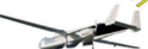
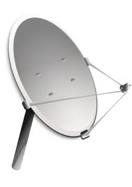
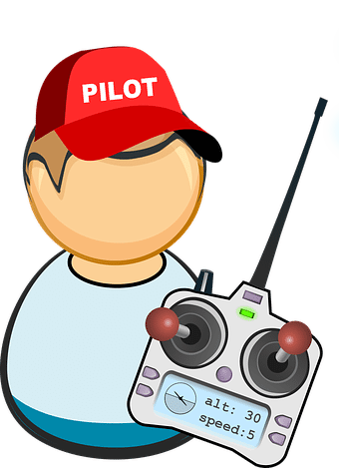

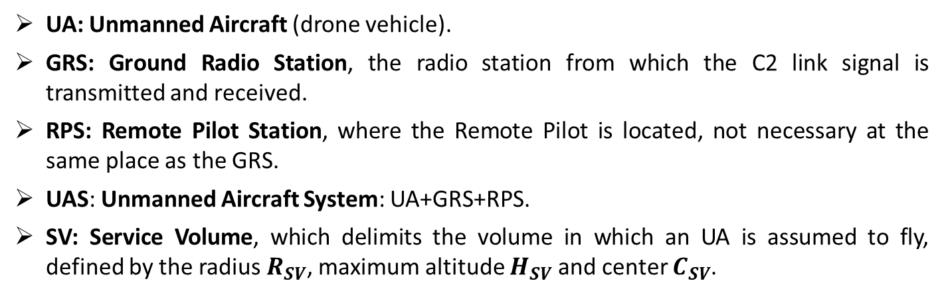

1. Introduction
1.3. Fundamental terminology
UA: Unmanned Aircraft (drone vehicle).
GRS: Ground Radio Station, the radio station from which the C2 link signal is transmitted and received.
RPS: Remote Pilot Station, where the Remote Pilot is located, not necessary at the same place as the GRS.
UAS: Unmanned Aircraft System: UA+GRS+RPS.
SV: Service Volume, which delimits the volume in which an UA is assumed to fly, defined by the radius $R_{SV}$, maximum altitude $H_{SV}$ and center $C_{SV}$.
Service Volume
UA
$$R_{SV}$$
C2 link
Terrestrial connection
$$C_{SV}$$
GRS
RPS

Slide 8
Organization of the presentation
Introduction and Scope of the study
Assumptions on the terrestrial C2 link system
Definition of the Static and Dynamic allocation processes
Results of the simulations
Conclusions and recommendations

Slide 9
2. Assumptions
The different assumptions that will be considered all along this study are grouped in 5 major categories:
  2.1. Assumptions on the types of UAS.
  2.2. Assumptions on the functions of the C2 link.
  2.3. Assumptions on the division of the 5030-5091 MHz band between the different UAS (Unmanned Aircraft Systems).
  2.4. Assumptions on the interference protection criteria.
  2.5. Assumptions on the division of the territory.
  2.6. Assumptions on the UAS communication architecture.

Slide 10
2. Assumptions
2.1. Types of UAS
As proposed in MOPS DO-362, the UAS (Unmanned Aircraft Systems) are divided in 3 categories of UAS, depending on their speed and SV (Service Volume) Dimensions:
UAS category | Service Volume Radius | Service Volume Ceiling | Maximum Speed
Small | 65 km | 1500 m | 110 km/h
Medium | 130 km | 6000 m | 220 km/h
Large | 185 km | 14000 m | 1200 km/h

Slide 11
2. Assumptions
2.2. Functions of the C2 link
Each category of UAS may use a specific set of functions of the C2 link:
Uplink data type | UAS type
Telemetry | Small, Medium, Large
Voice | Medium, Large
Navaid & Data display | Medium, Large
Detect and Avoid Targets | Medium, Large
Weather Radar | Large
Downlink data type | UAS type
Telecommand | Small, Medium, Large
Voice | Medium, Large
Navaid Setting | Large
The minimum data rate of each category are derived from the throughput requirements of the functions of the C2 link.
UAS category | Minimum data rate
Small | 34.5 kb/s
Medium | 180 kb/s
Large | 240 kb/s

Slide 12
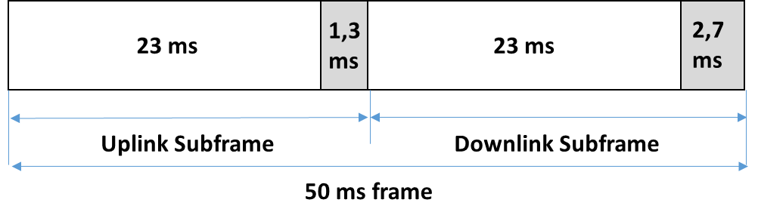
2. Assumptions
2.3. 5030-5091 MHz division in frequency channels
A frequency channel is the frequency interval allocated to a single UAS (Unmanned Aircraft System) for the C2 link communication UA-GRS, GRS-UA or both.
It is defined by :
  the Uplink/Downlink signal Duplexing architecture.
  the frequency channel bandwidth.
  the center frequency
In this study, the Uplink (UL) and Downlink (DL) signals of a given UAS are separated using Time Division Duplex (TDD), on the same carrier.
Important hypothesis: all the UAS of the territory synchronize their UL and DL time slots with a unique reference (all UAS are synchronized).

Slide 13
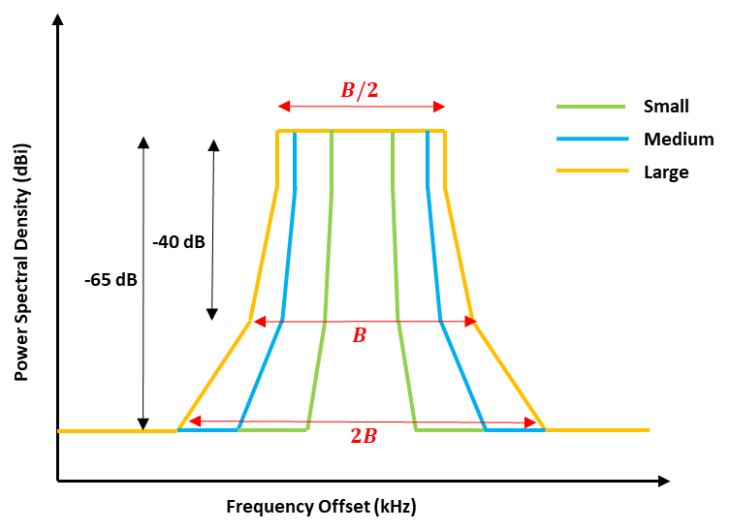
2. Assumptions
2.3. 5030-5091 MHz division in frequency channels
The frequency channel bandwidth is defined by the power spectrum density mask are used for the transmitted and received C2 link of a single UAS (provided by MOPS DO-362).
UAS category | Frequency channel bandwidth
Small | 85 kHz
Medium | 170 kHz
Large | 205 kHz
The center frequency of the C2 link frequency channel of a single UAS is given by the frequency channel allocation methods.

Slide 14

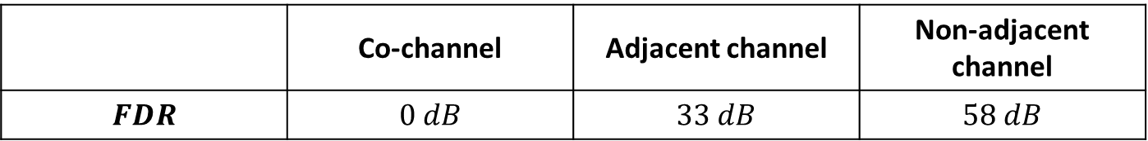
2. Assumptions
2.4. Interference protection criteria
The interference protection criterion is defined by a minimum Signal to Interference ratio. It is provided the minimum Signal to Noise ratio plus an ICAO safety margin (MOPS DO-362):
$\left[\frac{S}{I}\right]$ > 13.5 dB
For a given C2 link receiver, computation of the ratio between Desired signal (D) and Undesired signal (U):
$$\left[\frac{S}{I}\right]=\left(P_{T_{x}}^{D}−P_{T_{x}}^{U}\right)+\left(G_{T_{x}}^{D}−G_{T_{x}}^{U}\right)+20\log_{10}\left(\frac{d_{U}}{d_{D}}\right)+10\log_{10}\left(\frac{R_{S}^{U}}{R_{S}^{D}}\right)+\left(G_{R_{x}}^{D}−G_{R_{x}}^{U}\right)−M_{T}+FDR$$
Distance from the U and D Tx to the Rx
Tx output power (dBm)
Rx antenna gain (dBi)
Tx antenna gain (dBi)
Data rate (kbit/s)
Signal fading due to multipath
Frequency Dependant Rejection
The Frequency Dependant Rejection is the interference attenuation due to the frequency offset between Desired and Undesired signals. It is given by the frequency channel masks:
 | Co-channel | Adjacent channel | Non-adjacent channel
$$FDR$$ | $$0 dB$$ | $$33 dB$$ | $$58 dB$$

Slide 15
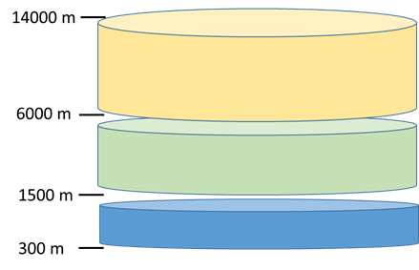
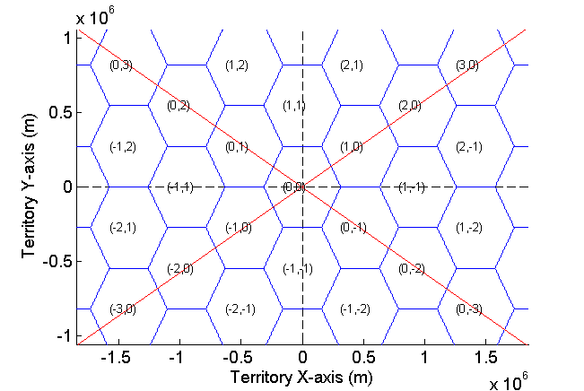
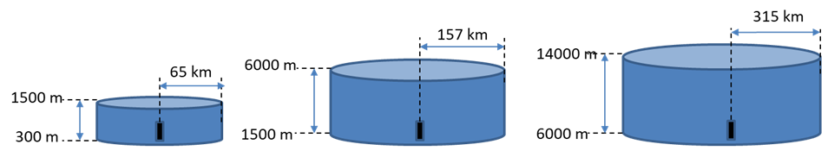

2. Assumptions
2.5. Division of the territory
The territory vertical axis has been divided in 3 altitude ranges. One given UA uses two distinct frequency channels in two different altitude ranges.
C
B
A
Territory length
Each altitude range is divided in a network of hexagonal cells. In one cell, a given UAS uses one unique frequency channel.
The radius of the cells is different for each altitude range. It is computed so that the center of the cell is in the Radio Horizon of any UA flying at minimum altitude, with:
$R_{H}(km)=4.21\sqrt{h(m)}$
B
C
A

Slide 16
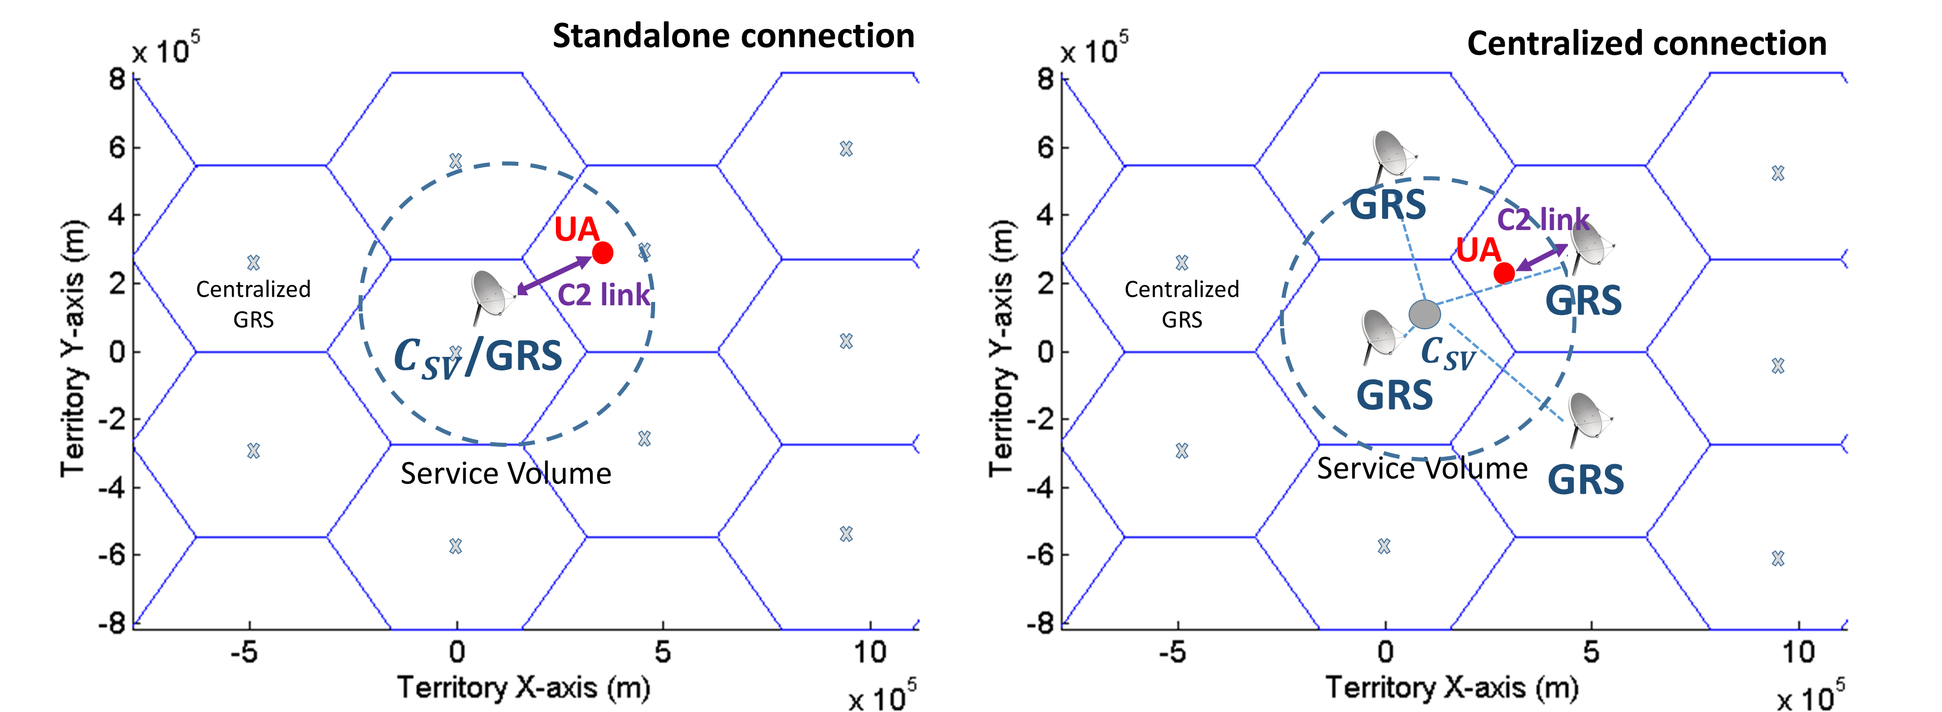
2. Assumptions
2.6. Communication architecture
Two possible communication architectures have been envisaged in this study:
  Standalone connection: The UA (Unmanned Aircraft) is connected to its own individual GRS (Ground Radio Station). Then, the GRS is located at the center of the SV (Csv), which might be anywhere within the cell.
  Centralized connection: The UA is connected to a network of centralized GRS, one GRS located at the center of each cell. The GRS is not at the same location as the Csv.

Slide 17
Organization of the presentation
Introduction and Scope of the study
Assumptions on the terrestrial C2 link system
Definition of the Static and Dynamic assignment processes
Results of the simulations
Conclusions and recommendations

Slide 18
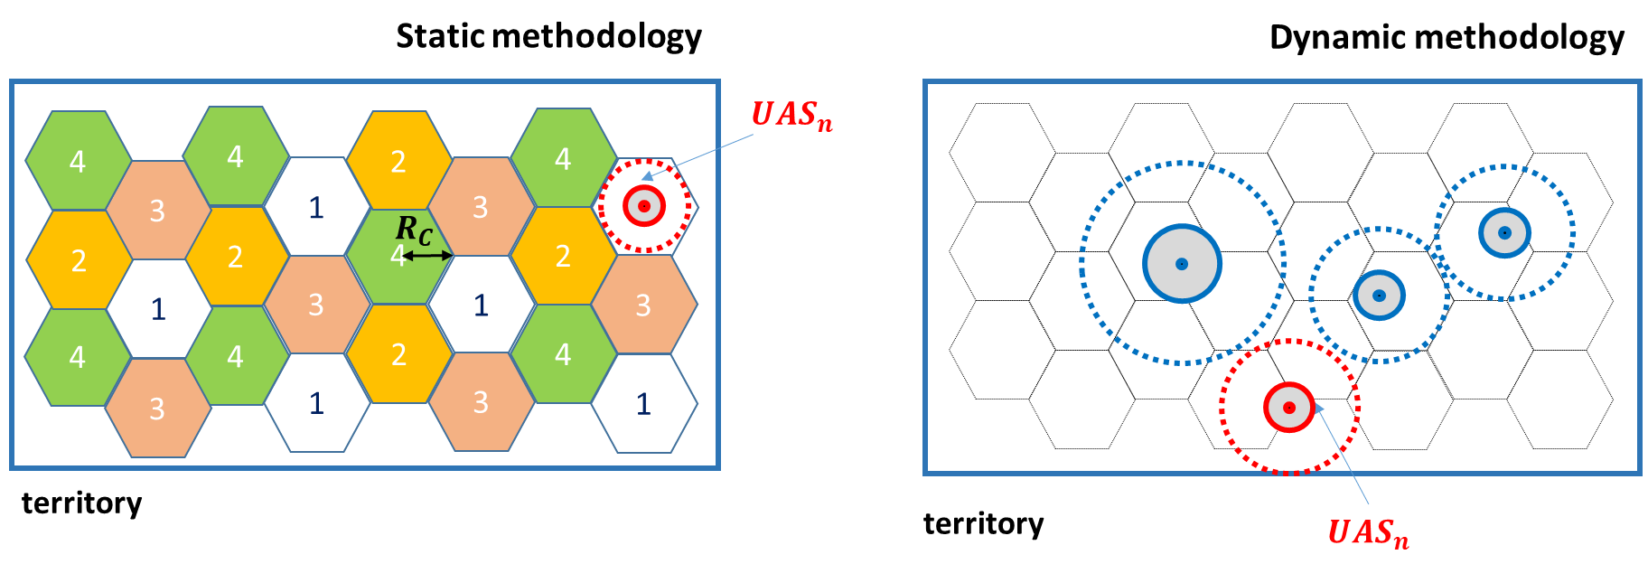
3. Assignment methods
3.1. General introduction to the methods
Two possible frequency assignment methodologies have been envisaged in this study:
  Static assignment: the UAS asking for a channel allocation in a given cell may only receive a frequency channel from a pre-defined list of channels. Each cell receives a fixed list of channels chosen so as to respect the interference protection criteria.
  Dynamic assignment: no fixed list of channel is pre-defined. The UAS asking for a channel assignment in a given cell may receive any channel respecting the interference protection criteria with respect to the other UAS users.

Slide 19
3. Assignment Methods
Static channel assignment method
    Pre-step: Allocation of a list of frequency channels to each cell.
    Channel assignment:
      Identify the cells in which the UAS may ask an assignment (cells intersected by the Service Volume).
      For each identified cell, determine if the UA can receive a frequency channel assignment respecting the interference protection criteria.
Dynamic channel assignment method
    Channel assignment:
      Identify the cells in which the UAS may ask an assignment (cells intersected by the Service Volume).
      For each identified cell, determine if the UA can receive a frequency channel assignment respecting the interference protection criteria.

Slide 20
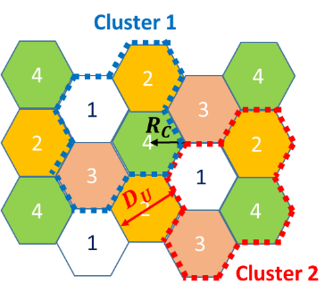
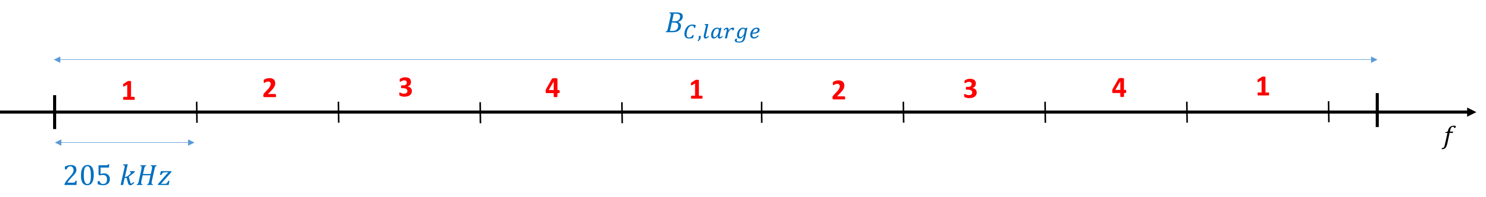
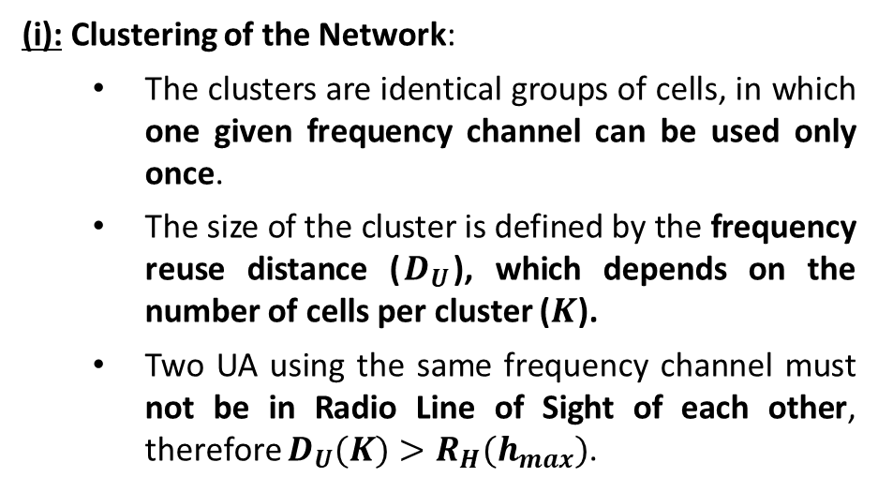
3. Assignment Methods
3.1. Static Assignment – pre-step
Pre-step: a fixed list of frequency channels must be attributed to each cell of the territory. The main constraints are to completely prevent the co-channel interference (i) and mitigate as much as possible the adjacent-channel interference (i).
(i): Clustering of the Network:
  The clusters are identical groups of cells, in which one given frequency channel can be used only once.
  The size of the cluster is defined by the frequency reuse distance ($D_{U}$), which depends on the number of cells per cluster ($K$).
  Two UA using the same frequency channel must not be in Radio Line of Sight of each other, therefore $D_{U}(K)>R_{H}(h_{max})$.
Clustering with K=4 cell per cluster, at altitude range C
(ii): Distribution of the frequency channels to the different cells of one cluster:
Example of attribution of Large UAS channels to the cells of a K=4 cluster
$B_{C, large}$ is the band reserved for the frequency channel of large UAS at altitude range C

Slide 21
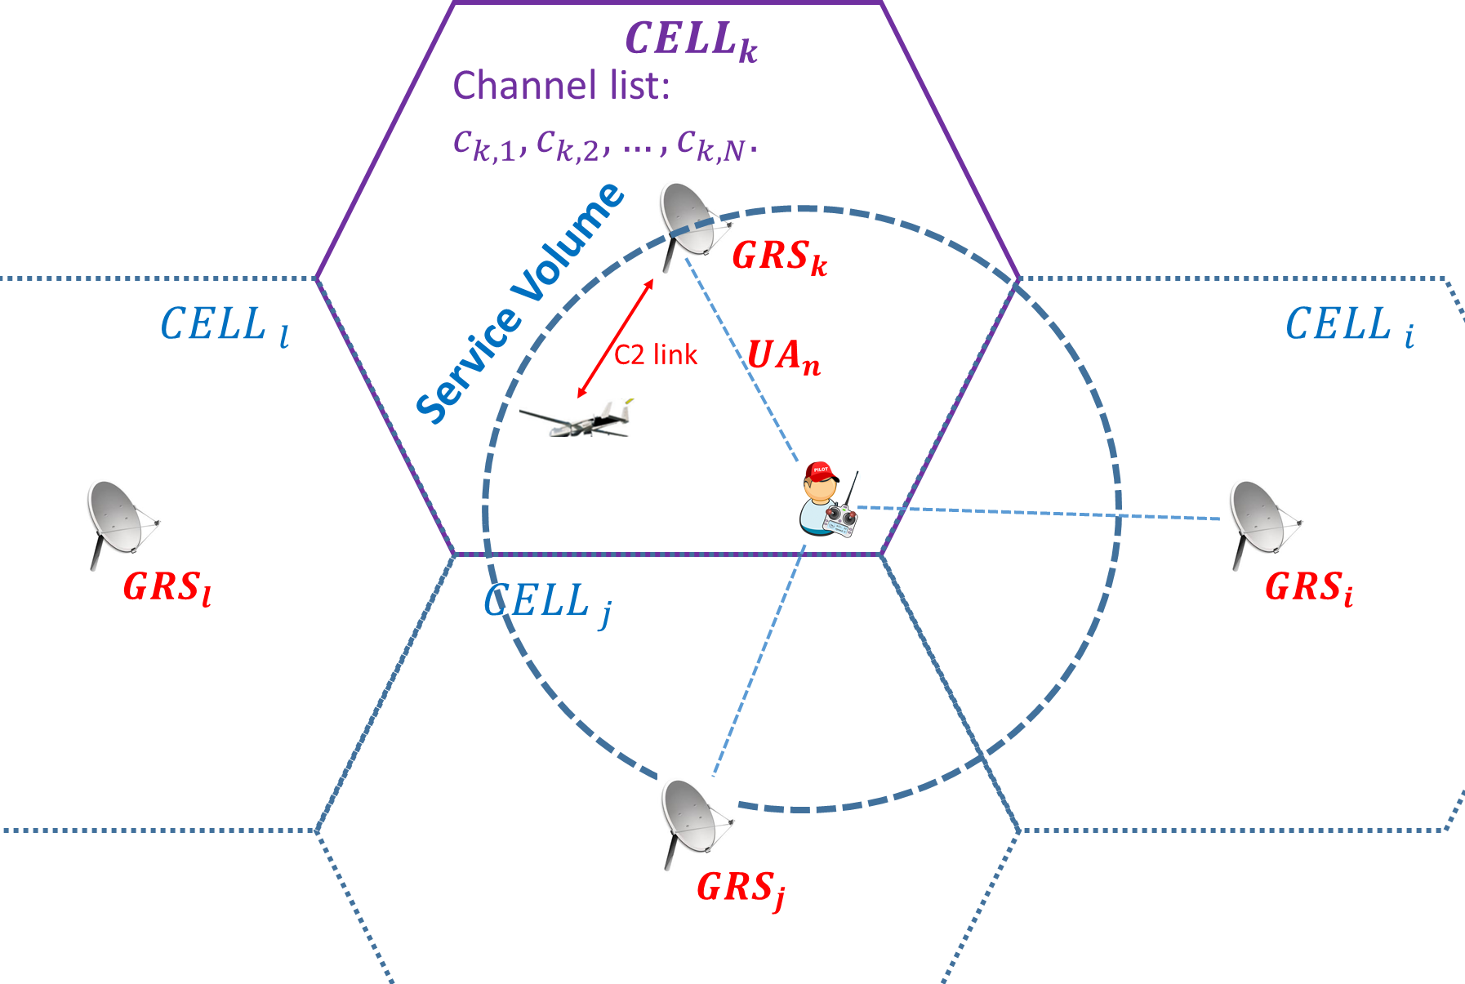
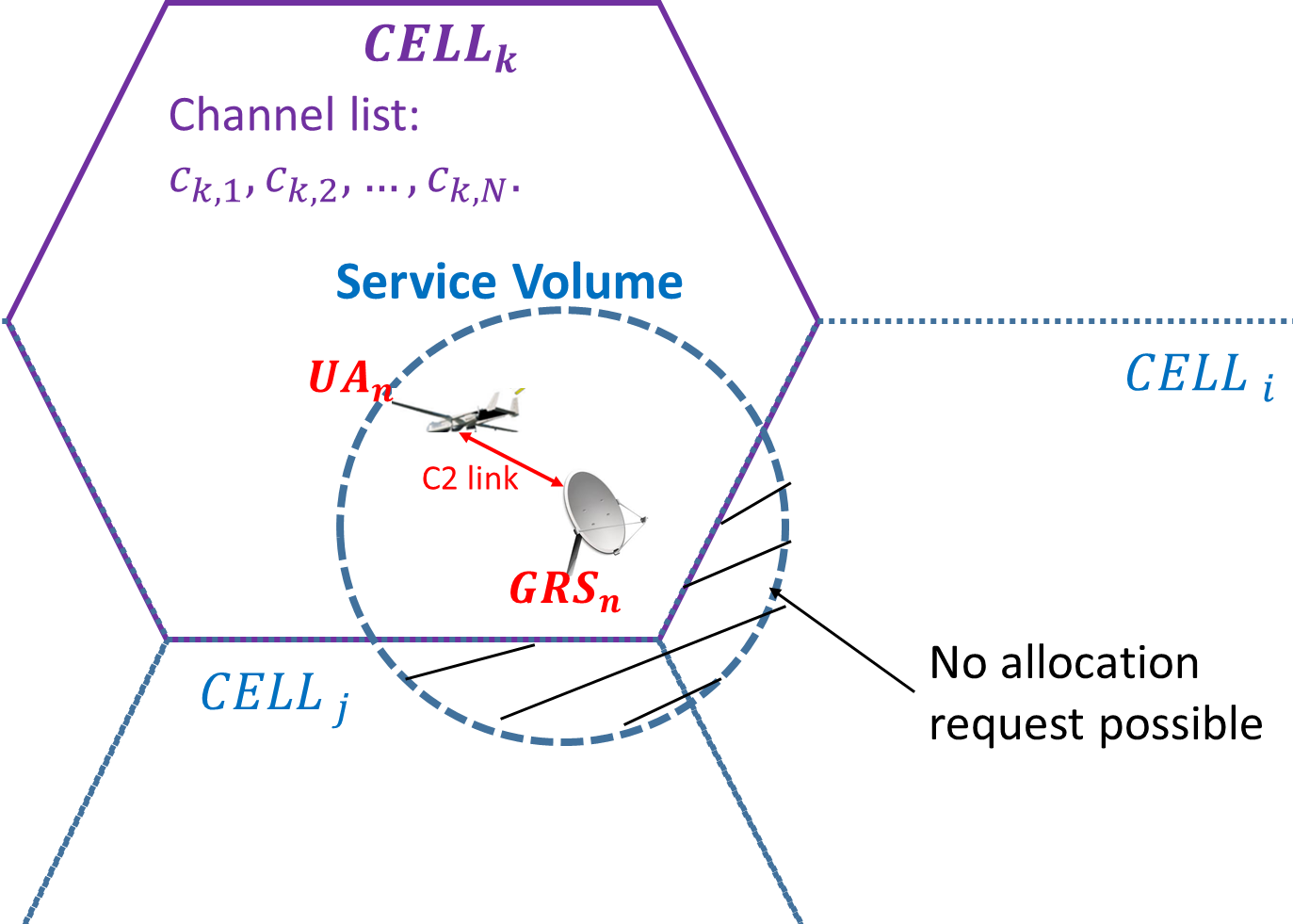
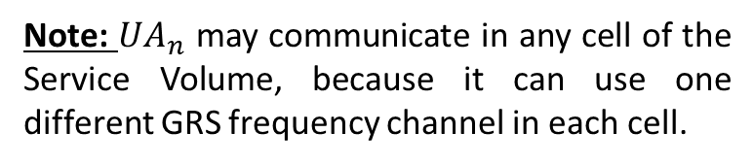
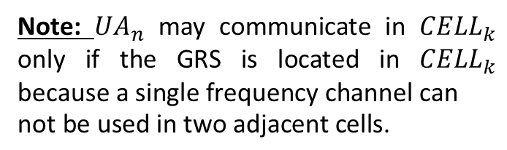
3. Assignment Methods
3.1. Static Assignment – Channel assignment step
Let us consider that ${UA}_{n}$ requests a frequency channel assignment in the ${CELL}_{k}$. ${UA}_{n}$ may receive a frequency channel to communicate with ${GRS}_{n}$ while it flies over ${CELL}_{k}$ if:
Is ${UA}_{n}$ allowed to communicate over ${CELL}_{k}$ ? Depends on the connection architecture.
Standalone connection
Centralized connection
Note: ${UA}_{n}$ may communicate in ${CELL}_{k}$ only if the GRS is located in ${CELL}_{k}$ $\text{because} \text{a} \text{single} \text{frequency} \text{channel} \text{can} \text{not} \text{be} \text{used} \text{in} \text{two} \text{adjacent} \text{cells}\text{.}$
Note: ${UA}_{n}$ may communicate in any cell of the Service Volume, because it can use one different GRS frequency channel in each cell.
Is there a frequency channel available in ${CELL}_{k}$ ?

Slide 22
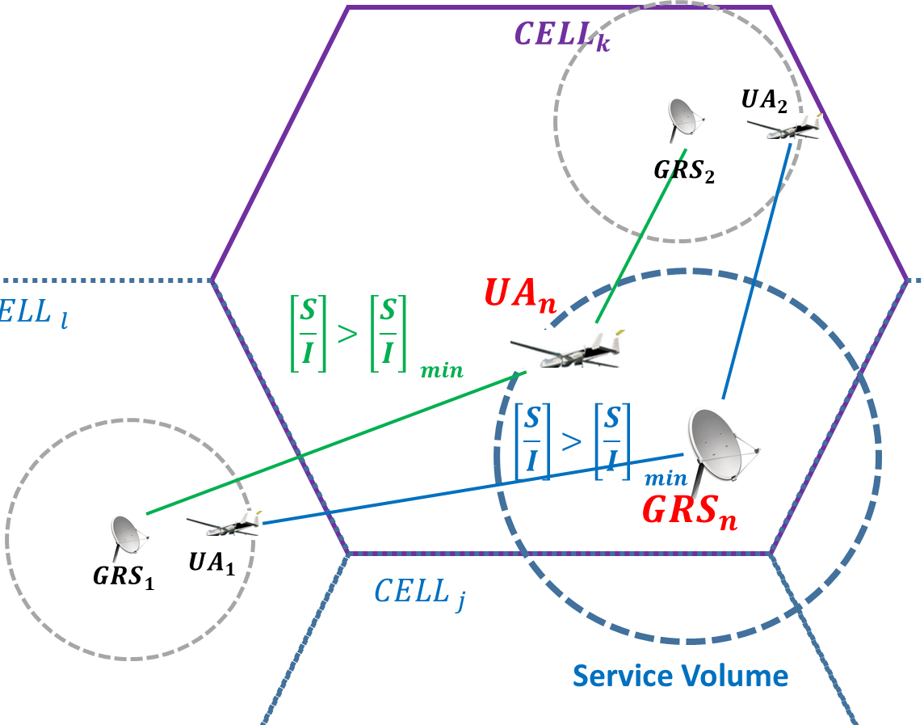
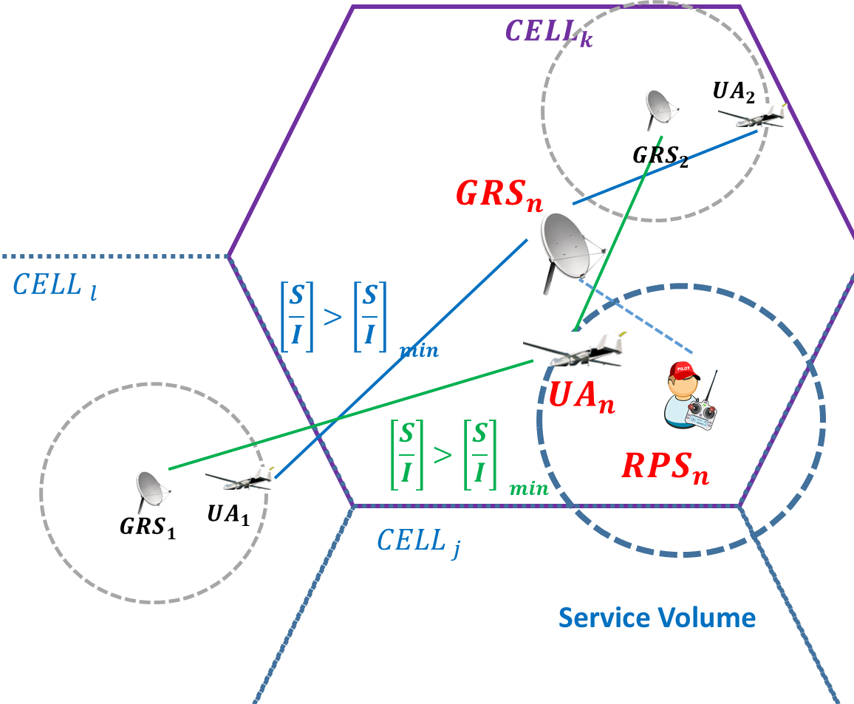
3. Allocation Methods
3.2. Dynamic Allocation – Channel assignment step
Let us consider that ${UA}_{n}$ requests a frequency channel allocation in the ${CELL}_{k}$. ${UA}_{n}$ may receive a frequency channel ${CELL}_{k}$ if it exists a channel $c_{k}$ so that:
${UA}_{n}$ causes no interference to the other GRS of the territory (and vice-versa).
${GRS}_{n}$ causes no interference to the other UA of the territory (and vice-versa).
Standalone connection
Centralized connection
On this example, ${UA}_{n}$ may receive channel $c_{k}$ in ${CELL}_{k}$ if and only if ${GRS}_{n}$ causes no interference to ${UA}_{1}$ and ${UA}_{2}$ AND ${UA}_{n}$ causes no interference to ${GRS}_{1}$ and ${GRS}_{2}$.

Slide 23
Organization of the presentation
Introduction and Scope of the study
Assumptions on the terrestrial C2 link system
Definition of the Static and Dynamic assignment processes
Results of the simulations
Conclusions and recommendations

Slide 24
4. Allocation Methods
Simulation of the study: allocation of C2 link frequency channels to a simulated traffic of UAS (Centralized or Standalone), on a given territory, using both Static and Dynamic assignment methods, respecting the interference protection criteria.
4.1. Presentation of the simulation
    Territory and Frequency band considered.
    UAS (Unmanned Aircraft System) traffic.
    C2 link parameters.
    Authorization to fly rules.
4.2. Simulation results: comparison of the Static and Dynamic allocation methods.
    Criterion 1: Number of UAS allowed to fly.
    Criterion 2: Number of cells in which the UAs are allowed to fly.

Slide 25
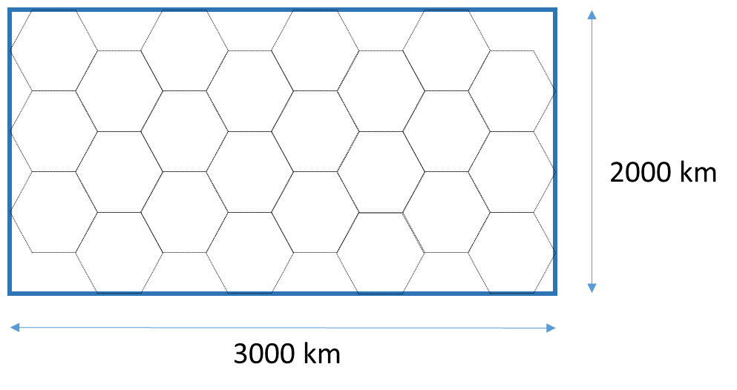
4. Simulation results
4.1. Simulation parameters
Territory: The territory considered for the simulation is 3000x2000 km large.
Frequency band: The part of the 5030-5091 MHz frequency band allocated to the Terrestrial system is considered 10 MHz wide.
Simulation of the UAS traffic: 3000 UAS, randomly spread on the territory, request an authorization to fly in a pre-defined order. The type of the UAS has been chosen so that:
  78% of the UA are “Small”, 18% are “Medium” and 4% are “Large” (MOPS DO-362) .
  The “Small” UA are always in altitude range A.
  76% of “Medium” UA are in altitude range B (cruise phase) and 24% are in altitude range A (approach phase).
  76% of “Large” UA are in altitude range C (cruise phase) and 24% are in altitude range A (approach phase).

Slide 26
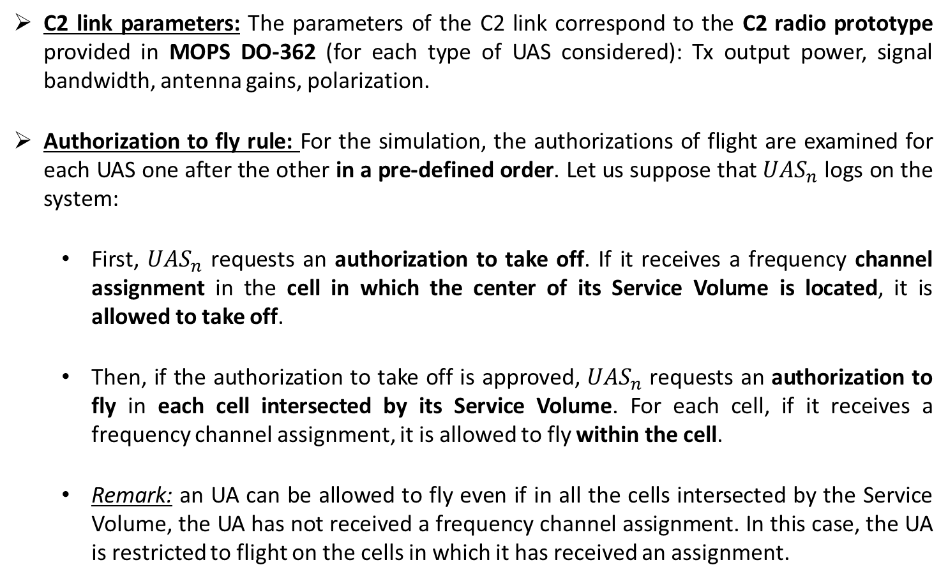
4. Simulation results
4.1. Simulation parameters
C2 link parameters: The parameters of the C2 link correspond to the C2 radio prototype provided in MOPS DO-362 (for each type of UAS considered): Tx output power, signal bandwidth, antenna gains, polarization.
Authorization to fly rule: For the simulation, the authorizations of flight are examined for each UAS one after the other in a pre-defined order. Let us suppose that ${UAS}_{n}$ logs on the system:
  First, ${UAS}_{n}$ requests an authorization to take off. If it receives a frequency channel assignment in the cell in which the center of its Service Volume is located, it is allowed to take off.
  Then, if the authorization to take off is approved, ${UAS}_{n}$ requests an authorization to fly in each cell intersected by its Service Volume. For each cell, if it receives a frequency channel assignment, it is allowed to fly within the cell.
  Remark: an UA can be allowed to fly even if in all the cells intersected by the Service Volume, the UA has not received a frequency channel assignment. In this case, the UA is restricted to flight on the cells in which it has received an assignment.

Slide 27
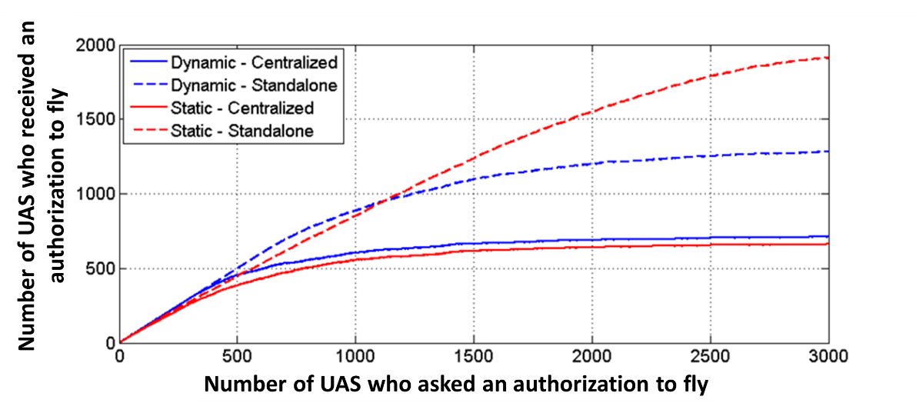
4. Simulation results
4.2. Simulation results
The first criterion of comparison of the Static and Dynamic allocation methods is the number of UAS who receive an authorization to fly (in at least one cell).
1913 UAS
1282 UAS
712 UAS
661 UAS
Considering UAS Standalone connection: More UAS receive an authorization to fly with Static assignment than with Dynamic allocation (Static > Dynamic).
Considering UAS Centralized connection: The performance of Dynamic and Static assignment are close, even if Dynamic is slightly superior (Static ≈ Dynamic).

Slide 28
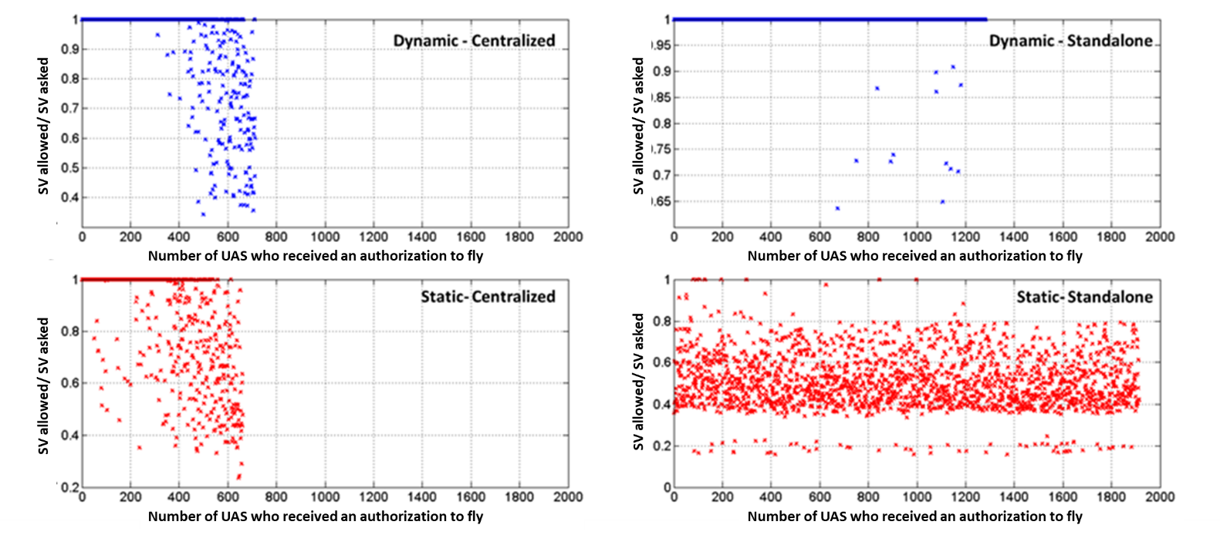
4. Simulation results
4.2. Simulation results
The second criterion of comparison of the Static and Dynamic assignment methods is the ratio between the area in which the UA is allowed to fly (cells in which it received an assignment) and the total area requested (area of the SV).
M=92%
M=99%
M=85%
M=51%
Considering UAS Standalone connection: A significantly larger ratio of the SV is available for the UAS with Dynamic assignment than with Static allocation. (Dynamic>> Static).
Considering UAS Centralized connection: The performance of Dynamic and Static assignment are close, even if Dynamic is slightly superior (Static ≈ Dynamic).

Slide 29
Organization of the presentation
Introduction and Scope of the study
Assumptions on the terrestrial C2 link system
Definition of the Static and Dynamic assignment processes
Results of the simulations
Conclusions and recommendations

Slide 30
5. Conclusion
5.1. Conclusion of the study
Two major conclusions can be drawn from the study presented:
Conclusion 1: comparison between Static and Dynamic assignment methodologies
  For UAS using Standalone connection:
    Number of authorization to fly (criterion 1): Static > Dynamic.
    However, for the ratio of the SV (Service Volume) in which the UA is allowed to fly (criterion 2):
      For Static assignment, the UA may fly in only 50% of the SV in average and no UA was allowed to fly over 100% of its SV.
      For Dynamic assignment, almost each UA may fly over 100% of its SV.
    ⇒ The use of the Dynamic assignment method may be recommended.
  For UAS using Centralized connection:
    criterion 1: Dynamic is slightly better than Static.
    criterion 2: Dynamic is slightly better than Static.
    ⇒ The use of the Static assignment method may be recommended, because it might be more adapted to future Frequency Provider implementations, especially for Centralized system (centralized GRS using the cellular network).

Slide 31
5. Conclusion
5.1. Conclusion of the study
Conclusion 2: absolute number of UAS allowed to fly
Considering 3000x2000 km territory, 10 MHz terrestrial bandwidth and the C2 prototype of MOPS DO-362:
  Standalone UAS: 1282 UAS (out of 3000) could receive an authorization to fly, over 100% of their SV for almost all of them, using the Dynamic assignment methodology.
  Centralized UAS: 660 UAS (out of 3000) could receive an authorization to fly, over 85% of their SV in average, using the Static assignment methodology.

Slide 32
5. Conclusion
5.2. Future works
Enhance to the Static assignment methodology, which might be the future implementation method for the future centralized UAS.
As for future UAS traffic, Standalone and Centralized UAS will co-exist, an hybridization of Static and Dynamic assignment could be envisaged.
More comparison criteria should be considered to consolidate the results of this study, including the impact of increase UAS density at some locations.
More realistic simulation parameters could be considered: relief and non uniform UAS distribution, other transmitted C2 link spectrum density mask.
Finally, similar channel assignment methodologies should be considered on the satellite system, so as to study the aggregation of satellite and terrestrial components on the 5030-5091 MHz band.

Slide 33
Thank you for your attention
Questions ?

Slide 34
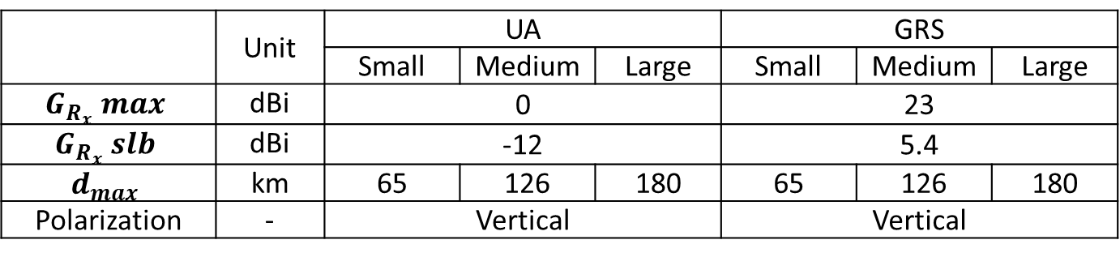
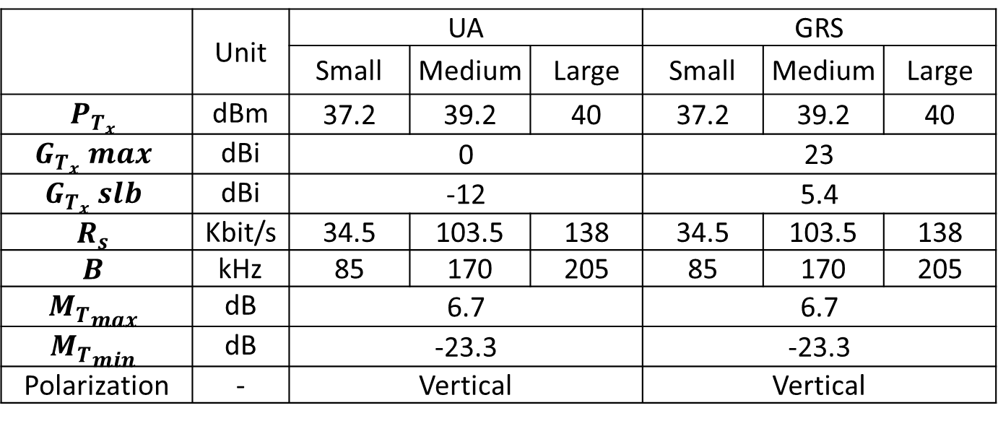
Backup slide
Parameters of the C2 link prototype of MOPS DO-362
 | Unit | UA |  |  | GRS
 |  | Small | Medium | Large | Small | Medium | Large
$$P_{T_{x}}$$ | dBm | 37.2 | 39.2 | 40 | 37.2 | 39.2 | 40
$$G_{T_{x}} max$$ | dBi | 0 |  |  | 23
$$G_{T_{x}} slb$$ | dBi | -12 |  |  | 5.4
$$R_{s}$$ | Kbit/s | 34.5 | 103.5 | 138 | 34.5 | 103.5 | 138
$$B$$ | kHz | 85 | 170 | 205 | 85 | 170 | 205
$${M_{T}}_{max}$$ | dB | 6.7 |  |  | 6.7
$${M_{T}}_{min}$$ | dB | -23.3 |  |  | -23.3
Polarization | - | Vertical |  |  | Vertical
 | Unit | UA |  |  | GRS
 |  | Small | Medium | Large | Small | Medium | Large
$$G_{R_{x}} max$$ | dBi | 0 |  |  | 23
$$G_{R_{x}} slb$$ | dBi | -12 |  |  | 5.4
$$d_{max}$$ | km | 65 | 126 | 180 | 65 | 126 | 180
Polarization | - | Vertical |  |  | Vertical

