Slide 1
ICAO WRC-23 Preparatory Workshop
(virtual)
April 2022
TITLE / HEADING
Agenda Item 1.6 – Radiocommunications for Suborbital Vehicles
Presented by:
Chris Tourigny
U.S. FAA

Slide 2
Agenda item 1.6 (WRC-23) - to consider, in accordance with Resolution 772 (WRC-19), regulatory provisions to facilitate radiocommunications for sub-orbital vehicles;
ITU-R is invited to study the radiocommunications for suborbital vehicles
ICAO is invited to participate in the studies and provide to ITU the relevant technical characteristics required for the studies
World Radiocommunication Conference 2023 is invited to consider the results of the studies above and take the appropriate action

Slide 3
Recognizing
a) that there is no internationally agreed legal demarcation between the Earth’s atmosphere
and the space domain;
b) that there is no formal definition of sub-orbital flight, although it has been assumed in
Report ITU-R M.2477 to be an intentional flight of a vehicle expected to reach the upper atmosphere with a portion of its flight path that may occur in space without completing a full orbit around the Earth before returning back to the surface of the Earth;
c) that stations on board sub-orbital vehicles may use systems operating under space and/or
terrestrial services;
d) that the current regulatory provisions and procedures for terrestrial and space services may not be adequate for international use of relevant frequency assignments by stations on board suborbital vehicles;
e) through h), see Resolution 772

Slide 4
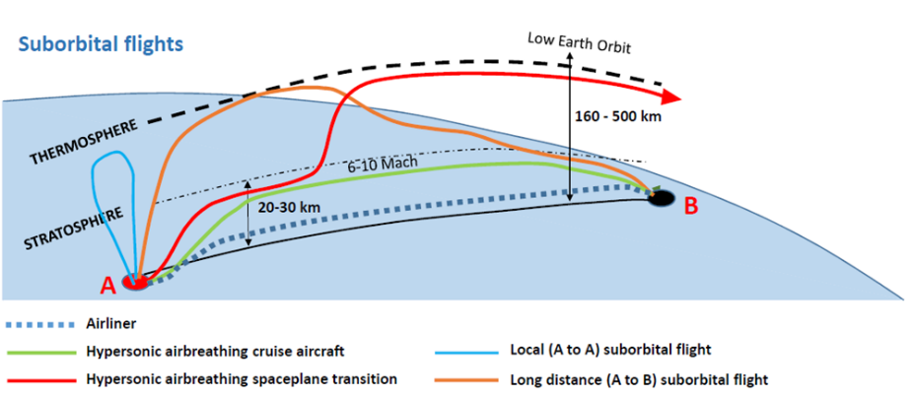
Potential ICAO standardized system use case:
ADS-B Version 3 1090ES and 978UAT
Standardized messages specifically for this application
  Max horizontal velocity: 15,690 kts
  Max verticle velocity: 415,258 ft/min
  Max altitude: 533 nmi
Picture credit: WP5B/481 Annex 1
Suborbital vehicles must be safely accommodated into airspace used by conventional
aircraft during certain phases of flight

Slide 5
ITU-R studies: Invites 1
to study spectrum needs for communications between stations on board sub-orbital vehicles and terrestrial/space stations providing functions such as, inter alia, voice/data
communications, navigation, surveillance and TT&C;

Slide 6
ITU-R studies: Invites 2
Invites 2 to study appropriate modification, if any, to the Radio Regulations, excluding any new allocations or changes to the existing allocations in Article 5, to accommodate stations on board suborbital vehicles, whilst avoiding any impact on conventional space launch systems, with the following objectives:
to determine the status of stations on sub-orbital vehicles, and study corresponding regulatory provisions to determine which existing radiocommunication services can be used by stations on sub-orbital vehicles, if necessary;
to determine the technical and regulatory conditions to allow some stations on board suborbital vehicles to operate under the aeronautical regulation and to be considered as earth stations or terrestrial stations even if a part of the flight occurs in space;
to facilitate radiocommunications that support aviation to safely integrate sub-orbital vehicles into airspace and ensure interoperability with international civil aviation;
to define the relevant technical characteristics and protection criteria for the studies to be undertaken in accordance with the bullet point below;
to conduct sharing and compatibility studies with incumbent services that are allocated on a primary basis in the same and adjacent frequency bands in order to avoid harmful interference to other radiocommunication services and to existing applications of the same service in which stations on board sub-orbital vehicles operate, having regard to the sub-orbital flight application scenarios;

Slide 7
ITU-R studies: Invites 3
to identify, as a result of the studies above, whether there is a need for access to additional spectrum that should be addressed after WRC-23 by a future competent conference

Slide 8
ITU-R supporting studies
Report ITU-R M.2477 provides information on the current understanding of
radiocommunications for sub-orbital vehicles, including a description of the flight trajectory,
categories of sub-orbital vehicles, technical studies related to possible avionics systems used by suborbital vehicles, and service allocations of those systems;
WP5B/481 Annex 1: Working document towards a draft CPM text for WRC-23 agenda item 1.6
Contains methods to resolve the agenda item
WP5B/481 Annex 30: Working document towards preliminary draft new Report on WRC-23 agenda item 1.6 [suborbital vehicles studies] - Regulatory, operational, and technical studies of radiocommunications for suborbital vehicles
Contains studies to support invites 1, 2, and 3

Slide 9
Status of the draft CPM text (subject to change)
Four Methods are proposed to address this agenda item:
Method A
No change to the Radio Regulations (RR).
Method B
A WRC Resolution, not incorporated by reference in the RR.
Method C
Modification of RR Article 4.
Method D
No Change to RR Article 4.

Slide 10
ICAO Position
“To support ITU-R studies and the definition of relevant technical characteristics as called for by Resolution 772 (WRC-19) to ensure aviation needs are satisfied. To support, if identified as required by the studies called for in Resolution 772 (WRC-19), modifications to the Radio Regulations that help enable the integration of sub-orbital vehicles into the airspace structure. To support, if studies show the need for access to additional spectrum, the establishment of a WRC agenda item at a future competent conference.”

Slide 11
Questions?

