Slide 1
WAIC Co-existence Scenarios
FSMP-WG3 Meeting
Montreal, Canada, 6 to 14 September 2016

Slide 2
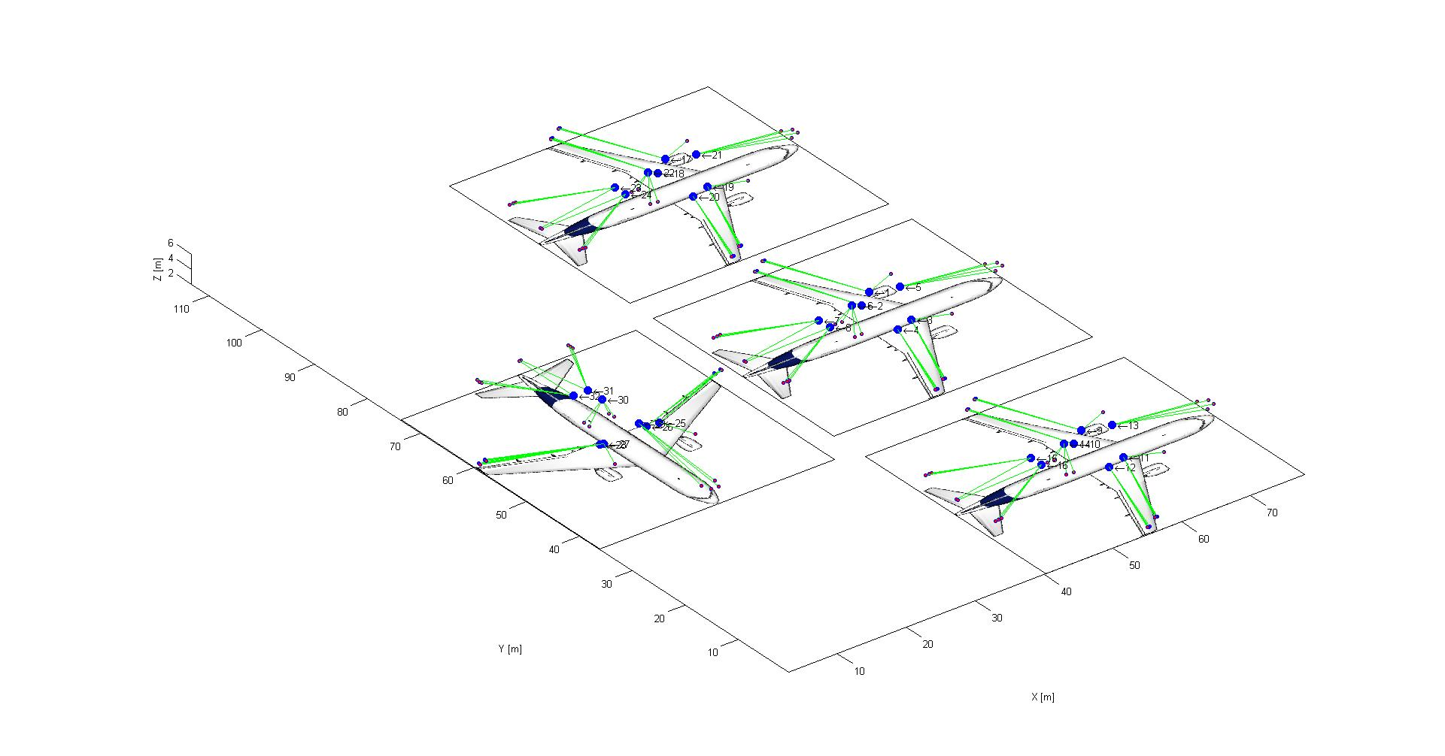
Airport Stand Scenario (1/2)
Geometry
Typical dimensions taken from IATA Airport Development Reference Manual (for ICAO Aerodrome Reference Code C)
Proposed scenario:
victim aircraft in the middle stand
two adjacent aircraft
one aircraft on taxi way
Interference analysis for:
RA+WAIC → WAIC
WAIC → RA
Victim Aircraft
Interfering Aircraft

Slide 3
Airport Stand Scenario (1/2)
Dimensions
Excerpt from IATA Airport Development Reference Manual
Excerpt from IATA Airport Development Reference Manual
ICAO Aerodrome Reference Code | Span Criteria | Aircraft |  |  | Head of Stand Access Road & Push Back Truck Clearance | Taxiway Centre Line To Taxiway Centre Line | Taxiway Outer Than Aircraft Stand Taxi-Lane, Centre Line To Object | Stand Depth | Head of Stand Access Road, Push Back Truck Clearance & Expansion Zone For Satellite | Satellite Width | Minimum Clearance Between Aircraft
 |  | Type | Length | Span | a | B | c | d | e | f | g
C | 24 m up to but not including 36 m | A319 A320-200 B737-800 | 33,84 37,57 39,50 | 34,10 34,10 34,30 | 20,00 | 44,00 | 28.00 | 45,00 | 30,00 | 25-35

Slide 4
Landing Scenario
Geometry (Source: ITU-R Report M.2319)
Three taxiing aircraft in line on taxiway
d_{Ground} = 87m (cf. ICAO Annex 14, Table 3-1,
ICAO Aerodrome Reference Code B)
d_{Taxi} = TBD

