Slide 1
ICAO - AFI Regional Preparatory Group (RPG) Workshop
&
7th Working Group meeting of the FSMP

Slide 2
CONTENTS
Meeting dates.
Location.
Weather information.
List of hotels around venue.
List of airports.
General information,

Slide 3
PROPOSED DATES
DATE : 4th – 5th SEPTEMBER 2018
Regional Preparatory Group (RPG) workshop.
DATE: 6th – 13th SEPTEMBER 2018
7th Frequency Spectrum Management Panel (FSMP) meeting.

Slide 4
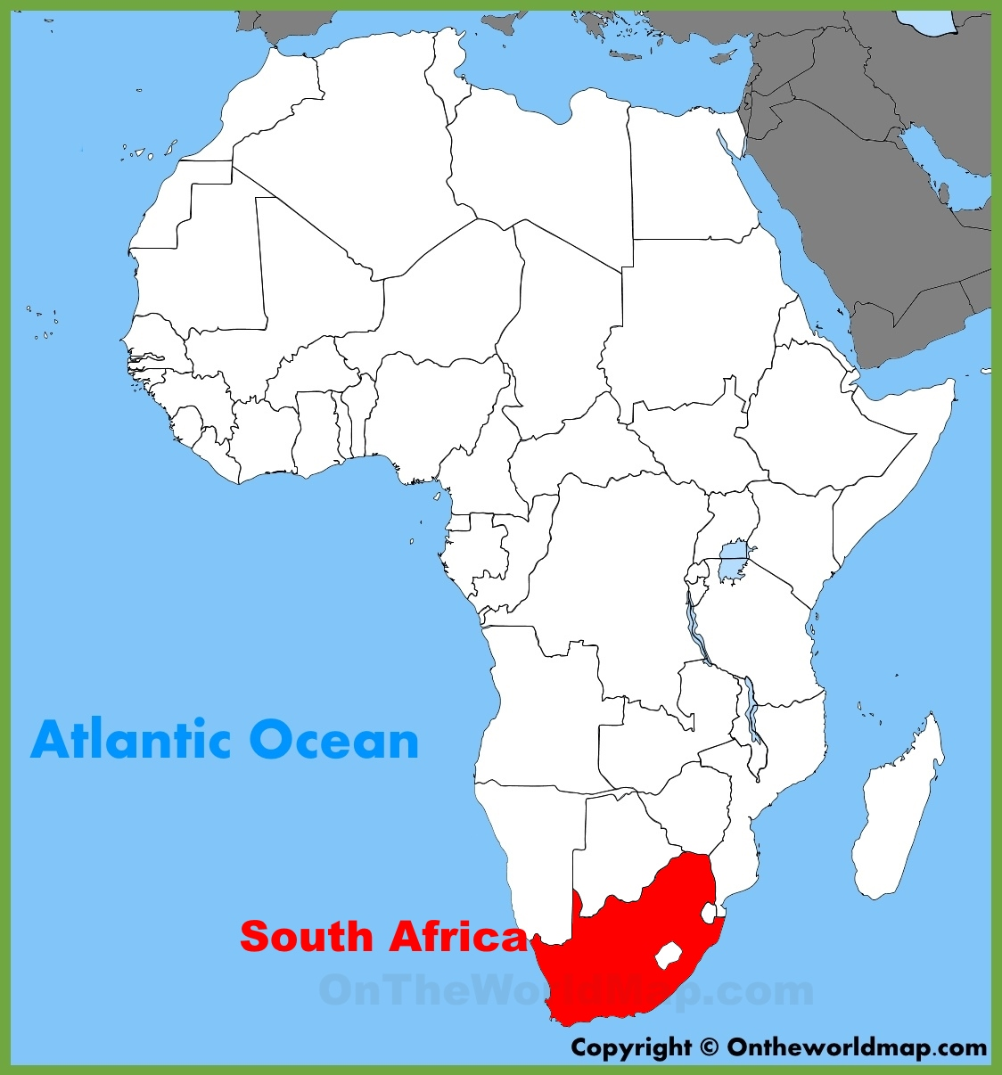
LOCATION
ICAO REGIONAL OFFICES:
ESAF ( East & South African ) – Nairobi , Kenya
WACAF ( West African ) – Dakar, Senegal

Slide 5

MEETING VENUE
LOCATION: Johannesburg; South Africa
CO-ORDINATES: 26.2041º S, 28.0473º E
DISTANCE: from the Indian / Atlantic Ocean South Coast – 1500 KM
ELEVATION: 1 753 metres (6 000 feet) ASL

Slide 6
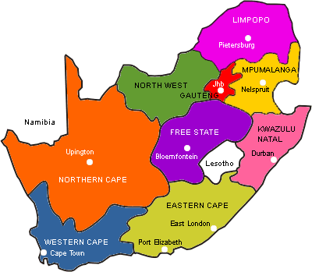
WEATHER INFORMATION
SEASON: Spring
WEATHER: Sunny, chilly air
TEMPERATURES: Low 10 ºC
High 25 ºC
Wind: 9 miles p/h
Humidity: 20%

Slide 7
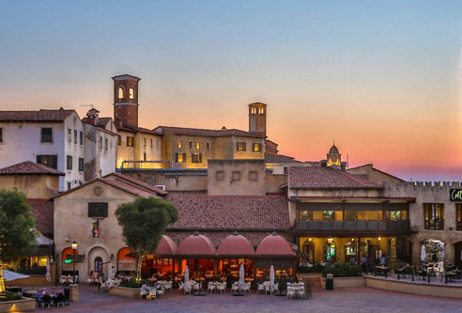
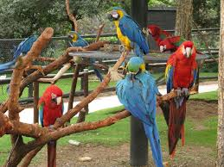
HOTEL INFORMATION
VENUE 1: FOURWAYS ( Home to Montecassino & The bird Garden)
LIST OF HOTELS:
Southern sun Montecassino hotel
Sun Square Montecassino hotel
The Palazzo Montecassino hotel
City Lodge Montecassino hotel
Indaba hotel
Fourways guest house
Oaktree guest house
King fisher guest house
MaBella lodge
Tuscany boutique hotel

Slide 8
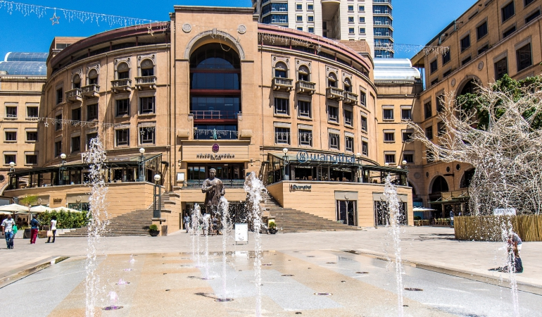
HOTEL INFORMATION
VENUE 2: SANDTON (Home to Mandela Square & Johannesburg Stock Exchange)
LIST OF HOTELS:
Radisson Blu hotel 9. Garden Court Sandton
Signature Lux hotel 10. Holiday Inn Sandton
The Michelangelo hotel 11. Protea hotel Sandton
DaVinci hotel 12. Park Inn Radisson Blu
Intercontinental hotel
Sandton Sun International hotel
Hilton hotel
The Maslow hotel

Slide 9
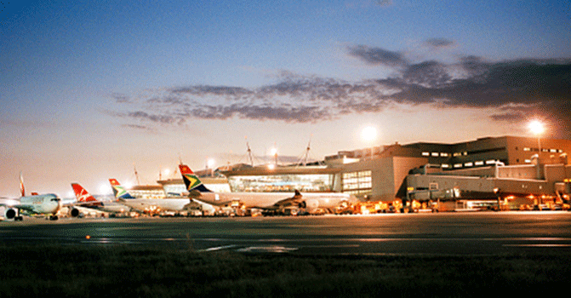
AIRPORTS IN JOHANNESBURG
OR Tambo International airport
Lanseria airport
Grand Central airport
Rand airport
Wonderboom airport

Slide 10
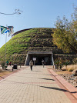
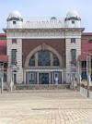
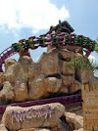
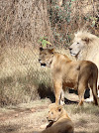
TOURIST ATTRACTION
LIST OF TOURIST PLACES IN JO’BURG:
Cradle of Human kind
Lion Park
Apartheid Museum
Museum Africa
Mandela Square
Gold Reef city
SAB World of beer

Slide 11
SA TOURISM VIDEO
https://youtu.be/mhtnMzCzrXk

