Slide 1
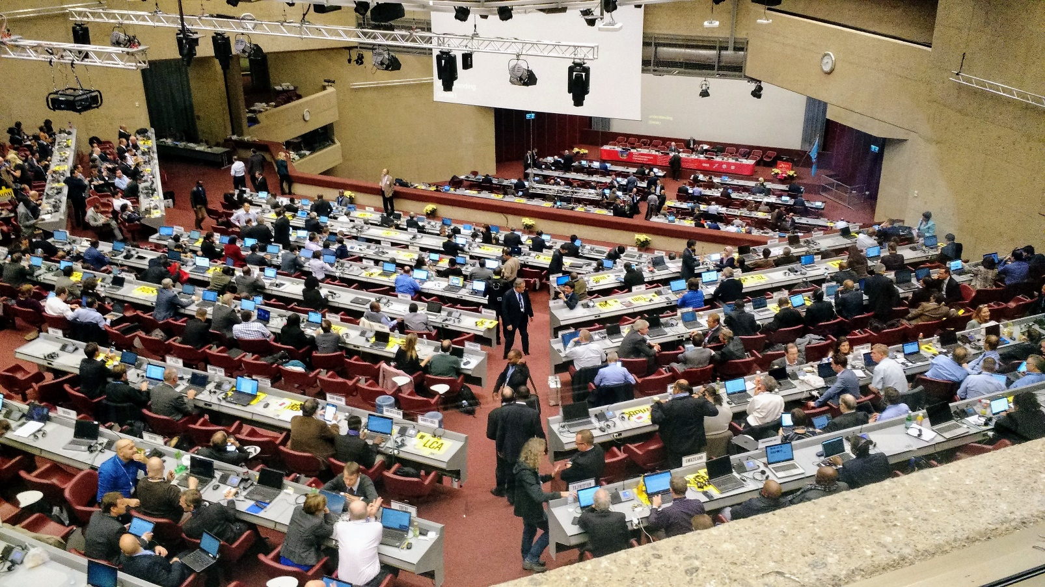
WRC-19 – Agenda Items for Other Issues
Andrew Roy - ASRI

Slide 2
Scope
1.7 - Non-GSO satellites
1.8 - Global Maritime Distress Safety Systems (GMDSS)
1.9 – Maritime Automatic Identifications System (AIS) and VHF data exchange system (VDES)
1.11 - railway radiocommunication systems
1.12 - Intelligent Transport Systems (ITS)
1.13 – New IMT between 24.25 and 86 GHz
1.14 - High-altitude platform stations (HAPS)
1.16 - Radio local area networks 5150 MHz and 5925 MHz
9.1.3 - Non-geostationary-satellite orbit systems in C-band
9.1.6 - Wireless Power Transmission (WPT)

Slide 3
Agenda Item 1.7
To study the spectrum needs for telemetry, tracking and command in the space operation service for non-GSO satellites with short duration missions
Assess the suitability of existing allocations to the Space Operation Service (SOS)
If necessary, to consider new SOS allocations
Resolution 659 (WRC 15).

Slide 4
Agenda Item 1.7 - Commentary
WRC-19 studies will determine if existing SOS allocations are sufficient
  If not, will consider new allocations within the frequency ranges 150.05-174 MHz and 400.15-420 MHz.
Primary concern is an affect on COSPAS SARSAT (EPIRB) in 406.1 MHz
Space planes may want to use SOS spectrum
  Need to ensure flexibility for any space plane use of SOS spectrum

Slide 5
Agenda Item 1.7 - ICAO Position
To oppose any new allocations to the space operations service unless agreed ITU-R studies have proven sharing and compatibility with aviation systems. In particular, oppose consideration of possible allocation to the space operation service in the frequency range 405.9 – 406.2 MHz unless agreed ITU-R studies have proven aviation use of the EPIRBs operating in the frequency band 406 - 406.1 MHz is protected in accordance with Resolution 205 (rev. WRC-15) and RR No. 5.267.
To ensure that any change to the regulatory provisions and spectrum allocations resulting from this agenda item do not preclude the use of SOS allocations for space planes if this service is deemed appropriate for such use.

Slide 6
Agenda Item 1.8
Regulatory actions to support Global Maritime Distress Safety Systems (GMDSS) modernization
To support the introduction of additional satellite systems into the GMDSS
Resolution 359 (Rev.WRC 15)

Slide 7
Agenda Item 1.8 - Commentary
Search and rescue aircraft are an integral part of the global maritime distress and safety system
  Need to ensure no adverse impact on the capability of search and rescue aircraft
If AMS(R)S system which already carries such communications is identified to also carry GMDSS
  Any AMS(R)S use must comply with priority requirements contained in ICAO SARPS

Slide 8
Agenda Item 1.8 - ICAO Position
To ensure that any change to the regulatory provisions and spectrum allocations resulting from this agenda item do not adversely impact on the capability of search and rescue aircraft to effectively communicate with vessels during disaster relief operations.
To ensure that any regulatory provisions in response to this agenda item do not adversely impact SARPS compliance of aeronautical mobile-satellite (route) service satellite systems.

Slide 9
Agenda Item 1.9 (incl 1.9.1 & 1.9.2)
1.9.1 - Regulatory actions within the frequency band 156-162.05 MHz for autonomous maritime radio devices to protect the GMDSS and automatic identifications system (AIS)
  Resolution 362 (WRC 15)
1.9.2 - Modifications of the Radio Regulations, including new spectrum allocations to the MMSS (E-s & s-E)
  Preferably within the frequency bands 156.0125-157.4375 MHz and 160.6125-162.0375 MHz of Appendix 18
  Enable a new VHF Data Exchange System (VDES) satellite component
  Do not degrade the current terrestrial VDES components or AIS
  Resolution 360 (Rev.WRC 15)

Slide 10
Agenda Item 1.9 - Commentary
Search and rescue aircraft are an integral part of the global maritime distress and safety system
  Need to ensure no adverse impact on the capability of search and rescue aircraft

Slide 11
Agenda Item 1.9 - ICAO Position
To ensure that any change to the regulatory provisions and spectrum allocations resulting from this agenda item do not adversely impact aviation systems, including the capability of search and rescue aircraft to effectively communicate with vessels during disaster relief operations.

Slide 12
Agenda Item 1.11
Railway radiocommunication systems between train and trackside
  Actions to facilitate global or regional harmonized frequency bands within existing mobile service allocations
Resolution 236 (WRC-15)

Slide 13
Agenda Item 1.11 - Commentary
Evolving rail operations requiring additional communications between train and trackside systems
  Meeting the needs of a high-speed railway environment
  New functions may not be supported by the current narrowband railway radiocommunication systems
Existing railway communication bands include 140-150 MHz, 330 – 360 MHz, 410 – 420 MHz and 450 – 460 MHz
  328.6 – 335.4 MHz an ARNS allocation for ILS glide slope
Aeronautical mobile service is a subset of the mobile service
  Need to protect existing aviation allocations

Slide 14
Agenda Item 1.11 - ICAO Position
To ensure, on the basis of agreed ITU-R studies, that any regulatory actions within existing mobile-service bands do not impact existing aeronautical systems operating in accordance with the Radio Regulations.

Slide 15
Agenda Item 1.12
Evolution of Intelligent Transport Systems (ITS)
  Consider possible global or regional harmonized frequency bands for implementation
  Use existing mobile-service allocations
Resolution 237 (WRC 15).

Slide 16
Agenda Item 1.12 - Commentary
New technologies can be integrated in a vehicle system to provide Intelligent Transport Systems (ITS)
  Improving traffic management and assisting safe driving
Harmonization of existing frequency bands for ITS not worldwide
Current bands being studied:
  5 725 0 - 5 875 MHz (dedicated short range communications)
  57 – 66 GHz (integrated systems for ITS)
  76 – 81 GHz (used for vehicular collision avoidance radars)
Aeronautical mobile service is a subset of the mobile service
  Need to protect existing aviation allocations

Slide 17
Agenda Item 1.12 - ICAO Position
To ensure, on the basis of agreed ITU-R studies, that any regulatory actions within existing mobile-service bands do not impact existing aeronautical systems operating in accordance with the Radio Regulations.

Slide 18
Agenda Item 1.13
International Mobile Telecommunications (IMT) above 24 GHz
  Requires identification of frequency bands for the future development
Resolution 238 (WRC 15)

Slide 19
Agenda Item 1.13 – Commentary
A number of frequency bands/ranges between 24.25 and 86 GHz have been identified for IMT (terrestrial)
8 bands already have a primary MS allocation
  24.25-27.5 GHz, 37-40.5 GHz, 42.5-43.5 GHz, 45.5-47 GHz, 47.2-50.2 GHz, 50.4-52.6 GHz, 66-76 GHz and 81-86 GHz
3 bands may require additional primary MS allocations
  31.8-33.4 GHz, 40.5-42.5 GHz and 47-47.2 GHz
24.25-24.65 GHz & 31.8-33.4 GHz bands are identified for Airport Surface Detection Equipment (ASDE)
  31.8-33.4 GHz also used for embedded systems that generate navigation information/video for pilots

Slide 20
Agenda Item 1.13 - Commentary Cont.
76-81 GHz is allocated to the radiolocation service
  Planned for non safety-critical, advisory applications on the airport surface such as wing-tip radar
  Band excluded from studies, but will need to be protected from adjacent band emissions either side
43.5-47 GHz and 66-71 GHz have allocations to the RNS and/or RNSS
  No aeronautical systems have currently been identified as operating in those frequency bands
Agenda Item work being developed in separate ITU-R Task Group 5/1
  Meeting collocated with ITU Working Parties 5A, 5B & 5C

Slide 21
Agenda Item 1.13 - ICAO Position
To oppose any identification of a frequency band for IMT that could impact aviation systems, within a new or existing allocation to the mobile service in the frequency range 24.25 GHz to 86 GHz, unless agreed ITU-R studies demonstrate no adverse impact to those systems.

Slide 22
Agenda Item 1.14
Appropriate regulatory actions for high-altitude platform stations (HAPS)
  Within existing fixed-service allocations.
Resolution 160 (WRC 15)

Slide 23
Agenda Item 1.14 - Commentary
High altitude platform stations (HAPS) stations located on an object at an altitude of 20-50 km
  Operate at a specified, nominal, fixed point relative to the Earth
Reviewing current RR identifications for HAPS
  6 440-6 520 MHz, 6 560-6 640 MHz, 27.9-28.2 GHz, 31.0-31.3 GHz, 47.2-47.5 GHz and 47.9-48.2 GHz
Additional spectrum possible in other FS bands
  38-39.5 GHz globally
  21.4-22 GHz and 24.25-27.5 GHz in Region 2

Slide 24
Agenda Item 1.14 – Commentary Cont
Future aviation may wish to incorporate the use of HAPS
  Global air ground communication network
  Alternative to VSAT ground networks
Additional concerns regarding the platform on which the HAPS resides
  Radio links used for the HAPS communications service function do not impact any radio links used for safe operation (e.g., command and control links or see-and-avoid) of those platforms.

Slide 25
Agenda Item 1.14 - ICAO Position
If agreed ITU-R studies demonstrate there is no adverse impact on aeronautical systems including those used for the safe operation of the platform on which the HAPS resides, then support the use of fixed service allocations for HAPS provided that any regulatory actions taken within the existing allocations to the fixed service noted in Resolution 160 (WRC-15) do not constrain the potential future use of those HAPS fixed links as part of aeronautical communication systems (e.g., VSAT enhancement).

Slide 26
Agenda Item 1.16
Consider wireless access systems, including radio local area networks (WAS/RLAN)
  5 150 MHz and 5 925 MHz
Take the appropriate regulatory actions, including additional spectrum allocations to the mobile service
Resolution 239 (WRC 15)

Slide 27
Agenda Item 1.16 - Commentary
5 150-5 250 MHz
  Use of WAS/RLAN in this band is currently limited to indoor systems
  Intent to show compatibility between incumbent services and outdoor WAS/RLAN systems
  Allocated worldwide on a primary basis to the ARNS & FS
    AMS allocation in Region 1 (some countries) and Brazil
  possible UAS sense and avoid collision awareness systems
    Designed to operate independently of Aircraft Collision Avoidance Systems (ACAS)
  Frequency band below 5 150 MHz allocated for ARNS, AMS(R)S, and AM(R)S
    Includes AeroMACS system

Slide 28
Agenda Item 1.16 – Commentary Cont
5 350-5 470 MHz
  Allocated worldwide on a primary basis to the ARNS
    Airborne weather radars
    Previous ITU-R studies indicated that sharing with WAS/RLAN was not feasible
  Autonomous UAS sense and avoid system described for the 5 150-5 250 MHz band above, is also being designed to be capable of operating in this frequency band
5 850-5 925 MHz
  Primary mobile allocation in all three regions
  Some countries in Region 2 have an AMS allocation in 5925-6700 MHz
    Does not preclude the use of this band by other mobile service applications
  FSS usage (E-s) by VSATs for critical aeronautical and meteorological information
Notes:
if existing WAS/RLAN mitigation measures limited to the regulatory provisions of Resolution 229 (Rev.WRC-12) were used

Slide 29
Agenda Item 1.16 - ICAO Position
To ensure, on the basis of agreed ITU-R studies, that any new provisions, or changes to existing regulatory provisions, in the frequency bands/ranges 5 150 -5 250 MHz, 5 350 – 5 470 MHz and 5 850 – 5 925 MHz do not adversely impact aviation systems.

Slide 30
Agenda Item 9.1.3
Study of technical and operational issues and regulatory provisions for non-geostationary-satellite orbit systems
  Existing frequency bands allocated to the fixed-satellite service
  3 700 – 4 200 MHz, 4 500 -4 800 MHz, 5 925 – 6 425 MHz and 6 725 – 7 025 MHz
Resolution 157 (WRC-15)

Slide 31
Agenda Item 9.1.3 - Commentary
3 700 – 4 200 MHz and 5 925-6 425 MHz are the main bands for VSAT transmissions used for aeronautical ground-ground communications
  Often used in remote areas
Adjacent to ARNS and AM(R)S band 4 200 – 4 400 MHz
  Both radio altimeter and Wireless Avionics Intra-Communication (WAIC) system

Slide 32
Agenda Item 9.1.3 - ICAO Position
To oppose any new or changes to existing regulatory provisions in Article 21 of the ITU Radio Regulations for the frequency bands 3 700 – 4 200 MHz and 5 925-6 425 MHz unless it has been demonstrated through agreed ITU-R studies that there will be no impact from the potential introduction of new non-geostationary-satellites on aviation use in those bands.
To oppose introduction of new non-geostationary-satellites in frequency bands near to the frequency band 4 200 – 4 400 MHz unless aviation use of that band is ensured through agreed ITU-R studies.

Slide 33
Agenda Item 9.1.6
Studies for Wireless Power Transmission (WPT) for electric vehicles
  Preparation for WRC-19
Resolution 958 (WRC-15)

Slide 34
Agenda Item 9.1.6 - Commentary
WPT being considered in the low and very low frequency ranges
  Power limits of up to 100kW for charging electric vehicles
Majority of work conducted externally to ITU-R standards organizations
Broader bandwidth with more complex modulation mechanisms than existing WPT technology
  Potentially leaking large amounts of power into adjacent band
  HF bands at potential risk

Slide 35
Agenda Item 9.1.6 - ICAO Position
To ensure that the protection of aeronautical systems is appropriately taken into account during the studies called for in response to Resolution 958 (WRC-15).

Slide 36
Supporting Info
Draft ICAO Position Document (from Sept 2016)
  http://www.icao.int/safety/FSMP/Documents/
ITU-R list of WRC-19 Agenda Items
  http://www.itu.int/en/ITU-R/study-groups/rcpm/Pages/wrc-19-studies.aspx
  Identifies lead ITU-R study group for each item
  Links to latest study group work (requires ITU TIES account)

Slide 37

Questions?

