Slide 1

Aerospace Vehicle Systems Institute
AVSI
Texas A&M Engineering
Experiment Station
Measurement of Interference Path Loss between WAIC System installed inside the Aircraft Cabin and Radio Altimeters within the frequency band 4 200 – 4 400 MHz
Author: Uwe Schwark (Airbus), Presenter: TBD
ICAO FSMP-WG/4, Bangkok, Thailand 29 March - 7 April, 2017

Slide 2
Background
WRC-15 has made a new AM(R)S allocation exclusively reserved for WAIC systems
RESOLUTION 424 (WRC-15) states within its resolves 2
“… that WAIC systems operating in the frequency band 4 200-4 400 MHz shall not cause harmful interference to, nor claim protection from, systems of the aeronautical radionavigation service operating in this frequency band”
In order for being able to quantify the potential interference impact of a WAIC system, the Interference Path Loss (IPL) is the relevant measure for characterizing the level of coupling between systems.
A systematic measurement campaign has been carried out to determine the minimum coupling between assumed installation locations of WAIC transmitting antennas inside the aircraft cabin and the radio altimeter receiver.

Slide 3
Goals of Measurement Campaign
Characterization of ‘Own Ship’ interference potential, i.e. determination of IPL between various points in the aircraft cabin and the own aircraft’s radio altimeter receiver
Characterization of ‘Off Board’ interference potential, i.e. determination of IPL between various points in the aircraft cabin and the radio altimeter receiver on board other (nearby) aircraft
Assessment of ‘Off Board’ IPL for relevant interference geometries, i.e. different distances and mutual orientations of two aircraft occurring in usual operational scenarios
Assessment of IPL for x, y and z polarization planes

Slide 4
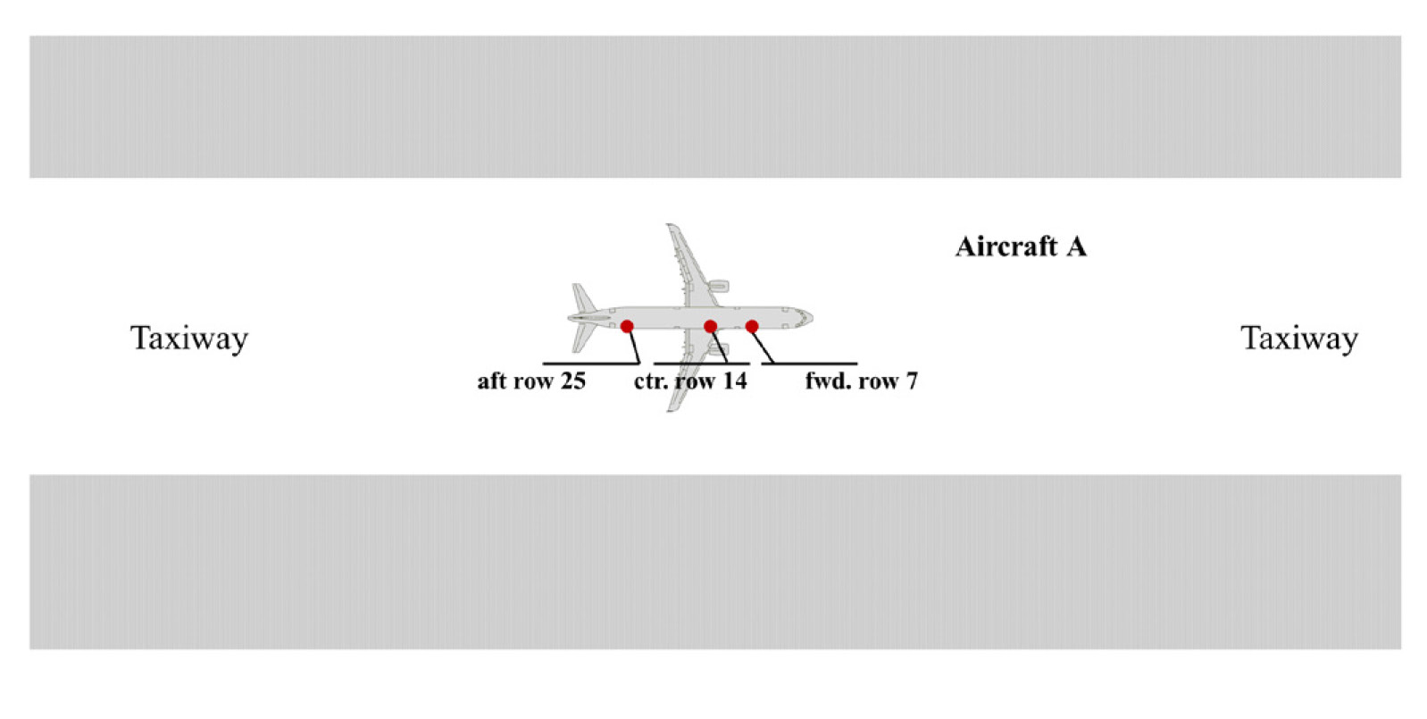
Measurement Scenarios I
‘Own Ship‘ IPL

Slide 5
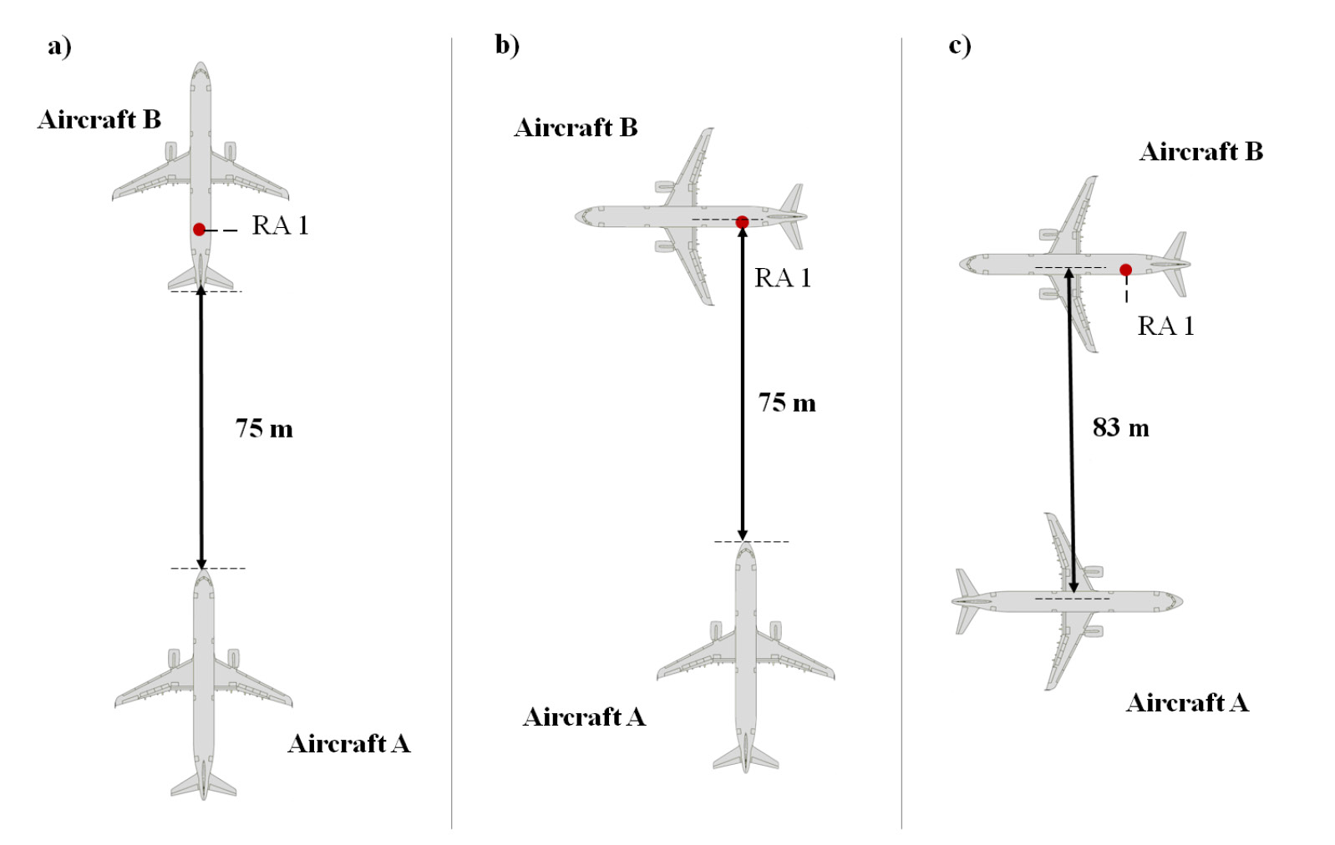
Measurement Scenarios II
‘Off Board’ IPL - Scenarios a) ‘Follow’, b) ‘Wait’ and c) ‘Pass-by’

Slide 6
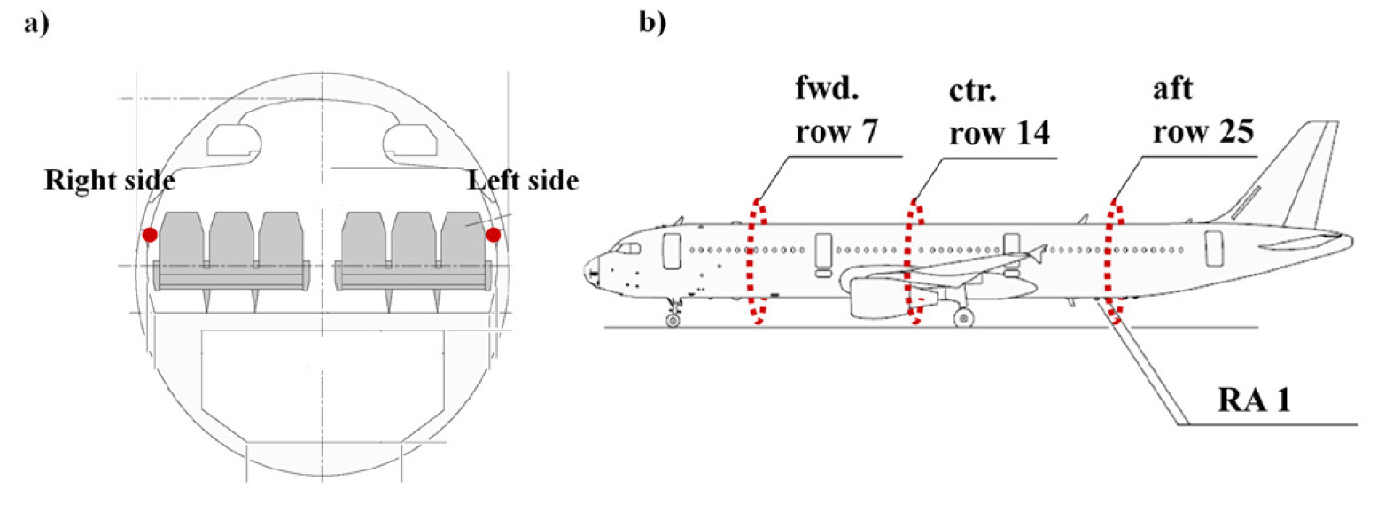
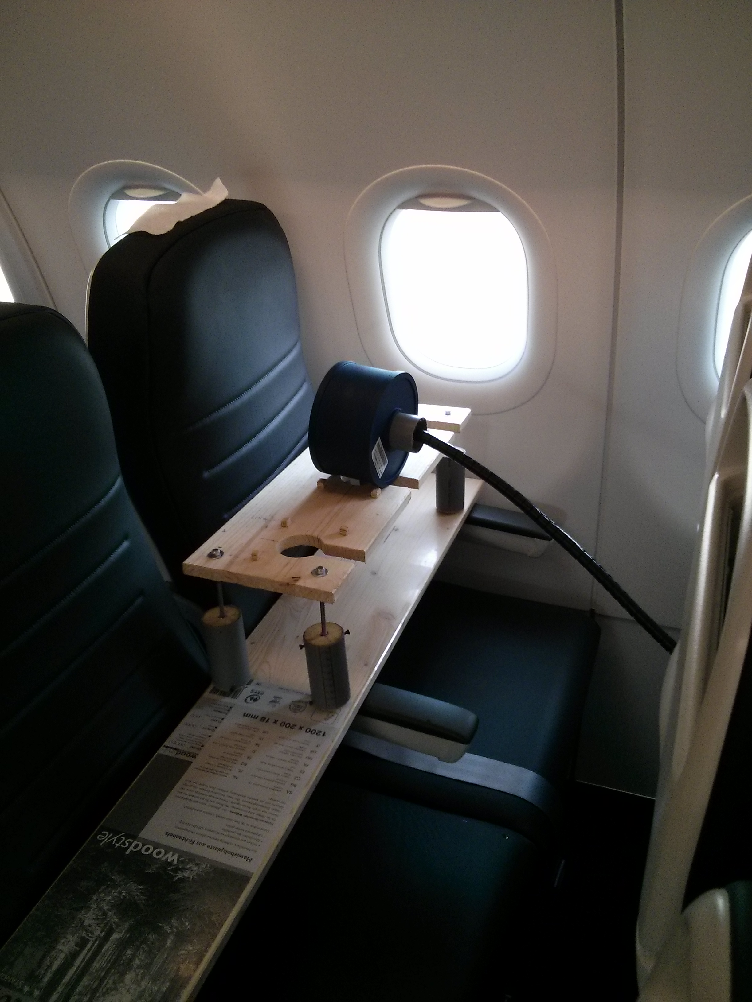
Measurement Locations within Cabin
Measurement locations in forward, center and aft fuselage sections within window aperture.

Slide 7
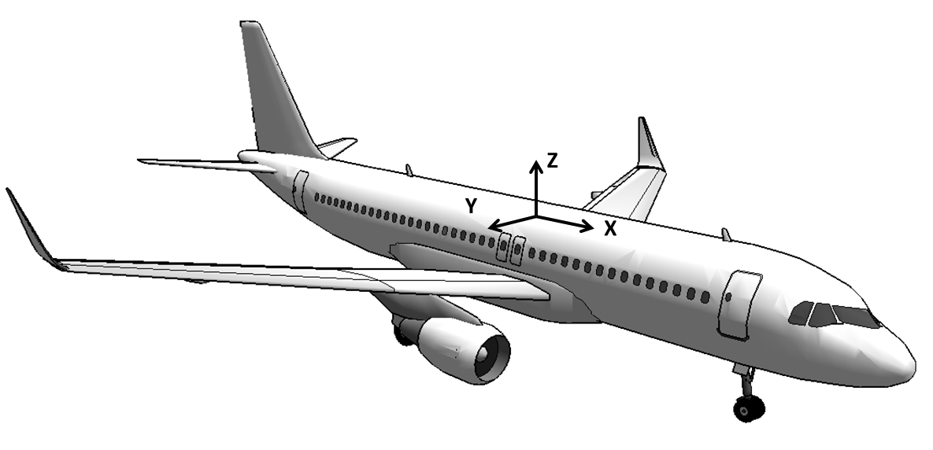
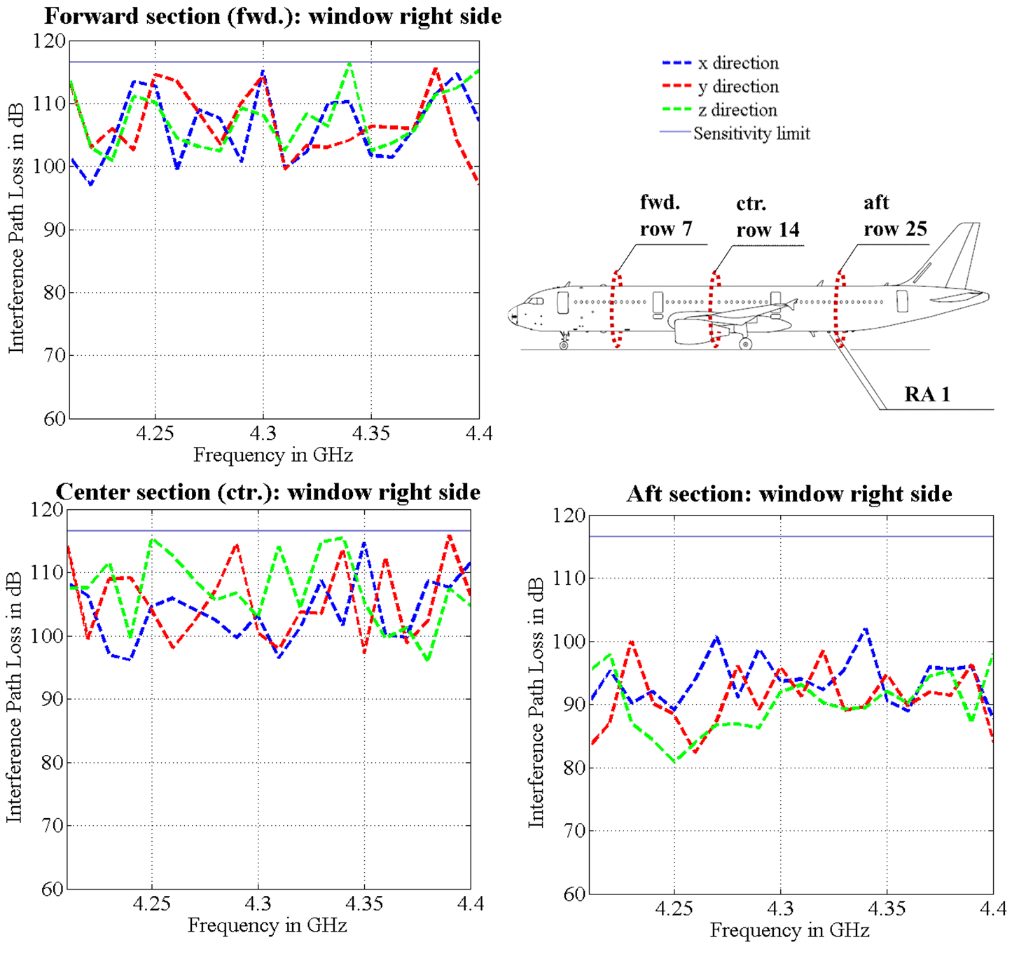

Results – ‘Own Ship’ IPL
Discussion
Lowest IPL is measured in aft cabin section due to shortest path (>80dB)
No significant difference in coupling for different polarizations due to indirect coupling paths (multiple reflections at ground, pylon and nacelles, RadAlt antenna is polarized in y-direction)

Slide 8
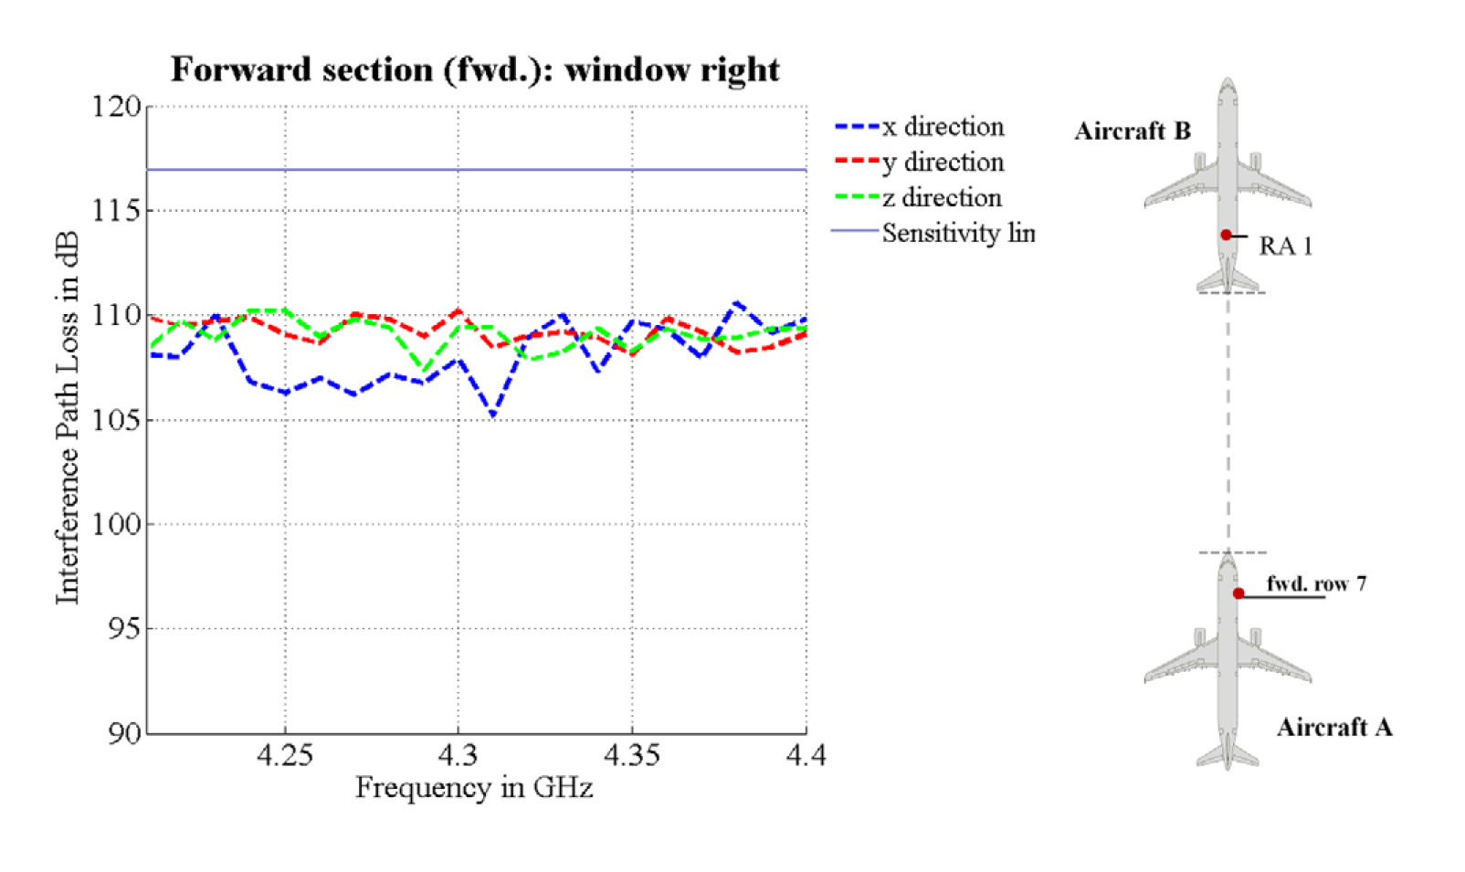
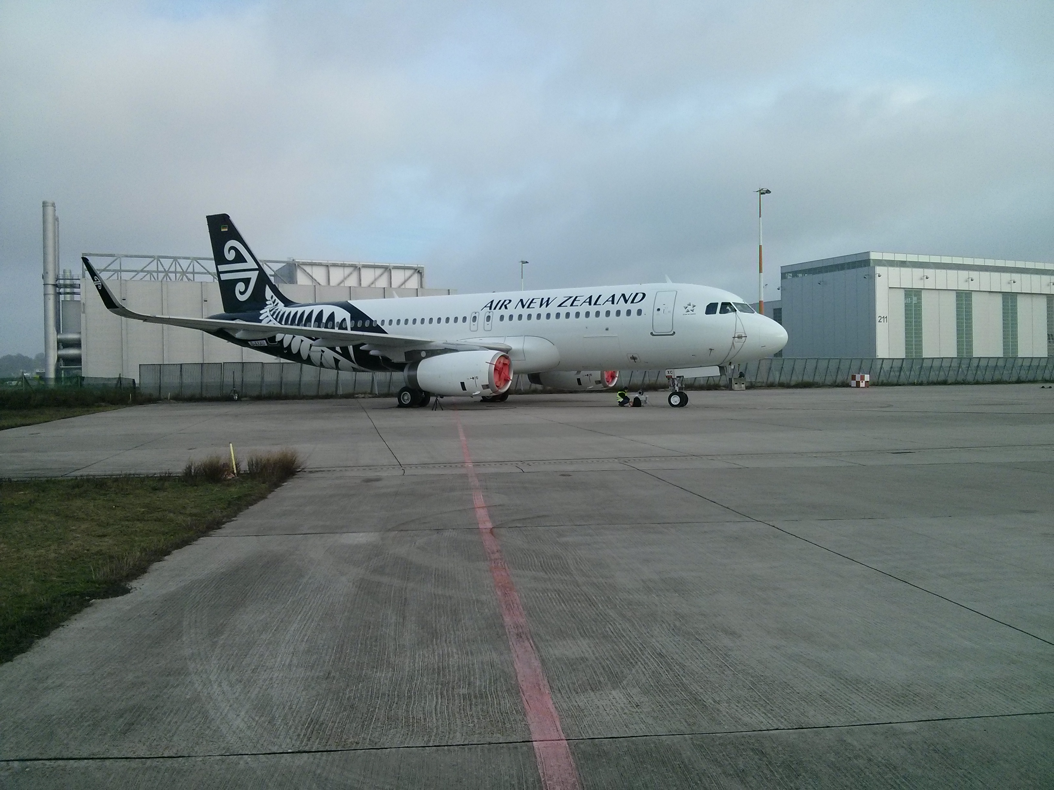

Results – ‘Off Board’ IPL, Scenario ‘Follow’
Discussion
IPL > 105 dB across all polarizations
Power measureable only on right hand side in forward fuselage of Aircraft A
Little variation of IPL across frequency

Slide 9
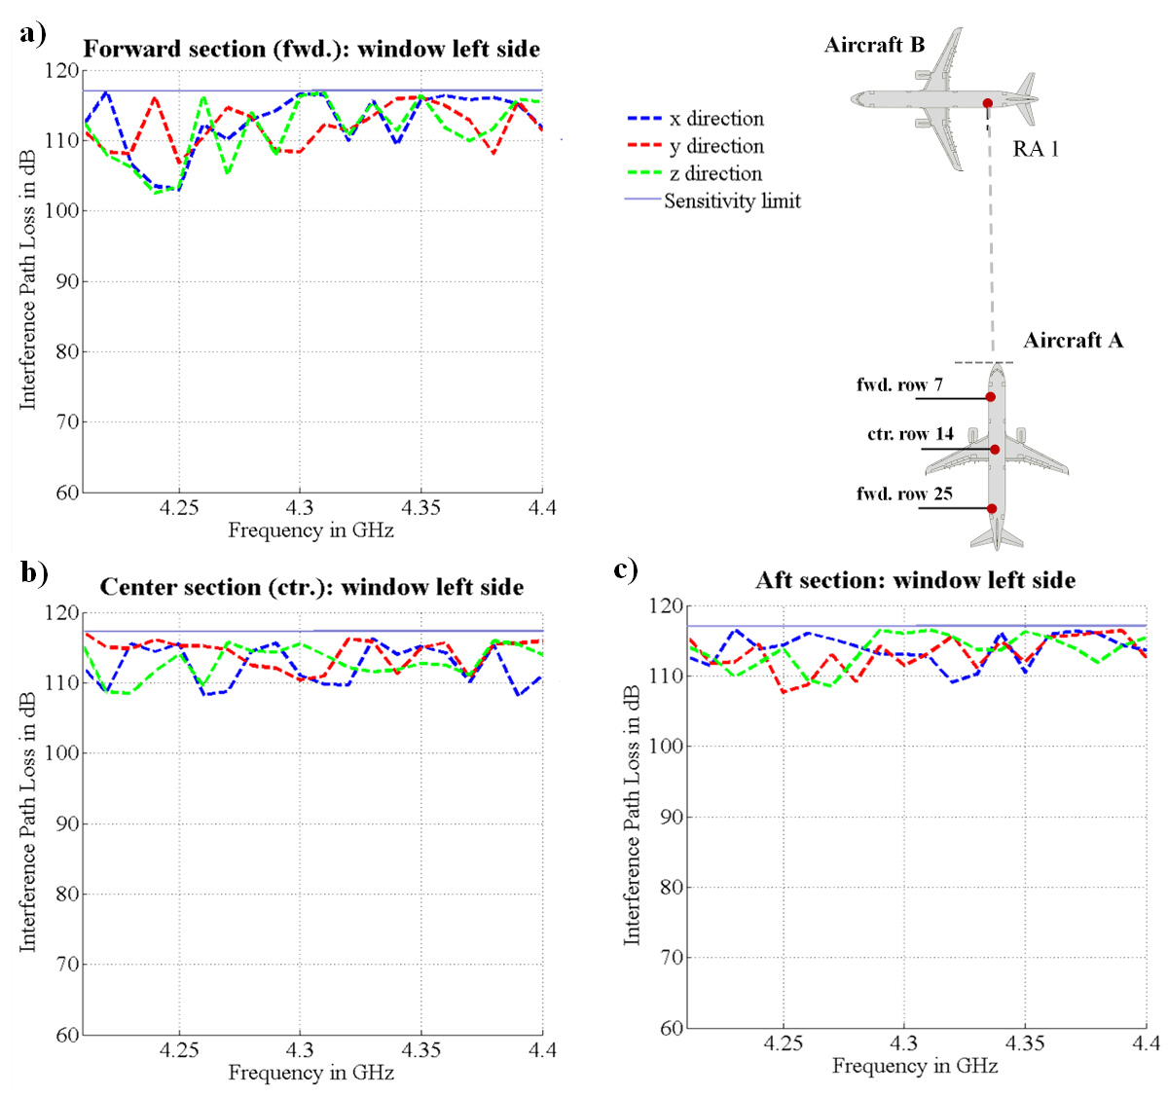

Results – ‘Off Board’ IPL, Scenario ‘Wait’
Discussion
IPL > 102 dB across all polarizations and locations
No significant difference in coupling for different polarizations due to indirect coupling paths (multiple reflections at ground, pylon and nacelles; RadAlt antenna is polarized in y-direction)

Slide 10
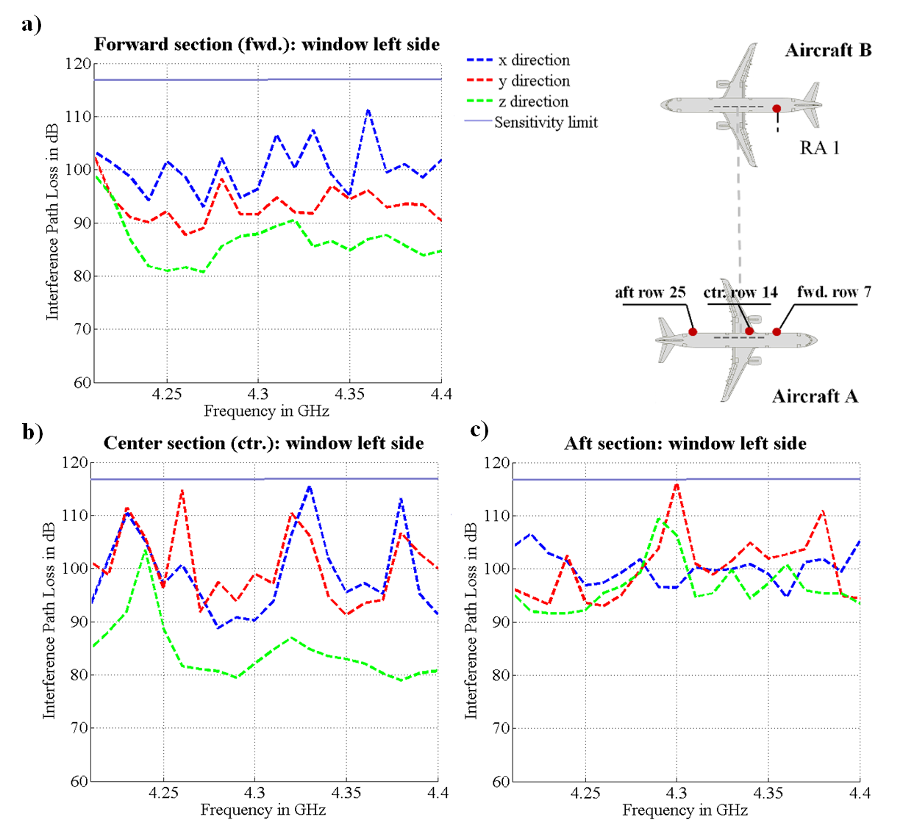
Results – ‘Off Board’ IPL, Scenario ‘Pass-by’
Discussion
IPL > 102 dB across all polarizations and locations
Large variation of IPL across frequency and polarizations (RadAlt antenna is polarized in y-direction)
lowest IPL, in z-direction, is about 80 dB in the forward and center aircraft sections
Measured IPL in the aft section about 92 dB
Difference between the IPL value determined in aft section and the ones in the forward and center sections can be attributed to shadowing effects caused by the wings of both aircraft

Slide 11
Summary
For both scenarios the worst-case interference path loss (IPL) values for measurement locations directly next to the windows in forward, center and aft fuselage and for receive antenna polarization in x-, y- and z planes were measured. The minimum observed IPL of around 80 dB occurs in two cases:
  Coupling between the radio altimeter system of an aircraft with an antenna located inside the aft fuselage of the same aircraft and
  Coupling between the radio altimeter system of a first aircraft with an antenna located in forward or center fuselage of a second aircraft aligned in parallel to the first one in a distance of 83m (min. separation between taxiway and runway center lines (ICAO code letter A instrument runway)
All IPL values presented in this paper reflect worst-case values as they were obtained in close proximity to the aircraft windows. In a realistic WAIC system installation additional isolation can be expected due to additional path loss and shadowing effects inside the cabin.

